Slide 1
Weekly meeting
8 1 2024
Ty Bottorff

Slide 2
Outline
P452 T1DAL MT variant sharing over time
P576 AbATE dimensional reductions, pseudotime

Slide 3
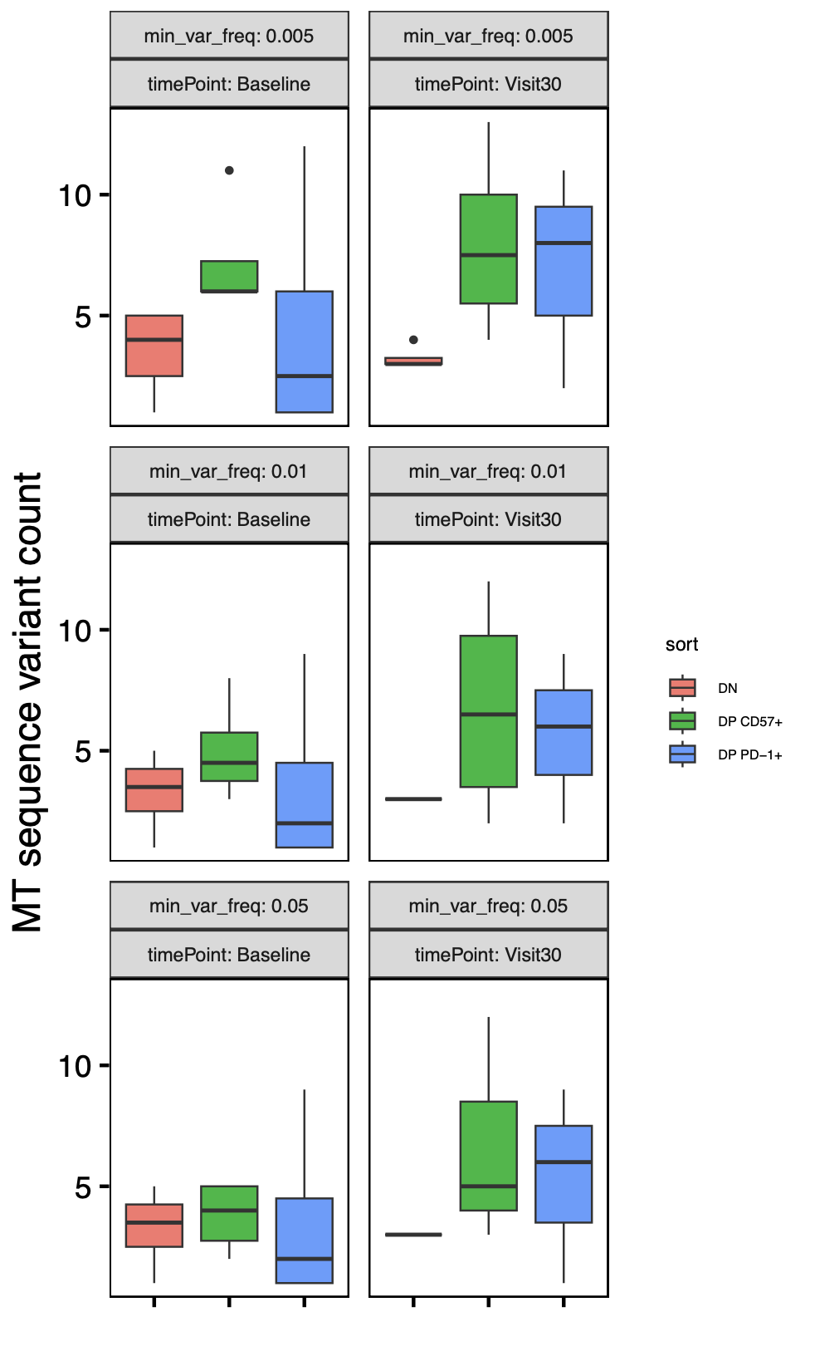
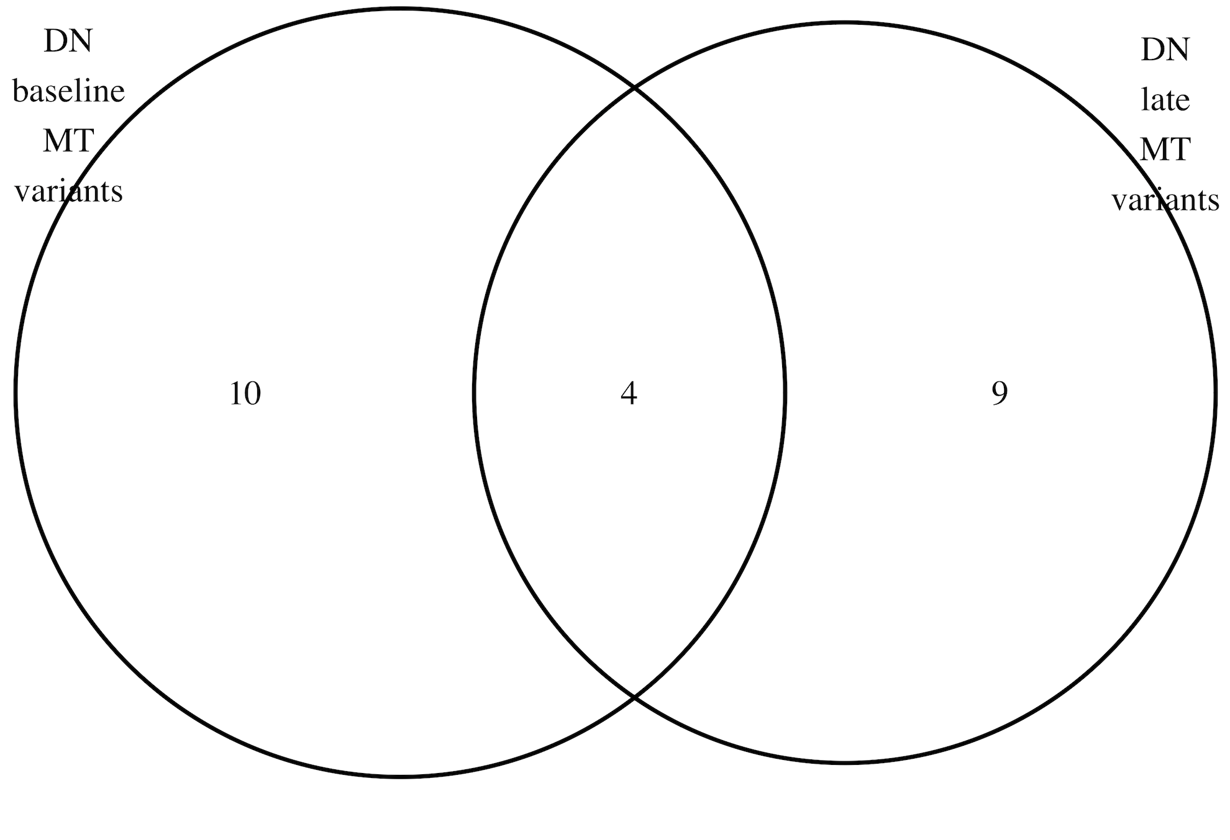
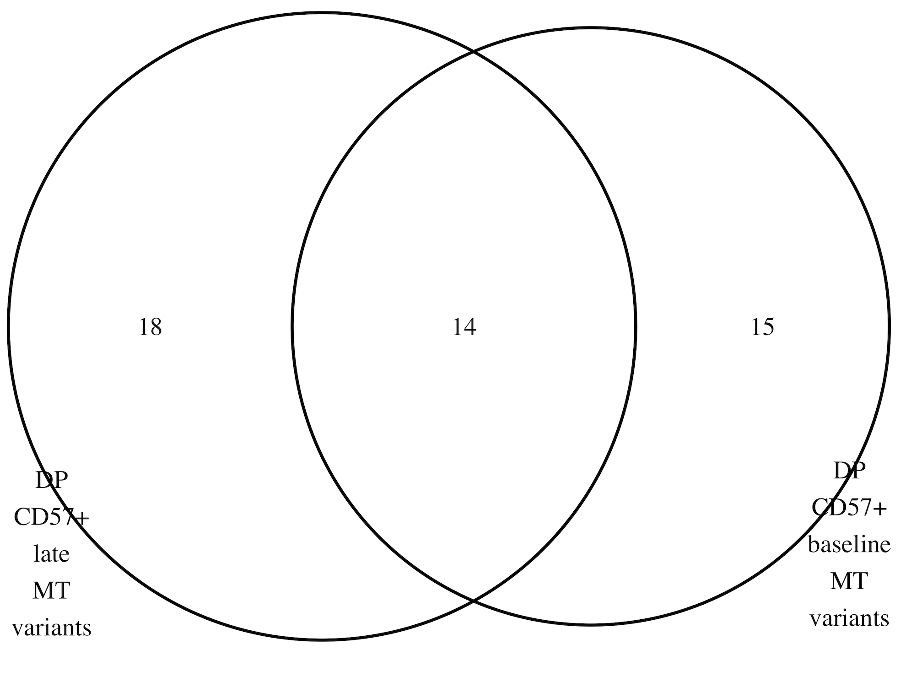
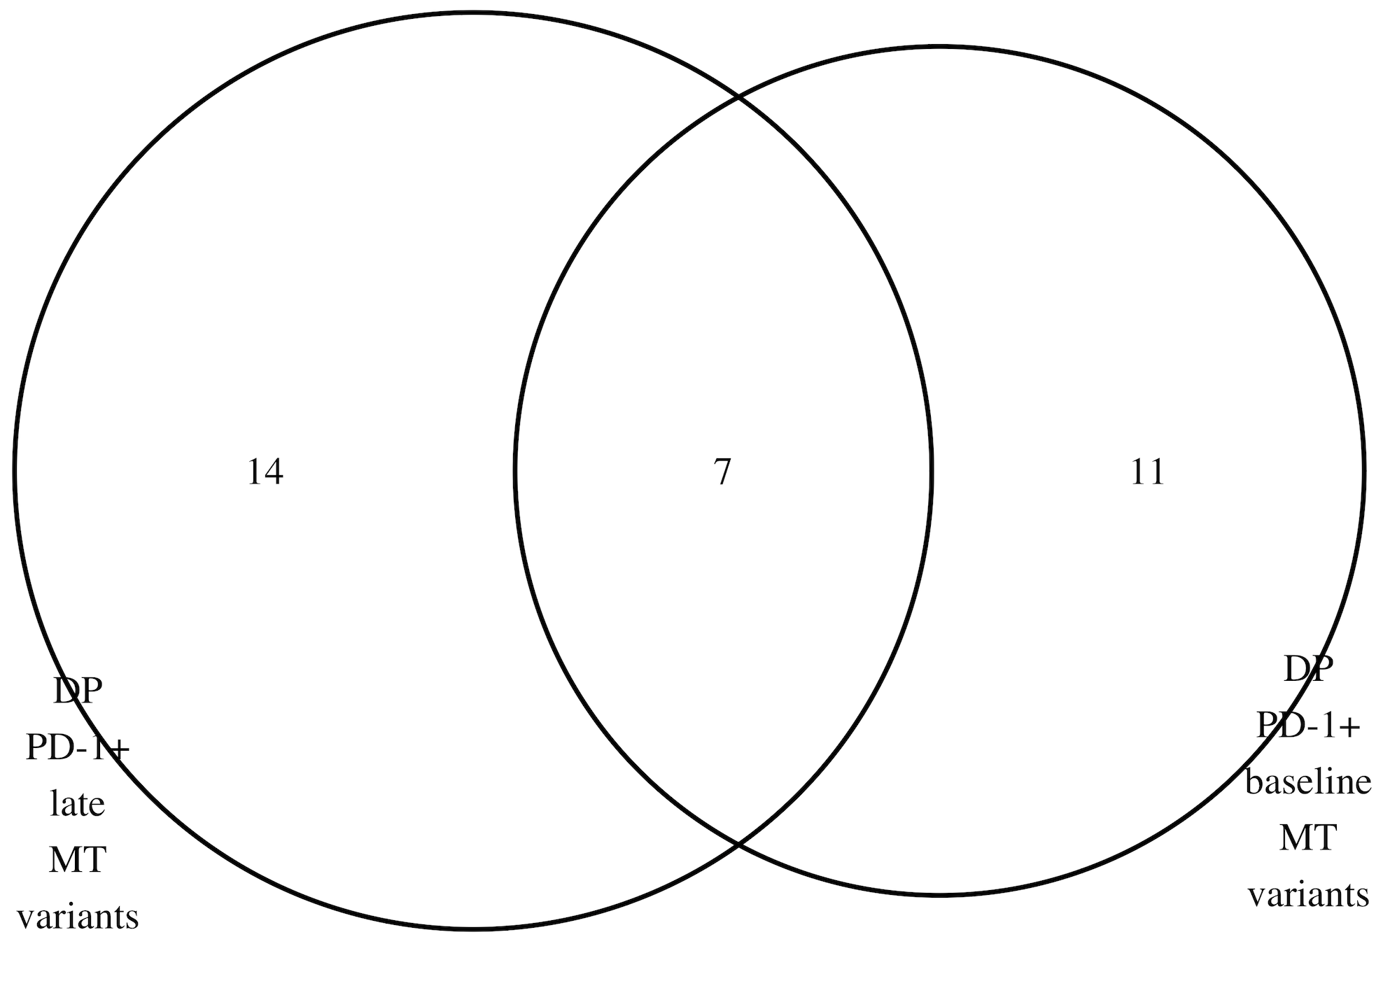
P452 (T1DAL): faceting MT variant analysis by timepoint
Takeaways:
- no significant differences in variant counts by timepoint within each sort
- substantial variant loss/gain over time
n = 4 (donors)
Notes:
Cell loss presumably explains higher than expected loss/gain of vars over time (loss could be death or swapping cell sort)
Only R in P452: “we first measured their bulk chromatin accessibility at baseline (Week 0/Visit 0) and 104 wk (Visit 30) post-treatment in alefacept responders (R, defined by C-peptide preservation) using ATAC-seq following sorting from PBMC (Figure 1A, Because cell population differences rather than treatment response differences were the focus of our investigation, we sequenced only alefacept responder (R) samples“
Updated to remove vars present in all sorts in a donor
MT notes:
Mitochondrial genomes have high copy number (100–1,000s)
homoplasmy is when all copies of the mitochondrial genome in a cell are identical; heteroplasmy is when there is a mixture of two or more mitochondrial genotypes
mutations in mtDNA often reach high levels of heteroplasmy (proportion of mitochondrial genomes containing a specific mutation) due to a combination of vegetative segregation, random genetic drift, and relaxed replication
Exclusively maternal inheritance
mtDNA mutation rates are estimated to be 10- to 100-fold higher than for nuclear DNA

Slide 4
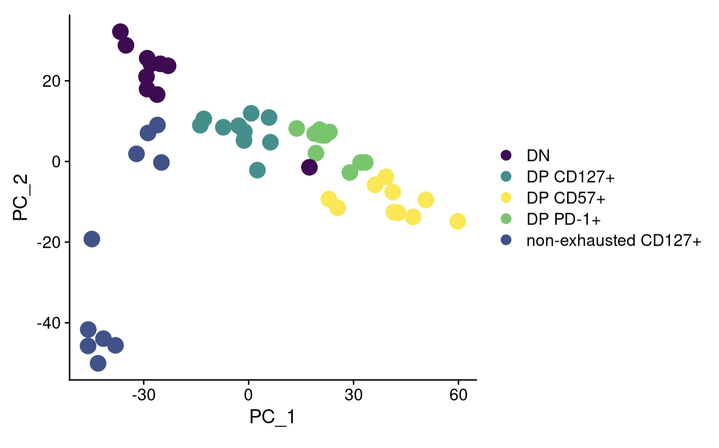
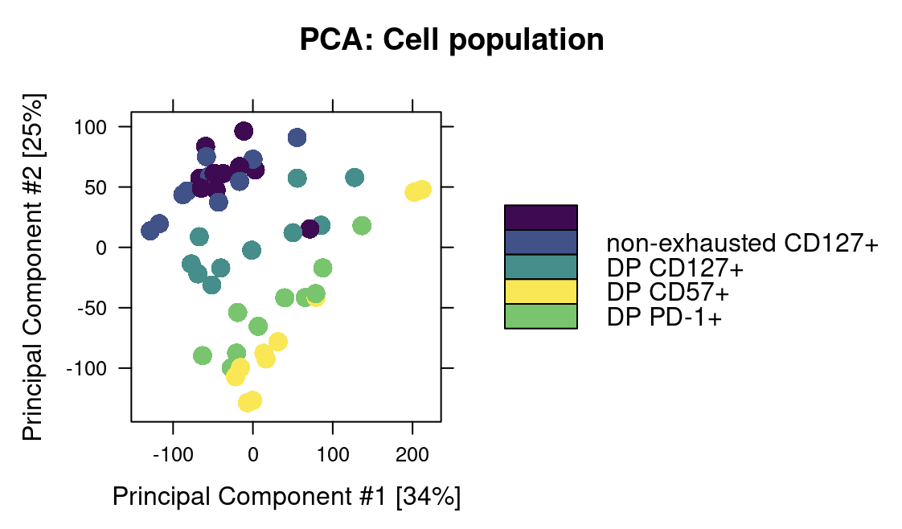
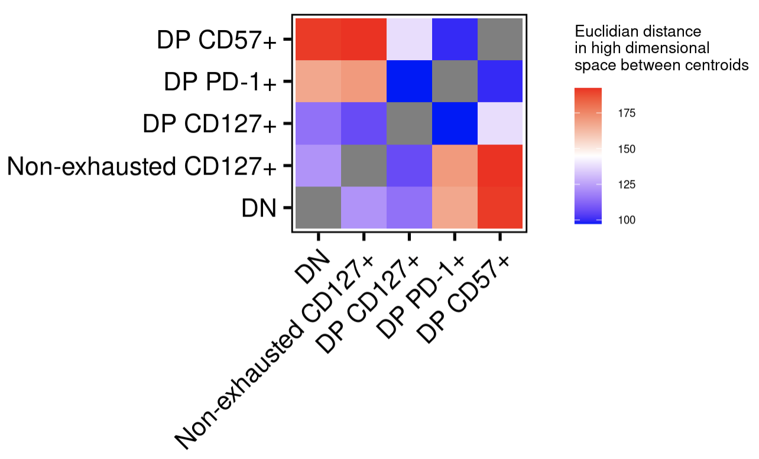
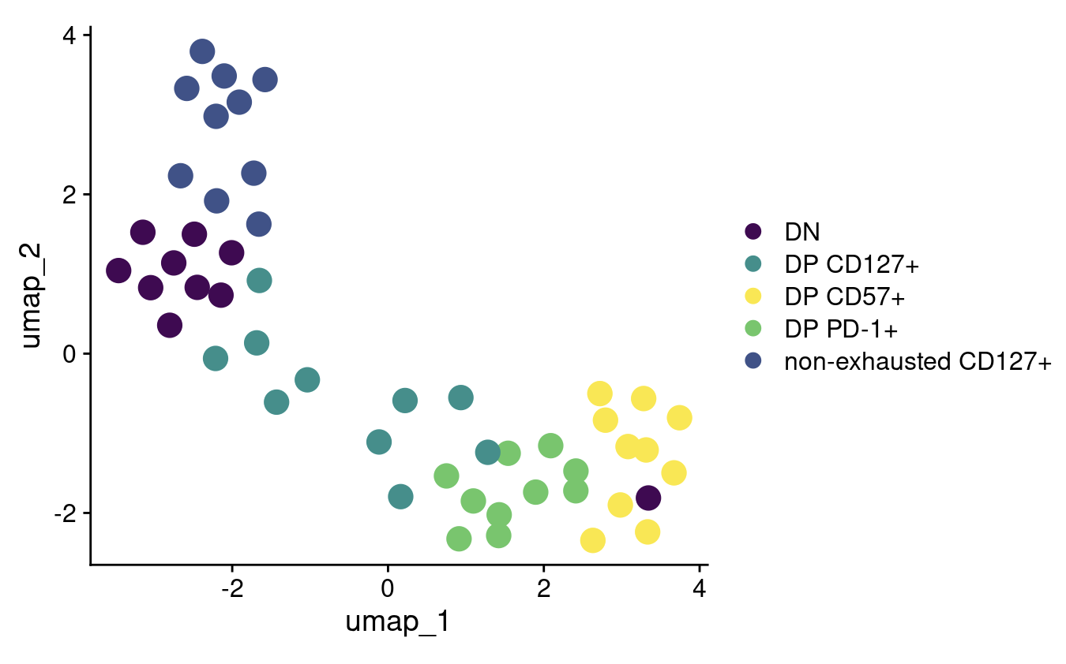
P576 (AbATE): just looking at top DARs in PCA/UMAP distinguishes cell sorts better, DP CD127⁺ also looks intermediate in high dimensional space
DN
Using all peaks
Using top variably accessible peaks
Using all peaks
Notes:
Just looking at top 2000 variable regions, which is what Seurat plotted on UMAP (less noisy than Diffbind default all regions)
To move to Seurat, took counts within peaks and ran that matrix through Seurat workflow (normalize, select variable peaks, scale…)
For distances, took scaled data from UMAPped Seurat object and ran distance formula on sort means (centroids)

Slide 5
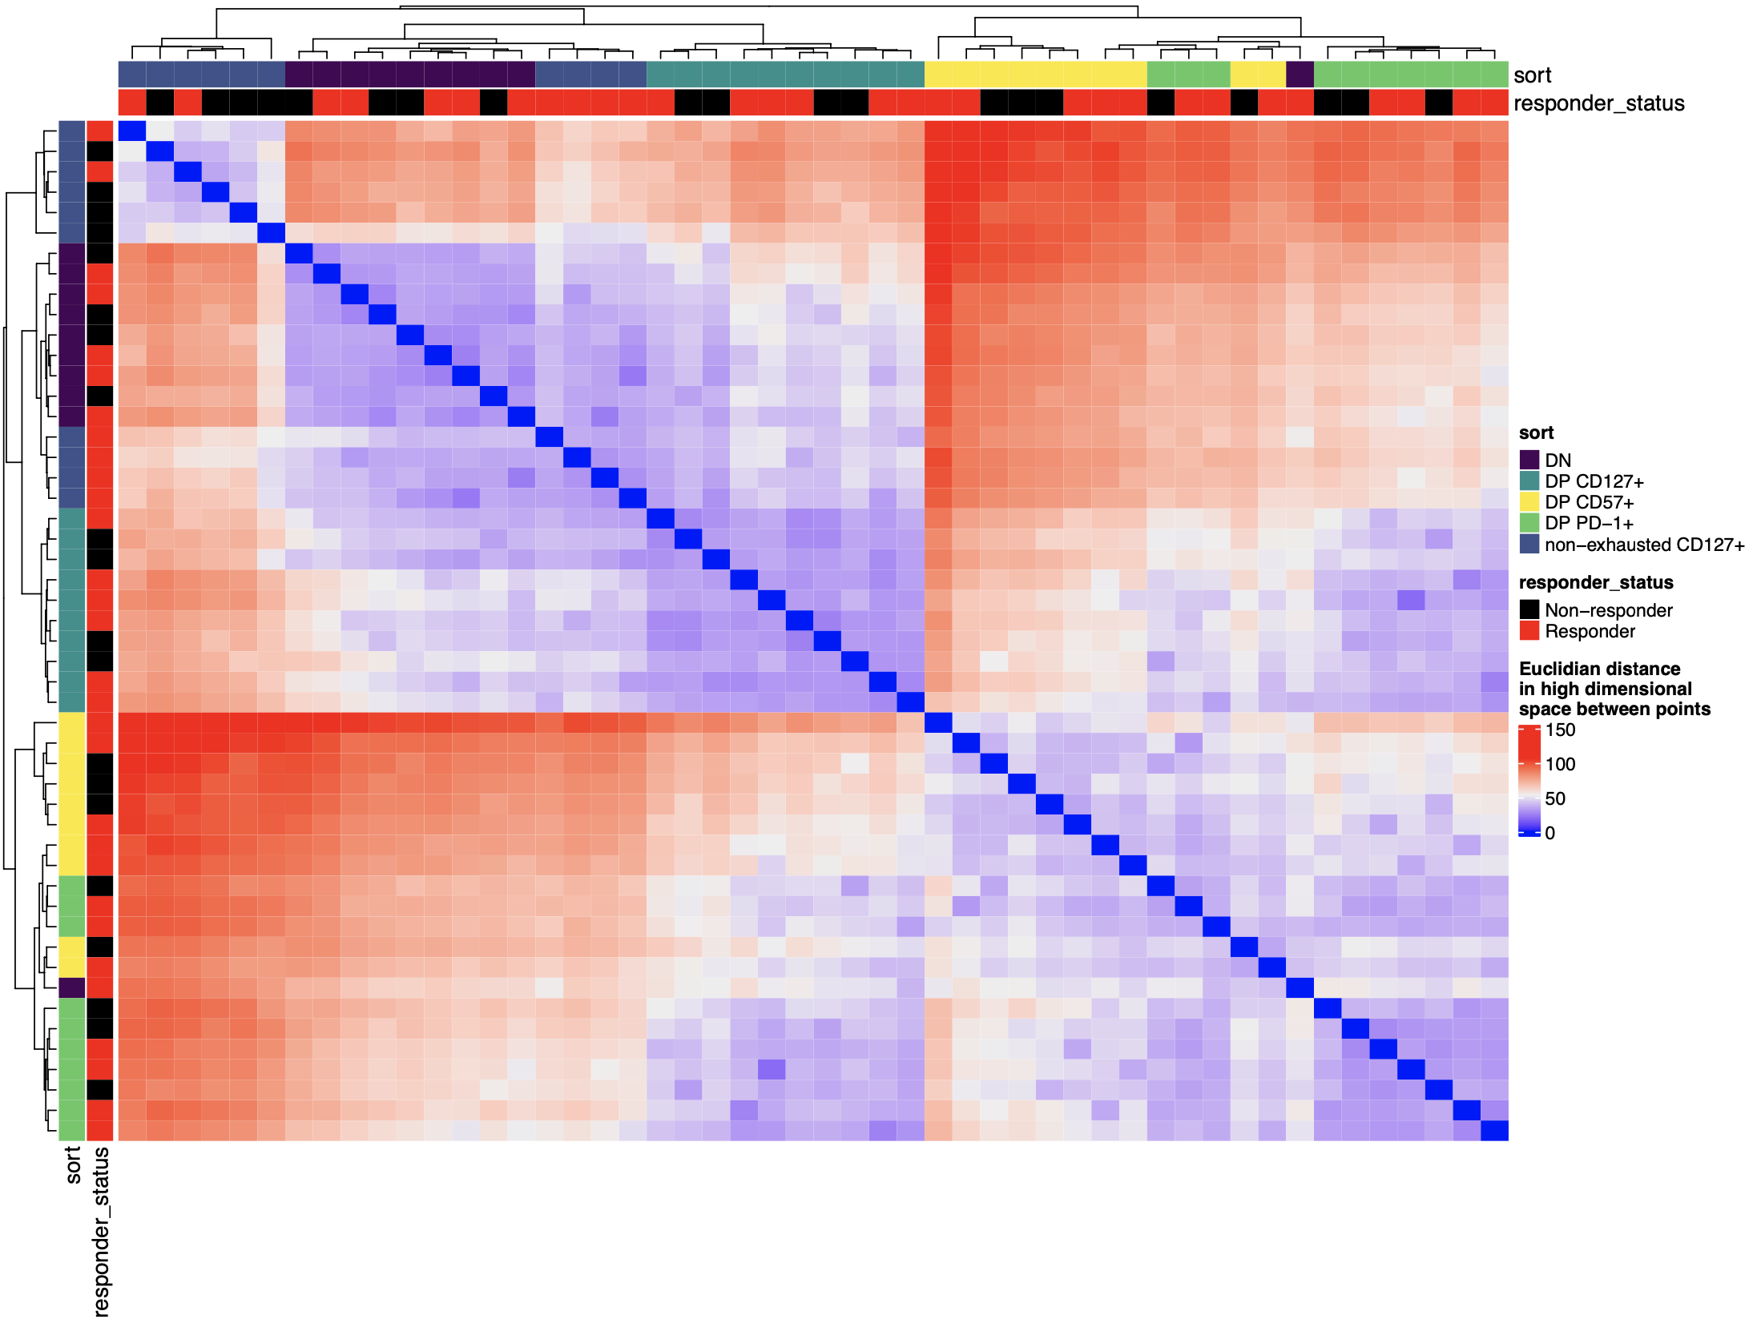
P576 (AbATE): can also look at each sample rather than centroids of cell sorts
Using top variably accessible peaks (gets noisy with all peaks, like PCA with all peaks)
Notes:
Perhaps interesting here that this clustering places DP CD127⁺ with DN and non-exhausted CD127⁺ and not with other DPs

Slide 6
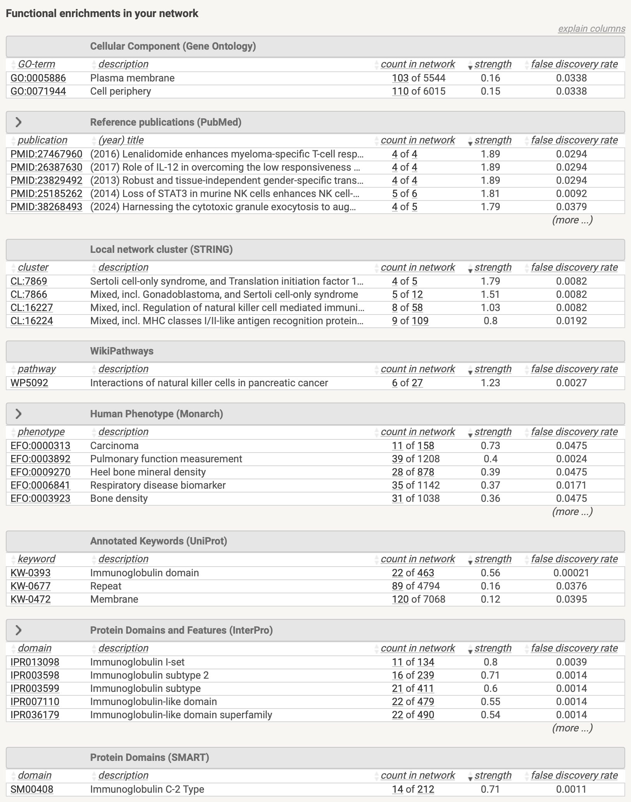
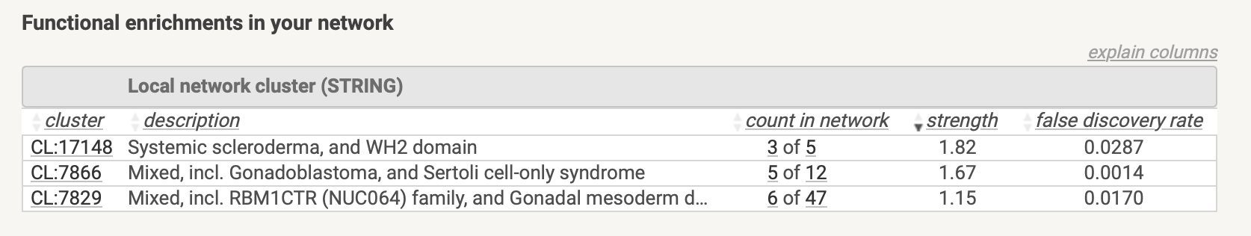
P576 (AbATE): enrichments in top variably accessible peaks’ closest genes and promoters
Genes
Promoters

Slide 7
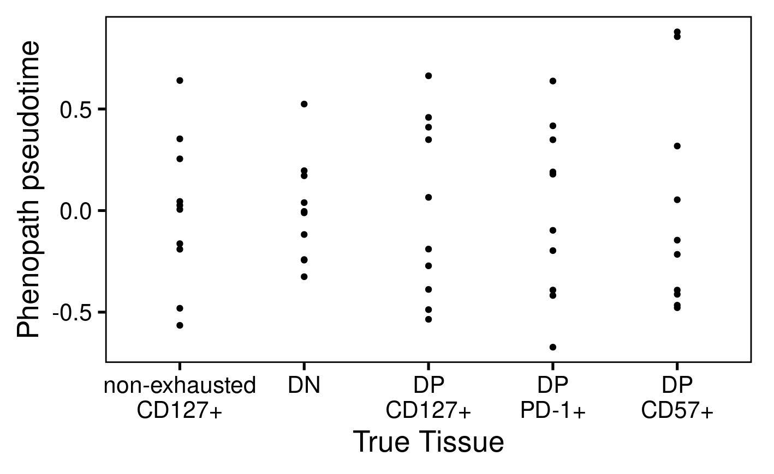
P576 (AbATE): don’t observe pseudotime associating with cell sort
Notes:
PhenoPath analyzes the accessibility of genomic regions (peaks) in your ATAC-seq data, modeling how these accessibilities change along a biological trajectory and how this trajectory is influenced by tissue type
PhenoPath models gene expression expression 𝑦 in terms of a latent pathway score (pseudotime) 𝑧. Uniquely, the evolution of genes along the trajectory isn’t common to each gene but can be perturbed by an additional sample-specific covariate 𝛽 (cell sort here)

Slide 8
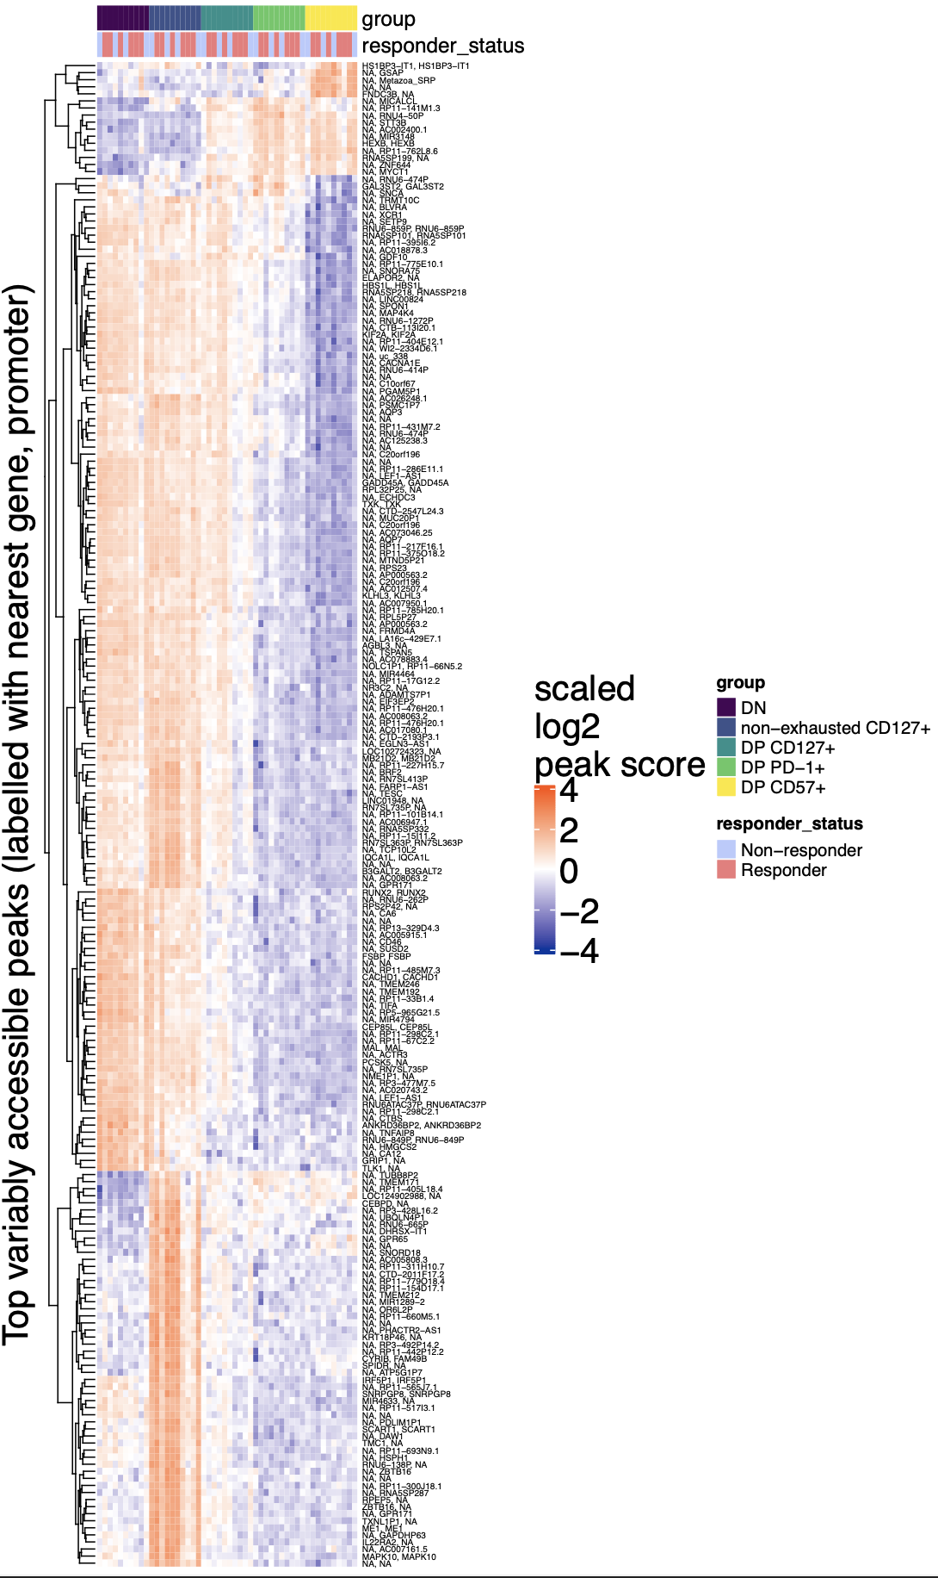
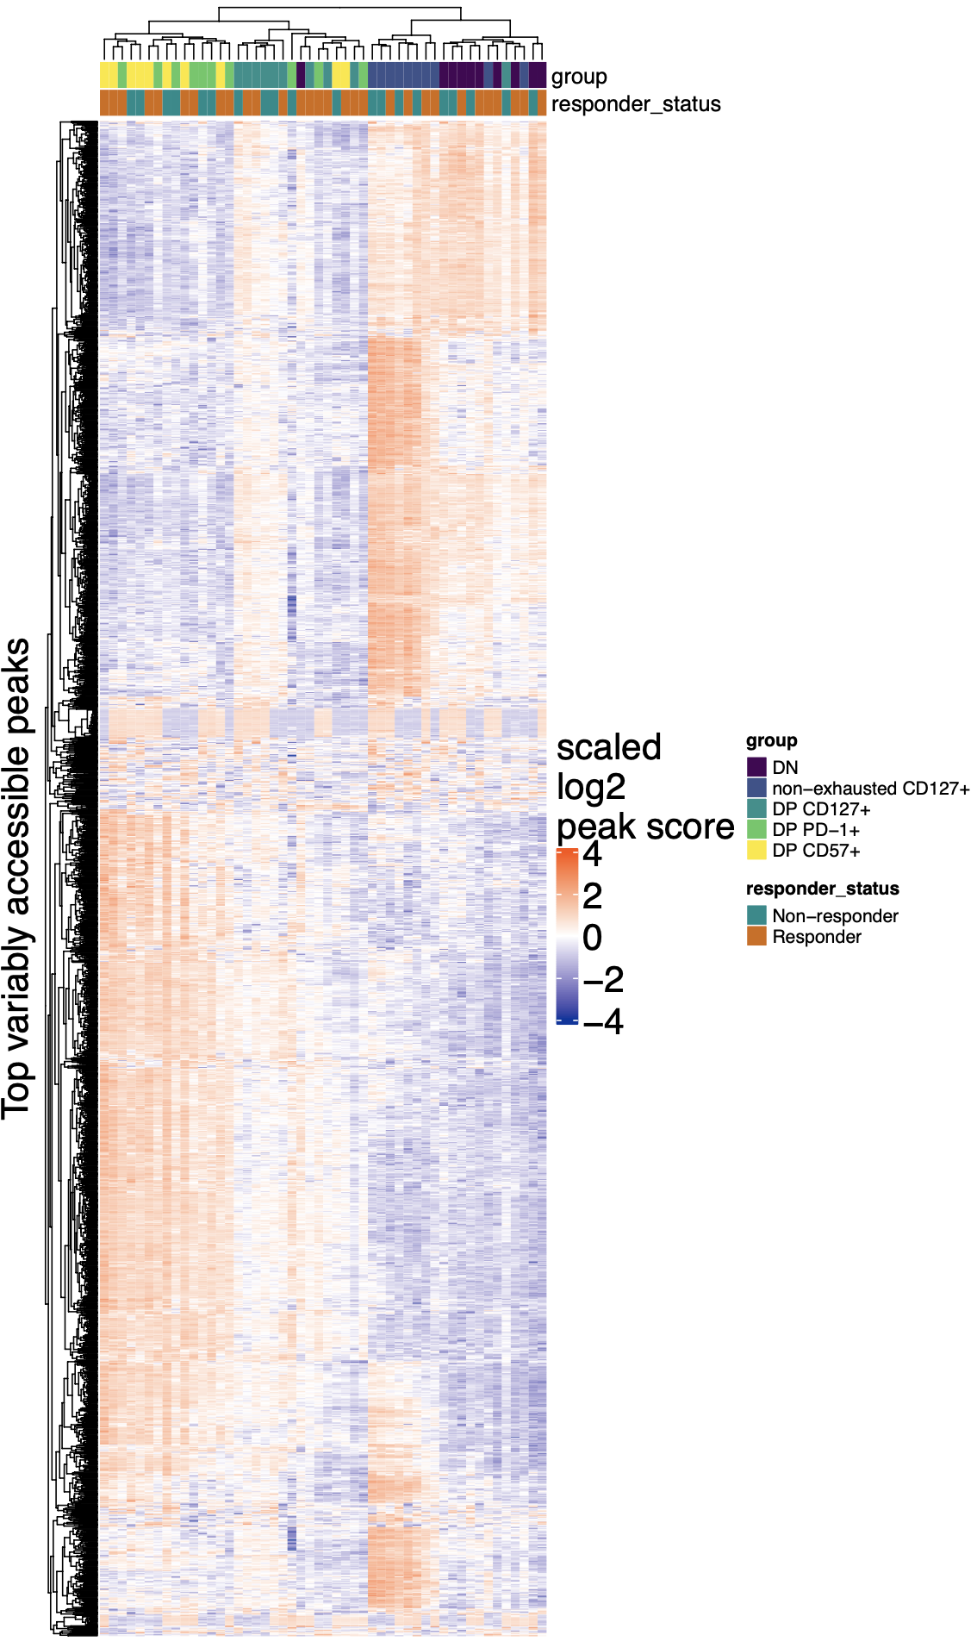
P576 (AbATE): using heatmap row clustering for pathway enrichment of genes/promoters
DP & DP CD57⁺ cluster enriched for N-glycan biosynthesis genes (HEXB, STT3B)
TODO: pathway enrichment on these?
Top 2000 variably accessible peaks
Top ~200 variably accessible peaks
Notes:
Took top 50 contrast defining peaks per each of 10 contrasts, found unique peaks from these (213, 194 are unique gene-promoter combos but I kept all 213), then annotated rows with nearest genes, promoters
Possible motivation for this is since it’s easy to overinterpret distances in PCA space (biased by projection), so here we can see (here biased by peaks we use for rows) how sorts differ (heatmap color blocks)

Slide 9
Next steps: scATACseq requirements for lineage mapping via MT variants
“… clonally resolved, single-cell transcriptomic and accessible chromatin atlas for around 150,000 human hematopoietic cells from 12 donors”: Weng et al. (2024) Nature
MT enrichment? “To retain mitochondria and mtDNA within their host cell, we combine fixation with milder lysis conditions to enable combined intranuclear and mitochondrial access of the Tn5 transposase … > 100,000 viable single cells for cell processing and mtscATAC-seq library generation and obtaining mtscATAC-seq data for 5,000–10,000 cells… between 30,000 and 35,000 paired-end reads … per cell in a library”: Lareau et al. (2023) Nat Protoc
“minimum of 3,000 mitochondrial reads per cell”: Kwok et al. (2022) Nature Communications
Notes:
scATAC-seq protocols focus on isolating nuclei devoid of mitochondria.
Can 17k budget be pushed to next project?
50M: $6,524 (since these were constructed in two pools of 25 with overlapping indexes, we’d need 2 P3 flowcells)
80M: $7,384 (2 P4s)
100M: $11,010 2 P2 and 2P3, if you don’t mind running each pool on two size flowcells—one P2 and 1 P3)
150M: $14,769 (4 P4 flowcells)
Peter says 20k purified for 10x. AbATE (n = 4 maybe) but may be ok from another project (T1DAL, Extend for placebo, T1Des which has some patient overlap with AbATE)

