Slide 1
Weekly meeting
9 12 2024
Ty Bottorff

Slide 2
Outline
Follow ups from last Long lab update

Slide 3
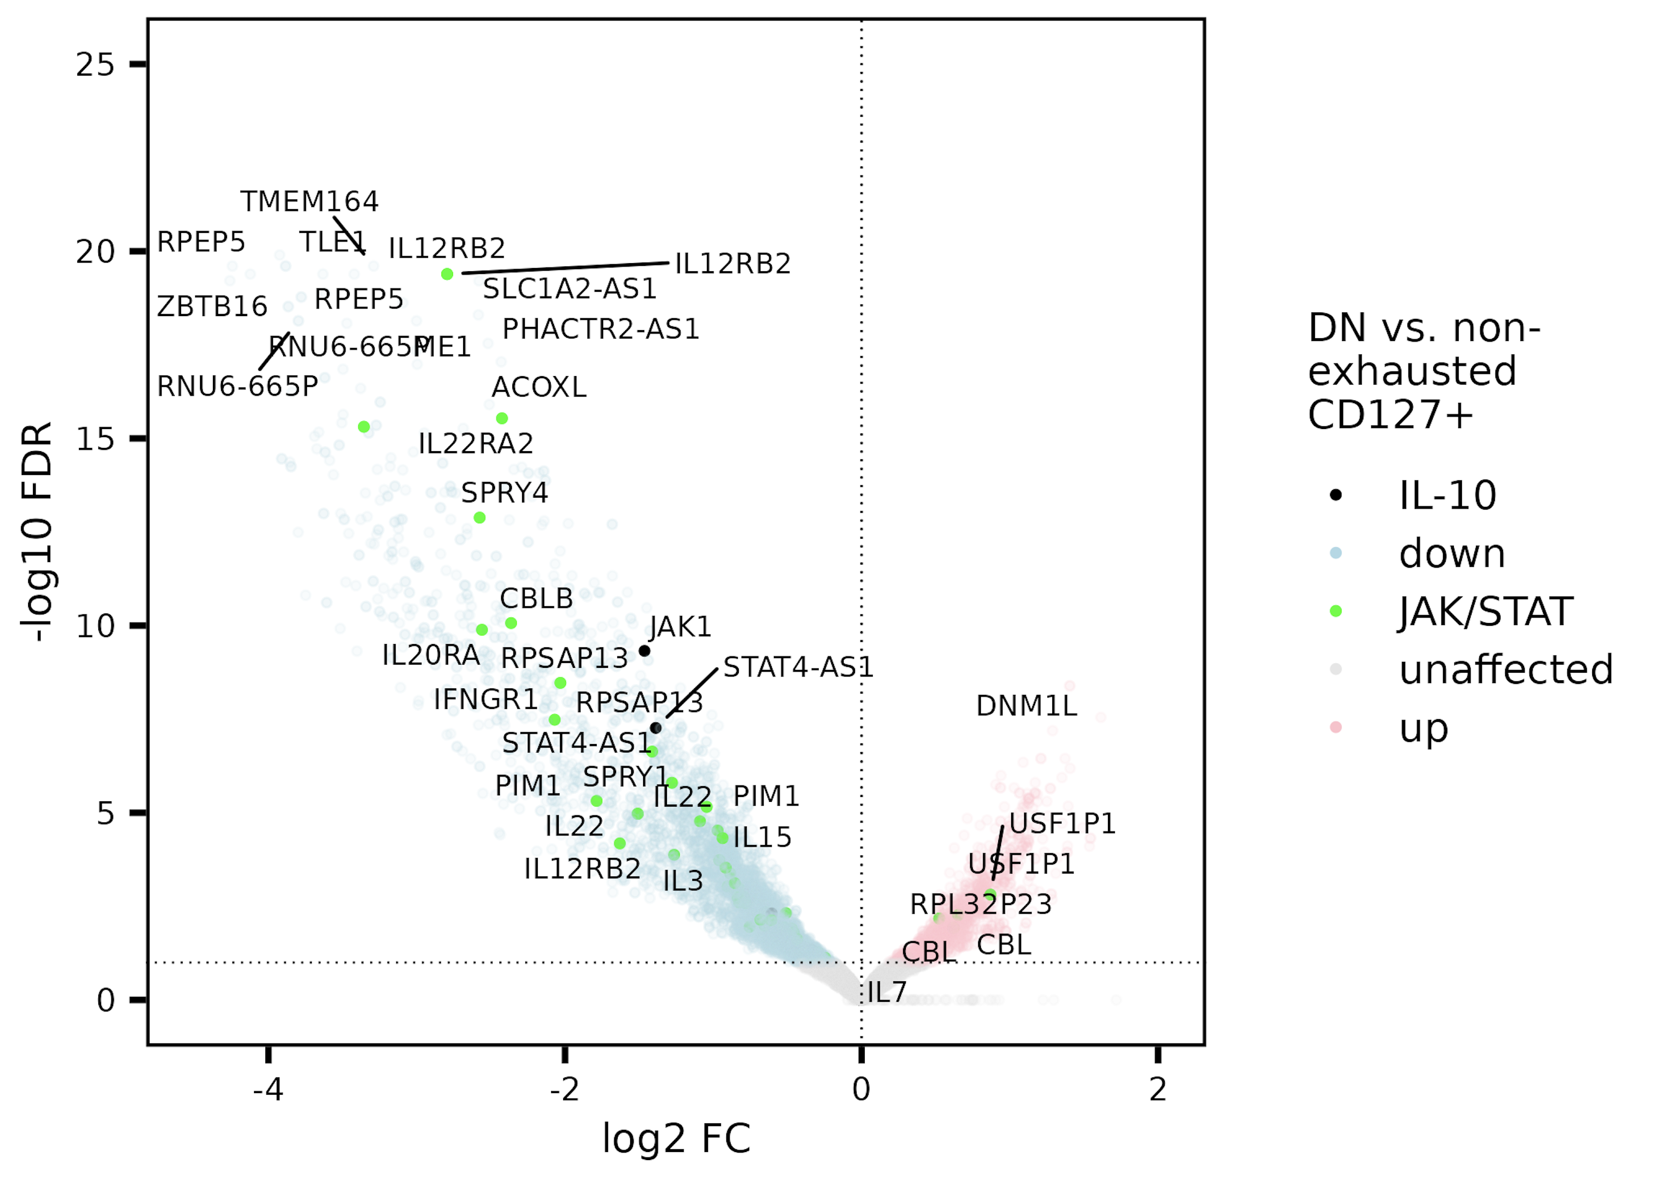
JAK/STAT gene set perhaps more accessible in (non-exhausted) CD127⁺ sort vs. DN
JAK/STAT & IL-10 enriched (stringdb) in peaks’ genes/promoters up in both CD127⁺ sorts vs. DN

Slide 4
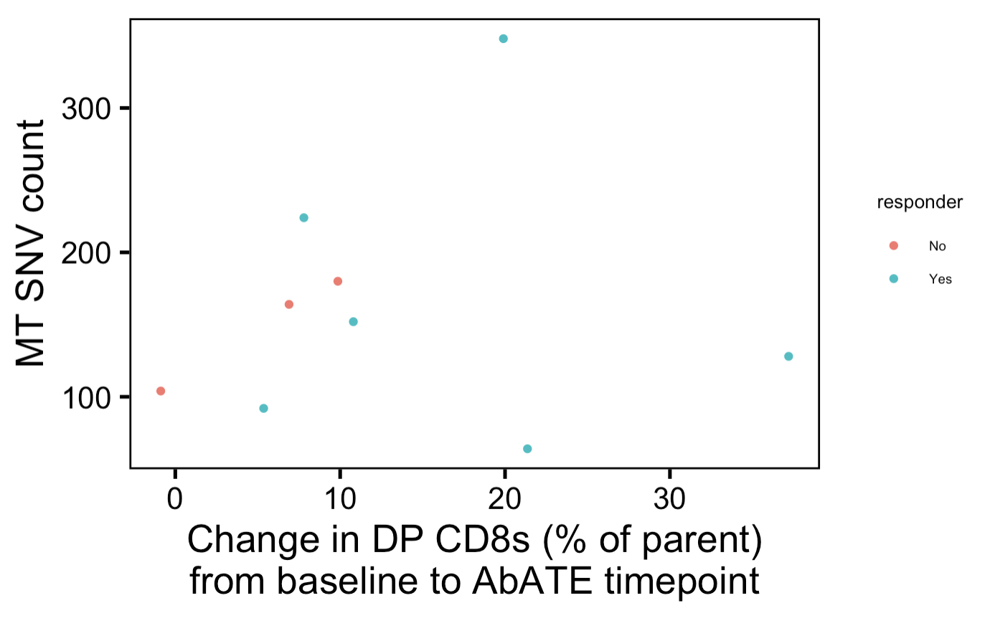
Overall, no correlation between change in DP CD8s (% or count) and MT SNV counts, but in NR perhaps correlated…
Notes:
Also checked within individual sorts…

Slide 5
Use of MT SNVs as proxy for cell division count in literature: not explicitly stated but consistent
The large range of detected mutations included clone- and sub-clone-specific mutations that were propagated over generations … nearly all progeny of an individual clone shared mutations that were unique and stably propagated over the course of the experiment … Furthermore, we detected new somatic mutations that arose within sub-clones and were stably propagated” (Ludwig et al. (2019) Cell)
The application of these approaches has revealed the high prevalence of somatic mtDNA mutations, many of which may further be stably propagated across cell divisions to facilitate retrospective clonal/lineage tracing studies in ex vivo derived human and clinical samples (Lareau et al. (2022) bioRxiv)

Slide 6
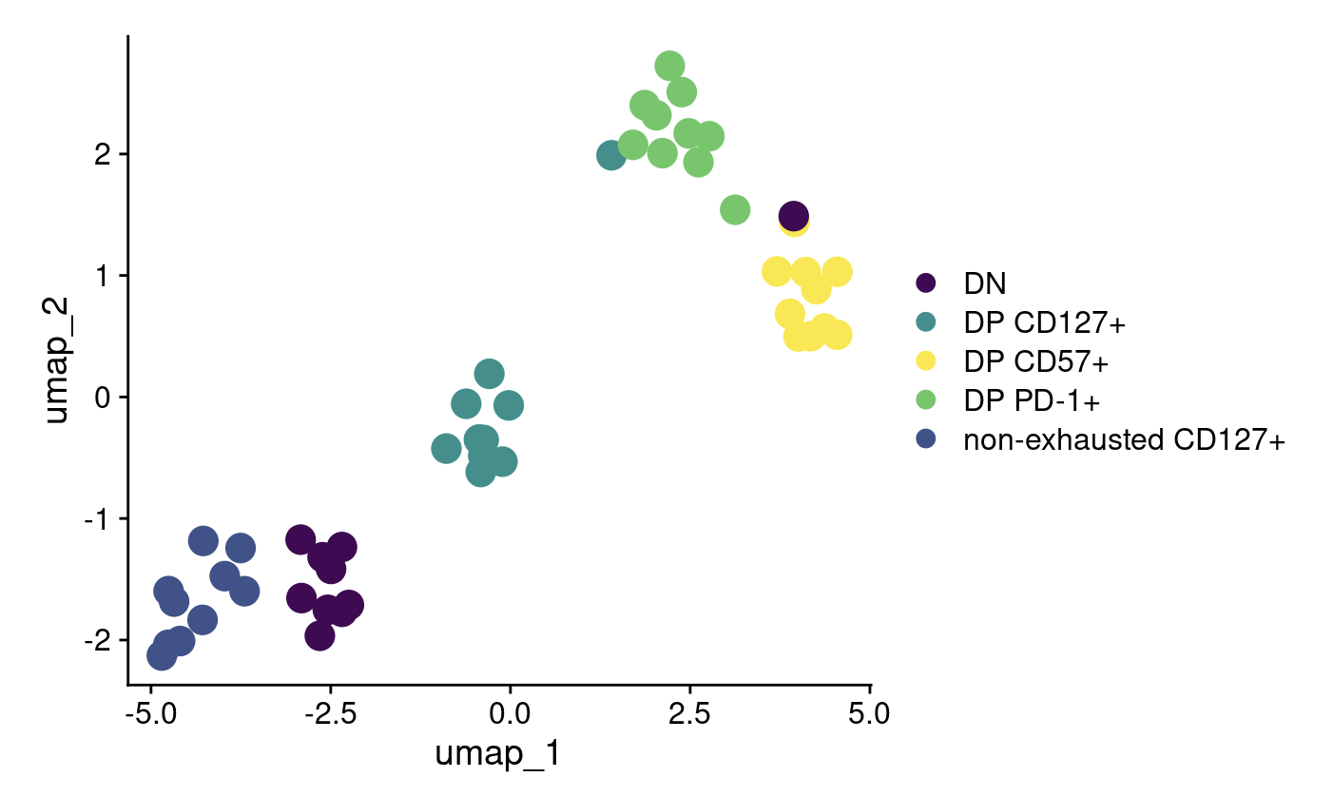
Conclusions
JAK/STAT gene set perhaps more accessible in (non-exhausted) CD127⁺ sort vs. DN
Use of MT SNVs as correlate for cell division count is justified despite no correlation between change in DP CD8s (% or count) and MT SNV counts
Helped Holly with heatmaps/stats for NCI project/WIP…
Shortlist of gene sets to test in pseudotime in TN10:
JAK/STAT
Purine metabolism
TGFβ, progenitor T_{ex} (custom gene set)
Effector/terminal T_{ex} (custom gene set)

Slide 7
Next steps
Working with Basilin on TN10 pseudotime analyses (meeting tomorrow): key TODO before next Long lab update
Preparing poster draft for 10/1 BRI retreat, aiming for 9/24 sharing w/ group
Continue working with Holly on NCI project
dimensional reduction plots
irAE grade as continuous var
other method ideas from papers Jane sent (subtracting ICI effects from baseline differences)

Slide 8
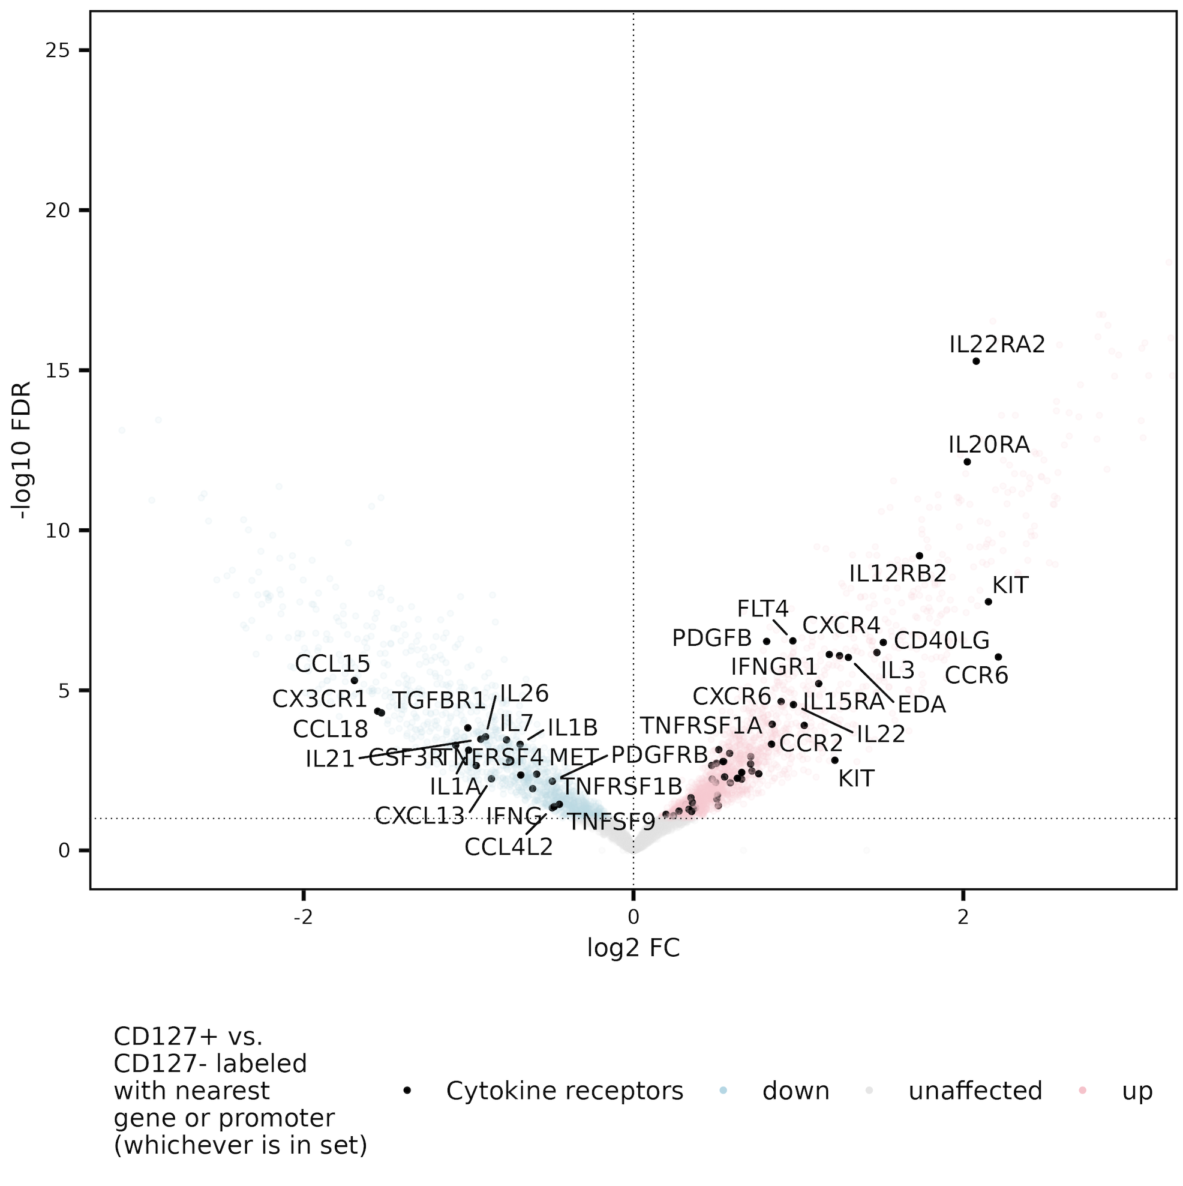
Cytokine receptor gene set perhaps more accessible in CD127⁺ vs. CD127⁻ sorts

Slide 9
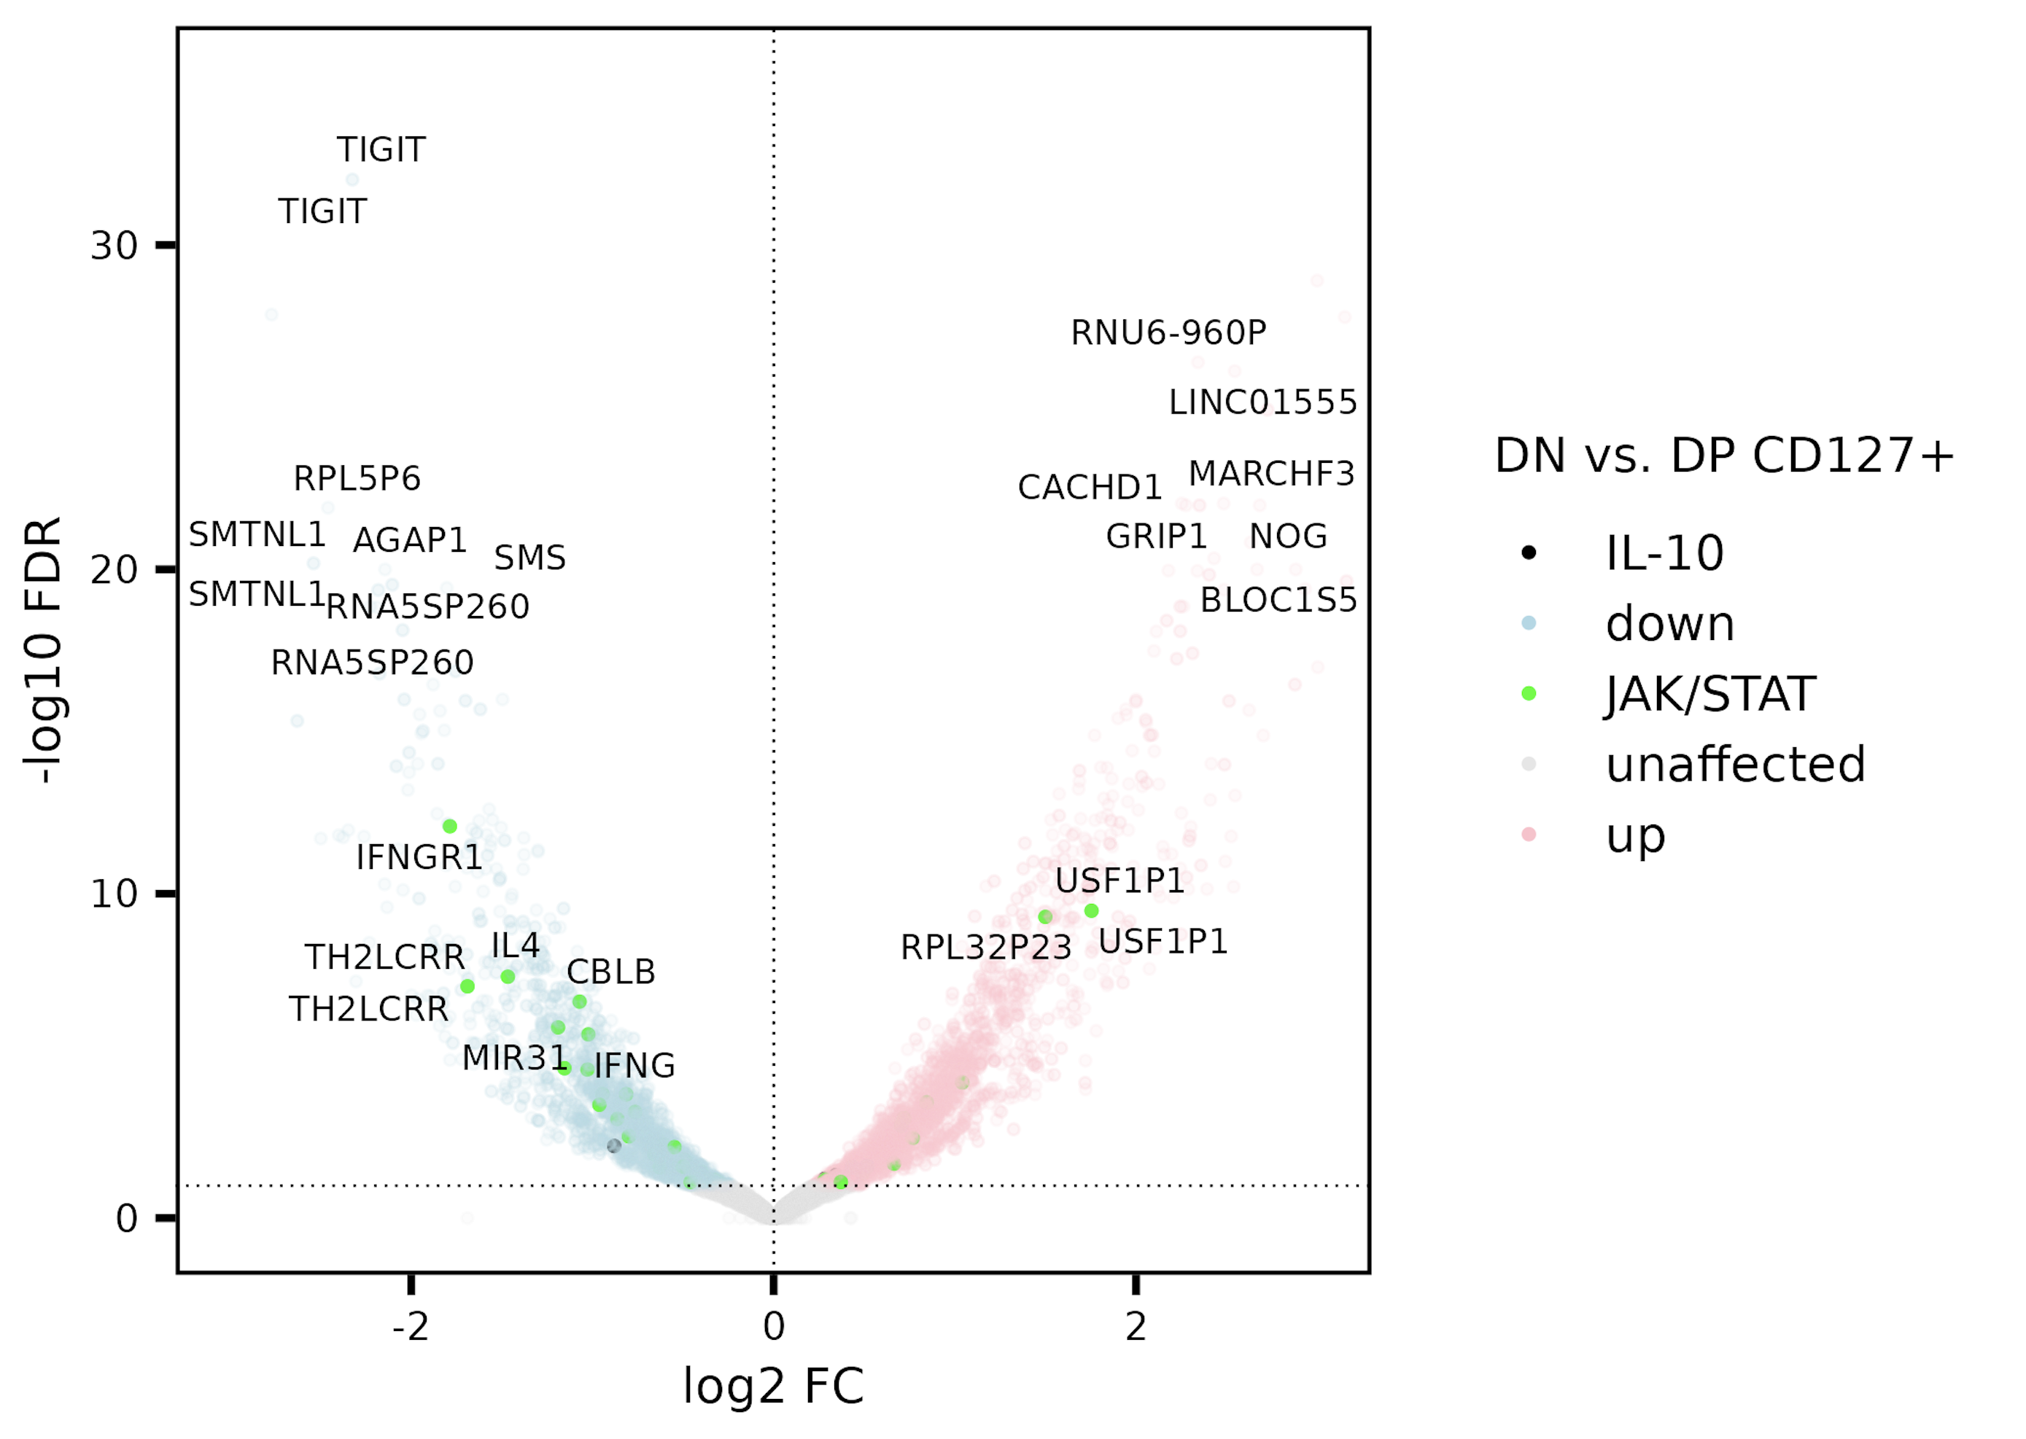
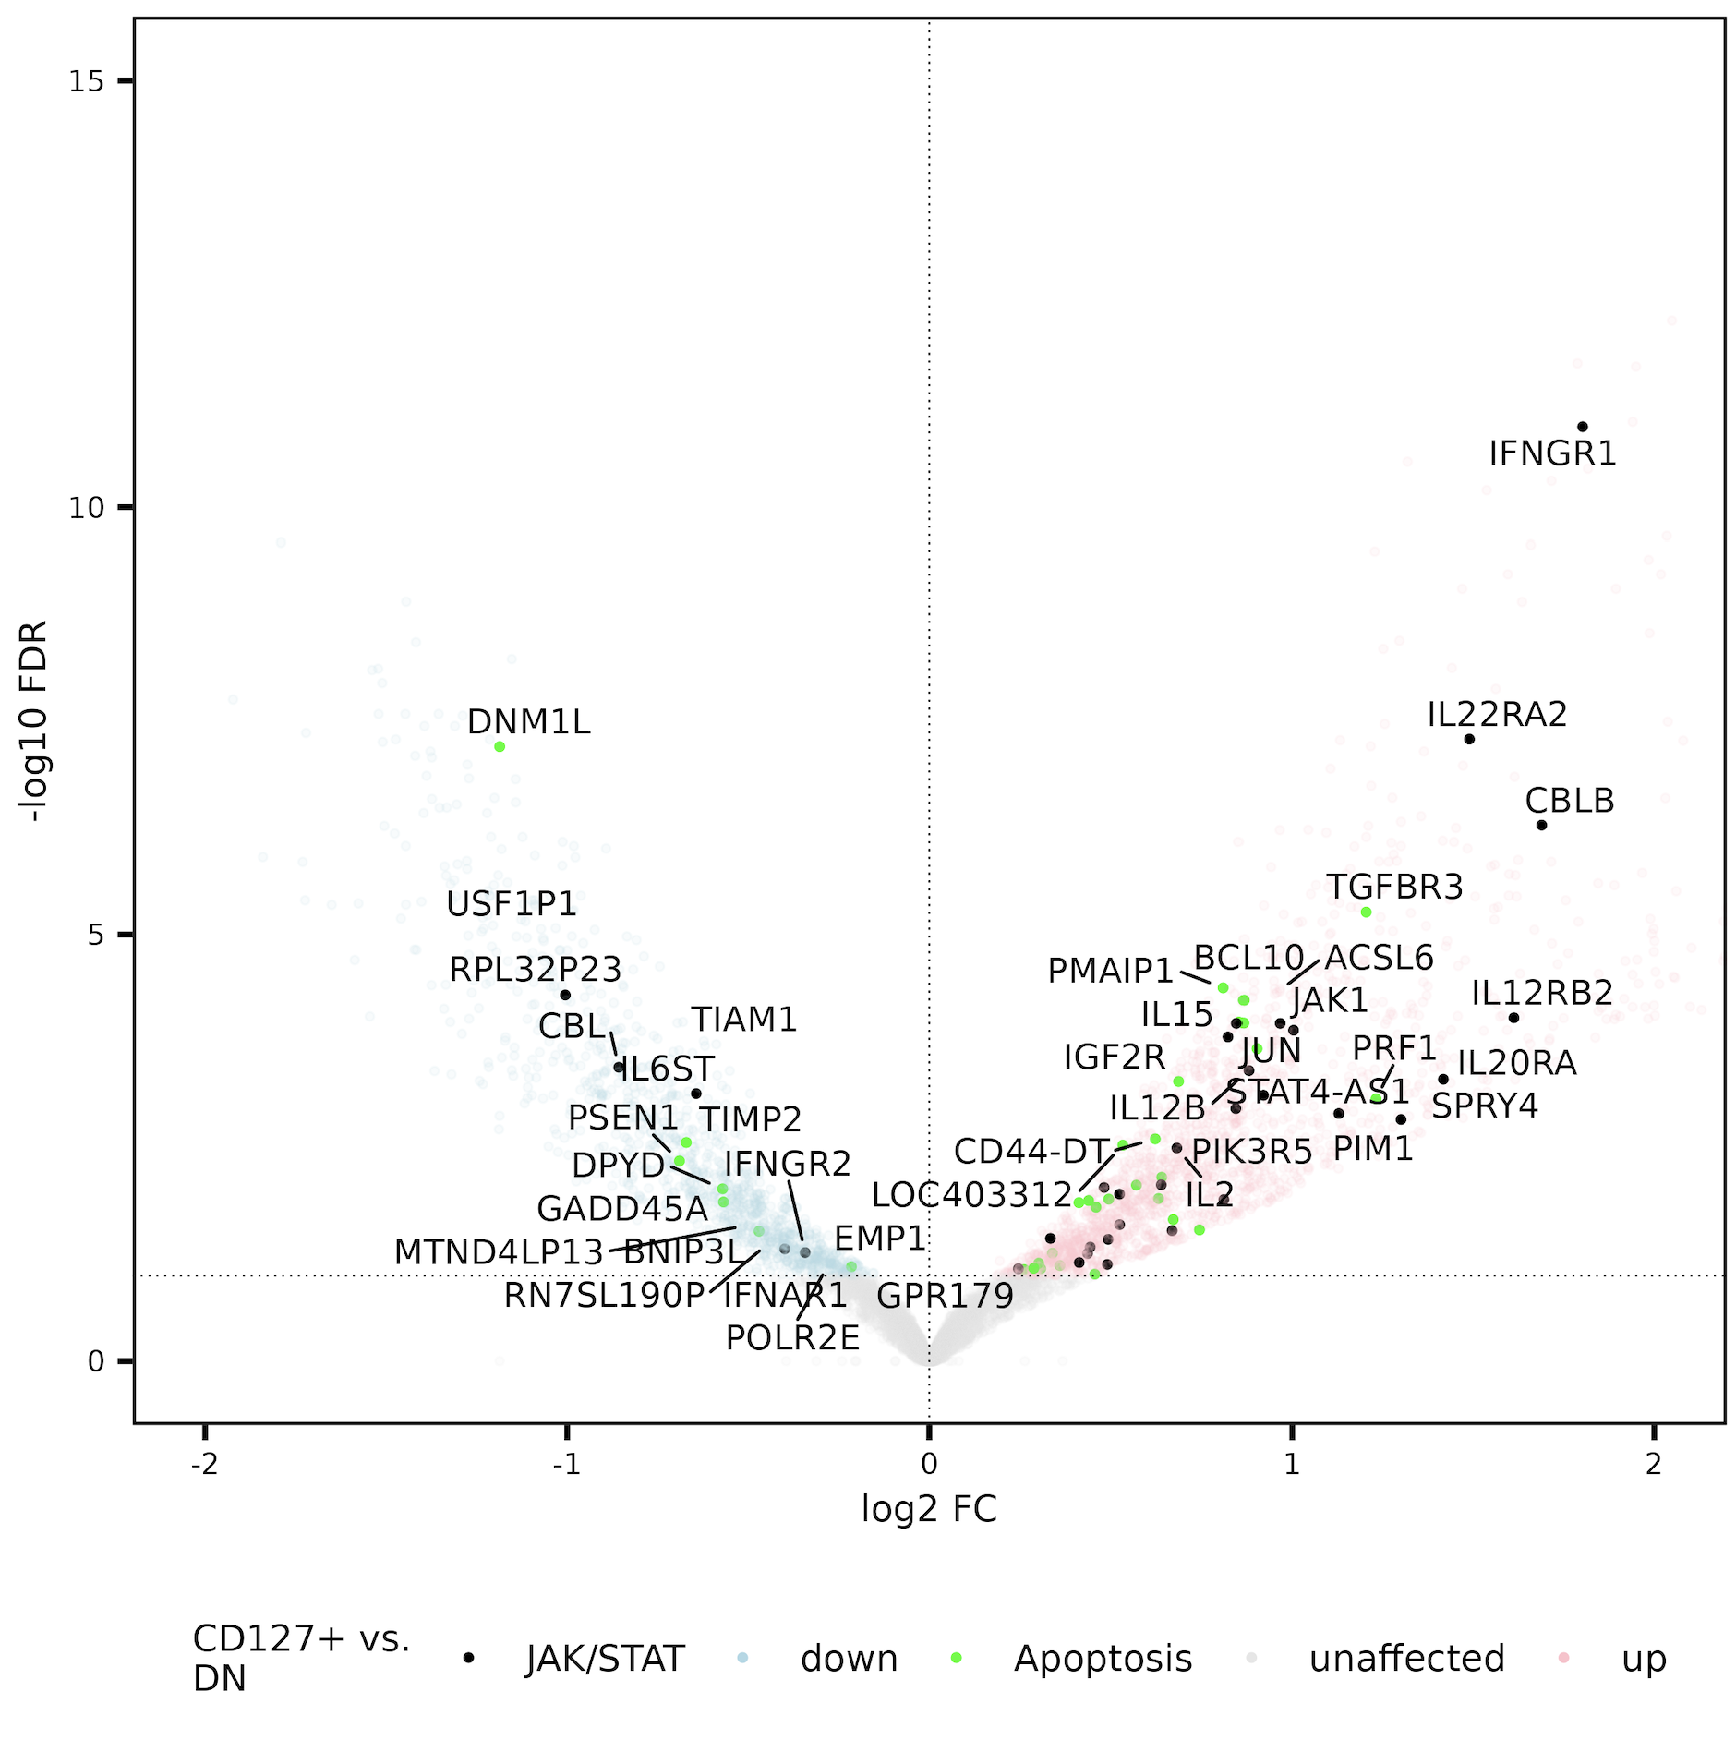
JAK/STAT gene set perhaps more accessible in CD127⁺ sorts vs. DN
JAK/STAT & IL-10 enriched (stringdb) in peaks’ genes/promoters up in both CD127⁺ sorts vs. DN
Notes:
Also checked within individual sorts…

