Slide 1
Weekly meeting
11 14 2024
Ty Bottorff

Slide 2
Outline
NCI irAE follow ups

Slide 3
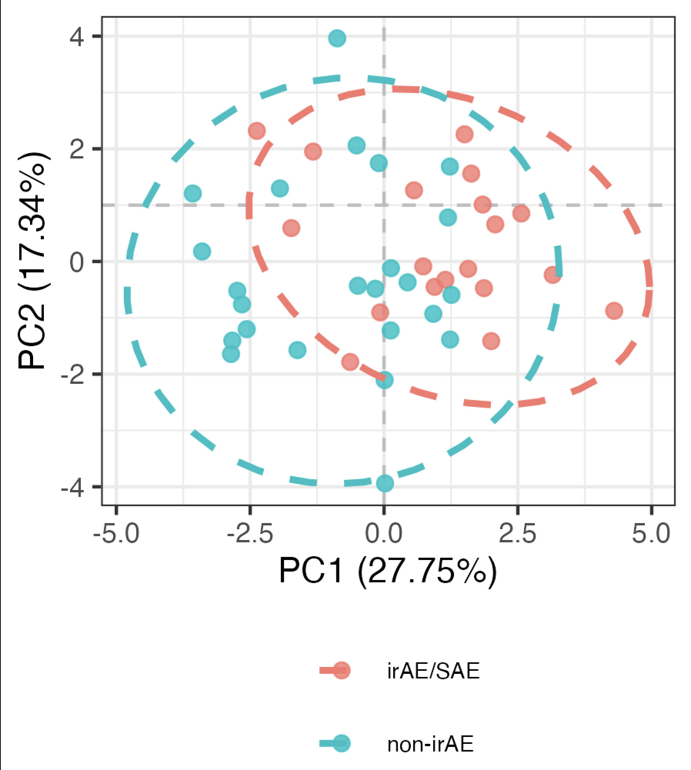
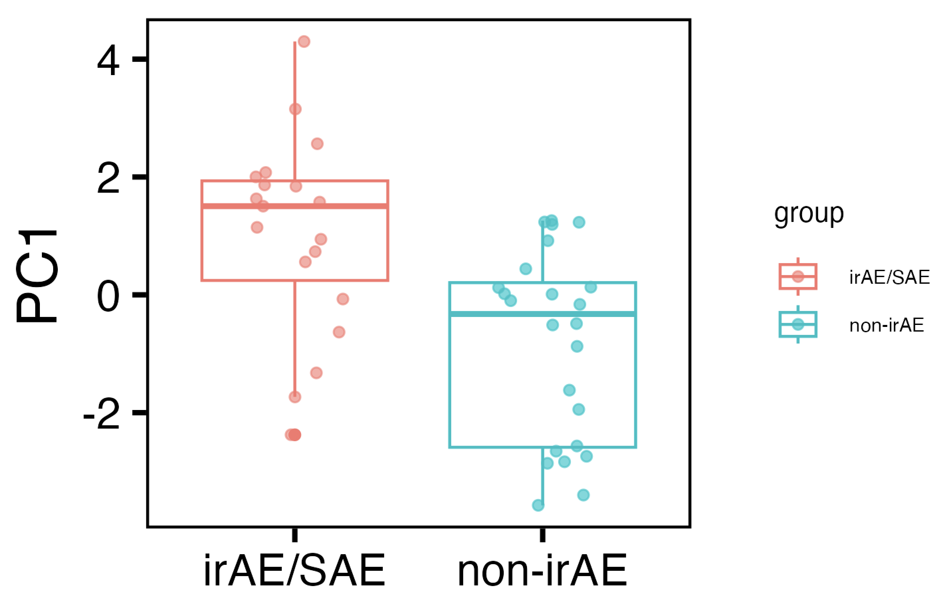
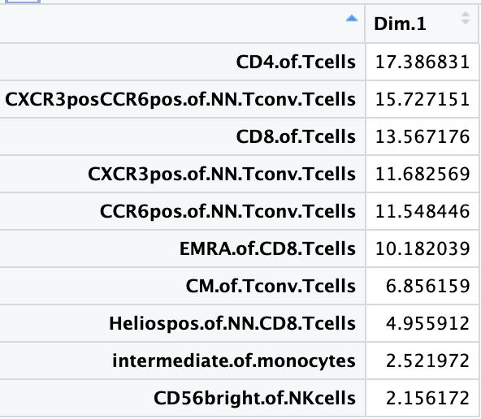
Baseline immunotypes do differ between irAE groups in PC1 of PCA using top features
PC1: p = 0.001
Notes:
Batch corrected, logit transformed, Z-scored freqs
Top 13 features here chosen from stats of batch-corrected logit transformed z-scored data unadjusted pval < 0.1
Directionality in PC space is arbitrary, so refer to mean module slide (next slide) for directionality

Slide 4
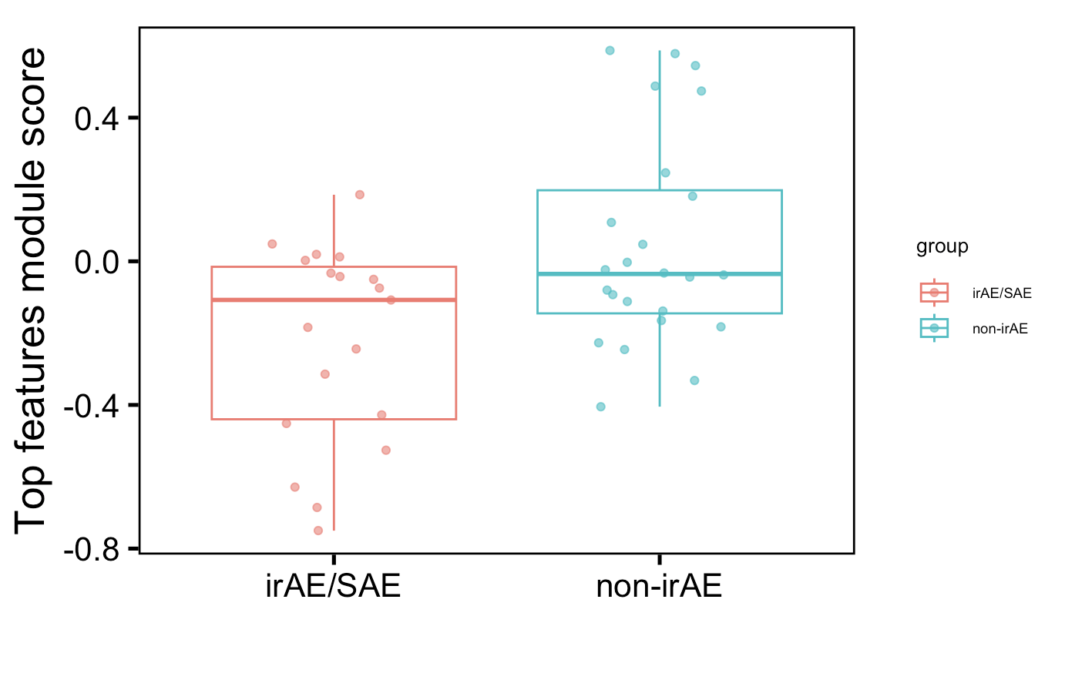
Also observe difference in mean module of top features (using more than previously)
p = 0.03
Notes:
Batch corrected, logit transformed, Z-scored freqs
Top 13 features here chosen from stats of batch-corrected logit transformed z-scored data unadjusted pval < 0.1

Slide 5
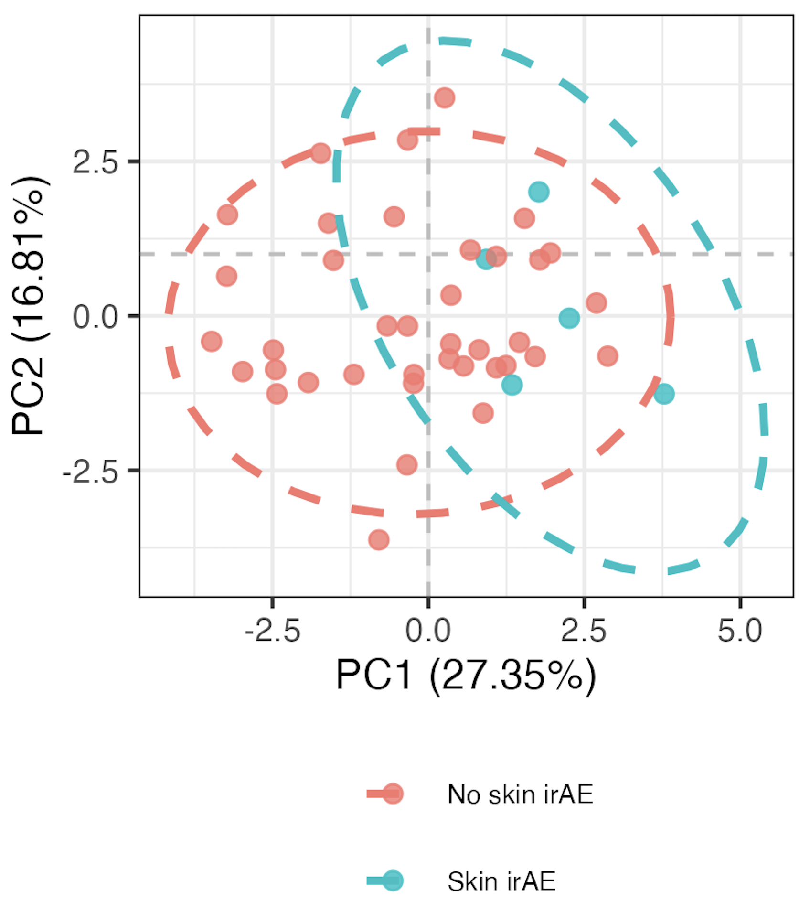
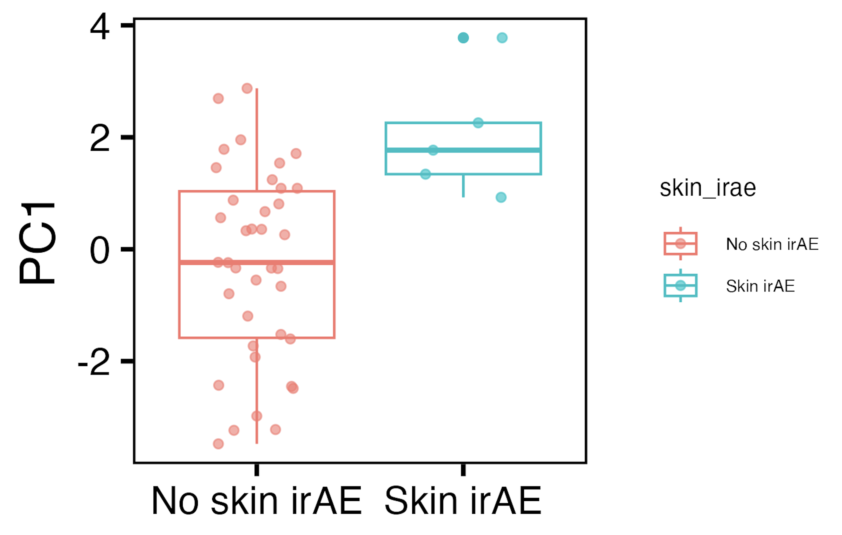
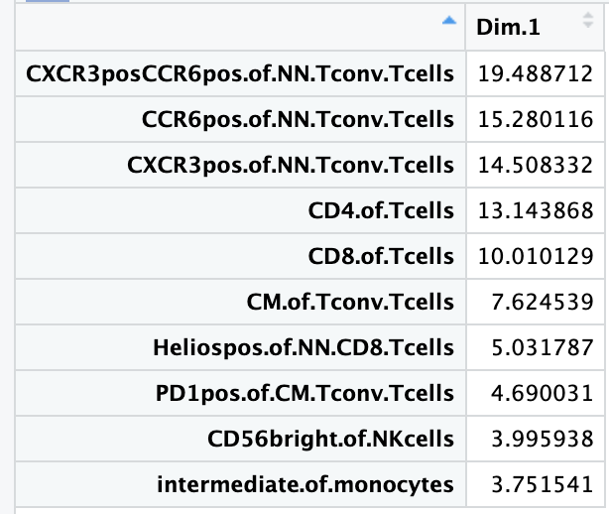
Baseline immunotypes do differ between skin irAE groups in PC1 of PCA using top features
PC1: p = 0.005
Notes:
Batch corrected, logit transformed, Z-scored freqs
Top features here chosen from stats of batch-corrected logit transformed z-scored data unadjusted pval < 0.1

Slide 6
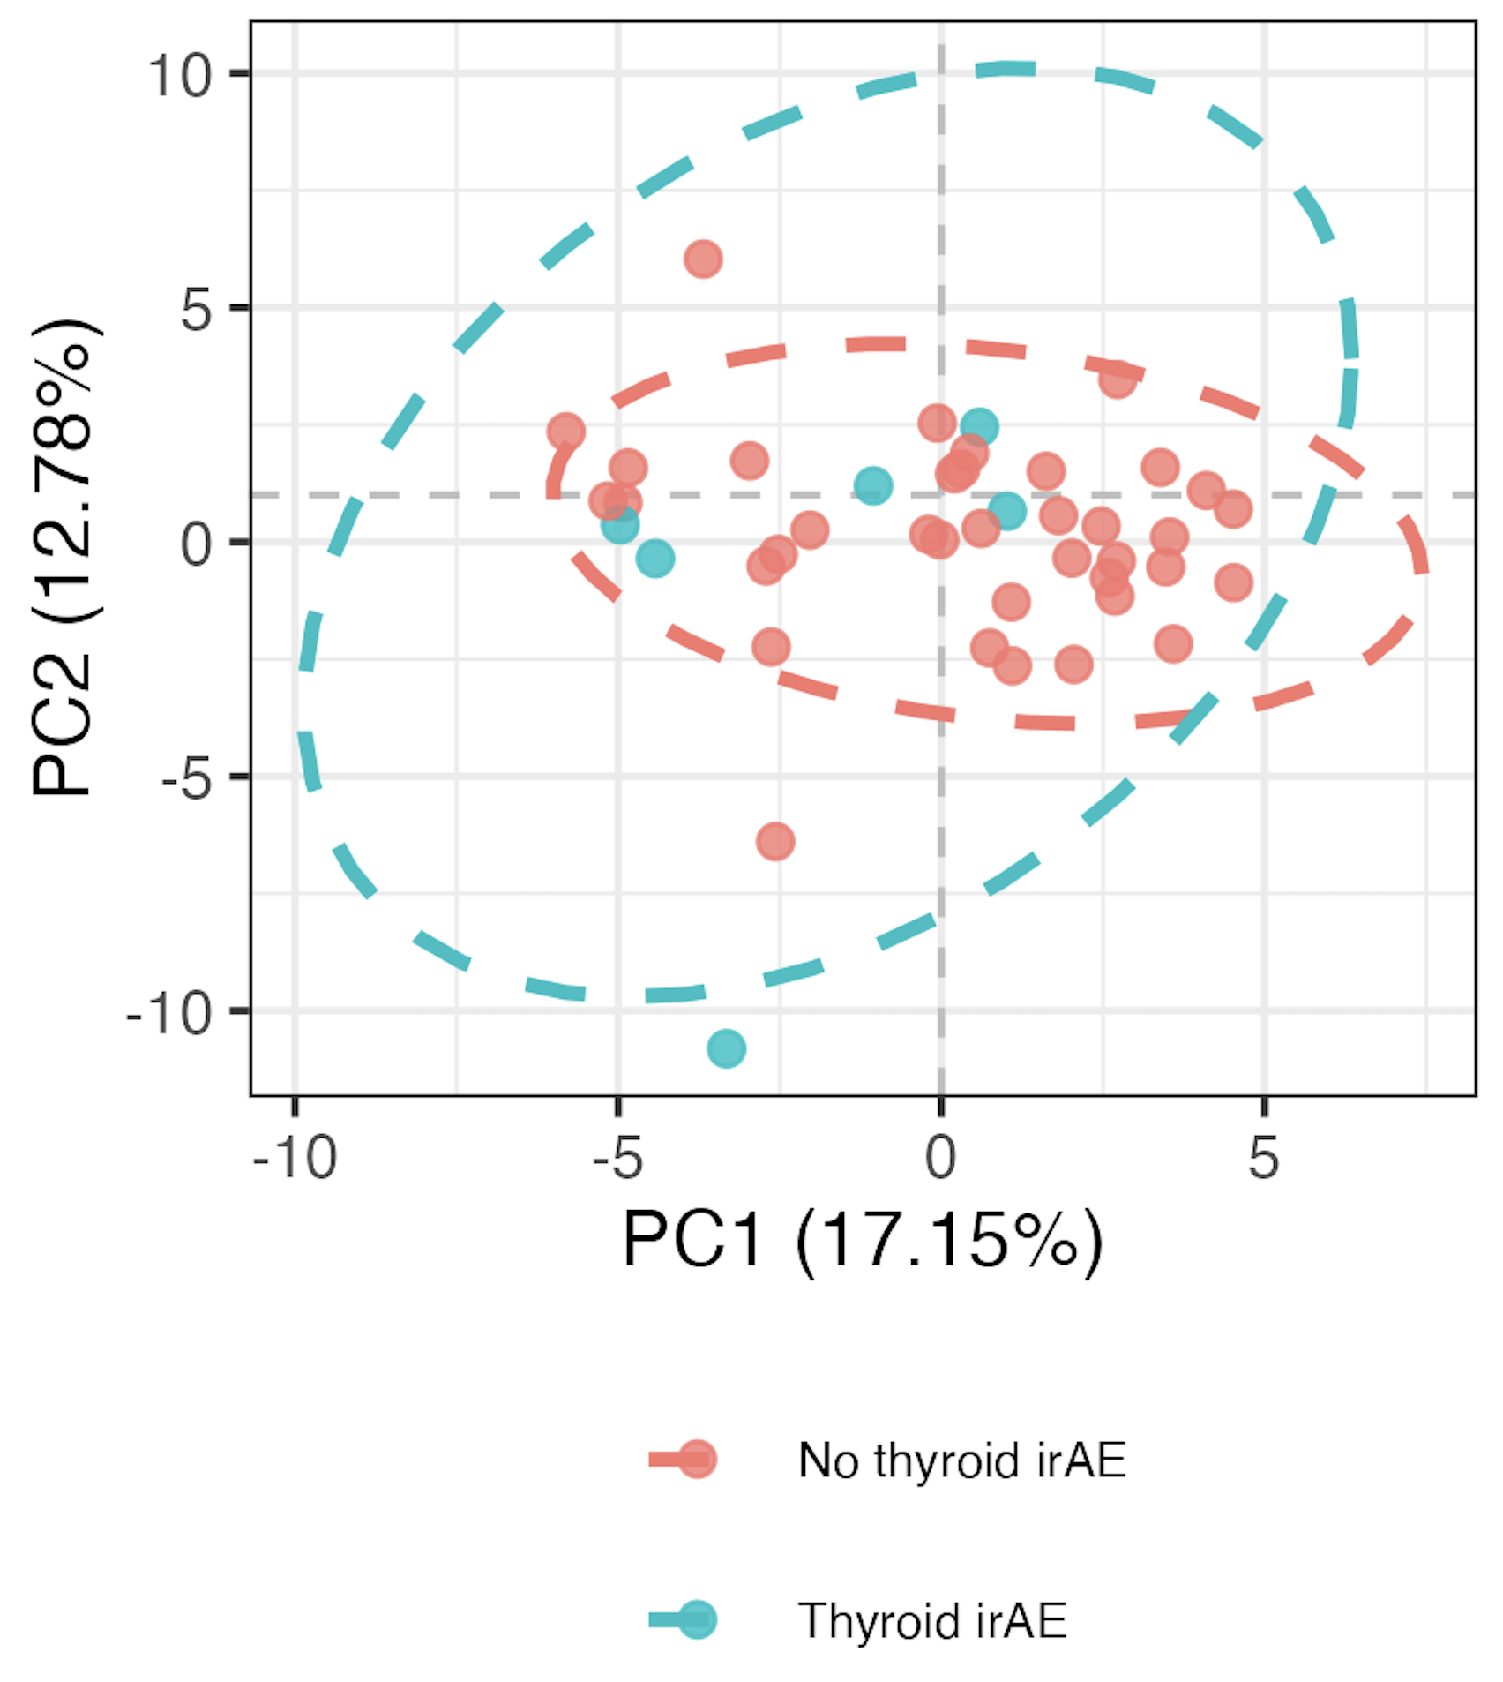
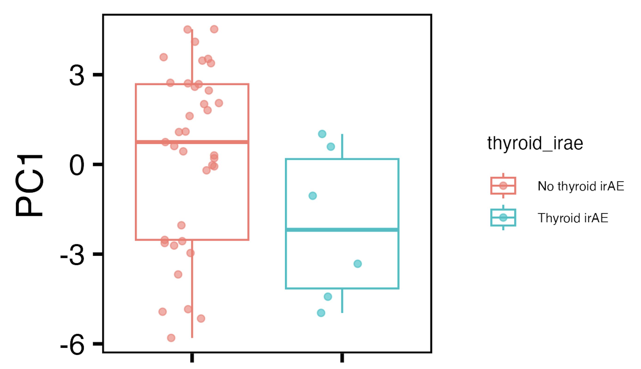
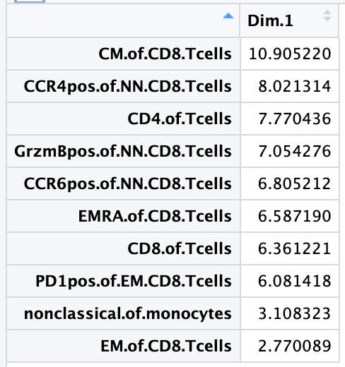
Baseline immunotypes slightly differ between thyroid irAE groups in PC1 of PCA using all features
PC1: p = 0.08
If including OOR, see no differences
Notes:
Batch corrected, logit transformed, Z-scored freqs
ALL features here

Slide 7
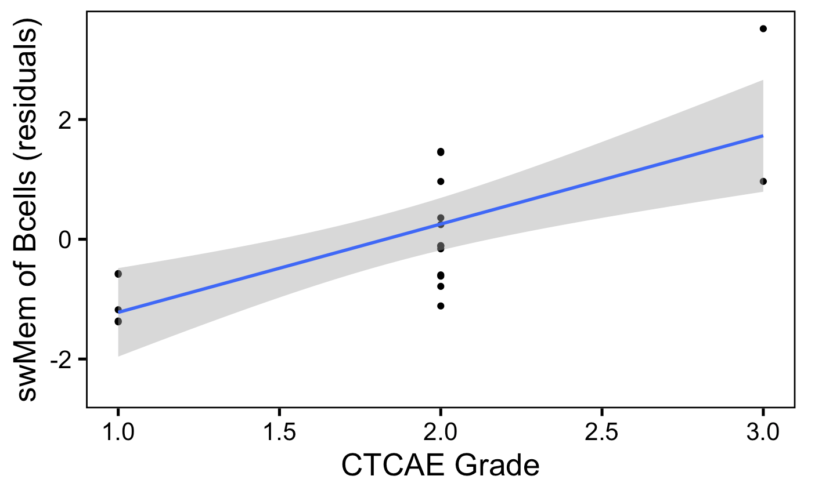
swMem of Bcells weakly correlates with irAE severity
padj = 0.06
Notes:
Batch corrected, logit transformed, Z-scored freqs

Slide 8
Conclusions
do observe some immunotype differences at baseline between (skin/thyroid) irAE groups using combinations of features (means, PCs)
swMem of Bcells weakly correlates with irAE severity

Slide 9
Next steps
markers in NCI panel (like CD57) that weren’t gated for can still be analyzed (i.e. apply CD57⁺ IMPACD gate within DP subset)

Slide 10
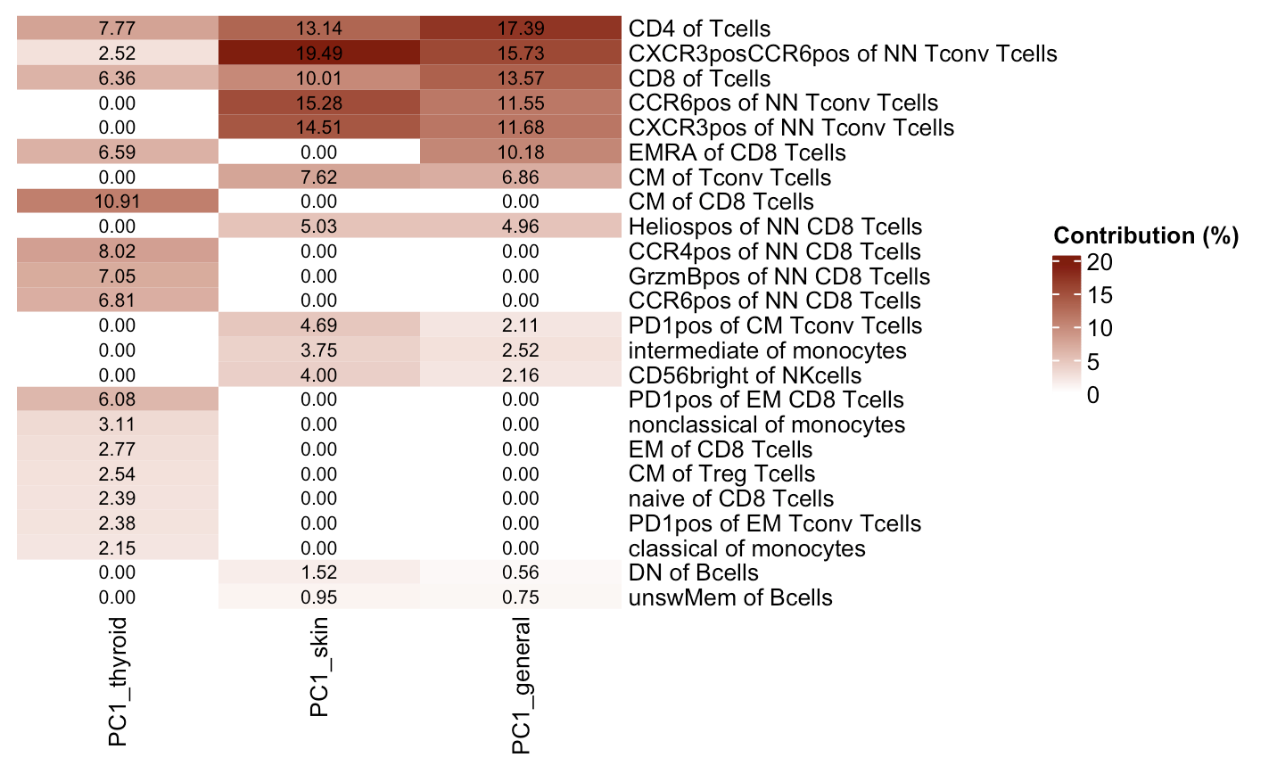
Features contributing to PC1s in 3 baseline irAE comparisons
Notes:
Thyroid comparison coming from all features, other 2 from top features do basically overlap (general just has a 13th feature that skin doesn’t)

