Slide 1
Weekly meeting
7 11 2024
Ty Bottorff

Slide 2
Outline
P576 MT var analyses

Slide 3
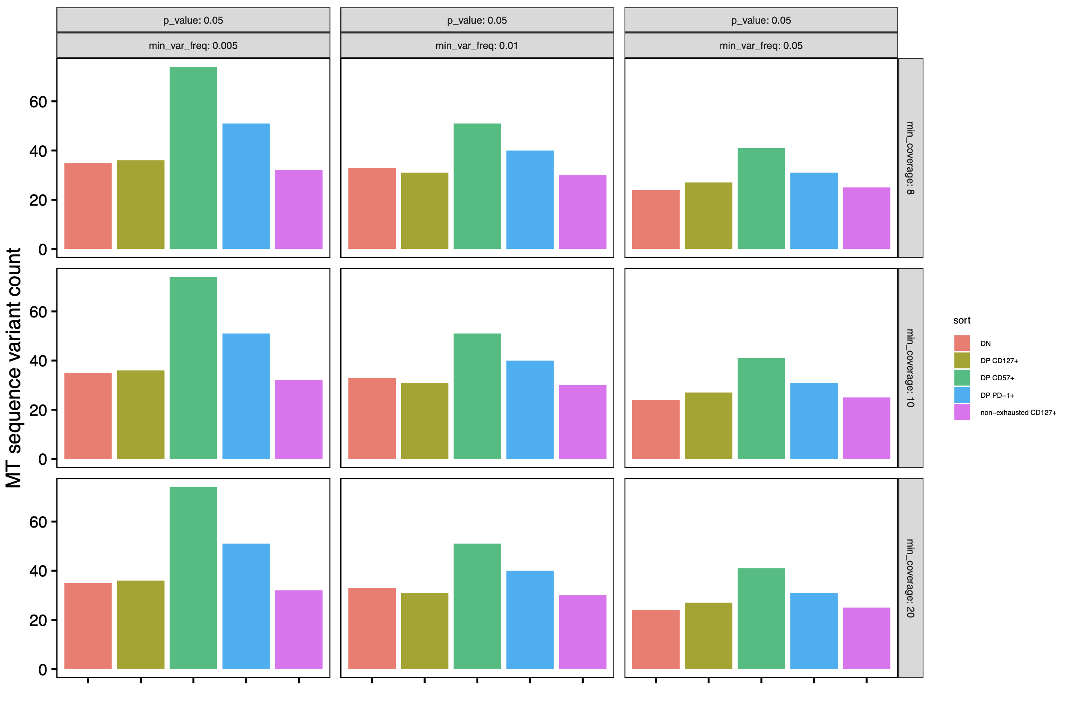
Sensitivity analysis shows min_var_freq as important parameter, chose 0.01 for next steps
Notes:
Going too low in min_var_freq may introduce noise, I believe 0.01 is recommended from sample size (0.5/sample of 50)

Slide 4
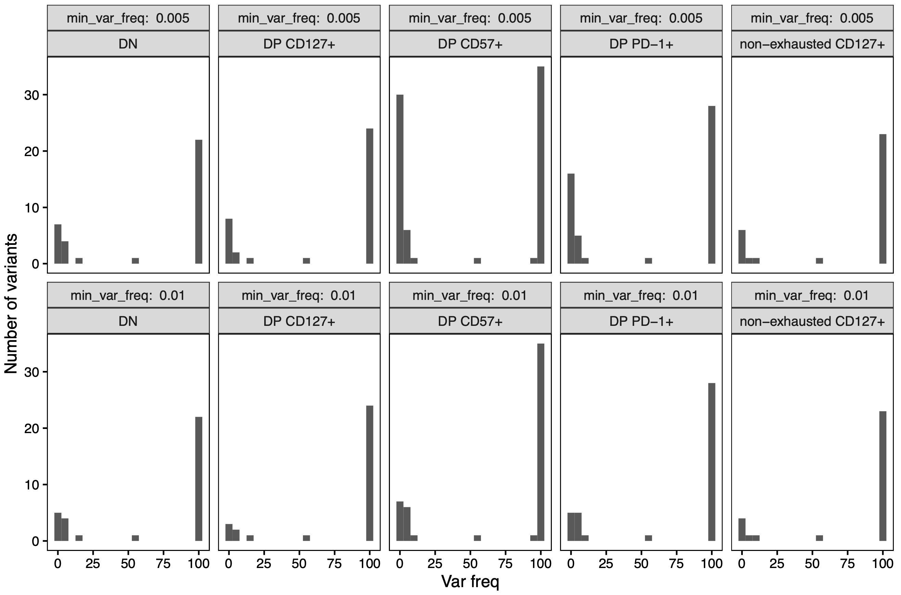
DP PD-1⁺ and DP CD57⁺, followed by DP CD127⁺ have most very low frequency variants, evidence for more terminal populations?
Notes:
I think bimodal distribution means frequent ones are “established” i.e. probably in most cells and older muts and infrequent ones are newer and in fewer cells, and I suppose perhaps that the transition is quick from new to established so there are few intermediately frequent vars

Slide 5
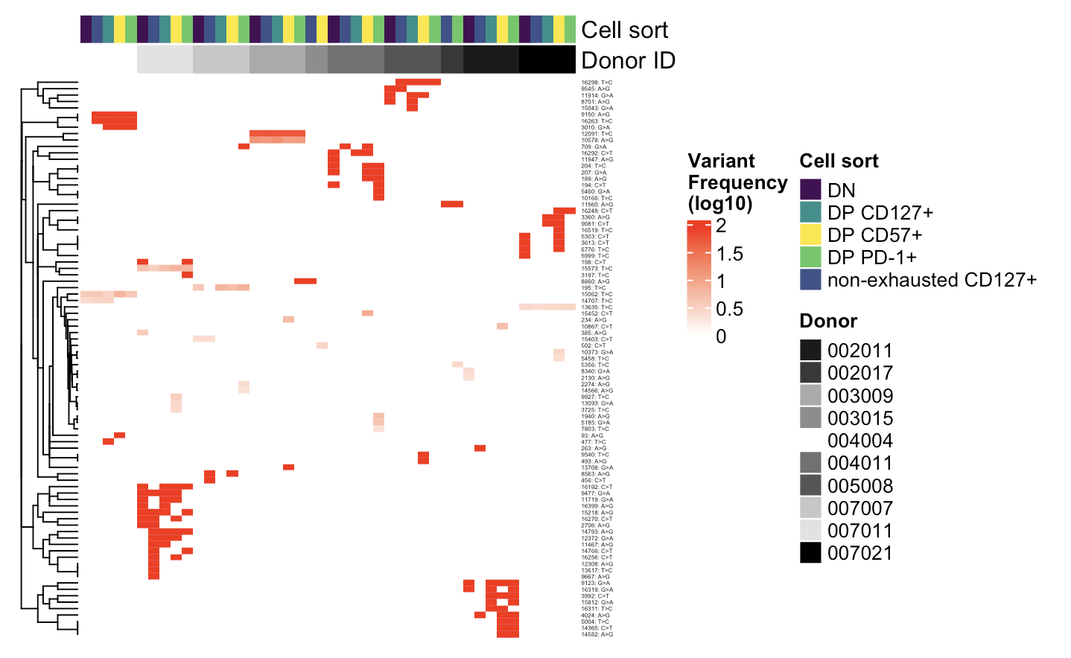
Heatmap of MT variants
Example of var in > 1 donor
Example of var in all cell sorts in 1 donor
Notes:
Pseudocount for log

Slide 6
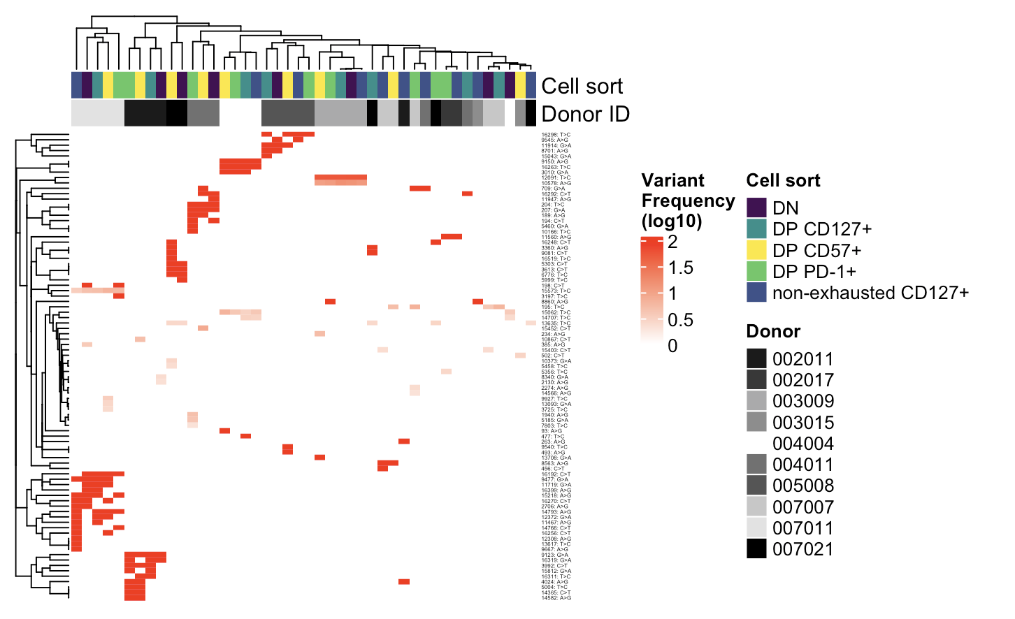
Clustering cols shows donor effects > sort effects, as expected
Notes:
Pseudocount for log

Slide 7
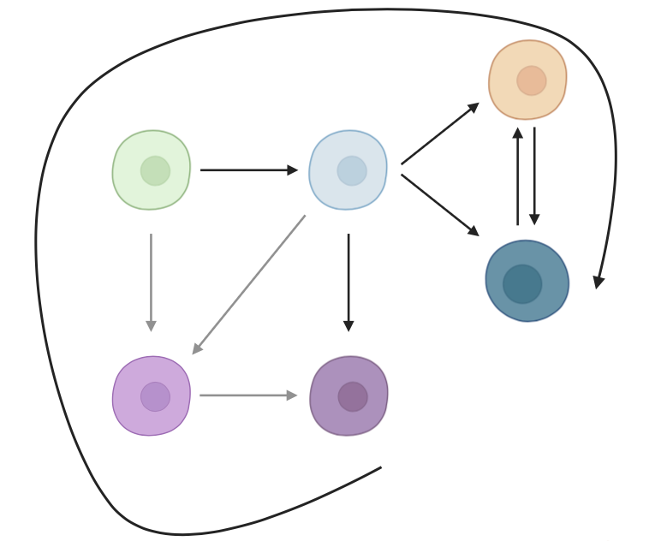
Unique MT var counts overlayed on differentiation model, DP PD-1⁺ and DP CD57⁺ are more terminal
DP PD-1⁺: 11
TIGIT⁻
KLRG1⁻: 5
TIGIT⁺
KLRG1⁺ (DP)
DP CD57⁺: 14
not DP,
CD127⁺: 6
DP
CD127⁺: 2
Notes:
Unique var counts: 2 CD127, 5 DN, 6 non-exh, 11 PD1, 14 CD57

Slide 8
Conclusions
DP CD57⁺, along with DP PD-1⁺, are the most terminal cell types
Using DN’s MT genome for alignment and variant calling unexpectedly didn’t result in obvious differences (data not shown), so I’m dropping this lead

Slide 9
Next steps
Working to analyze Erin’s T1DAL RNAseq (P362) – in progress

