Slide 1
Weekly meeting
1 4 2024
Ty Bottorff

Slide 2
Outline
Cell type abundance differences by irAE group
VJ gene usage differences by irAE group
Donors/junction (AA) vs. donors/junction (nt) plots

Slide 3
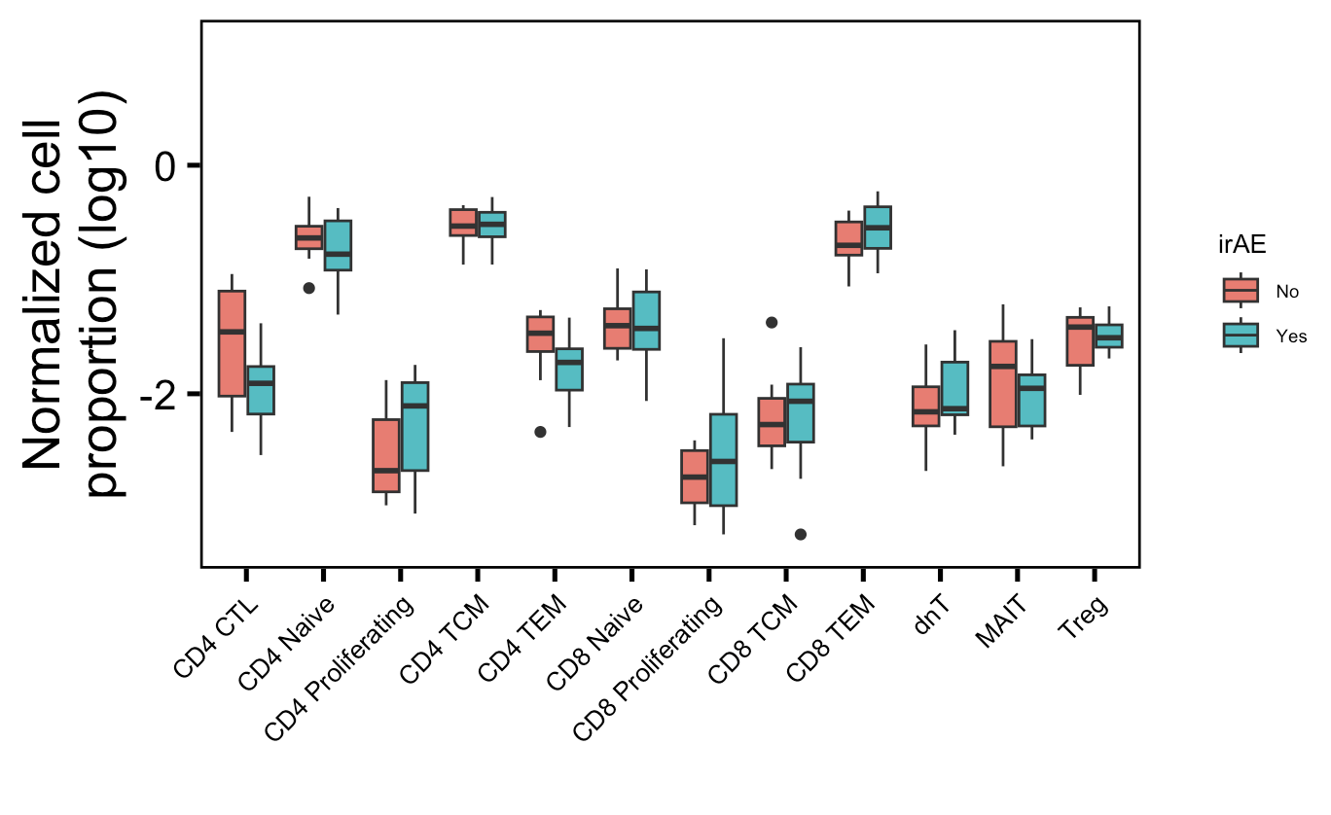
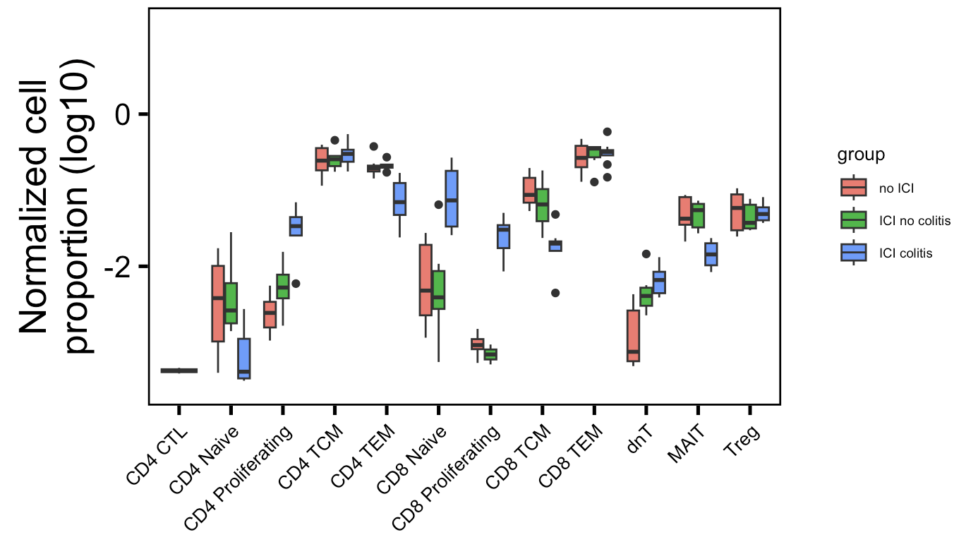
Some cell type normalized abundances in irAE tissue (colitis dataset) are different between irAE groups
Myocarditis dataset
Colitis dataset
**
**
*
*
**
More proliferating T cells (CD4 and CD8), fewer memory T cells (CD4 TEM, CD8 TCM),
fewer MAITs in irAE tissue
Wilcoxon rank sum test. **, p <1e-2; *; p <0.05
Notes:
Fewer Tregs associated with irAEs in literature, don’t see that here though

Slide 4
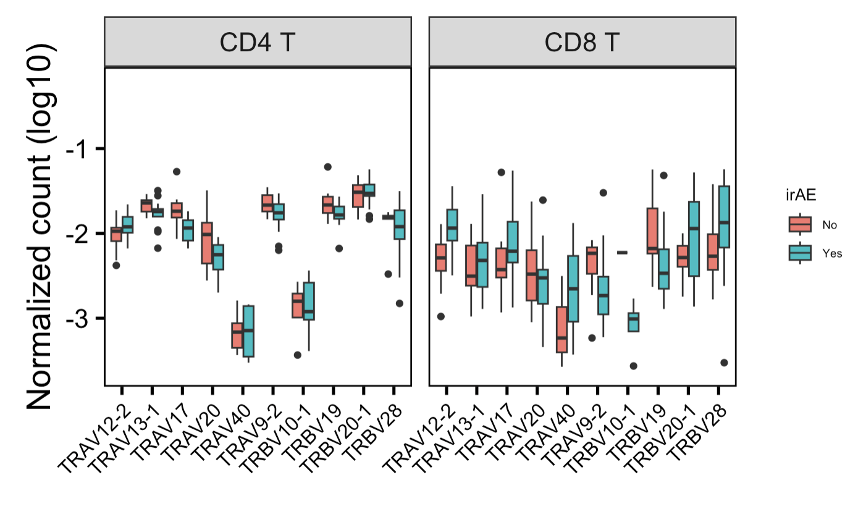
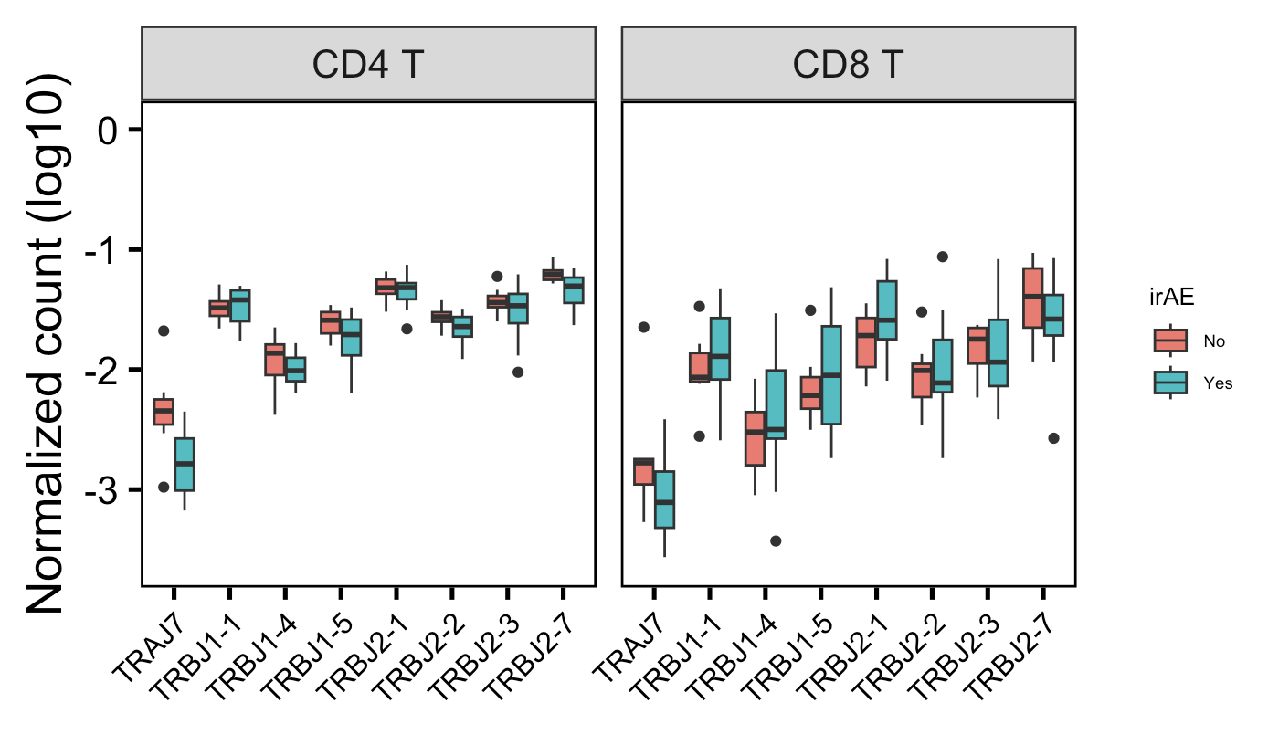
In myocarditis dataset, a few VJ genes are differentially encountered in different irAE groups
*
*
**
Showing 10 V/J genes with highest differences in median normalized counts between irAE groups
Wilcoxon rank sum test. **, p <1e-2; *; p <0.05

Slide 5
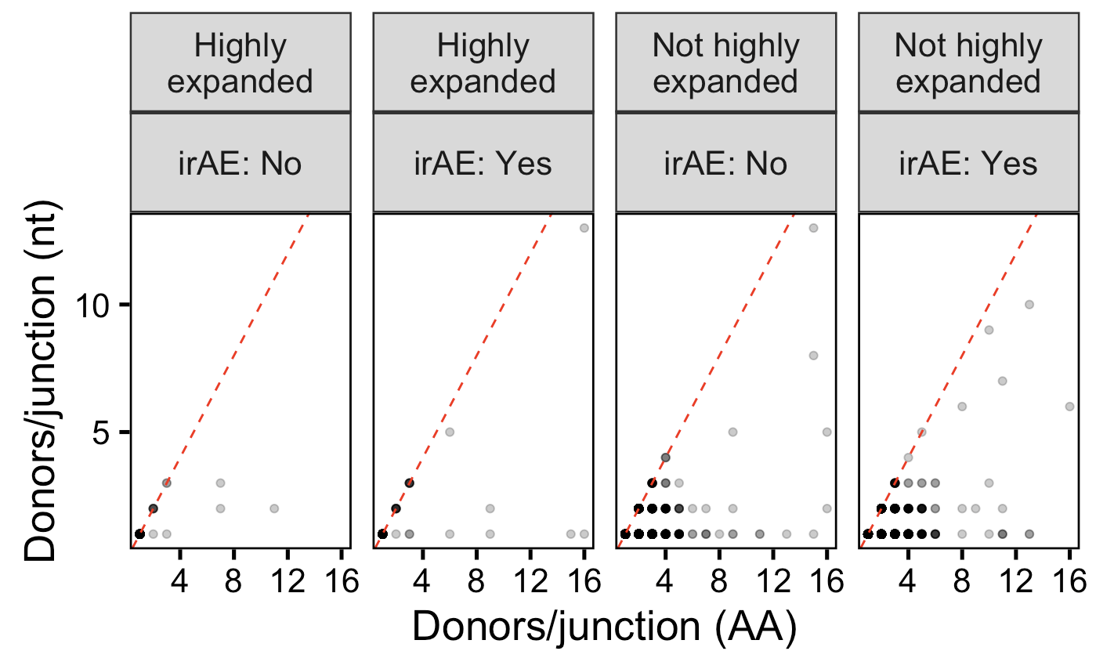
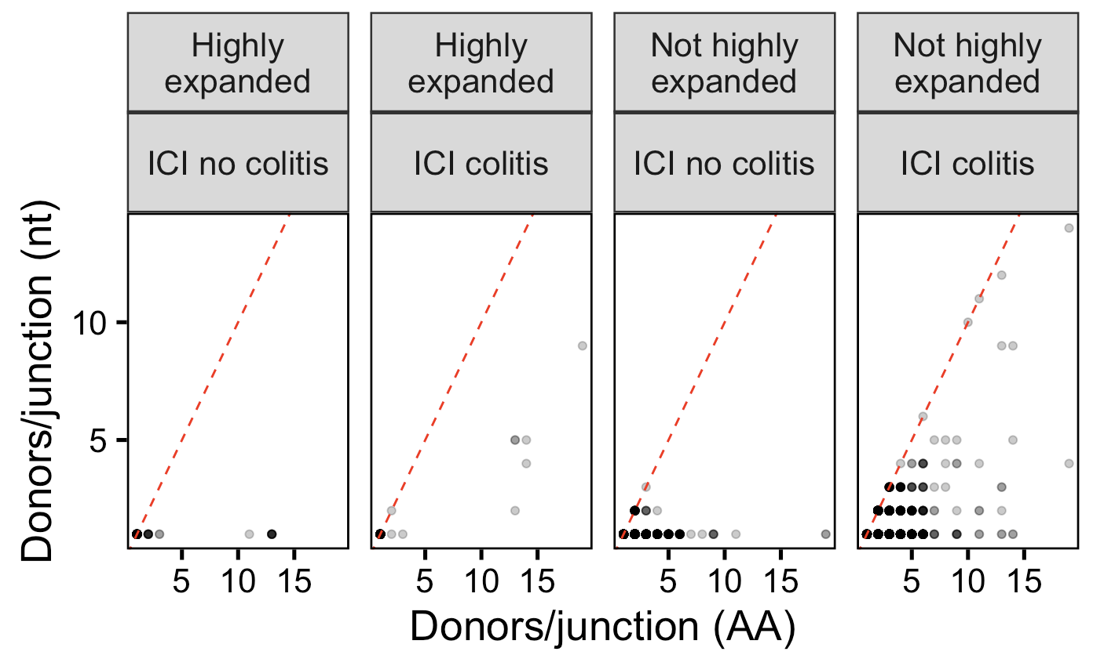
In colitis dataset, see more convergence in irAE group
Myocarditis dataset
Colitis dataset

Slide 6
Conclusions
In myocarditis dataset, a few VJ genes are differentially encountered in different irAE groups
Colitis dataset
More proliferating T cells (CD4 and CD8), fewer memory T cells (CD4 TEM, CD8 TCM), fewer MAITs in irAE tissue
More convergence in irAE group
Found some additional weak TCR feature (junction length, chain germline-ness) differences betweeen irAE groups (data not shown), but nothing consistent between both datasets or as strong as CD8 TEM TRB pgen feature different between irAE groups

Slide 7
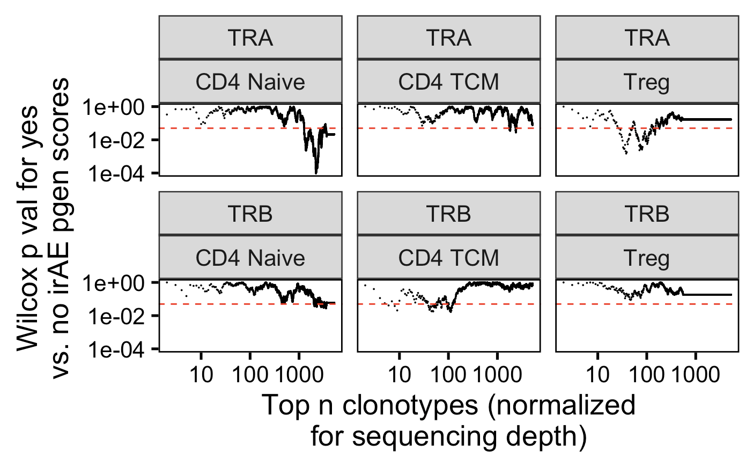
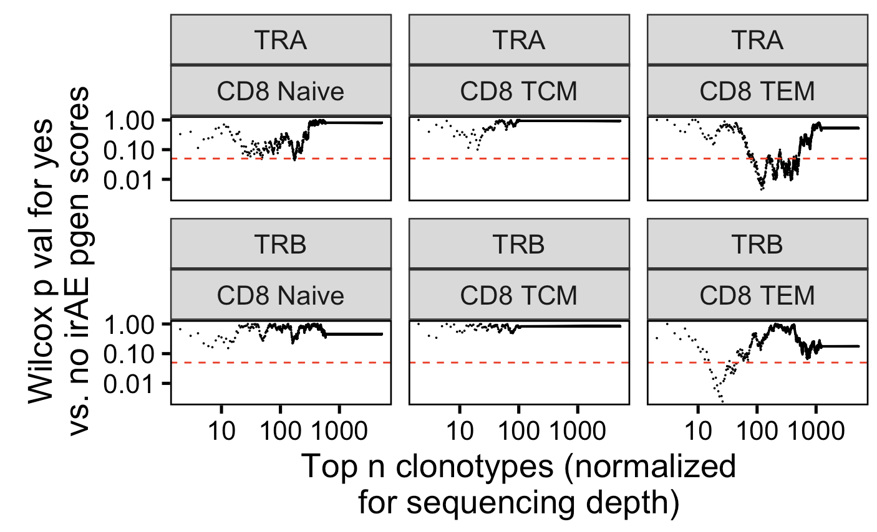
Next steps: summary plots?
Notes:
Caveats with summary plots as I currently have it:
Pval not padj…
no way to know if effect is in same direction for each test (i.e. pgens could be lower significantly in one and higher significantly in another, and I don’t know ahead of time what the effect direction is…), although it’s unlikely for nearby top n clonotype comparisons (i.e. top 30 and top 31 likely same effect direction if both significant)

Slide 8
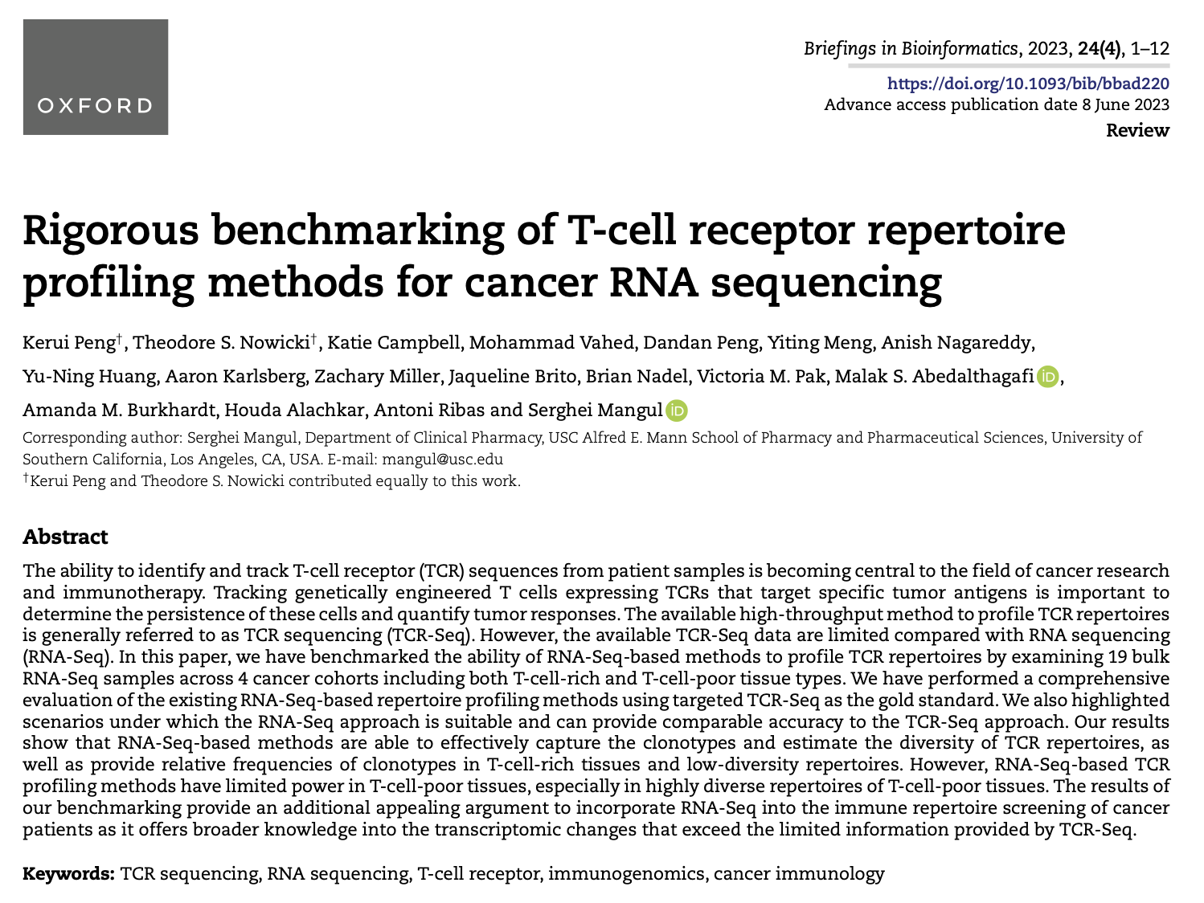
Next steps: JC prep
perhaps supports use of datasets with no TCRseq (using RNAseq to call TCR clonotypes), although only from T cell rich tissue with low diversity
Notes:
Caveats with summary plots as I currently have it:
Pval not padj…
no way to know if effect is in same direction for each test (i.e. pgens could be lower significantly in one and higher significantly in another, and I don’t know ahead of time what the effect direction is…), although it’s unlikely for nearby top n clonotype comparisons (i.e. top 30 and top 31 likely same effect direction if both significant)

Slide 9
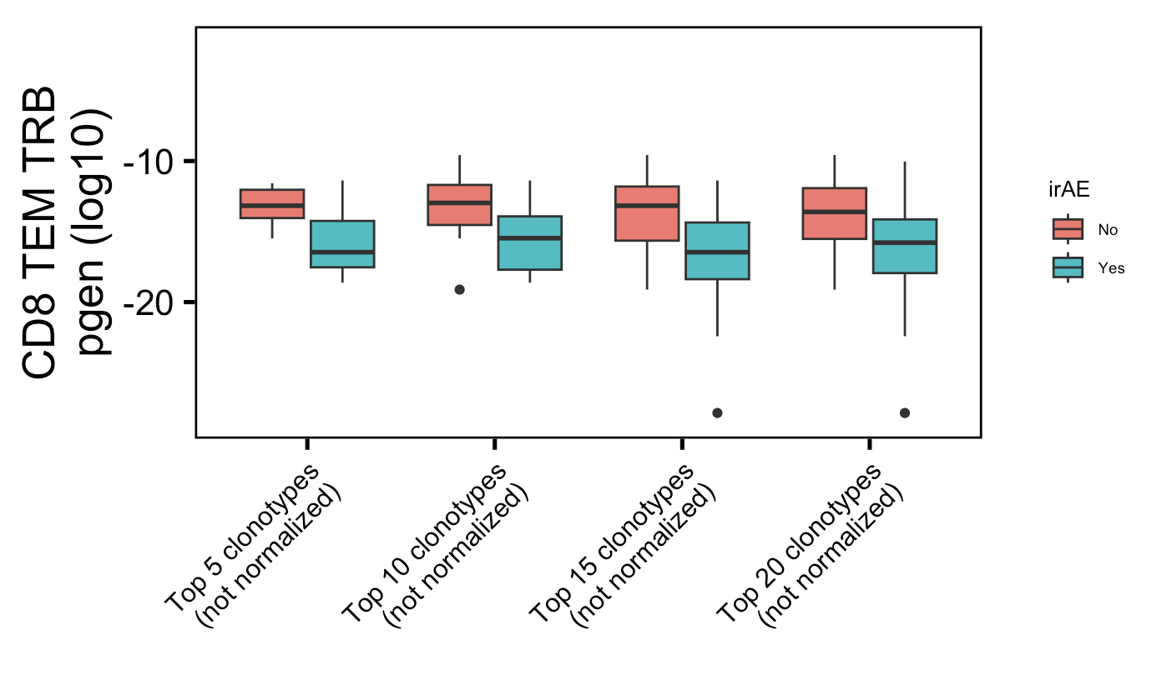
Strongest myocarditis conclusion for comparison
*
*
Not just seen for not normalized (reason why its not weak)
Wilcoxon rank sum test. **, p <1e-2; *; p <0.05

Slide 10
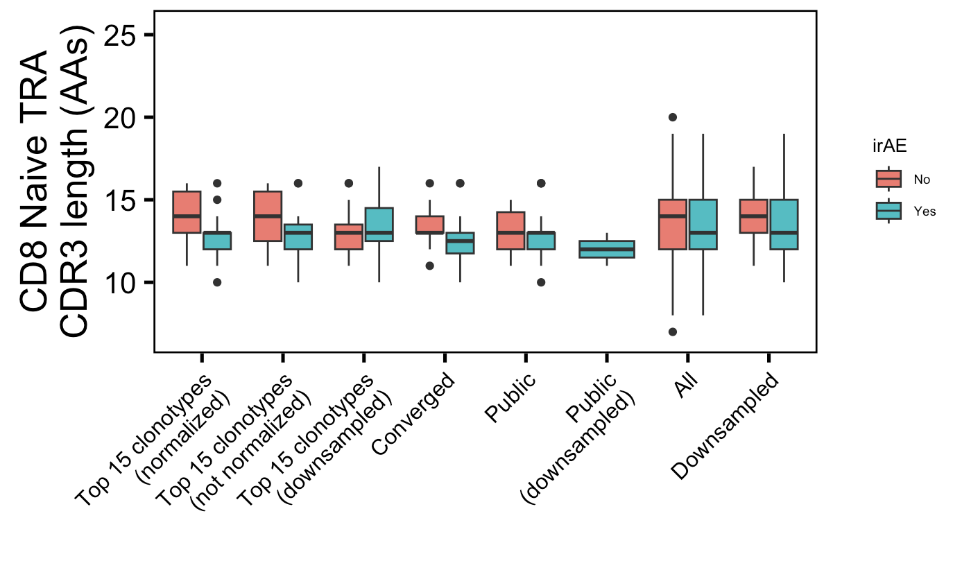
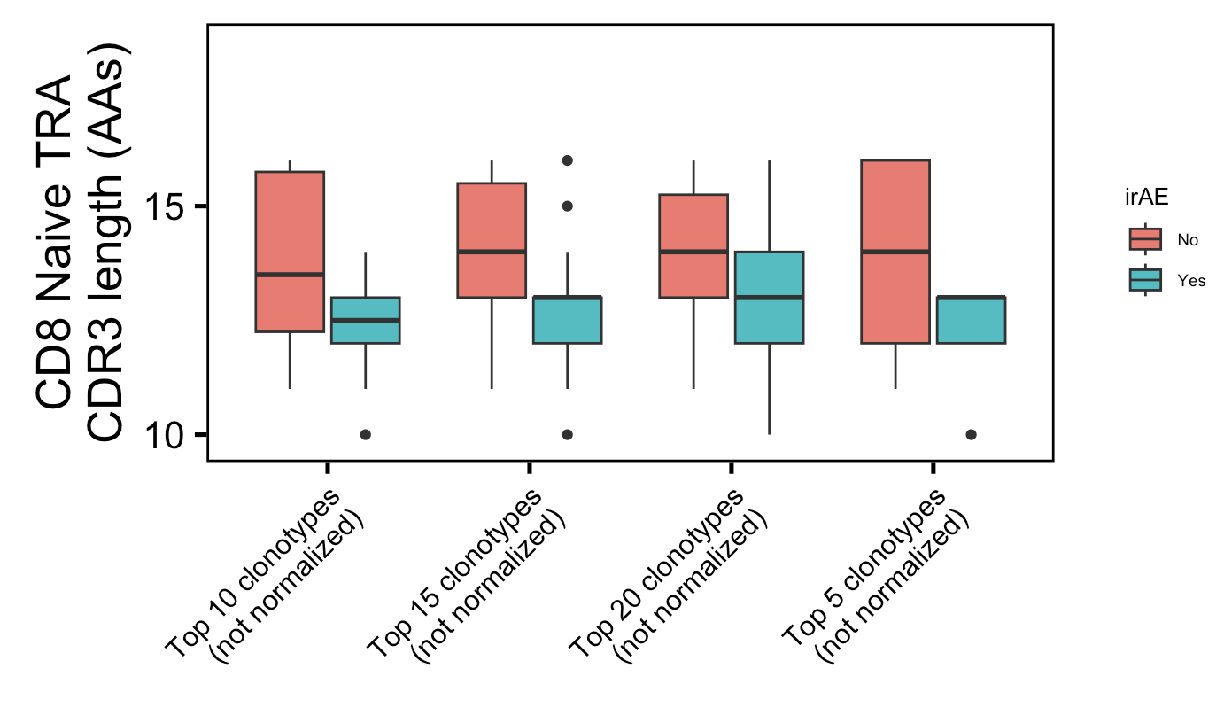
Additional weak conclusion 1 from myocarditis dataset: highly expanded CD8 Naïve TRA CDR3s shorter in irAE patients
*
*
*
5
10
15
20
Top n clonotypes (normalized)
Wilcoxon rank sum test. **, p <1e-2; *; p <0.05
Label wrong they’re normalized
Notes:
No pgen differences (least at 15 clonotype level)

Slide 11
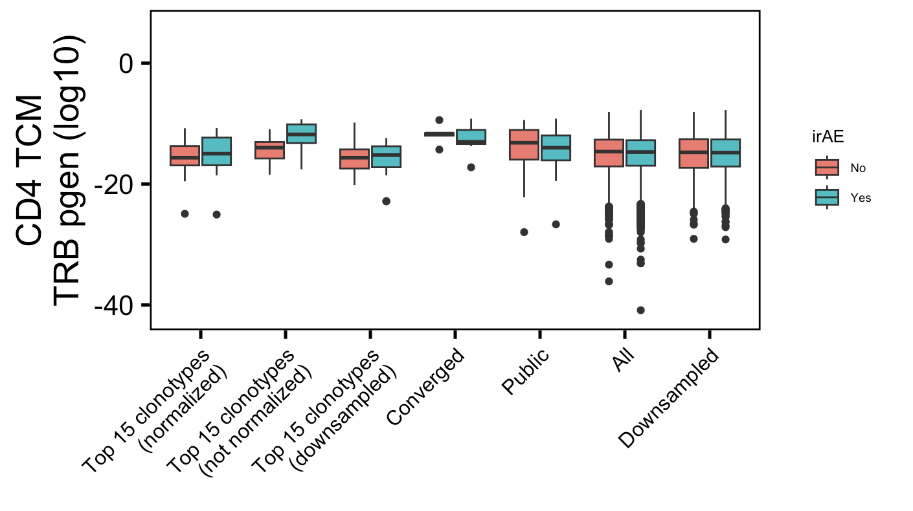
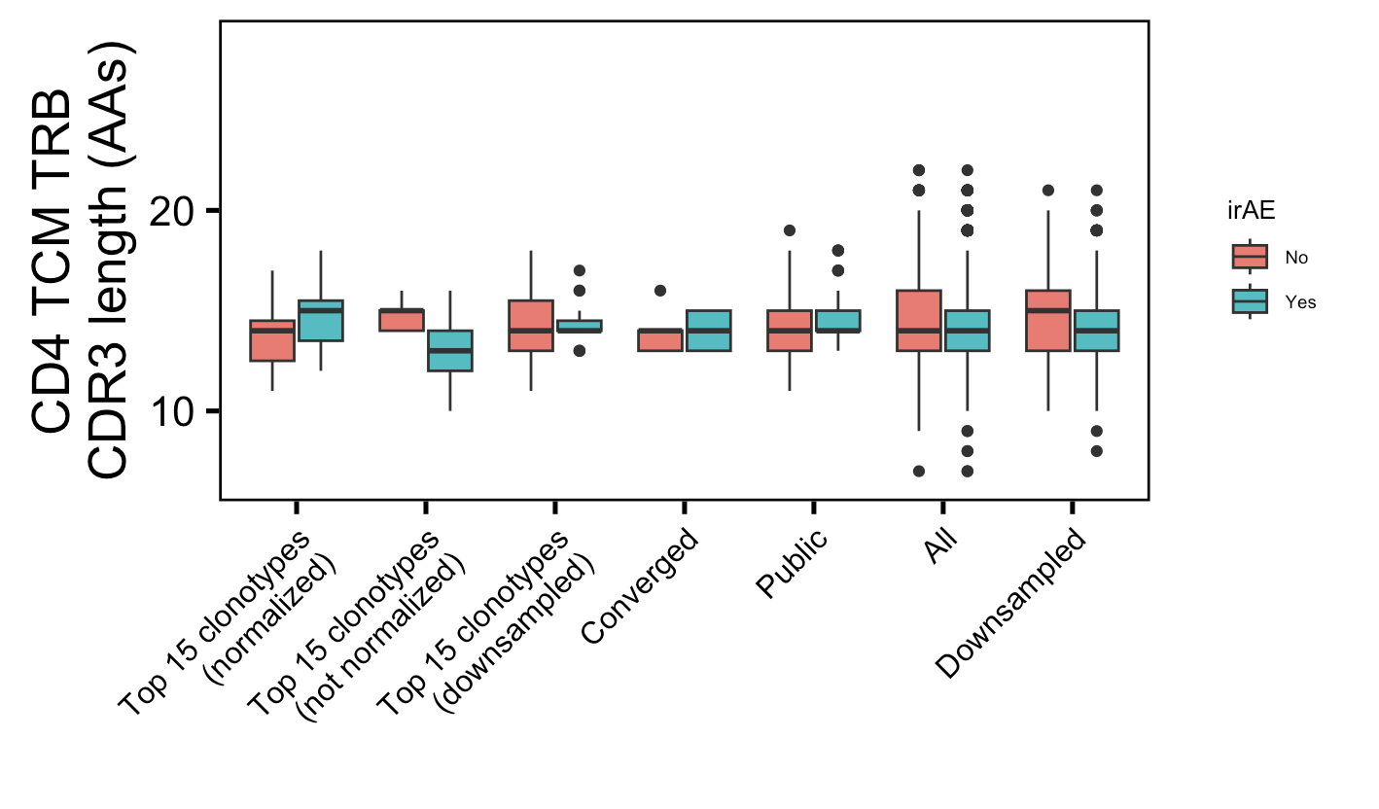
Additional weak conclusion 2 from myocarditis dataset: highly expanded CD4 TCM TRB more germline-like in irAE patients
*
*
Also significant for top 20 clonotypes
Not significant for top 5, 10, or 20 clonotypes
Wilcoxon rank sum test. **, p <1e-2; *; p <0.05

Slide 12
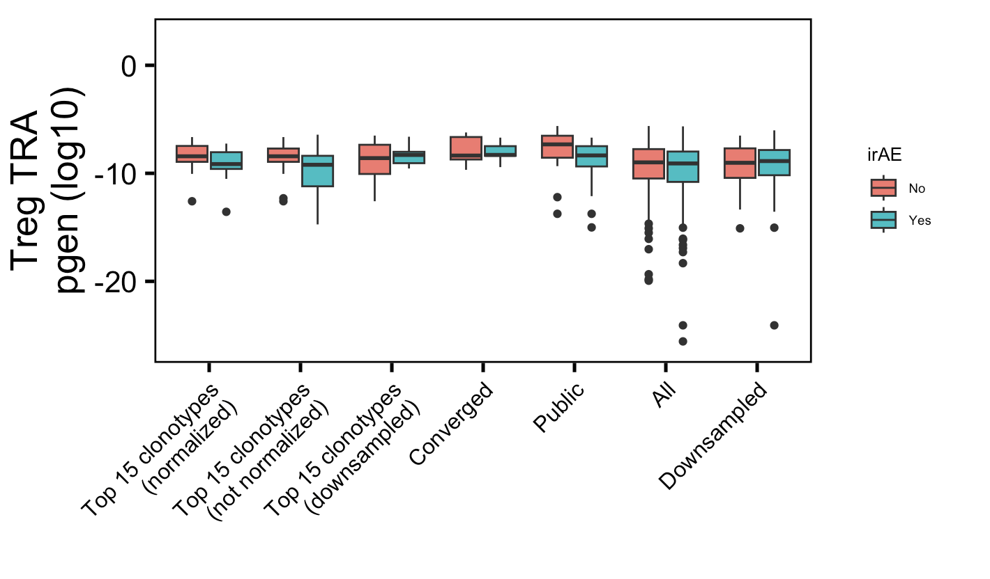
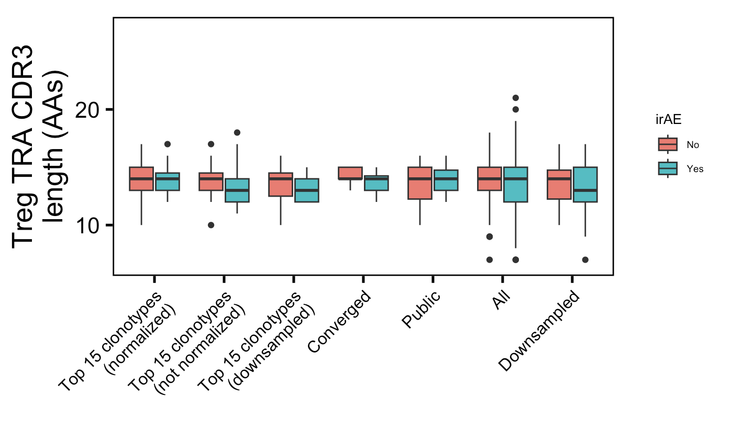
Additional weak conclusion 3 from myocarditis dataset: public Treg TRAs less germline-like in irAE patients
*
Wilcoxon rank sum test. **, p <1e-2; *; p <0.05

Slide 13
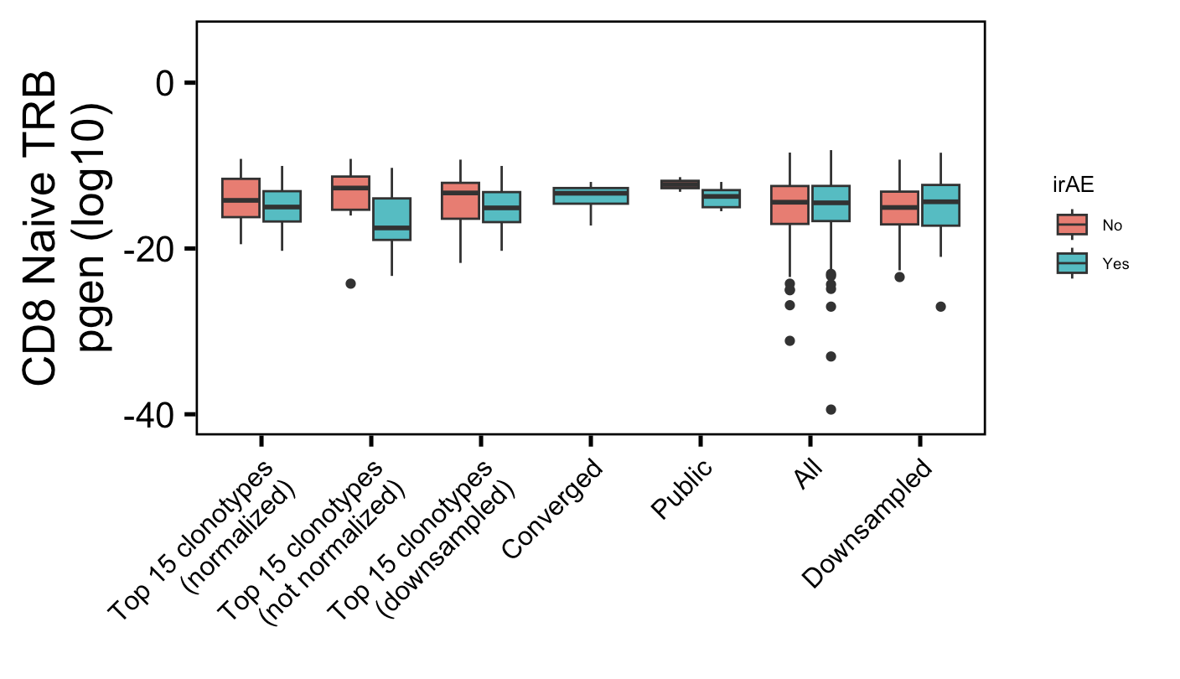
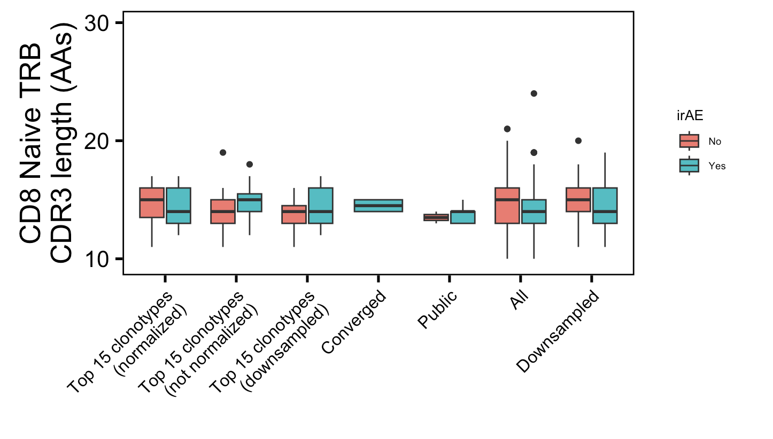
Additional super weak conclusion 1 from myocarditis dataset: highly expanded CD8 Naïve TRBs less germline-like in irAE patients
**
Not significant for top 5, 10, 20 clonotypes
Wilcoxon rank sum test. **, p <1e-2; *; p <0.05

Slide 14
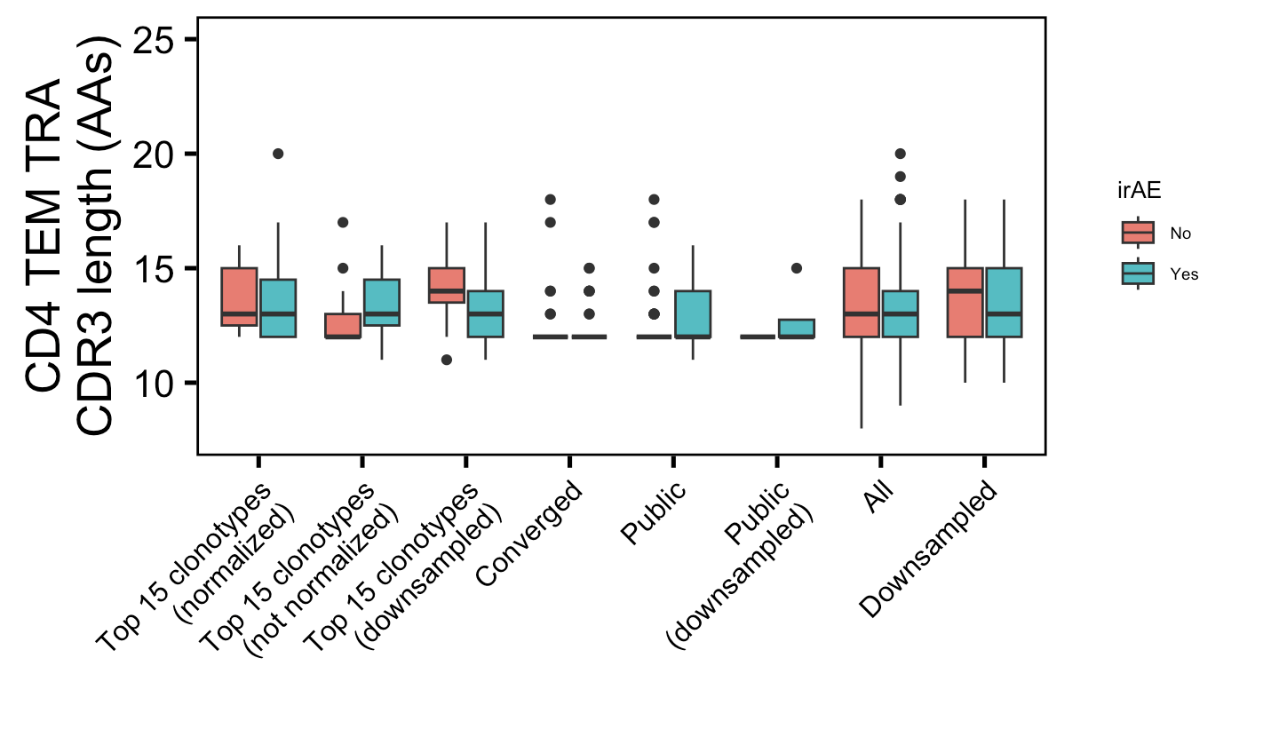
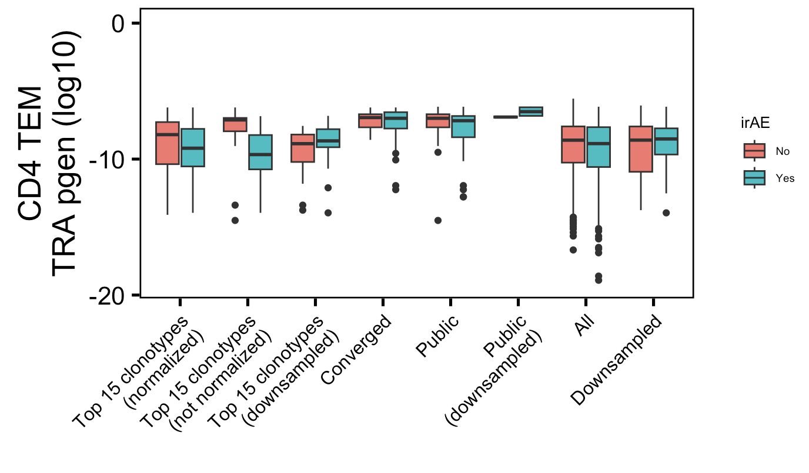
Additional super weak conclusion 2 from myocarditis dataset: highly expanded CD4 TEM TRAs less germline-like in irAE patients
*
Not significant for top 5, 10, 20 clonotypes
Wilcoxon rank sum test. **, p <1e-2; *; p <0.05

Slide 15
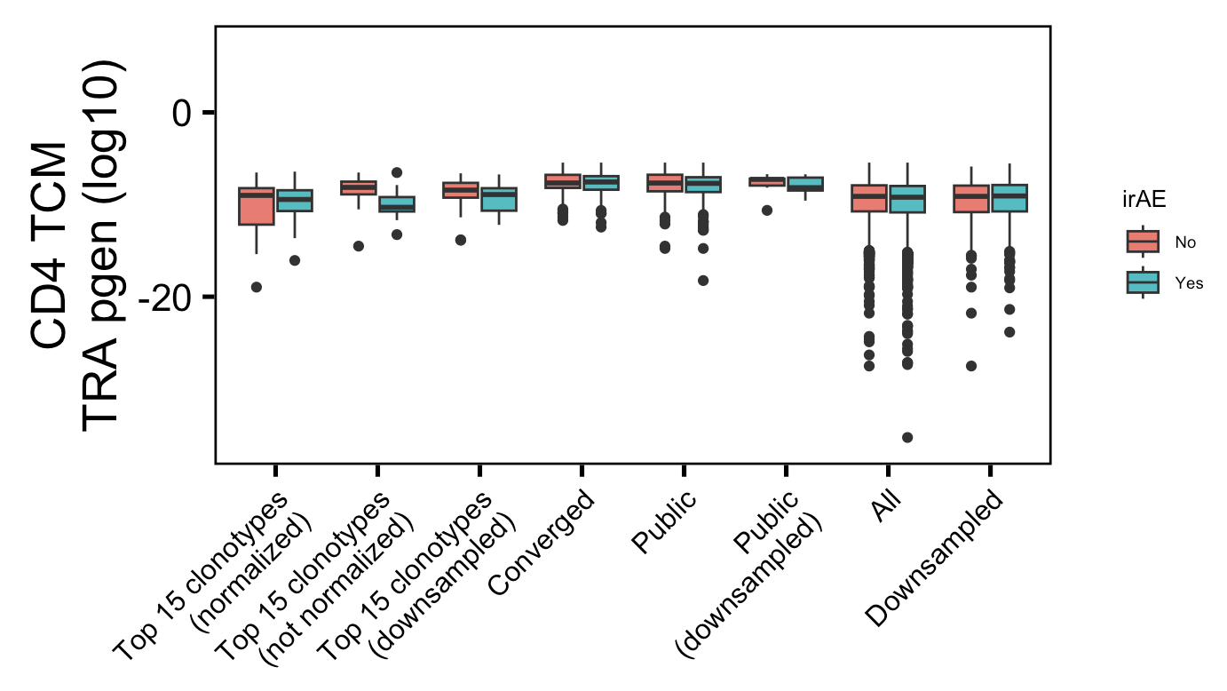
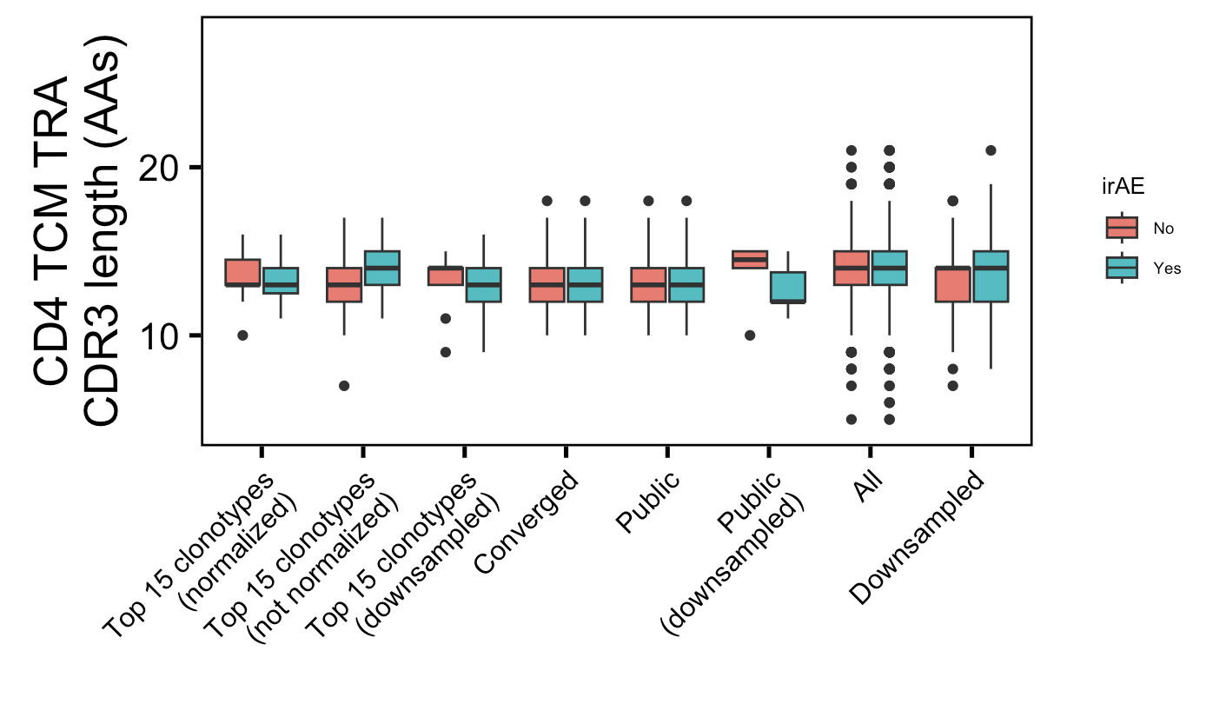
Additional super weak conclusion 3 from myocarditis dataset: highly expanded CD4 TCM TRAs less germline-like in irAE patients
*
Not significant for top 5, 10, 20 clonotypes
Wilcoxon rank sum test. **, p <1e-2; *; p <0.05

Slide 16
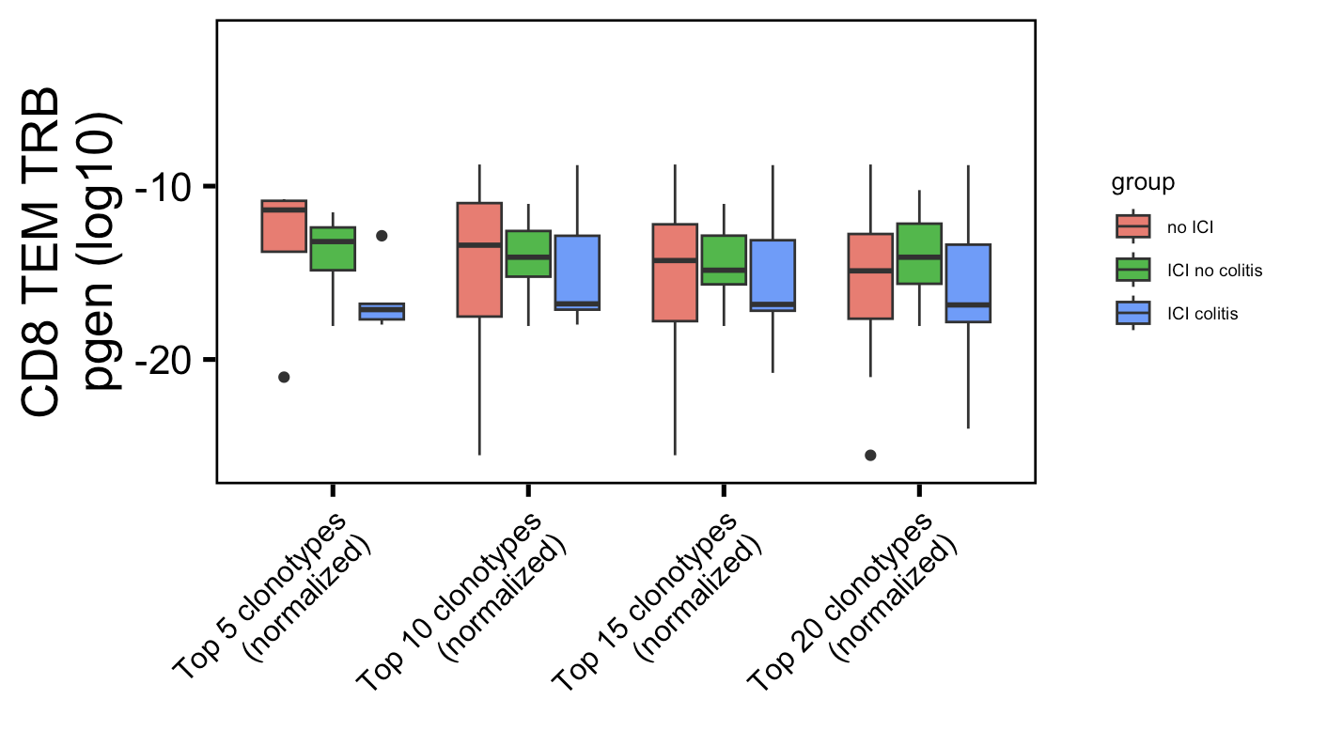
Weak conclusion 1 from colitis dataset (seen last week):
*
Label wrong not normalized
Wilcoxon rank sum test. **, p <1e-2; *; p <0.05

Slide 17
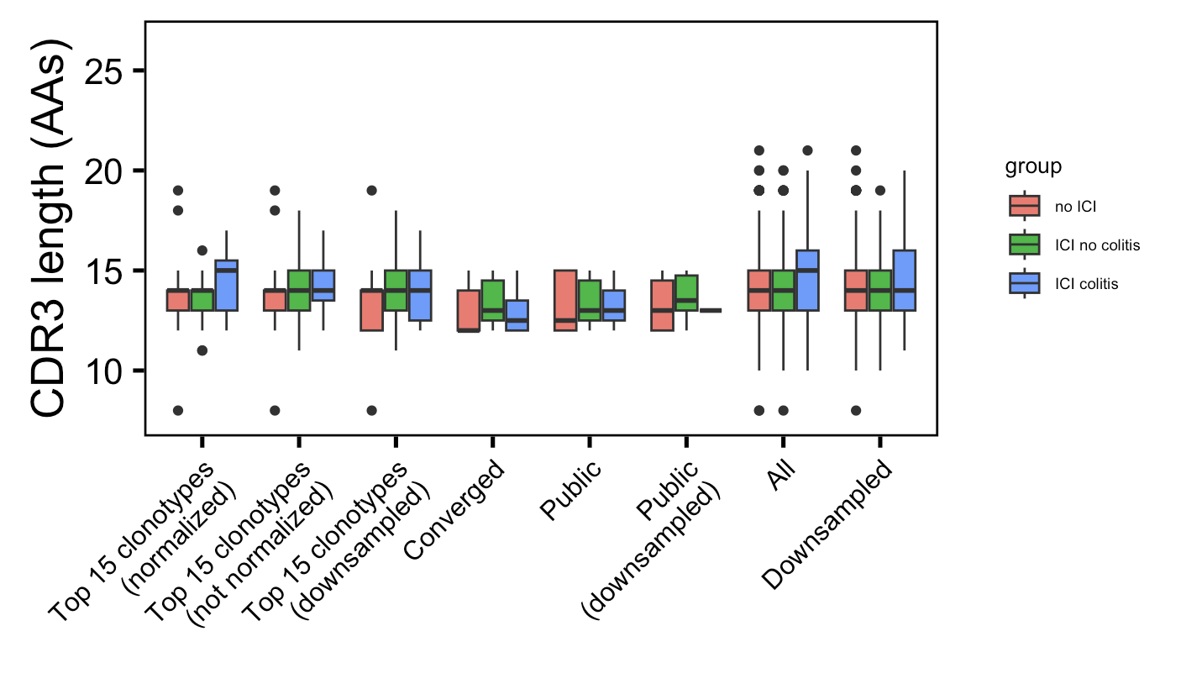
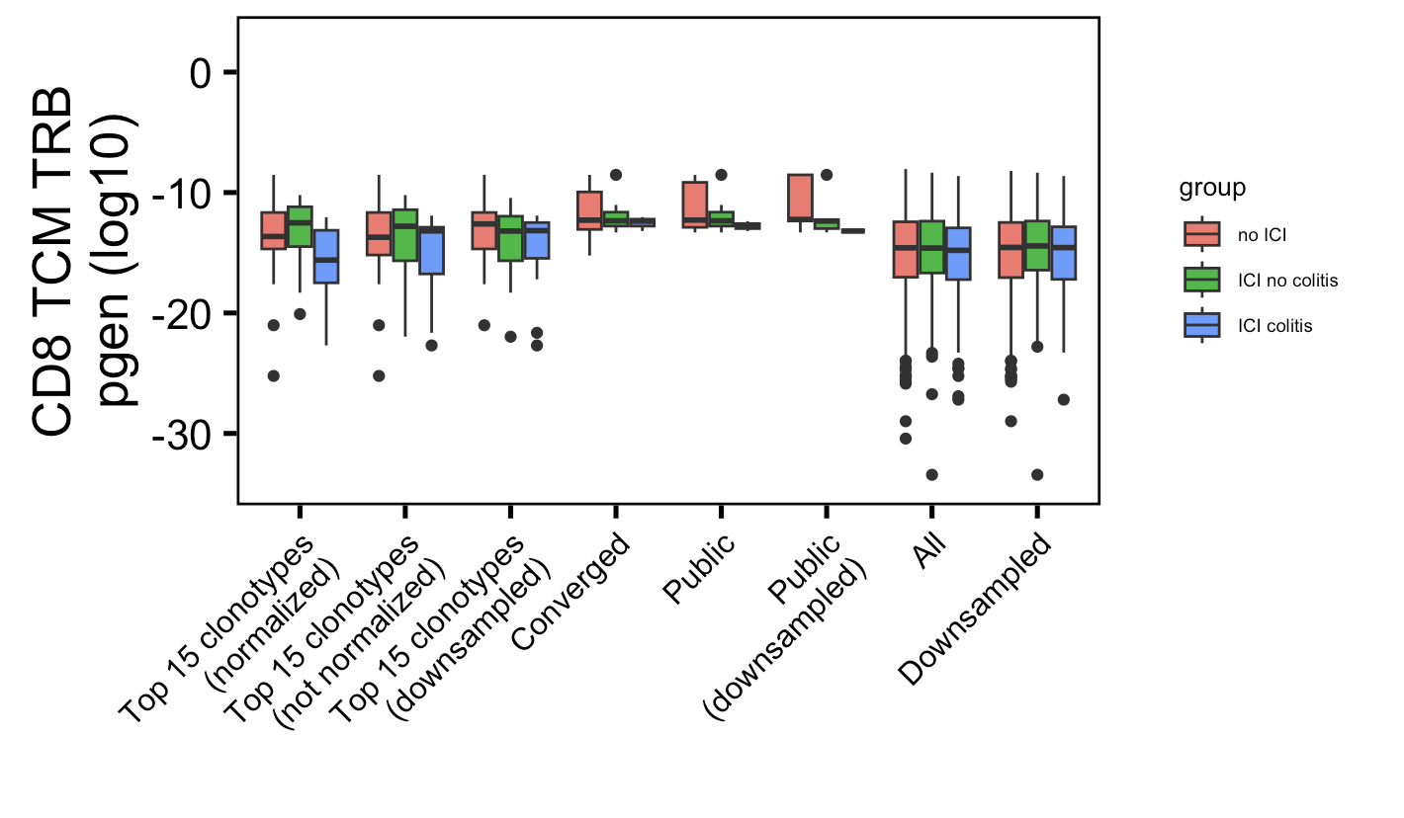
Additional weak conclusion 1 from colitis dataset: highly expanded CD8 TCM TRBs less germline-like in colitis patients
*
Not significant for top 5, 10, 20 clonotypes
Wilcoxon rank sum test. **, p <1e-2; *; p <0.05

Slide 18
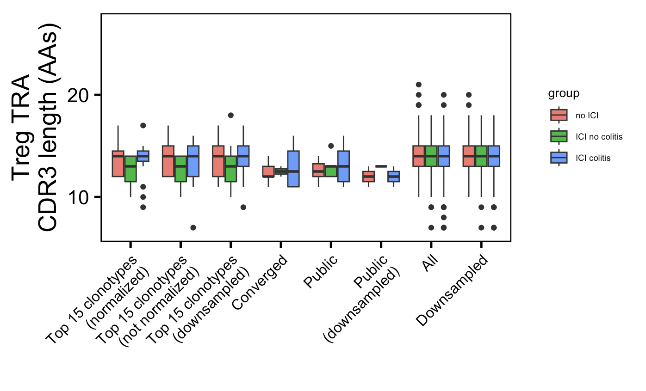
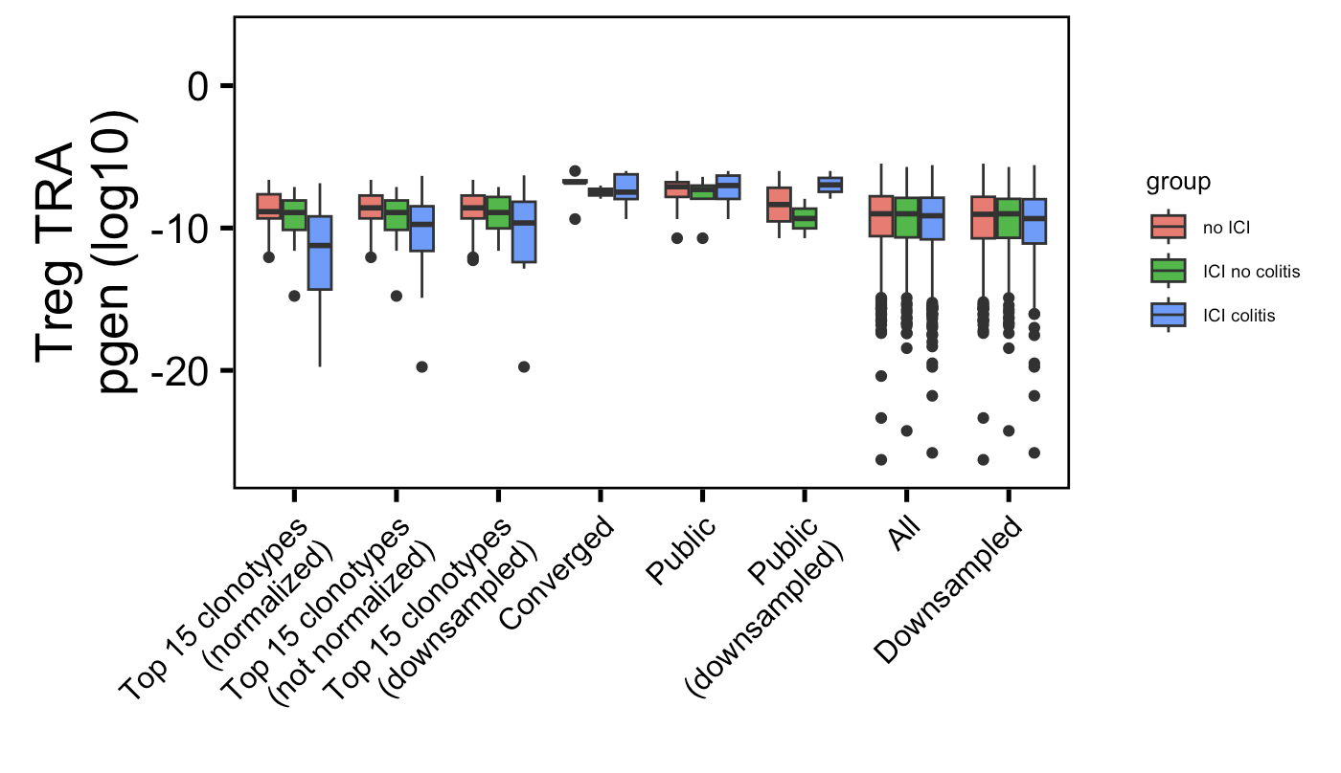
Additional weak conclusion 2 from colitis dataset: highly expanded Treg TRA CDR3s longer in irAE patients
*
Not significant for top 5, 10, 20 clonotypes
Wilcoxon rank sum test. **, p <1e-2; *; p <0.05

