Slide 1
Weekly meeting
8 15 2024
Ty Bottorff

Slide 2
Outline
MT var analyses from P576 re-seq

Slide 3
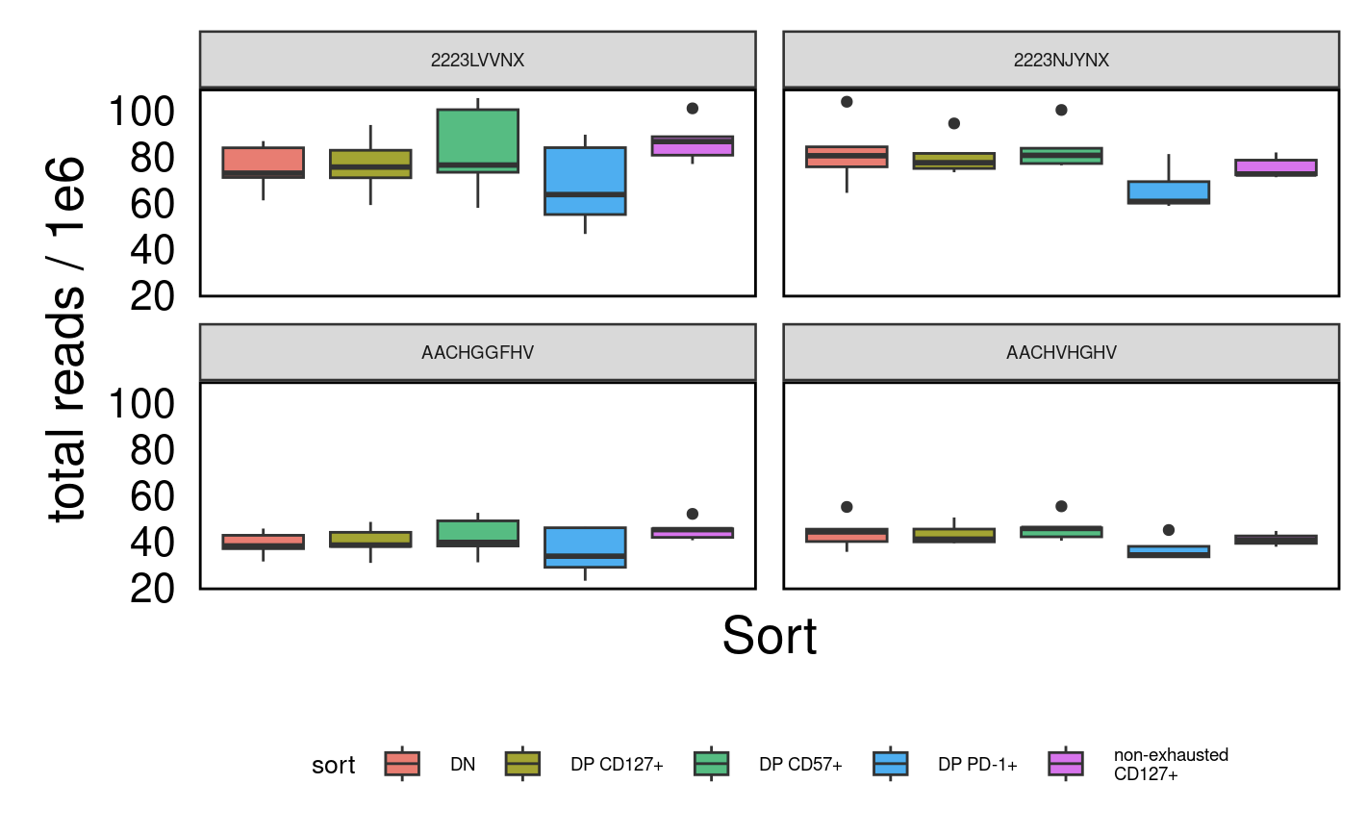
High read counts from re-run (top row)

Slide 4
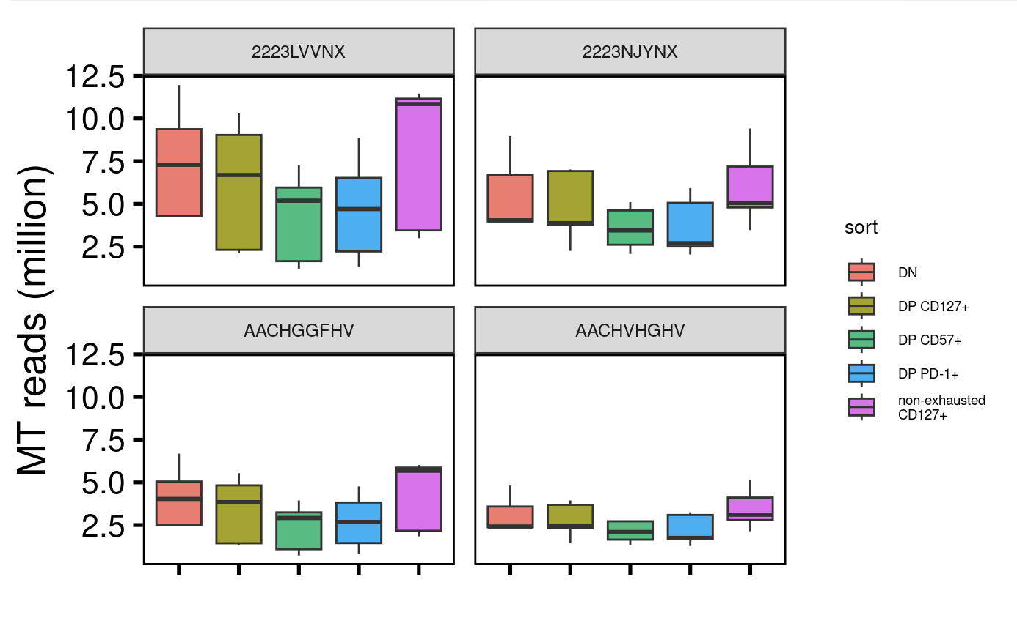
Also gained many MT mapping reads from re-run (top row)

Slide 5
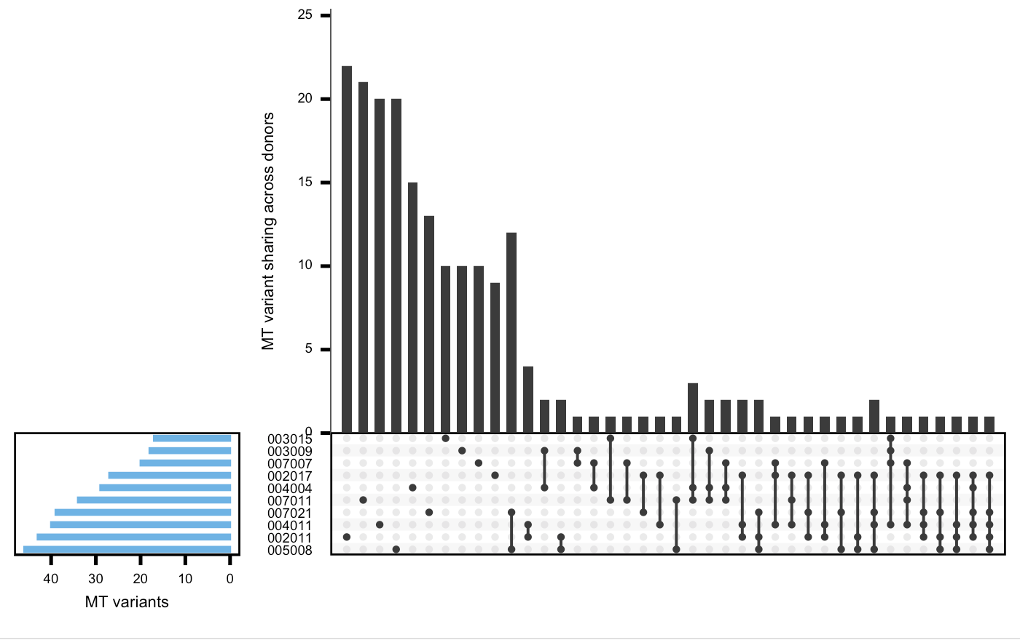
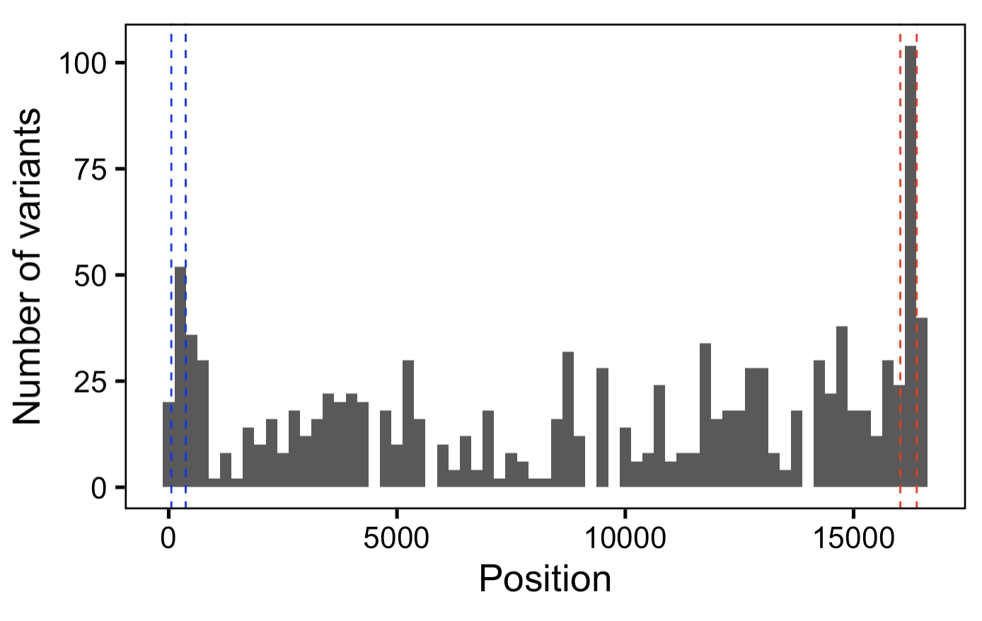
MT var QC looks fine with reseq, observe more MT vars per donor
with more depth, see more (public) vars
high sharing between donors 005008 and 007021 only seen with lowest min_var_freq here
Notes:
Both made using lowest min_var_freq 0.001
High MT var sharing between donors 005008 ad 007021 perhaps evidence for sample swaps?

Slide 6
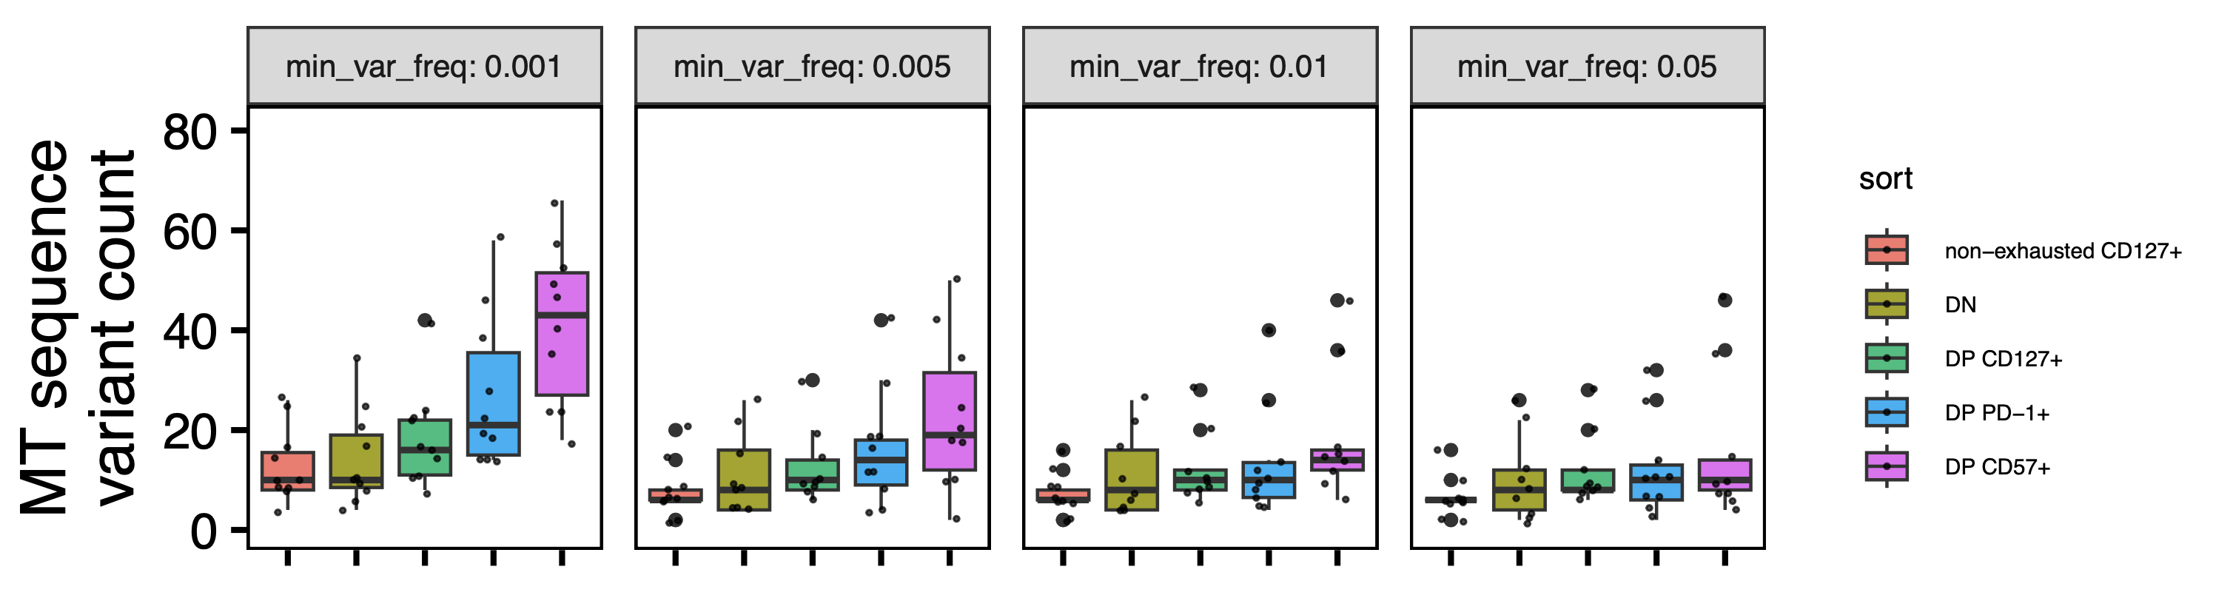
See ~similar results at old 0.5% lower bound for var freq, see padj significance at lower 0.1% bound
**
**
**
*
0.21% is lowest observed var_freq, lowest # of reads supporting a var is 10 (I filtered for > 4, 2 from each strand as done here, they also used min_var_freq of 0.001)
Wilcoxon rank sum test. **, padj <1e-2; *; padj <0.05
Notes:
~issue is that with more seq also get more vars sharing across all sorts within a donor → we remove these, also ~issue is that with more seq uncover more vars even in DN/non-exh…
MT genome is 16 kb
Mean fragment size (from peak calling output) ~ 540 bp
~8 million MT mapping reads per library
min reads at a pos to call it: 20 (shouldn’t matter, min reads across vars is ~2k), min var reads at pos: 4 (2 from each strand)
vars not uniformly distributed in genome...

Slide 7
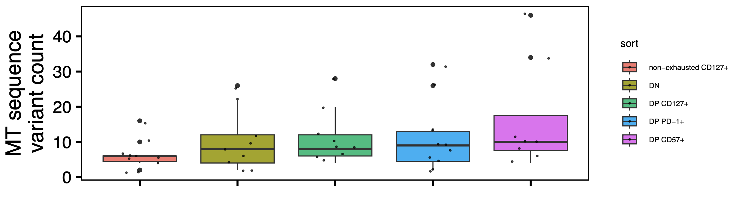
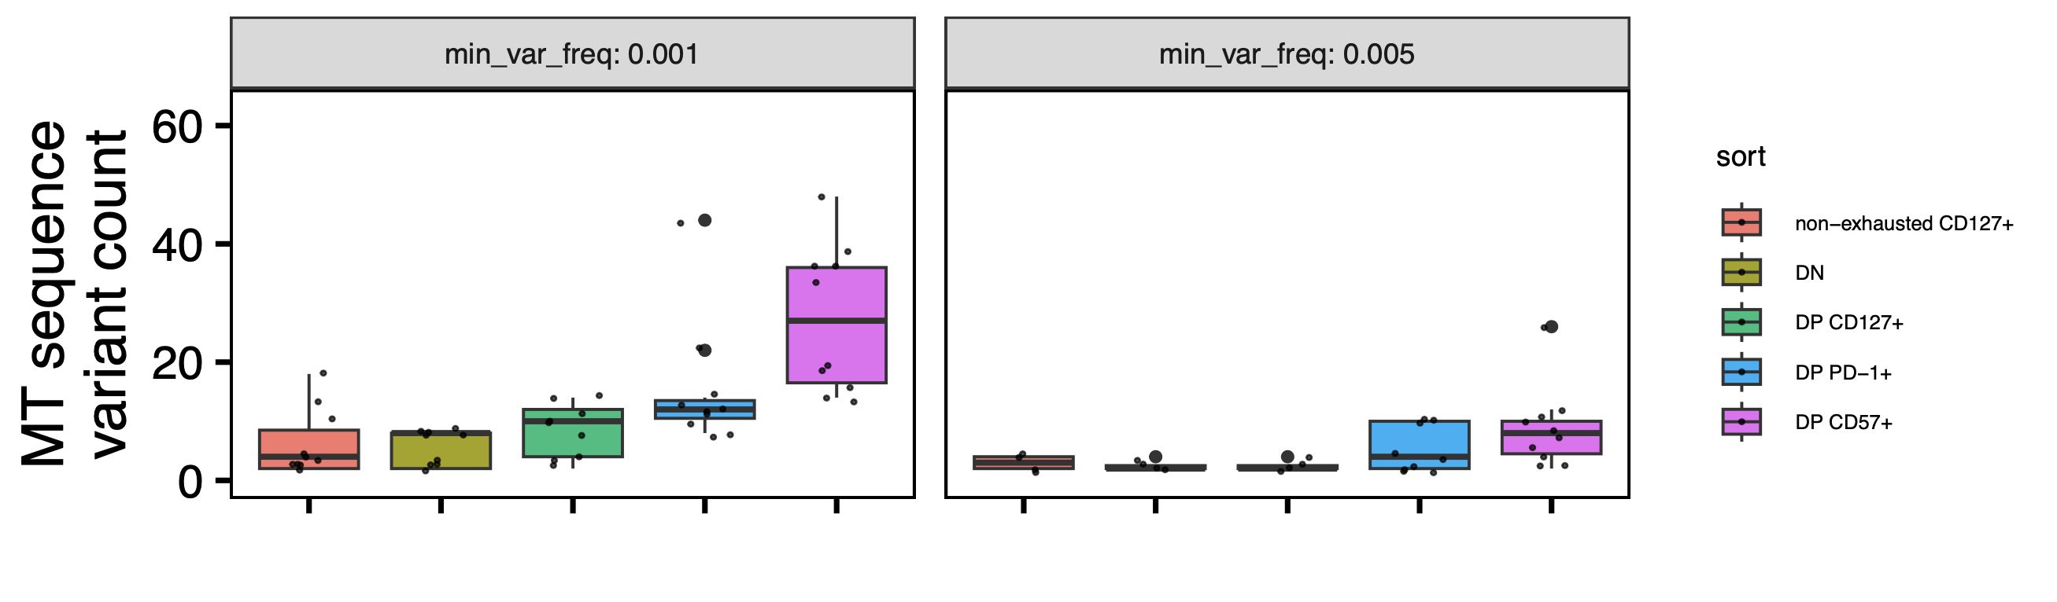
As before, trend mostly driven by low freq vars
Variants > 99% freq
*
**
**
Variants < 5% freq
**
*
**
Wilcoxon rank sum test. **, padj <1e-2; *; padj <0.05

Slide 8
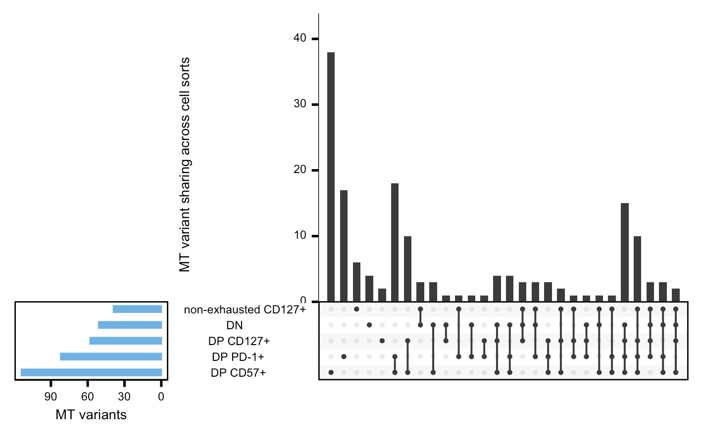
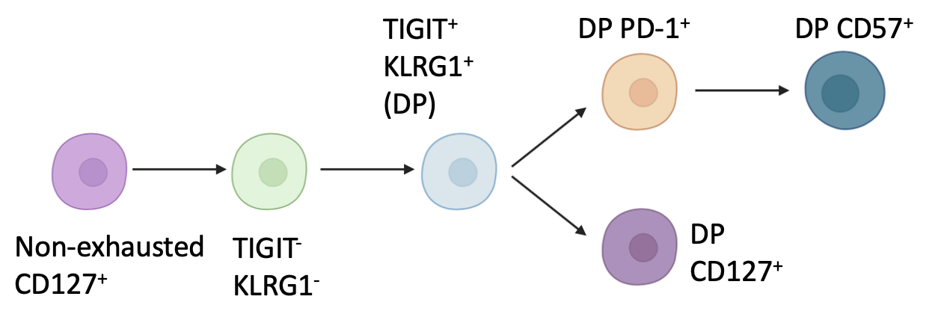
Perhaps MT vars sharing across not non-exhausted CD127⁺ being higher than sharing across non-DN is consistent with non-exhausted CD127⁺ being parent to DN
Notes:
This is also at 2nd lowest min_var_freq

Slide 9
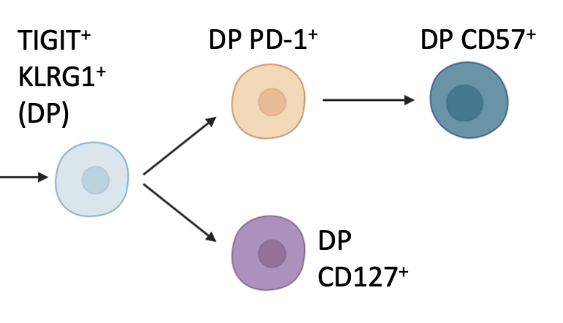
DP PD-1⁺ and DP CD127⁺ share less vars (only 1) than DP CD57⁺ and DP CD127⁺ (10) despite more similar var counts in DP PD-1⁺ and DP CD57⁺, inconsistent with model
Not sure how to interpret this, perhaps it’s due to complications from sharing across > 2 sets vs. 2 sets only
Notes:
This is also at 2nd lowest min_var_freq, and also see same trend with lowest min_var_freq

Slide 10
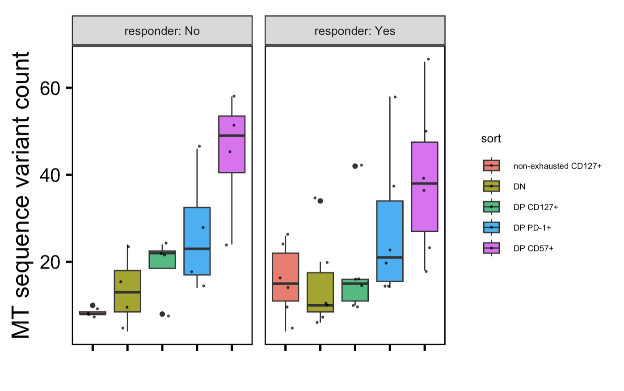
Similar trends b/w R and NR (using lowest min_var_freq here)
No padj differences between R vs. NR within sorts OR sort vs. sort within responder statuses

Slide 11
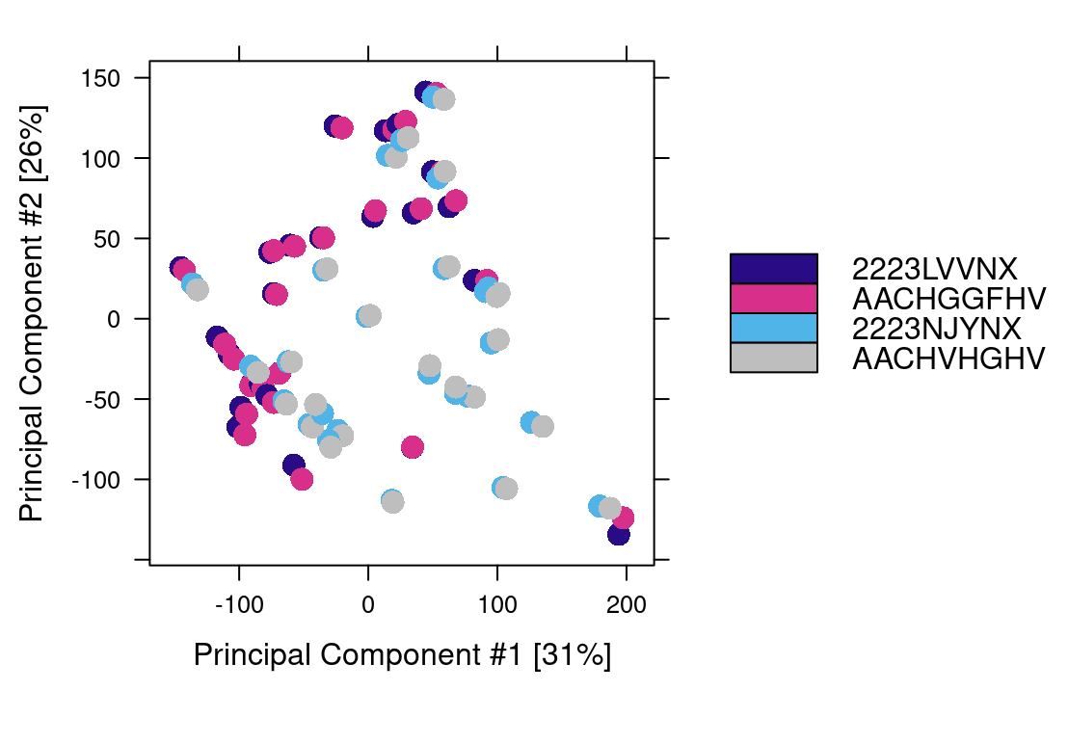
Epigenetics within libids look very similar across seq batches (AA_ fcids vs. 22_ flow cell IDs)
- so I merged alignment files by libid and then called peaks on those merged alignment files
Notes:
Maybe should do this for just top VARs using Seurat? If anything one might expect this one to be noisier using all peaks…

Slide 12
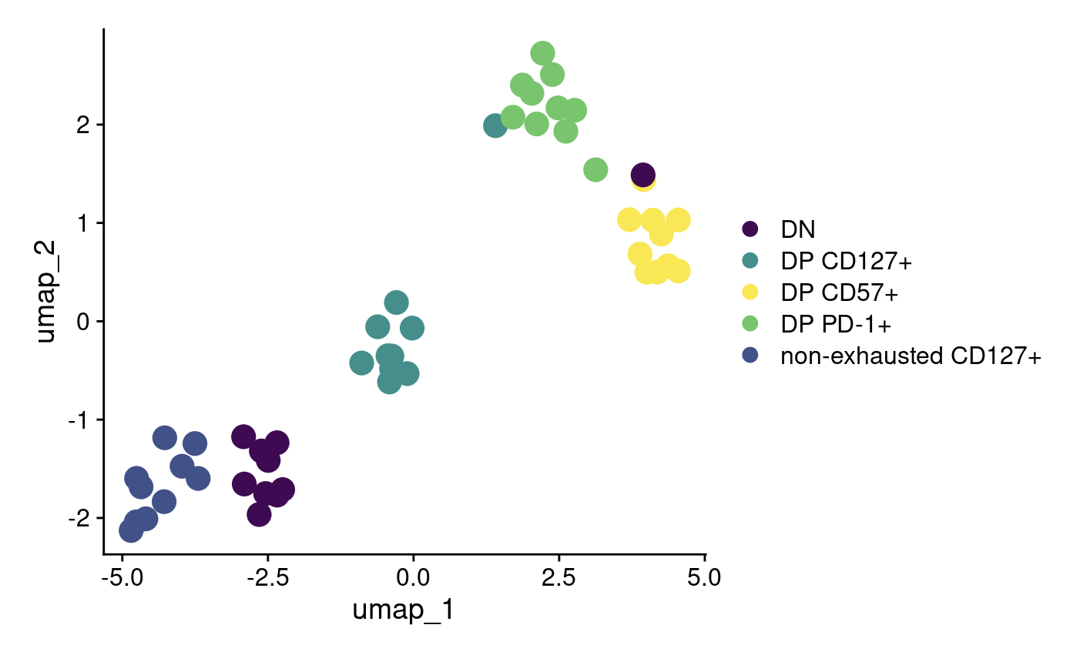
UMAP with reseq (donorId and responder status regressed out)
- using UMAP hyperparams to minimize number of “dubious cells” (to 0), although there are still “intermediate cells”
Notes:
Went from ~28k to ~35k features (consensus peaks) with reseq, still just top 2k shown here though
Not sure why DN outlier here and now before but before it was UMAP really hiding it (was outlier in high dim space)

Slide 13
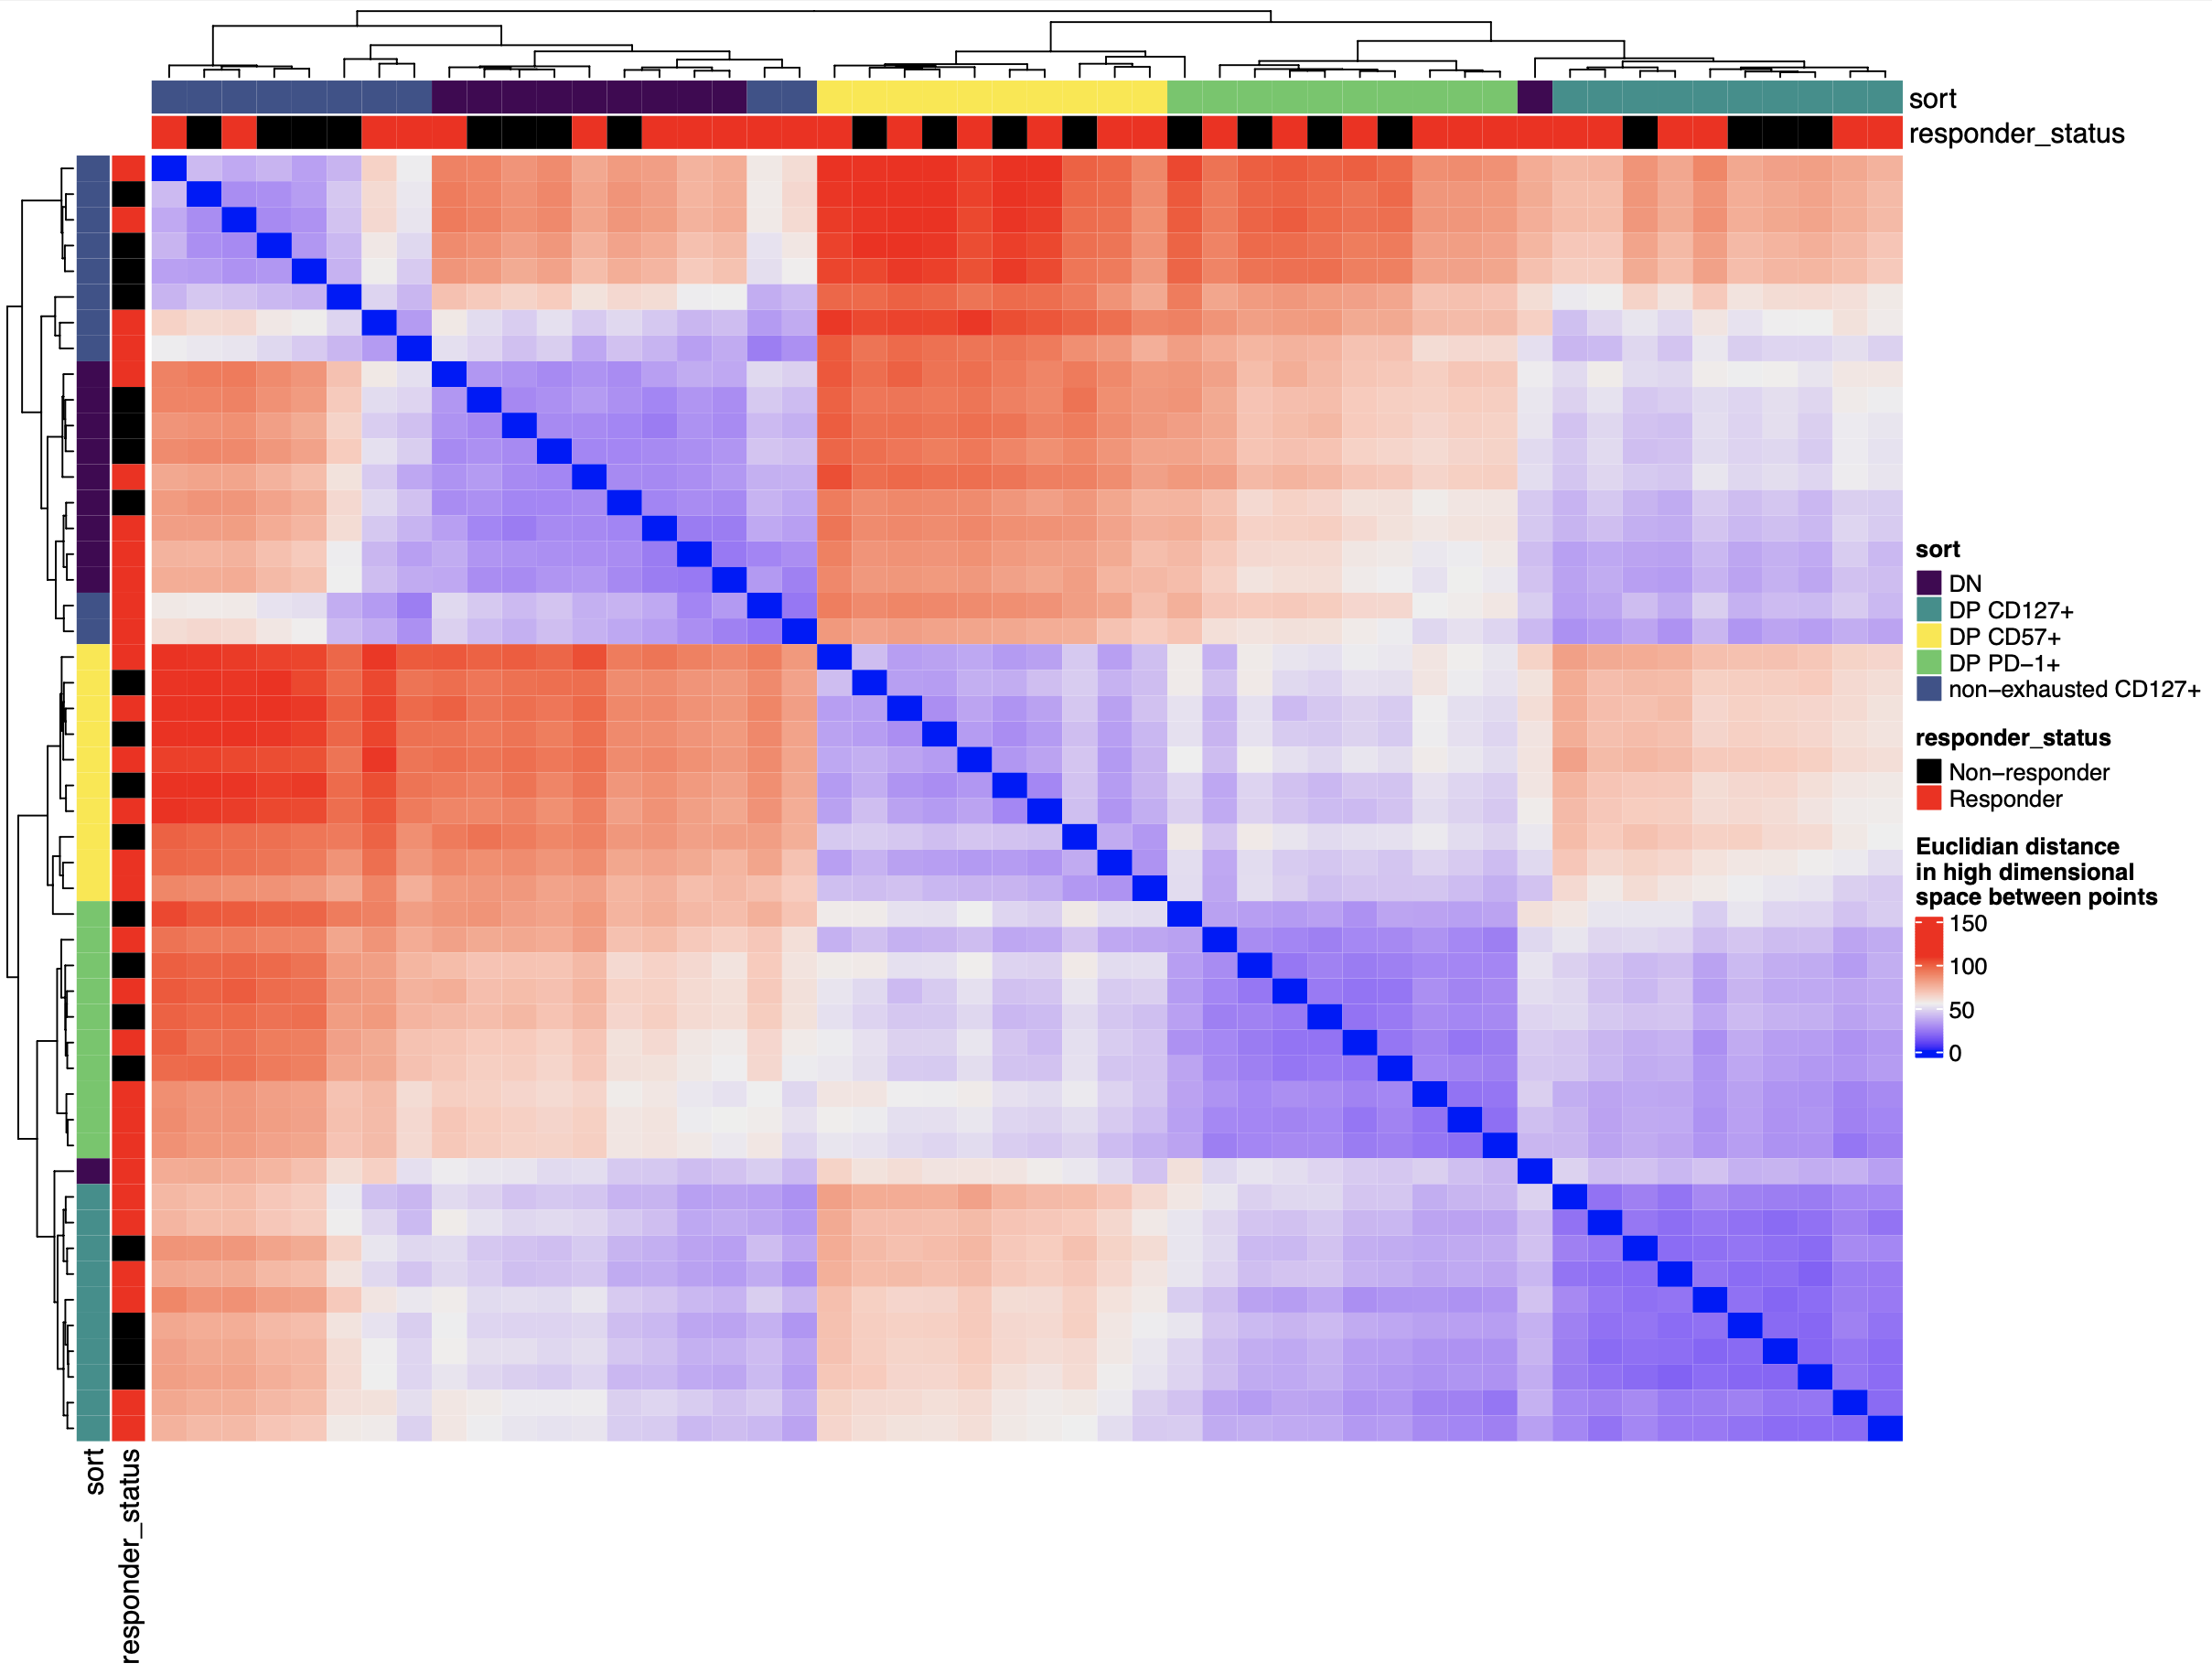
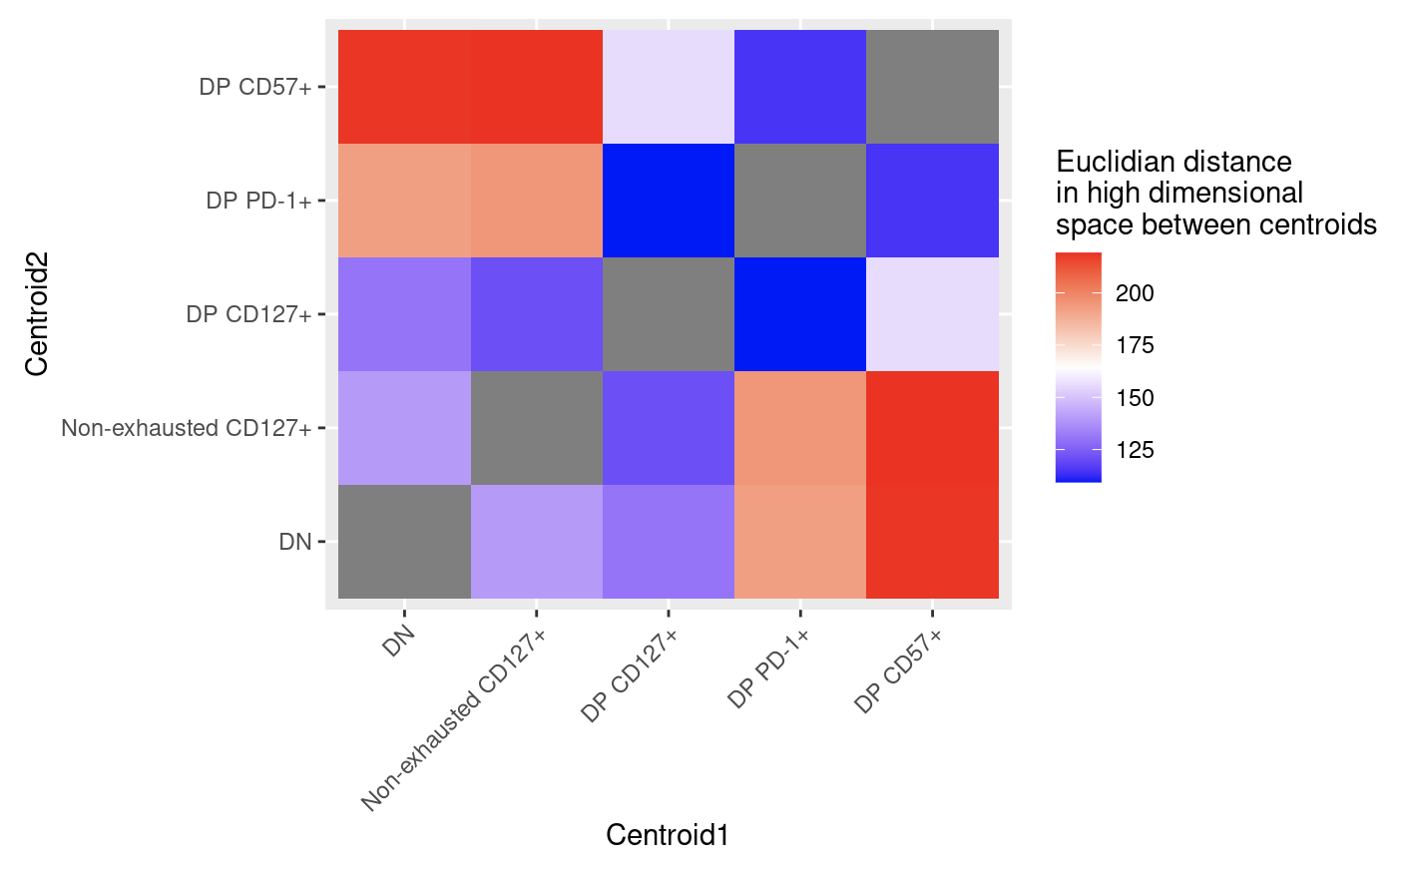
A look at high dimensional space
All peaks
Top variably accessible peaks
Notes:
Went from ~28k to ~35k features (consensus peaks) with reseq
Not sure why DN outlier here and now before but before it was UMAP really hiding it (was outlier in high dim space)
donorId and responder status regressed out here too

Slide 14
Conclusions
Reseq looks fine at QC level
MT vars
still see DP CD57⁺ having more vars than other sorts especially non-exhausted CD127⁺ and DN, stronger confidence now though
some evidence for DP PD-1⁺ also having more vars than DN/non-exhausted CD127⁺
some evidence for non-exhausted CD127⁺ being parent to DN
Epigenetics
no evidence of seq re-run introducing batch effect
cell sorts still show distinct epigenetic profiles, still see 1 DN outlier
still don’t see differences R vs. NR (not shown)

Slide 15
Next steps
Submit abstract today for BRI retreat
Epigenetic analyses from re-seq: key VPs
Homer TF analyses given greater read depth
MT vars: getting biological relevance
Potential rabbit hole: simulate MT dynamics to try and equate MT var counts to # of cell divisions? Would be helpful to know order of magnitude here (i.e. DP CD57+ divided 1X, 10X, or 100X more than nonexh/DN?)
How to choose a sensible lower bound for var freqs? Simulations could perhaps also inform this bound, i.e. how many divisions to see 0.1% freq vars appear vs. 0.5% ones appear?
Notes:
Also considered keeping all seq runs separate and regressing out seq run… but I think having 2X the points in PCA/UMAP would be misleading, ALTHOUGH I COULD DO THIS FOR non-dim reduc plots (VPs, heatmaps), but I’d like to be consistent and I don’t think it’d matter much anyways…
Not super worried about noise driving effects we see because it’s consistent with T1DAL but still
MT genome is 16 kb
Mean fragment size (from peak calling output) ~ 540 bp
~8 million MT mapping reads per library
min reads at a pos to call it: 20 (shouldn’t matter, min reads across vars is ~2k), min var reads at pos: 4 (2 from each strand)
vars not uniformly distributed in genome...

Slide 16
Better defining exhausted TIGIT⁺KLRG1₊ subsets in teplizumab-treated T1D subjects using ATAC-seq: epigenetics and mitochondrial variants
T cell exhaustion, a state of reduced effector function, results from chronic stimulation from antigens that cannot be fully cleared.
In recent T1D studies, levels of TIGIT+KLRG1+ (DP) PD-1+ and DP CD57+ exhausted CD8s early after treatment have correlated with better response to therapy, consistent with the reduced effector function of these exhausted T cells.
However, levels of DP CD127+ exhausted CD8s may in fact correlate with worse outcome in T1D.
To investigate this heterogeneity in association with response to therapy amongst DP exhausted CD8s and given the epigenetic changes that characterize T cell exhaustion, here we profiled the epigenetic states of different non-naive CD8 populations from PBMCs of 10 T1D patients treated with teplizumab using bulk ATAC-seq.
We found that the epigenetic states of DP CD127+ CD8s were intermediate to that of other DP CD8s (PD-1+ and CD57+) and TIGIT+KLRG1+ CD8s.
We also analyzed mitochondrial-mapping ATAC-seq reads and found that the DP CD8s had more mitochondrial single nucleotide variants than DN CD8s with DP CD57+ specifically having the most variants.
We hypothesize that non-naïve CD8 differentiation flows from DP CD127+ to DP PD-1+ to the more terminal DP CD57+.
Notes:
I guess I don't really have any evidence for DP CD127+ splitting off... it could still be parent to other DPs and blocking IL7R doesn't kill cells (OR DOES LACK OF IL7 MAINTAINCE LEAD TO DEATH?) it would just make it as if they were CD127-...
Role of IL-7 in T cell survival (of naïve T cells) not enough to propose bifurcation over linear path I don’t think
heterogeneity in association w/ response, does a linear path make sense with this? possibly…

Slide 17
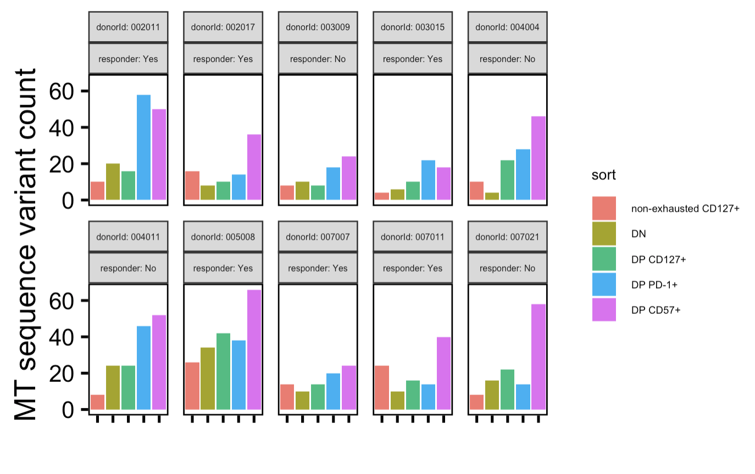
Donor facet

Slide 18
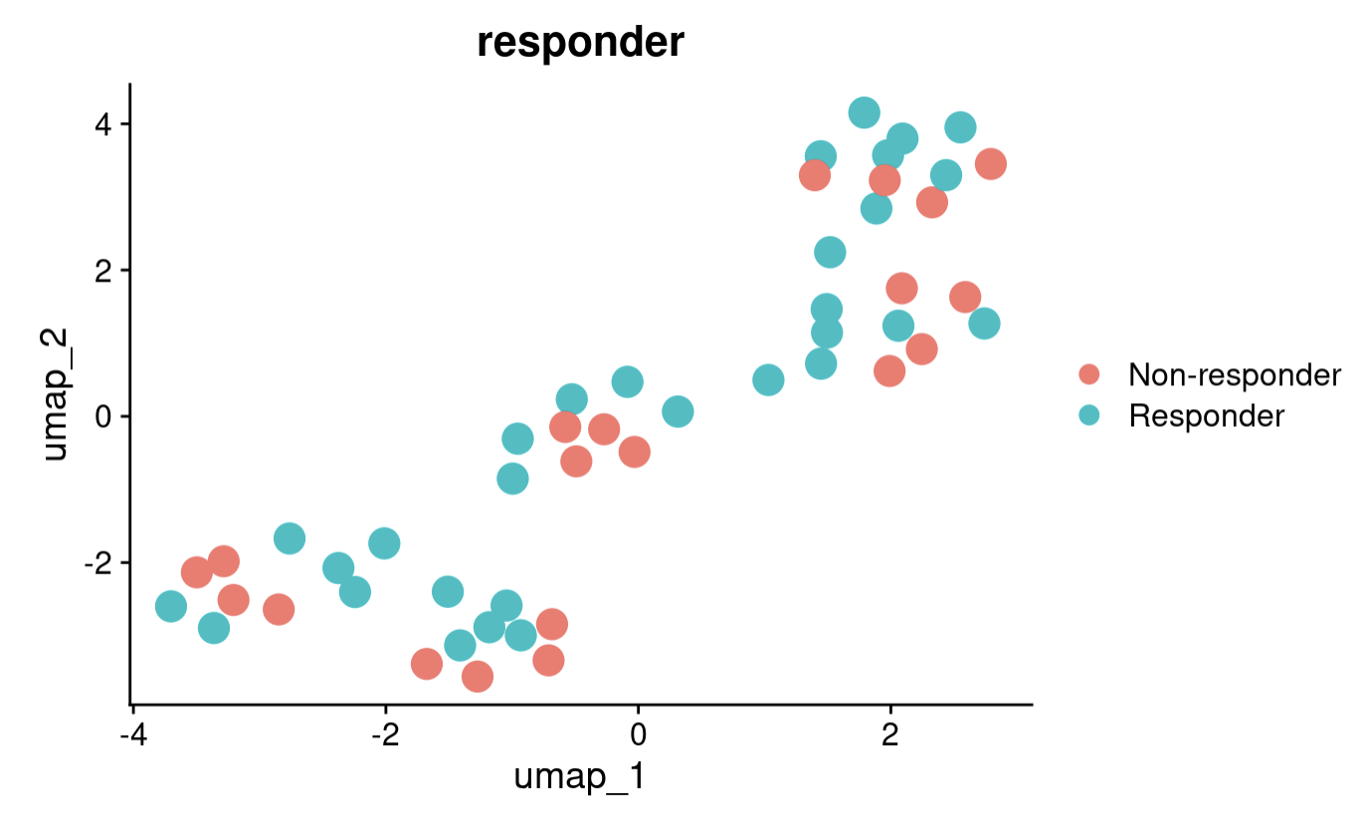
With reseq, still see no big epigenetic differences b/w R and NR
Notes:
donorId and sort regressed out here

