Slide 1
Weekly meeting
12 7 2023
Ty Bottorff

Slide 2
Outline

Slide 3
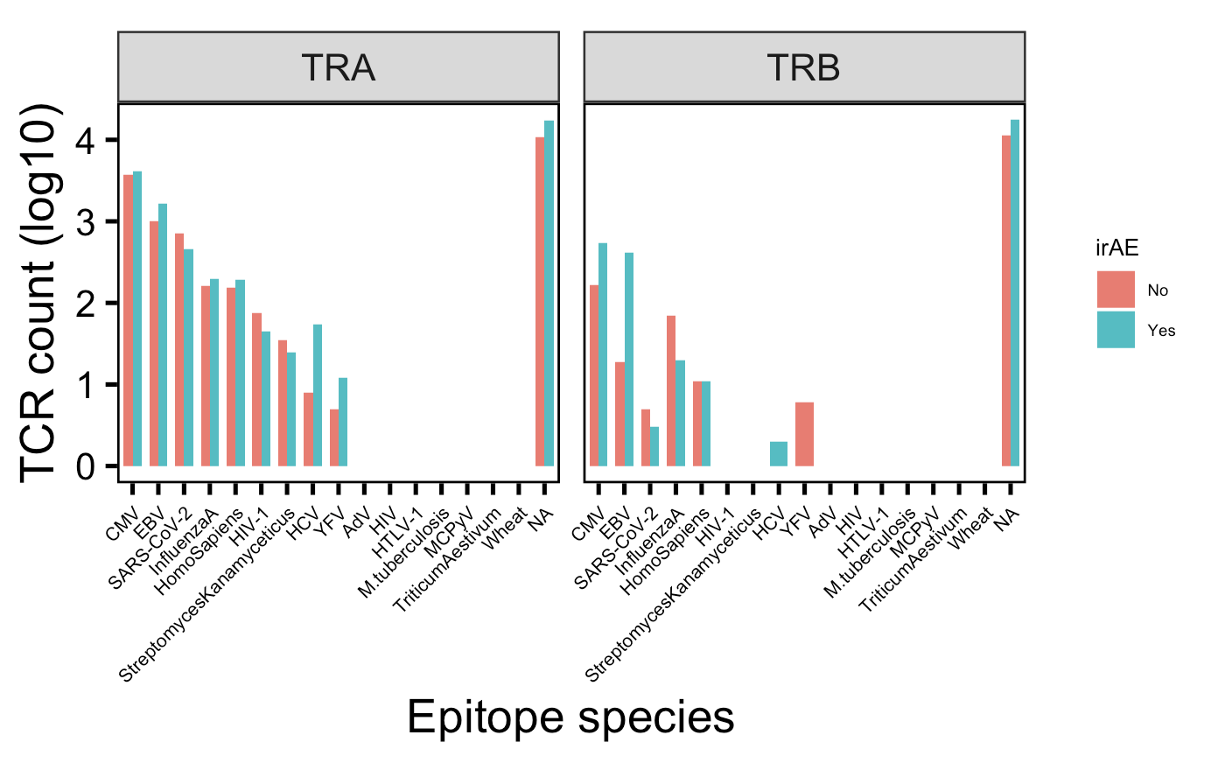
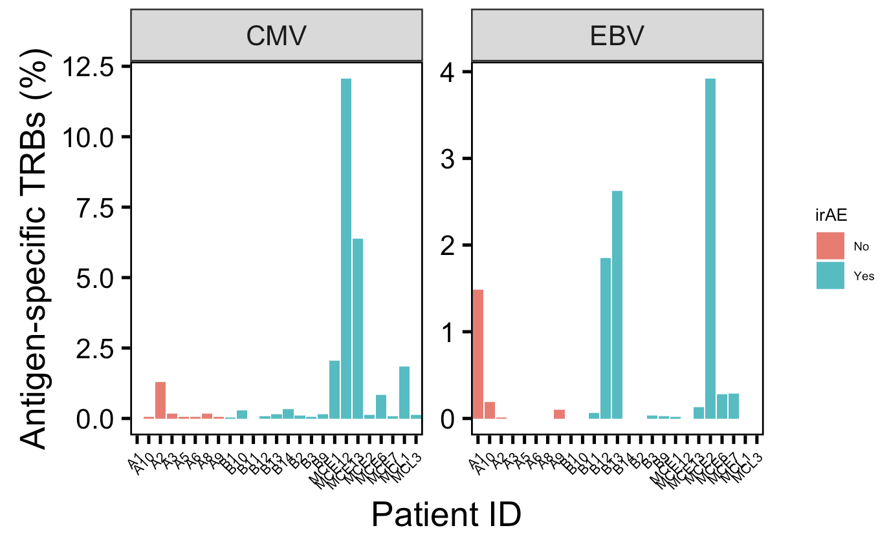
There are many more TRBs specific for CMV and EBV in those developing irAEs, mostly driven by a few patients
Notes:
Perhaps related to connection between infections before autoimmune development? Or just bystanders?
VDJdb mostly MHC class I (80k, 4k class II)

Slide 4
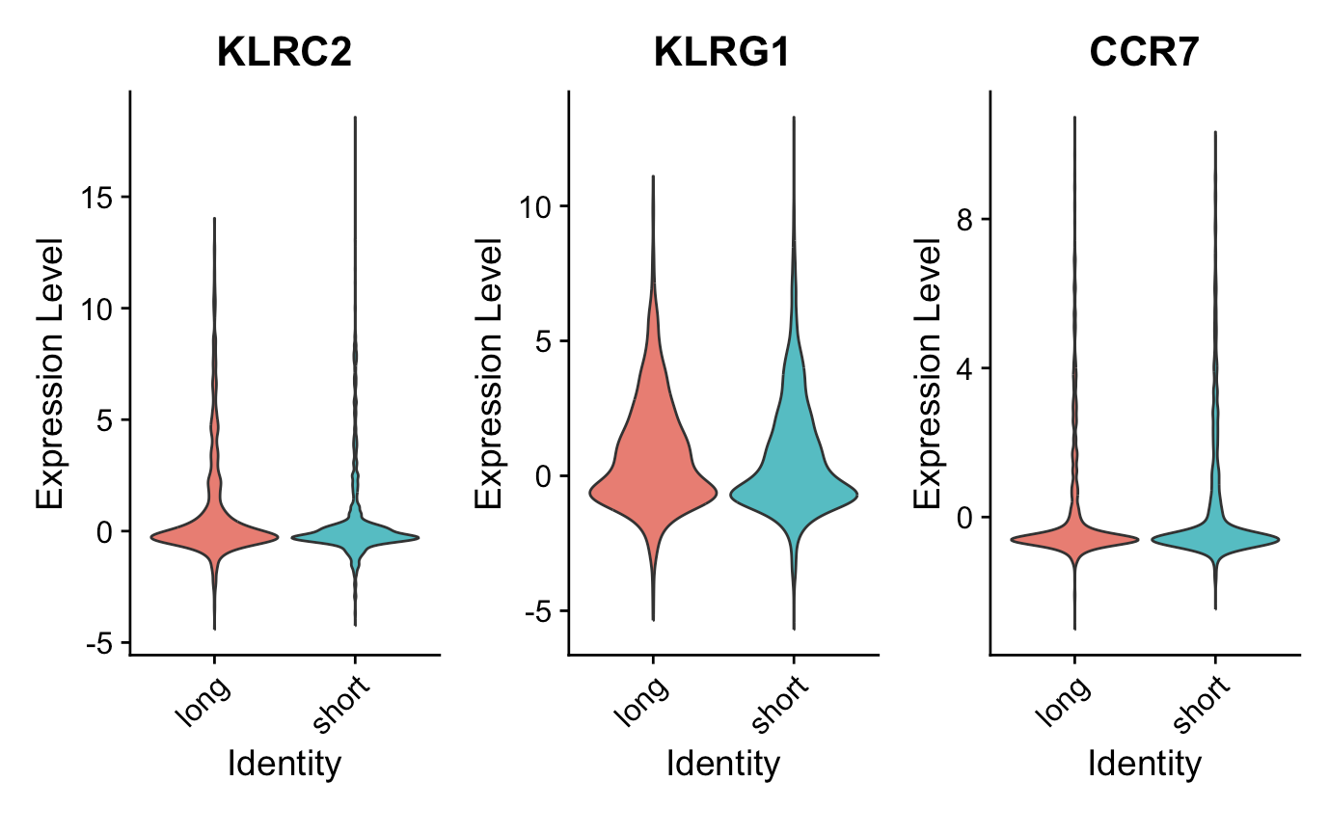
KLRC2 is the only gene significantly differentially expressed between longest and shortest CDR3β CD8 T cells
**
n = 1,200
n = 1,200
Wilcoxon rank sum test. ****, padj <1e-4; **, padj <1e-2; *; padj <0.05
Notes:
took longest 50 and shortest 50 CDR3βs from CD8 T cells per patient
KLRC2 is an NK-associated gene

Slide 5
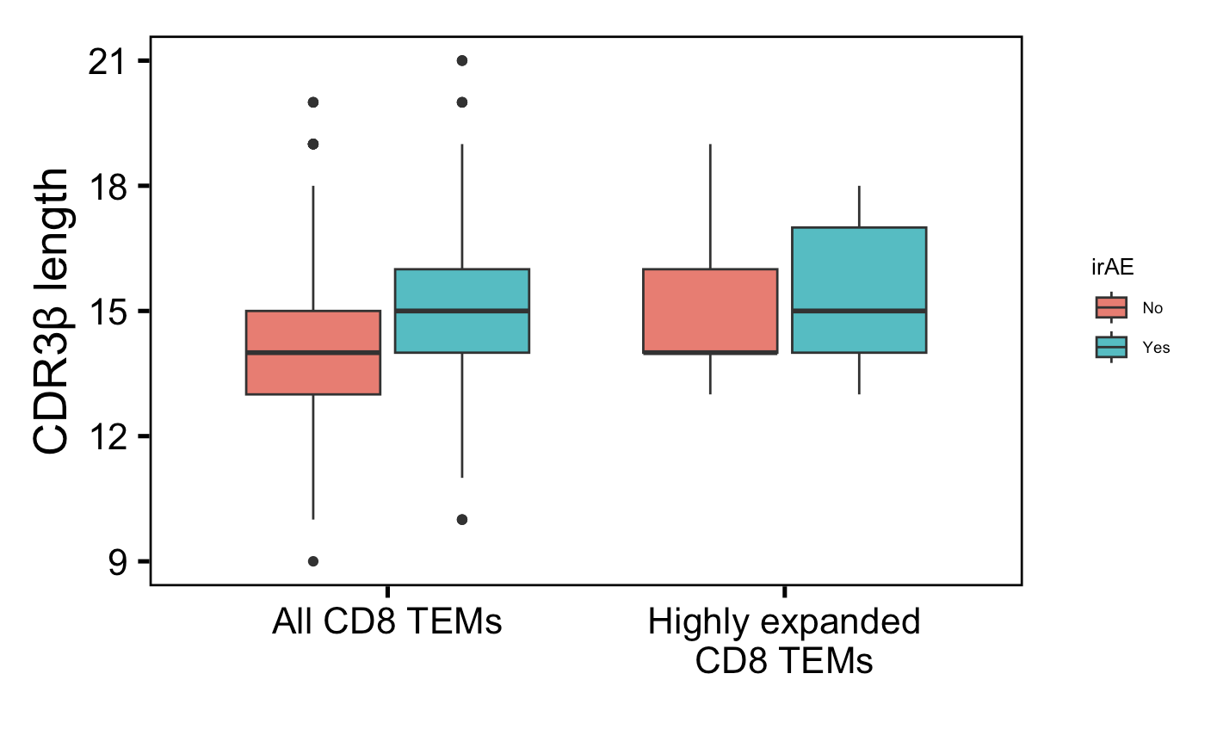
Solid conclusion #1 from myocarditis dataset: CD8 TEM CDRβs longer in those developing irAEs
**
**
n = 278
n = 816
n = 50
n = 306
Wilcoxon rank sum test. ****, p <1e-4; **, p <1e-2; *; p <0.05
Notes:
Downsampled

Slide 6
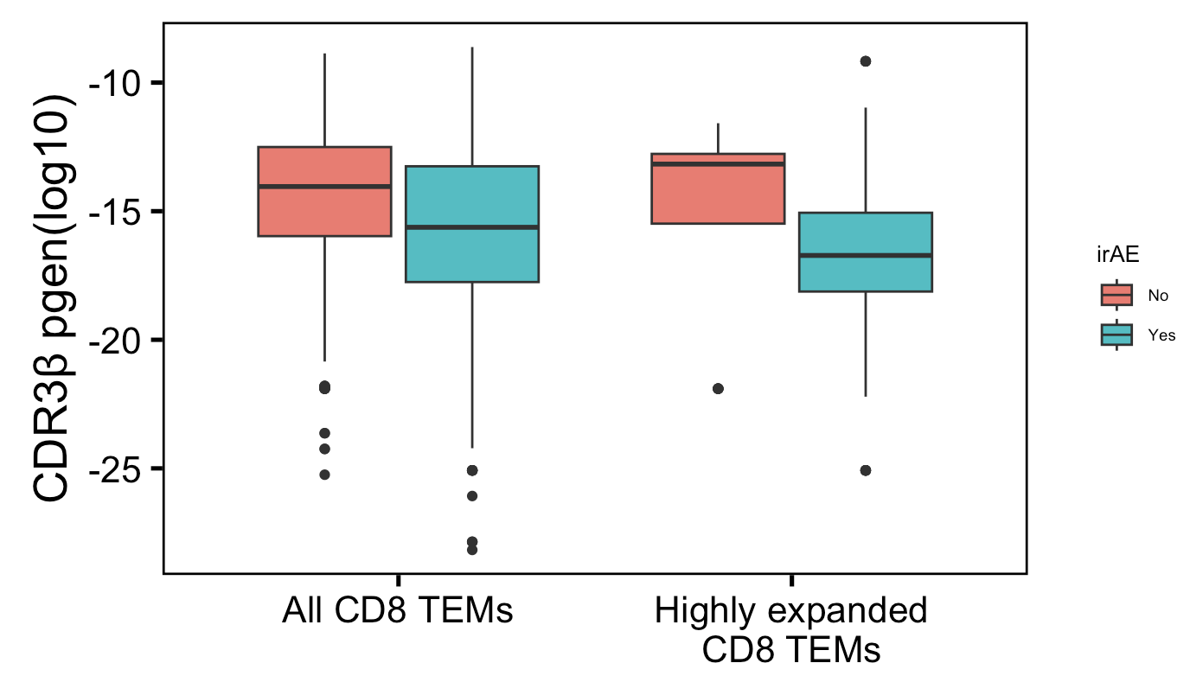
Solid conclusion #1 from myocarditis dataset: CD8 TEM TRBs less germline-like in those developing irAEs
****
****
n = 278
n = 816
n = 50
n = 306
Wilcoxon rank sum test. ****, p <1e-4; **, p <1e-2; *; p <0.05
Notes:
Downsampled

Slide 7
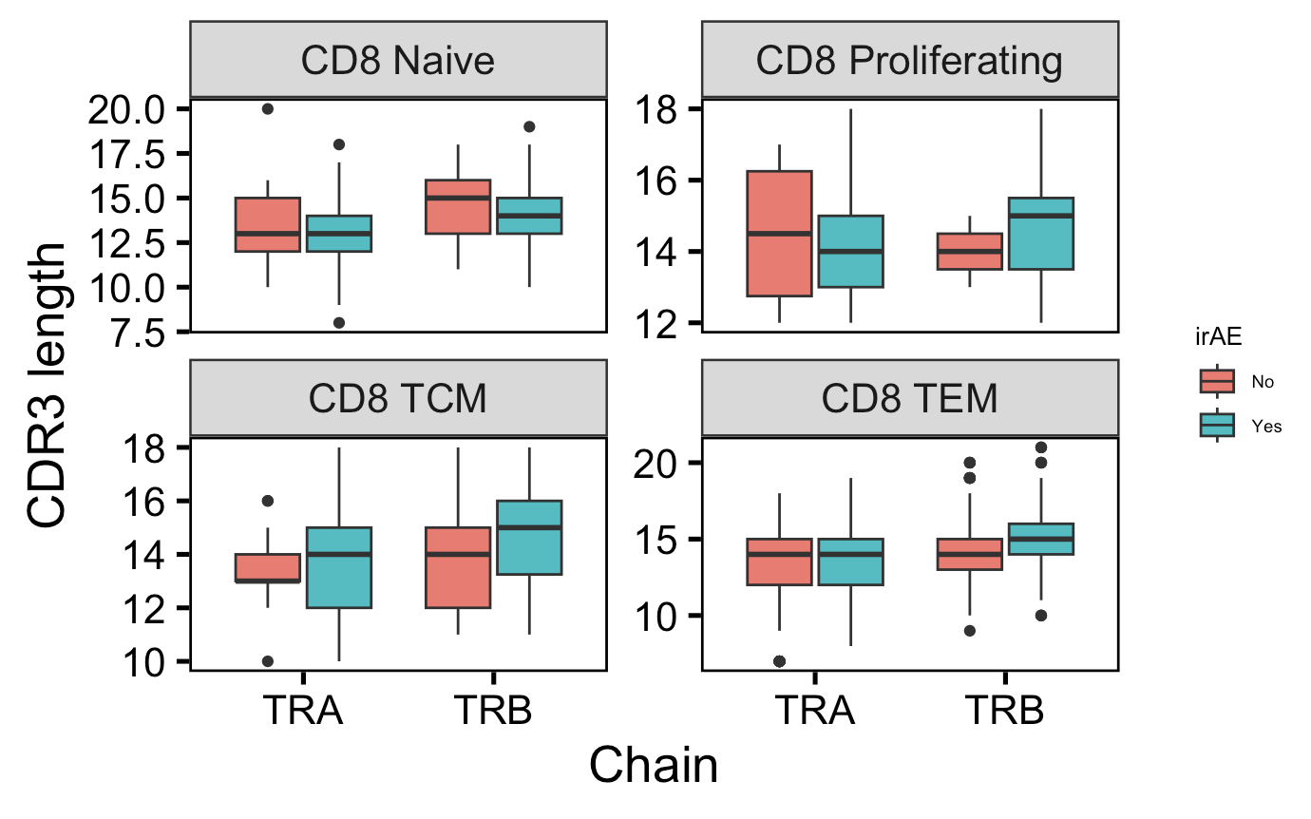
Somewhat solid conclusion #1 from myocarditis dataset: CD8 TCM CDR3βs longer in those developing irAEs
CD8 TCM TRB pval = 0.08
n = 29
n = 46
Notes:
Downsampled

Slide 8
Unanswered questions from myocarditis dataset
Antigen specificities

Slide 9
Conclusions

Slide 10
Next steps
Slowly beginning to assemble SI presentation slides

