Slide 1
Weekly meeting
4-10-2025
Ty Bottorff

Slide 2
Outline
NCI irAE analyses prompted by recent update

Slide 3
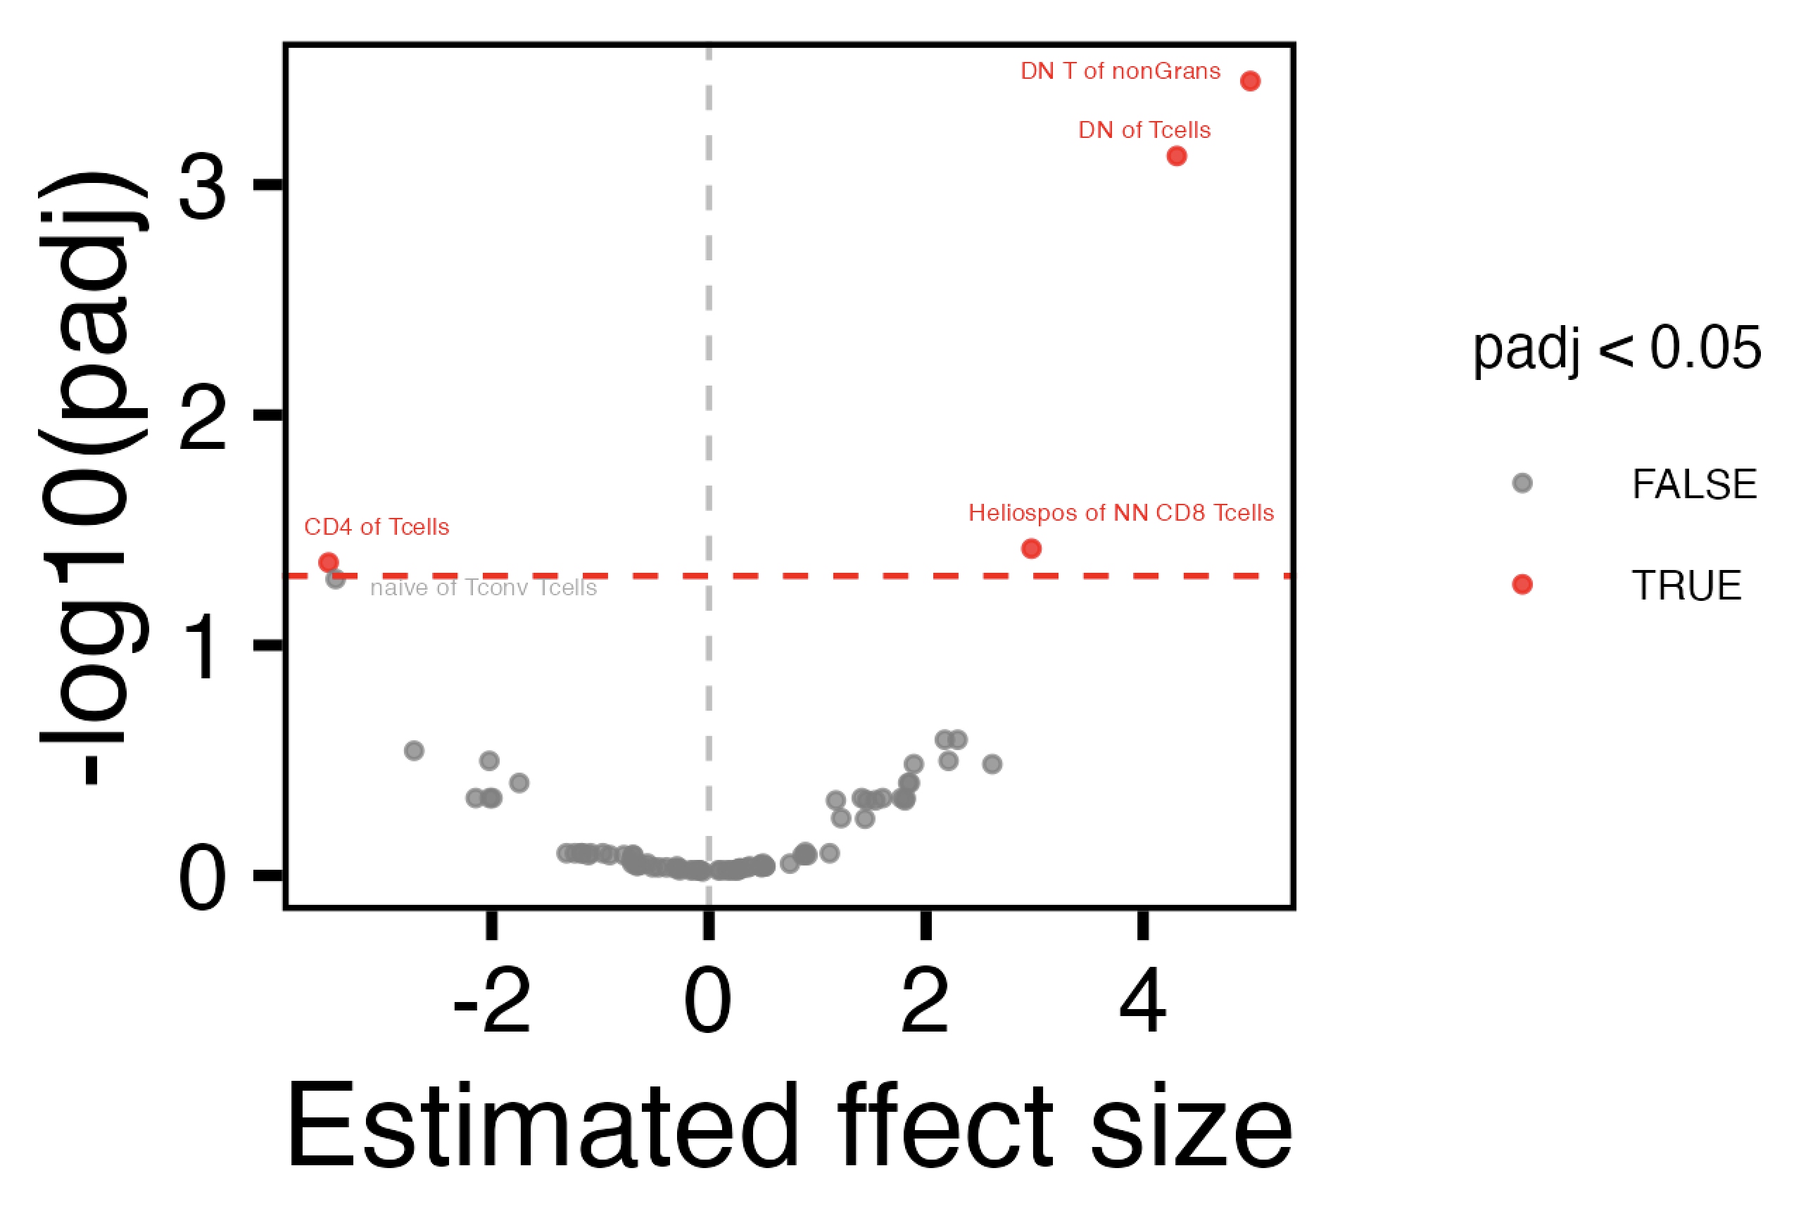
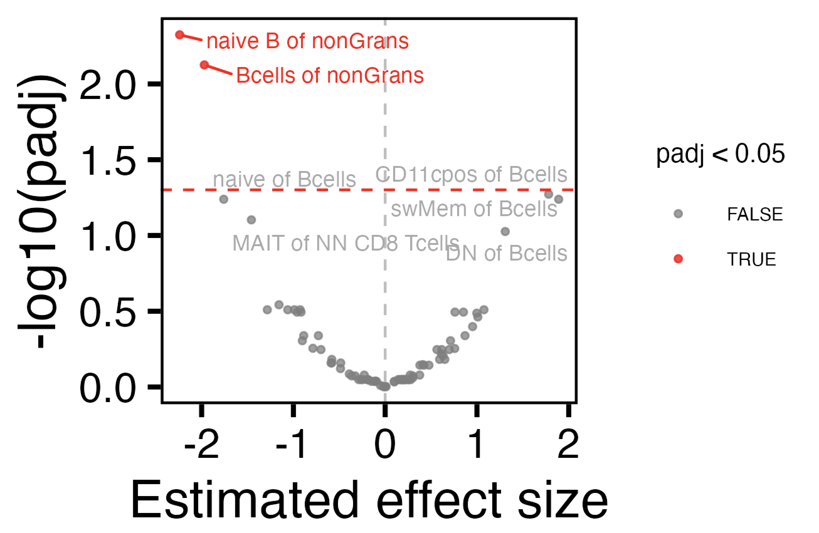
Including “new” subsets as % of total instead of % direct parent doesn’t provide new information
Down at baseline in subjects who later develop gastrointestinal irAEs
Up at baseline in subjects who later develop gastrointestinal irAEs
Down at baseline in subjects who later develop any irAE
Up at baseline in subjects who later develop any irAE
% T of nonGrans doesn’t vary by group
% B of nonGrans does vary by group

Slide 4
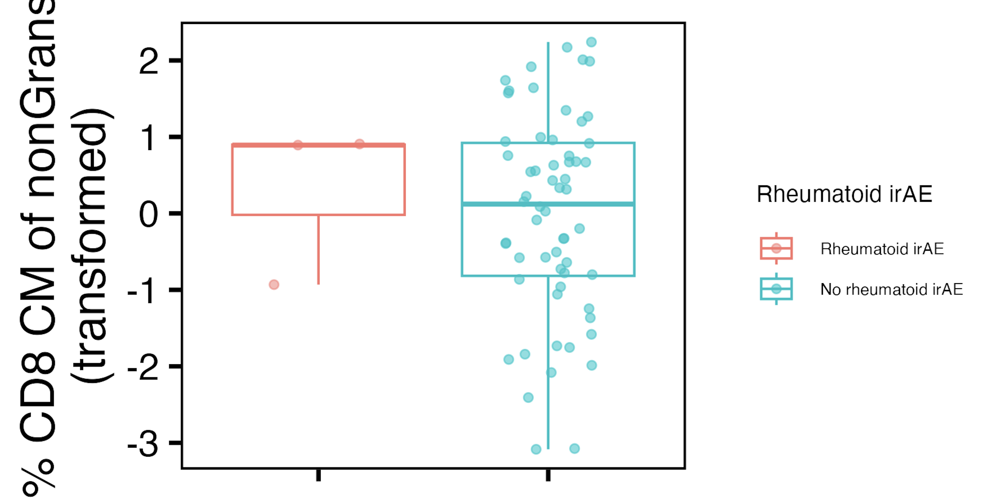
Do not see Bukhari, 2023 baseline arthritis result in our data: they observed subjects who later develop arthritis having fewer CD8 TCM at baseline
Notes:
Why? Underpowered… also maybe what I call rheumatoid irAE here isn’t always arthritis… (2/3 are arthralgia not arthritis, arthralgia may not have inflammation?)

Slide 5
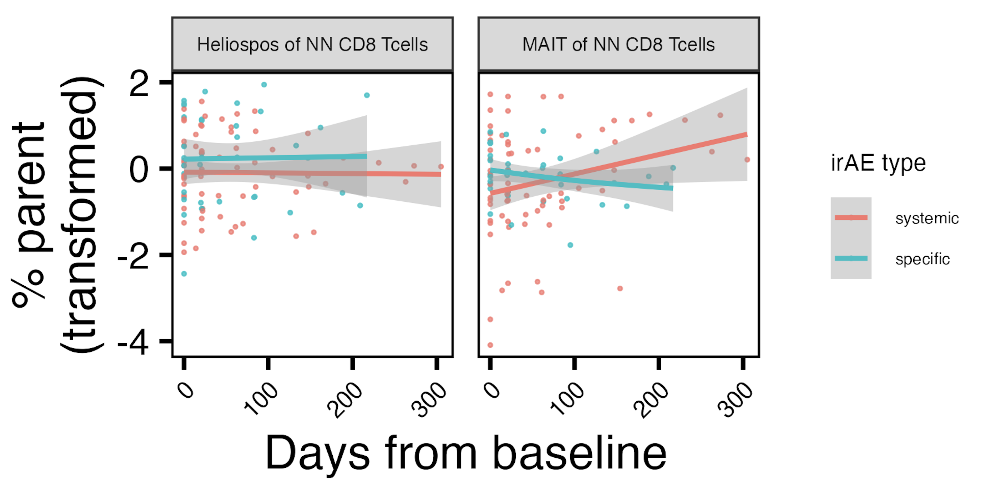
Over ICI, multi-organ irAEs are associated with lower levels of Helios⁺ NN CD8s and increases in MAITs
* (group effect)
** (interaction effect)
*: padj < 0.01
**: padj < 0.001

Slide 6
Effect of benchmarking irAE development
Changed + irAE grouping to - if first irAE development date was > 90 days from ICI start
Baseline results quite similar
Longitudinal results show some differences
Skin irAE CD4:CD8 changes (driven by late timepoints) no longer apparent
Thyroid irAE: some results now (% CM of CD8 T cells)
Notes:
If benchmarking AND including thyroid OOR in thyroid irAE no longer see baseline MAIT effect though…

Slide 7
Effect of including thyroid OOR in thyroid irAE category
Still see depletion of MAITs at baseline in subjects who later develop thyroid irAE (including OOR)
Longitudinal results now show some differences
Notes:
If benchmarking AND including thyroid OOR in thyroid irAE no longer see baseline MAIT effect though…

Slide 8
Conclusions
Adding “new” % total subsets does not provide new information
Testing Bukhari, 2023 results in our cohort
do not see that subjects who later develop arthritis (or arthralgia in our cohort) have fewer CD8 TCM at baseline
Over ICI, multi-organ irAEs are associated with lower levels of Helios⁺ NN CD8s and increases in MAITs
Longitudinal results look different with irAE benchmarking, inclusion of thyroid OOR in thyroid irAE category

Slide 9
Next steps
Help write CD127 manuscript
Testing Bukhari, 2023 result in our data: subjects who later develop thyroid irAEs have more CD4 Th17 at baseline
requires > 1 modifier node on top of a subset (can’t do this currently)…

Slide 10
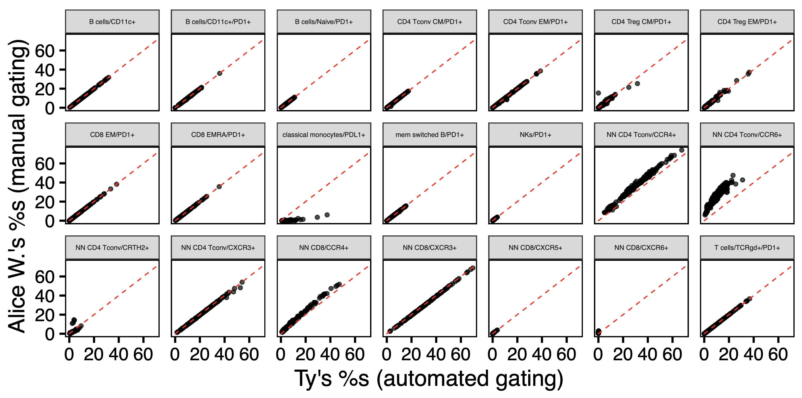
IMPACD automated gating is usually very accurate
Notes:
This is ~all of the manually gated subsets that overlap with level 1 gating of Alice W.’s subsets (i.e. what I can directly test for level 1 gating accuracy)
Unfortunate that the NN CD4 Tconv/CCR6+ is not super accurate given that’s what we’ll be using for CD4 Th17…

