Slide 1
SI talk
January 2024
Ty Bottorff

Slide 2
Outline

Slide 3
Immune checkpoints

Slide 4
Immune checkpoint blockade (ICB)
Notes:
Clinical outcome following checkpoint therapy in renal cell carcinoma is associated with a burst of activated CD8 T cells in blood: model: pool of tumor-specific TCF-1<sup>+</sup> stem-like CD8 T cells that aren't proliferating or generating antitumor effector cells that are a reservoir unleashed by ICB, seen by large burst of HLA-DR<sup>+</sup> CD38<sup+</sup> CD8 T cells after ICB and new repertoire
Distinct cellular mechanisms underlie anti-CTLA-4 and anti-PD-1 checkpoint blockade
- PD-1 blockade predominantly induces expansion of specific tumor infiltrating exhausted-like CD8<sup>+</sup> T cell subsets
- CTLA-4 blockade induces expansion of ICOS<sup>+</sup> Th1-like CD4<sup>+</sup> effector T cells, also engages specific subsets of exhausted-like CD8<sup>+</sup> T cells
Immune-related adverse events in checkpoint blockade: observations from human tissue and therapeutic considerations
PD-1 blockade more CD8 effect, CD4 effect more for CTLA-4 blockade
Mechanisms of immune-related adverse events during the treatment of cancer with immune checkpoint inhibitors
anti-CTLA-4 and anti-PD-1/PD-L1 antibodies called "immune enhancers" and "immune normalizers" (normalizing T cell immunity in tumor microenvironment), respectively, consistent with PD-1 blockade having less irAEs
T cell repertoire diversity: friend or foe for protective antitumor response?
high TCR diversity/richness/evenness (all same here, highly polyclonal synonyms) in blood associted with good ICB outcome
clonal replacement: recruitment of less dysfunctional peripheral T cell clonotypes to tumor that were not detectable in tumor prior to PD-1 blockade, i.e. from tumor draining lymph node, more important in ICI than previously thought**
- **clonal revival: replenishment of highly dysfunctional T cell clones in tumor with new, less dysfunctional T cells (perhaps from periphery, local expansion within tumor) that can be novel clonotypes (i.e. clonal replacement) or clonotypes pre-existing in tumor
tumor type matters for ICB response: melanoma/NSCLC have higher response rates, colon/endometrium cancers do not respond well to ICB (although those with high microsatellite instability and MMRd repsond well), tumor burden is a good predictor of ICB response (neoantigen generation to elicit antitumor immunity)
ovarian cancers ICB resistant, not known why (perhaps TIM-3 checkpoint), despite tumor-infiltrating leukocytes present in most ovarian cancer patients (or perhaps these are bystanders reactive to viruses rather than tumor antigens)

Slide 5
Immune-related adverse events (irAEs) from ICB
Notes:
Autoimmune toxicity occurs in up to 60% of patients treated with immune checkpoint inhibitor (ICI) therapy

Slide 6
irAEs vs. autoimmune conditions
Notes:
Perhaps worth trying to make analogy between viral infections preceeding autoimmunity and tumor response preceeding irAEs?
Immune-related adverse events in various organs caused by checkpoint inhibitors
irAEs progress more rapidly than autoimmune conditions, also transient often with quick recovery
CTLA-4 and PD-1 signaling converge on Akt, regulator of T cell activation
CTLA-4 blockade induces more diversified T cells (including autoreactive ones), PD-1 blockade induce more clonal TCR repertoire and proliferation of intratumoral CD8<sup>+</sup> T cells
severe irAEs may represent a subclinical or latent autoimmune state that is unmasked upon ICI treatment

Slide 7
Biomarkers for irAE development from ICB
Notes:
Biomarkers of checkpoint inhibitor induced immune-related adverse events - a comprehensive review: on treatment markers including clonal expansion of more T cell clones, more newly emerging T cell clones, decline in T cell clonality all very interestingly associated with more irAEs
External validation of biomarkers for immune-related adverse events after immune checkpoint inhibition: unable to reliably predict risk of irAEs in most cases from pre-therapy flow cytometry and clinical data
Germline variants associated with toxicity to immune checkpoint blockade: IL7 cryptic exon, IL7 supports aberrant immune activity in autoimmunity, limits organ toxicity during antiviral immune response, blocks PD-1 leading to T1D (blocking checkpoint when it would have prevented autoimmunity, so IL7 acts as a natural ICB and is therefore rationally associated with irAEs
T cell characteristics associated with toxicity to immune checkpoint blockade in patients with melanoma
activated CD4 effector memory T abundance and TCR diversity associated with irAE
in responsive patients peripheral compartment is a major source of T cells activated by ICB and majority of pre-existing intratumoral T cells are terminally exhausted and refractory to ICB
some circulating PD-1<sup>+</sup> CD8<sup>+</sup> T cells share TCR sequences with T cells in TME, and this frequency predicts ICB response
Checkpoint blockade-induced dermatitis and colitis are dominated by tissue-resident memory T cells and Th1/Tc1 cytokines
Single cell T cell landscape and T cell receptor repertoire profiling of AML in context of PD-1 blockade therapy
- TCR repertoires expand in responders, contract in therapy resistant patients

Slide 8
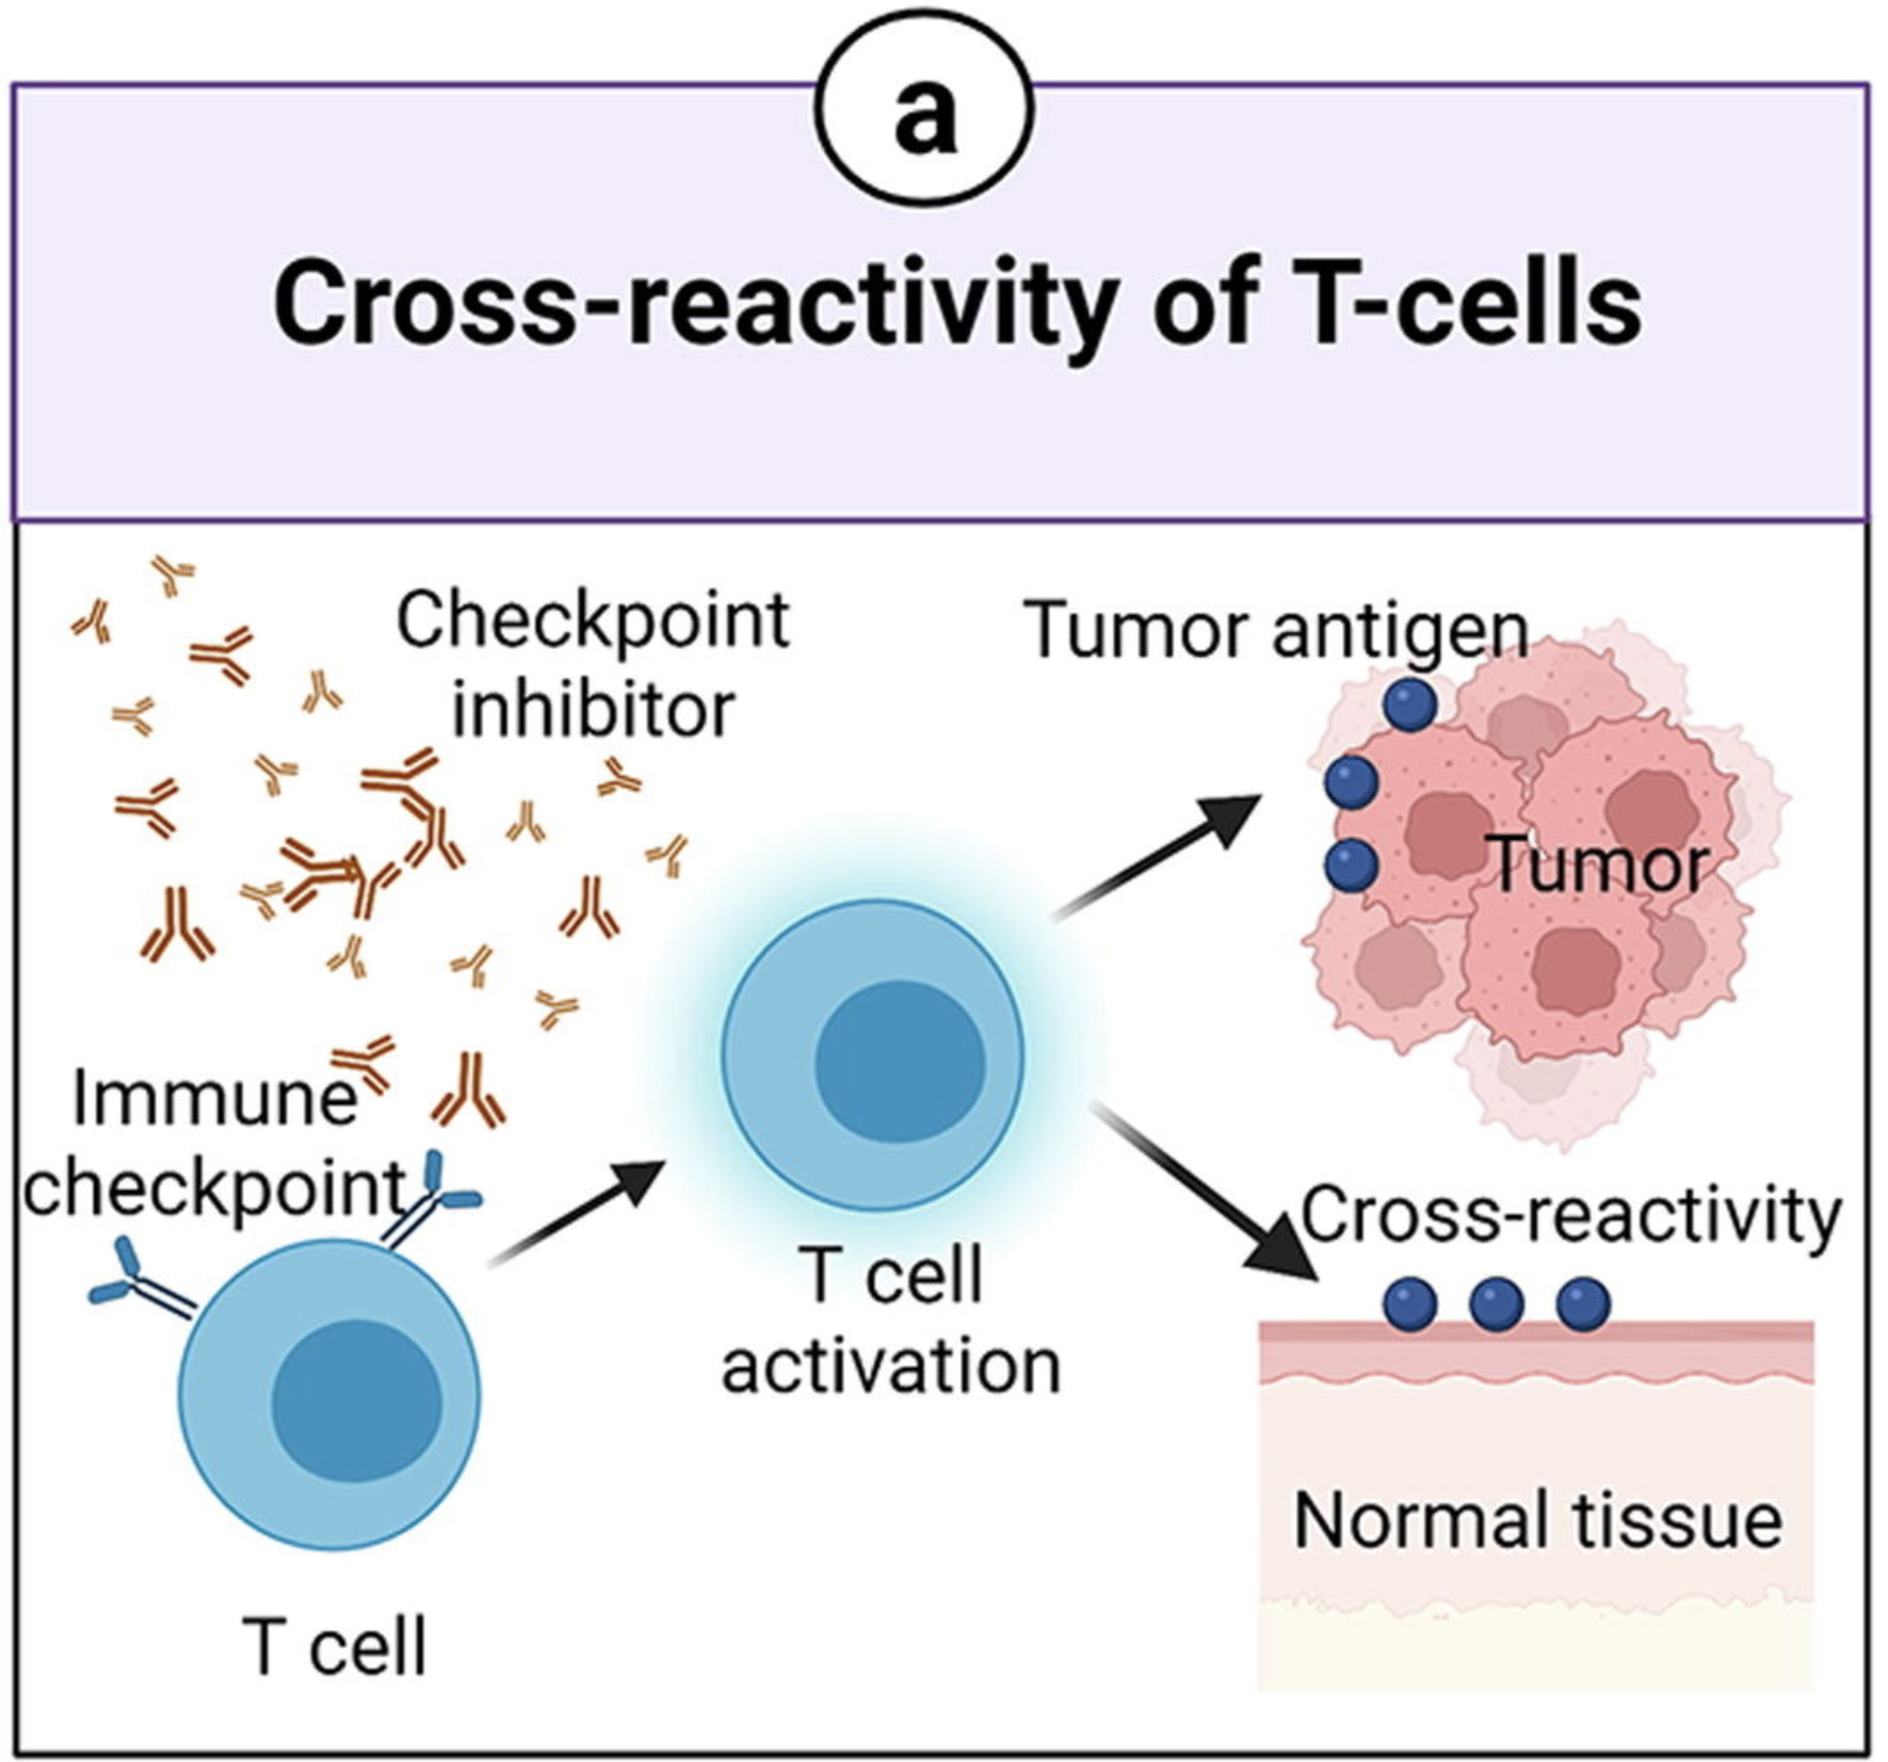
Hypotheses for irAE development
cross-reactive T cells reacting to both tumor and self
evidence for dense infiltration of T cells in sites of irAEs
evidence for ICIs inducing expansion of T cells
evidence for irAE development being associated with expansion of T cells
Notes:
Picture from Advanced materials for management of immune-related adverse events induced by immune checkpoint inhibitors
We want to confirm that TCR expansion is directly related to irAE development
estimate TCRs to be able to bind ~10^5 to 10^6 peptides (Amino acid similarity accounts for T cell crossreactivity and for "holes" in the T cell repertoire)
TCR conceivably could recognize ~ 1 million peptides, crossreactive peptides likely often better agonists than original one that activated T cell, but few (~1%) of peptides are actually presented on MHC, so probably crossreactivity estimate closer to 1 in ~10,000**
Association of checkpoint inhibitor-induced toxic effects with shared cancer and tissue antigens in non-small cell lung cancer:
irAEs associated with response to therapy (also can cite Association of vitiligo with tumor response in patients with metastatic melanoma treated with pembrolizumab), also Nivolumab in resected and unresectable metastatic melanoma: characteristics of immune-related adverse events and association with outcomes
seems like most similar self tissue to tumor has highest chance of irAE, skin second most similar to NSCLC after lung and had second highest proportion of irAEs (can also cite Autoreactive napsin A-specific T cells are enriched in lung tumors and inflammatory lung lesions during immune checkpoint blockade)
see dense infiltration of T cells in sites of irAEs
same T cell clonotypes infiltrated both lung tumor and autoimmune skin lesions
Speculation for what crossreactive T cells are actually targeting, perhaps T cells targeting cancer neoantigens cross-react with WT version of protein in healthy tissue (Autoreactive napsin A-specific T cells are enriched in lung tumors and inflammatory lung lesions during immune checkpoint blockade)
What makes TCRs crossreactive? cross-reactivity need not result from sequence similarity (3D structural similarity more important than 1D sequence similarity (Peter’s paper: Autoreactive T cell receptors with shared germline-like α chains in type 1 diabetes)
Characterization of anti-cancer immune response associated with immune-related adverse events in patients with kidney cancer
- more irAEs in ICB responders, not a new finding
- irAE patients had more peripheral T cell clones shared with TILs
- some irAE-provoked T cell clones circulate systemically and attack tumor cells leading to ICB response in irAE patients or vice a versa some tumor-provoked T cell clones circulate systemically and attack self leading to irAEs? not sure how they differentiate between the two
Clonal expansion of CD8 T cells in the systemic circulation precedes development of ipilimumab-induced toxicities: CD8 T cell clonal expansion was greater in patients developing severe irAEs
Effective use of latent semantic indexing and computational linguistics in biological and biomedical applications: HLA-B57 restricted T cells are more crossreactive to mutants of target epitopes, this HLA allele also associated with autoimmunity
Epitope spreading toward wild type melanocyte-lineage antigens rescues suboptimal immune checkpoint blockade response
- expansion of peripheral CD8<sup>+</sup> T cell populations specific for melanocyte antigens observed only in patients who responded to anti-PD-1 therapy, so ICI can promote breakdown of tolerance towards tumor-lineage self-antigens
- perhaps in responders with low neoantigen tumors more often will see irAEs given necessity for immune activity against tumor associated antigens shared between tumor and self
Exceptional response and multisystem autoimmune-like toxicities associated with the same T cell clone in a patient with uveal melanoma treated with immune checkpoint inhibitors
identical CD8<sup>+</sup> T cell clone found in 4 tissues in a patient with widespread irAEs (duodenum for enteritis irAE, PBMCs, original tumor and liver metastasis responses as well), evidence for crossreactivity underlying irAEs OR common antigen between tumor and self underlying irAEs
duodenitis blocked by antibody to integrin α 4 β 7 (LPAM-1) which blocks T cell infiltraton into GI tract, suggesting that GI toxicity resulted from circulating T cells trafficked to GI tract following expansion elsewhere i.e. in the tumor perhaps
Global analysis of shared T cell specificities in human non-small cell lung cancer enables HLA inference and antigen discovery: autoreactive T cells in peripheral blood may exist (pruned but not clonally deleted thymus) in order to avoid immunologic "blind spots" to pathogens, i.e. pathogens that look like self would get by free otherwise if we didn't have some autoreactivity perhaps
Identification of neoantigens for individualized cancer immunotherapy
cross-reactivity is possible due to low affinity of functional TCR-pMHC interaction
Heterogeneity of autoreactive CD8<sup>+</sup> T cells at sites of inflammation
shared clonal origin among CD8<sup>+</sup> T cells at site of colitis with gut T<sub>RM</sub> cells, suggesting clonal expansion from T<sub>RM</sub> population being responsible for irAEs (different from autoimmune, so for tissues that lack T<sub>RM</sub> cells, like the synovium, trafficking of T cells from the periphery may be important for irAEs)
Immune-related adverse events in various organs caused by checkpoint inhibitors
T cells seen infiltrating into irAE tissue, T cells seen targeting irAE tissue seen in blood, so T cells involved in irAEs
autoantibodies present ~50% of time for irAEs
Immune toxicities elicited by CTLA-4 blockade in cancer patients are associated with early diversification of the T cell repertoire
CTLA-4 blockade induced greater diversification of T cell repertoire (more clonotypes including newly detected clones, decreased clonality) in irAE patients compared to no irAE patients
Improved survival with T cell clonotype stability after anti-CTLA-4 treatment in cancer patients
diverse repertoires are important in limiting the magnitude of immune escape but may also promote self-reactive clones and induce host inflammation
Insight into immune profile associated with vitiligo onset and anti-tumoral response in melanoma patients receiving anti-PD-1 immunotherapy
they usually find different TCR sequences in vitiligo and primary melanoma lesions, so T cell response against normal melanocytes leading to vitiligo is not usually mediated by reactivation of T cell clones infiltrating/specific to primary melanoma but rather perhaps by T cells targeting metastatic tissues, so kind of different from my thinking of usually crossreactivity between primary tumor and irAE site but could also be crossreactivity between metastases and irAE sites
metastasis and vitiligo sample TCRs more similar than primary melanoma and vitiligo TCRs
Interpreting T cell crossreactivity through structure: implications for TCR-based cancer immunotherapy
crossreactivity driven by structural similarities of seemingly unrelated pMHCs (by sequence)
The promising link among tumor mutational burden, immune-related adverse events, and immune checkpoint inhibitors efficacy in SCLC
can see same clonotypes of T cells reactive against tumor and self in irAEs
T<sub>RM</sub> cells locally expanded in irAE-dermatitis and -colitis

Slide 9
Goal: determine if TCR (junction) features can serve a proxy for T cell cross-reactivity
Hydrophobicity
more hydrophobic TCRs might be more cross-reactive as they allow more alternative contacts
Germline-ness
more germline-like TCRs might be more cross-reactive as they have lower sequence complexity
Length
longer junctions might promote cross-reactivity as they allow more alternative contacts
Notes:
Entropic contributions and the influence of the hydrophobic environment in promiscuous protein-protein association: interface demonstrates promiscuity in part due to the number of interactions this hydrophobic interface allows, which allows many alternative contacts (increased entropy, drives forward binding) with other binding partners hence promiscuity
Repertoire analyses reveal T cell receptor sequence features that influence T cell fate
TRB CDR3 hydrophobicity promotes reactivity to self-peptides
Functionally specialized human CD4<sup>+</sup> T cell subsets express physiochemically distinct TCRs: longer CDR3s might promote crossreactivity

Slide 10
Study design

Slide 11
Methods

Slide 12
Results
Notes:
only a small portion of an antigen is needed to be recognized by a TCR (8-10 amino acids for MHCI, 14-18 for MHCII, does this mean that CD8<sup>+</sup> T cells might be more cross-reactive?)
T cell repertoire analysis and metrics of diversity and clonality
CDR1-2 contact MHC and CDR3 contacts peptide is the general rule, but CDR1α also contacts peptide and CDR3β doesn't contact peptide too much

Slide 13
Conclusions

Slide 14
Next steps

