Slide 1
Weekly meeting
1 30 2025
Ty Bottorff

Slide 2
Outline
IMPACD progress for NCI irAE project
CD8 analysis from Kevan Herold scRNAseq

Slide 3
IMPACD progress
Able to do level 1 (1 gate on top of parent root) & level 2 (modifier) analyses on any parent subset of interest
No baseline combined irAE group differences (FDR < 0.05) yet
Next steps
Decide what subsets and relevant markers to interrogate (computationally intensive to use all markers for level 2 analysis)
Look at specific irAEs & changes over ICI as well
Add in 4 additional batches of samples into workflows (IMPACD & previous work on % parent freq comparisons)
Notes:
Batches 10-14 = some additional NCI samples mixed w/ DS, HC

Slide 4
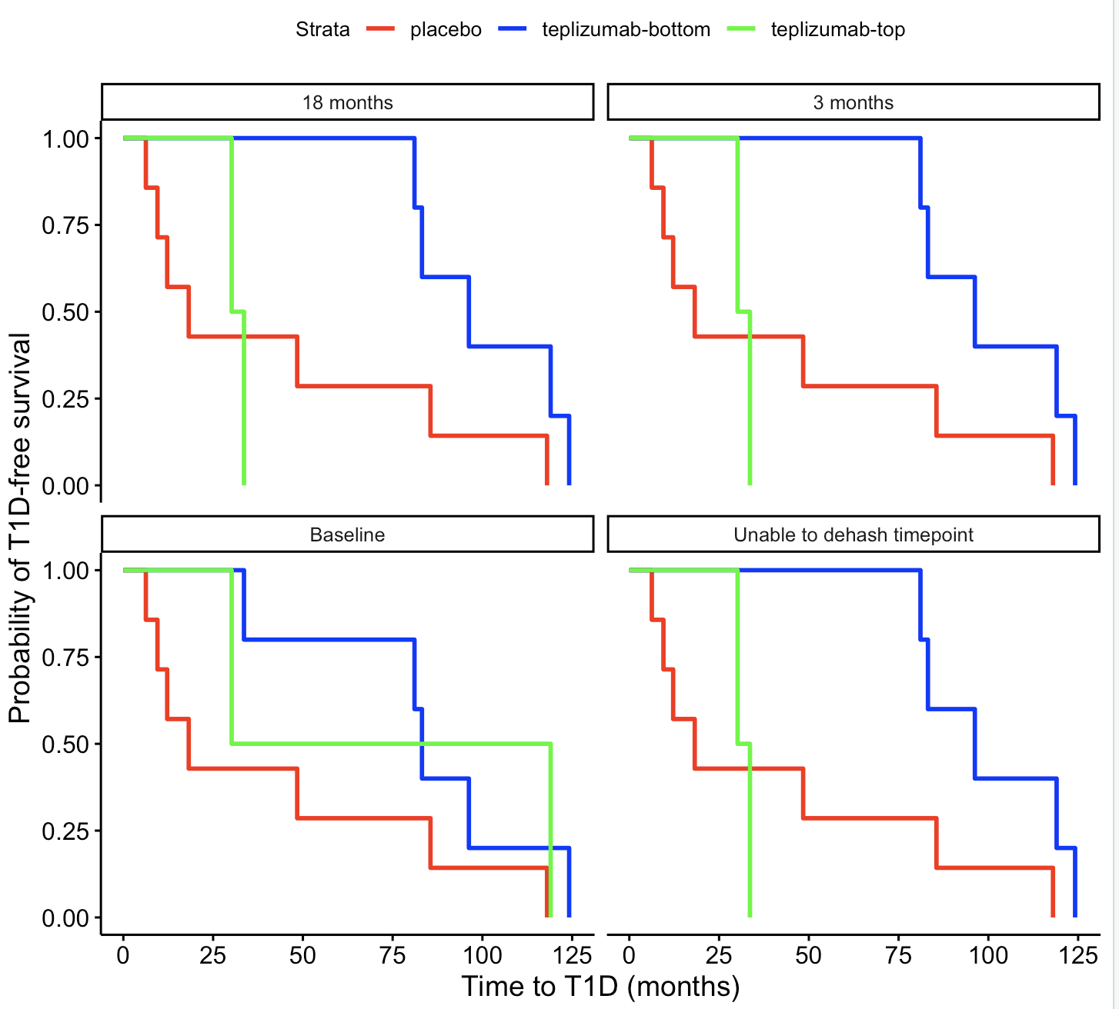
Patients with higher CD8 CD127 levels at non-baseline timepoints have shorter T1D-free intervals (Kevan Herold scRNAseq)
Main caveat: no event occurrence info provided, so just called them all 1 (T1D occurred, non-NA time to T1D events)
Notes:
Top 1/3 vs bot 2/3
Significant differences b/w top/bot at non-baseline
same as what they saw w/ flow
caveats: manually chose CD8 clusters by marker expr (switch to ref map) and naives still included so should remove those... but CD127 result (and EOMES kinda) are strong so it doesnt seem to be fault of caveats

Slide 5
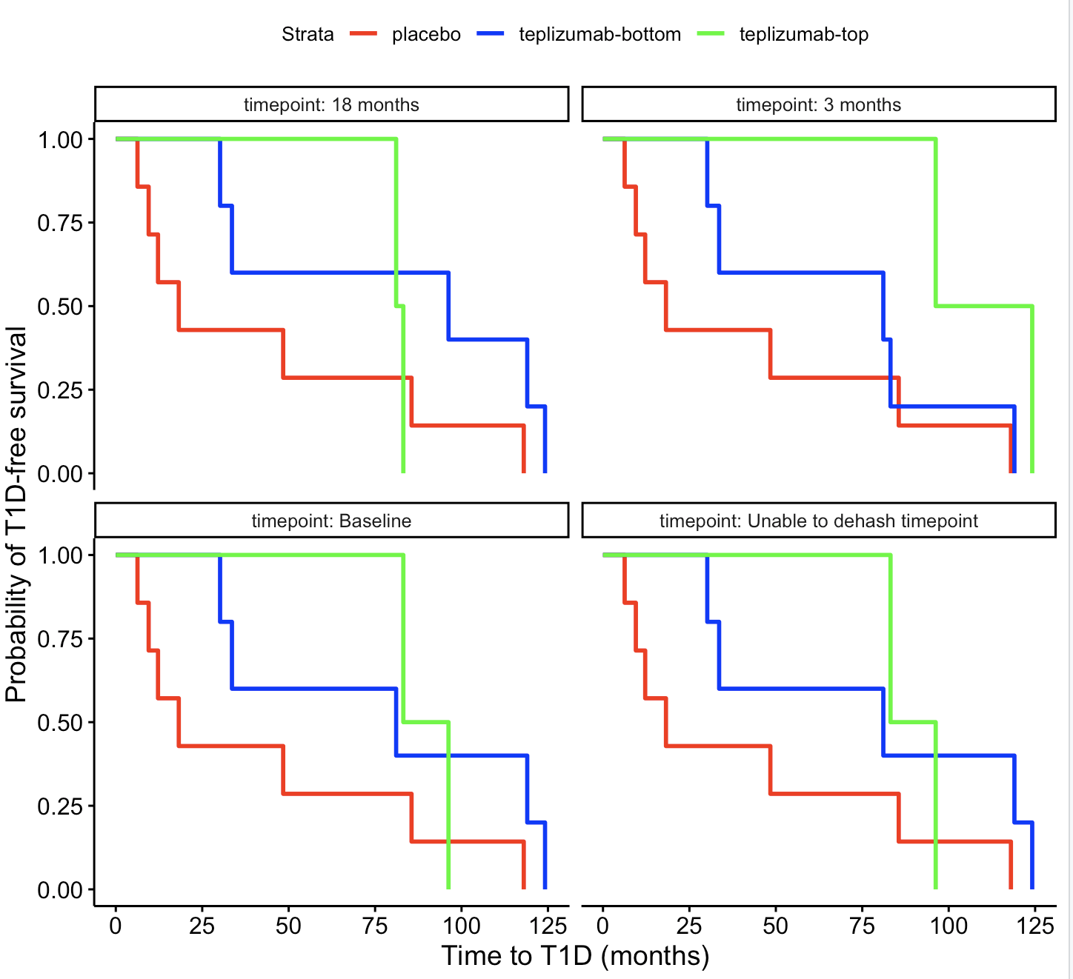
Patients with higher CD8 EOMES module levels at 3 months may have longer T1D-free intervals
p = 0.15 (top vs. bot @ 3 months)
Notes:
Top 1/3 vs bot 2/3 here
caveats: manually chose CD8 clusters by marker expr (switch to ref map) and naives still included so should remove those... but CD127 result (and EOMES kinda) are strong so it doesnt seem to be fault of caveats

Slide 6
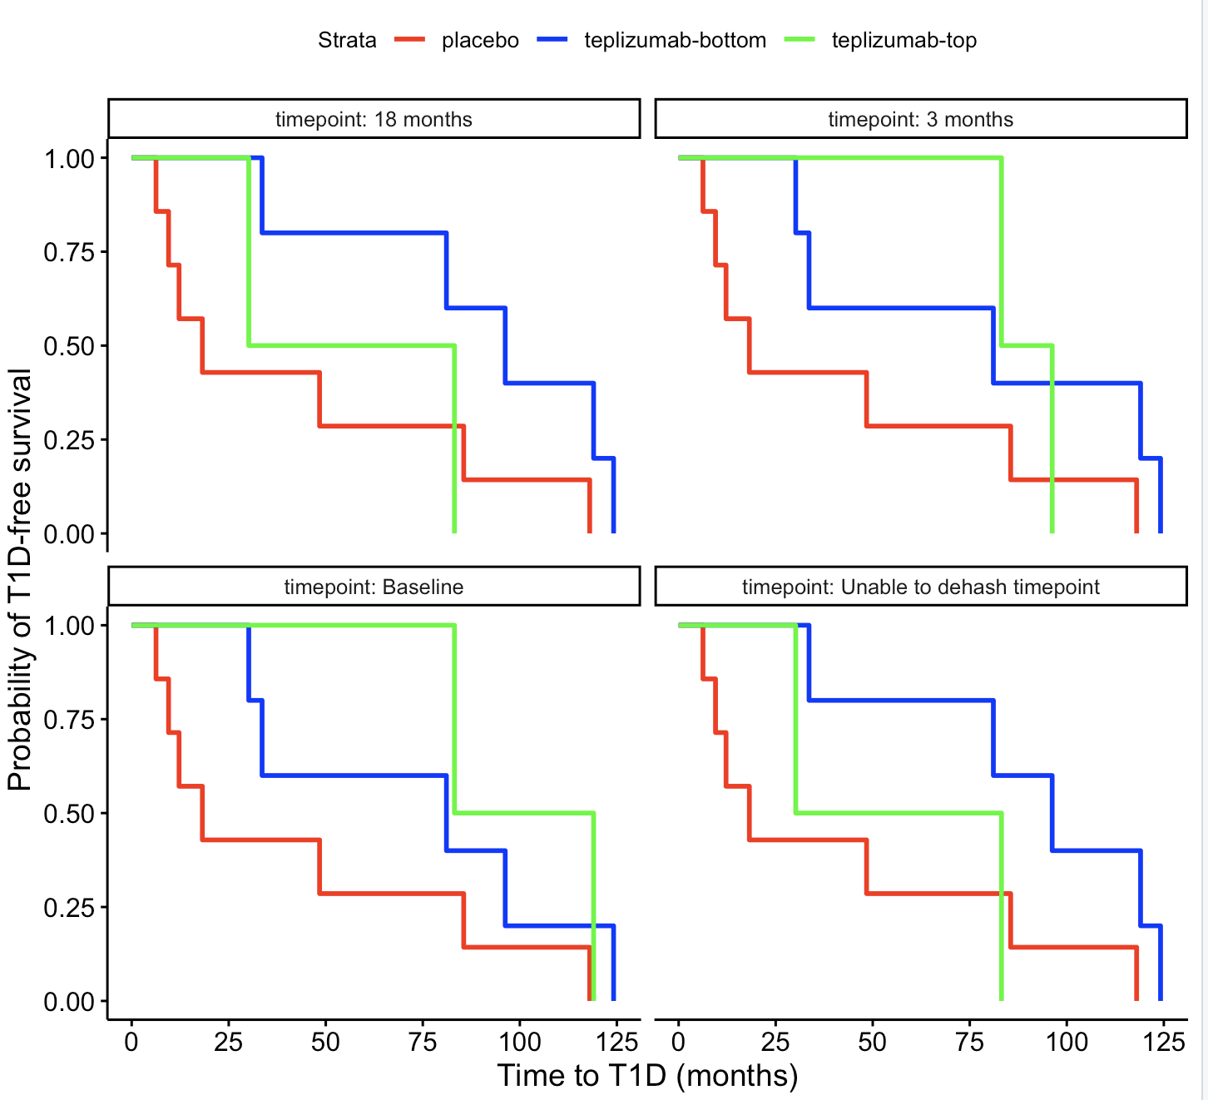
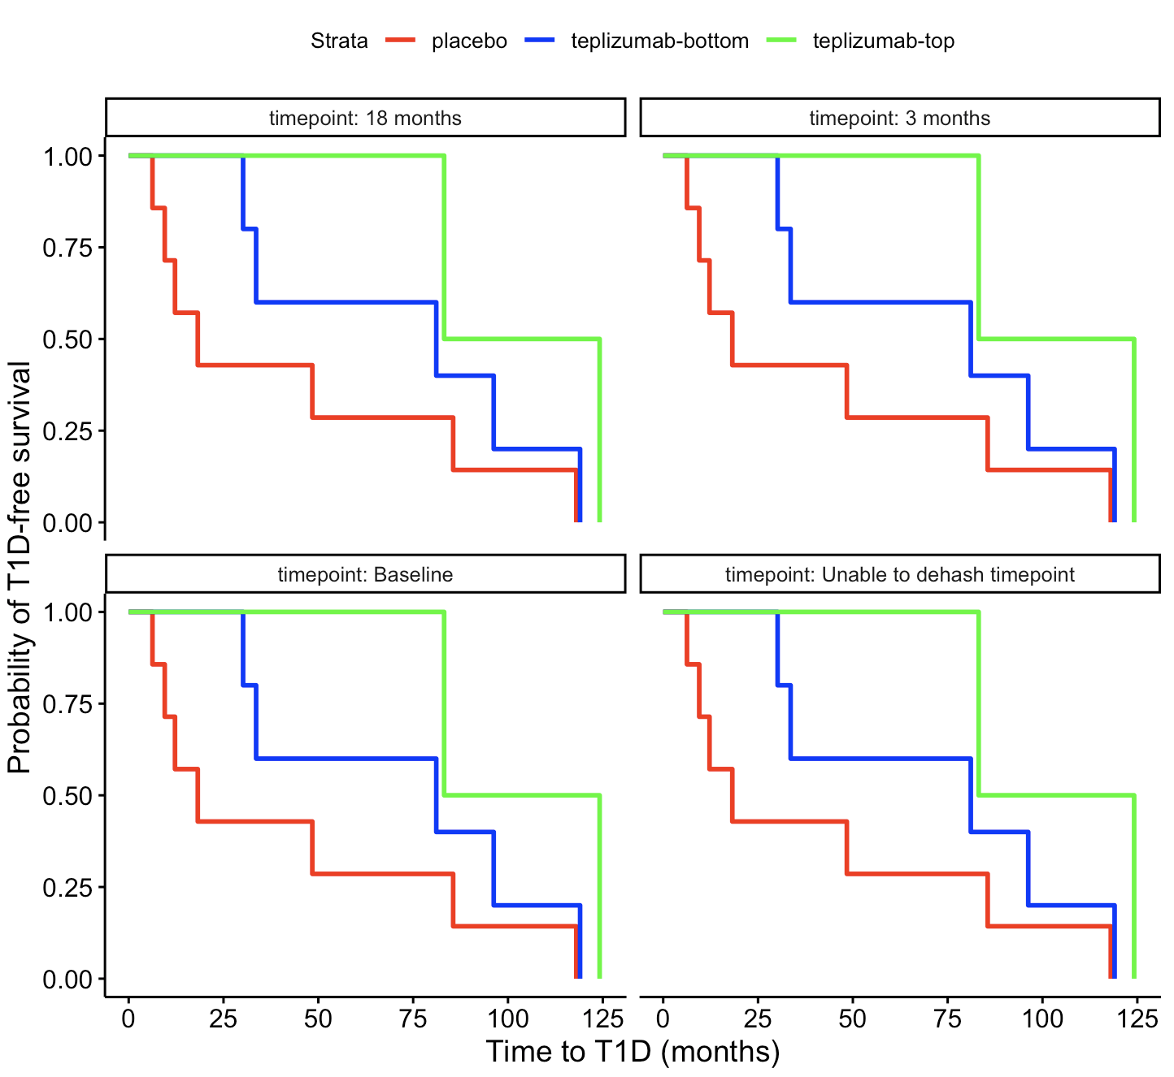
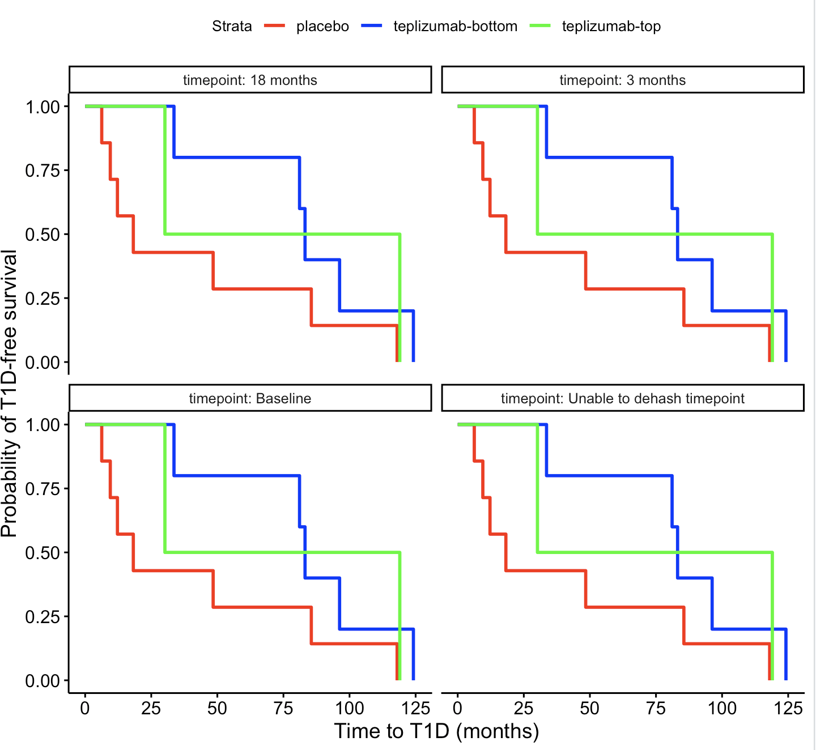
Expression of cluster markers, MAIT module, IL7 module in CD8s don’t seem to relate as expected to T1D-free intervals
TIGIT⁻KLRG1⁺CD127⁺ (T1D/HC cluster) markers
MAIT module
IL7 module
Notes:
Top 1/3 vs bot 2/3 here
Stratification same across timepoints apparently for MAIT module

