Slide 1
Weekly meeting
3 7 2024
Ty Bottorff

Slide 2
Outline
Colitis cohort differences & combining datasets

Slide 3
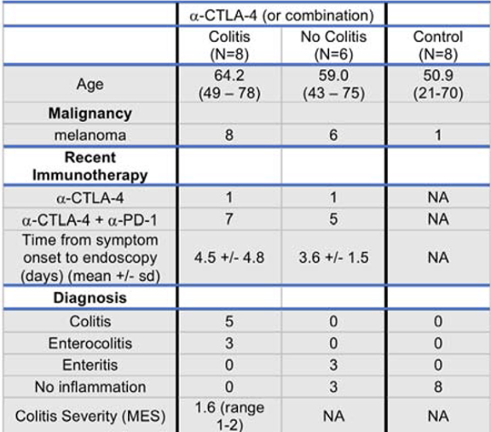
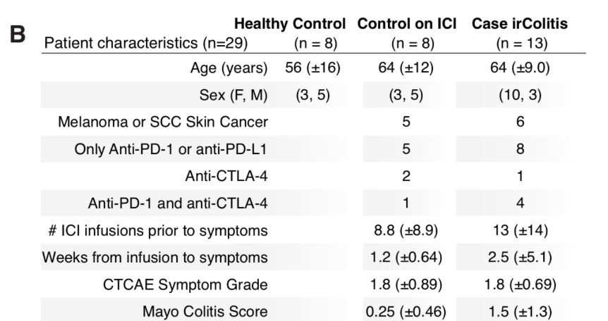
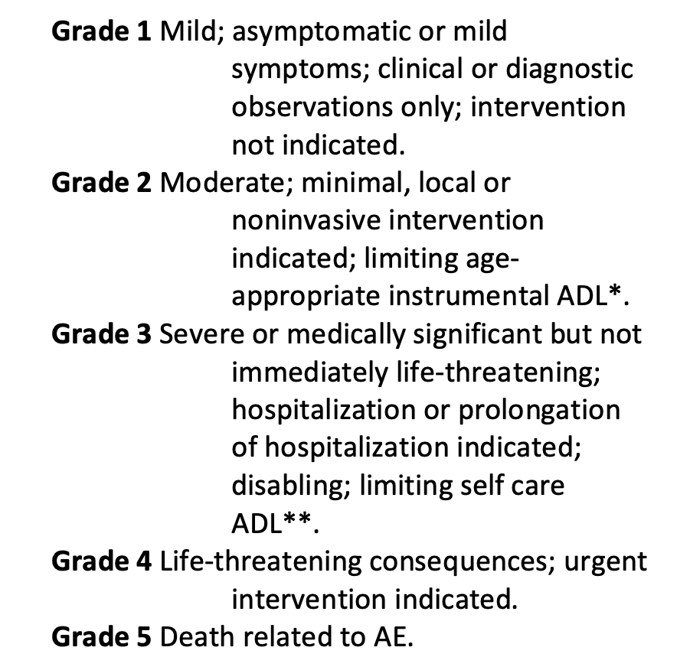
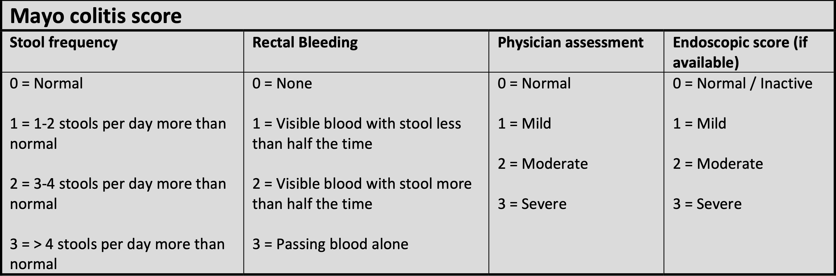
Mayo endoscopic/colitis scores similar between datasets, so colitis severity seems similar
2020 cell Luoma
2021 biorxiv Thomas
CTCAE grades
Notes:
MES = Mayo endoscopic score
Active colitis elsewhere defined as Mayo colitis score > 1

Slide 4
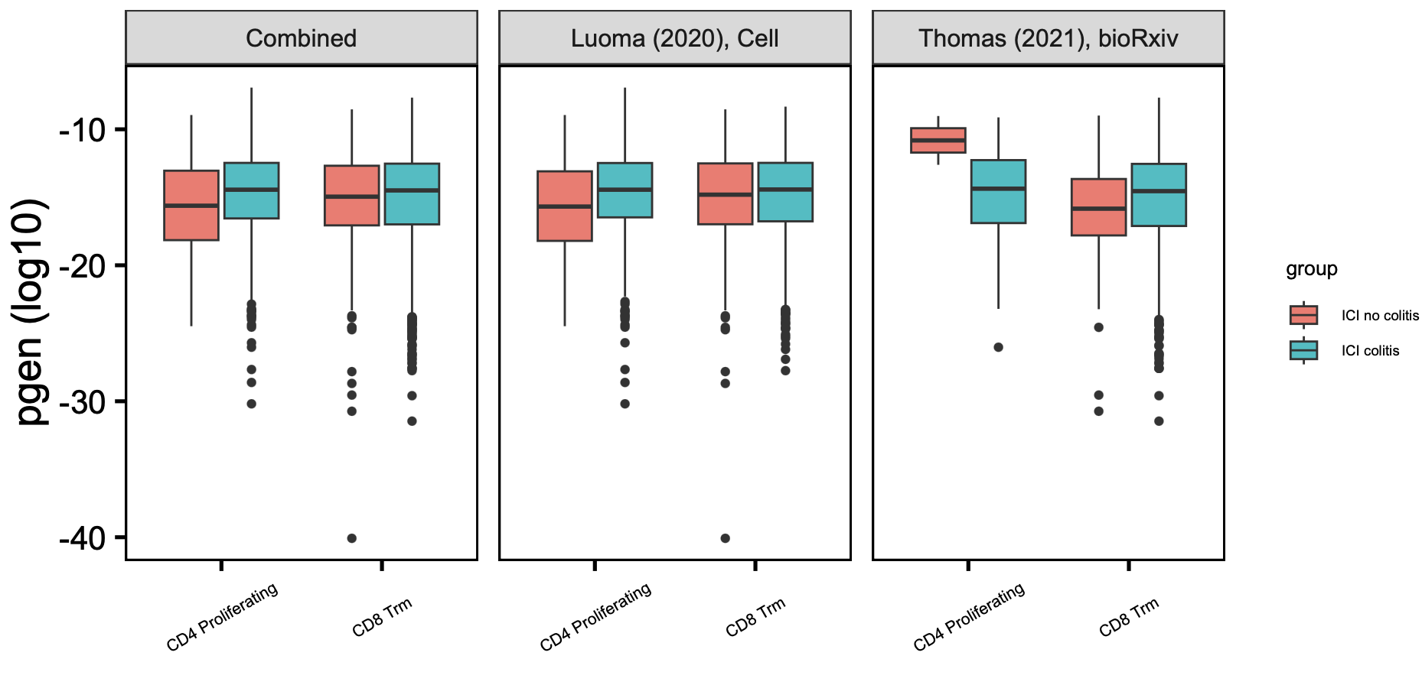
CD4 proliferating TRB pgen effect opposite in 2 datasets, but CD8 Trm TRBs seem slightly more germline in both datasets
*
padj = 0.08
*
many more CD4 proliferating clonotypes in Luoma, but about same for CD8 Trm in both datasets
Wilcoxon rank sum test. *, padj < 0.05
Notes:
TRB
There are many more unique CD4 prolif clonotypes in Luoma (~1200) than in Thomas (~200), about same for CD8 Trm (~3.5k in Luoma and ~4.5k in Thomas)

Slide 5
Conclusions
Joined analysis results
Highly expanded CD8 Trm TRAs may be more germline-like in colitis tissue (driven by Luoma dataset though, shown in last week presentation)
CD8 Trms TRB may be more germline-like in colitis tissue across both datasets
CD4 proliferating TRB germline effect opposite in 2 datasets

Slide 6
Next steps

