Slide 1
Weekly meeting
1 30 2025
Ty Bottorff

Slide 2
Outline
NCI irAE sc-seq idea
IMPACD progress for NCI irAE project
CD8 analysis from Kevan Herold scRNAseq

Slide 3
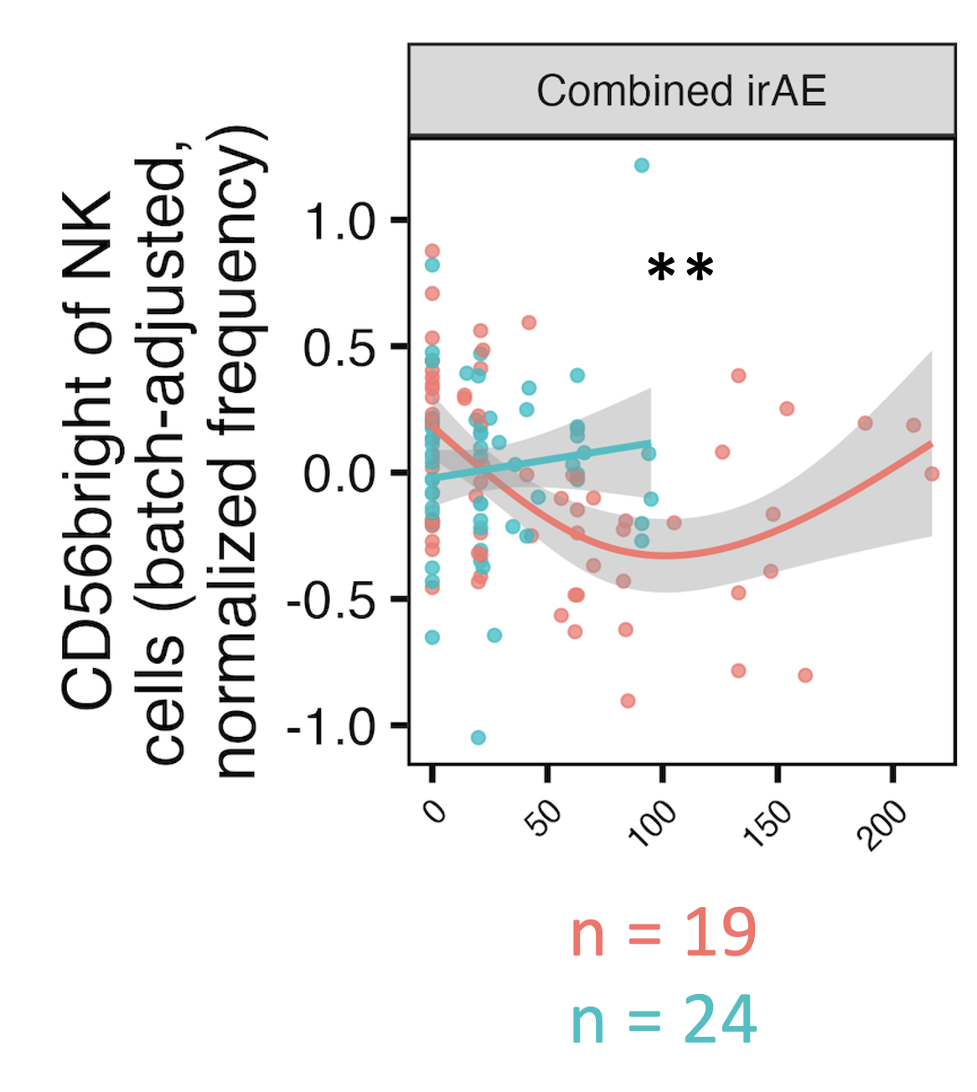
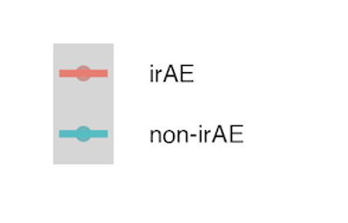
Proposed scRNAseq follow up experiment
n = 4/group (irAE, no irAE, HC), baseline & 1 post-ICI for cancer samples
Sample choices
Choose cancer samples based on baseline CD56^{bright} NK freqs changes w/ ICI
Choose HCs w/ high range in freq
Look for phenotypic differences..
b/w CD56^{bright} and dim NKs (CITEseq?)
b/w irAE & no irAE at baseline/over ICI
n = 4 from irAE group (with steep decline in freq over ICI)
post-ICI timepoint
n = 4 from no-irAE group (with low baseline freq)
Notes:
CD56bright vs. dim NKs: hypothesize that CD56bright NKs are promoting irAE development, expect to see more cytokine in CD56bright NKs (based on literature) but cytotoxicity may vary depending on activation status
This is ~pending IMPACD results (would want to see how anything I find there fits in before spending $ here)
Analogous to sample choices from AbATE
If doing TCRseq, would maybe want to use baseline SCM freqs instea to choose samples
Could hashtag to multiplex timepoints to reduce # samples from 20 to 12

Slide 4
IMPACD progress
Can run level 1 & level 2 (modifier) analyses on any parent subset of interest
No baseline combined irAE group differences (FDR < 0.1) so far
Next steps
Choose relevant markers to examine subsets (casting a wide net in the meantime)
Look at specific irAEs & changes over ICI as well
Add in 4 additional batches of samples into workflows
Notes:
Level 1: 1 gate at a time on top of root subset
Batches 10-14 = some additional NCI samples mixed w/ DS, HC

Slide 5
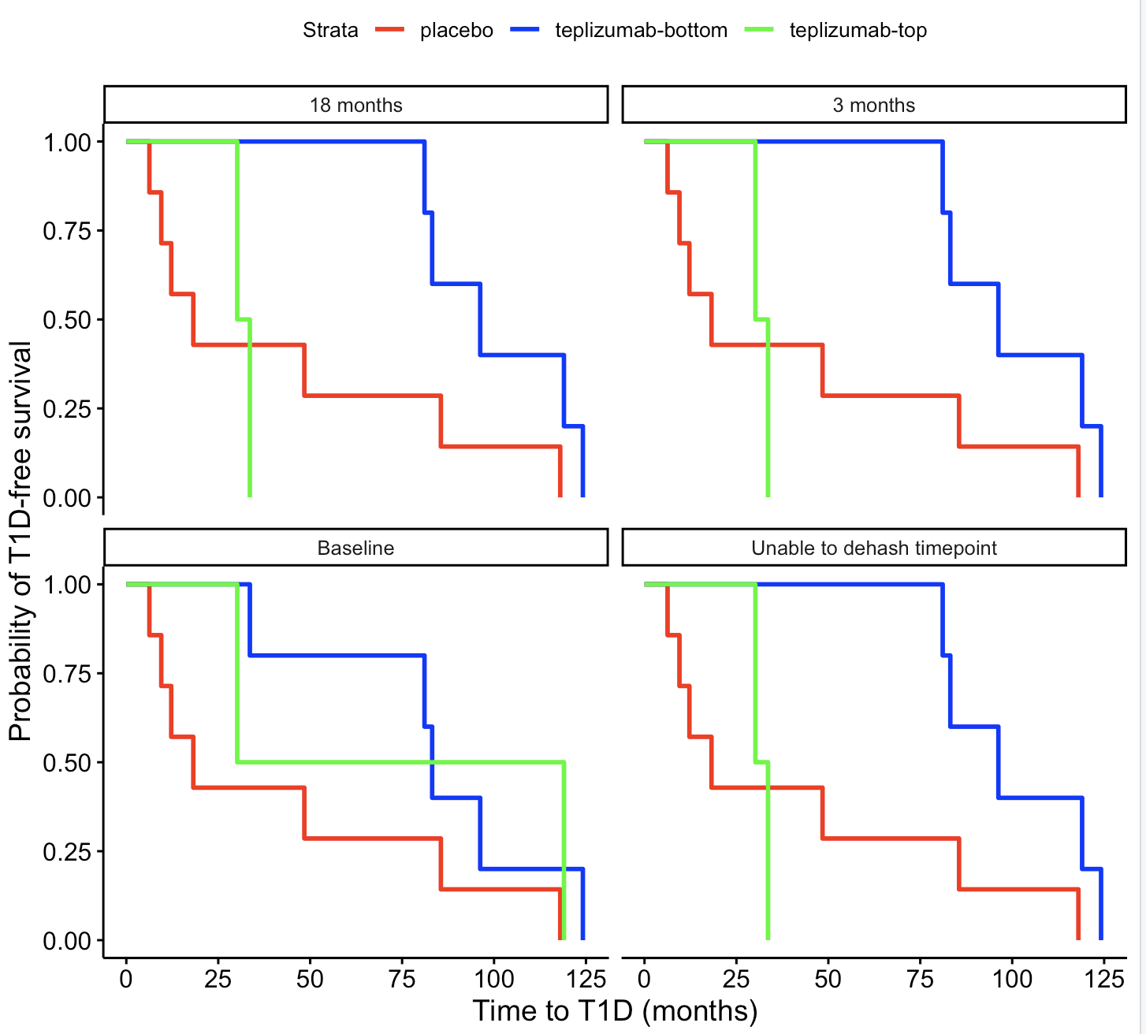
Patients with higher CD8 CD127 levels at non-baseline timepoints have shorter T1D-free intervals (Kevan Herold scRNAseq)
Main caveat: no event occurrence info provided, so just called them all 1 (T1D occurred, non-NA time to T1D events)
Notes:
Top 1/3 vs bot 2/3
Significant differences b/w top/bot at non-baseline
same as what they saw w/ flow
caveats: manually chose CD8 clusters by marker expr (switch to ref map) and naives still included so should remove those... but CD127 result (and EOMES kinda) are strong so it doesnt seem to be fault of caveats

Slide 6
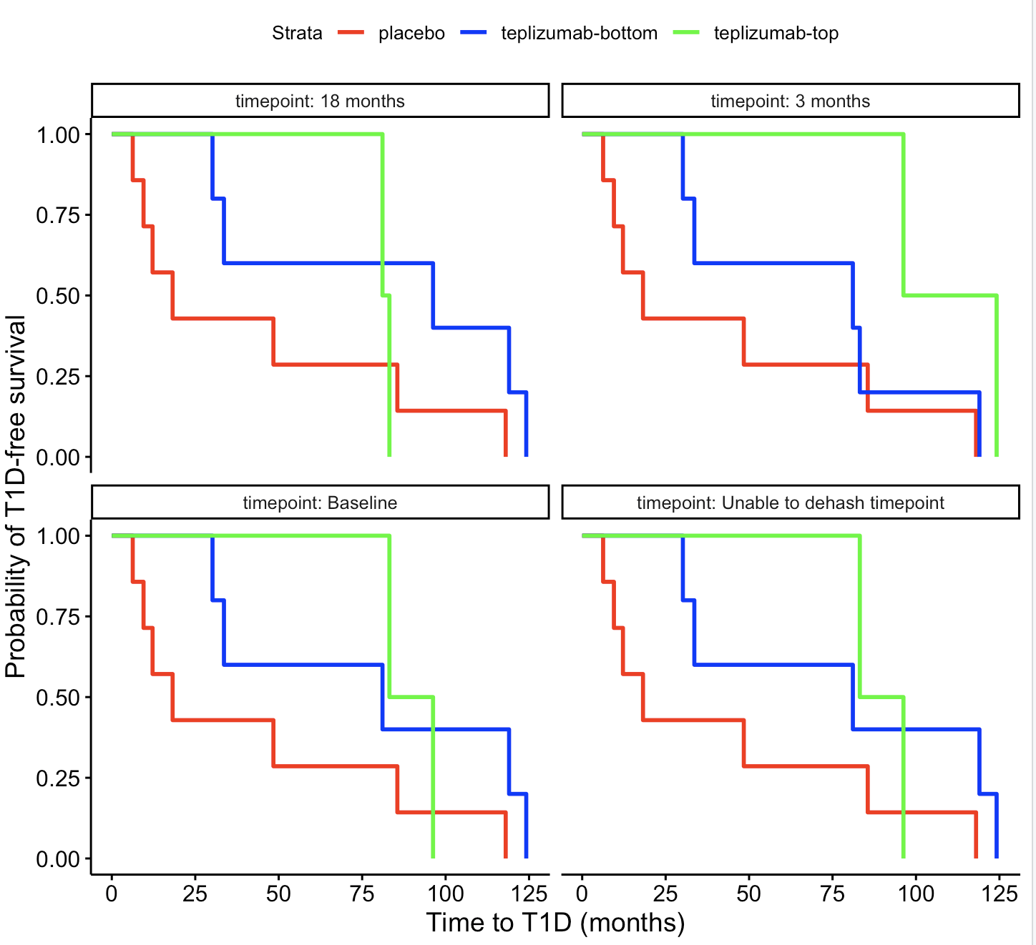
Patients with higher CD8 EOMES module levels at 3 months may have longer T1D-free intervals
p = 0.15 (top vs. bot @ 3 months)
Notes:
Top 1/3 vs bot 2/3 here
caveats: manually chose CD8 clusters by marker expr (switch to ref map) and naives still included so should remove those... but CD127 result (and EOMES kinda) are strong so it doesnt seem to be fault of caveats

Slide 7
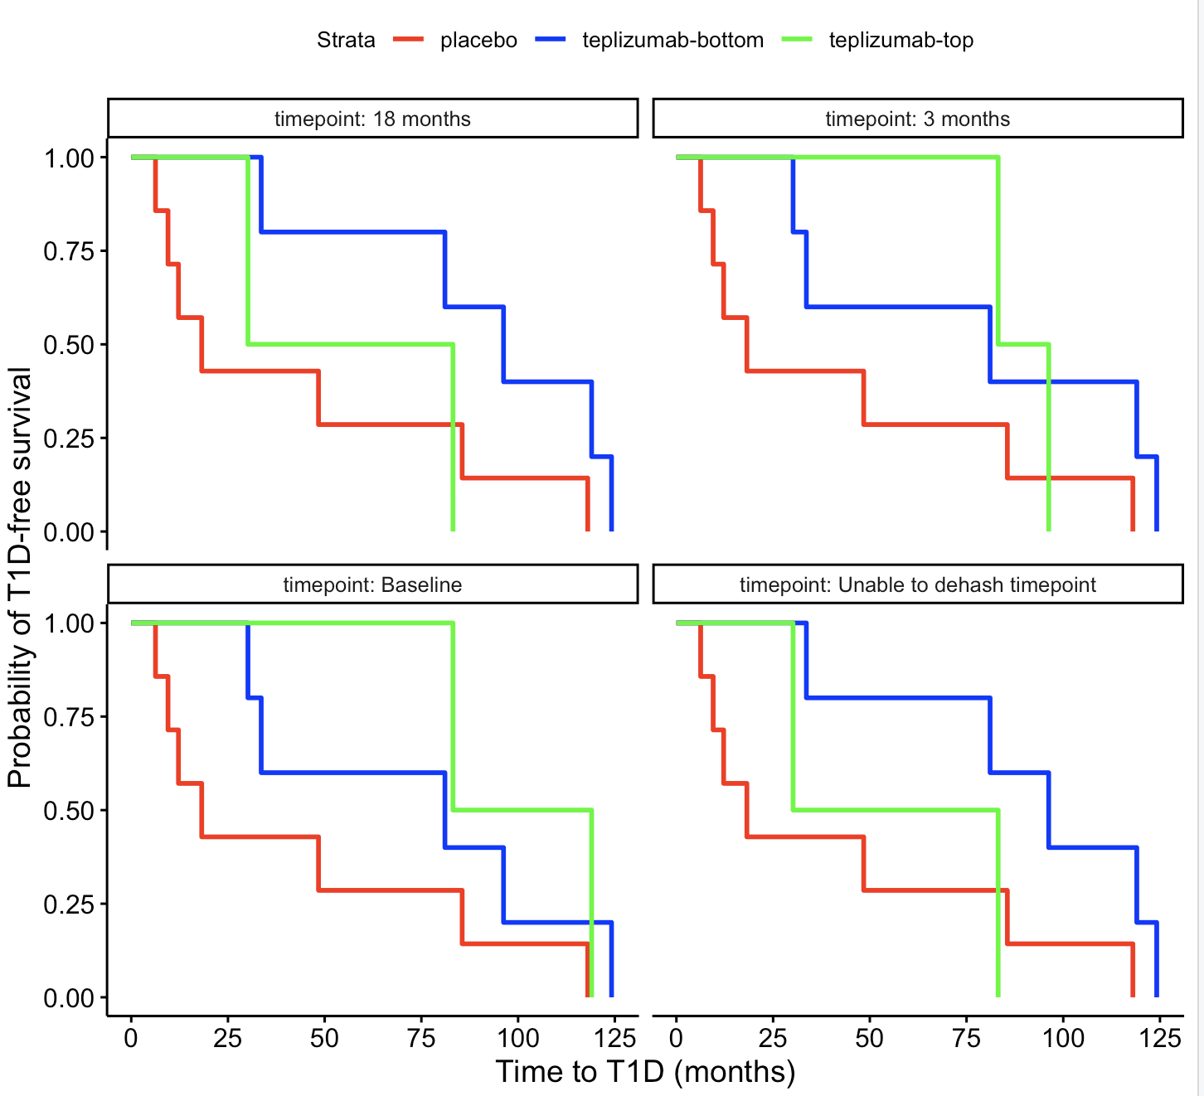
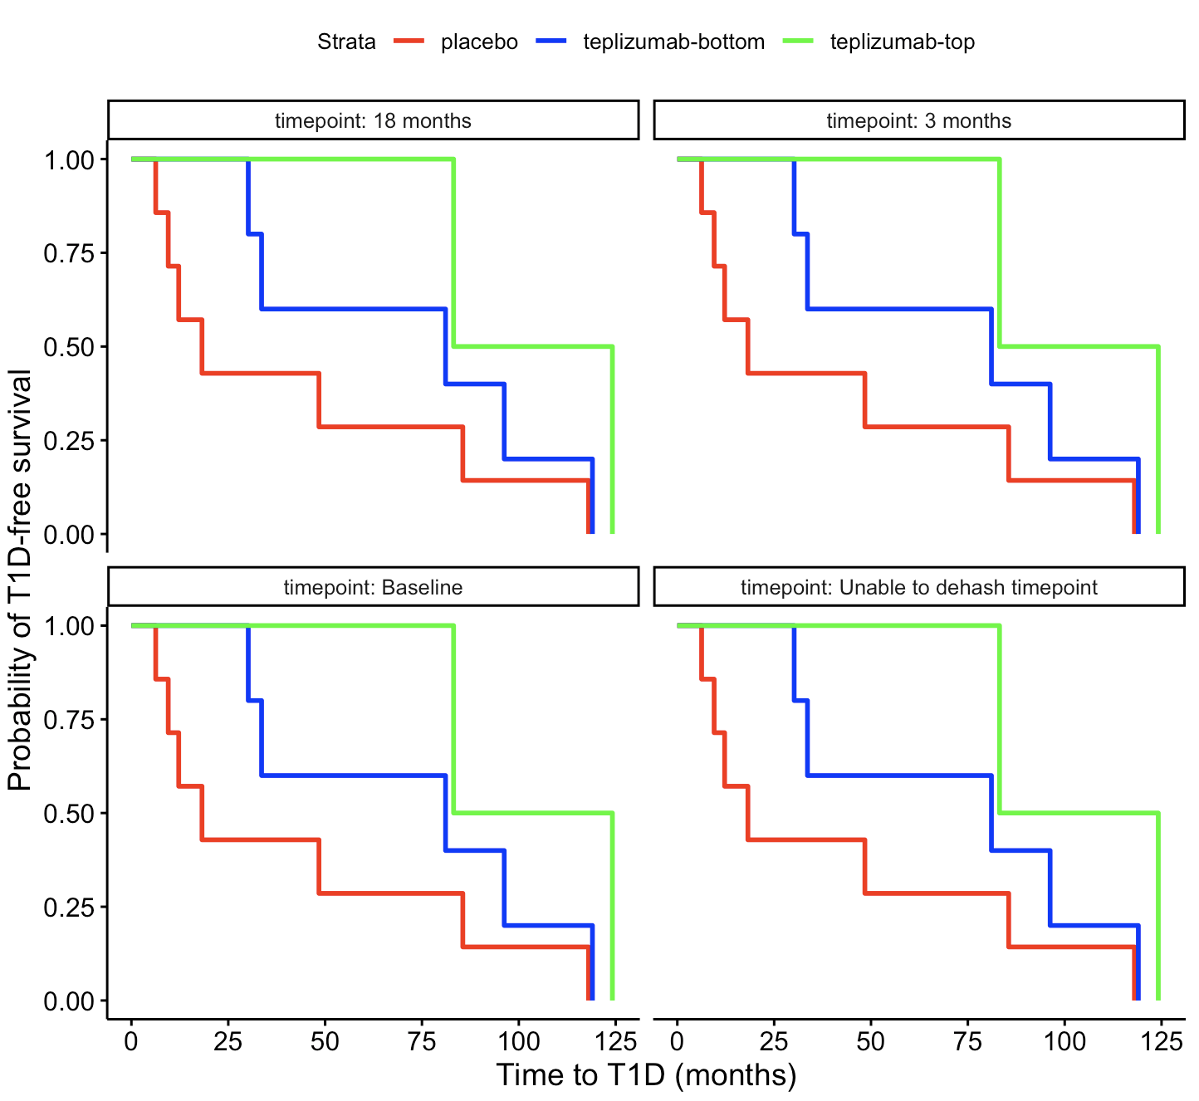
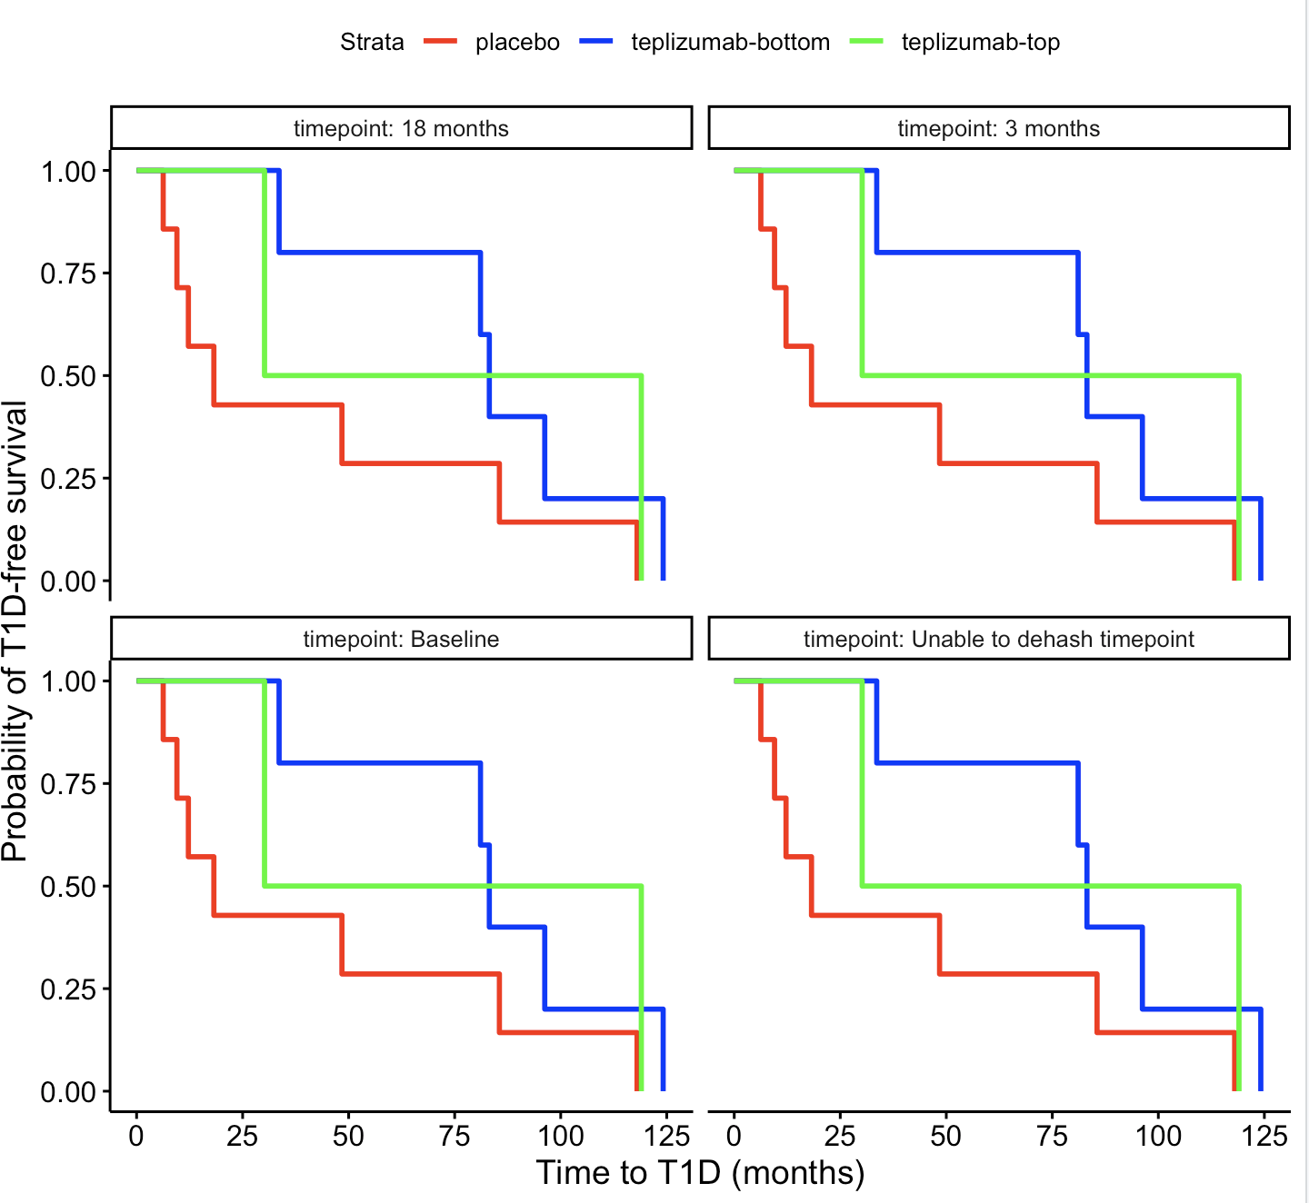
Expression of cluster markers, MAIT module, IL7 module in CD8s don’t seem to relate as expected to T1D-free intervals
TIGIT⁻KLRG1⁺CD127⁺ (T1D/HC cluster) markers
MAIT module
IL7 module
Notes:
Top 1/3 vs bot 2/3 here
Stratification same across timepoints apparently for MAIT module

