Slide 1
Weekly meeting
3-14-2025
Ty Bottorff

Slide 2
Outline
NCI project: KM plots
CD127 project: exhaustion (anti)correlation analysis

Slide 3
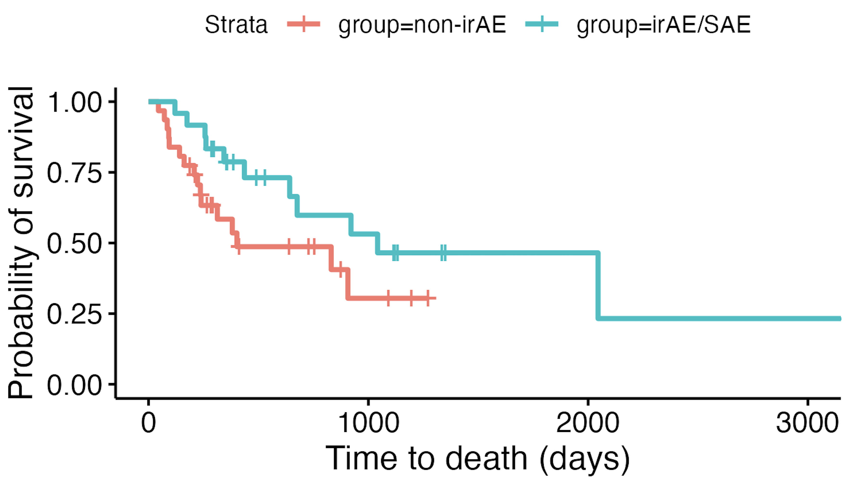
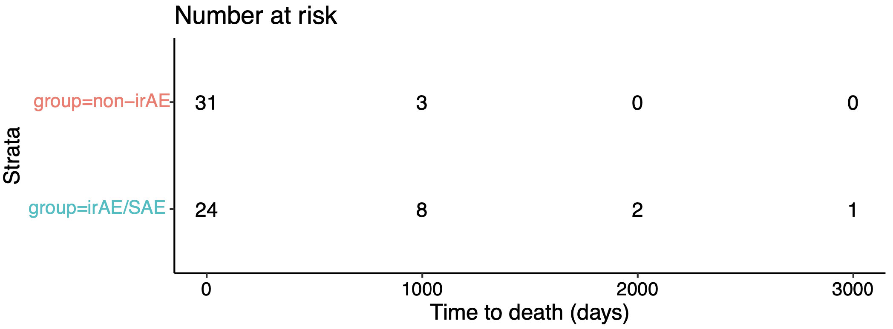
ICI patients with irAEs may die later
p = 0.09
Notes:
Using data lock date as end of study date
Filtered out patients who we lost contact with (don’t know if alive/dead at end date)
No need to take batch into affect here ofc…
Ticks here likely are from patients having different amount of time in study, so ticks mean that’s their last known status date (i.e. entered into study at day -200 from data lock so they have a dash at day 200)

Slide 4
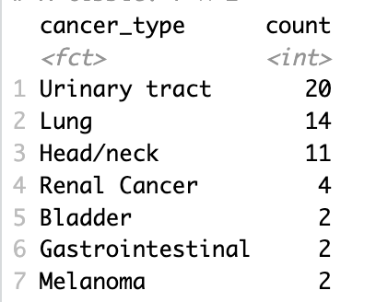
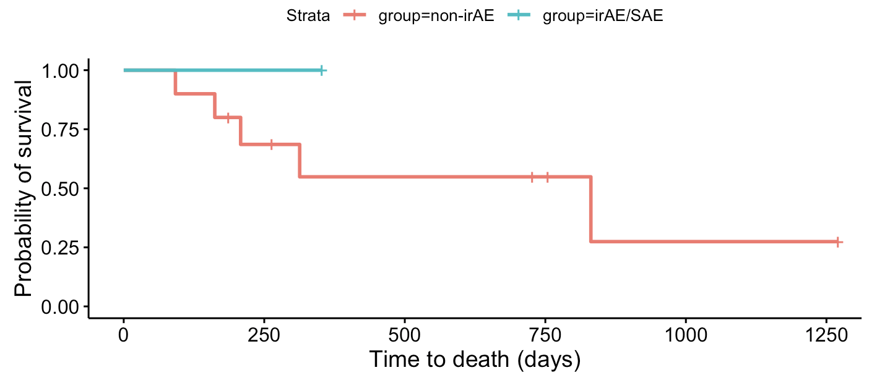
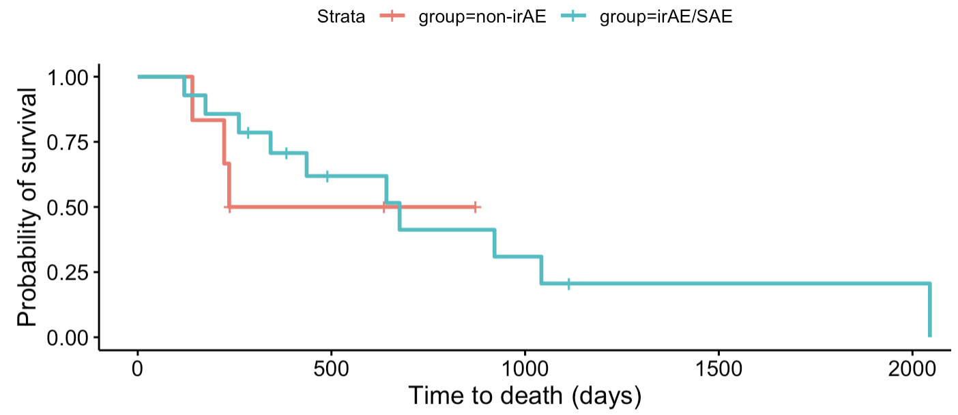
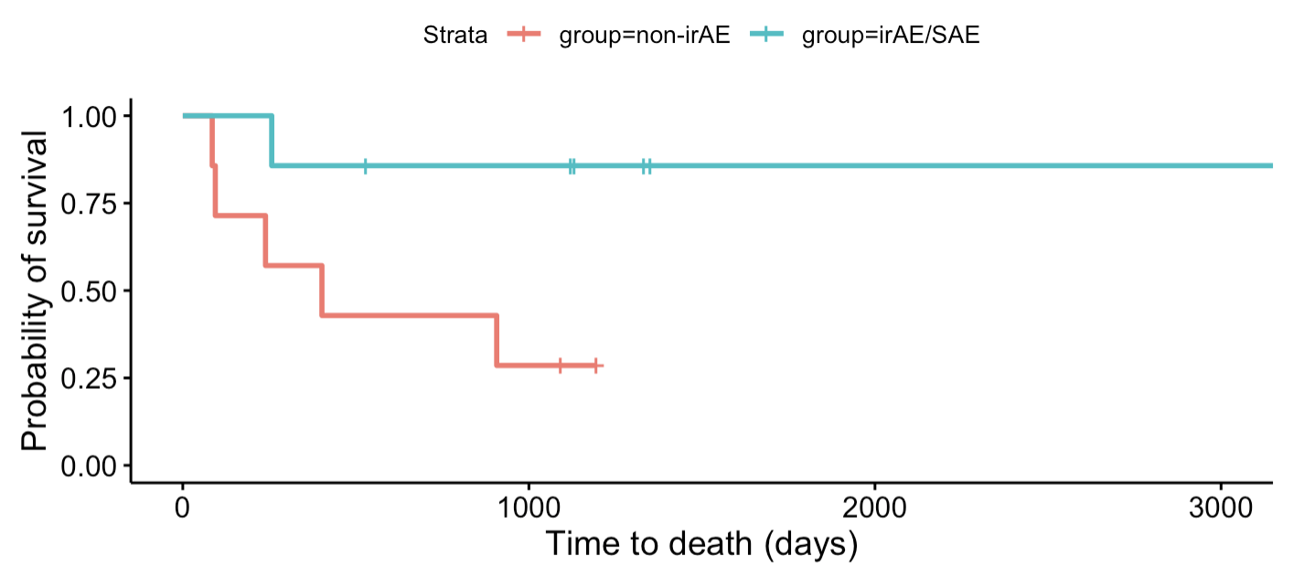
Trend ~holds under different cancer types
Head/neck
Urinary tract
Lung

Slide 5
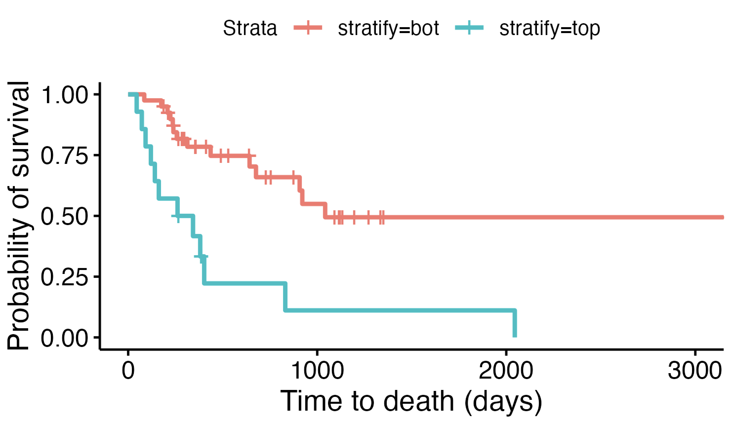
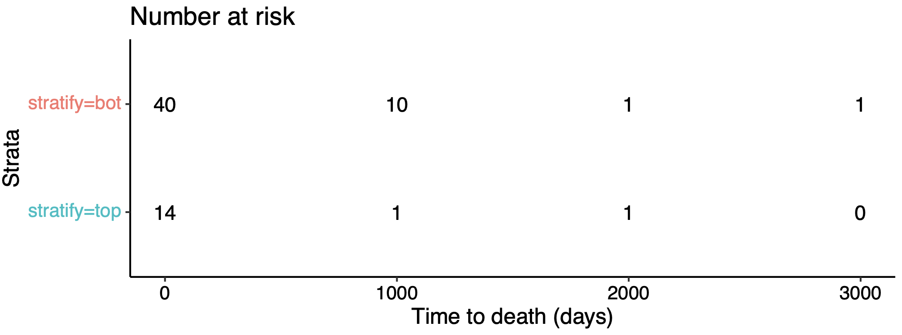
ICI patients with highest baseline frequencies of ICOS⁺ of T_{fh} T_{conv} may die sooner
Bot 75%
Top 25%
padj = 0.07
Notes:
Using data lock date as end of study date
Filtered out patients who we lost contact with (don’t know if alive/dead at end date)
BATCH YES TAKEN INTO ACCOUNT BUT SOME BATCHES ALL ALIVE/DEAD SO… hard for model to account for that
Generally true across non-urinary tract cancers it seems
Ticks here likely are from patients having different amount of time in study, so ticks mean that’s their last known status date (i.e. entered into study at day -200 from data lock so they have a dash at day 200)

Slide 6
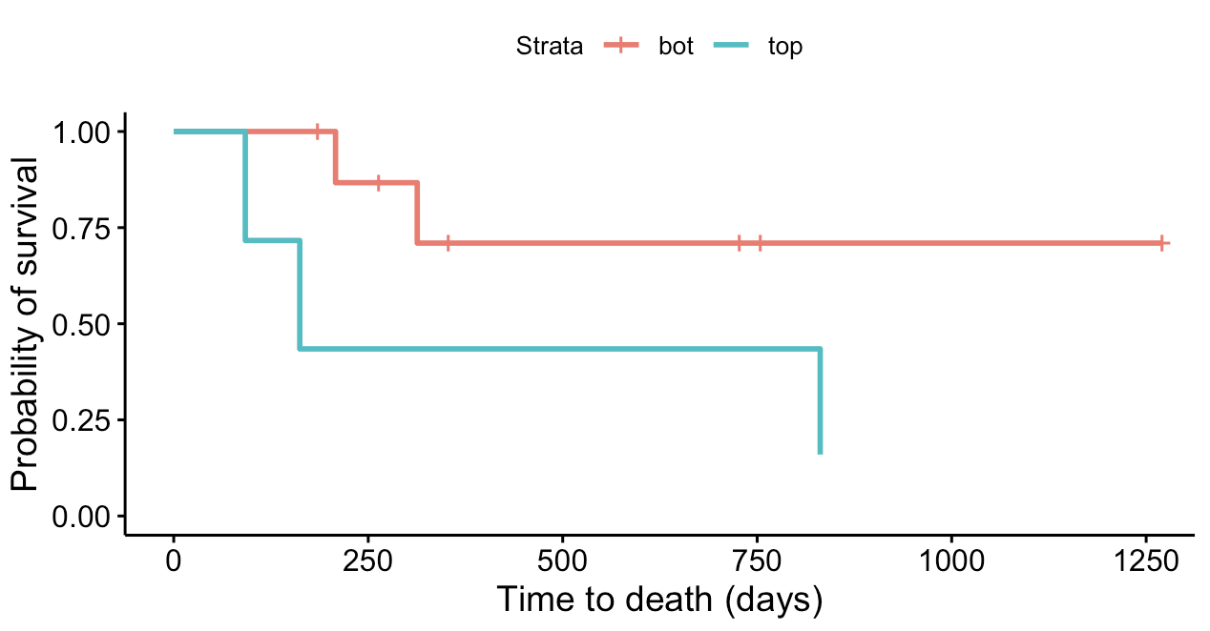
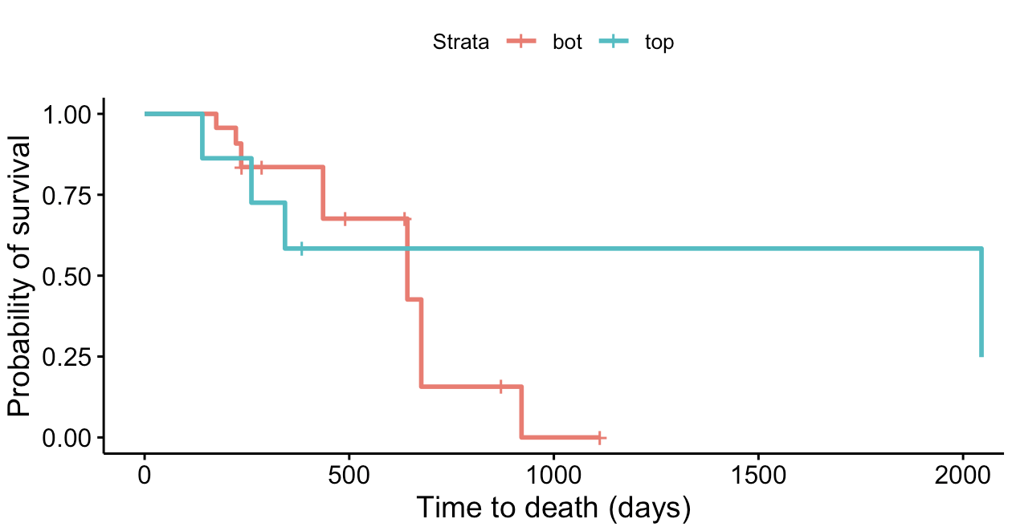
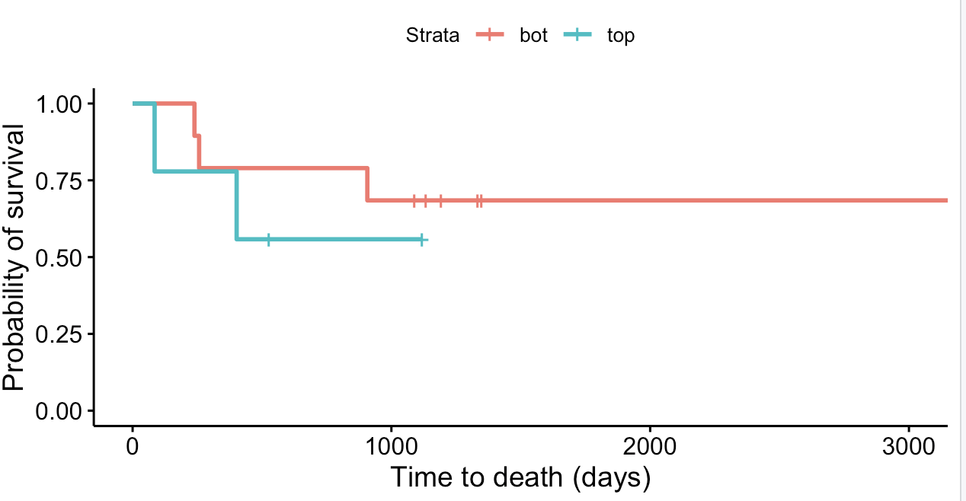
But trend doesn’t hold with urinary tract group
Head/neck
Urinary tract
Lung
Notes:
Did do leave 1 out analyses, this pop is still most significant regardless
CD56bright of NKcells also sig if leaving out head/neck cancer...

Slide 7
CD127 correlation analysis: method
Pseudobulk by donor
Compare gene expression at timepoint X to DP frequency at same timepoint or delta in DP frequency from timepoint X to X+1
X being baseline, 3 months, or 6 months

Slide 8
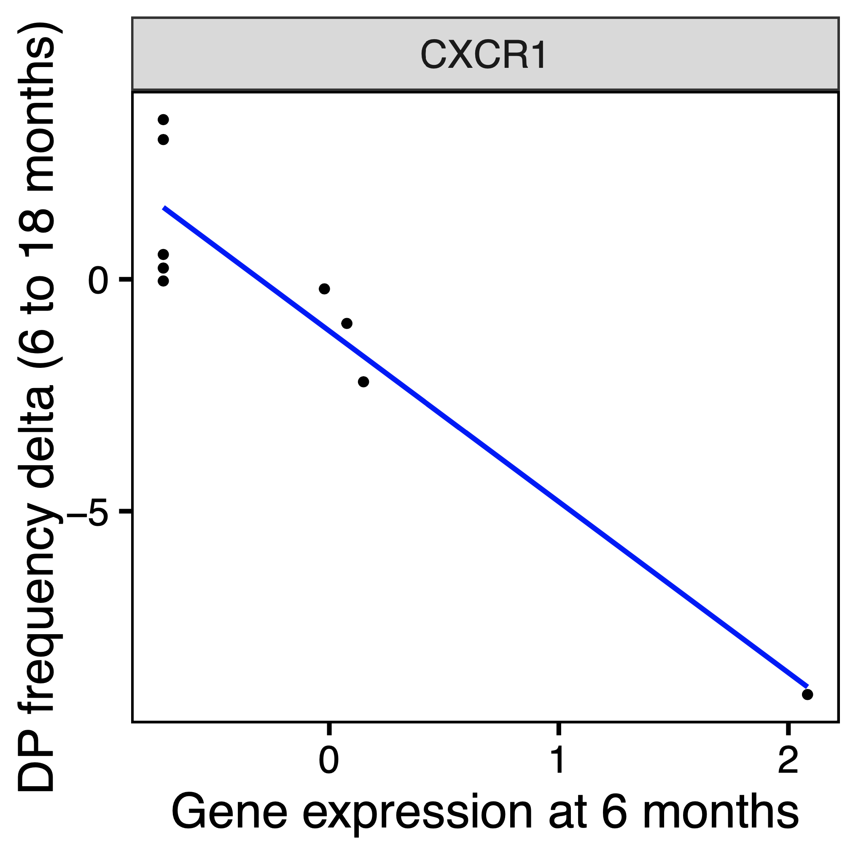
CXCR1 expression at 6 months inversely correlates with change in DP frequency (6 to 18 months)
~*
padj < 0.15: ~*
P348-2 (Kirsten’s scRNAseq)

Slide 9
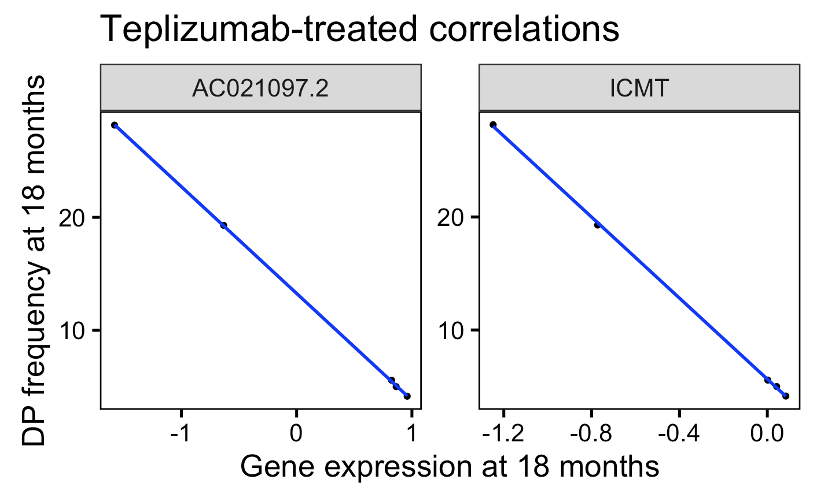
ICMT expression at 18 months inversely correlates with DP frequency at 18 months
*
~*
padj < 0.1: ~*
padj < 0.05: *
Kevan Herold’s scRNAseq

Slide 10
Conclusions
NCI
ICI patients with irAEs may die later
ICI patients (especially those without urinary tract cancer) with highest baseline frequencies of ICOS⁺ of T_{fh} T_{conv} may die sooner
CD127
There are genes whose expression ~significantly (anti)correlates with (change in) DP frequency at the same timepoint → Josh (CXCR1, ICMT)
Notes:
We do have pbmc, serum, plasma and tempus (whole blood RNA) samples from each study visit apparently, could propose unbiased autoAb profiling!
None of these genes for CD127 correlation analysis overlap with MAIT genes or IME cluster markers

Slide 11
Next steps
Help Josh w/ stats for changes in DP stratified by baseline CD127⁺ levels

