Slide 1
Monthly update
11 17 2023
Ty Bottorff

Slide 2
Outline
Hypothesis
Cohort info/paper intro
Methods
TCR feature analysis
Next steps

Slide 3
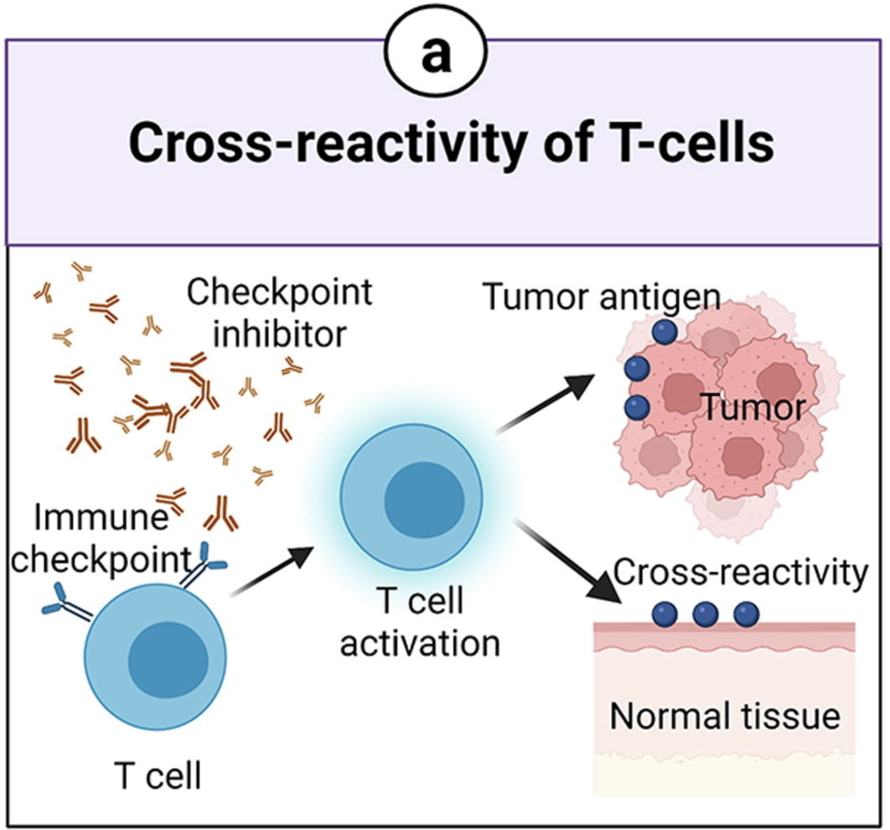
Hypothesis: irAEs might arise due to expansion of cross-reactive T cells reacting to both tumor and self
Use TCR features as a proxy for cross-reactivity, study how TCR repertoire features change during ICB
Hydrophobicity: more hydrophobic TCRs might be more cross-reactive
Germline-ness: more germline-like TCRs might be more cross-reactive as they have lower sequence complexity
Length
Notes:
Picture from Advanced materials for management of immune-related adverse events induced by immune checkpoint inhibitors
We want to confirm that TCR expansion is directly related to irAE development

Slide 4
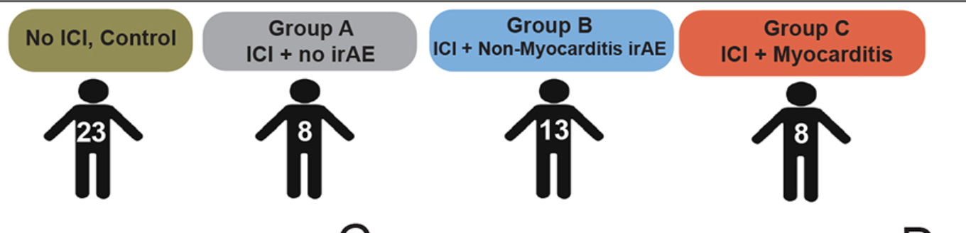
Identification of Pathogenic Immune Cell Subsets Associated with Checkpoint Inhibitor-induced Myocarditis

Slide 5
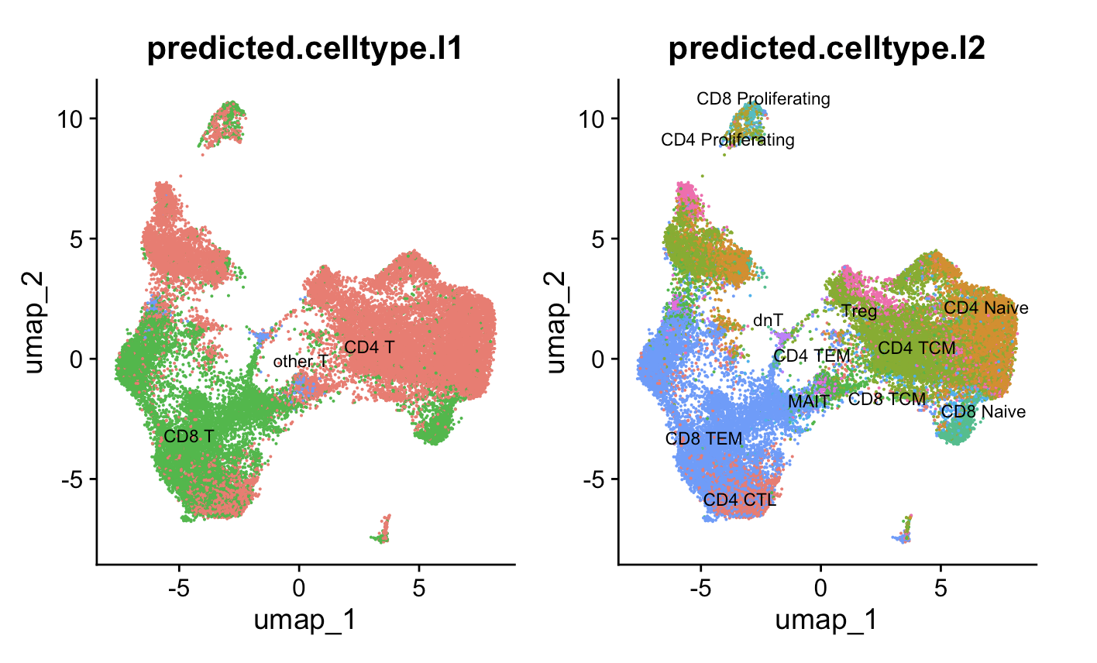
Seurat reference mapped cell types, just looked at T cells in myocarditis dataset
Notes:
MAITs: Mucosal-associated invariant T cells (MAIT cells) make up a subset of T cells in the immune system that display innate, effector-like qualities. MAIT cells constitute a subset of αβ T lymphocytes characterized by a semi-invariant T cell receptor alpha (TCRα) chain. The TCRα originates from the rearrangement of TCRα variable (V) and joining (J) gene segments TRAV1-2/TRAJ12/20/33 during VDJ recombination in the nucleus. However, TRAJ33 is expressed more often than TRAJ12 and TRAJ20.^{[3][9]} With little diversity in the TCRα chain, the TCR is more conserved in MAIT cells than in other T cell subsets. In addition, the TCRα chain can combine with a restricted number of possible TCRβ chains to form a functional MAIT cell TCR, further limiting TCR diversity.^{[10]}

Slide 6
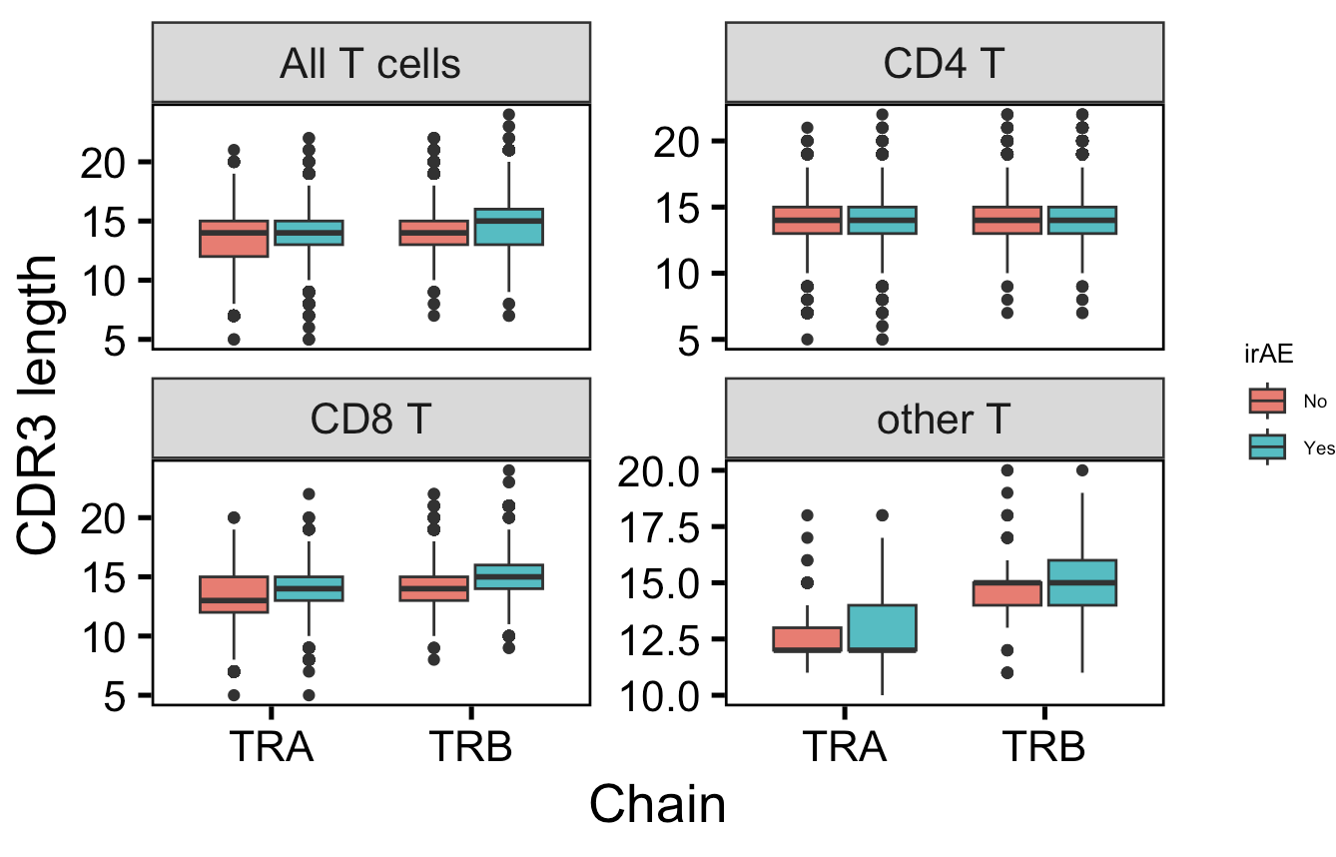
Across all CD8 TCRs in myocarditis dataset, CDR3s are longer in those developing irAEs
*
**
n.s
n.s
n = 7,324
n = 10,926
n = 11,886
n = 18,250
**
**
n.s
*
n = 4,418
n = 7,120
n = 144
n = 204
Notes:
other T includes double negative T (dnT), MAITs
this is consistent with past results before QC/aberrant TCR exclusion

Slide 7
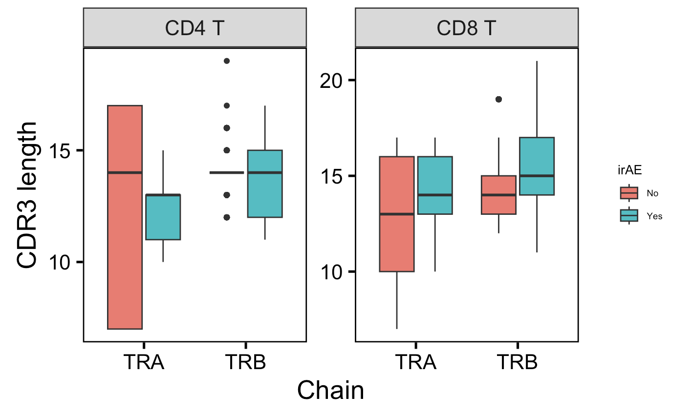
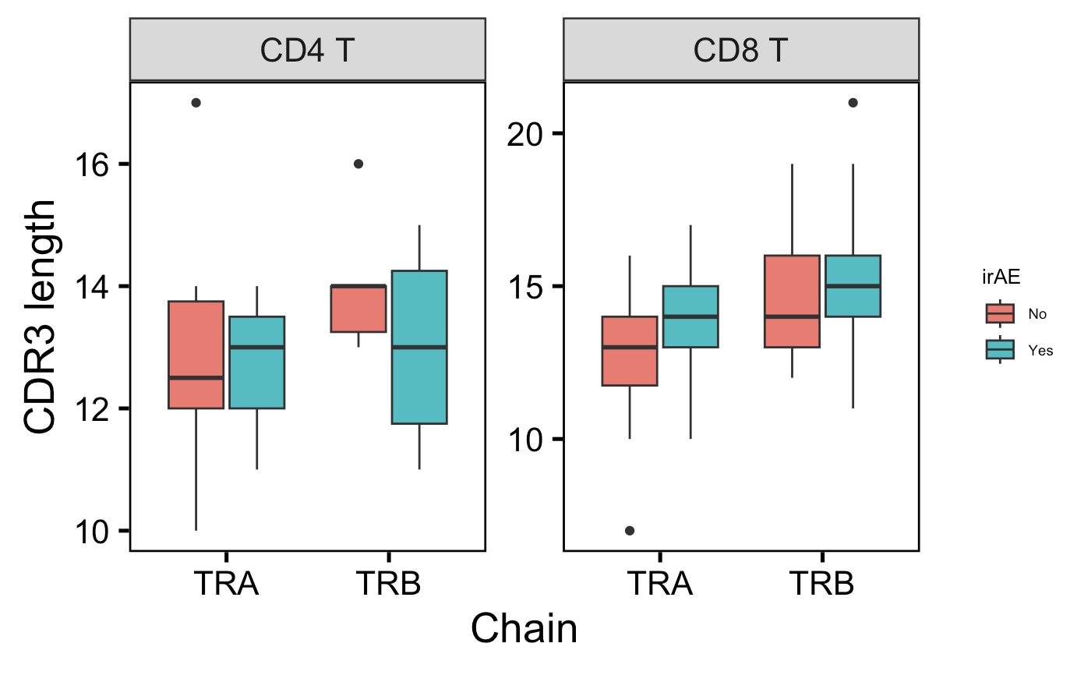
Within (unique) highly expanded T cells, still observe longer CD8 TRA CDR3s with irAEs
All highly expanded TCRs
Unique highly expanded TCRs
*
*
**
**
n.s.
n.s.
n.s.
p = 0.06
n = 616
n = 133
n = 623
n = 148
n = 1,777
n = 3,446
n = 1,790
n = 3,557
n = 6
n = 3
n = 6
n = 4
n = 20
n = 54
n = 20
n = 54
Notes:
Counts > 20

Slide 8
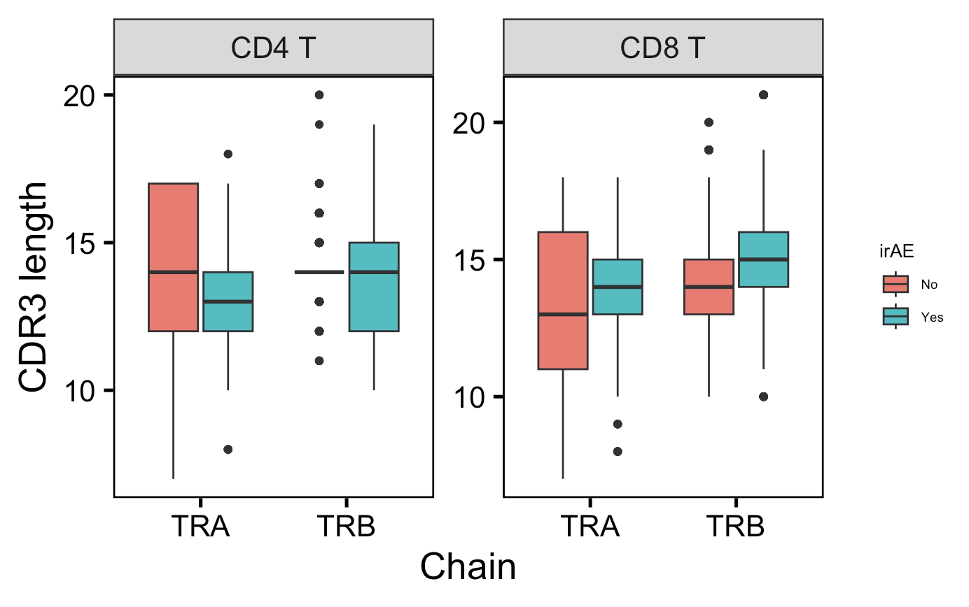
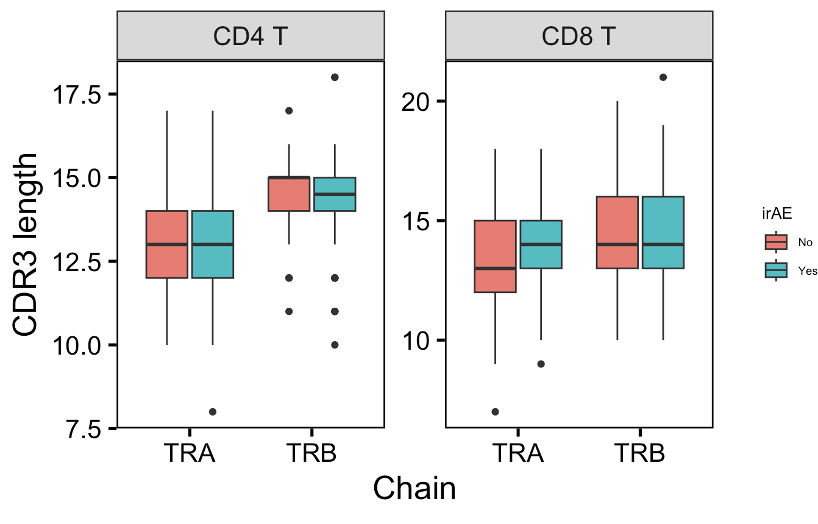
Within (unique) differentially encountered TCRs between yes/no irAEs, still generally observe longer CD8 TRA CDR3s with irAEs
Most differentially encountered TCRs
Between yes/no irAEs
Unique most differentially encountered TCRs
Between yes/no irAEs
p = 0.07
*
**
**
n.s.
n.s.
p = 0.19
n.s.
n = 861
n = 475
n = 797
n = 395
n = 2,556
n = 4,984
n = 2,535
n = 4,970
n = 62
n = 113
n = 37
n = 54
n = 138
n = 289
n = 123
n = 269

Slide 9
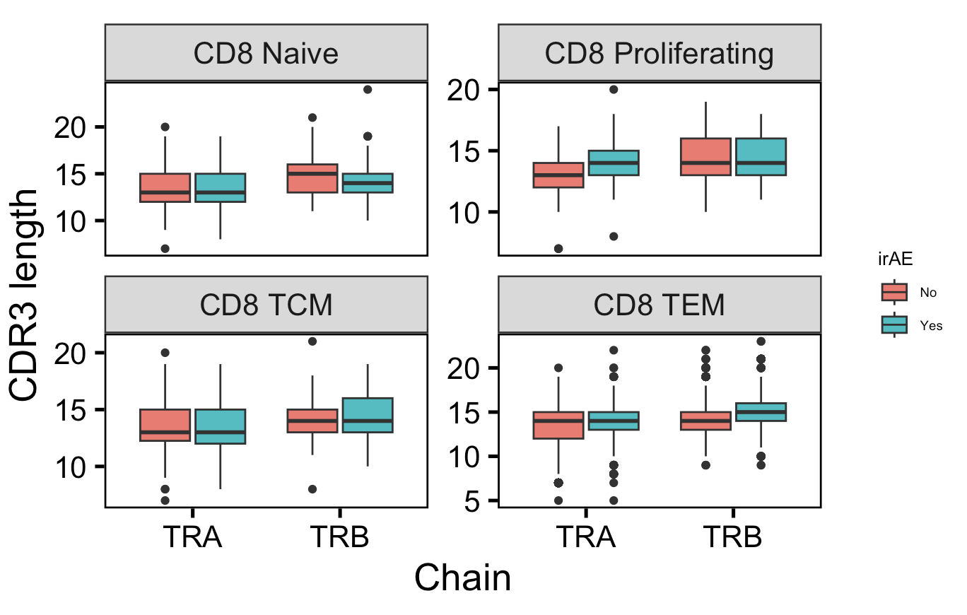
CD8 TEMs follow bulk CD8 pattern for both chains, as do proliferating CD8s for TRA, but naïve CD8s TRB opposite general CD8 length trend
n = 421
n = 428
n.s.
n.s.
n = 31
n = 121
*
*
n.s.
*
**
**
n = 202
n = 280
n = 3,764
n = 6,291

Slide 10
Conclusions
Proliferating and TEM CD8 TRA CDR3s longer in patients developing irAEs

Slide 11
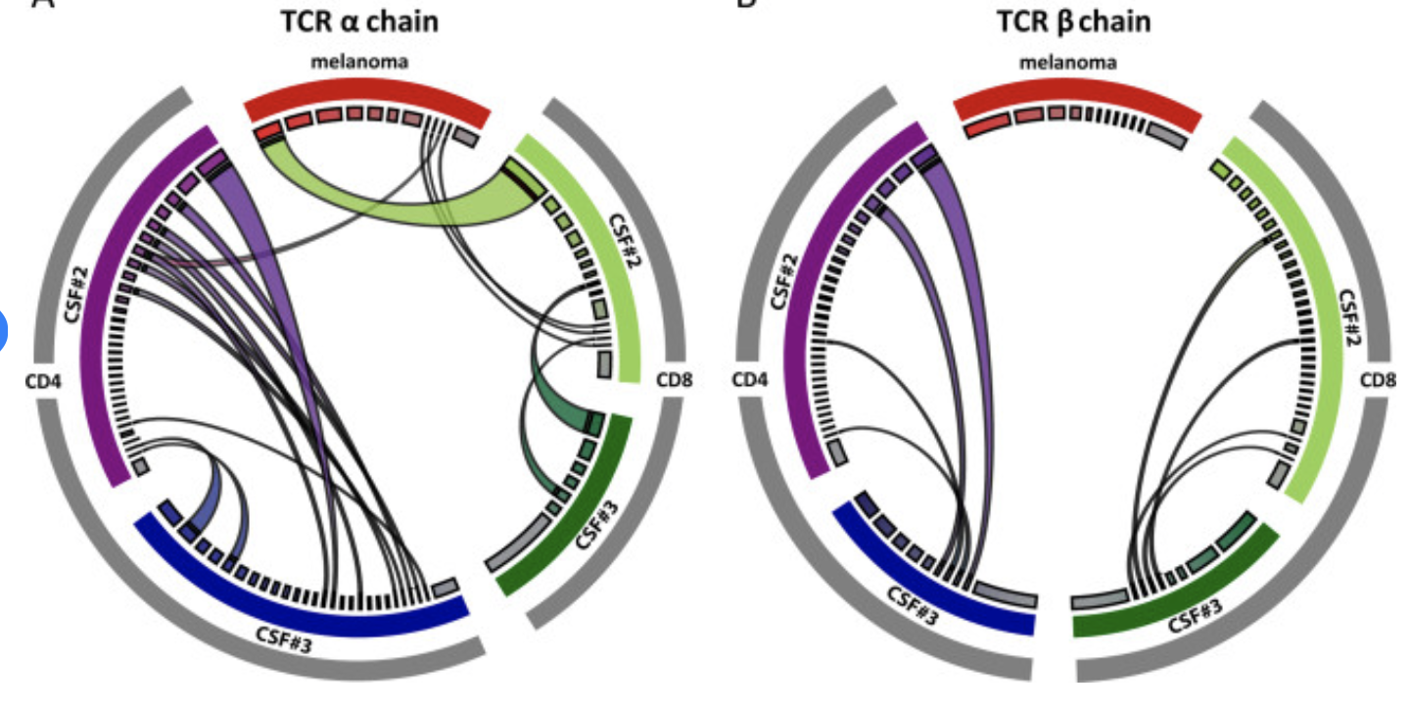
Next steps
Circos plot
GLIPH: find AA motifs differentially encountered in yes vs. no irAEs to pinpoint feature analysis
More feature analyses
IGoR probability of generation
IMGT/HighV-Quest mutation statistics
CDR3 AA charge, volume, polarity
Focusing on central 5 AA of CDR3
Predicted energy of CDR3-pMHC interaction across diverse pMHCs

Slide 12
Side project for Nidhi
Plan for bulk RNAseq analysis
Find differentially expressed genes between +/- ICB treatment, overlay onto UMAP
Find differentially expressed genes between +/- severe irAE development, overlay onto UMAP

