Slide 1
Weekly meeting
8 8 2024
Ty Bottorff

Slide 2
Outline
AbATE DN outlier analyses

Slide 3
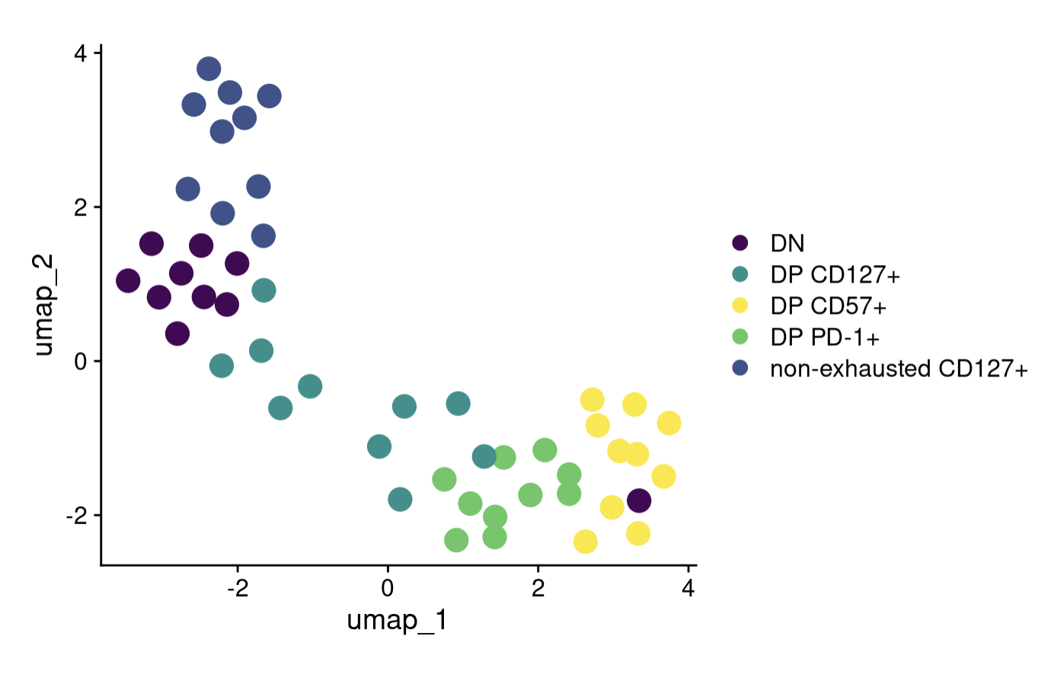
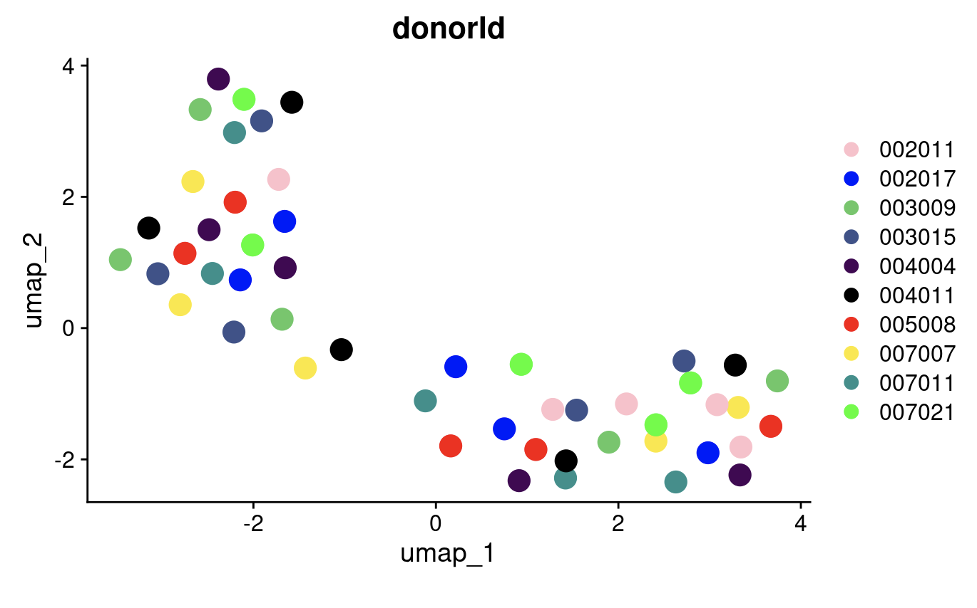
Outlier DN (donorId 002011): 4/5 donor sorts cluster ~closer than other donors’ sorts
Notes:
Perhaps that donor’s DNs were just much less DN and much more DP whatever than other donors’ DNs… hard to believe in bulk though…

Slide 4
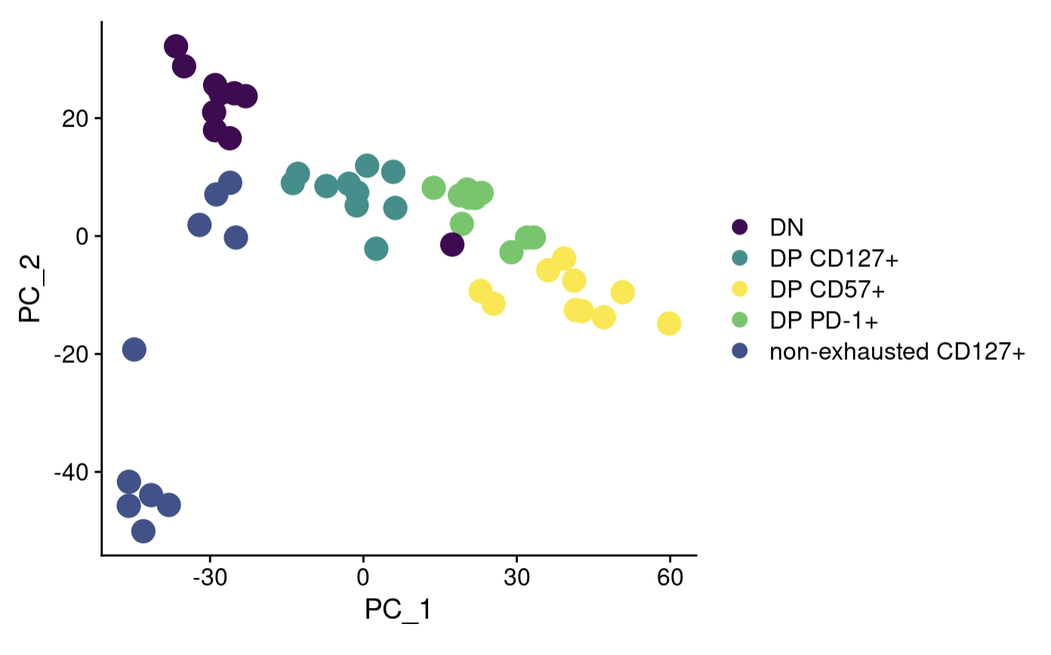
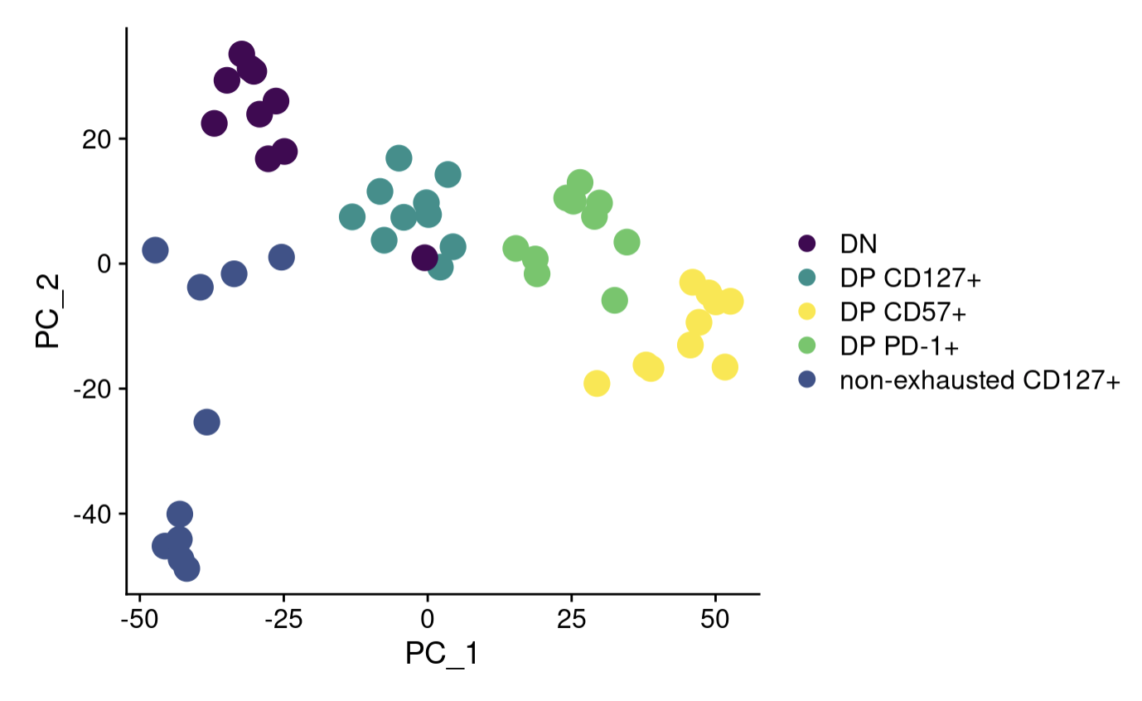
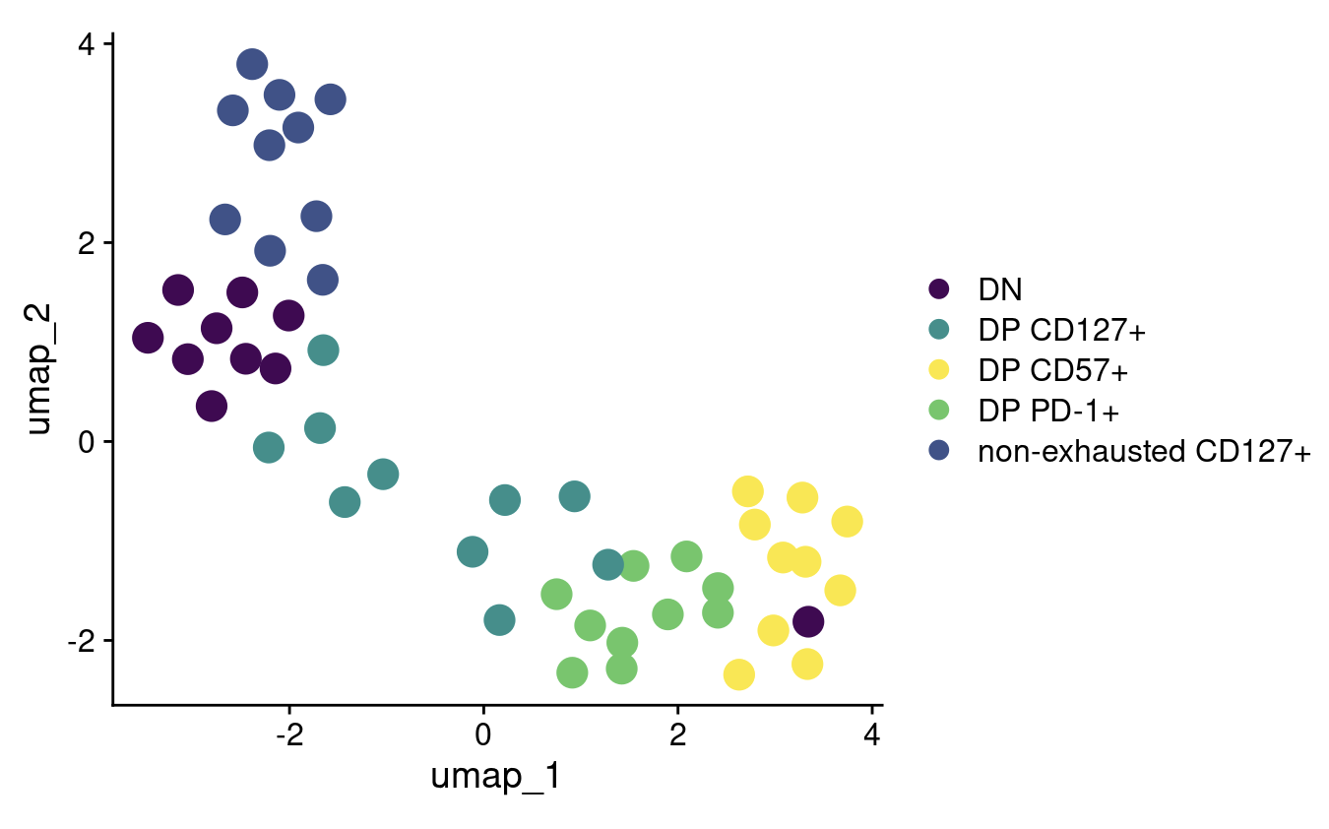
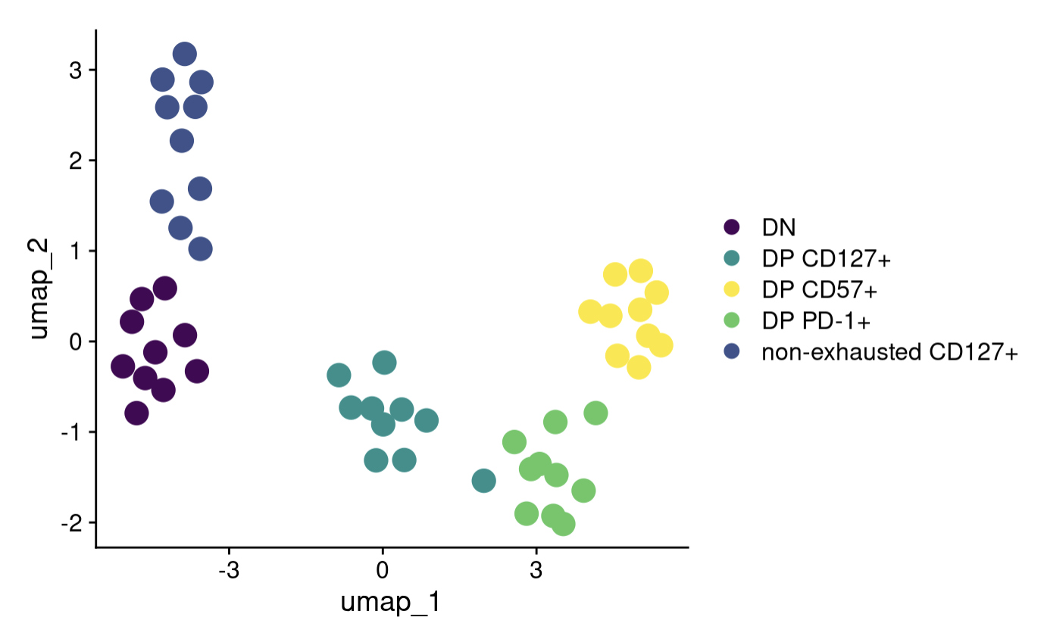
Regressing out donorId and responder status (had done in DiffBind but hadn’t done in Seurat)
Not regressed out
Regressed out
Notes:
Perhaps that donor’s DNs were just much less DN and much more DP whatever than other donors’ DNs… hard to believe in bulk though…
Diffbind did regress out/block for responder status (and replicate), replicate symmetric (not right word but mapped 1:1 to) with donorId, so diffbind regressing out/blocking is fine! It’s just that I forgot to do this in Seurat

Slide 5
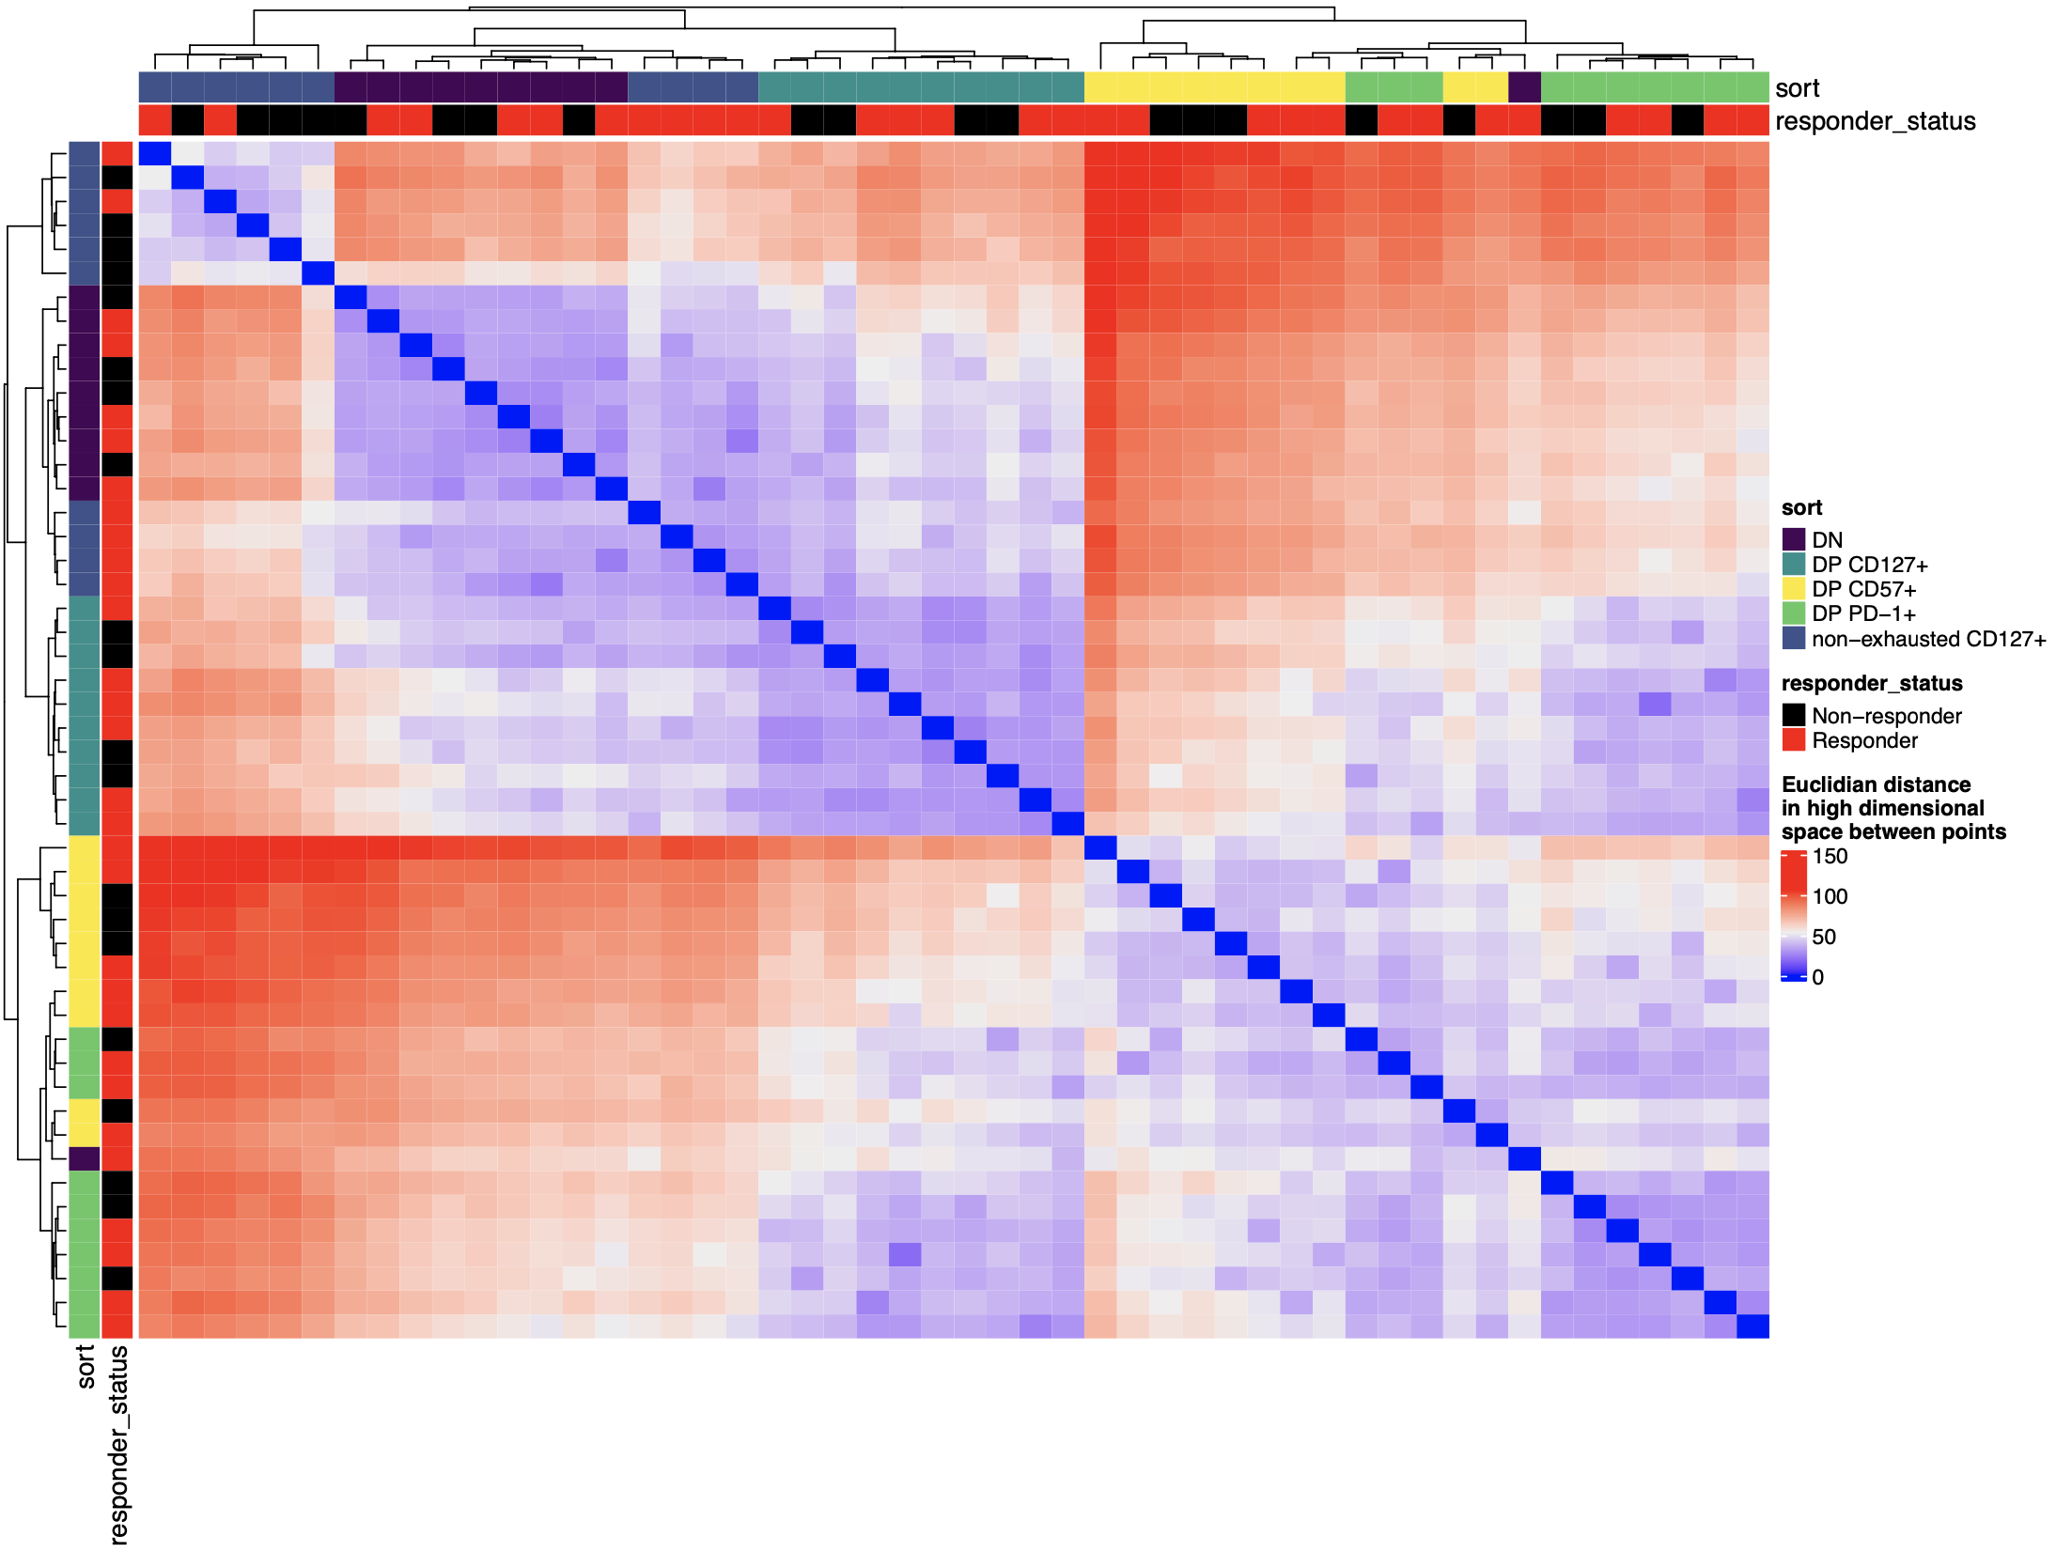
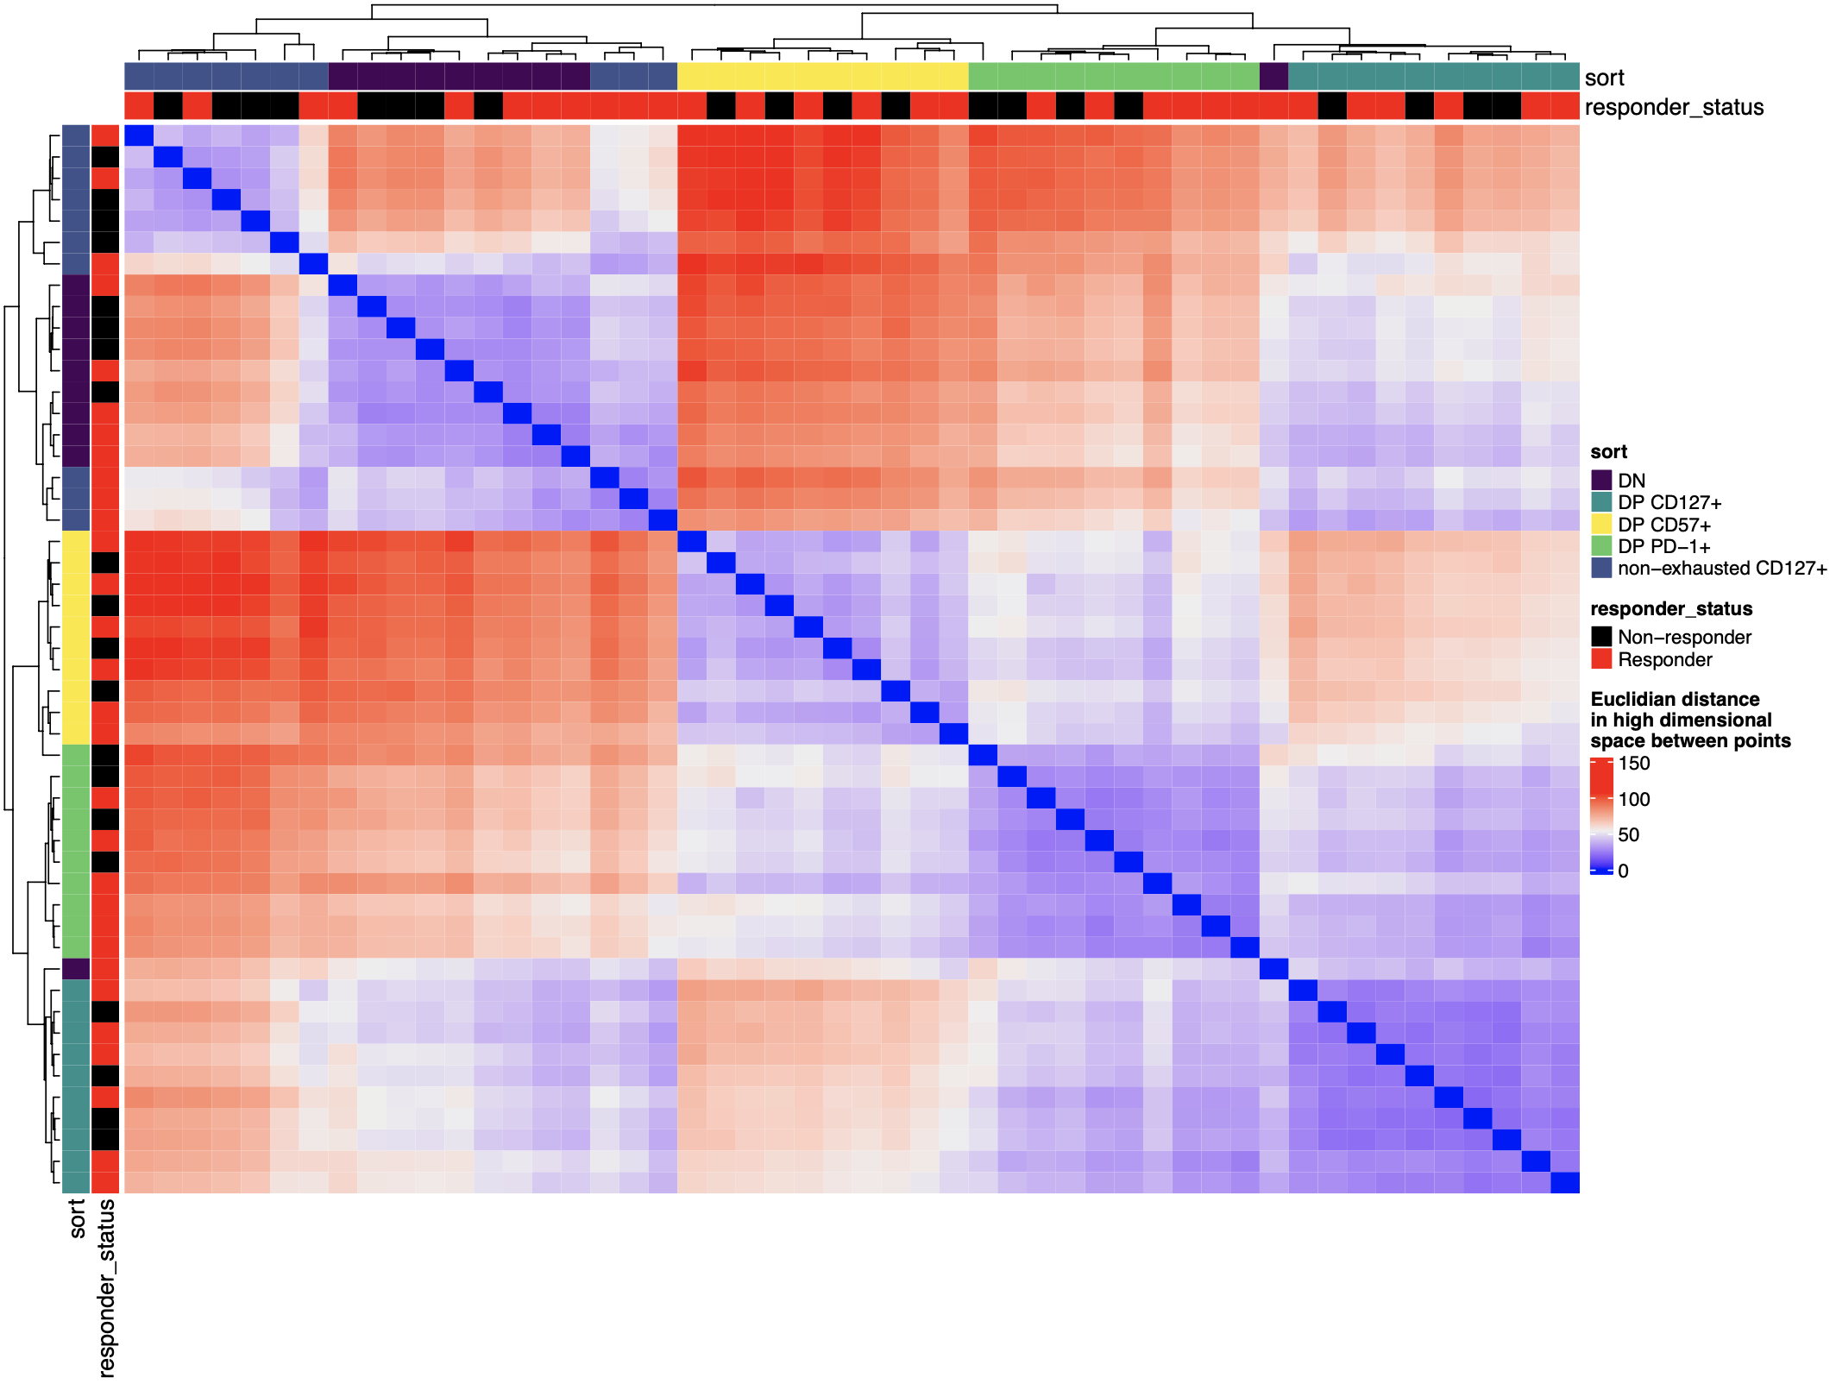
Outlier DN still outlier when looking at top 2000 variably accessible regions in high dimensional space, even after regressing out donorId & responder status
Not regressed out
Regressed out

Slide 6
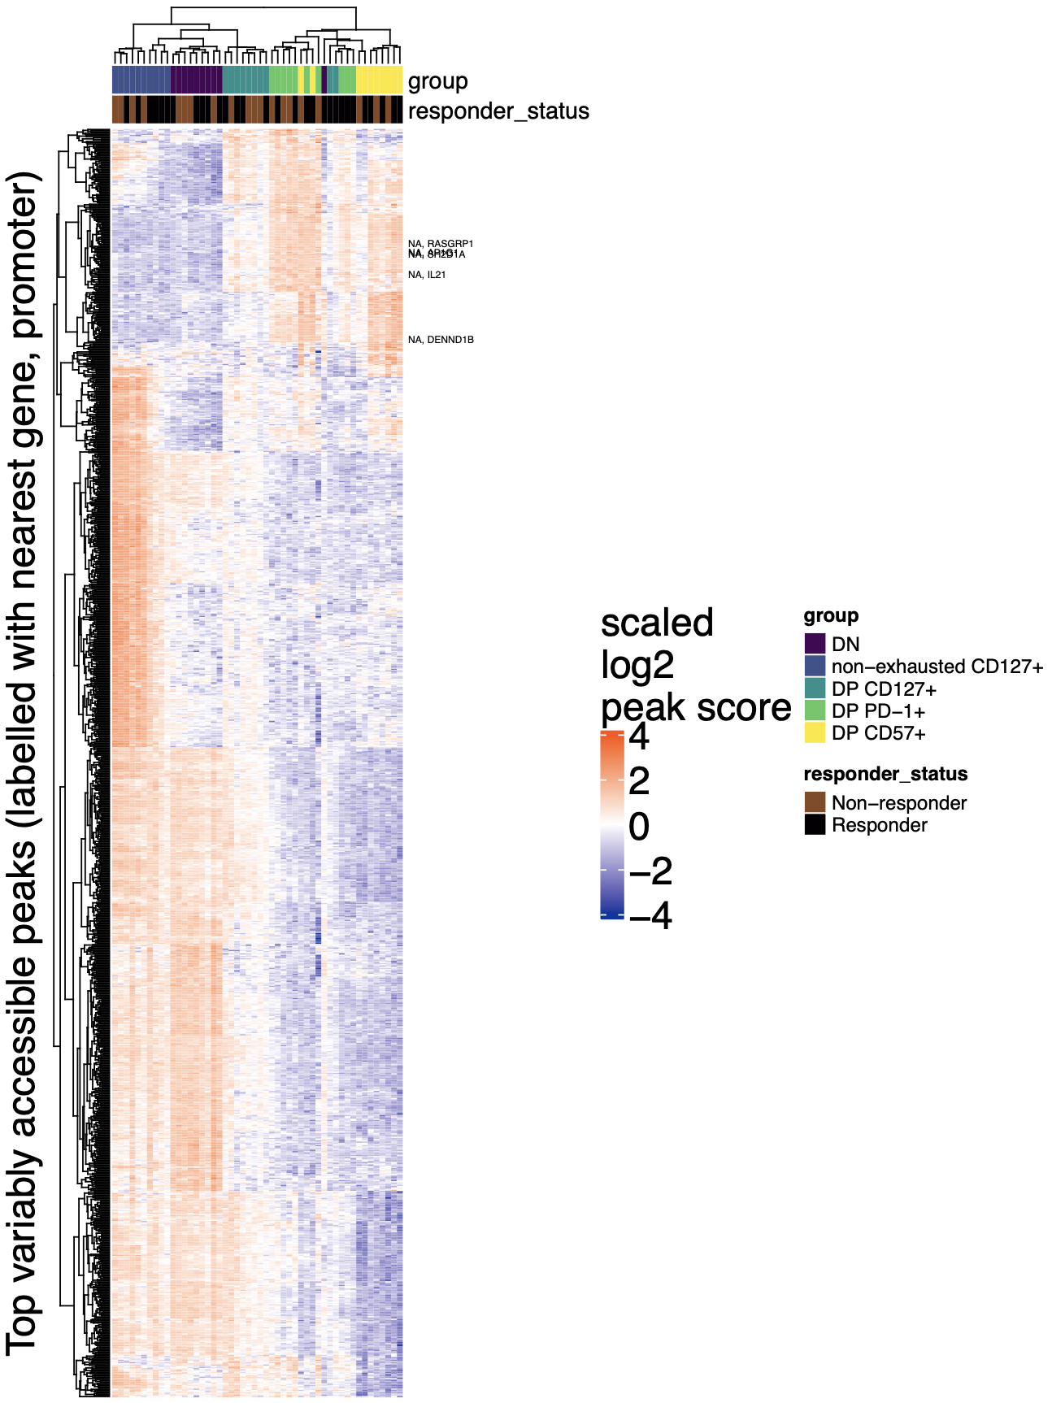
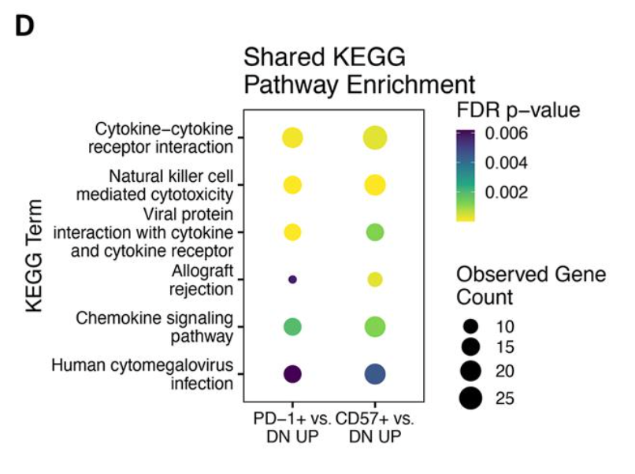
Peaks near promoters related to positive regulation of NK/lymphocyte-mediated cytotoxicity/immunity more accessible in DP CD57⁺/DP PD-1⁺ clusters
Enrichment in this top block
Positive regulation of lymphocyte mediated immunity
IL21, SH2D1A, RASGRP1, AP1G1, DENND1B (5/116)
FDR: 0.02
Positive regulation of NK cell mediated cytotoxicity
IL21, SH2D1A, RASGRP1, AP1G1 (4/27)
FDR: 0.007
Consistent with Erin’s
Notes:
Not the most correct method here, summing peaks from 10 pairwise contrasts (to get ~1000 peaks) rather than the more correct way of finding variably accessible peaks from Seurat code stuffs, but this is consistent with Erin’s so not too worried

Slide 7
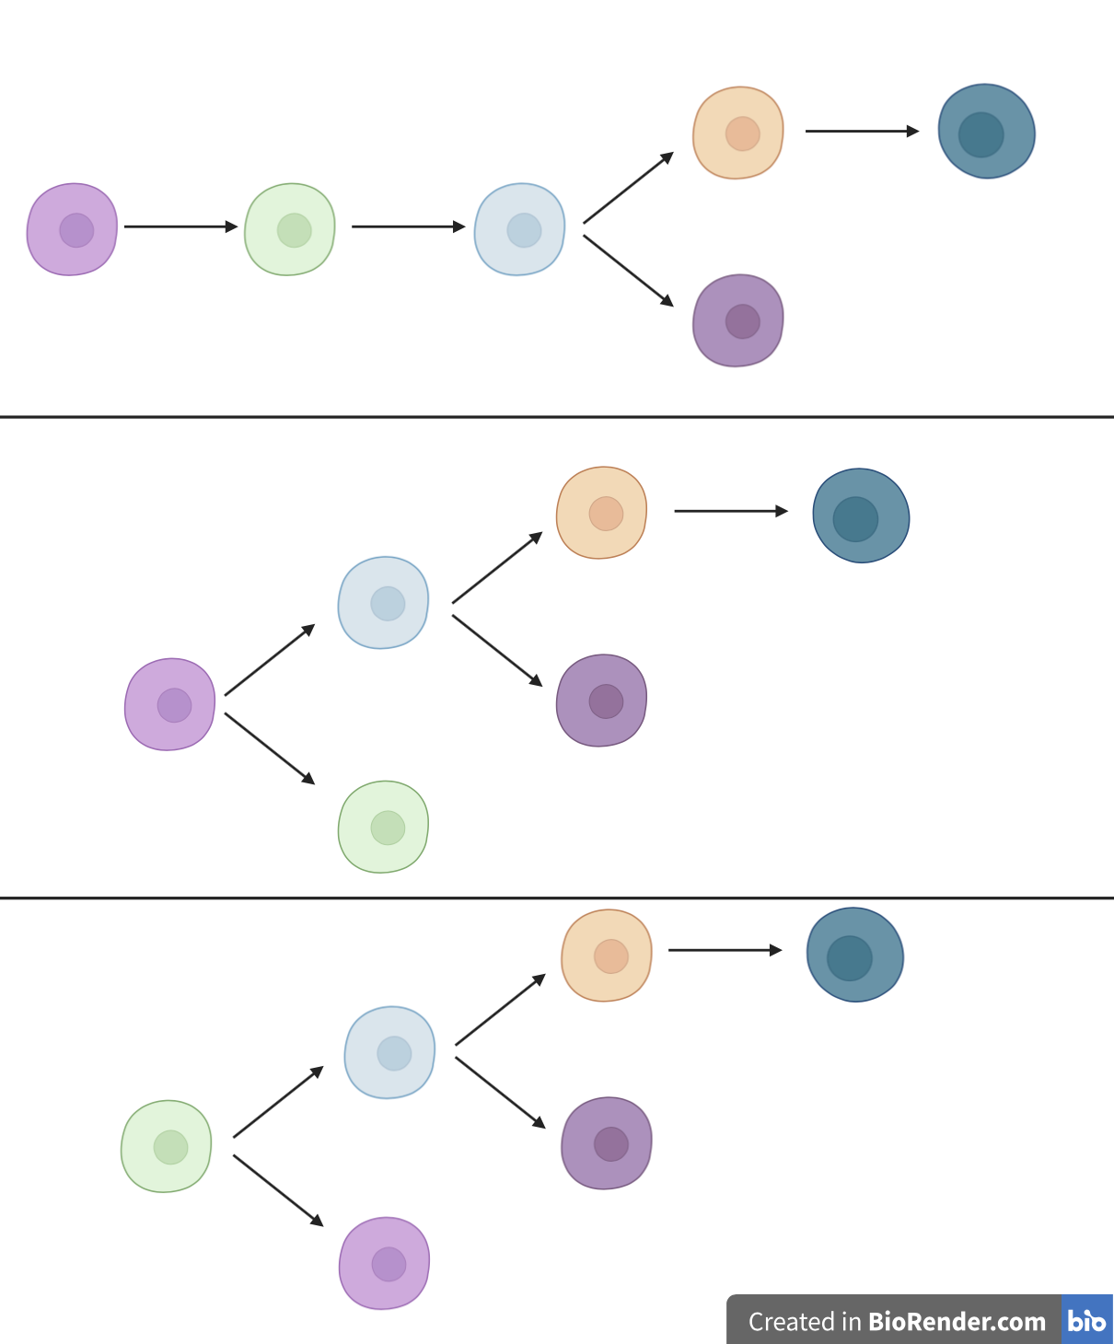
Conclusions
TIGIT⁺
KLRG1⁺
(DP)
DP PD-1⁺
DP CD57⁺
Non-exhausted
CD127⁺
TIGIT⁻
KLRG1⁻
DP
CD127⁺
AbATE: still didn’t observe pseudotime associating with cell sort (data not shown)
T1DAL: var freq (high vs. low) didn’t matter much for sharing across time points (data not shown)
DP CD127⁺ being parent or sister to other DPs is ambiguous from nuclear ATACseq data, leaning sister from MT variants being no different between DP CD127⁺ & DP PD-1⁺ (and this is consistent with IL7R blockade being efficacious in T1D)
Non-exhausted CD127⁺ or DN being parent/daughter is yet unknown (their MT variant levels aren’t different)
Notes:
Not drawing a DN → nonexh → DPs linear path because we don’t observe that in UMAP/PCA plots, but it could also be possible…

Slide 8
Next steps
Analyzing additional AbATE reads as soon as sequenced/aligned
Preparing poster for BRI retreat (all abstracts make a poster?)
scATACseq for MT variant-based lineage mapping
authors from this paper recommended working backwards from rare variant frequency threshold to get cell numbers (i.e. with a lower bound variant frequency of 0.0005 then want 2,000 cells per sort per replicate, presumably?), that’s already lower bound than lowest bound I have looked at/showed results for… so maybe we don’t need (many) more cells for scATACseq than bulk ATACseq…
might ask around BRI for/download public scATACseq data eventually to practice lineage mapping

Slide 9
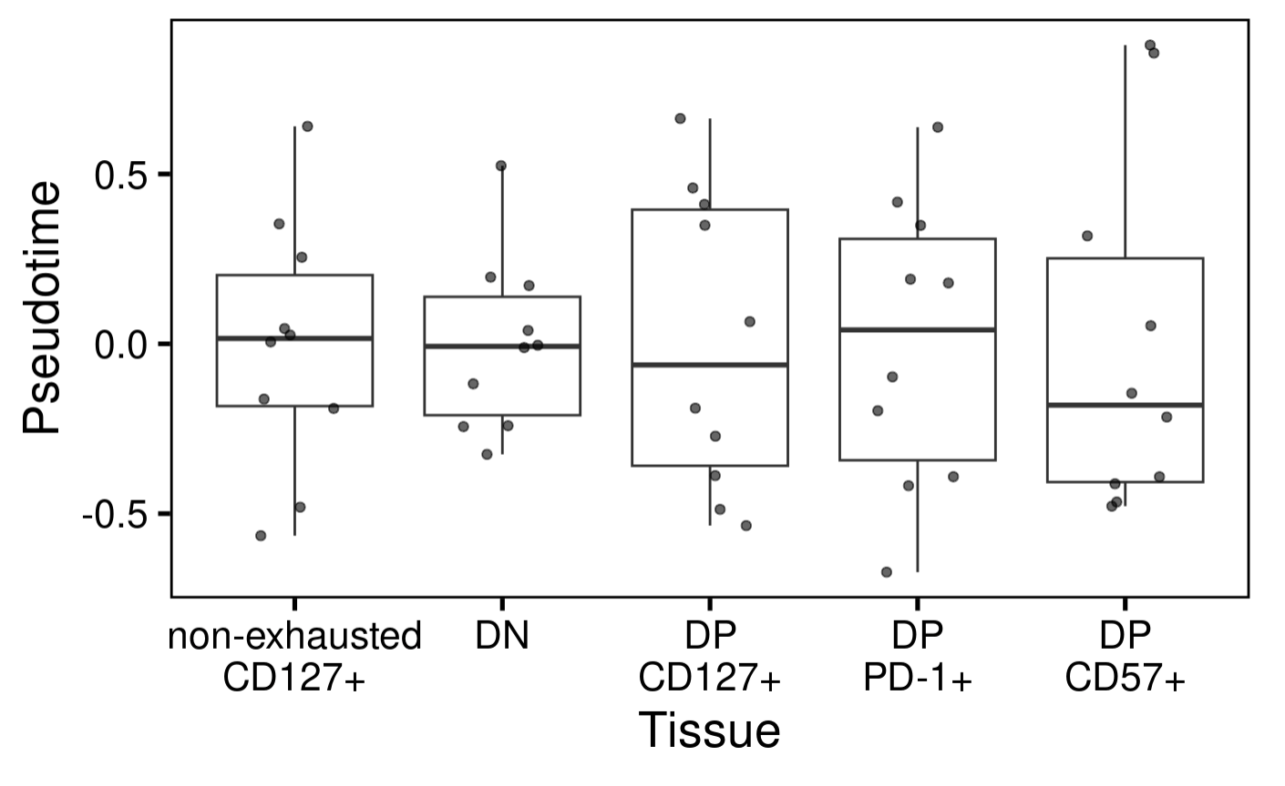
P576 (AbATE): don’t observe pseudotime associating with cell sort
Notes:
Tested for significances already
tried working from peak scores as well as Seurat scaled read counts in peak regions, different values but still 5 not different box plots
PhenoPath analyzes the accessibility of genomic regions (peaks) in your ATAC-seq data, modeling how these accessibilities change along a biological trajectory and how this trajectory is influenced by tissue type
PhenoPath models gene expression expression 𝑦 in terms of a latent pathway score (pseudotime) 𝑧. Uniquely, the evolution of genes along the trajectory isn’t common to each gene but can be perturbed by an additional sample-specific covariate 𝛽 (cell sort here)

Slide 10
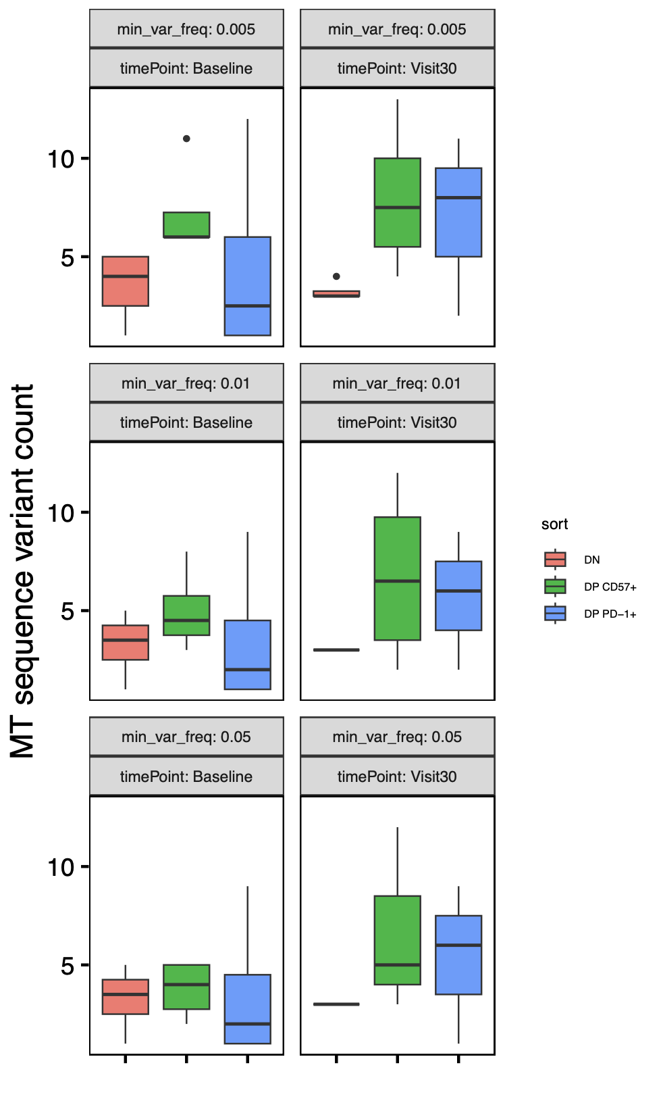
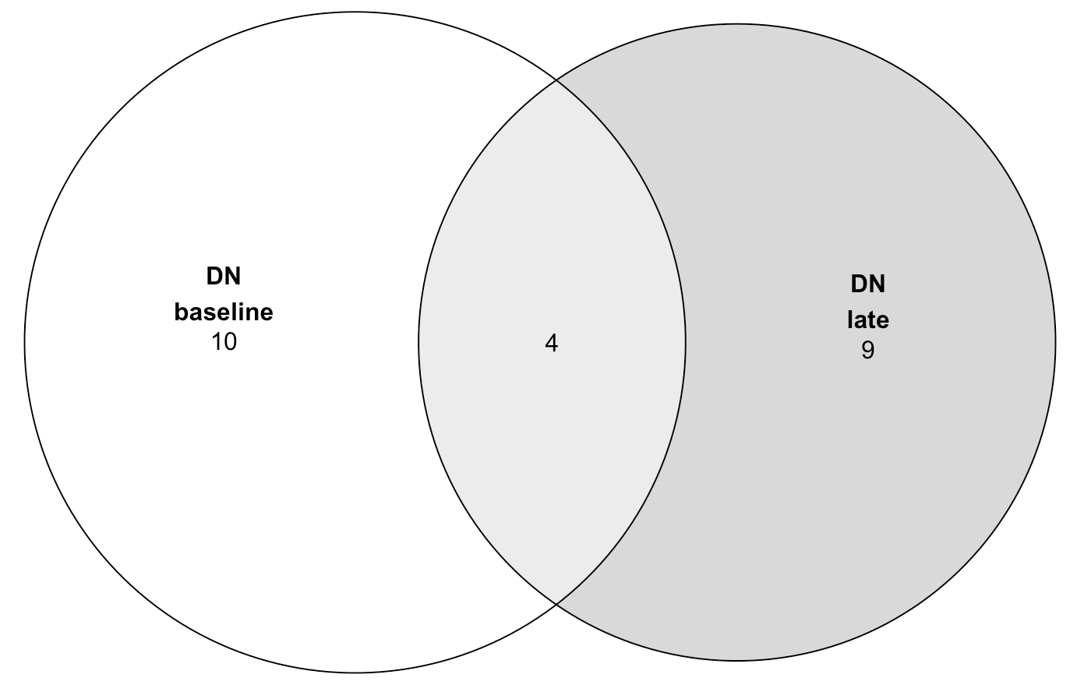
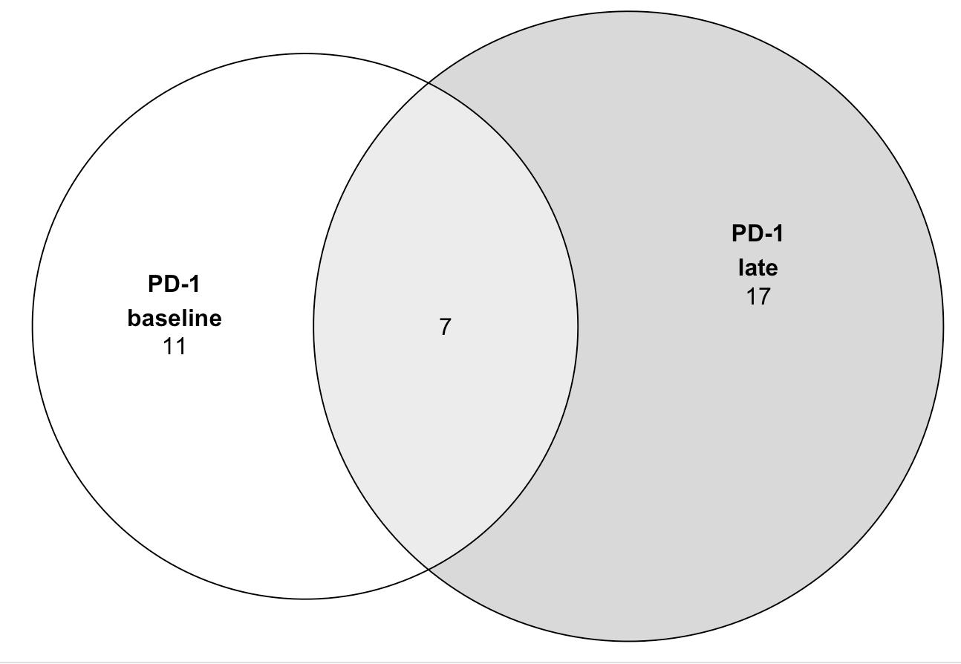
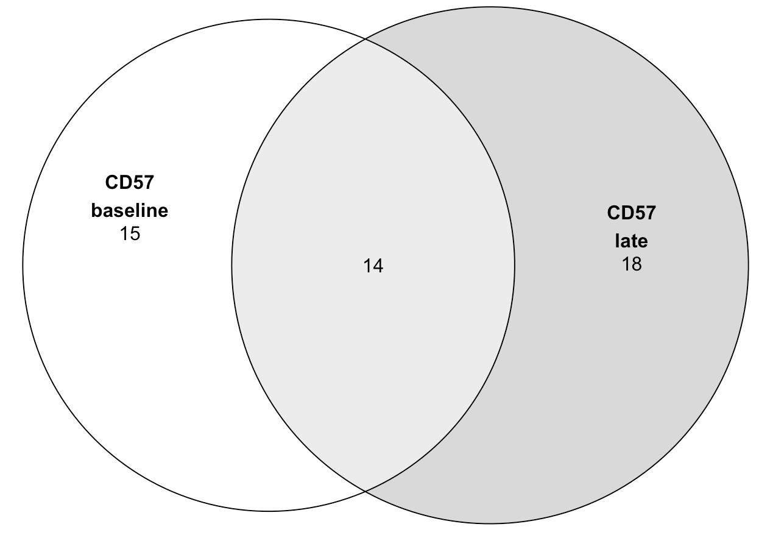
P452 (T1DAL): faceting MT variant analysis by timepoint
Takeaways:
- no significant differences in variant counts by timepoint within each sort
- substantial variant loss/gain over time (more sharing in CD57s ~30% vs. ~20% for others)
- not very different filtering for high freq vars (most here are high freq)
n = 4 (donors)
Notes:
Cell loss presumably explains higher than expected loss/gain of vars over time (loss could be death or swapping cell sort), loss/gain could also be due to insufficient sampling
Only R in P452: “we first measured their bulk chromatin accessibility at baseline (Week 0/Visit 0) and 104 wk (Visit 30) post-treatment in alefacept responders (R, defined by C-peptide preservation) using ATAC-seq following sorting from PBMC (Figure 1A, Because cell population differences rather than treatment response differences were the focus of our investigation, we sequenced only alefacept responder (R) samples“
Updated to remove vars present in all sorts in a donor
MT notes:
Mitochondrial genomes have high copy number (100–1,000s)
homoplasmy is when all copies of the mitochondrial genome in a cell are identical; heteroplasmy is when there is a mixture of two or more mitochondrial genotypes
mutations in mtDNA often reach high levels of heteroplasmy (proportion of mitochondrial genomes containing a specific mutation) due to a combination of vegetative segregation, random genetic drift, and relaxed replication
Exclusively maternal inheritance
mtDNA mutation rates are estimated to be 10- to 100-fold higher than for nuclear DNA

