Slide 1
Weekly meeting
4 4 2024
Ty Bottorff

Slide 2
Outline
Proliferation vs. activation comparison
TCR graphs
ATAC QC

Slide 3
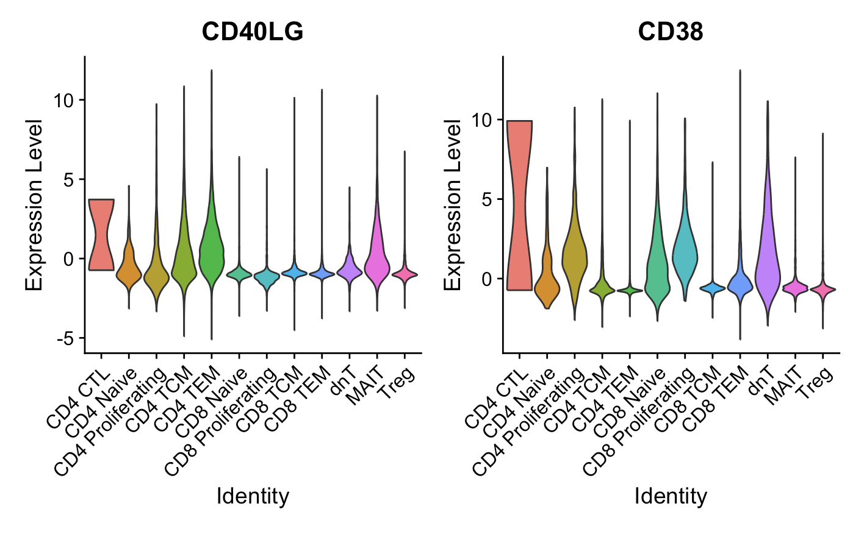
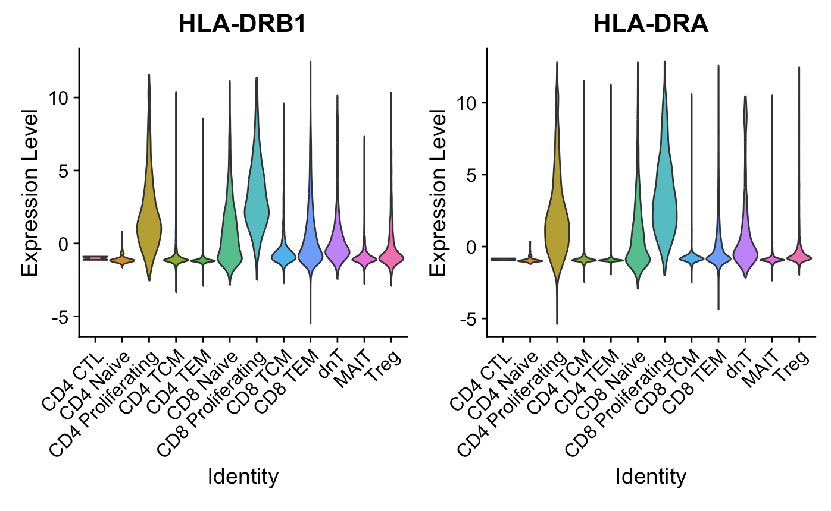
Proliferating cells are ~generally high for activation markers (Luoma (2020), Cell dataset)
CD154
*CD69, CD44, EGR1 different stories
Notes:
CD69, not really higher in proliferating cells, also a marker for Trm though? so...
CD154/CD40LG: kinda high in CD4 prolif but moreso in CD4 CTL/TCM?TEM and MAITs
EGR1, low in everything except MAITs
CD44: lowest in proliferating cells
CD38: yes higher in proliferating cells but really highest in CD4 CTLs, also high in dnTs
HLA-DR: B1 yes higher in proliferating cells (also CD8 naive/TEM), A (yes higher in proliferating cells also in CD8 naive), B5 kinda higher in proliferating cells
HLA-DRB1/DRA are class II, some CD8s can express it but it seems pretty high in CD8 prolif… but they definitely have high CD8A/B…

Slide 4
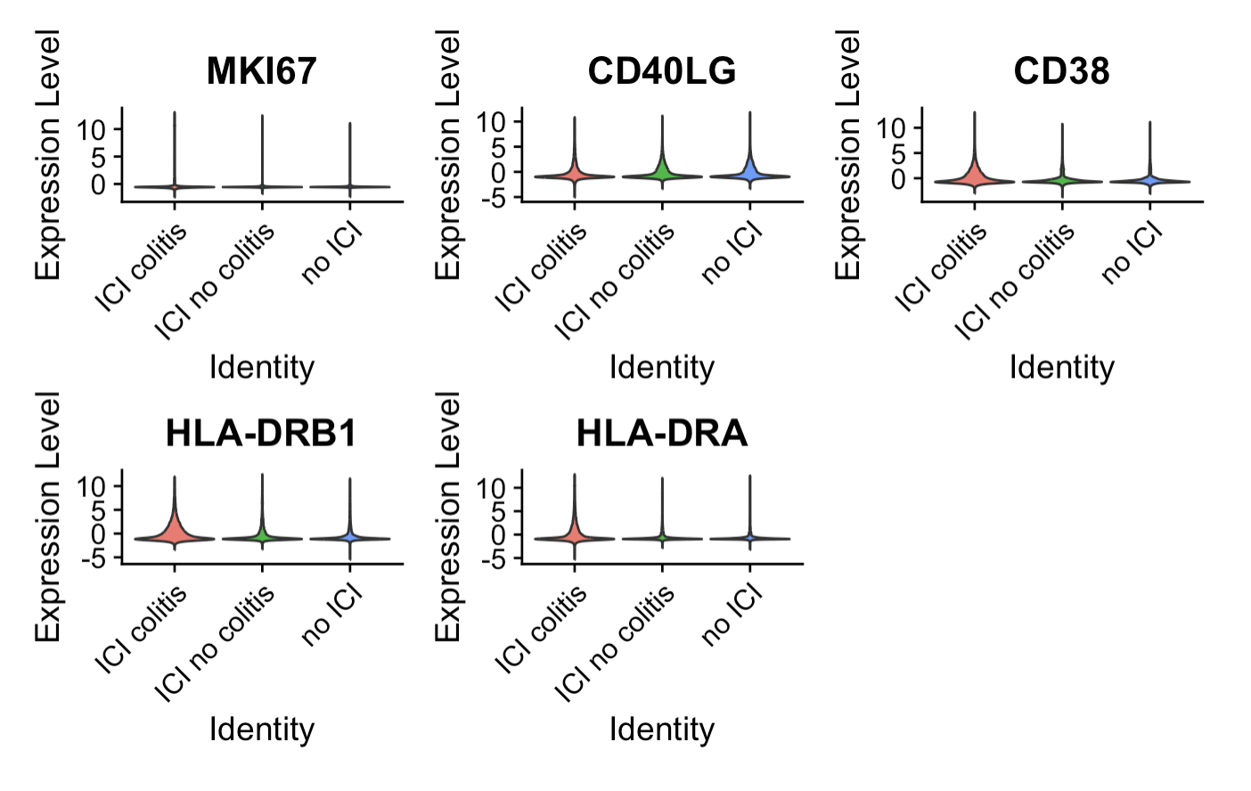
Some activation markers appear higher in ICI colitis tissue (Luoma (2020), Cell dataset), but no significant differences
Notes:
MKI67 probably looks same because there are so few proliferating cells and difference between irAE groups wasn’t even huuge in proliferating cells alone
Did for all T cells, CD4 prolifs, didn’t try for all CD4s but yea not expecting anything…

Slide 5
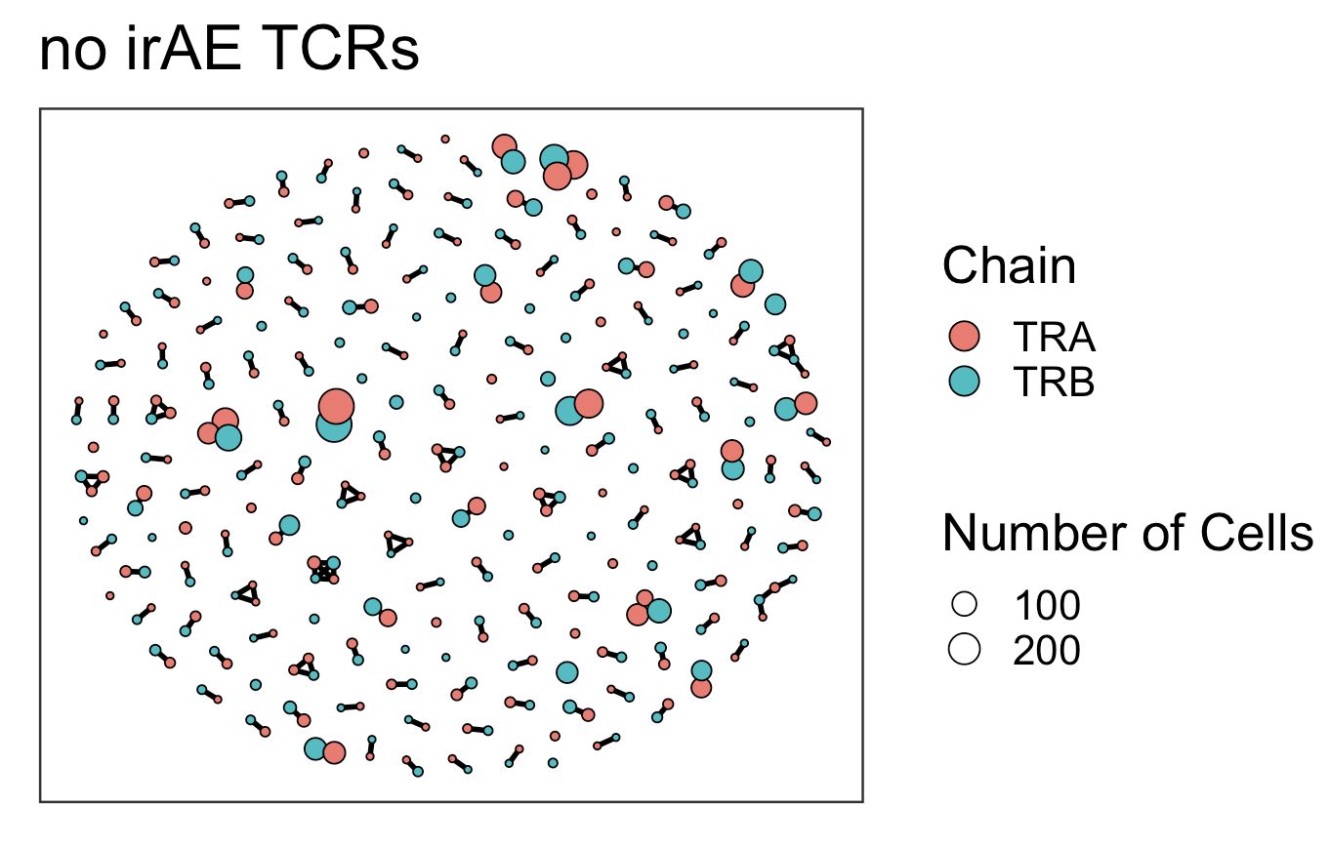
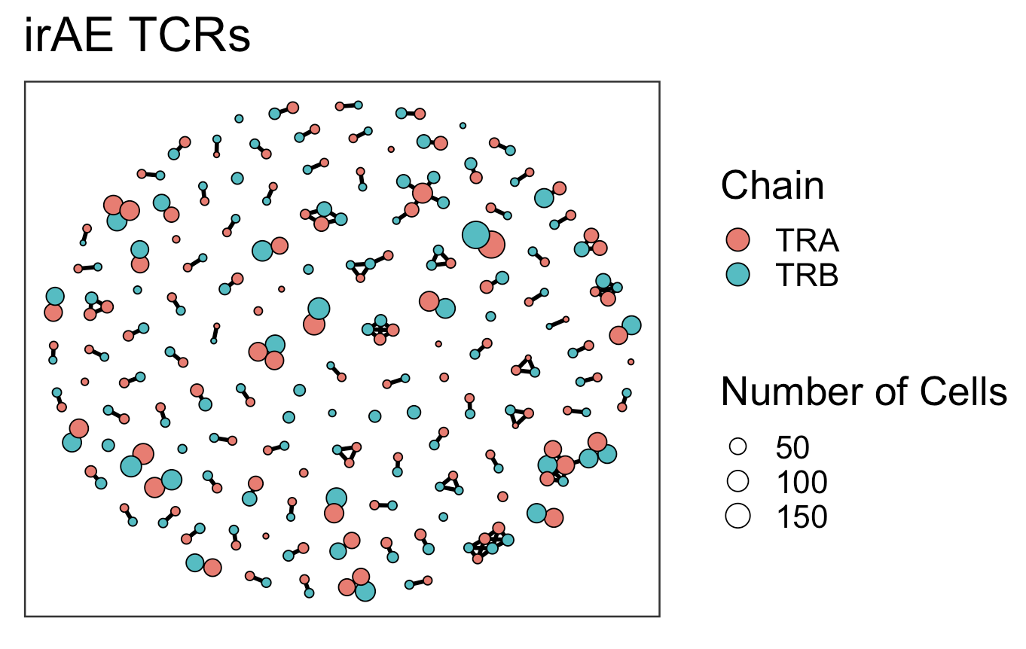
TCR graphs similar between irAE groups (Luoma (2020), Cell dataset), perhaps slightly higher connectivity (2*edges/vertices) in irAE group
Average Connectivity: 1.03
Number of Edges: 173
Number of Vertices: 336
Average Connectivity: 1.26
Number of Edges: 163
Number of Vertices: 259
Notes:
average_connectivity = 2 * num_edges / num_vertices
Top 350 clonotypes per patient per chain

Slide 6
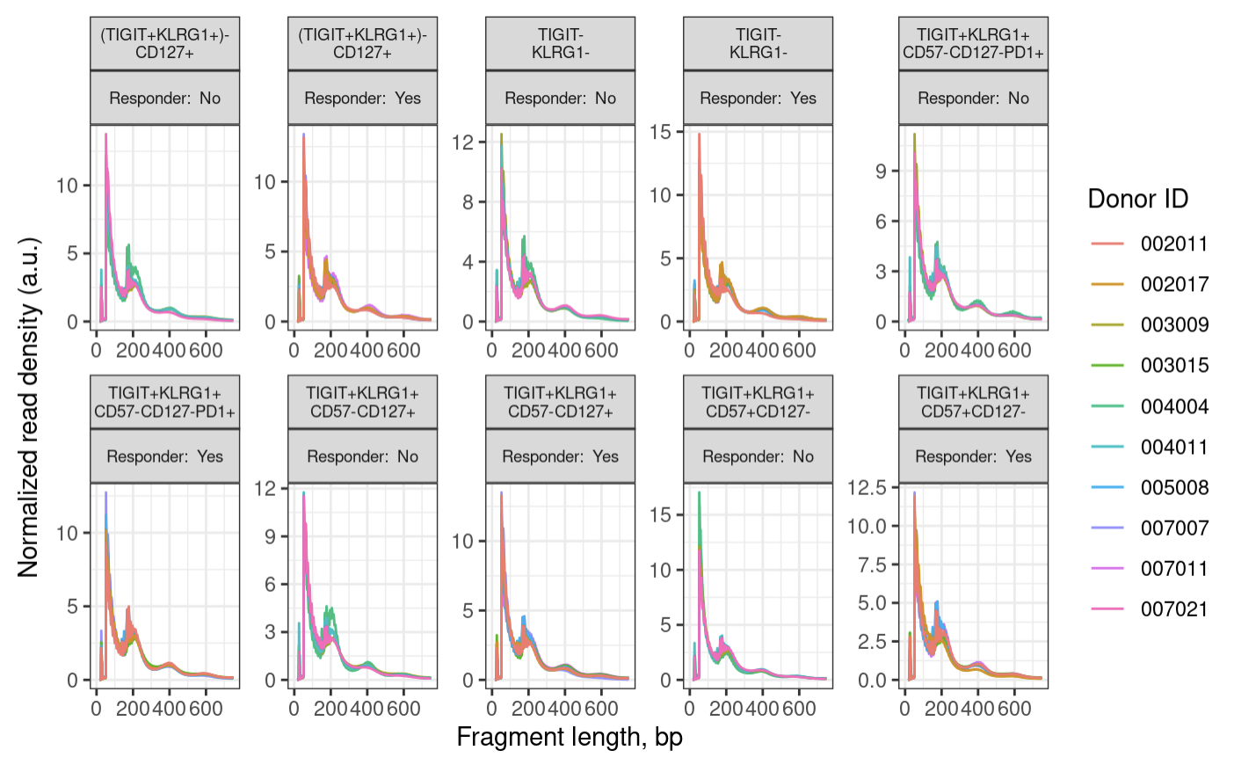
ATAC QC: fragment size distributions look good (100 bp peak, 200, 400 bp oscillations)
Notes:
expect a peak around 100 bp (nuclesome free region) and then oscillations with maxima 200 bp mono-nucleosome, 400 bp di-nucleosome and so on
wiggles in the below plot are a biological feature and come from 10 bp per helical turn of the DNA

Slide 7
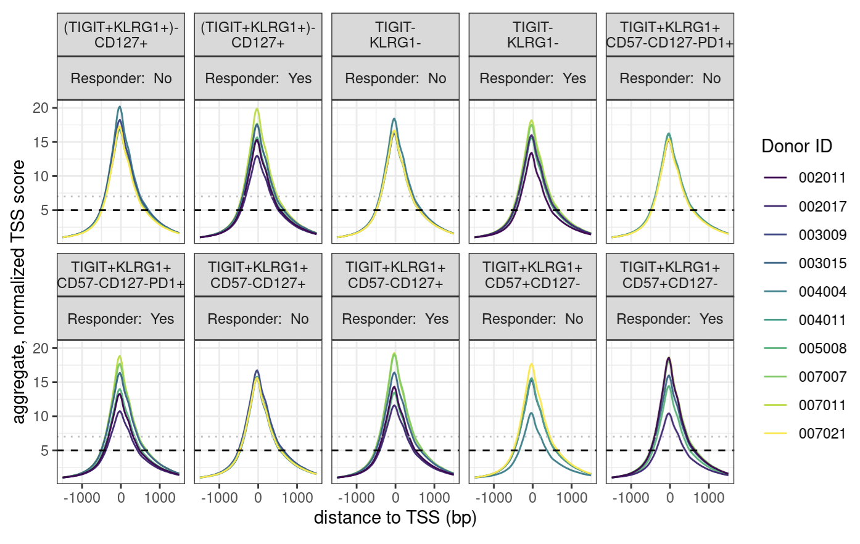
ATAC QC: TSSe looks good
Notes:
enrichment over TSS, signal:noise
we are looking for > 7, while 5-7 is still acceptable

Slide 8
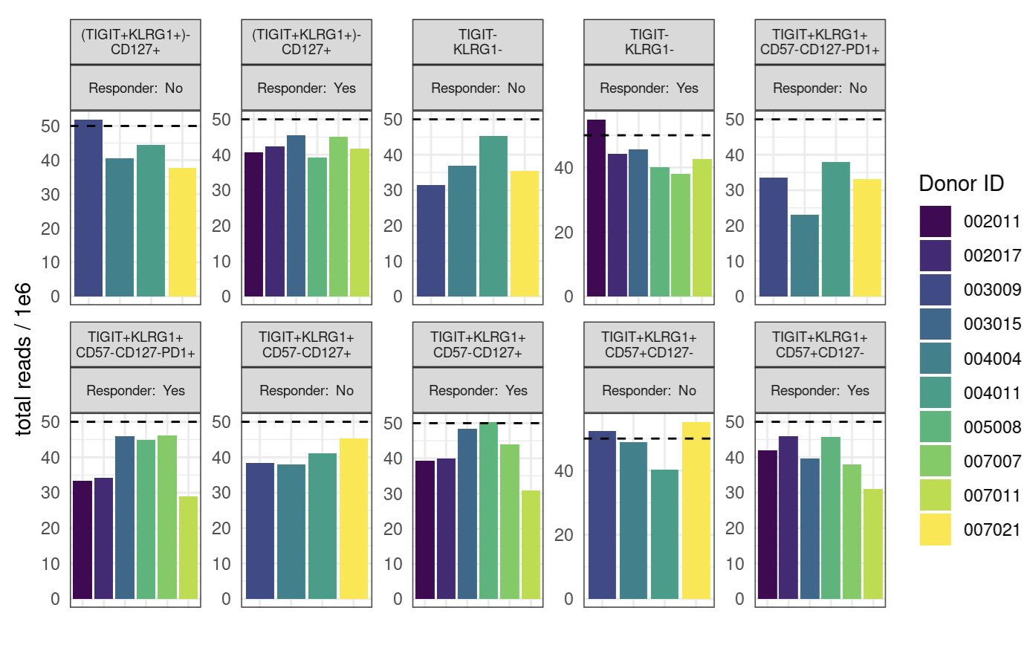
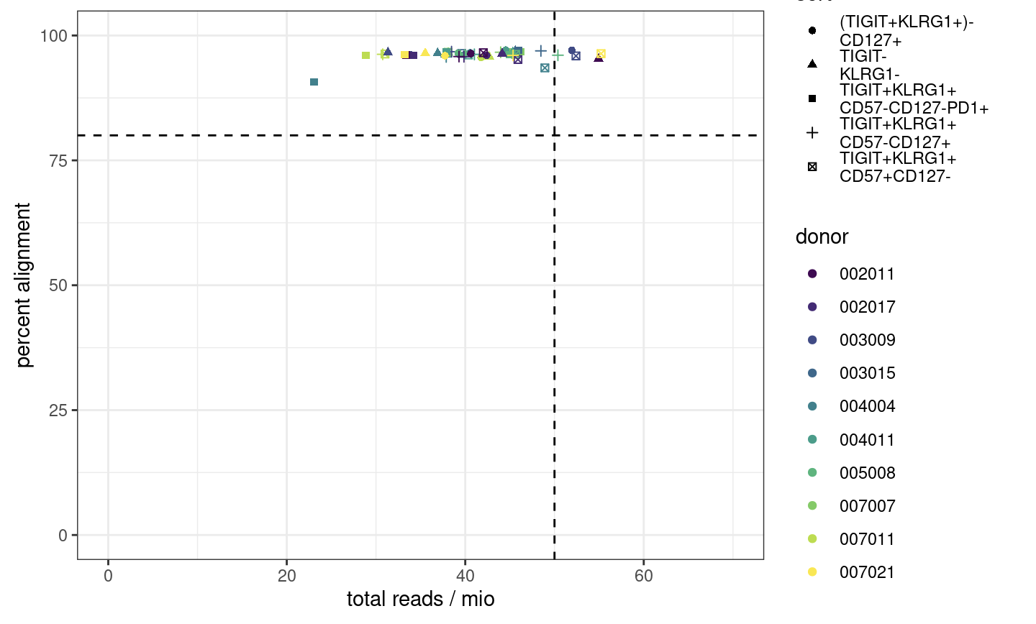
ATAC QC: most samples’ read counts are lower than desired, alignment good though
Notes:
ENCODE recommends 50 mio (aligned) reads for paired-end, 25 mio for single read
ENCODE: each replicate should have 25 million non-duplicate, non-mitochondrial aligned reads for single-end sequencing and 50 million for paired-ended sequencing (i.e. 25 million fragments, regardless of sequencing run type). The alignment rate, or percentage of mapped reads, should be greater than 95%, though values > 80% may be acceptable
want 10-50 mil reads depending on if TF analysis required (ENCODE suggestions)
we now want our samples to fall into the top right corner
consequences: may have reduced sensitivity (for low abundance/rare stuff), increased noise, decreased reproducibility across replicates (i.e. within sort+responder groups)

Slide 9
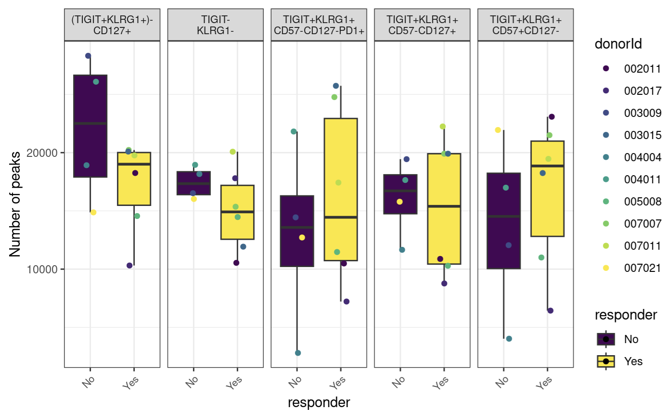
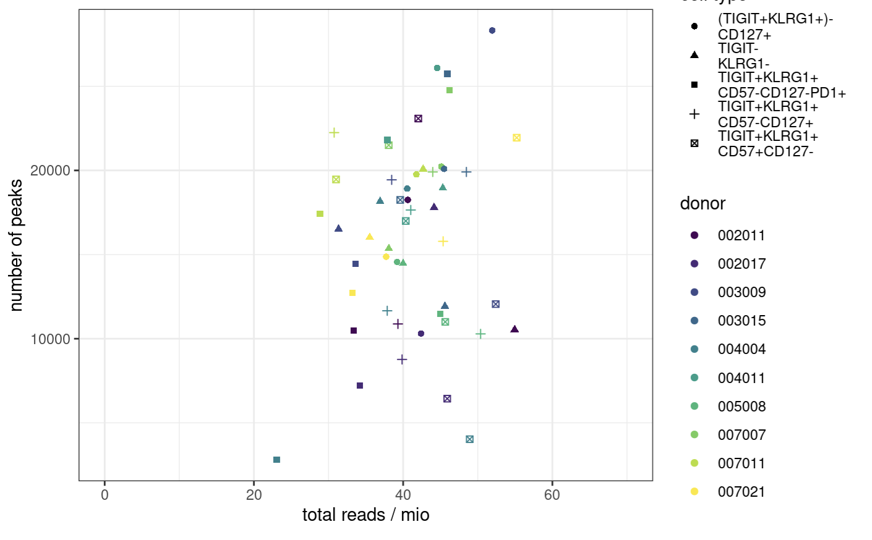
ATAC QC: way fewer than desired peaks
Notes:
ENCODE:The number of peaks within a replicated peak file should be >150,000, though values >100,000 may be acceptable.
ENCODE recommends > 150,000 peaks, although > 100,000 is still acceptable

Slide 10
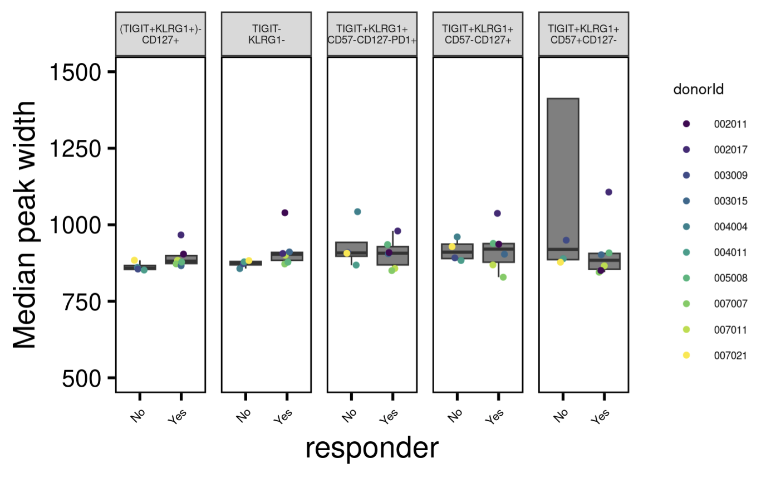
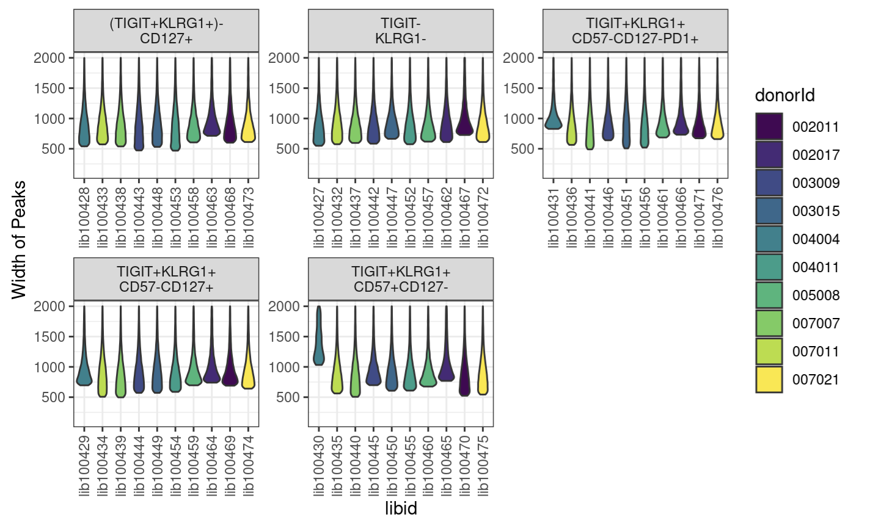
ATAC QC: one sample has way wider peaks than desired
Notes:
want ~400-1000 bp peak widths as medians
libid100430 is wide peak one

Slide 11
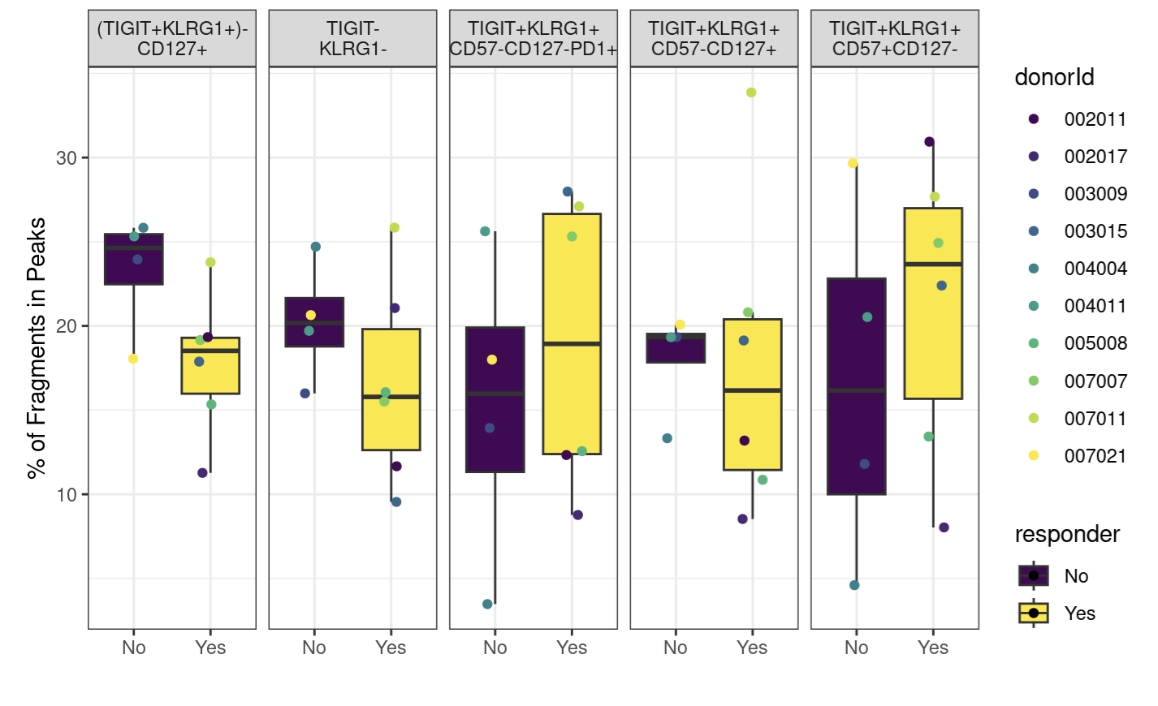
ATAC QC: fraction of reads in peaks lower than desired for most samples
Notes:
ENCODE: The fraction of reads in called peak regions (FRiP score) should be > 0.3, though values greater than 0.2 are acceptable. TSS enrichment remains in place as a key signal to noise measure
FRiP is calculated by going through the bam files and counting the reads that fall within a called peak

Slide 12
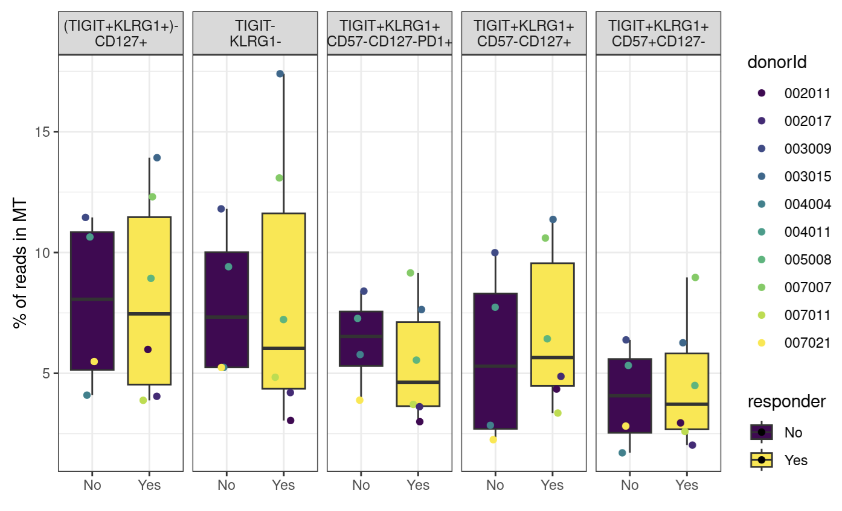
ATAC QC: MT %s

Slide 13
Conclusions
ATACseq QC: generally good, may exclude few samples from subsequent analyses, still conferring with Stephan for advice
TCR graphs were similar between irAE groups
Not shown: Erin’s ATACseq, comparing Stephan’s method vs. Erin’s method
Merged alignment files by condition/timepoint
Ran peak caller on merged alignment files

Slide 14
Next steps
ATACseq: excluding libraries that failed QC, merging alignment files, calling peaks on aligned files, differentially accessible gene analysis (volcano plot comparison)
Erin’s ATACseq data: differentially accessible gene analysis (volcano plot comparison)
Worth trying to make activated (CD4) cell type category to compare abundances between irAE groups?
Would need to set thresholds for +/- for markers like CD154, CD38, HLA-DR(A/B1)

