Slide 1
Weekly meeting
1 23 2025
Ty Bottorff

Slide 2
Outline
CD127 project analysis progress

Slide 3
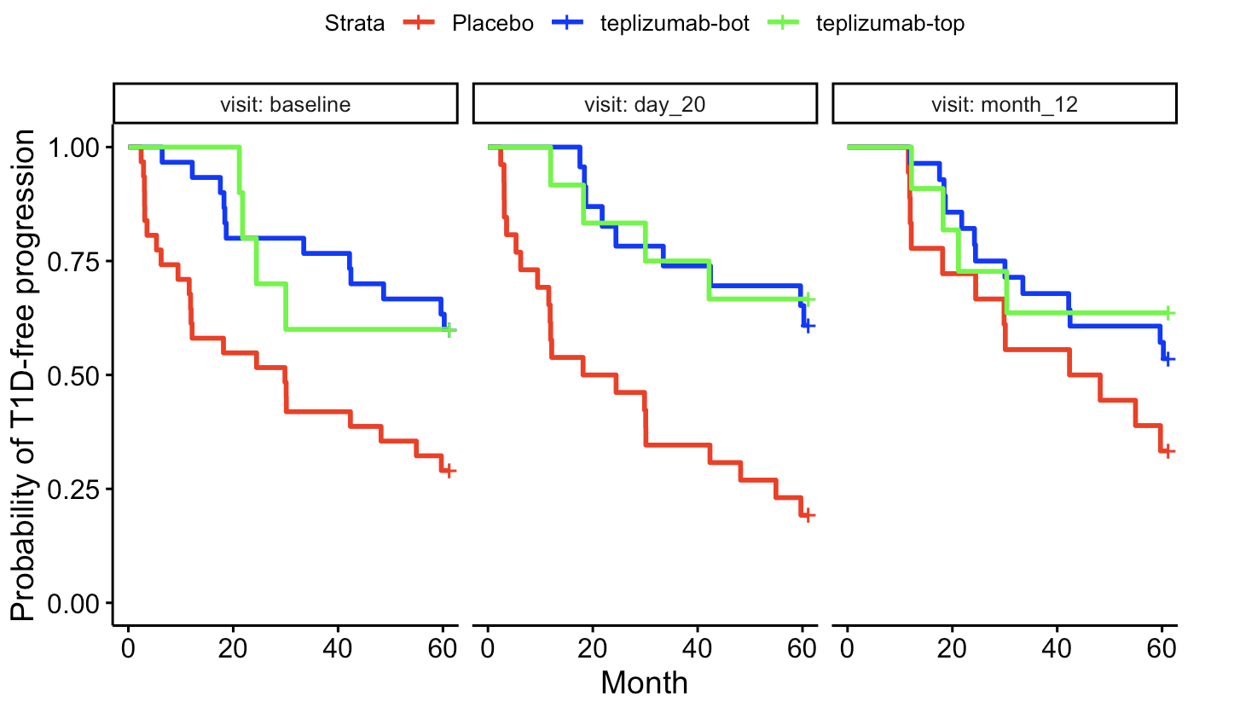
TN10 whole blood RNAseq analysis
Split teplizumab-treated patients by EOMES module expression
Stratified teplizumab-treated patients by expression of gene set
Tried with MAIT genes, EOMES module (AbATE), TIGIT⁻KLRG1⁺CD127⁺ T1D/HC cluster markers, IL7 genes from immune dictionary…
Tried different cutoffs (top 25%, 33%...)
Made KM plot (added time to T1D as max + 1 for those with NA time)
Did not observe significant differences b/w top/bot of teplizumab-treated

Slide 4
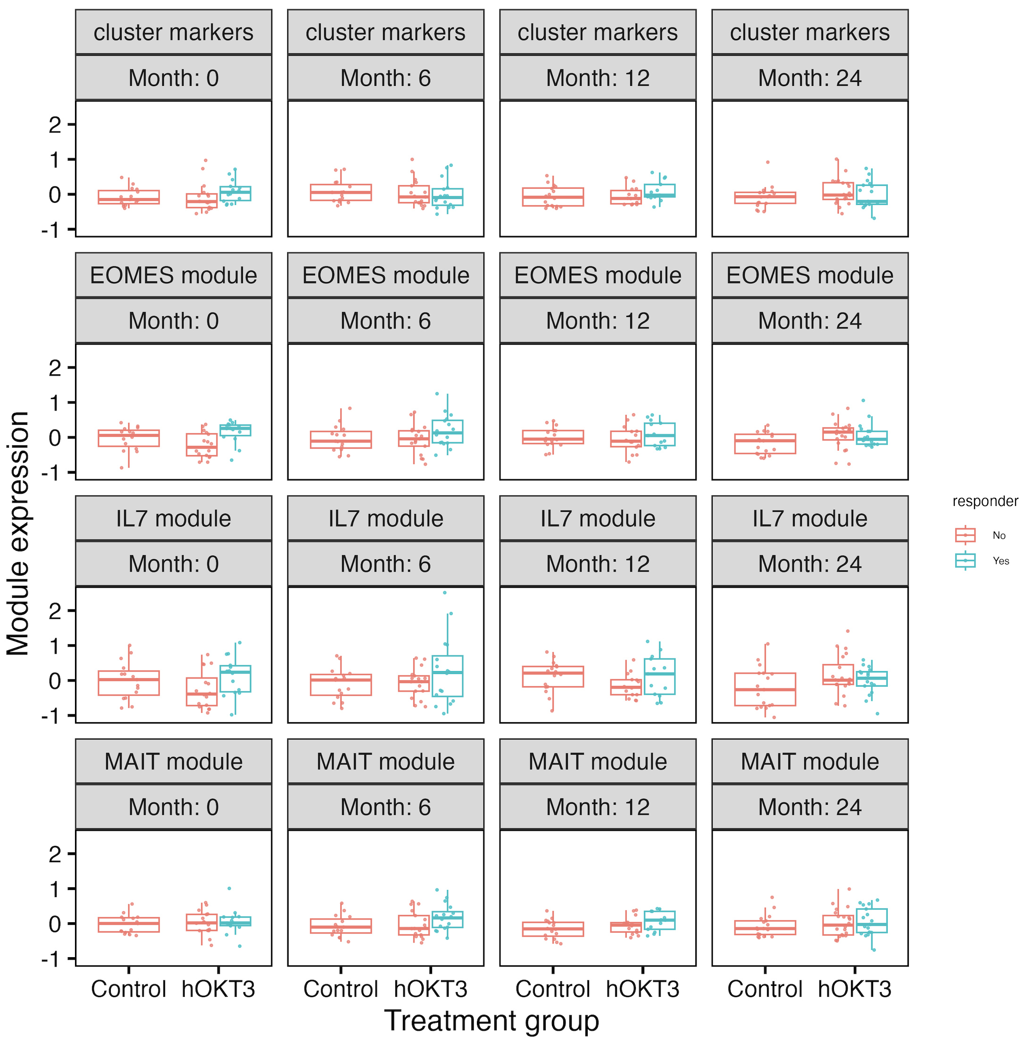
AbATE whole blood RNAseq analysis
Got batch-adjusted counts from Peter’s GitHub
Scaled count values per gene
Do observe higher EOMES module expr in R, but do not observe higher MAIT or IL7 module expr in NR
Notes:
https://github.com/linsleyp/Long_Linsley_AbATE/blob/master/data_files/WB_RNA-seq/combined_ABATE_TMM_batch_corrected_counts_after_qc_063016.rds

Slide 5
Conclusions
TN10 whole blood RNAseq: do not observe significant differences in time to T1D (KM plots) between those with high vs. low expression of various gene sets (MAIT, EOMES, IL7…)
AbATE whole blood RNAseq: do observe higher EOMES module expr in R, but do not observe higher MAIT or IL7 module expr in NR

Slide 6
Next steps
CD127 project
manuscript-quality figures
new analyses?
helping writing?
NCI irAE project: IMPACD

Slide 7
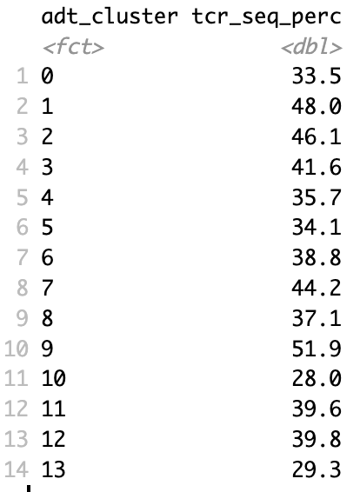
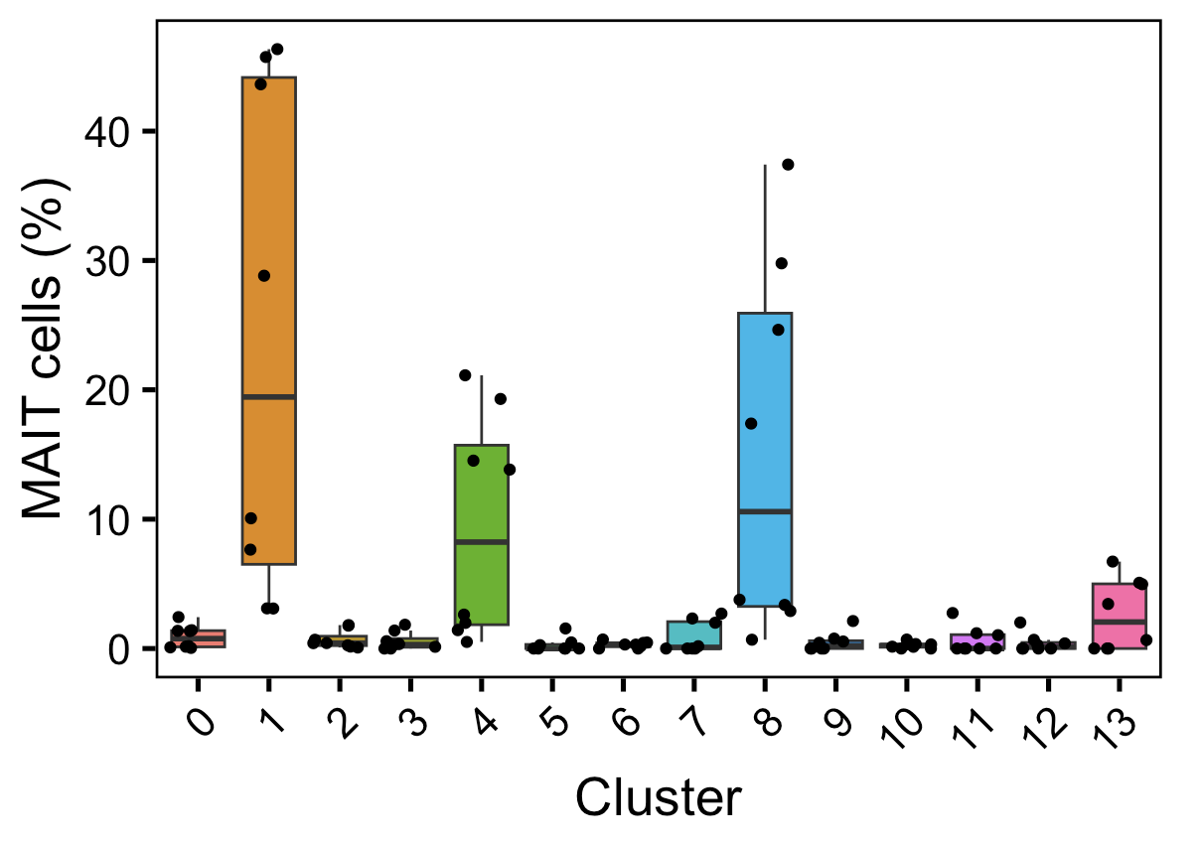
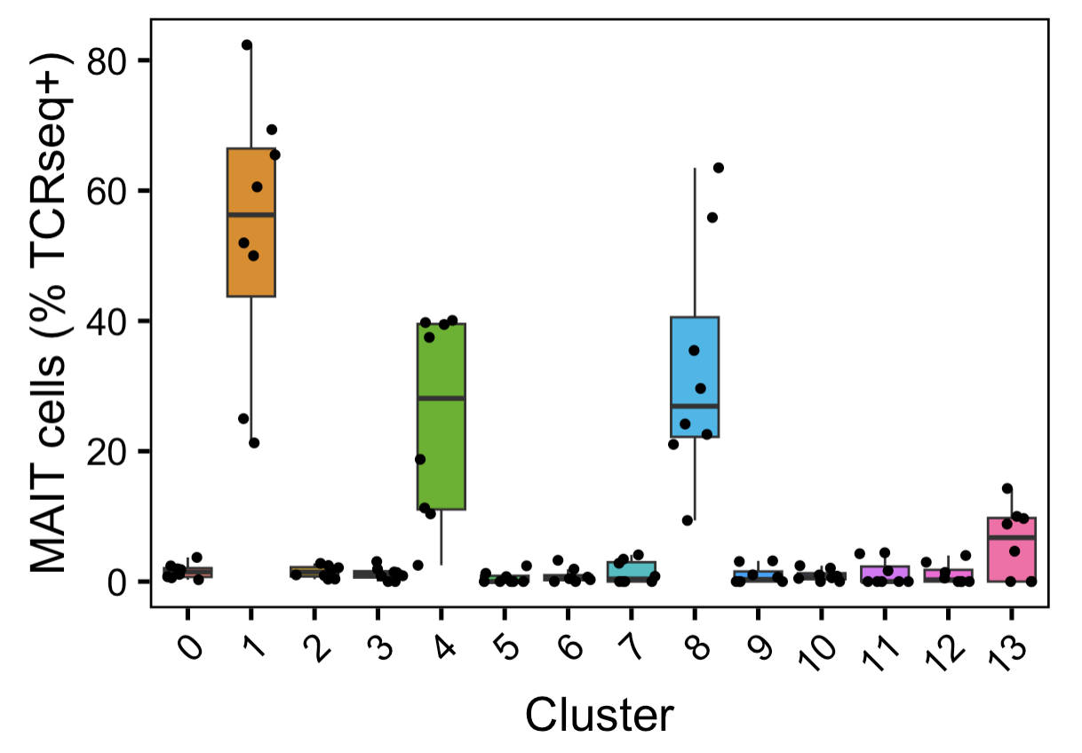
Extra TCRseq analyses for P348-4 (T1D/HC)
% cells/cluster with TCRseq data
MAIT % (of total cluster cells)
MAIT % (of TCRseq+ cells)

