Slide 1
Weekly meeting
11 21 2024
Ty Bottorff

Slide 2
Outline

Slide 3
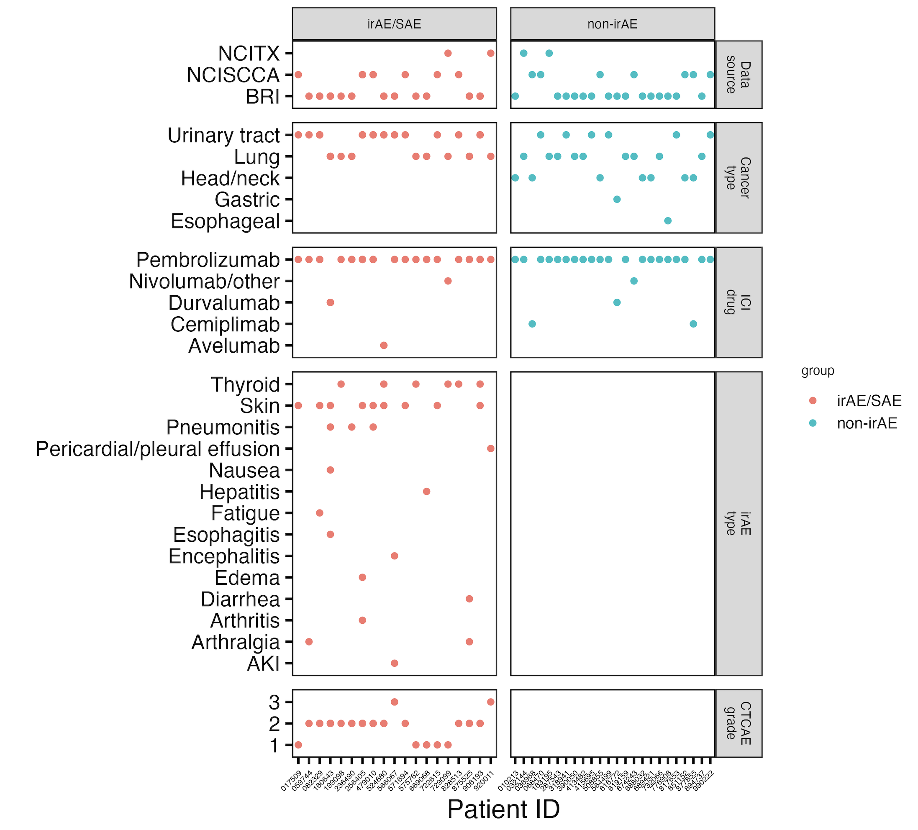
Updated NCI irAE cohort summary
Notes:
Still not sure why head/neck no irAEs… Holly proposed that this may be a less aggressive cancer…

Slide 4
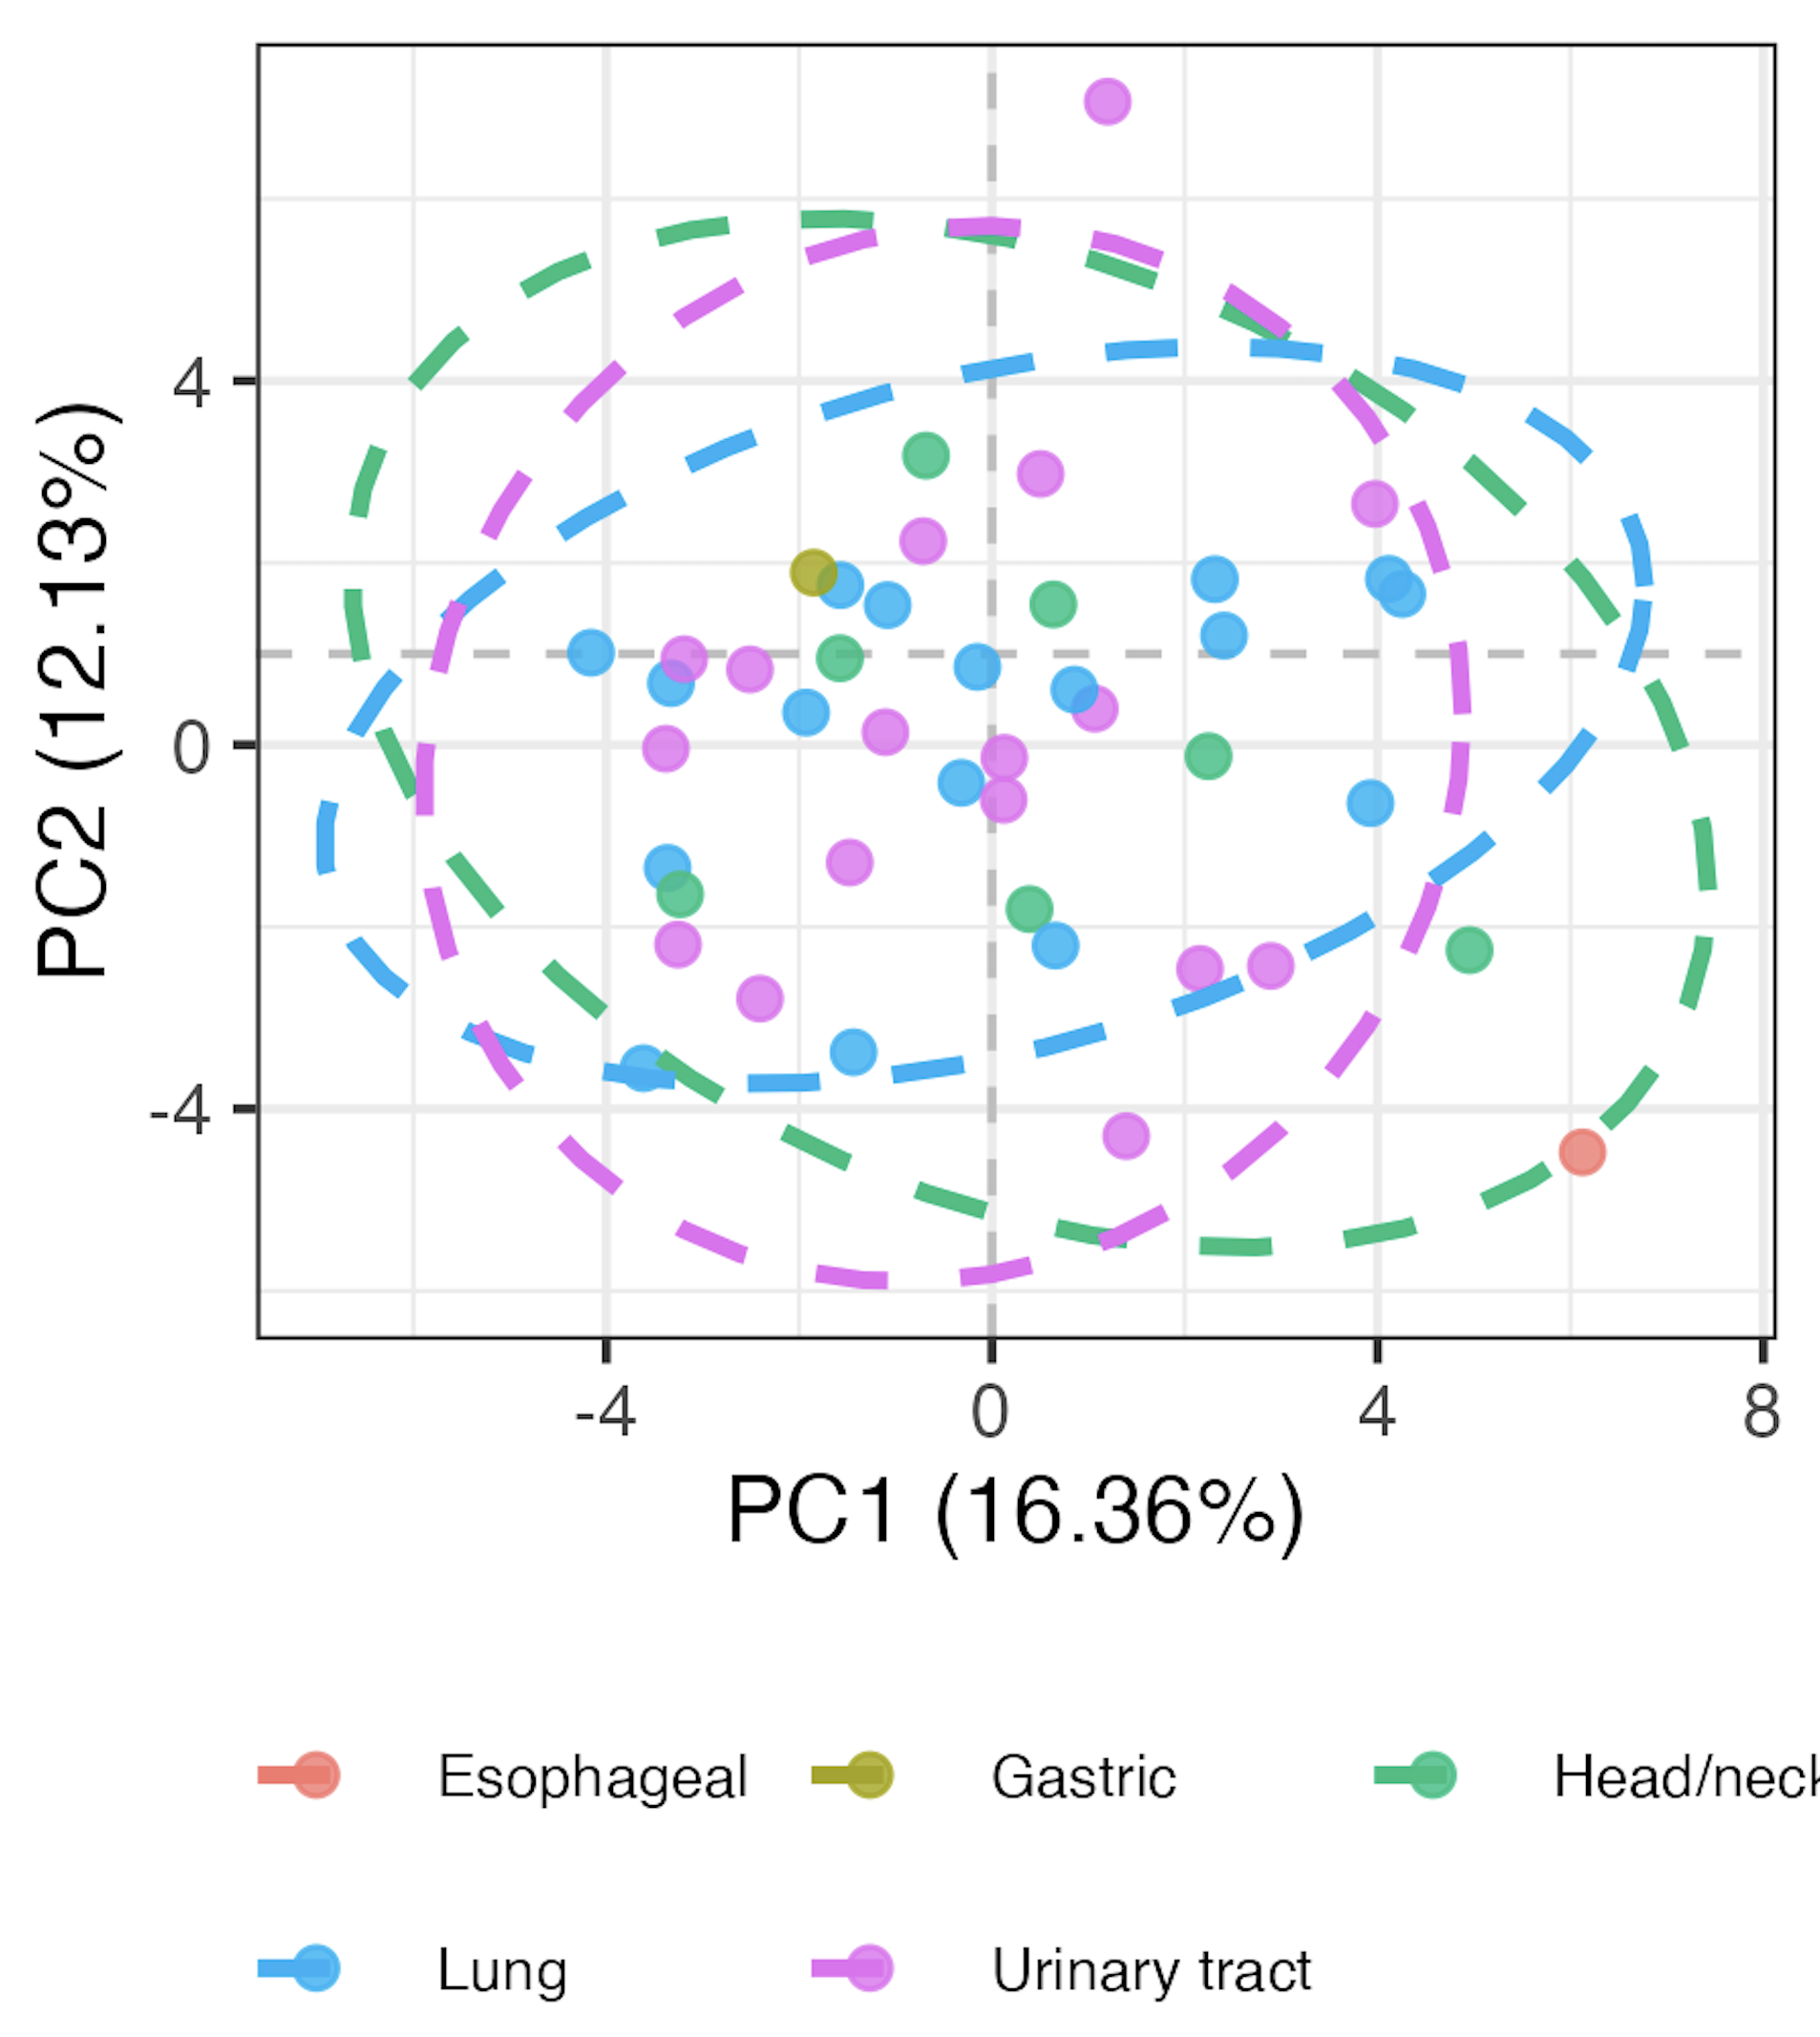
Baseline immunotypes do not greatly differ by primary cancer type

Slide 5
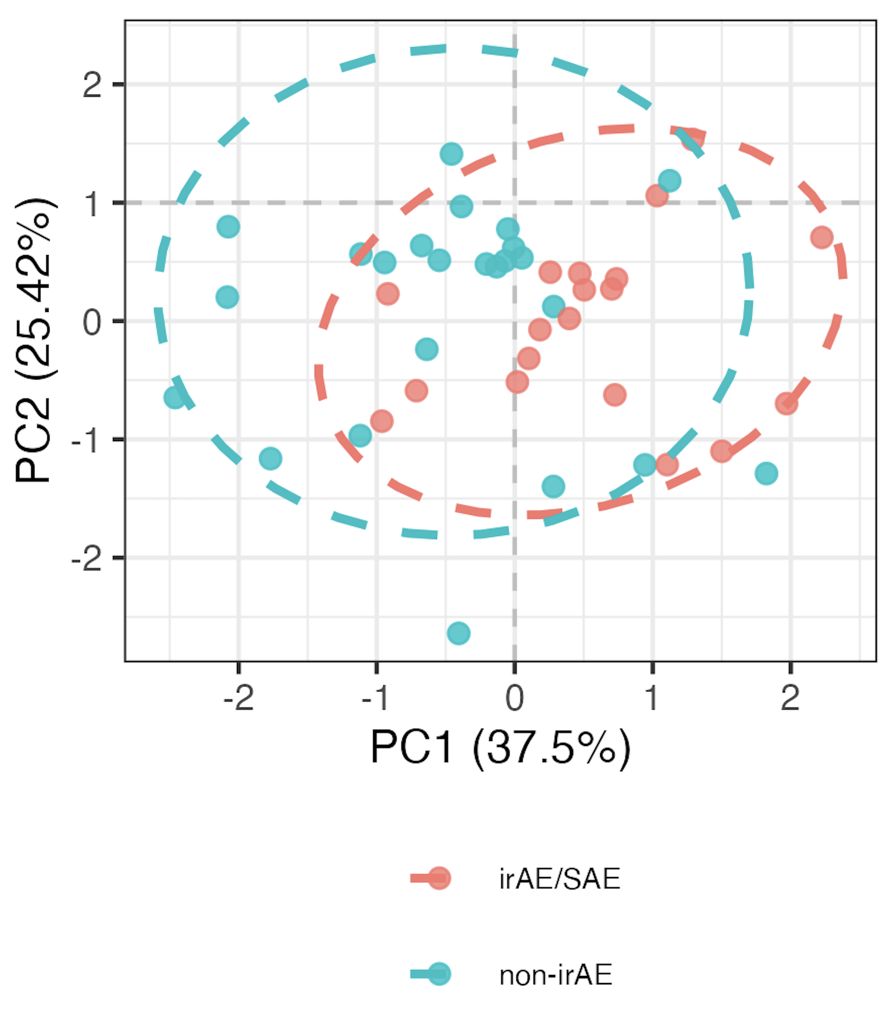
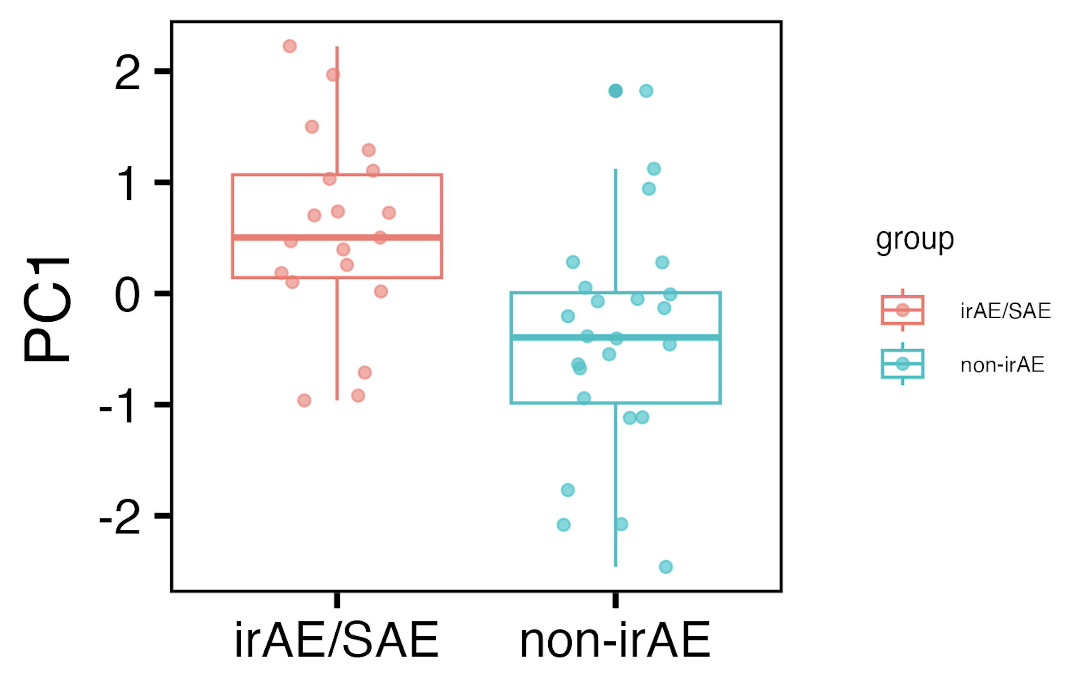
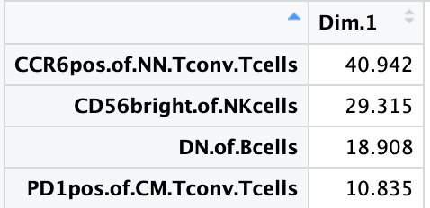
Whittled down to 4 features (w/ pval for PC1 still = 0.001)
Notes:
Other feature combinations definitely also discriminate immunotypes though…

Slide 6
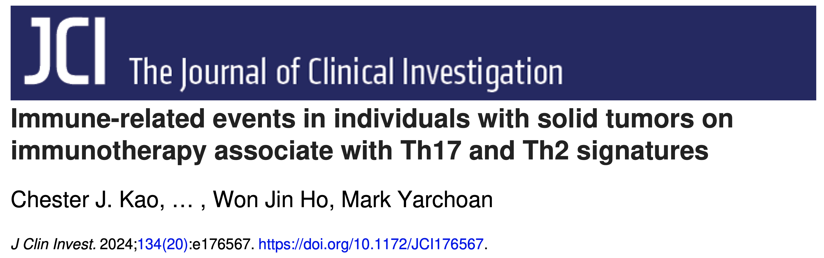
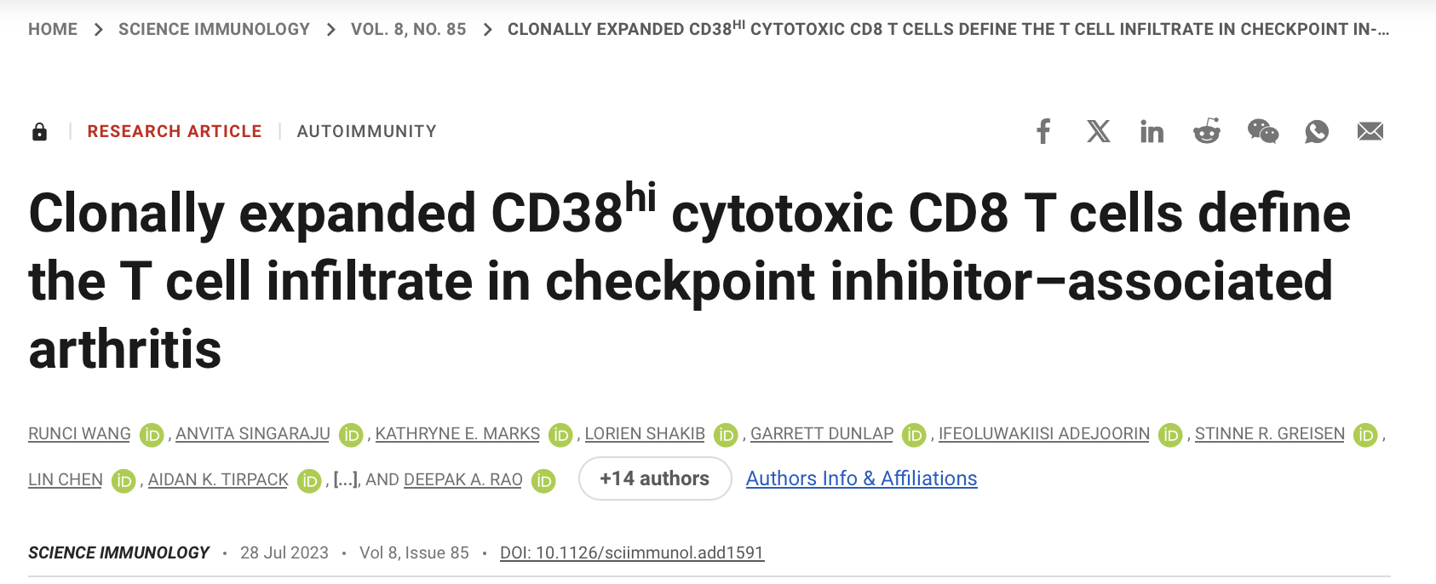
2 potential datasets with necessary features to test our module in
Notes:
Both have CCR6, PD1, CD56…
But neither have data easily accessible

Slide 7
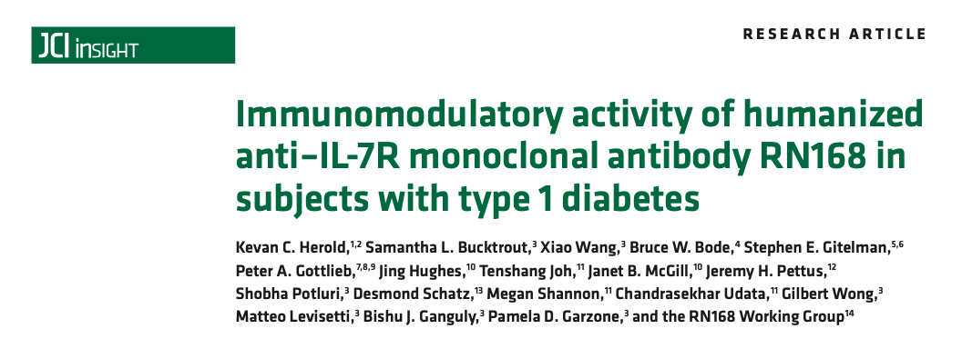
Bulk RNAseq of CD8s at baseline and 85 days on IL7R blockade
They did not see significant differences in PD-1 expression in CD8s after IL7R blockade
Potentially could look at mean expression of DP PD-1 “module” (and DP CD57 one) but bulk sequencing is limitation here…
Data not available, would need to ask Kevin Harold/others

Slide 8
Conclusions
Data not shown: also tried baseline pneumonitis (+/- pericardial/pleural effusion) and rheumatoid irAE yes vs. no, similar to thyroid irAE yes vs. no in that there were weaker results (less patients with these irAEs than skin irAEs)

Slide 9
Next steps

