Slide 1
Weekly meeting
10 26 2023
Ty Bottorff

Slide 2
Outline
Choosing new dataset(s)
Summary of findings
Limitations
Preliminary data reproduction
Next steps

Slide 3
Choosing new dataset(s)
No pairing of samples
Identification of pathogenic immune cell subsets associated with checkpoint inhibitor-induced myocarditis
No irAE tracking
Distinct mechanisms of mismatch repair deficiency delineate two models of response to PD-1 immunotherapy in endometrial carcinoma
Immune checkpoint blockade sensitivity and progression-free survival associates with baseline CD8⁺ T cell clone size and toxicity
No pre-ICB data
Distinct molecular and immune hallmarks of inflammatory arthritis induced by immune checkpoint inhibitors for cancer therapy
Notes:
No pairing of samples: different people get no ICI vs. yes ICI, could maybe still test for expansion of public TCRs?

Slide 4
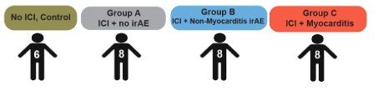
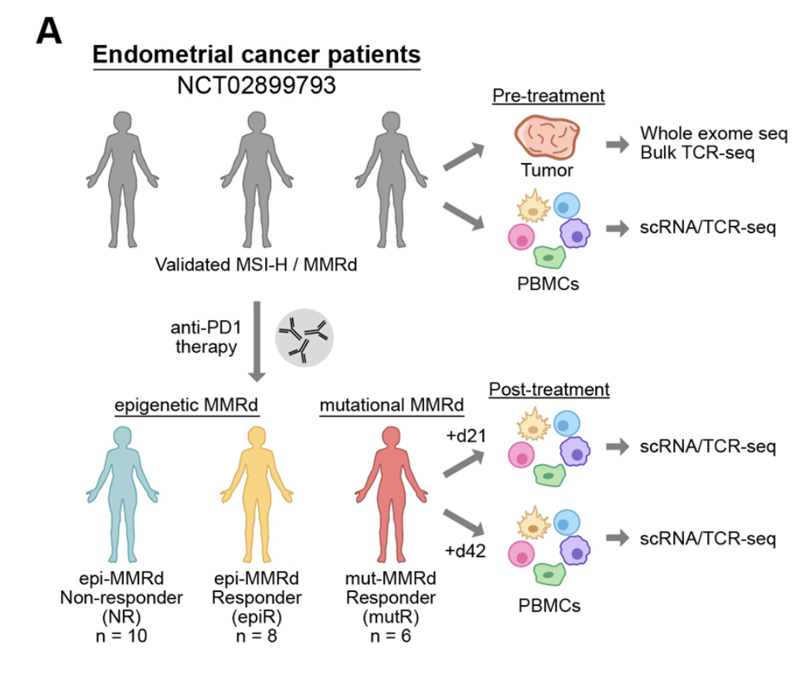
New datasets cohorts
Identification of pathogenic immune cell subsets associated with checkpoint inhibitor-induced myocarditis
Distinct mechanisms of mismatch repair deficiency delineate two models of response to PD-1 immunotherapy in endometrial carcinoma
→ scRNA-seq/scTCR-seq
Notes:
No ICI controls also have cancer, diverse cancers for this dataset

Slide 5
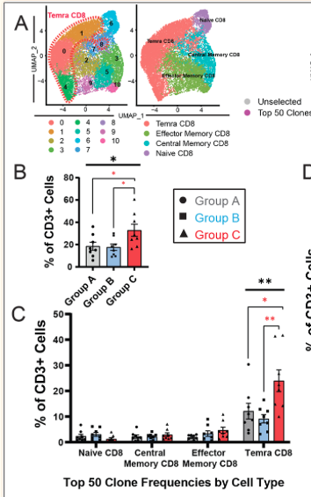
Summary of findings from Identification of pathogenic immune cell subsets associated with checkpoint inhibitor-induced myocarditis
Find expansion of cytotoxic CD8⁺ Temra cells in ICI myocarditis patients
These CD8⁺ Temra cells express proinflammatory cytokines early, progress into exhausted phenotype later (1 patient longitudinal data)
Notes:
Circulation journal

Slide 6
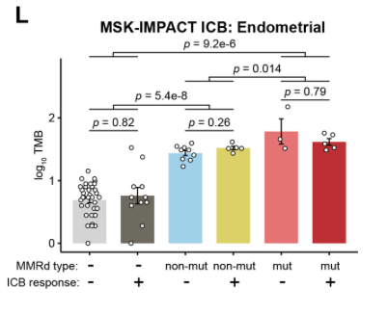
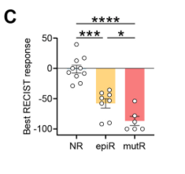
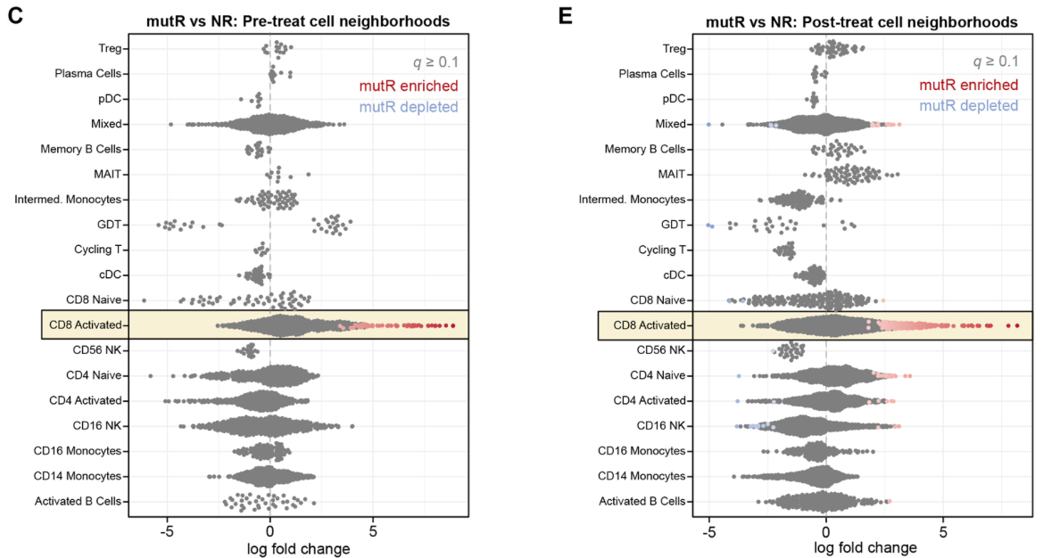
Summary of findings from Distinct mechanisms of mismatch repair deficiency delineate two models of response to PD-1 immunotherapy in endometrial carcinoma
Mutational MMRd patients had higher response rates than those with epigenetic MMRd, but mutational burden didn’t correlate with ICB response within each category
CD8⁺ effector T cells correlated with mutational MMRd response, activated CD16⁺ NK cells associated with ICB-responsive epigenetic MMRd tumors
Notes:
Cancer discovery journal

Slide 7
Limitations of datasets
Identification of pathogenic immune cell subsets associated with checkpoint inhibitor-induced myocarditis
Male sex dominance (22/30 patients male)
No paired samples
Longitudinal data was just 1 patient
Distinct mechanisms of mismatch repair deficiency delineate two models of response to PD-1 immunotherapy in endometrial carcinoma
Epi-MMRd tumors tend to develop at older age than mut-MMRd tumors, don’t notice significant differences in patient age between groups but can’t rule out possible effect
Some non-responders didn’t experience disease progression for a year or more, perhaps split that group?
Notes:
Immune system function changes over time

Slide 8
Methods for preliminary data reproduction for Distinct mechanisms of mismatch repair deficiency delineate two models of response to PD-1 immunotherapy in endometrial carcinoma
Read in .rds file of their QC filtered, normalized Seurat object
Recreate UMAP of all cell types
Filter for just T cells
Re-perform dimensional reduction, clustering
Assign cell subtypes

Slide 9
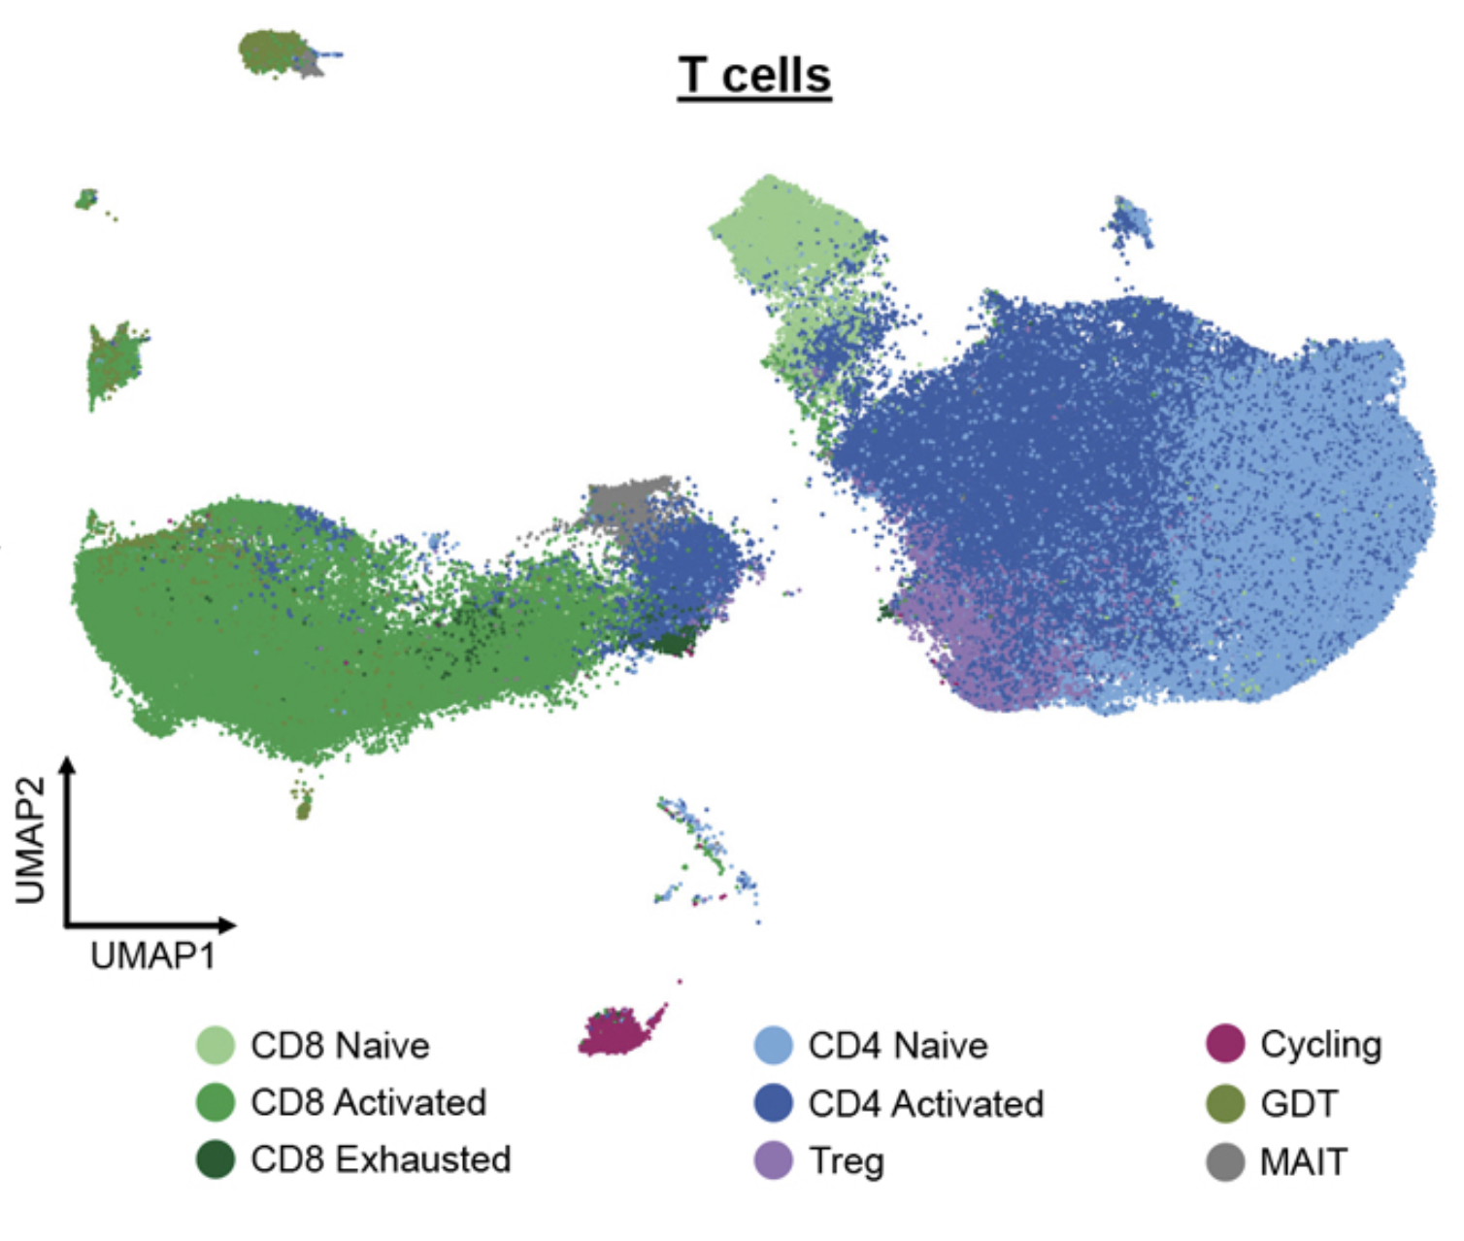
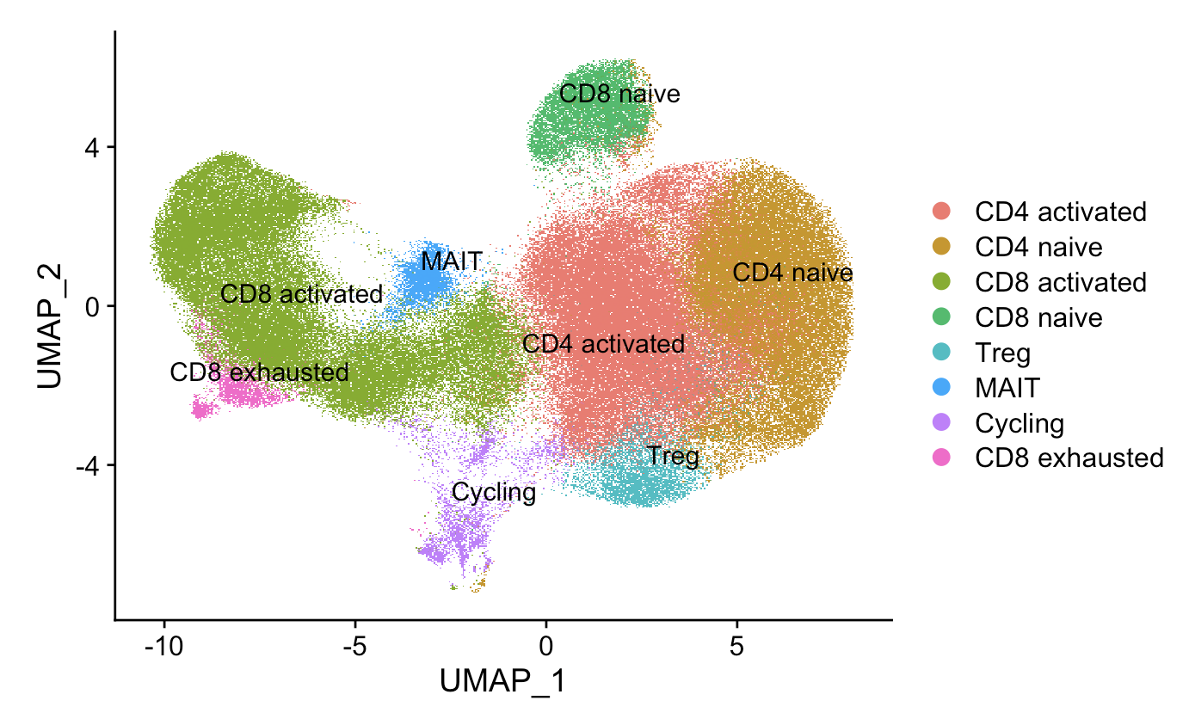
Preliminary data reproduction for Distinct mechanisms of mismatch repair deficiency delineate two models of response to PD-1 immunotherapy in endometrial carcinoma
their UMAP
Ty’s UMAP

Slide 10
Preliminary data exploration for Distinct mechanisms of mismatch repair deficiency delineate two models of response to PD-1 immunotherapy in endometrial carcinoma
Read in .rds file of their scTCR-seq data
Filter for barcodes with 1 alpha and 1 beta chain
Stitch TCR sequences
Run through IGoR to get pgen
Run through IMGT/HighV-Quest
Notes:
Almost all 1 alpha 1 beta same barcode come from different contigs
Again lose most barcodes during stitching (171,541 → 29,465 (alpha) or 70,713 (beta)), alpha worse again
Running through IMGT/HighV-Quest to get n value(s)

Slide 11
Methods for preliminary data reproduction for Identification of pathogenic immune cell subsets associated with checkpoint inhibitor-induced myocarditis
Read in raw data
Recreate UMAP of all cell types
Maybe also…
Filter for just CD8 T cells
Re-perform dimensional reduction, clustering
Assign cell subtypes

Slide 12
Next steps
Continue with light data reproduction and TCR feature exploration in chosen dataset(s)
Ask Distinct mechanisms of mismatch repair deficiency delineate two models of response to PD-1 immunotherapy in endometrial carcinoma authors for irAE data (in progress)
Collaborate with Matt Lawrence for feature comparison of crossreactive vs. non-crossreactive TCRs?
If we find that TCR repertoires’ features differ with irAE development after ICB, does this warrant experimental testing of cross-reactivity of some of these TCRs?
Transduce TCRs into T cells
Stimulation assay: use peptides from tumor and irAE organs
Notes:
Need to transduce TCRs into TCR-deficient T cells?
Select peptides that are known to have high affinity to the specific MHC molecules expressed by T cell line used (MHC genotyping), can use computational prediction tools to predict peptides likely to bind MHC molecule
Positive controls (peptides known to stimulate T cells) and negative controls (peptides unlikely to stimulate any T cells)
Stimulation assay out measure: cytokine measurement (IFN-gamma, IL-2/4 to measure activation via ELISA/flow)

