Slide 1
Weekly meeting
1 18 2024
Ty Bottorff

Slide 2
Outline

Slide 3
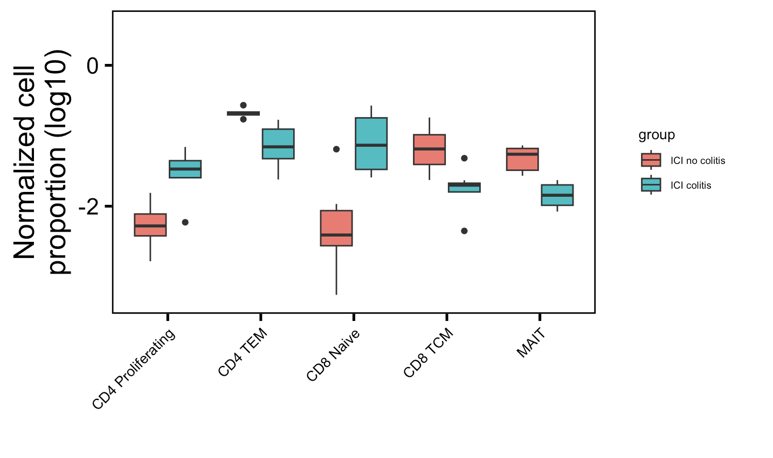
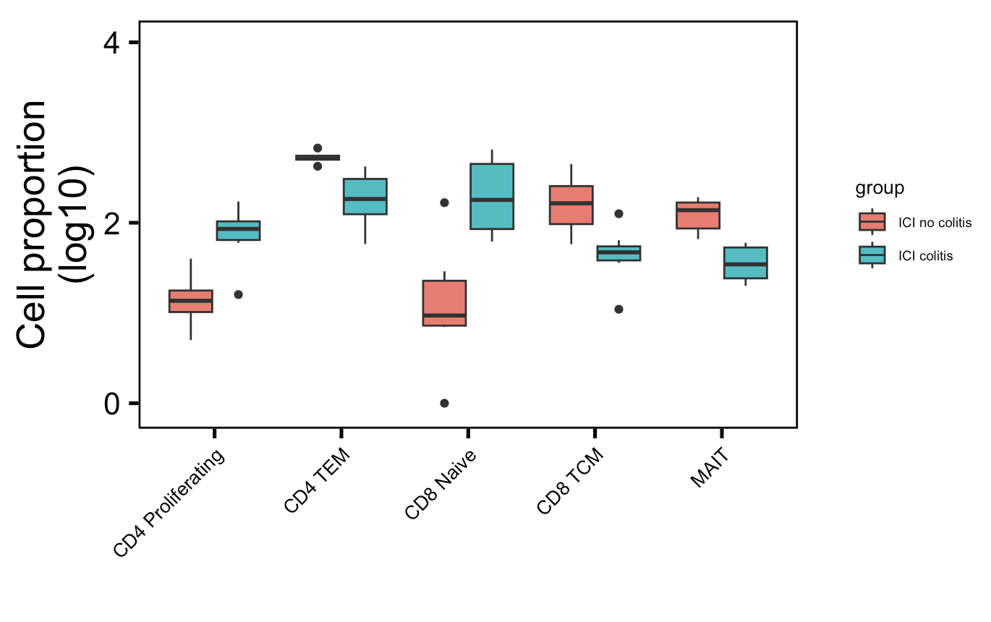
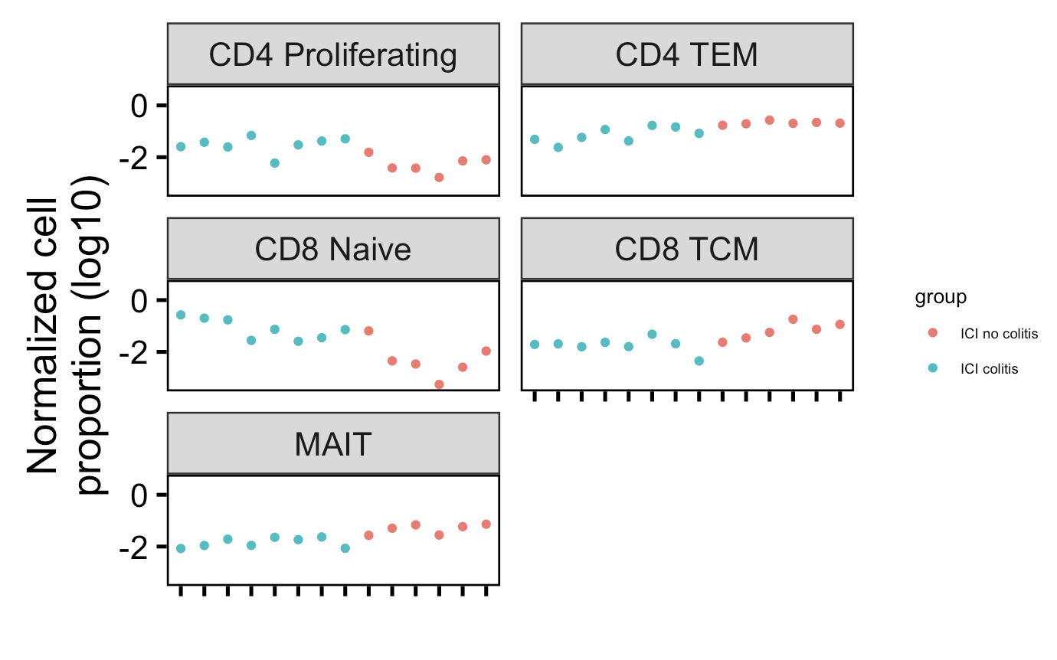
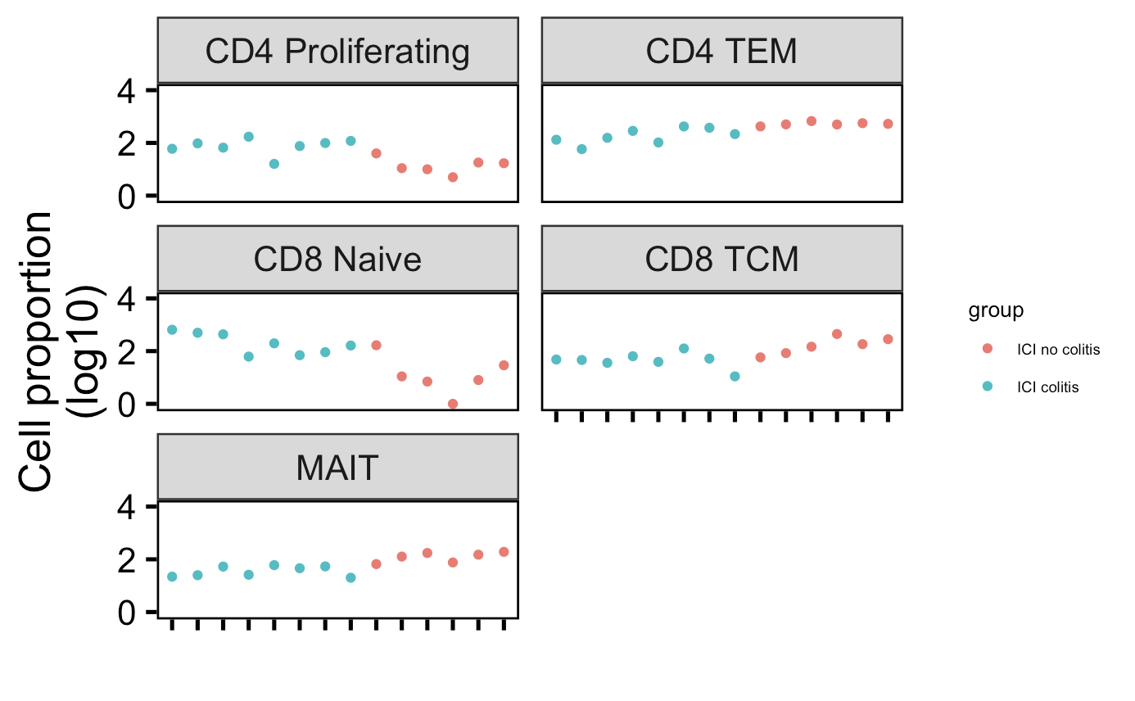
Cell type abundance differences in colitis dataset do not seem to be driven by single/few patients
Normalized by clonotype depth
Downsampled
*
**
*
*
**
*
**
*
*
**
Wilcox rank sum test: **; padj <1e-2, *; padj <0.05
Notes:
There’s only 1 patient in myocarditis dataset that had colitis and had scRNAseq data… not worth looking into anything with n = 1 I don’t think
# padj normalized by clonotype depth
# CD4 Proliferating: 0.01
# CD4 TEM: 0.004
# CD8 Naive: 0.01
# CD8 TCM: 0.01
# MAITs: 0.004
# padj values downsampled
# CD4 Proliferating: 0.01
# CD4 TEM: 0.004
# CD8 Naive: 0.02
# CD8 TCM: 0.01
# MAITs: 0.004

Slide 4
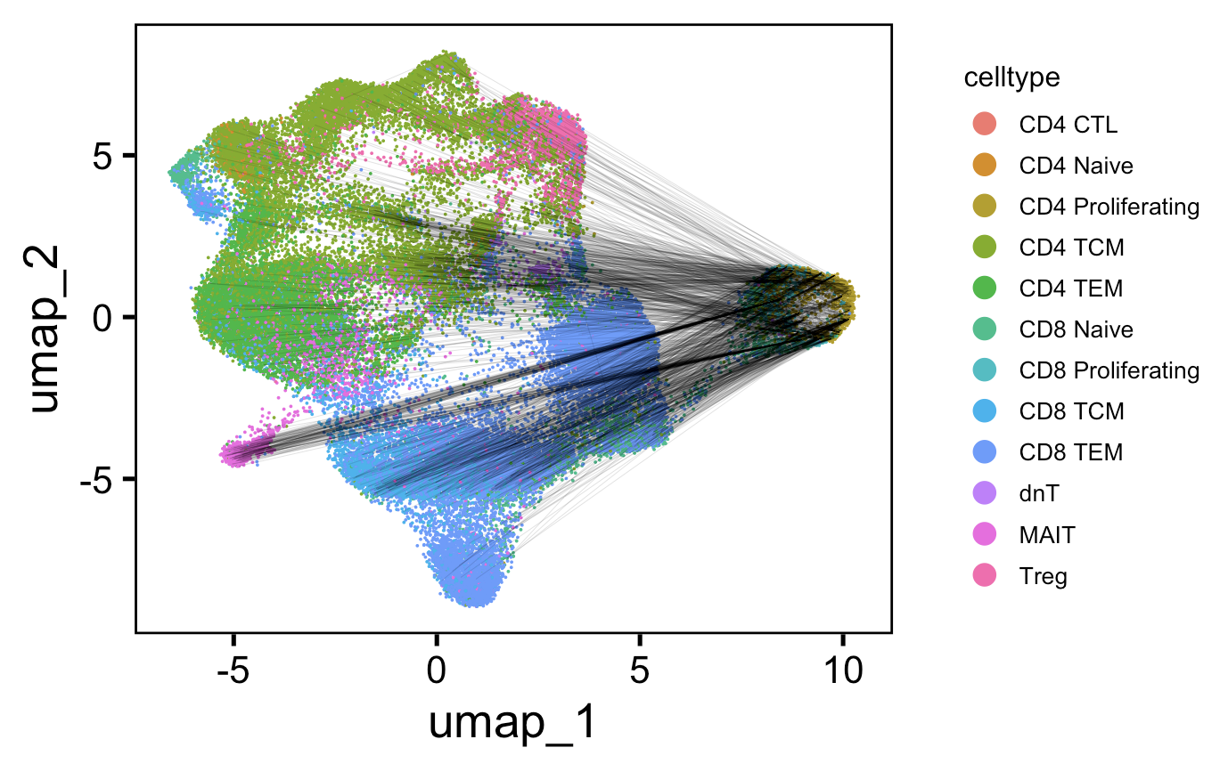
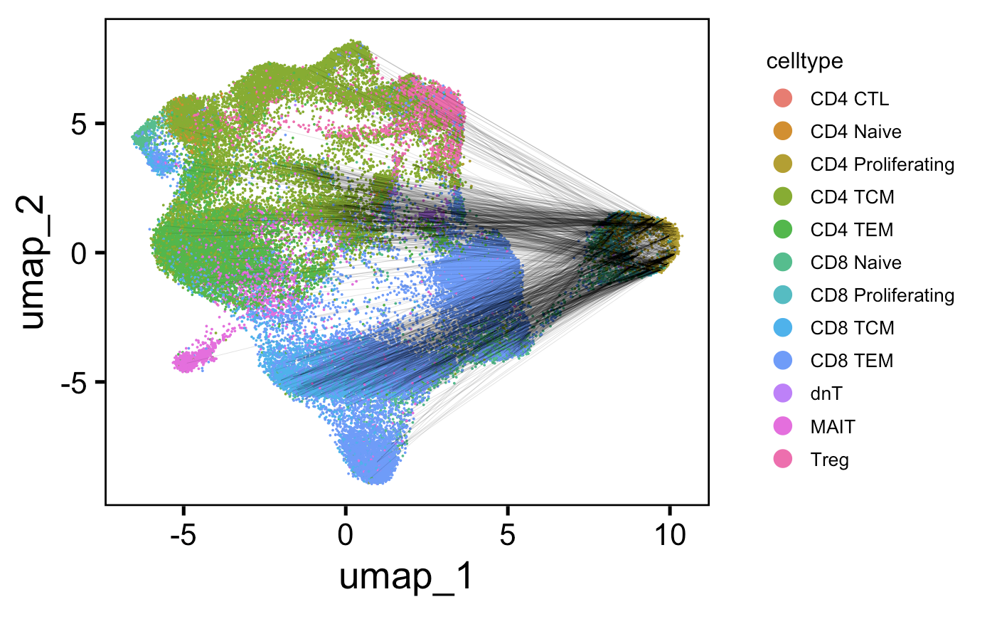
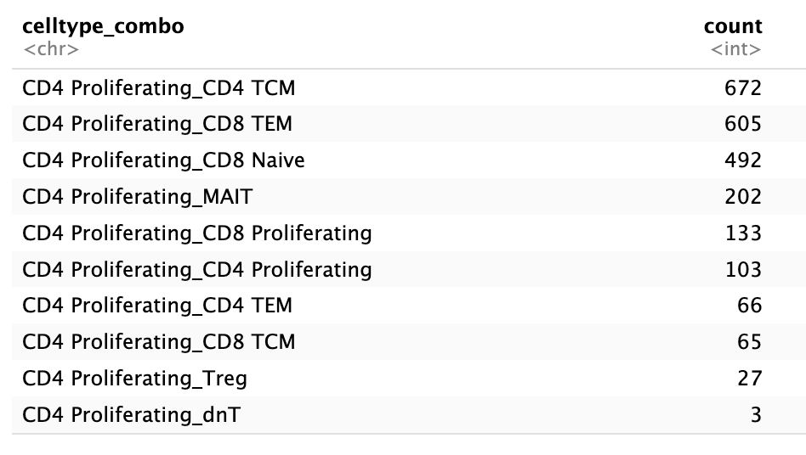
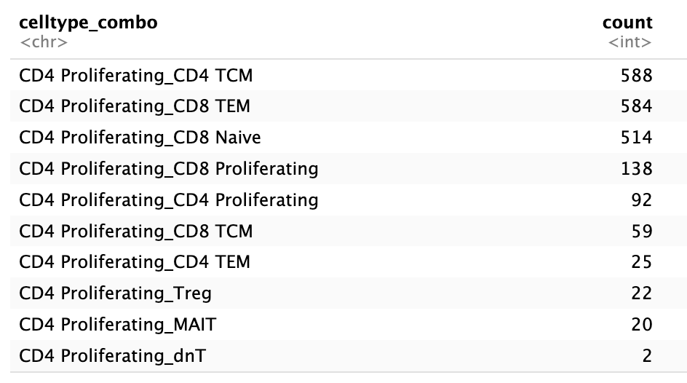
In colitis dataset, junctions of CD4 proliferating cells mostly shared with CD4 TCM, CD8 TEM, CD8 Naïve cells
TRA
TRB
Chose 1500 random linkages
to plot (memory limit)

Slide 5
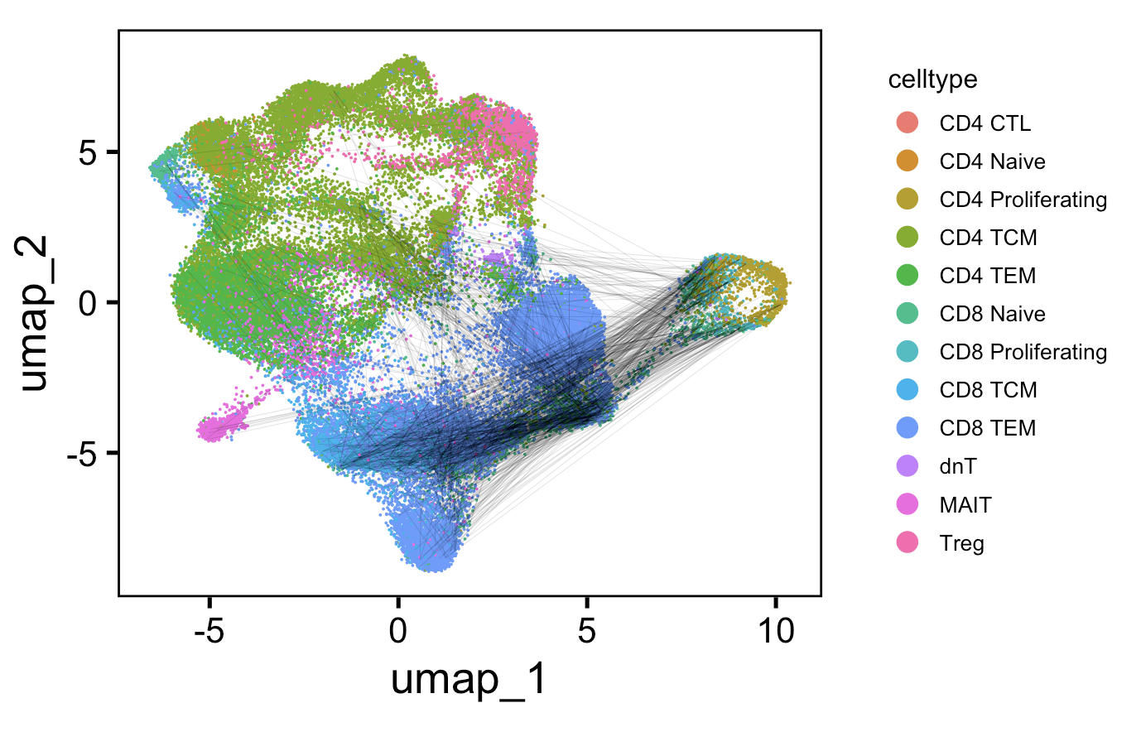
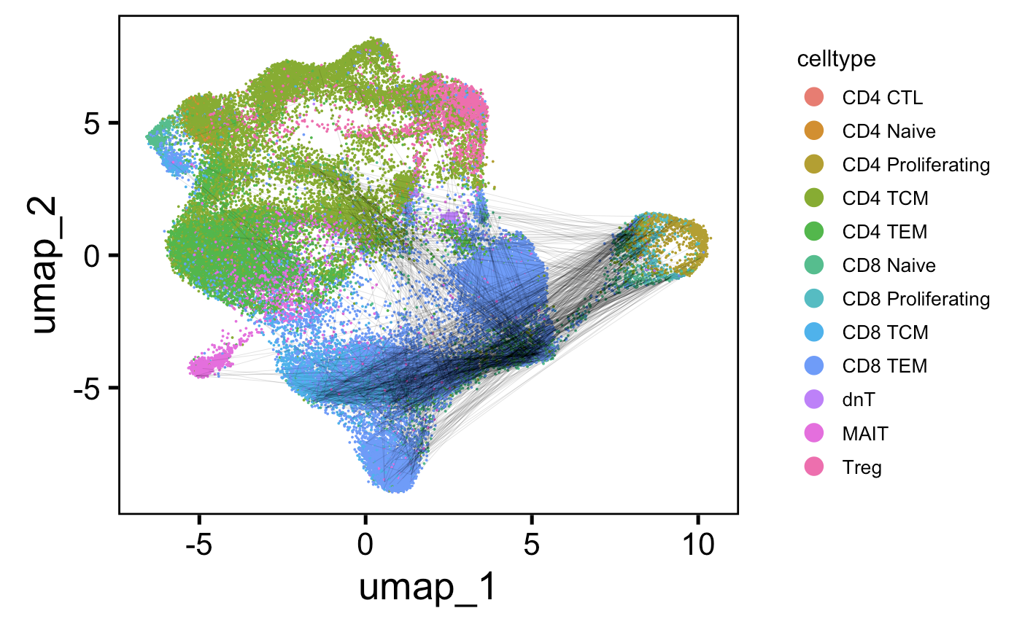
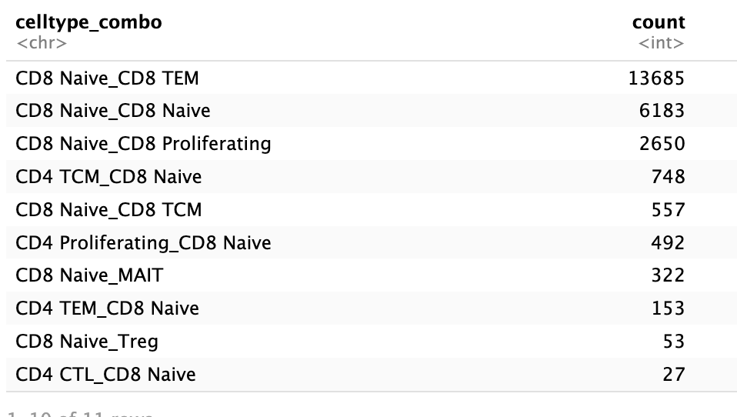
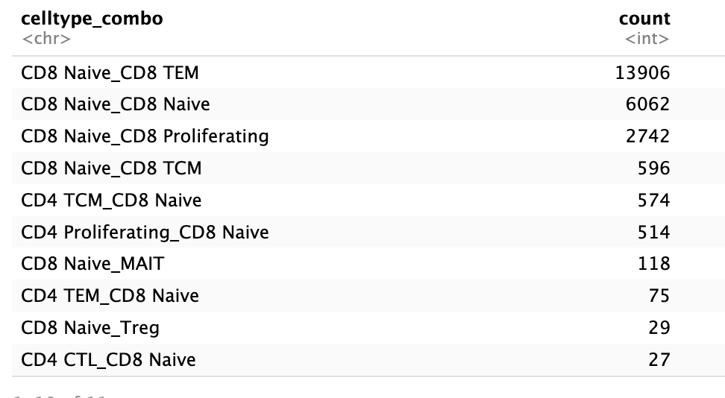
In colitis dataset, junctions of CD8 naive cells mostly shared with CD8 TEMs, themselves, CD8 proliferating cells
TRA
TRB
TRA
TRB
Chose 1500 random linkages
to plot (memory limit)

Slide 6
Convergence methods
Colitis dataset: filter out no ICI group
Group by cdr3 AA sequence
Count n_distinct cdr3 NT seqs per CDR3 AA
Ungroup
Group by CDR3 and irAE group (to deal with cases where CDR3 in both groups, also don’t want to group by patient because then double counting CDR3s?)
Slice(1)
Perform wilcox test on distributions of CDR3 NT seqs/CDR3 AA for 2 groups
To plot histogram, normalize each group by sum of counts

Slide 7
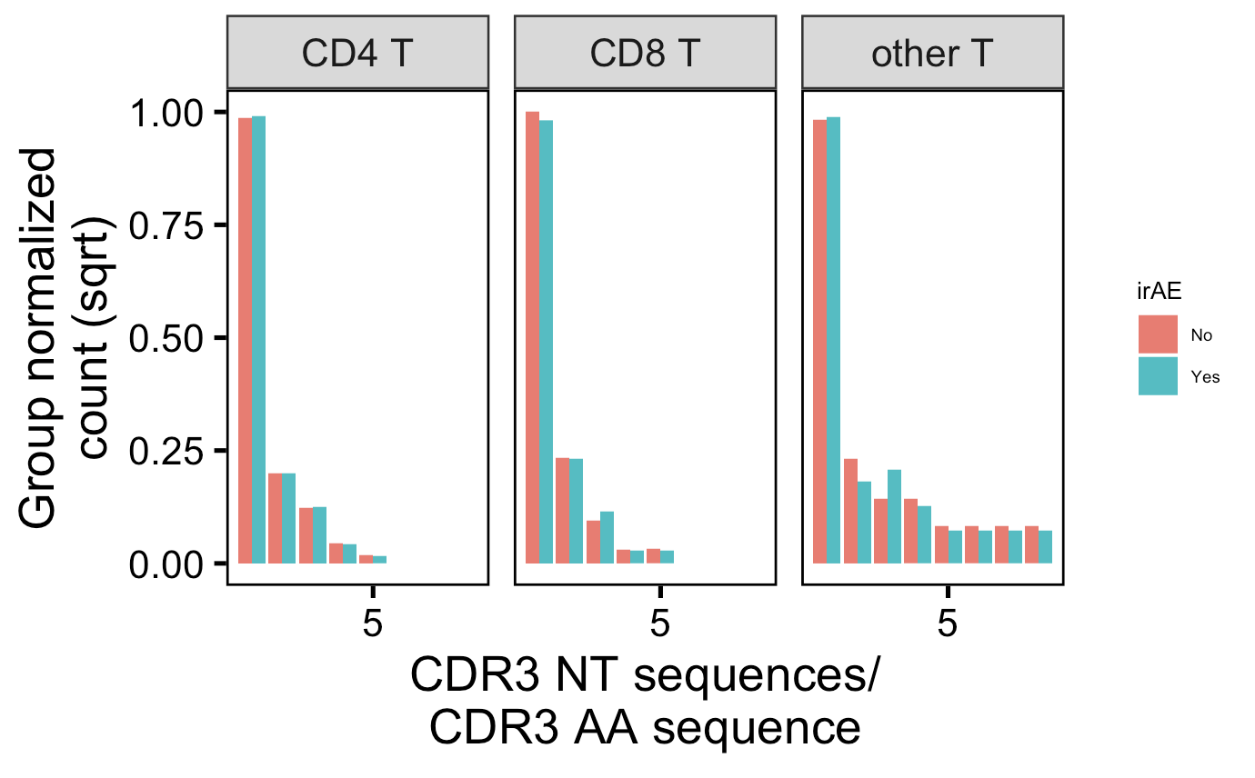
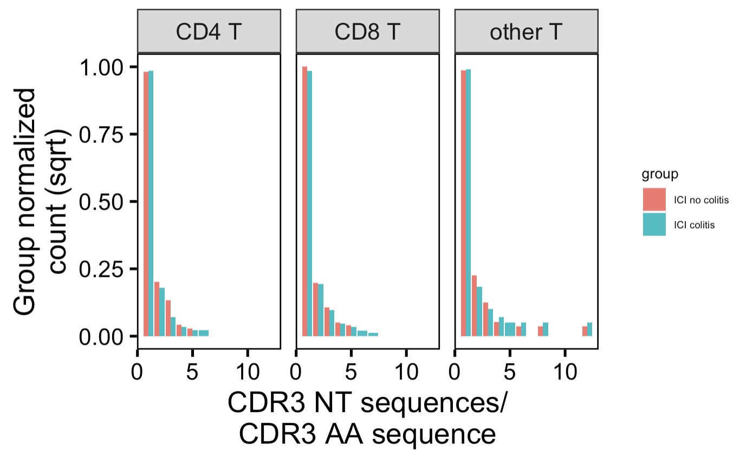
Convergence might be higher in CD4 Ts in no irAE group?
Myocarditis dataset
Colitis dataset
Caveat:
- including both intrapatient & interpatient convergence
Notes:
Myo # CD4 T: 0.00062 (padj)
Colitis # CD4 T: 2e-6 (padj)

Slide 8
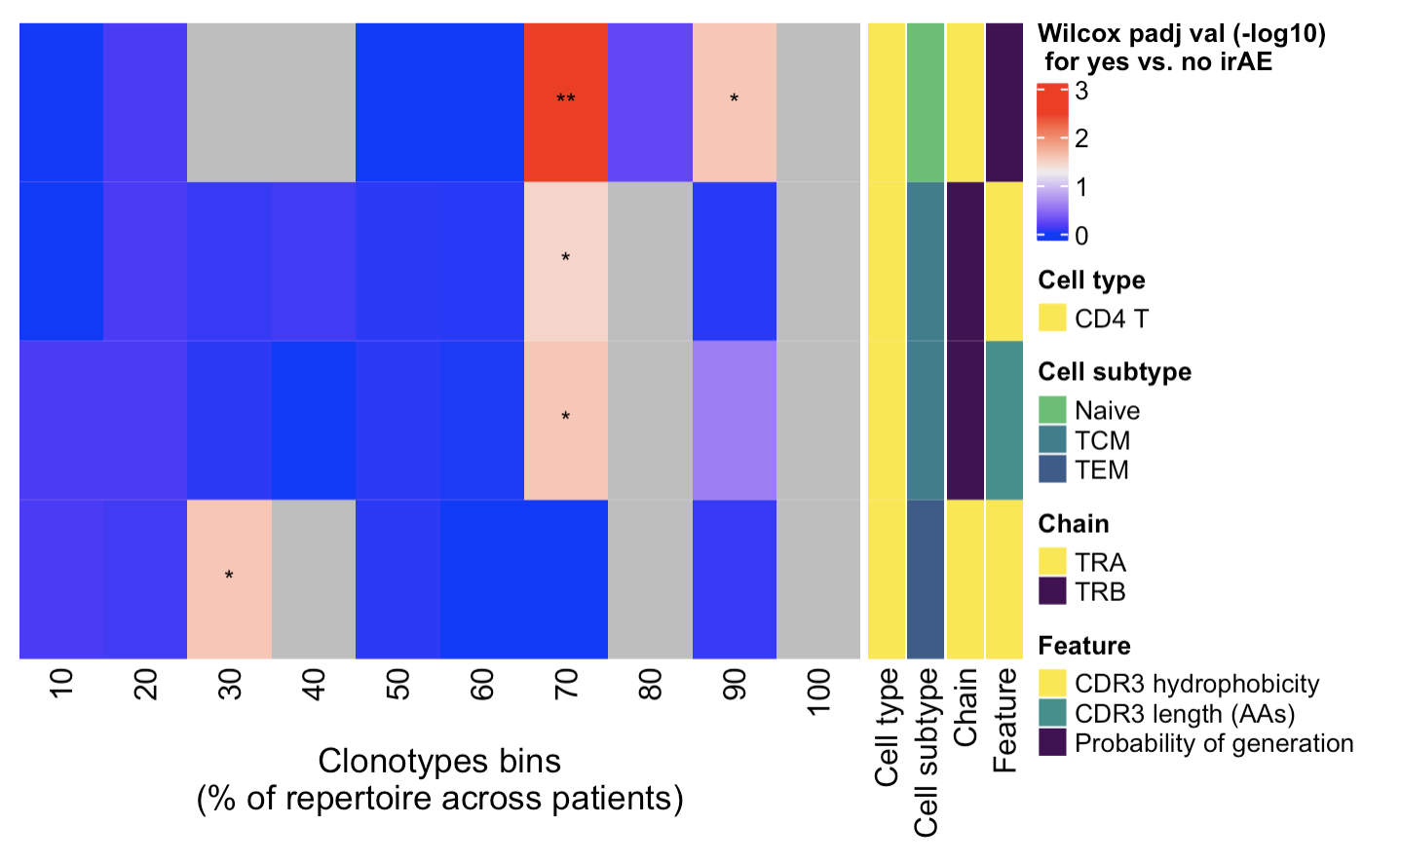
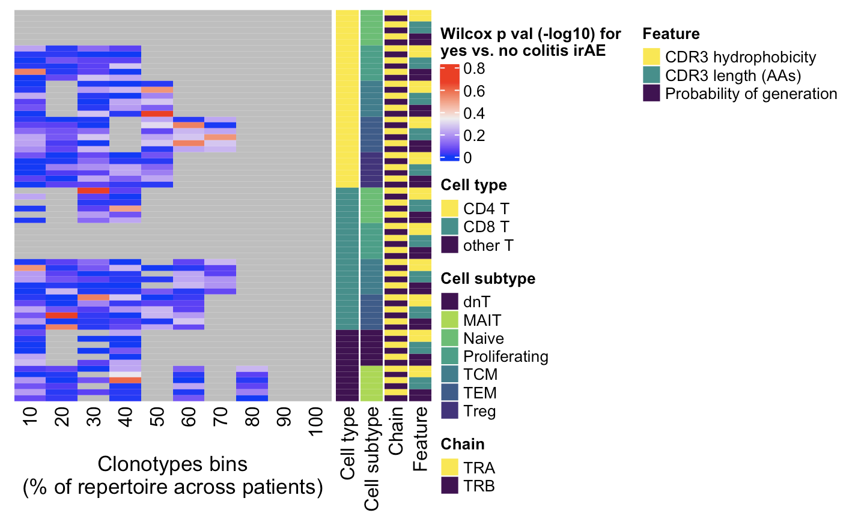
Given ability of rare clonotypes to drive disease, also looked into non-cumulative clonotype heatmaps
CD4s in myocarditis dataset (normalized by clonotype depth) have some feature differences (padj), not recapitulated if downsampled or in colitis dataset
Myocarditis dataset
Colitis dataset
← Increasing clonotype abundance
← Increasing clonotype abundance
**, p <1e-2; *; p <0.05
Notes:
# CD4 Naive TRB hydrophobicity 70, 90%
# CD4 TCM TRB hycrophobicity 70%
# CD4 TCM TRB CDR3 length 70%
# CD4 TEM TRA hydrophobicity 30%

Slide 9
Conclusions

Slide 10
Next steps

