Slide 1
Weekly meeting
7 25 2024
Ty Bottorff

Slide 2
Outline
P576 and P452 MT variant analyses
P576 UMAPs/heatmaps

Slide 3
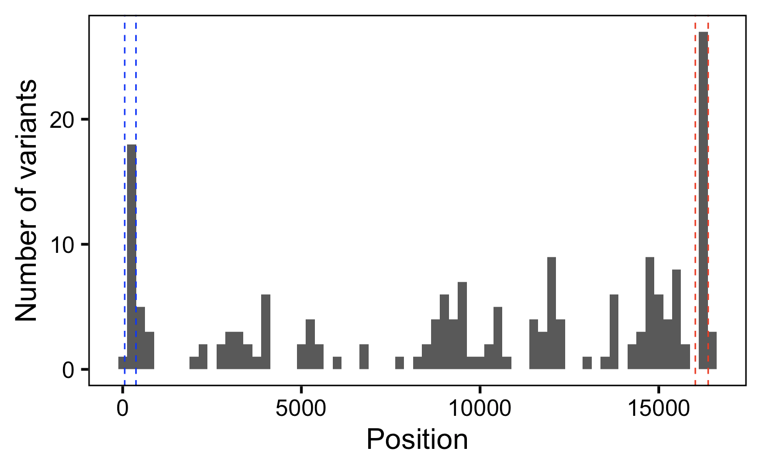
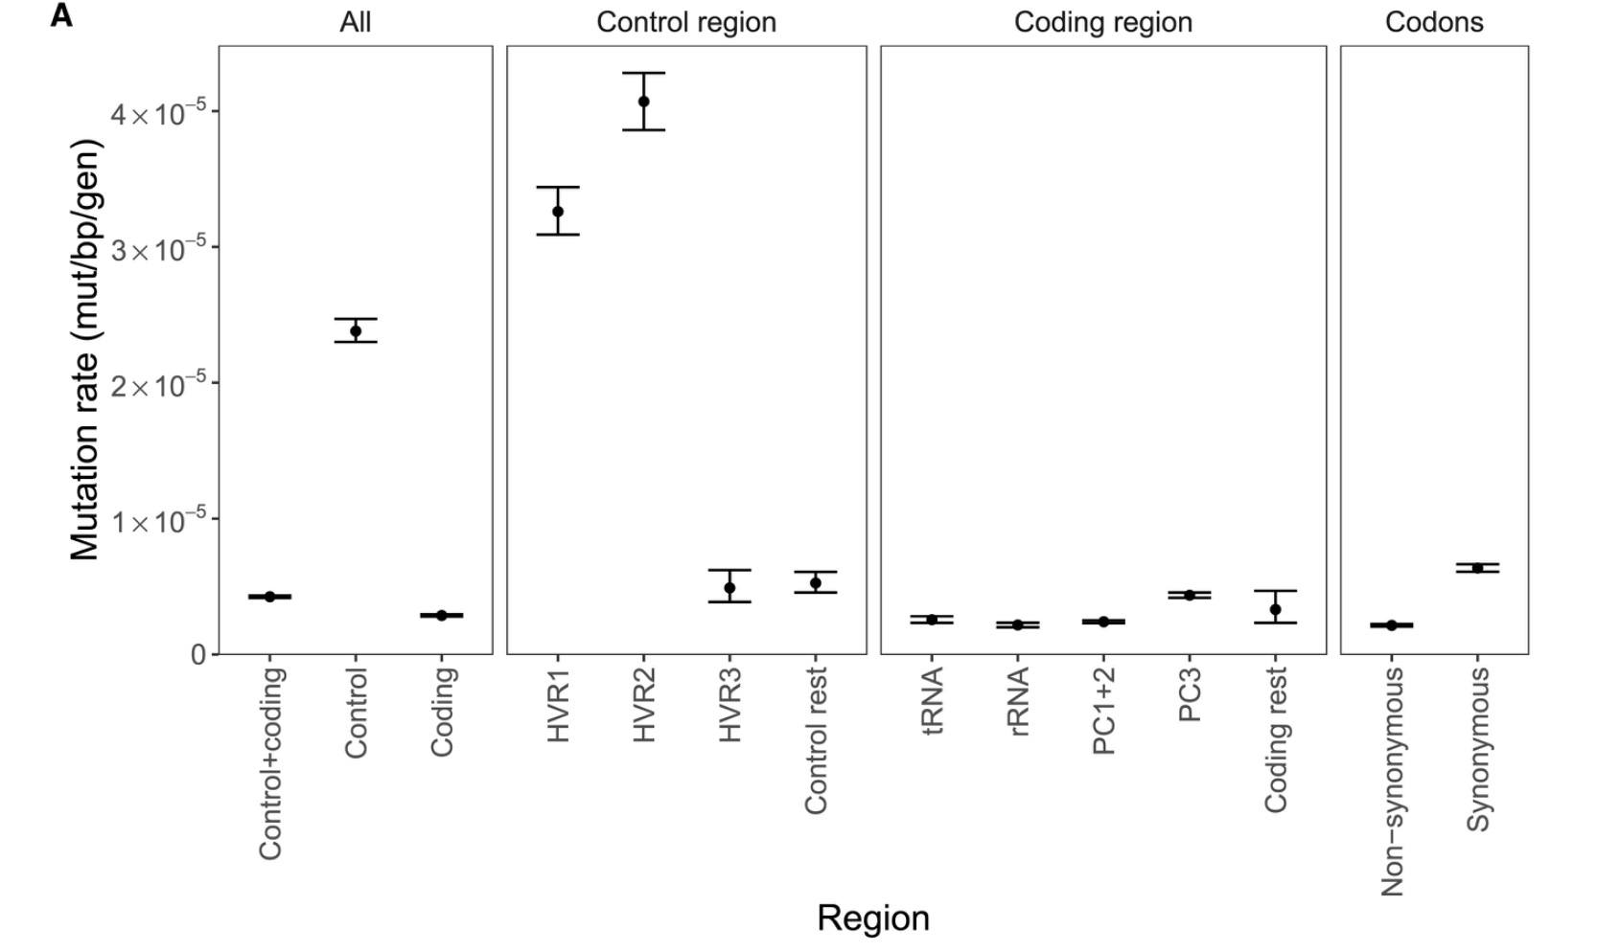
P576: SNV counts in HV1/2 vs. other regions seem to be within order of magnitude of estimated mutation rate fold differences
HV2
HV1
Árnadóttir et al. (2024) Cell

Slide 4
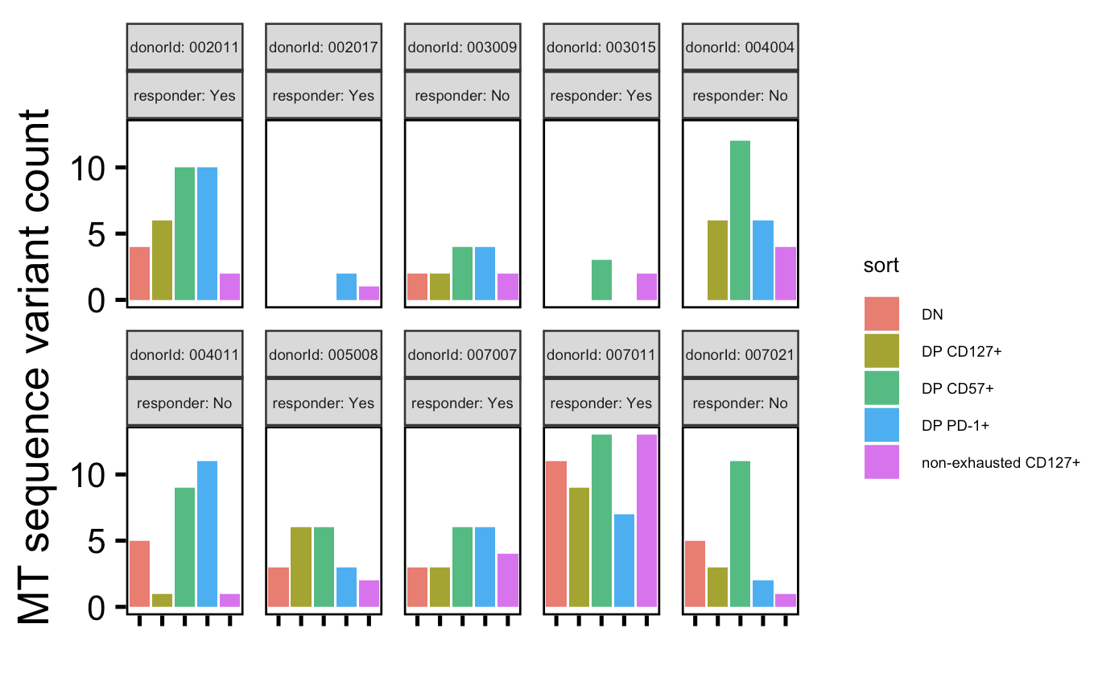
P576: MT variant ordering by cell sort is rather consistent across donors (DP CD57⁺ usually top, non-exhausted CD127⁺ usually bottom)

Slide 5
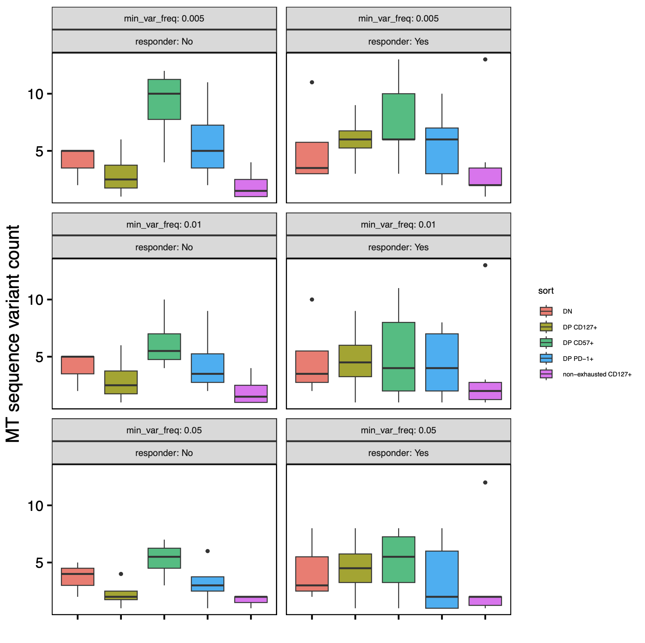
P576: no significant differences in var counts between R vs. NR, although DP CD127⁺ vars trend up in R
n = 6 (R)
n = 4 (NR)

Slide 6
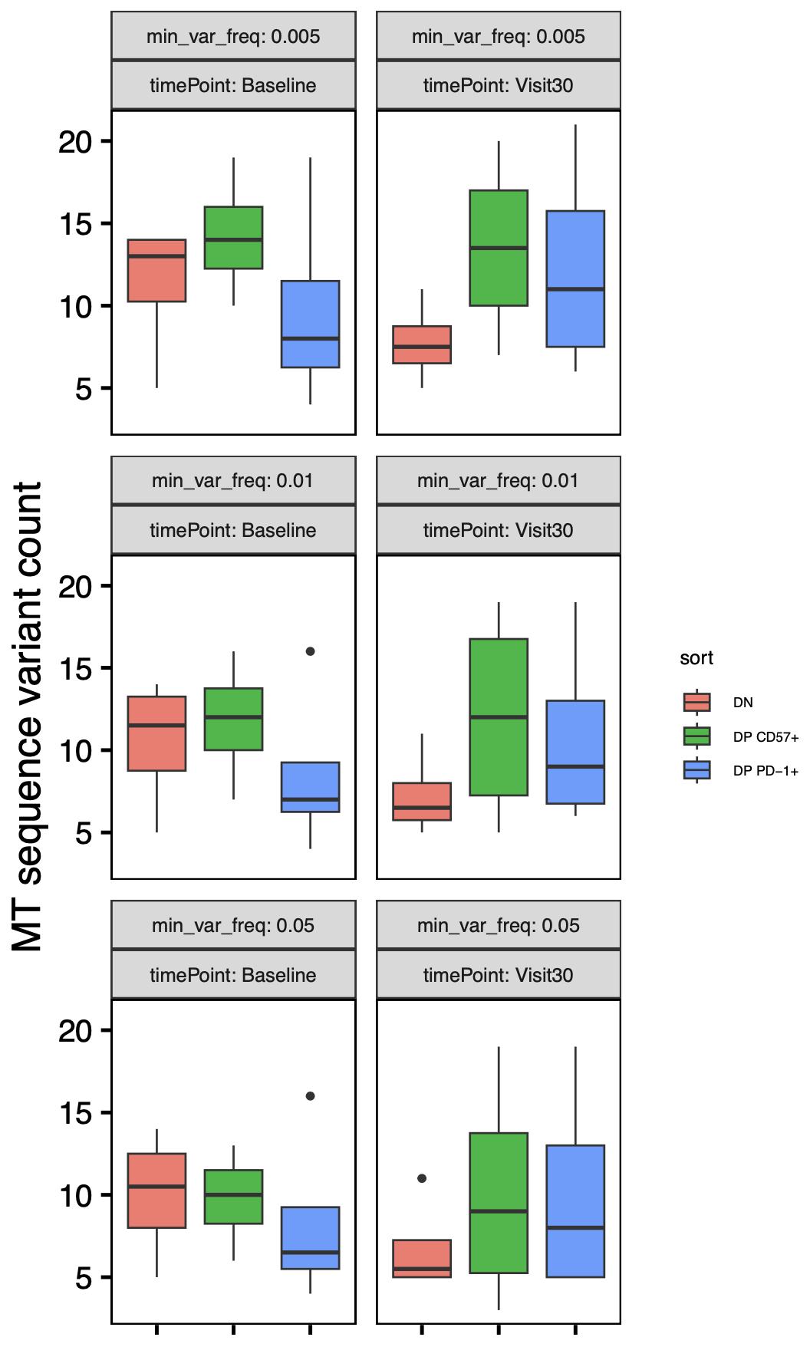
P452: no significant differences in var counts between timepoints, although DP PD-1⁺ vars trend up and DN ones trend down over time
n = 4 (donors)
Notes:
Expectation from Long lab: increased vars over time in PD-1+ and maybe CD57 already high at baseline
No significant differences between timepoints across cell sorts/min_var_freqs

Slide 7
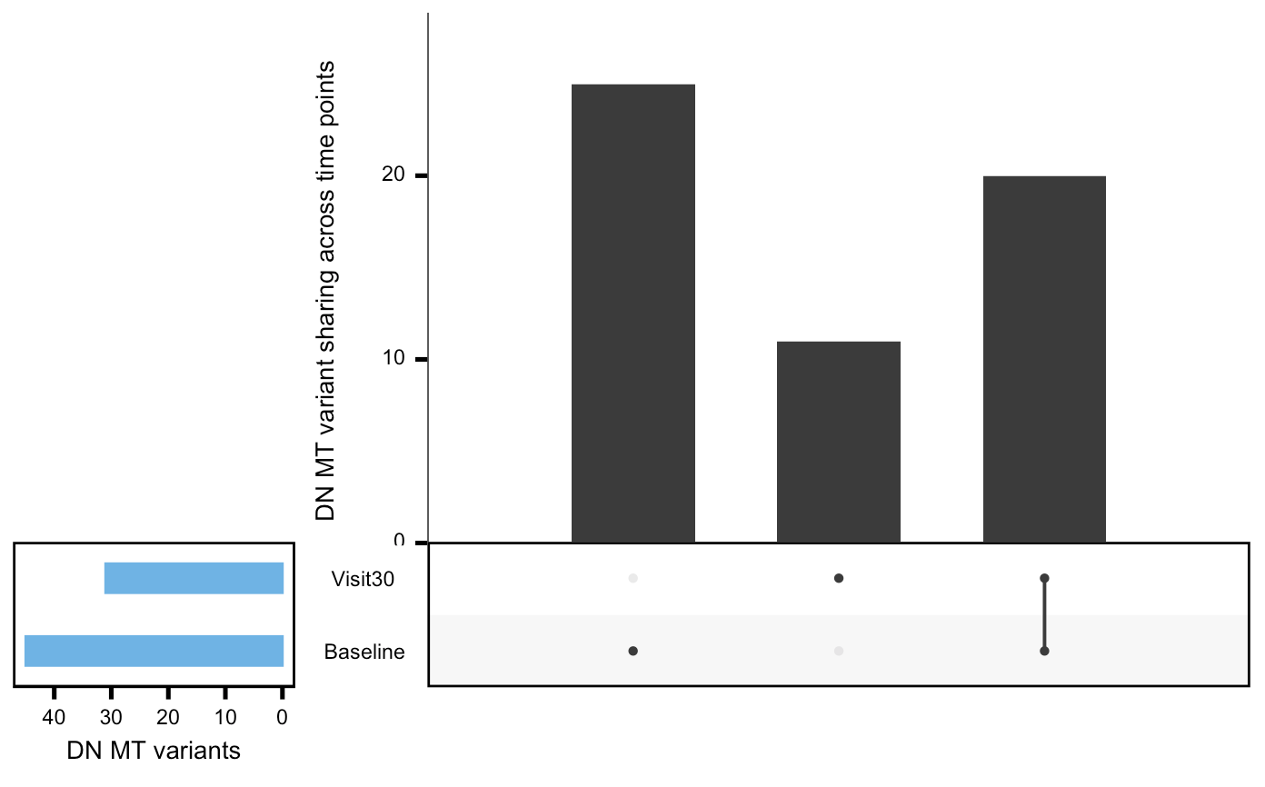
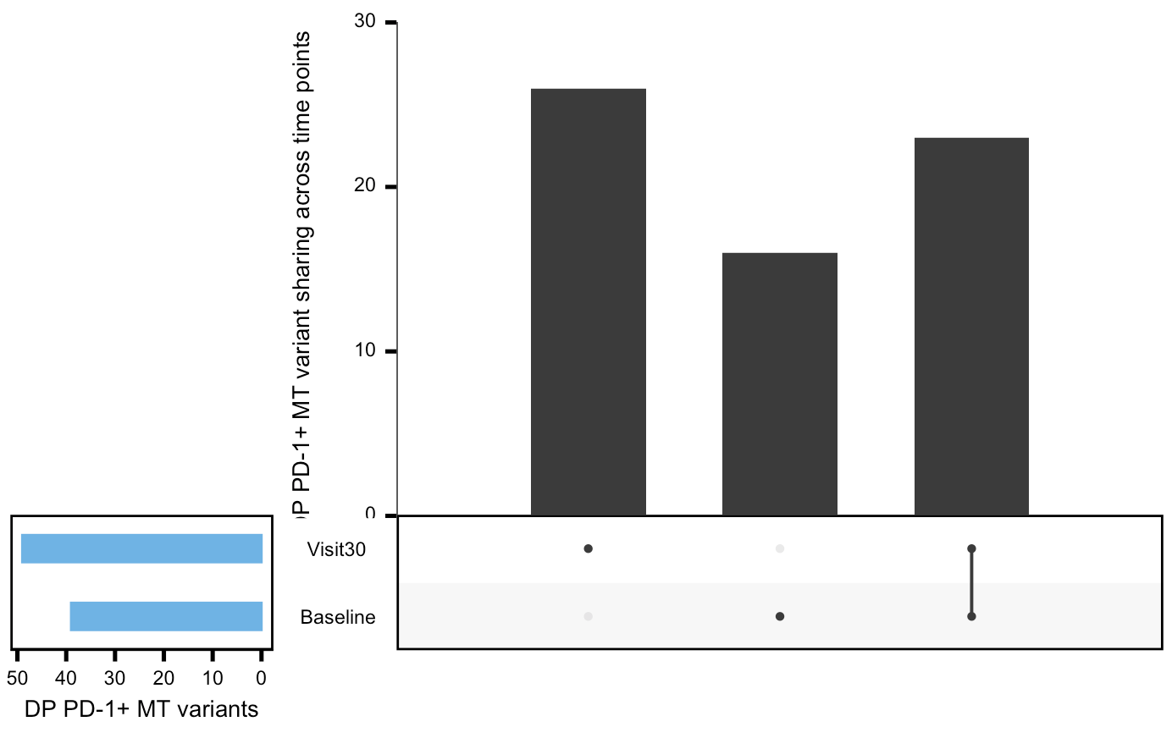
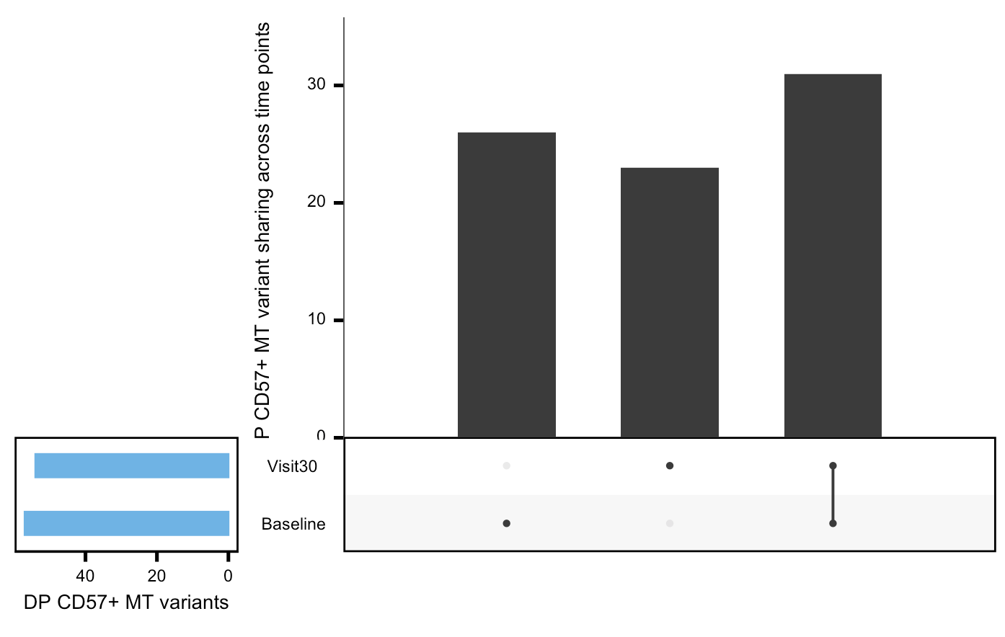
P452: observe substantial variant (position) losses and gains in all 3 cell sorts between timepoints
Notes:
Looks ~same if just considering var position not most common mut allele, so it’s that new positioned vars are being gained and lost, not that the most common allele at a var is changing
Expectation from Long lab: increased vars over time in PD-1+ and maybe CD57 already high at baseline

Slide 8
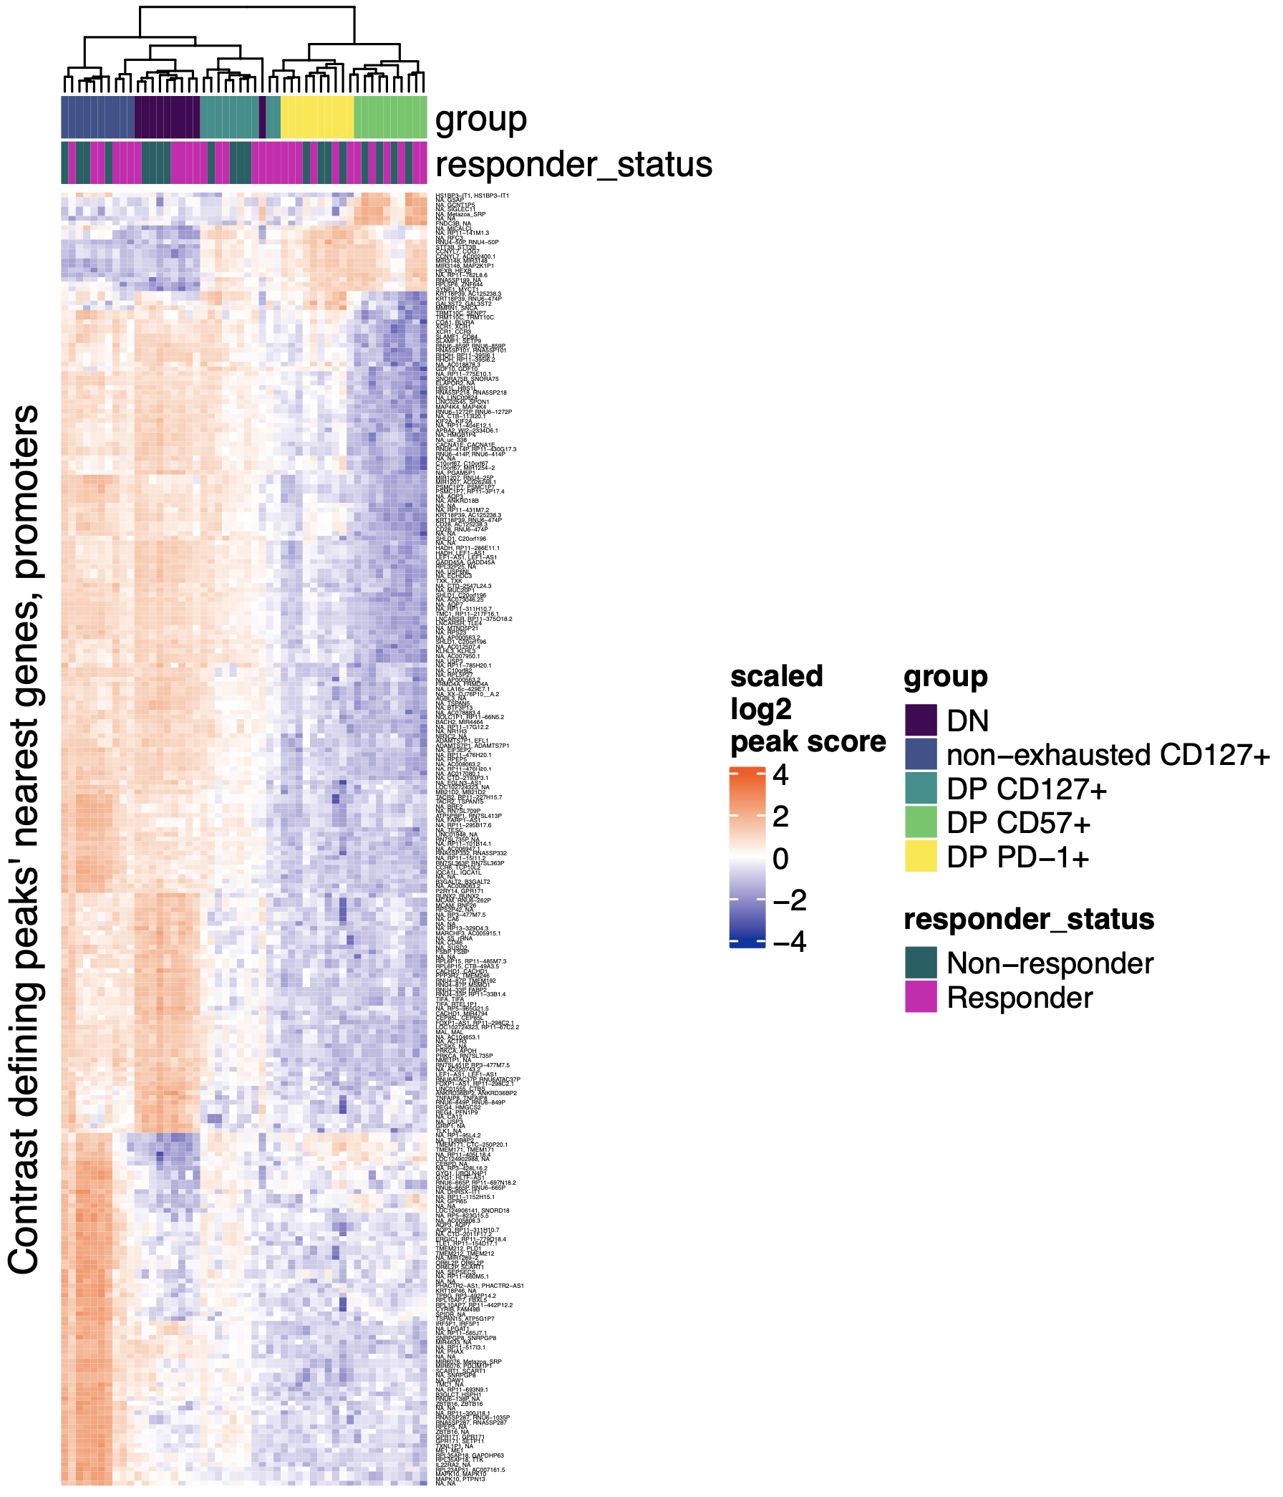
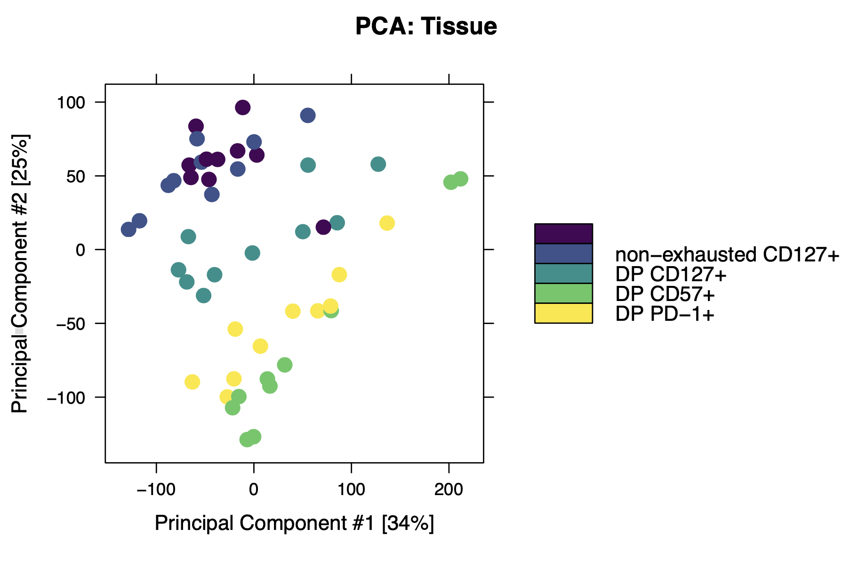
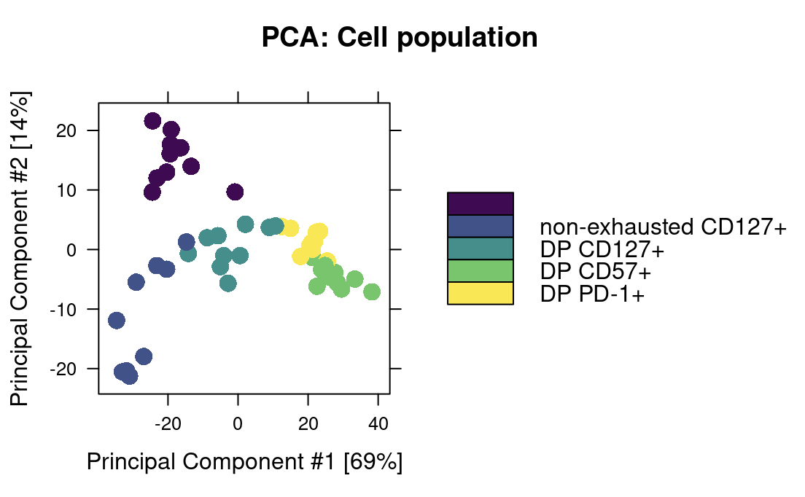
P576: combined heatmap, ~same conclusions as UMAP
DN
UMAP using heatmap peaks
DN
UMAP using all peaks
Notes:
Took top 50 contrast defining peaks per each of 10 contrasts, found unique peaks from these (213, 194 are unique gene-promoter combos but I kept all 213), then annotated rows with nearest genes, promoters
Possible motivation for this is since it’s easy to overinterpret distances in UMAP space (biased by projection), so here we can see (here biased by peaks we use for rows) how sorts differ (heatmap color blocks)

Slide 9
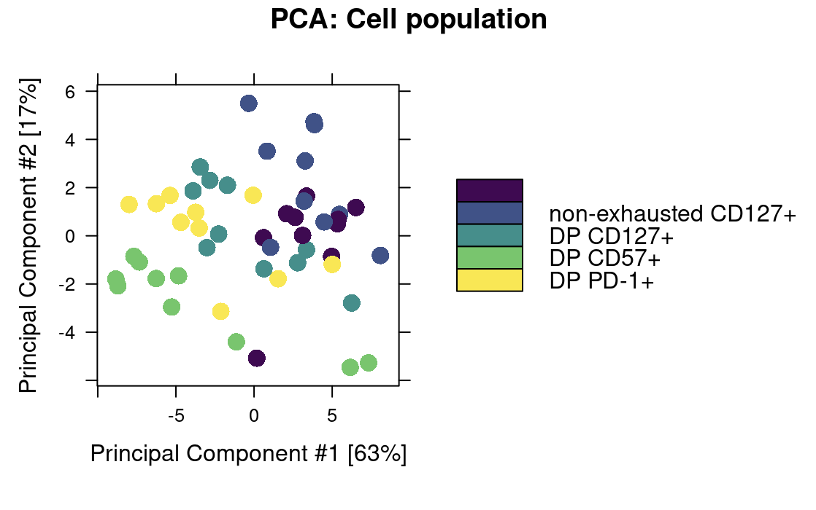
P576: using sites near exhaustion/cytotoxicity genes obscures cell sort differences in UMAP
DN
DN
*Not sure if correct sites used, still confirming

Slide 10
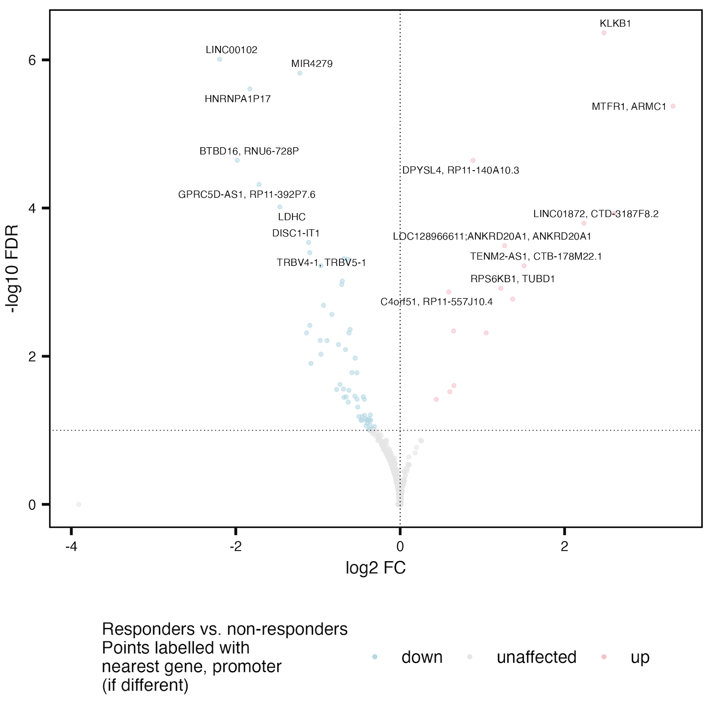
Do see some overlap of R vs. NR DARs in grouped cell sort (right) vs. 1 at a time (below)
C10orf128
F8A1
MIR1184-1
AC007679.3
PPIAP68
C10orf71
DISC1
DISQ
BTBD16
RNU6-728P
MIR4279
Notes:
Plot/analysis made with new covariate regressing out code
Adjusted for donor and responder status effects when comparing cell sorts (no big changes) and donor and sort effects when comparing R vs. NR

Slide 11
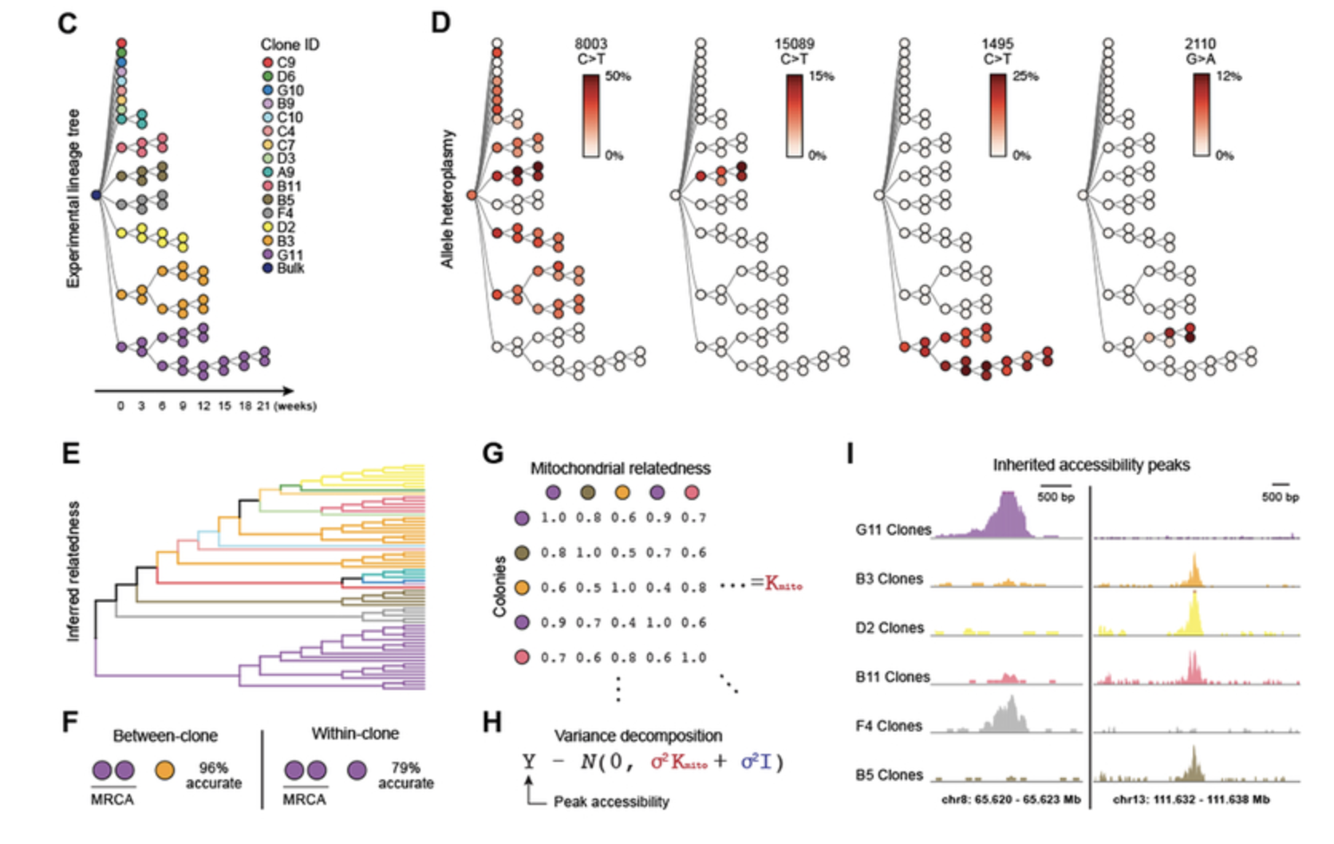
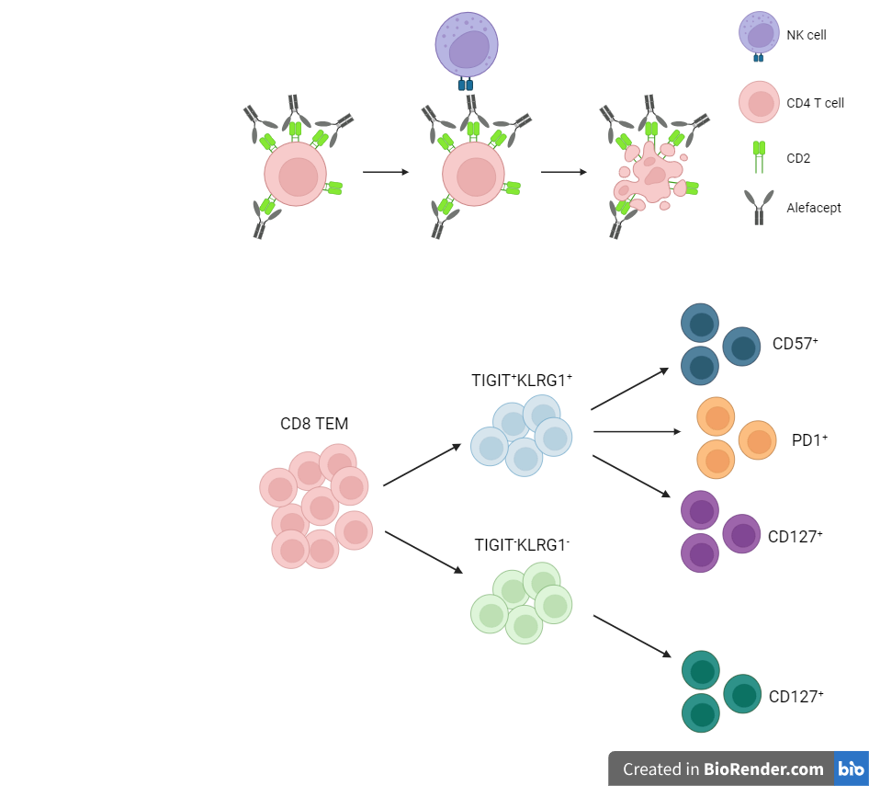
Next experiment ideas
Unique benefits of scATAC/STAMP over bulk
scATACseq: if interested in both MT genome (SNVs) and nuclear genome (> 80% of reads likely)
scSTAMP: sequencing by targeted amplification of multiplex probes, if only interested in MT genome, already applied in human immune cells (Guo et al, 2022, PNAS)
More sequencing of current libraries: would only expect < 20% of additional reads to map to MT genome, so mileage wouldn’t go very far for MT vars specifically, might be of use to re-run variant calling on downsampled P576
Plan: create fig E diagram and color by cell sort
Perhaps would want to change sorting strategy to include parent DP. PD-1⁺ and CD57⁺, or CD127⁺ ever co-expressed?
TIGIT⁺
KLRG1⁺ (DP)
non-naive
CD8s
DP CD57⁺
Ludwig et al. (2020) Cell
DP PD1⁺
DP CD127⁺
non-exhausted (not DP) CD127⁺
TIGIT⁻KLRG1⁻ (DN)

Slide 12
Conclusions
P576 peak score heatmaps by cell sort AND responder status: responder status annotation doesn’t add any info to clustering of cytotoxicity/exhaustion gene/promoter peaks (data not shown)
Notes:
heatmaps look at R vs. NR (slide 11), perhaps that explains sorts splitting in 2 places

Slide 13
Next steps
Re-run variant calling on downsampled P576 to get a sense of how much additional sequencing might help

