Slide 1
Weekly meeting
10 12 2023
Ty Bottorff

Slide 2
Outline
Clarification of hypothesis
Progress in exploring unanalyzed data from T cell characteristics associated with toxicity to immune checkpoint blockade in patients with melanoma
Next steps
Plans to explore unanalyzed data from other papers after brief data reproduction
Distinct mechanisms of mismatch repair deficiency delineate two modes of response to PD-1 immunotherapy in endometrial carcinoma
Lineage tracing reveals clonotype progenitors and long-term persistence of tumor-specific T cells during immune checkpoint blockade

Slide 3
Hypothesis: TCRs of expanding cells during ICB might have specific distinguishing features (length/germline-ness) that predict irAE development
Rationale
ICI induces expansion of peripheral¹ and tumor infiltrating² tumor-specific T cells
irAE development associated with…
Clonal expansion of more T cell clones in peripheral blood³
Early expansion of Ki-67⁺ Tregs and CD8⁺ T cells⁴
Increased expansion of peripheral activated CD4 T_{EM}⁵
Correction from Peter: this isn’t as established as I make it sound here → 1st half of goal is to test if TCR expansion is related to irAE development (and not just co-occurring randomly)
Big picture: irAEs arise due to cross-reactive TCRs reacting to tumor and self
How broad is this potential cross-reactivity? Relationship between TCR features and cross-reactivity?
Post-meeting idea from literature: we expect more germline-like TCRs to be more cross-reactive as they have lower sequence complexity?
Distinct from shared (tissue-associated) antigens (antigen mimicry) between tumor and self?
irAE most likely in most similar healthy tissue to tumor, same T cell clonotypes infiltrate lung tumor and autoimmune skin lesions⁶
Clinical response with avoidance of irAEs perhaps more likely with tumors with high mutational burdens, more neoantigens (barring cross-reactivity between mutant neoantigens and WT healthy antigens)

Slide 4
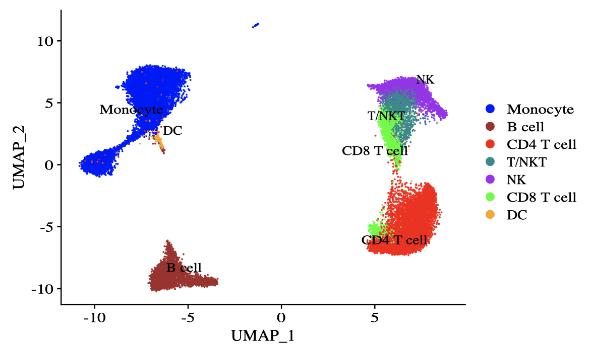
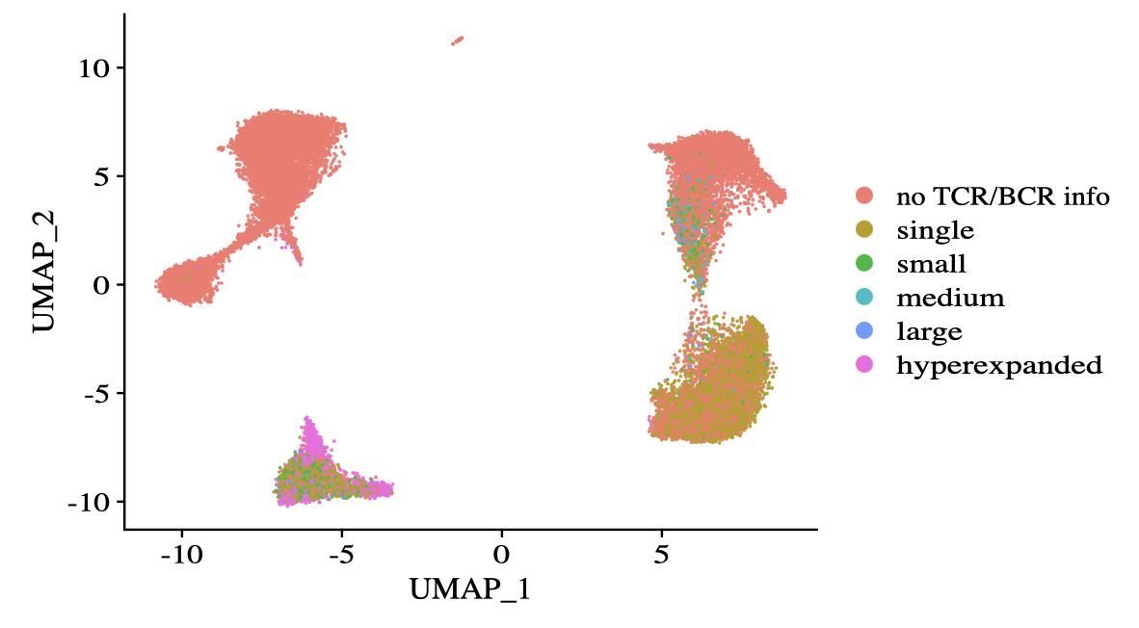
Newman lab data: B cells show the highest degree of (CDR3-measured) expansion

Slide 5
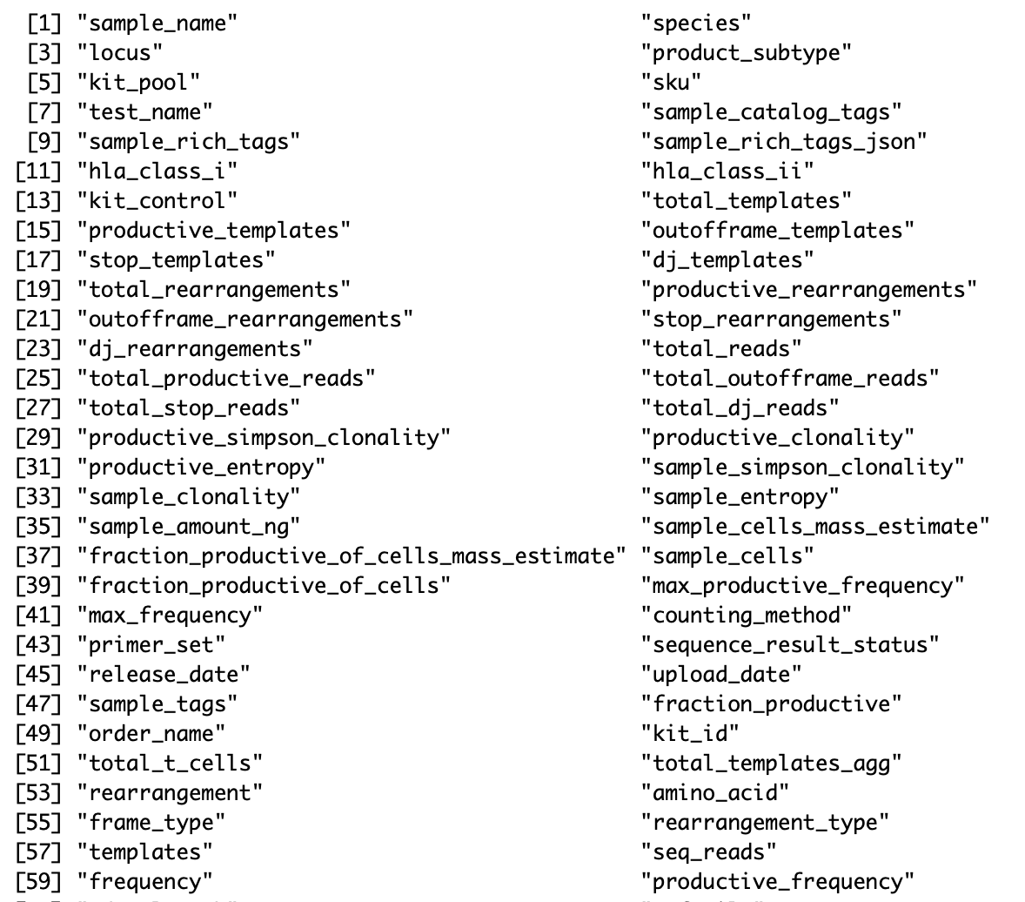
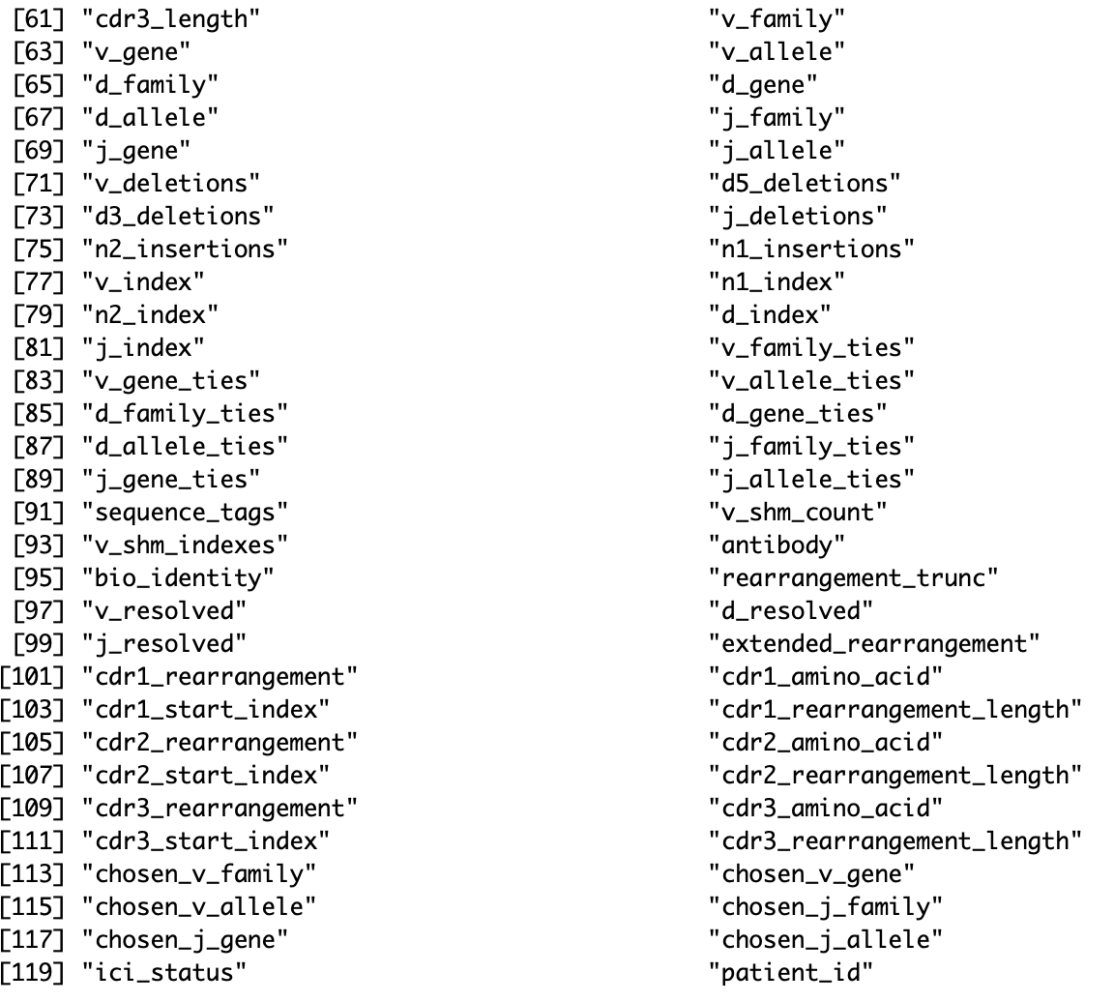
ImmunoSEQ bulk TCRβ chain profiling data included some TCR length and germline-ness measures

Slide 6
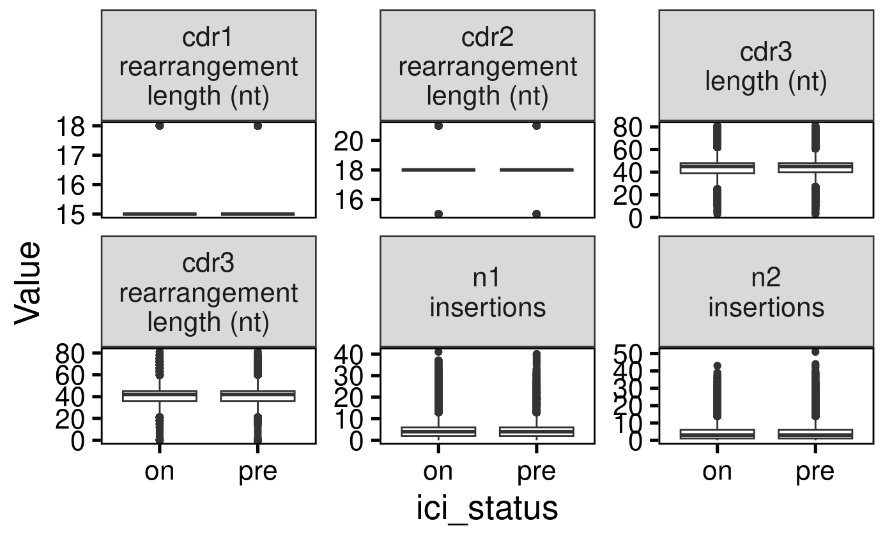
Bulk TCRβ chain profiling shows no differences before and on ICI treatment

Slide 7
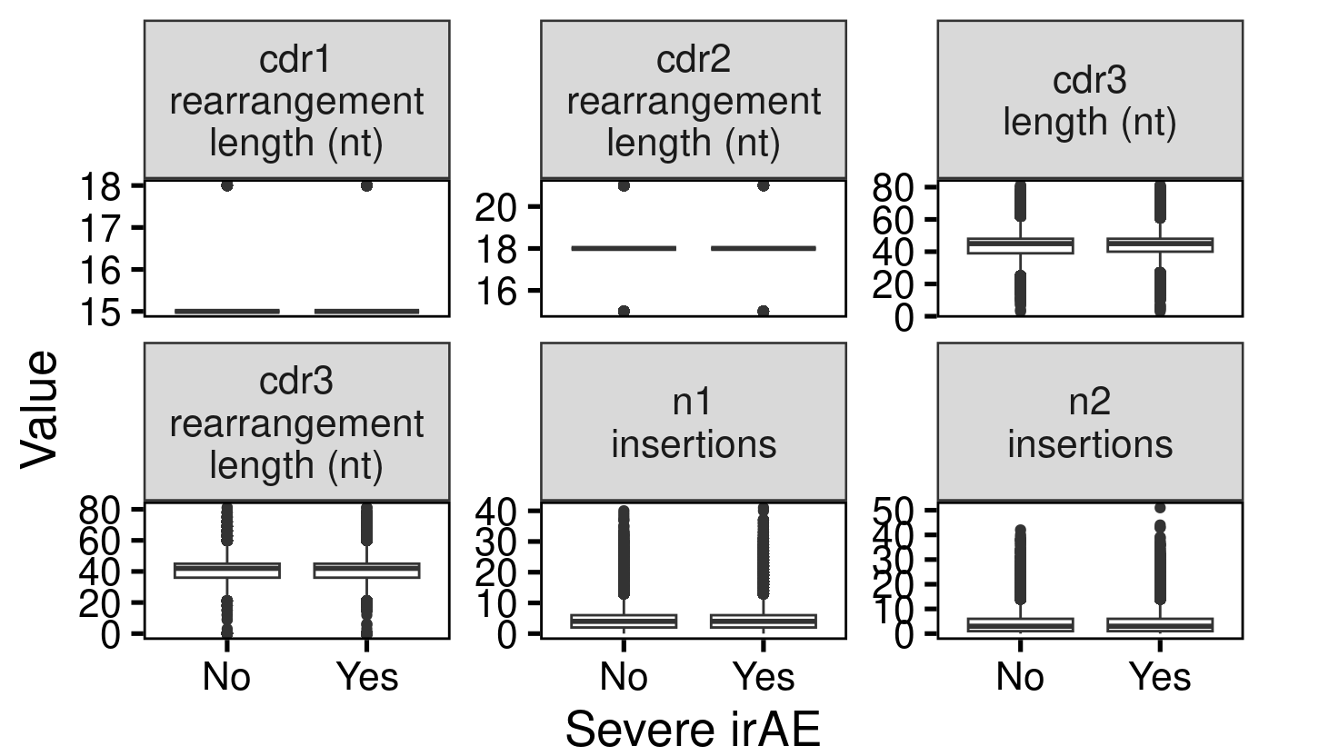
Bulk TCRβ chain profiling shows no differences by severe irAE development

Slide 8
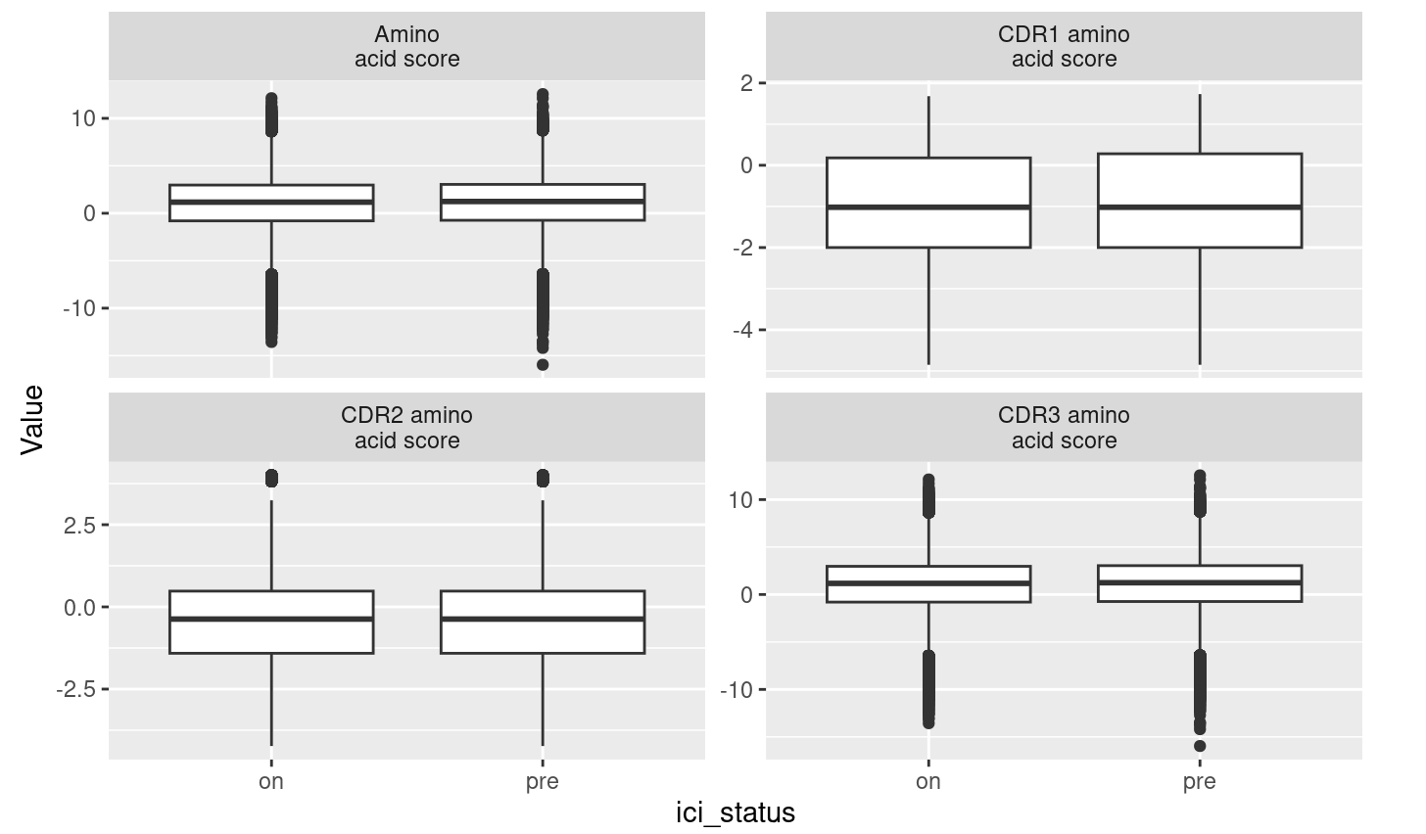
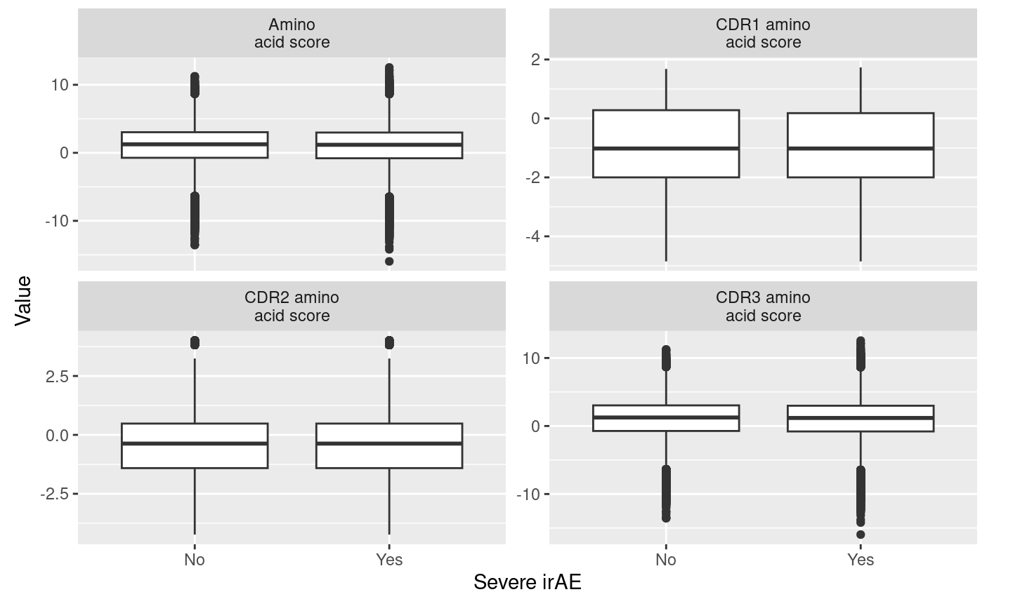
Bulk TCRβ chain profiling of amino acid hydrophobicity shows no differences by ICI status or severe irAE development

Slide 9
Next steps with this dataset before moving on to other datasets
Use Stitchr to produce complete TCR cDNAs from V/J/CDR3 AA sequences
Input into IMGT/HighV-QUEST
Input into IGoR for probability of generation score (higher meaning more germline-like)

Slide 10
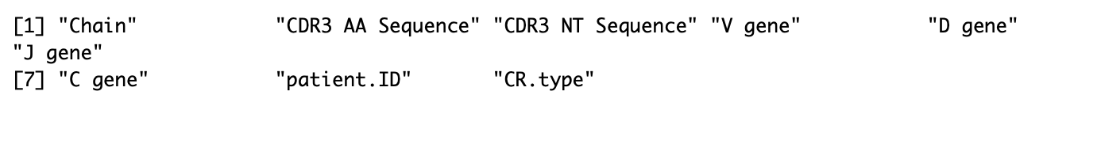
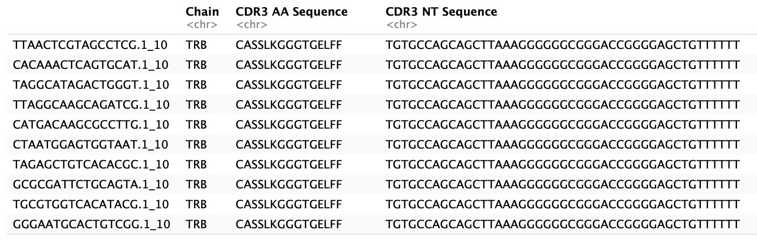
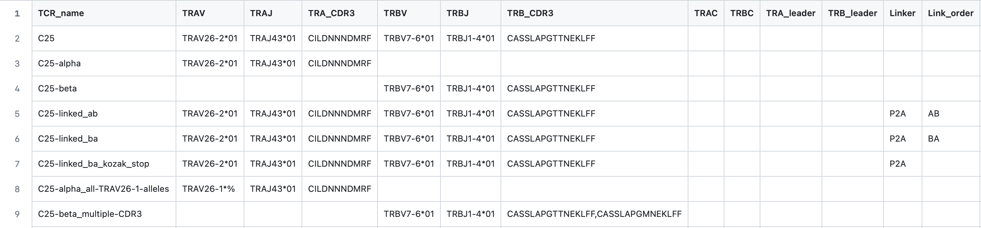
Stitchr pre-processing
V(D)Jseq data from Newman lab
Stitchr input example

Slide 11
Next steps with other datasets
Other datasets
Distinct mechanisms of mismatch repair deficiency delineate two modes of response to PD-1 immunotherapy in endometrial carcinoma
Lineage tracing reveals clonotype progenitors and long-term persistence of tumor-specific T cells during immune checkpoint blockade
Plan
Summarizing main findings, limitations, unexplored areas
Brief data reproduction
Analyze scRNA/TCRseq
Germline-ness
IMGT/HighV-Quest
IGoR
Expansion
Length
Hydrophobicity, perhaps relates to cross-reactivity
Notes:
Eisenberg hydrophobicity scale

Slide 12
References
Le DT, Durham JN, Smith KN, Wang H, Bartlett BR, Aulakh LK, Lu S, Kemberling H, Wilt C, Luber BS, Wong F, Azad NS, Rucki AA, Laheru D, Donehower R, Zaheer A, Fisher GA, Crocenzi TS, Lee JJ, Greten TF, Duffy AG, Ciombor KK, Eyring AD, Lam BH, Joe A, Kang SP, Holdhoff M, Danilova L, Cope L, Meyer C, Zhou S, Goldberg RM, Armstrong DK, Bever KM, Fader AN, Taube J, Housseau F, Spetzler D, Xiao N, Pardoll DM, Papadopoulos N, Kinzler KW, Eshleman JR, Vogelstein B, Anders RA, Diaz LA Jr. Mismatch repair deficiency predicts response of solid tumors to PD-1 blockade. Science. 2017 Jul 28;357(6349):409-413. doi: 10.1126/science.aan6733. Epub 2017 Jun 8. PMID: 28596308; PMCID: PMC5576142.
Wei SC, Levine JH, Cogdill AP, Zhao Y, Anang NAS, Andrews MC, Sharma P, Wang J, Wargo JA, Pe'er D, Allison JP. Distinct Cellular Mechanisms Underlie Anti-CTLA-4 and Anti-PD-1 Checkpoint Blockade. Cell. 2017 Sep 7;170(6):1120-1133.e17. doi: 10.1016/j.cell.2017.07.024. Epub 2017 Aug 10. PMID: 28803728; PMCID: PMC5591072.
Subudhi SK, Aparicio A, Gao J, Zurita AJ, Araujo JC, Logothetis CJ, Tahir SA, Korivi BR, Slack RS, Vence L, Emerson RO, Yusko E, Vignali M, Robins HS, Sun J, Allison JP, Sharma P. Clonal expansion of CD8 T cells in the systemic circulation precedes development of ipilimumab-induced toxicities. Proc Natl Acad Sci U S A. 2016 Oct 18;113(42):11919-11924. doi: 10.1073/pnas.1611421113. Epub 2016 Oct 3. PMID: 27698113; PMCID: PMC5081579.
Nuñez NG, Berner F, Friebel E, Unger S, Wyss N, Gomez JM, Purde MT, Niederer R, Porsch M, Lichtensteiger C, Kramer R, Erdmann M, Schmitt C, Heinzerling L, Abdou MT, Karbach J, Schadendorf D, Zimmer L, Ugurel S, Klümper N, Hölzel M, Power L, Kreutmair S, Capone M, Madonna G, Cevhertas L, Heider A, Amaral T, Hasan Ali O, Bomze D, Dimitriou F, Diem S, Ascierto PA, Dummer R, Jäger E, Driessen C, Levesque MP, van de Veen W, Joerger M, Früh M, Becher B, Flatz L. Immune signatures predict development of autoimmune toxicity in patients with cancer treated with immune checkpoint inhibitors. Med. 2023 Feb 10;4(2):113-129.e7. doi: 10.1016/j.medj.2022.12.007. Epub 2023 Jan 23. PMID: 36693381.
Lozano AX, Chaudhuri AA, Nene A, Bacchiocchi A, Earland N, Vesely MD, Usmani A, Turner BE, Steen CB, Luca BA, Badri T, Gulati GS, Vahid MR, Khameneh F, Harris PK, Chen DY, Dhodapkar K, Sznol M, Halaban R, Newman AM. T cell characteristics associated with toxicity to immune checkpoint blockade in patients with melanoma. Nat Med. 2022 Feb;28(2):353-362. doi: 10.1038/s41591-021-01623-z. Epub 2022 Jan 13. PMID: 35027754; PMCID: PMC8866214.
Berner F, Bomze D, Diem S, Ali OH, Fässler M, Ring S, Niederer R, Ackermann CJ, Baumgaertner P, Pikor N, Cruz CG, van de Veen W, Akdis M, Nikolaev S, Läubli H, Zippelius A, Hartmann F, Cheng HW, Hönger G, Recher M, Goldman J, Cozzio A, Früh M, Neefjes J, Driessen C, Ludewig B, Hegazy AN, Jochum W, Speiser DE, Flatz L. Association of Checkpoint Inhibitor-Induced Toxic Effects With Shared Cancer and Tissue Antigens in Non-Small Cell Lung Cancer. JAMA Oncol. 2019 Jul 1;5(7):1043-1047. doi: 10.1001/jamaoncol.2019.0402. Erratum in: JAMA Oncol. 2019 Jul 1;5(7):1070. PMID: 31021392; PMCID: PMC6487908.

Slide 13
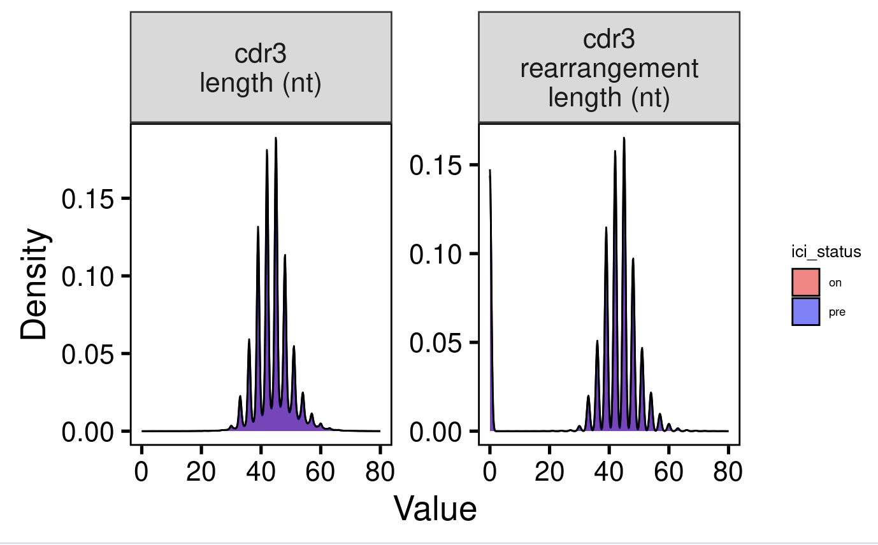
Bulk TCRβ chain profiling of CDR3 shows no differences before and on ICI treatment

Slide 14
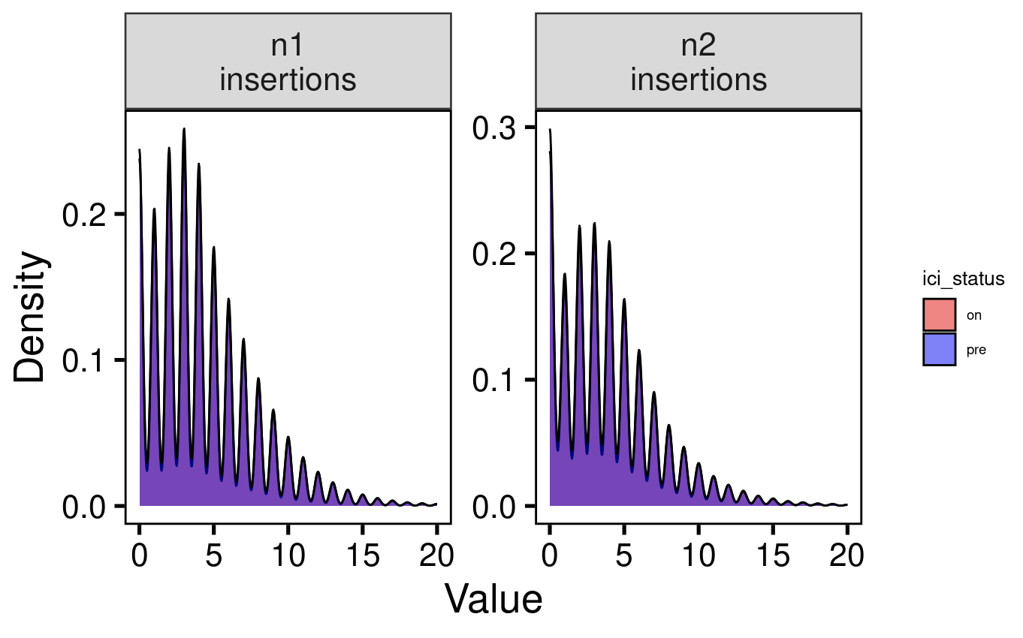
Bulk TCRβ chain profiling of n1/2 insertions shows no differences before and on ICI treatment

Slide 15
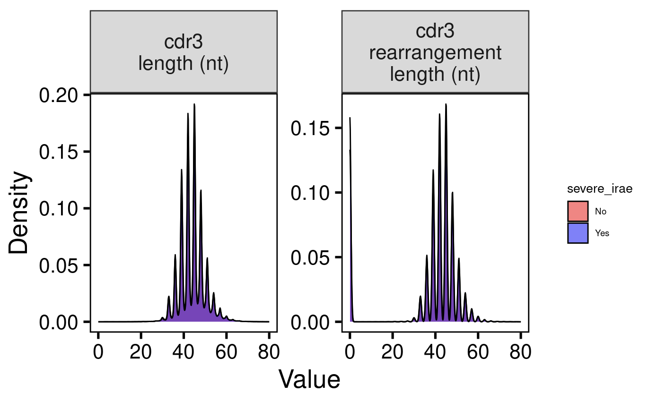
Bulk TCRβ chain profiling of CDR3 shows no differences by severe irAE development

Slide 16
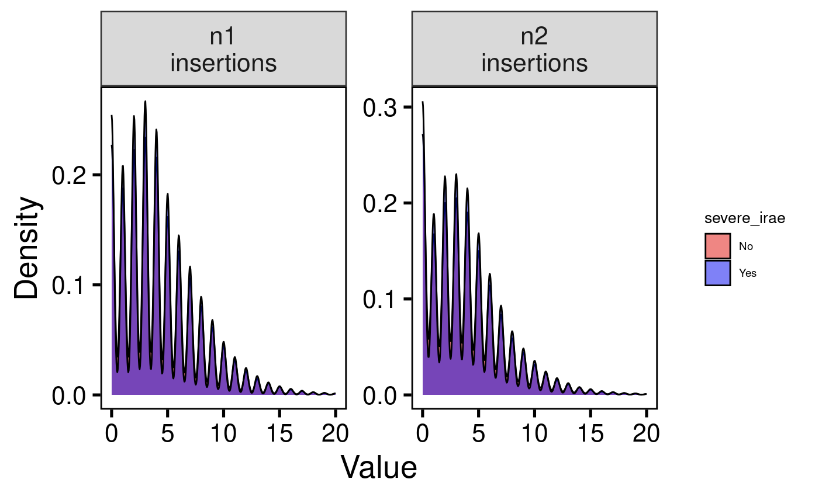
Bulk TCRβ chain profiling of n1/2 shows no differences by severe irAE development

