Slide 1
Weekly meeting
10 19 2023
Ty Bottorff

Slide 2
Outline
Exploration into Newman TCR features with stitchr, IGoR analysis
Next steps

Slide 3
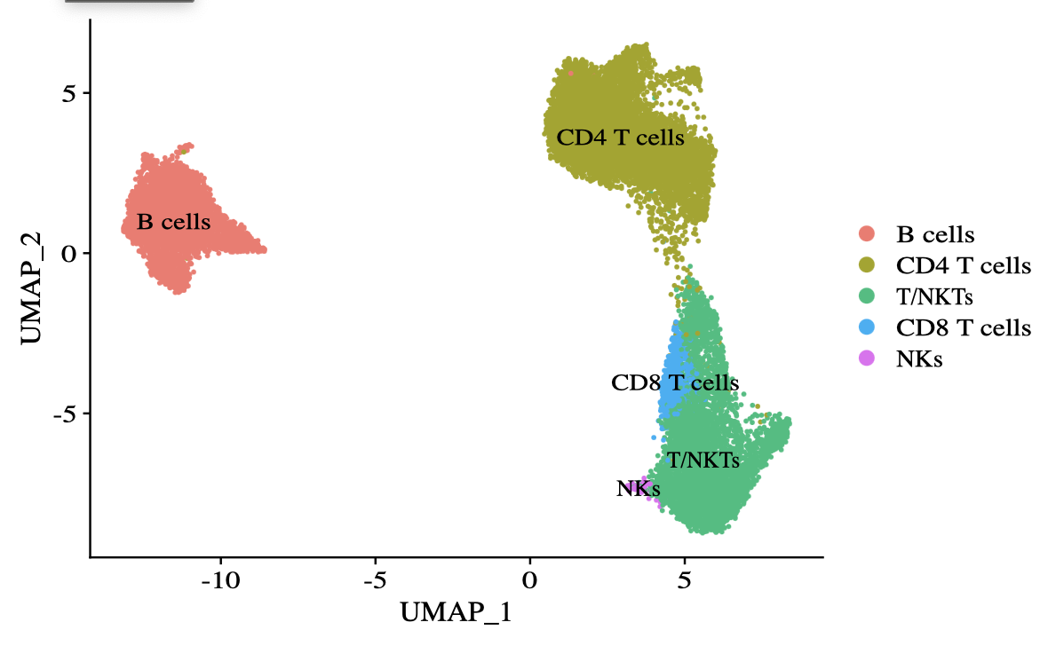
Re-performed dimensional reduction, clustering after removing monocytes, DCs

Slide 4
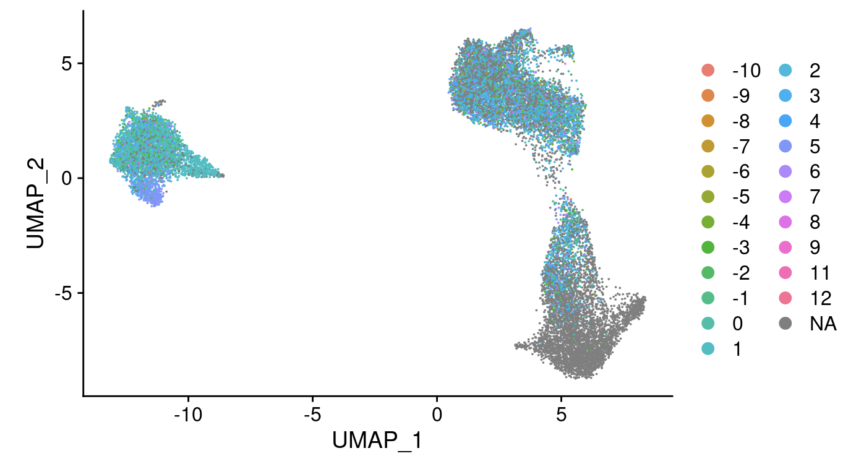
Overlayed CDR3 hydrophobicity onto UMAP

Slide 5
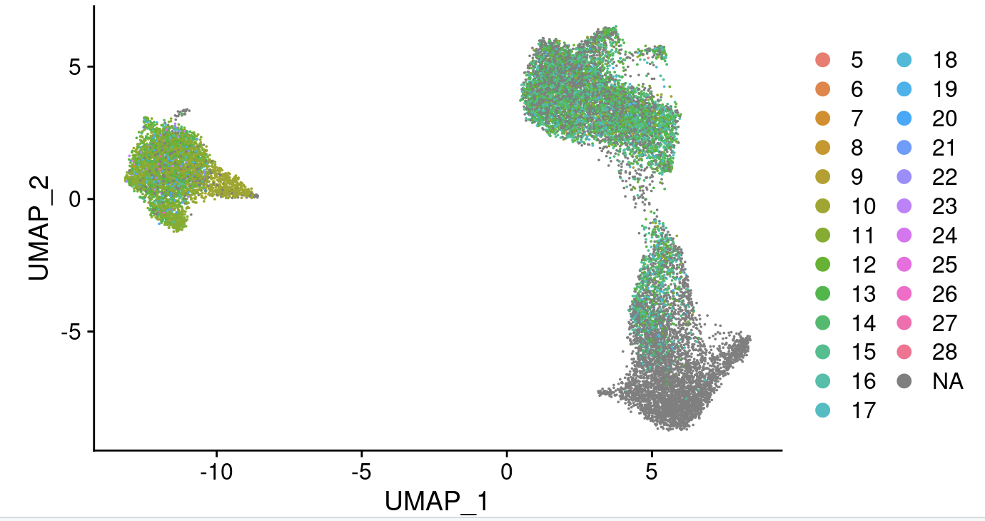
Overlayed CDR3 AA length onto UMAP

Slide 6
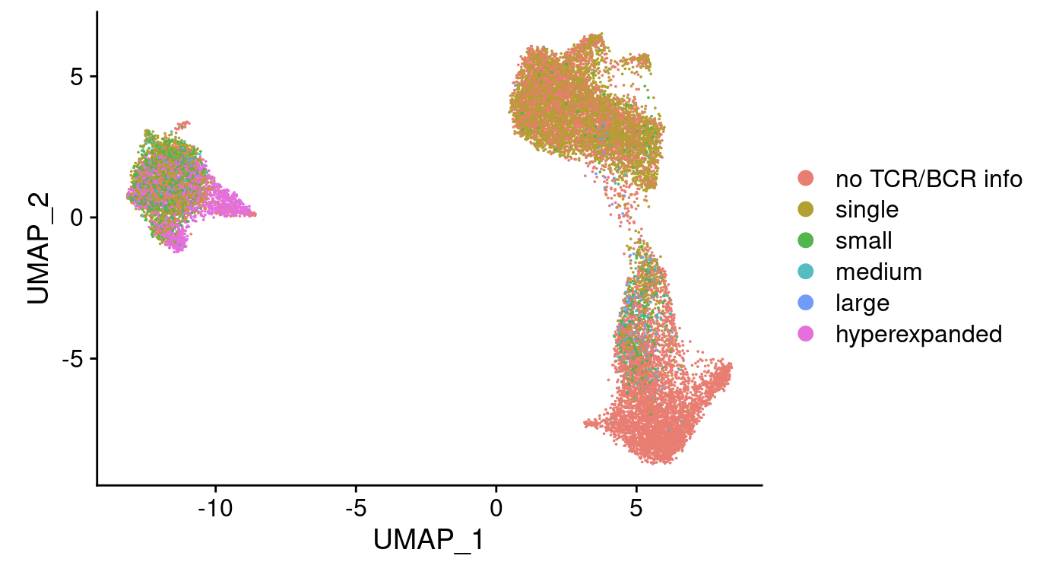
Overlayed (pre-treatment) expansion onto UMAP

Slide 7
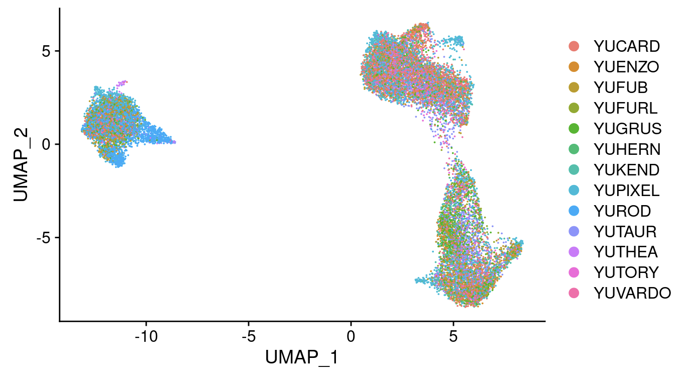
Overlayed patient ID onto UMAP, YUROD patient dominates specific B cell subclusters

Slide 8
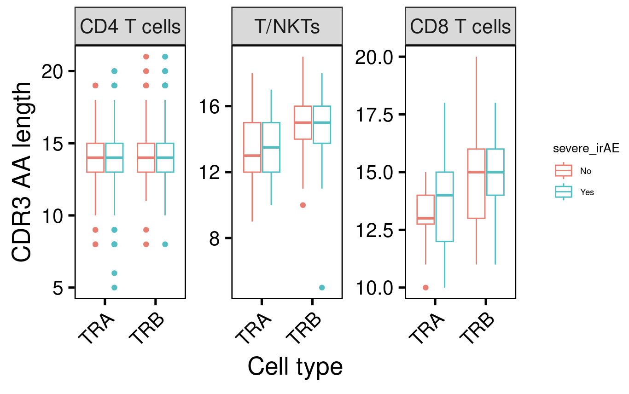
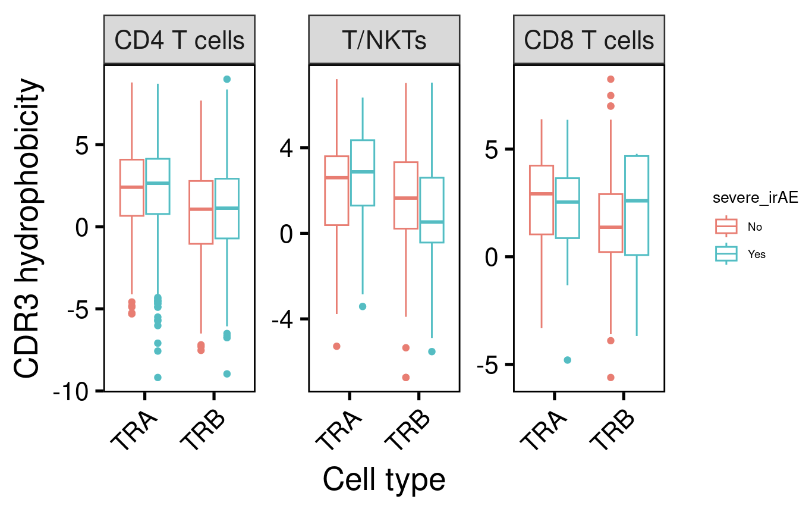
See little to no differences in CDR3 AA length or hydrophobicity among cell types/chains by severe irAE development

Slide 9
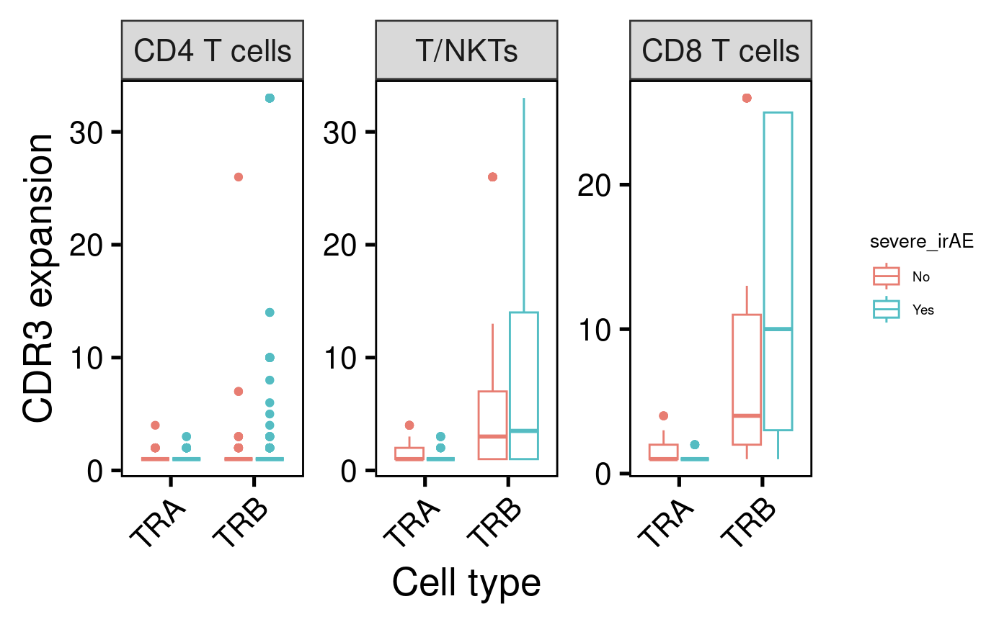
CD8 T cell TRB CDR3 (pre-treatment) expansion may predict severe irAE development
*
P = 0.02
(Wilcoxon rank sum test)
Notes:
Wilcoxon rank sum test with continuity correction data: W = 3047.5, p-value = 0.01733 alternative hypothesis: true location shift is not equal to 0
Yes n = 72, no n = 102

Slide 10
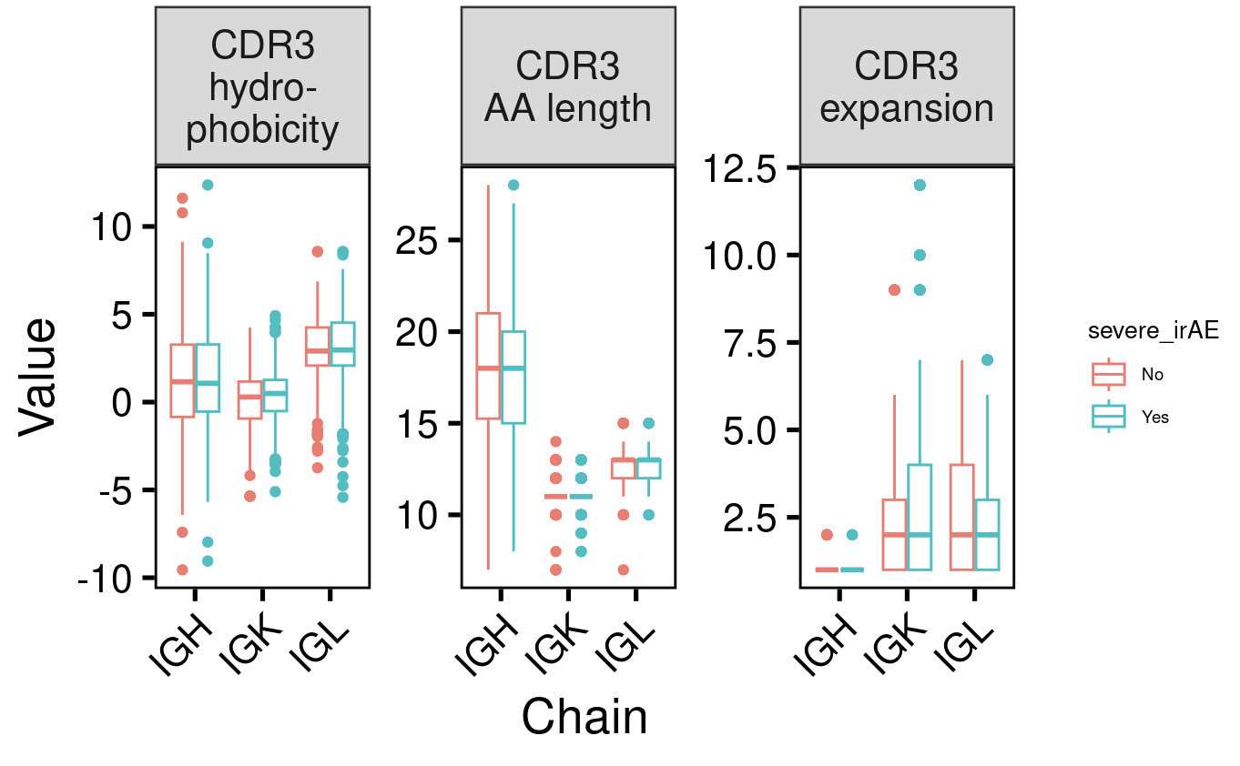
See no differences in B cell CDR3 features among chains by severe irAE development

Slide 11
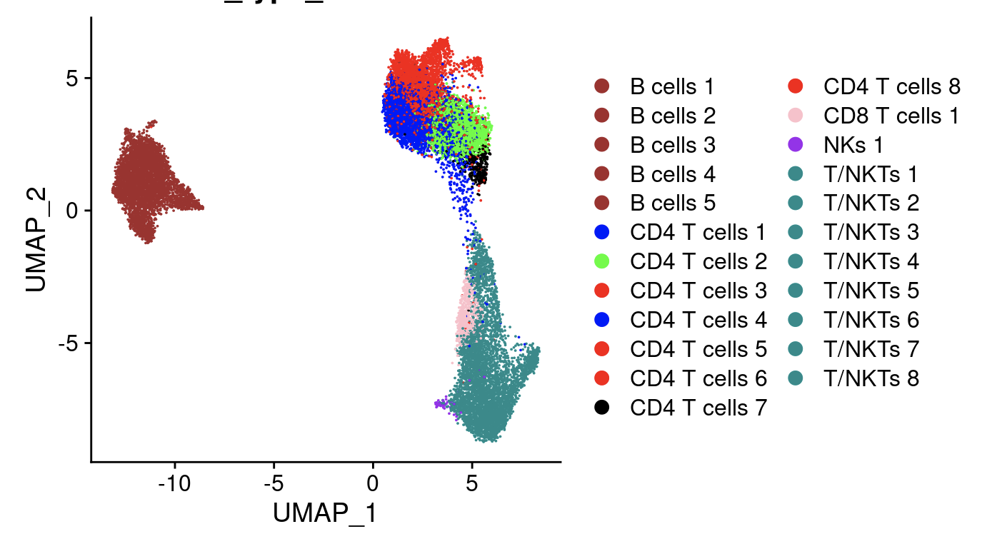
Focused in on CD4 T effector memory cells authors found to expand with ICB
subclusters 2, 4, 7

Slide 12
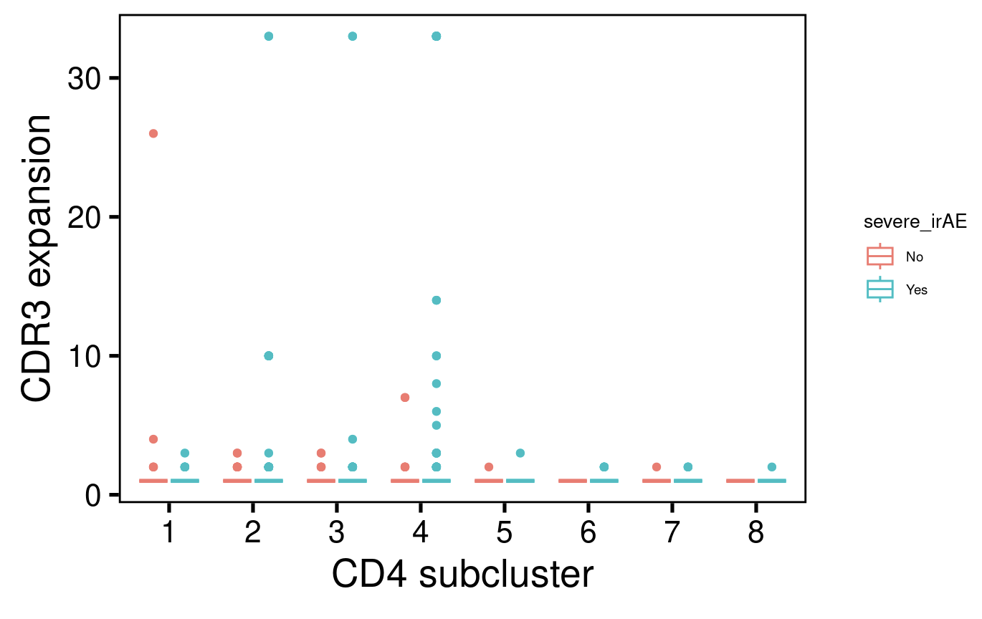
See no predictors of severe irAE development by (pre-treatment) expansion among CD4 subclusters

Slide 13
Stitchr and IGoR & IMGT/HIGHV-QUEST methods
Stitchr
Read in scV(D)Jseq data: 13,403 (7,141 unique) barcodes
Filtered for barcodes with exactly 1 alpha and 1 beta chain (4232 unique barcodes)
Run Stitchr
Only get full TCR linked sequences for 1,067 barcodes, 1,631 for alpha chain, 2,793 for beta chain
IGoR & IMGT/HIGHV-QUEST
Run separately for alpha and beta chains

Slide 14
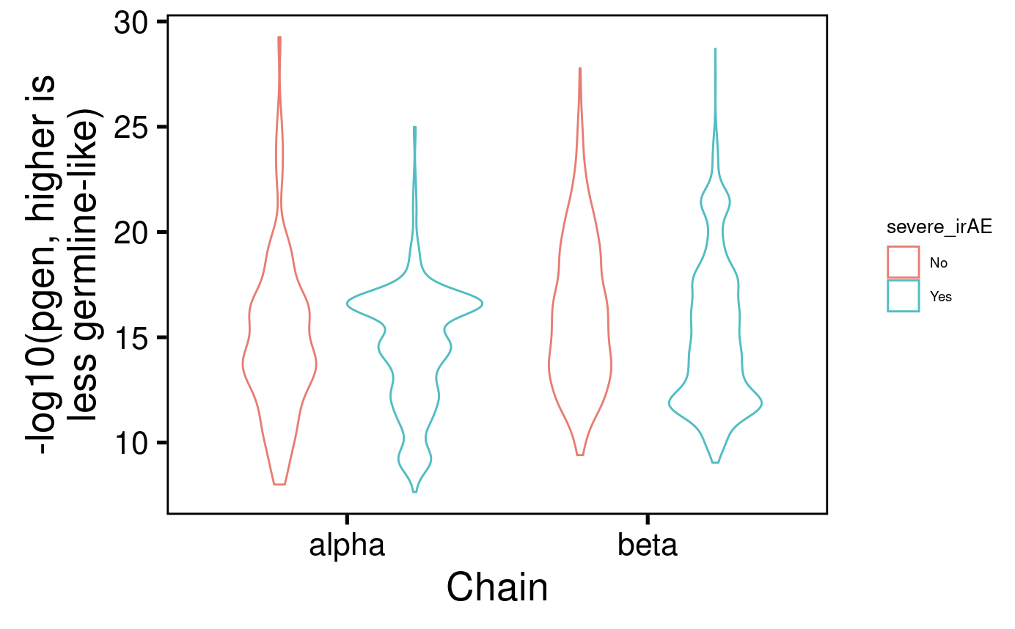
pgen scores similar between TCR chains by severe irAE development
Notes:
Higher -log10(pgen value) means higher probability of generation (more germline-like) because higher (less negative) pgen values have a higher probability of generation by V(D)J recombination. Conversely, sequences with lower (more negative) pgen values have a lower probability of generation

Slide 15
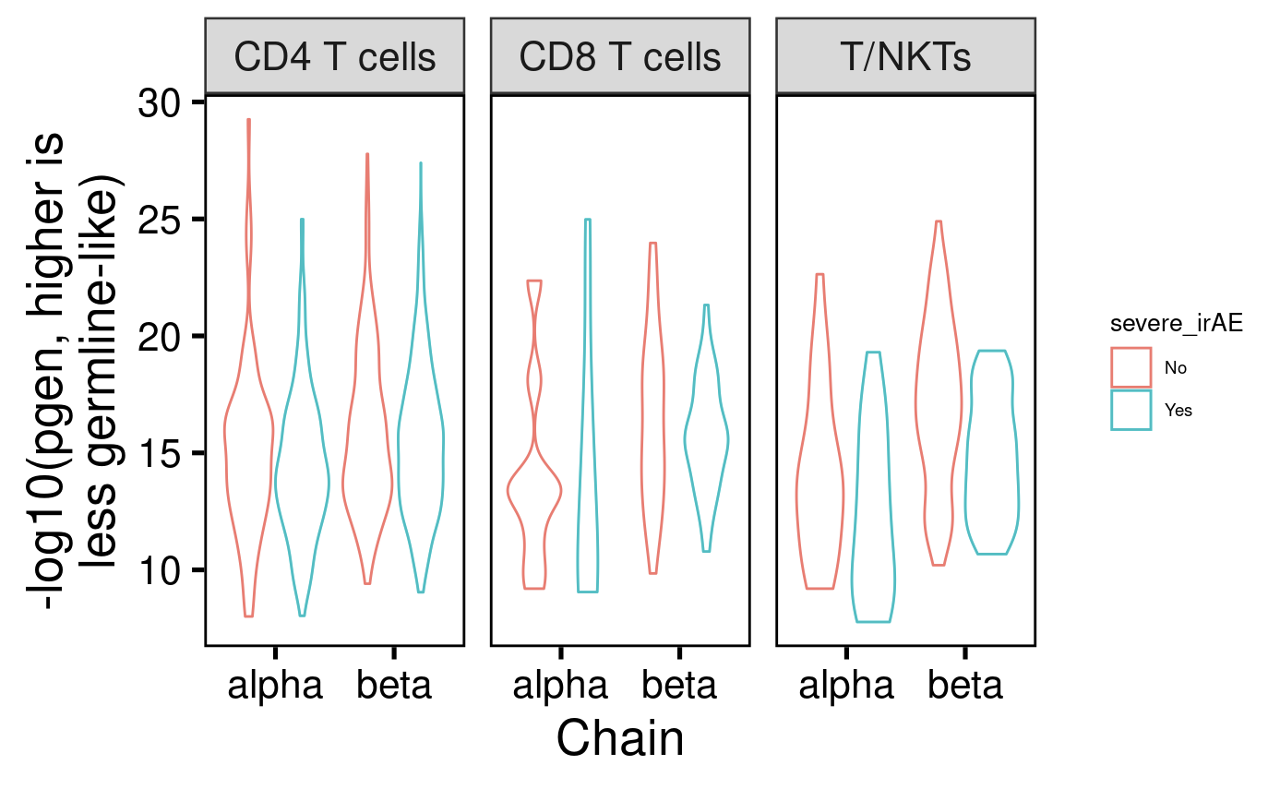
pgen scores don’t dramatically differ between TCR chains or cell type by severe irAE development

Slide 16
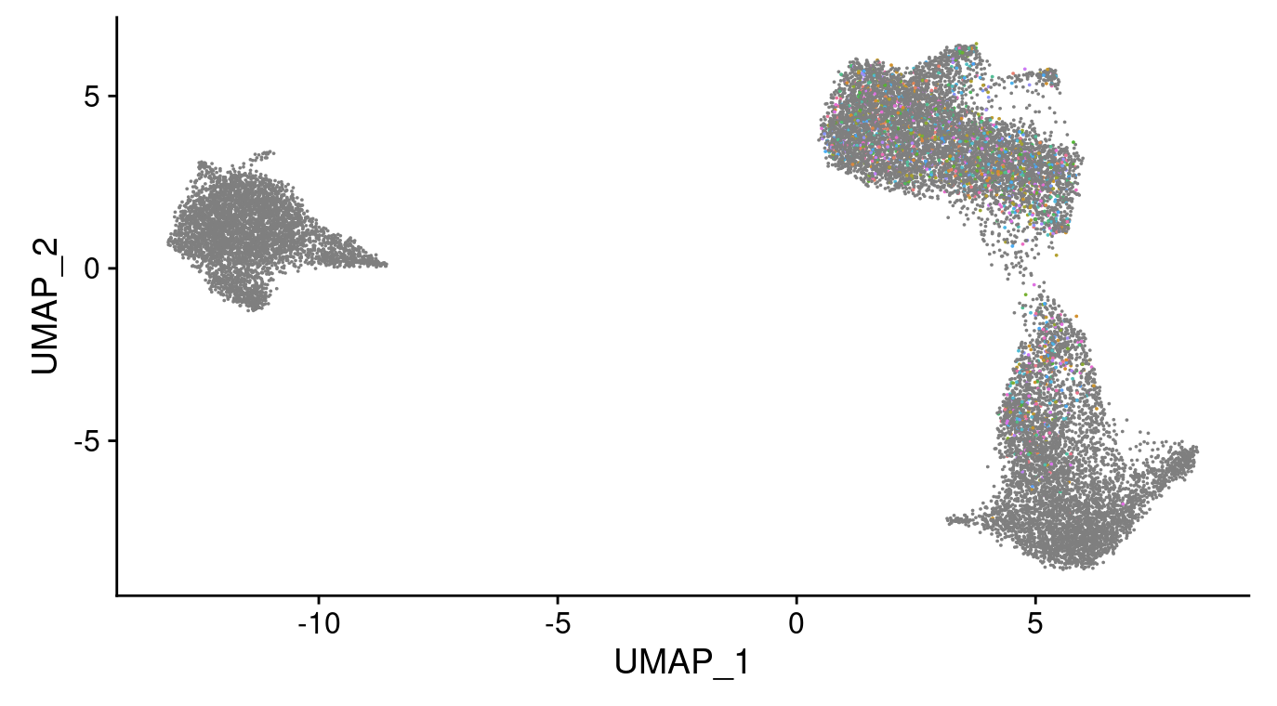
Lost too many barcodes during stitching process to gain insights from UMAP overlay
Lost barcodes
in gray

Slide 17
Next steps
Non-manual cell type assignments
Try to recover more barcodes in stitchr analysis by resolving errors
Analyze IMGT/HighV-Quest output
Input stitched TCR seqs into algorithms to predict/cluster by epitope specificity
GLIPH: group TCRs of common specificities, define TCR clusters often contacting antigenic peptides
TCRdist
VDJdb
Move on to other datasets
Notes:
Unable to locate N terminus of CDR3 in V gene correctly. Please ensure sequence plausibility. Cannot stitch a sequence for TRA
Problematic TRAV genes seem to not have allele specified, no help when adding on *01 or *% to specify 1 or all, respectively
String index out of range. Cannot stitch a sequence for TRB

Slide 18
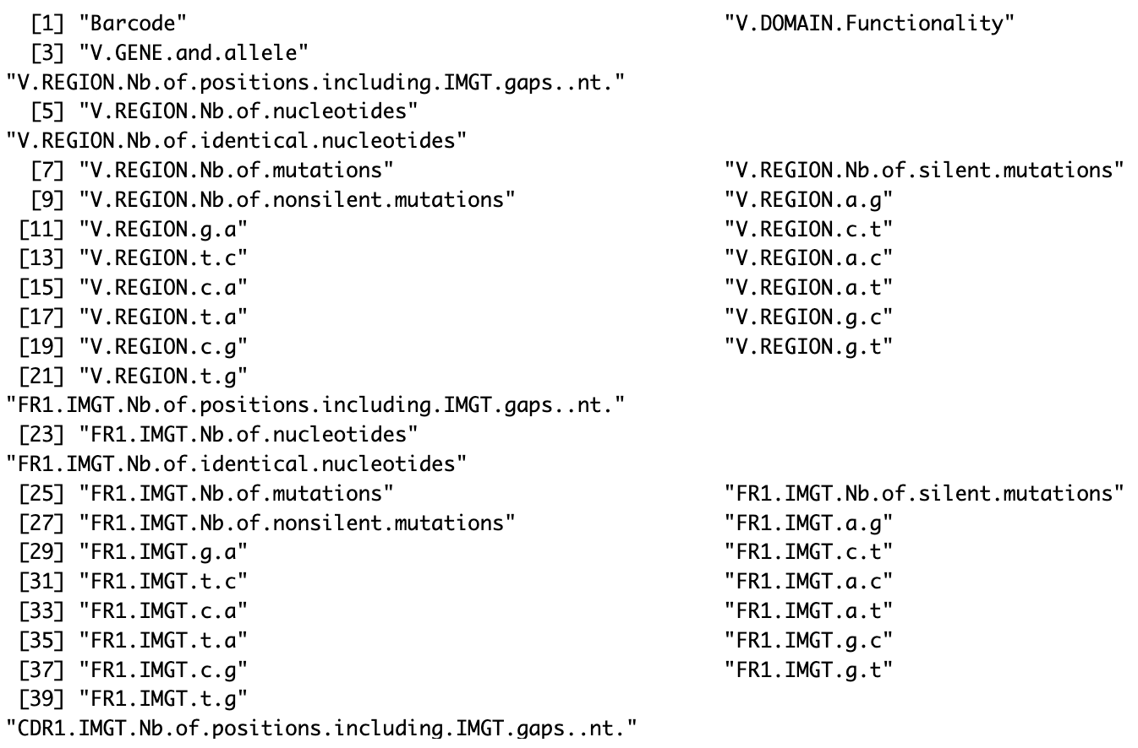
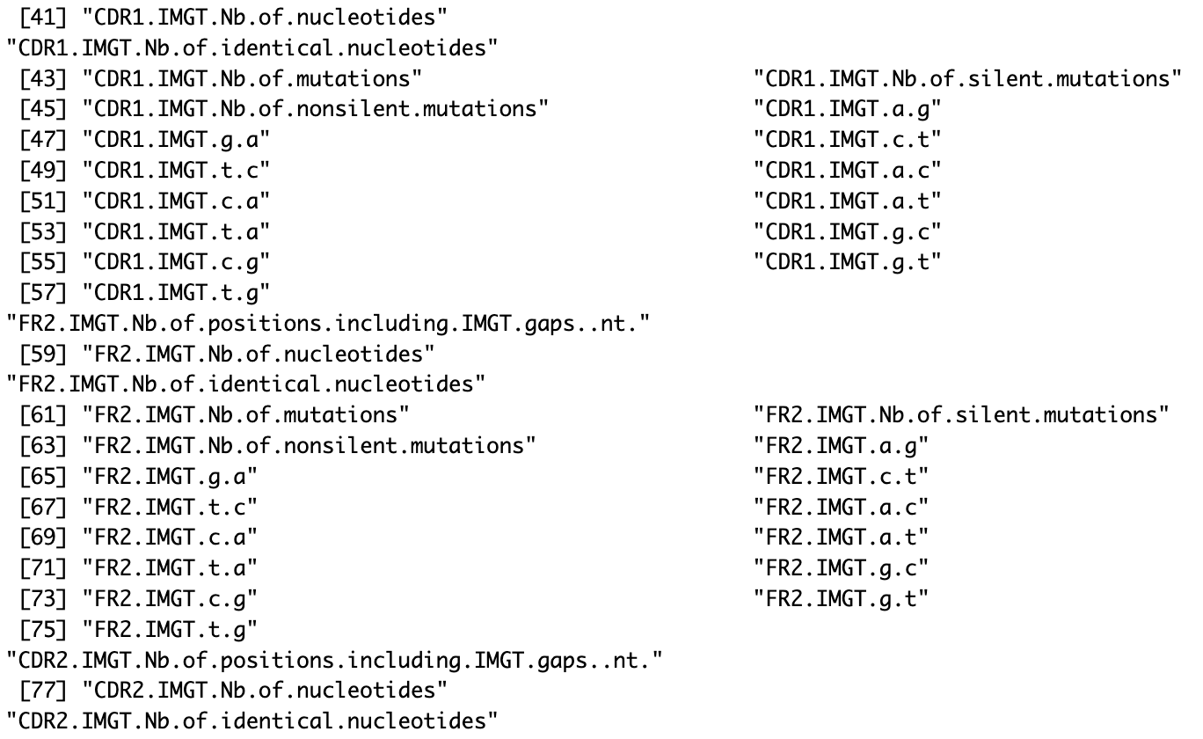
Analyze IMGT/HighV-Quest output: Junction and V-REGION-nt-mutation-statistics files

Slide 19
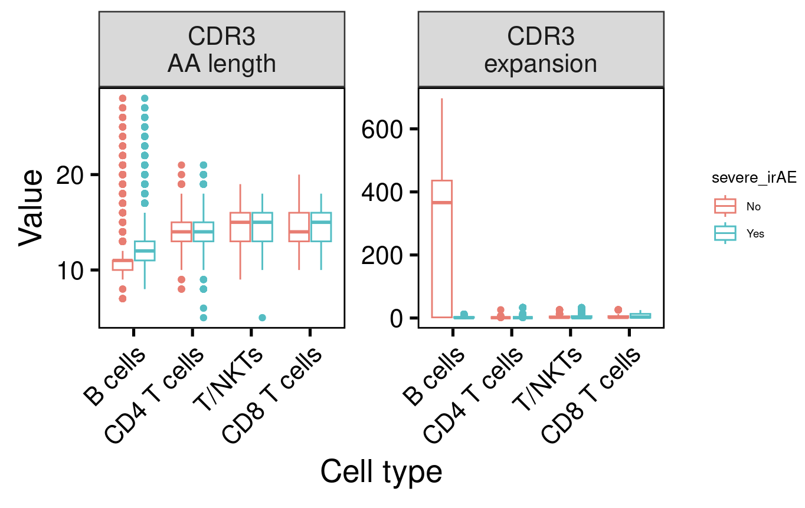
With all patients included, B cell CDR3 AA length and (pre-treatment) expansion seems to relate to severe irAE development

Slide 20
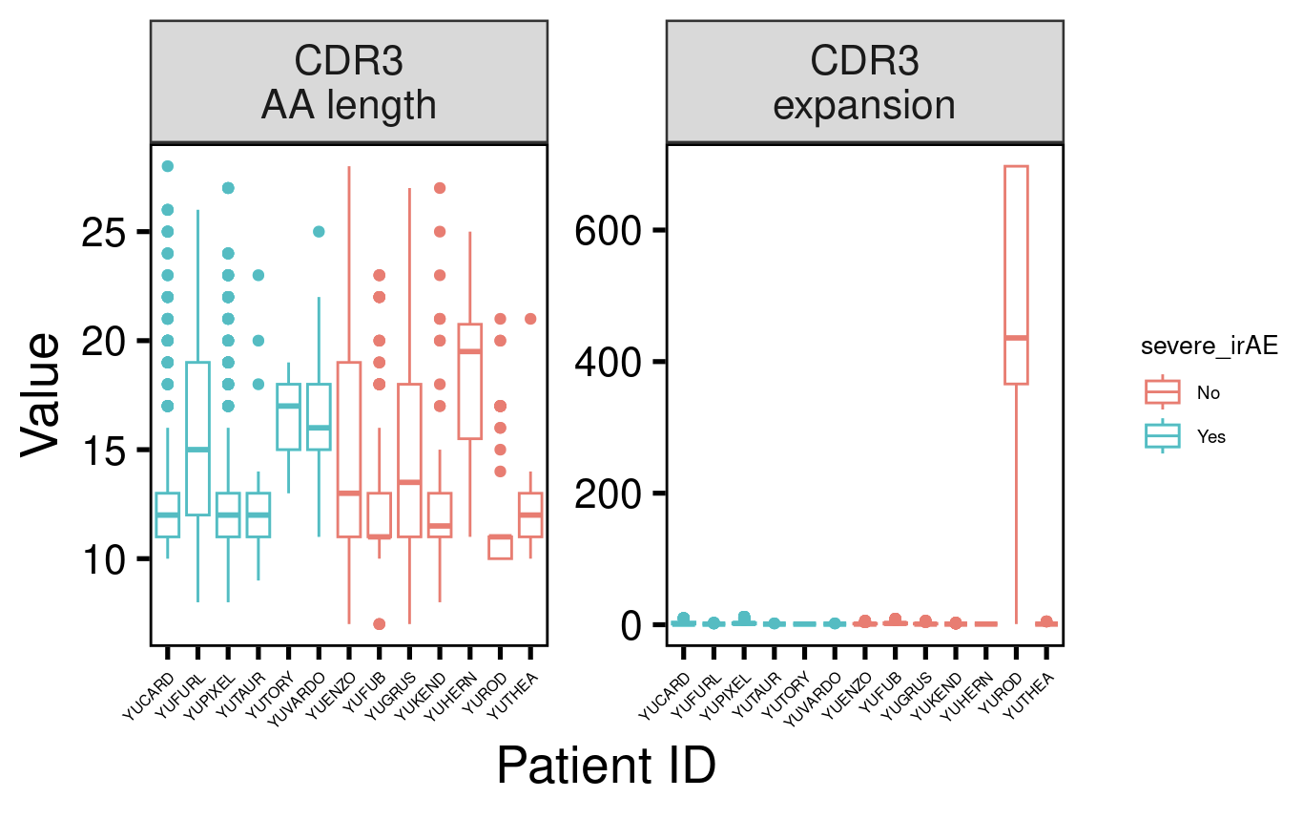
B cell CDR3 AA length and (pre-treatment) expansion differences by severe irAE development are driven by 1 patient (YUROD)

Slide 21
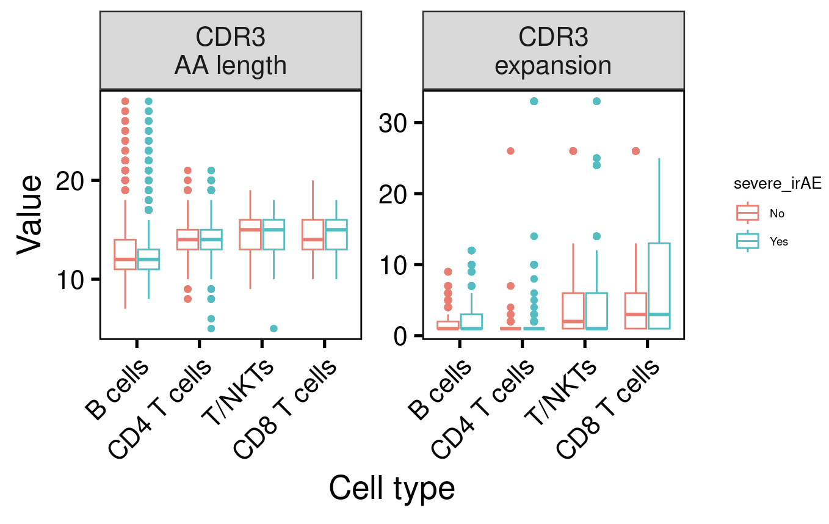
No longer observe B cell CDR3 AA length and (pre-treatment) expansion differences by severe irAE development when removing YUROD patient sample

