Slide 1
Weekly meeting
11 16 2023
Ty Bottorff

Slide 2
Outline
Myocarditis irAE dataset progress
Completed cell type assigning
TCRseq quality seems poor
Briefly looked at TCR features by cell type
Next steps

Slide 3
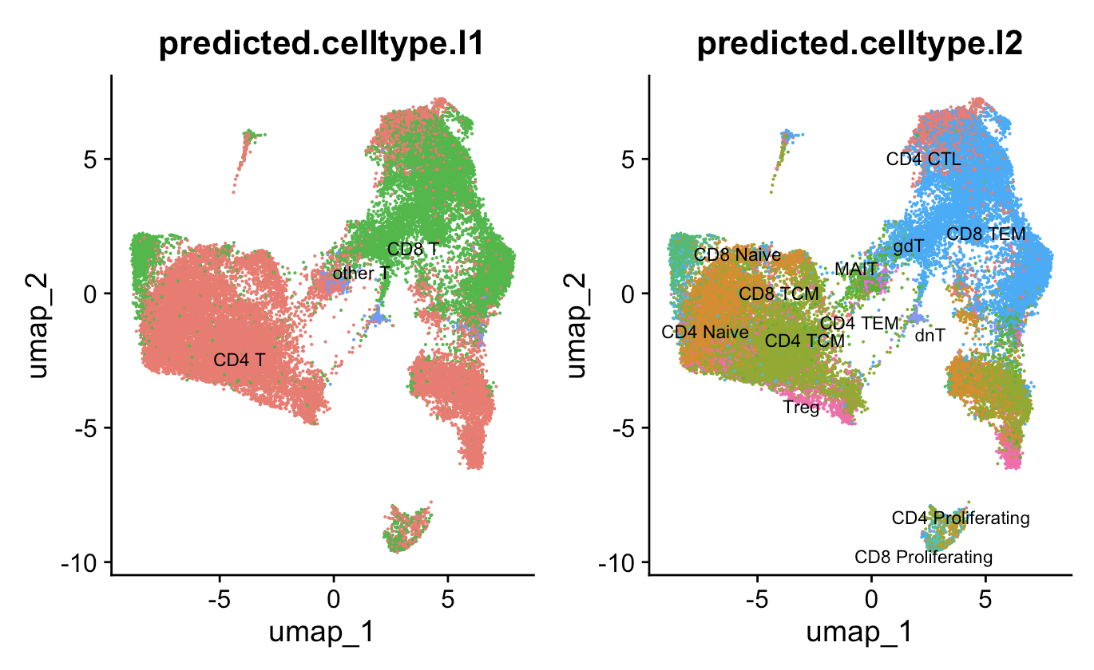
Seurat reference mapped cell types, just looked at T cells in myocarditis dataset
n.s.
n.s.
Notes:
Should have removed gdT (gamma delta T) as I don’t think chains were nothing other than alpha/beta but whatever it’s perhaps low quality anyways
MAITs: Mucosal-associated invariant T cells (MAIT cells) make up a subset of T cells in the immune system that display innate, effector-like qualities. MAIT cells constitute a subset of αβ T lymphocytes characterized by a semi-invariant T cell receptor alpha (TCRα) chain. The TCRα originates from the rearrangement of TCRα variable (V) and joining (J) gene segments TRAV1-2/TRAJ12/20/33 during VDJ recombination in the nucleus. However, TRAJ33 is expressed more often than TRAJ12 and TRAJ20.^{[3][9]} With little diversity in the TCRα chain, the TCR is more conserved in MAIT cells than in other T cell subsets. In addition, the TCRα chain can combine with a restricted number of possible TCRβ chains to form a functional MAIT cell TCR, further limiting TCR diversity.^{[10]}

Slide 4
Myocarditis dataset TCRseq quality seems poor
Unsurprisingly, non-T cells (by scRNAseq) with TCRseq reads weren’t a major contributor to poor stitching
Email authors for viability %?
Not sure if issue lies in V(D)J, and C gene calling and/or in CDR3 sequence
Stitchr summary after removing non-T cels with TCRseq reads | TRA | TRB
# stitched | 9,044 | 20,545
# unable to stitch | 21,195 | 9,694
IMGT/HighV-Quest summary after removing non-T cels with TCRseq reads | TRA | TRB
# productive | 5 | 3,235
# rearranged but no junction found | 1,724 | 13,619
# unproductive | 7,315 | 3,691
Notes:
imgt_df_1_alpha
# 3947 + 3368 (stop codons) unproductive
imgt_df_1_beta
# 2394 + 1297 (stop codons) unproductive

Slide 5
Surprisingly, couple other public TCRseq datasets also seem to be poor quality
 | TRA stitchr % success | TRB stitchr % success | TRA IMGT % productive | TRB IMGT % productive
Myocarditis dataset | 29.9% | 67.9% | 0.06% | 15.8%
Lineage tracing reveals clonal progenitors and long-term persistence of tumor-specific T cells during immune checkpoint blockade | 19.6% | 68.2% | 0.04% | 11%
Gene expression profile and TCR sequencing data of CD45⁺ cells sorted from single cell suspensions of tumors after in vitro anti-CD3 stimulation and treatments | 33.4% | 75.6% | 0.01% | 11.7%
Single-cell RNA sequencing coupled to TCR profiling of large granular lymphocyte leukemia T cells | 16.1% | 89.2% | 0.02% | 7.8%
Notes:
Caveat: didn’t do RNA QC for other papers, but wouldn’t expect that to be the sole reason for poor quality
Single-cell RNA sequencing coupled to TCR profiling of large granular lymphocyte leukemia T cells isn’t ICB it’s anti-CD52 but it’s another TCRseq quality comparison

Slide 6
Next steps
Try to determine if TCR quality issue stems from V(D)J gene calling and/or CDR3 sequence
Could try stitching failed CDR3s with other V genes?
Find a new dataset, test TCRseq quality first by stitching, IMGT/HighV-Quest
What’s best to give up on in new TCRseq dataset?
sc vs. bulk TCRseq
Inclusion of (sc)RNAseq
High number of patients
irAE tracking
Merge all IMGT/HighV-Quest called productive TCRs across datasets?
Extending feature analysis
Predicted energy of TCR-pMHC interaction across diverse pMHCs
CDR3 AA charge, volume, polarity
Focusing on central 5 AA of CDR3
Notes:
central 5 AA of CDR3 often contact antigen: citation: The Changing Landscape of Naive T Cell Receptor Repertoire With Human Aging

Slide 7
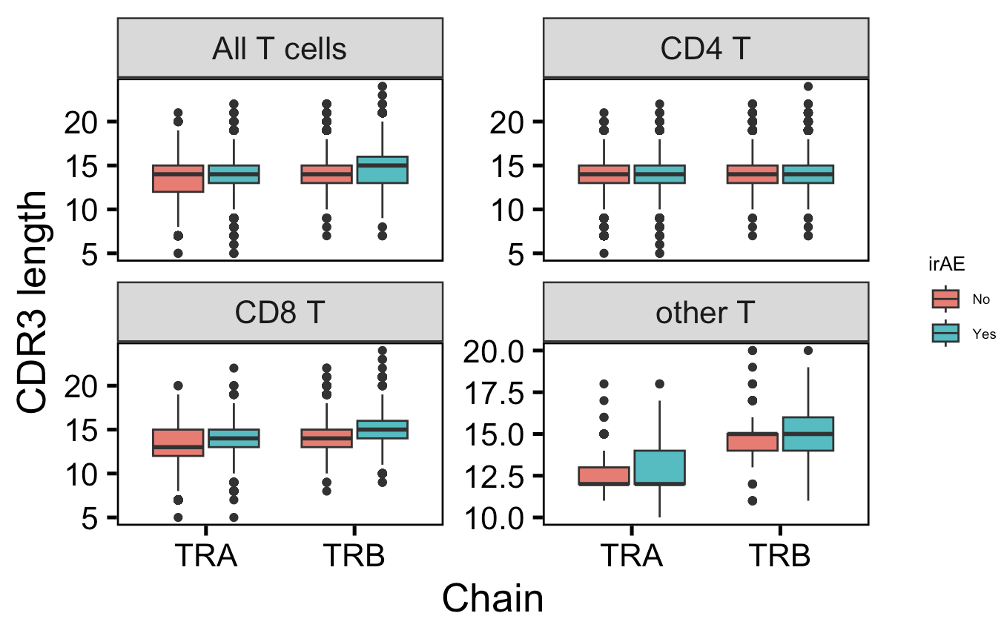
Across all CD8 TCRs in myocarditis dataset, CDR3s are longer in those developing irAEs
n = 12,036
n = 18,361
*
**
n.s.
n.s.
n = 7,476
n = 10,990
**
**
n.s.
p = 0.08
n = 4,405
n = 7,166
n = 155
n = 205
Notes:
I must have filtered for 1 TRA & 1 TRB per barcode at some point (same n values for TRA and TRB)
other T includes double negative T (dnT), MAITs, gamma delta T (gdT), CD4/8 TEMs for some reason… need to remove gdTs so this conclusion is ~to be verified
This is consistent with past results before QC/aberrant TCR exclusion

Slide 8
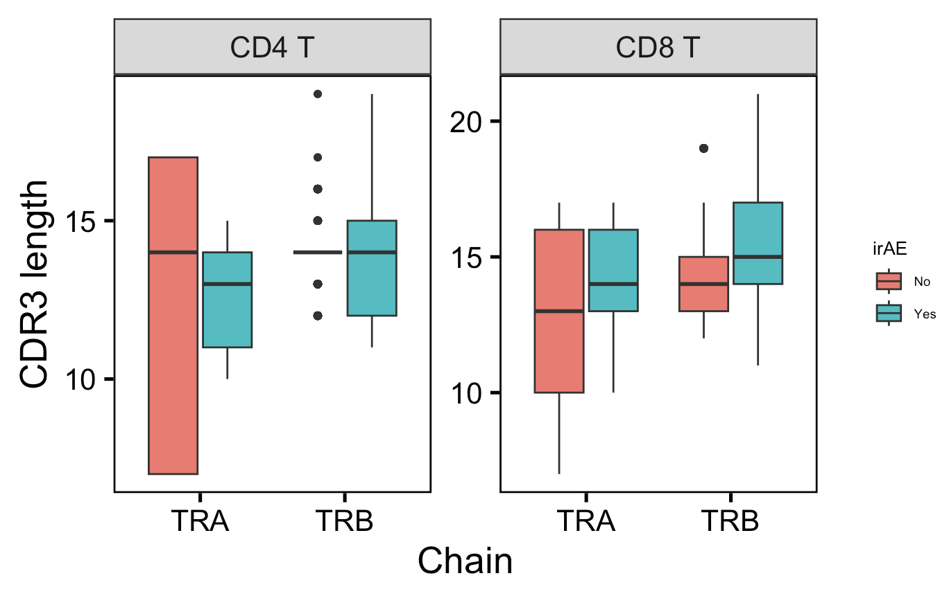
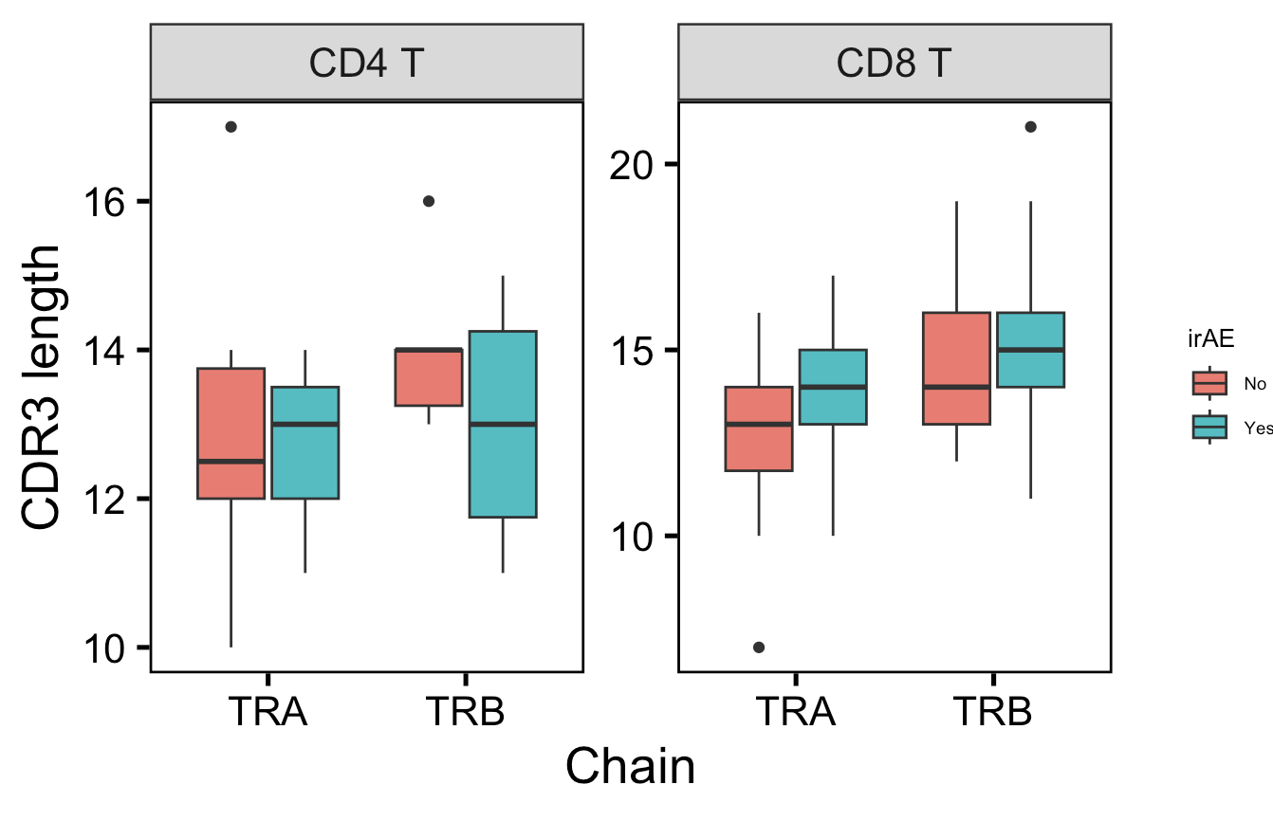
Within highly expanded T cells, still observe CDR3 length differences within CD8 T cells across both chains
All highly expanded TCRs
Unique highly expanded TCRs

Slide 9
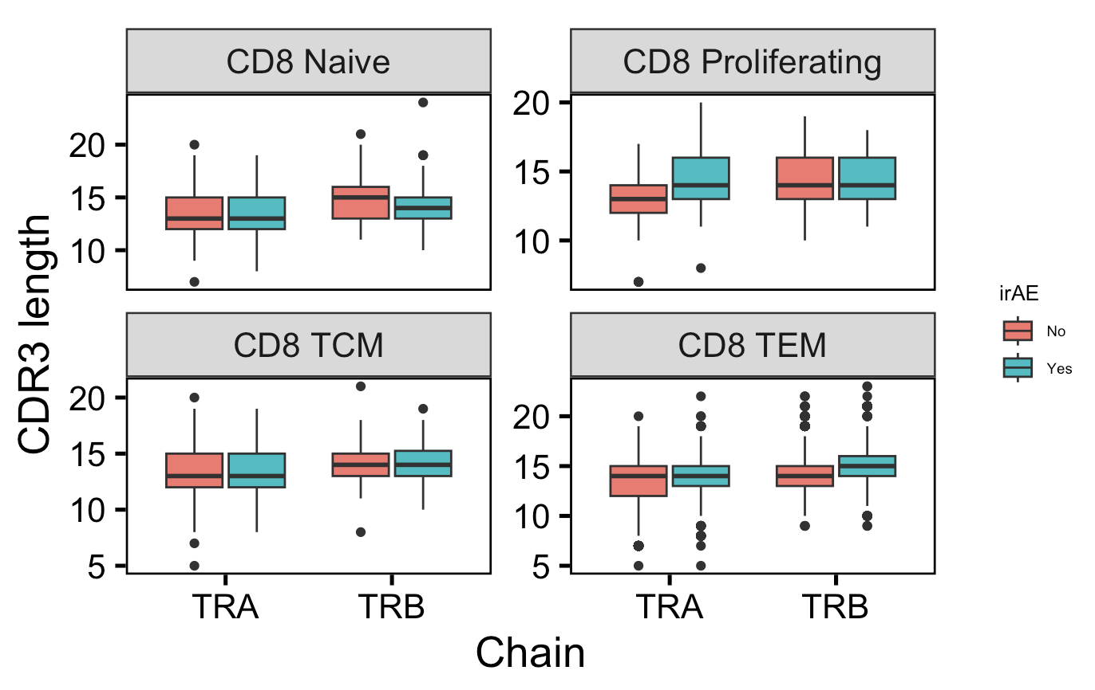
CD8 TEMs drive length differences across both chains, proliferating CD8s drive TRA length difference, naïve CD8s opposite general CD8 TRB trend
n = 425
n = 433
n = 30
n = 131
*
*
**
**
n = 240
n = 304
n = 3,807
n = 6,345

Slide 10
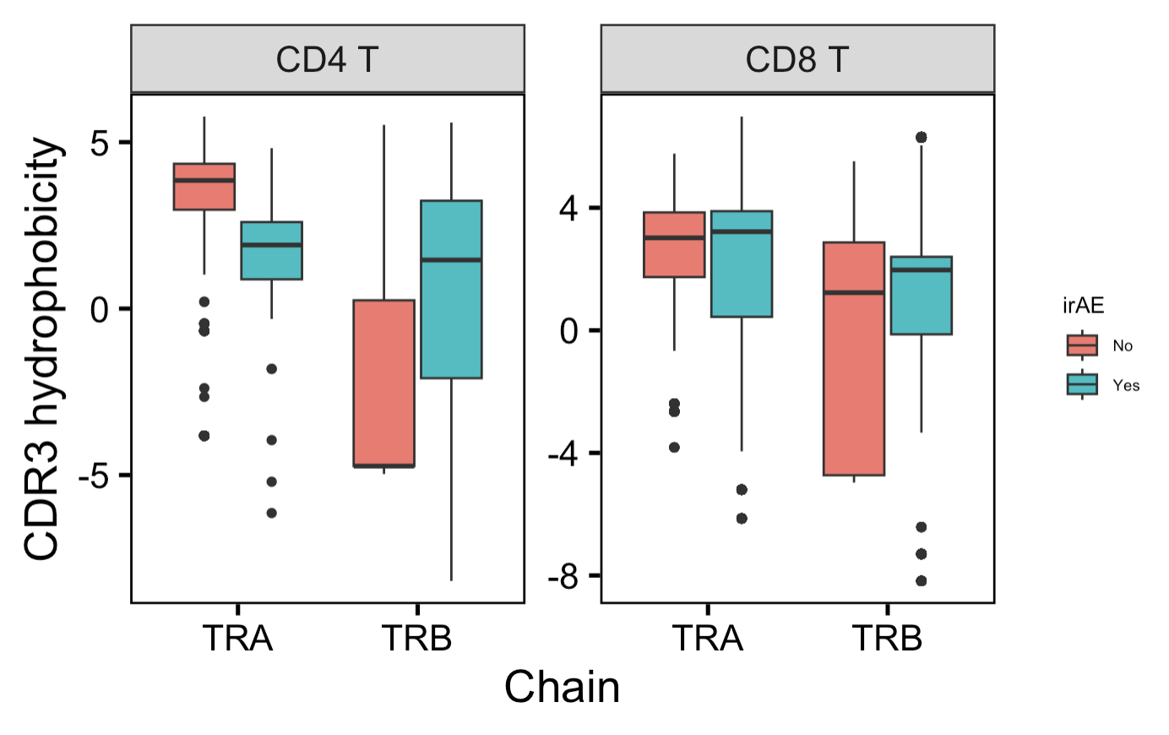
Within highly expanded T cells, observe stronger hydrophobicity differences for CD4 T cells

Slide 11
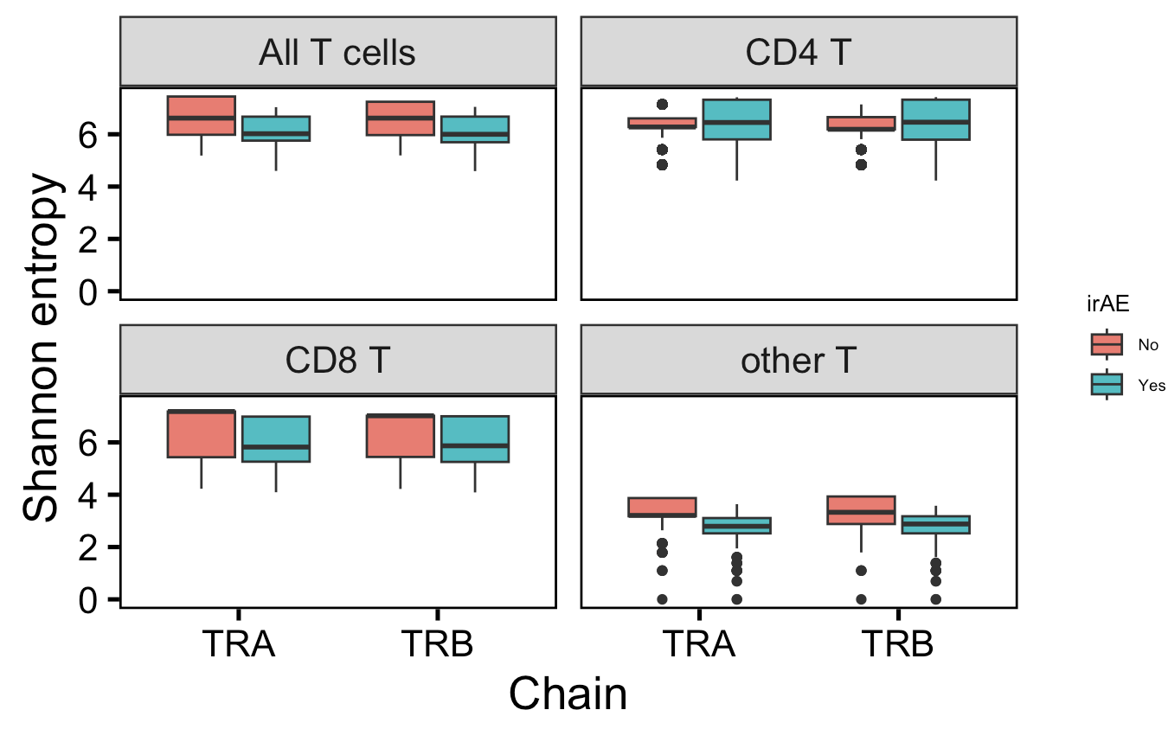
TCR repertoires differ in diversity by irAE group across cell types
**
**
**
**
n = 16
n = 34
**
**
**
**
Notes:
# Shannon entropy: 0 means monoclonal, higher means polyclonal, weights richness (total # of unique clones) over evenness

