Slide 1
Weekly meeting
11 9 2023
Ty Bottorff

Slide 2
Outline
Myocarditis irAE dataset progress
Attempts to improve stitching
IMGT/HighV-Quest data issues
CDR3 AA length & hydrophobicity plots by expansion degree, for public TCRs
Conclusions
Next steps

Slide 3
Attempts to improve stitching and lose fewer TCRs
Main error: unable to find N terminus of CDR3 in V gene, more often for TRA than TRB
Trends of yes/no errors: problematic V genes more often lack *01 suffix
Attempts to fix
Try CDR3 nt sequence instead of AA sequence as input: no change
Try stripping C & F from CDR3 AA to use CDR3 not junction as input: lose even more TCRs
Add *01 (prototypical allele designation) to V/J alleles: no change

Slide 4
Stitching likely dysfunctional despite producing TCR sequences
Filtered input data for productive TCRs
Removes 16,713 unproductive TCRs, leaves 112,549 productive ones
Stitch
”User specified leader sequence is not evenly divisible by 3 – stitched TCR frame will likely be wrong” error present for all stitched TCRs
IMGT/HighV-Quest TCR issues
2nd-CYS 104 not identified: this may indicate potential nucleotide insertion(s) and/or deletion(s) which are not dealt in this release
IMGT/HighV-Quest summary | TRA | TRB
# productive | 7 | 3,502
# rearranged but no junction found | 1,762 | 14,592
# unproductive | 7,703 | 3,959
Notes:
All TRA_aa and TRB_aa from stitchr have stop codons… at least in frame it’s displayed in
TRA
# 4104 + 3602 (stop codons) unproductive
TRB
# 2621 + 1338 (stop codons) unproductive
It’s only the productive called ones that match stitchr, NOT ALWAYS SAME AS original CDR3 seq

Slide 5
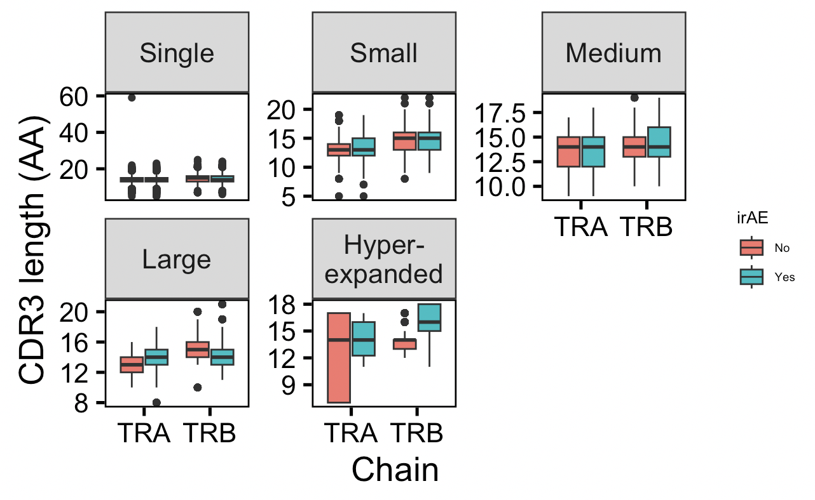
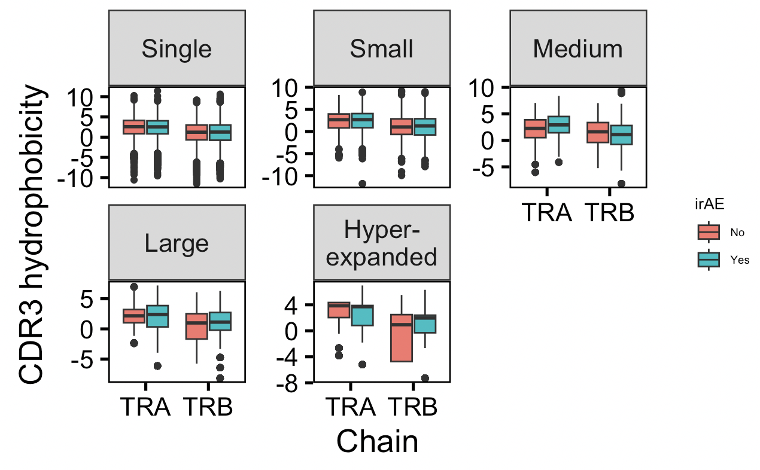
Stratifying TCR feature analysis by expansion degree
**
**
Notes:
count == 1 ~ "Single",
count > 1 & count <= 5 ~ "Small",
count > 5 & count <= 20 ~ "Medium",
count > 20 & count <= 100 ~ "Large",
count > 100 ~ "Hyperexpanded"

Slide 6
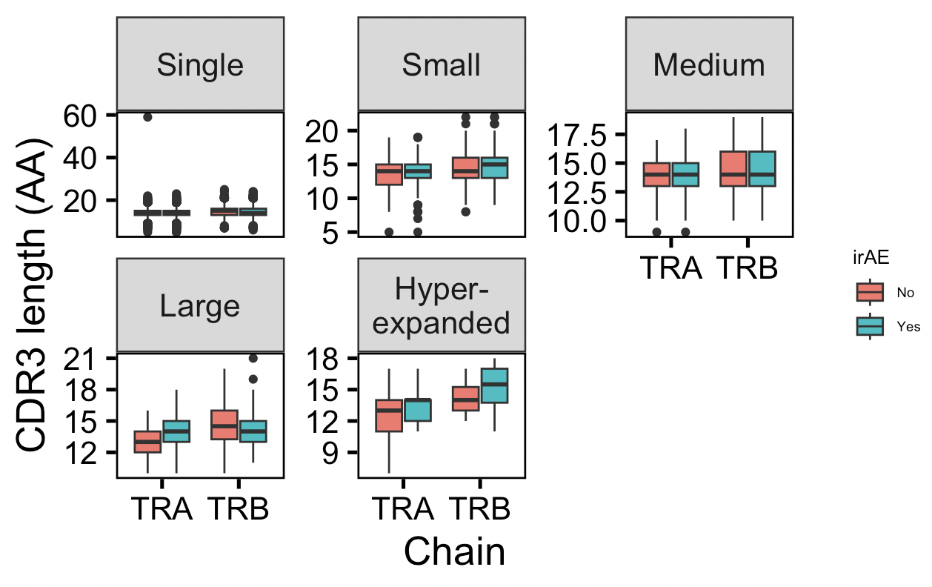
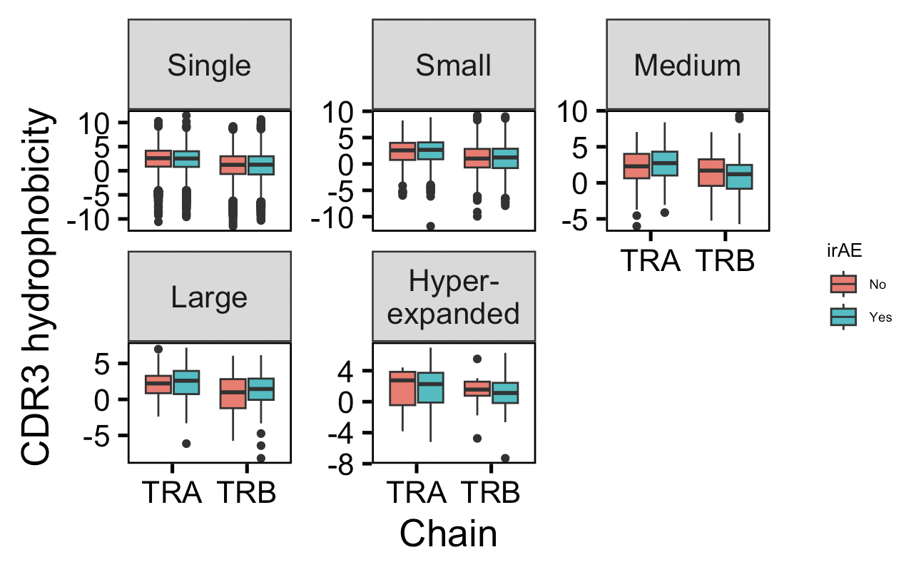
Stratifying unique TCR feature analysis by expansion degree
*
n.s.
p = 0.1
p = 0.15

Slide 7
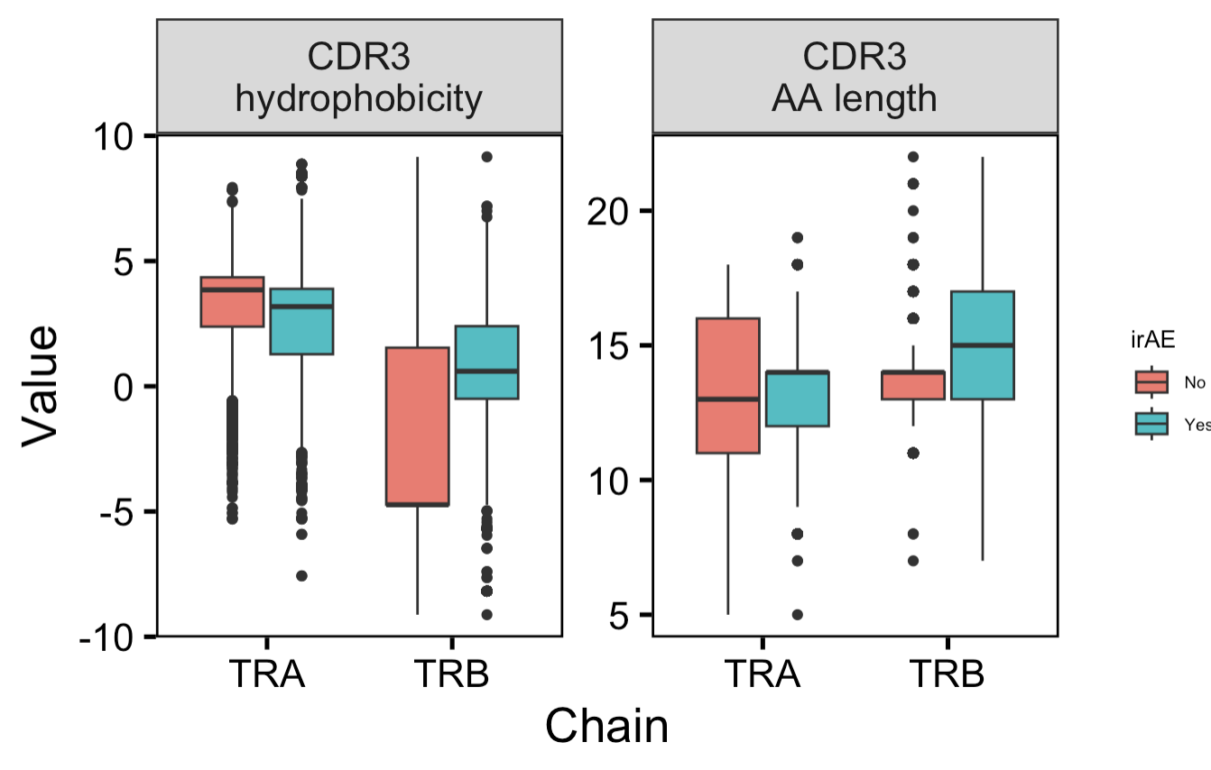
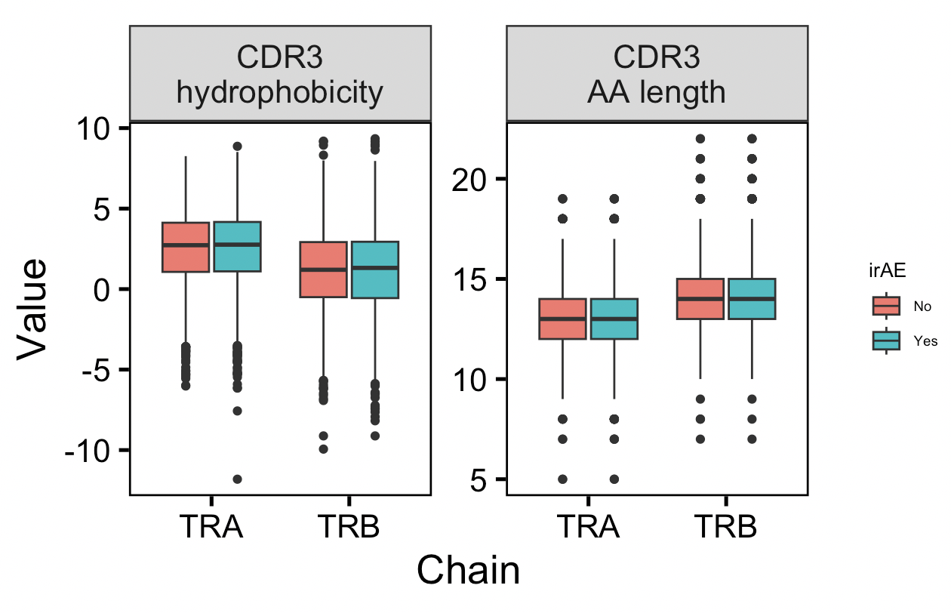
Public TCR feature analysis
All public TCRs
Unique public TCRs

Slide 8
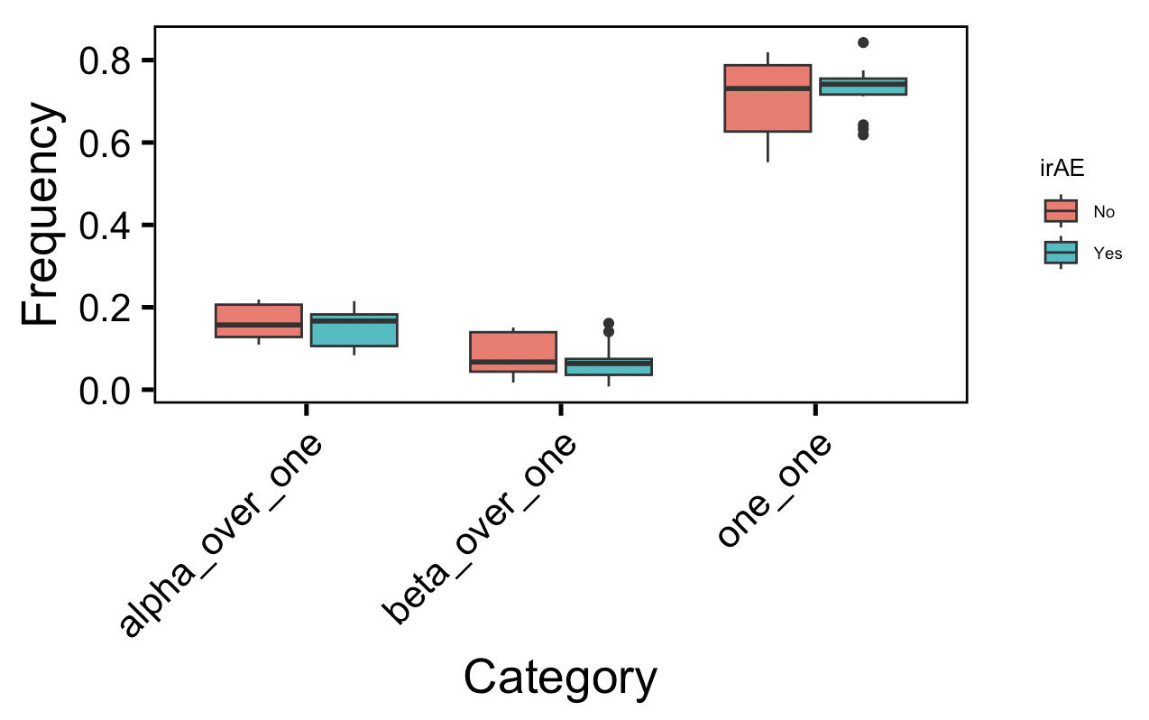
Calculating frequencies of TRA:TRB combinations per patient
Notes:
~30% of T cells apparently have 2 alpha, ~1% 2 beta

Slide 9
Conclusions
Across largely/hyper-expanded (unique) TCR alpha chains, CDR3s are marginally longer in those developing irAEs
Consistent with marginal effect across all unique TCRs
TRB CDR3s lengths show marginal effects, same trend as TRA with hyperexpanded unique TCRs, opposite trend with large ones
Notes:
This was a marginal effect across all unique TCR alpha chains (not just highly expanded ones), in last week presentation

Slide 10
Next steps
Finish up faceting TCR feature analysis by cell type (in progress)
Circos plot, phylogenetic tree, grouping of CDR3 seqs
Look at private vs. public, clonality, diversity
Using GLIPH to find CDR3 AA motifs differentially encountered in yes vs. no irAEs
Use presence of motif to pinpoint feature analysis
Use GIANA to cluster TCR seqs into groups by predicted shared antigen specificity
Expanding study to transplant rejection? Are there TCR features that can predict who will experience transplant rejection with immunotherapy?
Using TCRfold/TCRmodel2 to predict if a TCR’s specificity ranks higher for tumor or self antigens, or both rank high?
Compare tumor vs. self specificity rankings of expanded TCRs in patients with and without irAEs

