Slide 1
NCI update – analyzing CyTOF data
12-6-2024
Ty Bottorff – Bioinformatics postdoc
Linsley lab

Slide 2
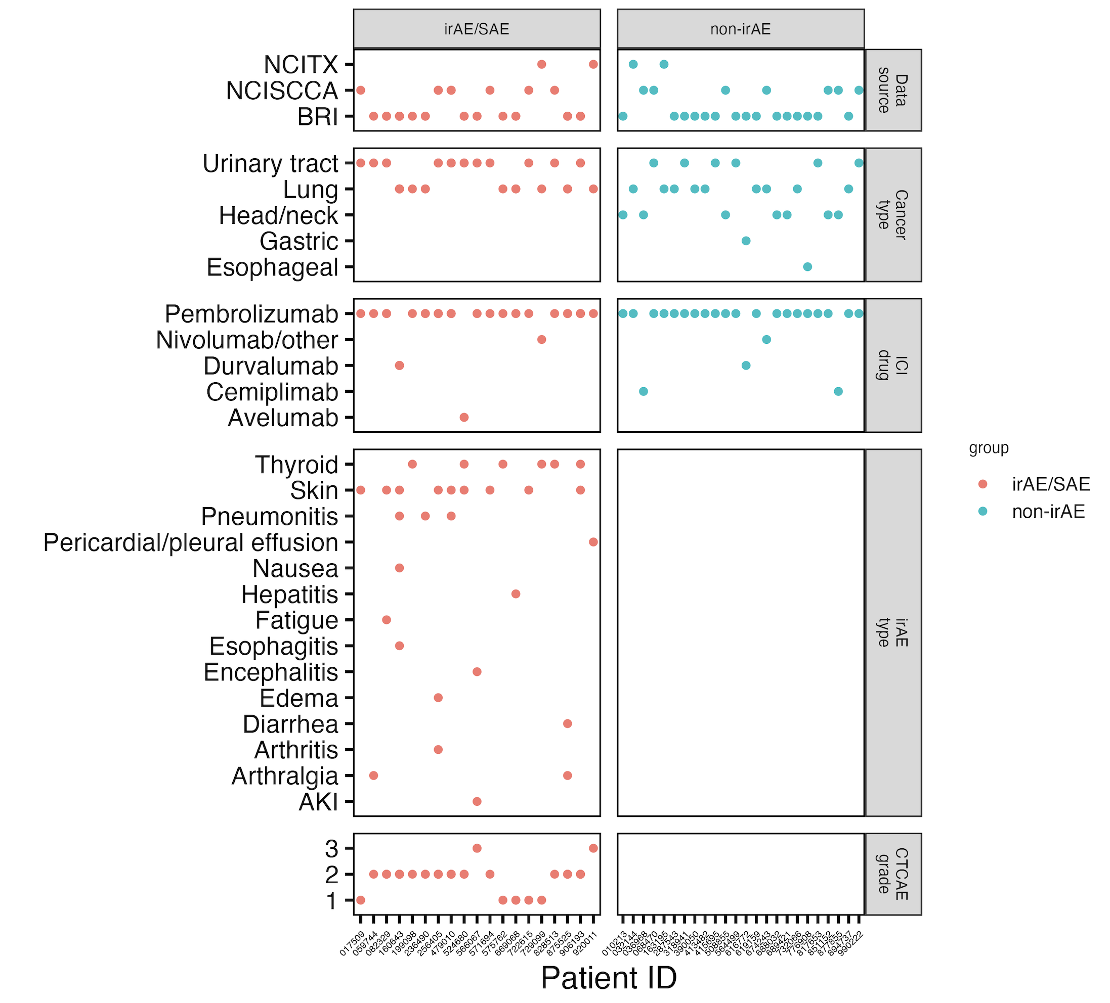
Cancer cohort metadata

Slide 3
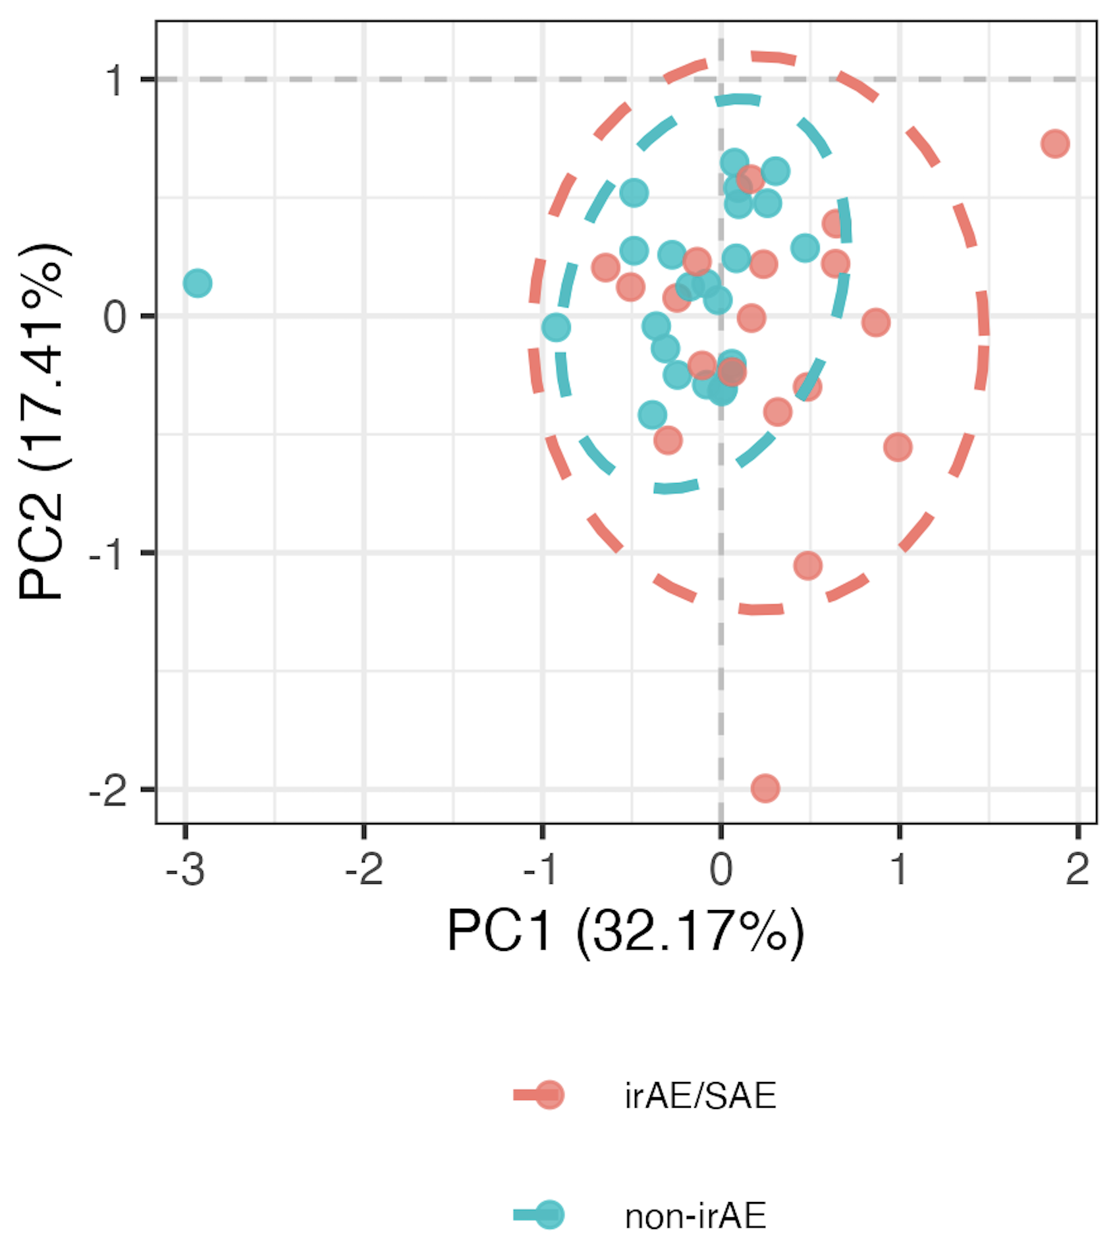
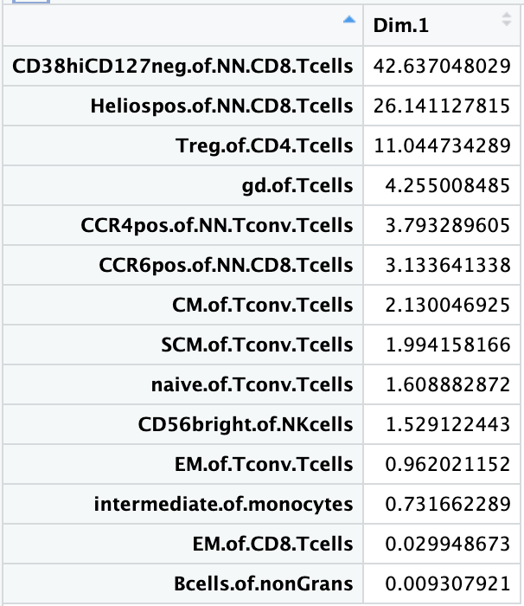
Using module of baseline feature frequencies, can differentiate between those who develop irAEs
PC1 pval: 0.013
PC1 contributions

Slide 4
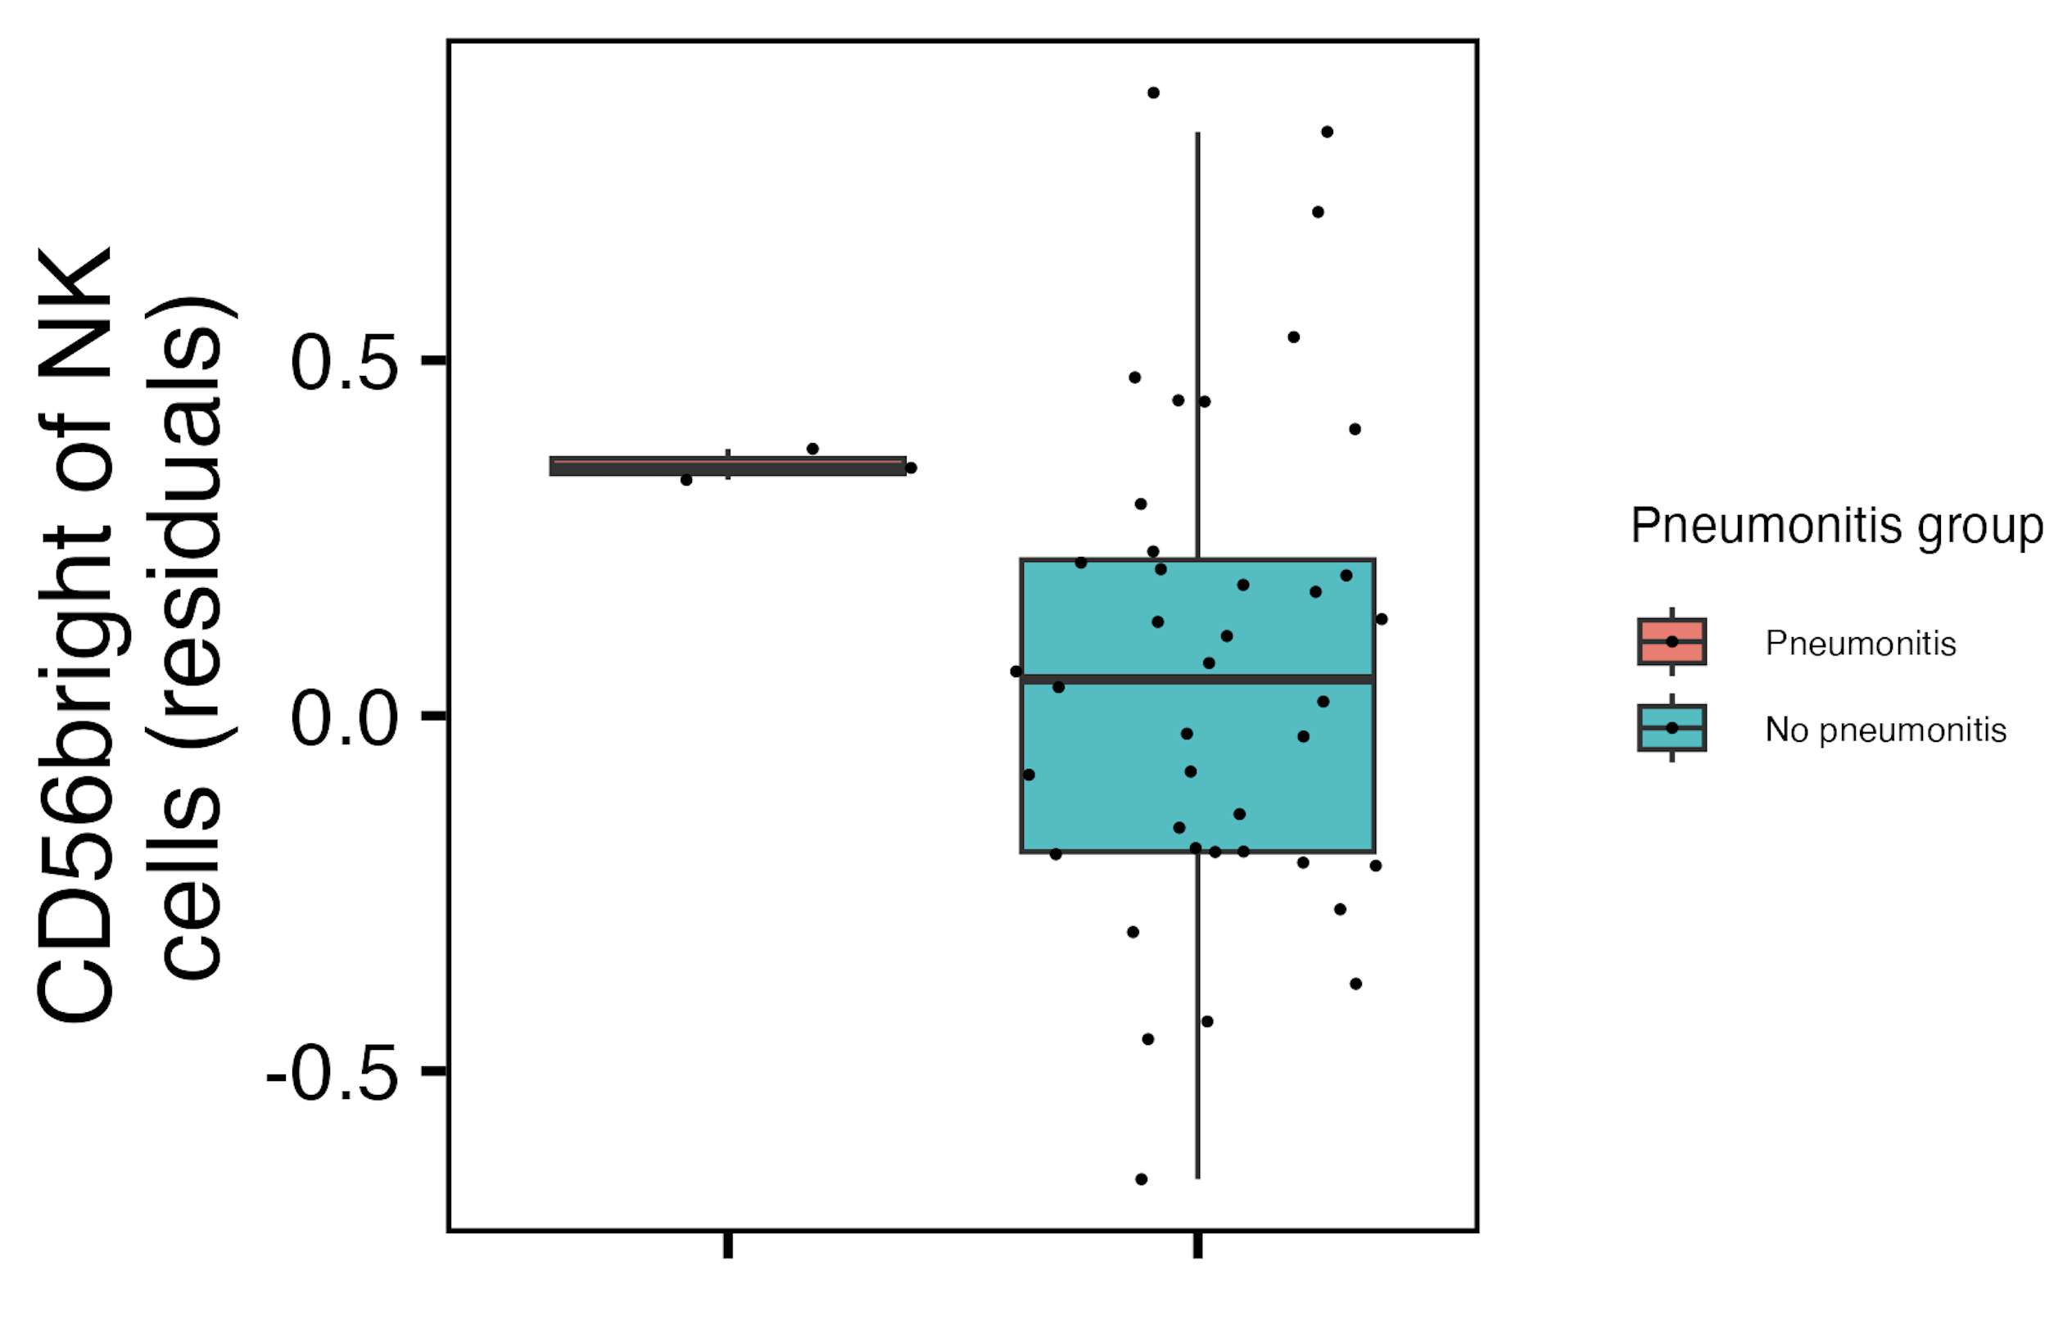
Baseline CD56^{bright} of NK cells frequency higher in those developing pneumonitis
padj = 3.4*10⁻⁴
Notes:
~similar if including pleural effusion (pval drops to 2.7 from 3.4)

Slide 5
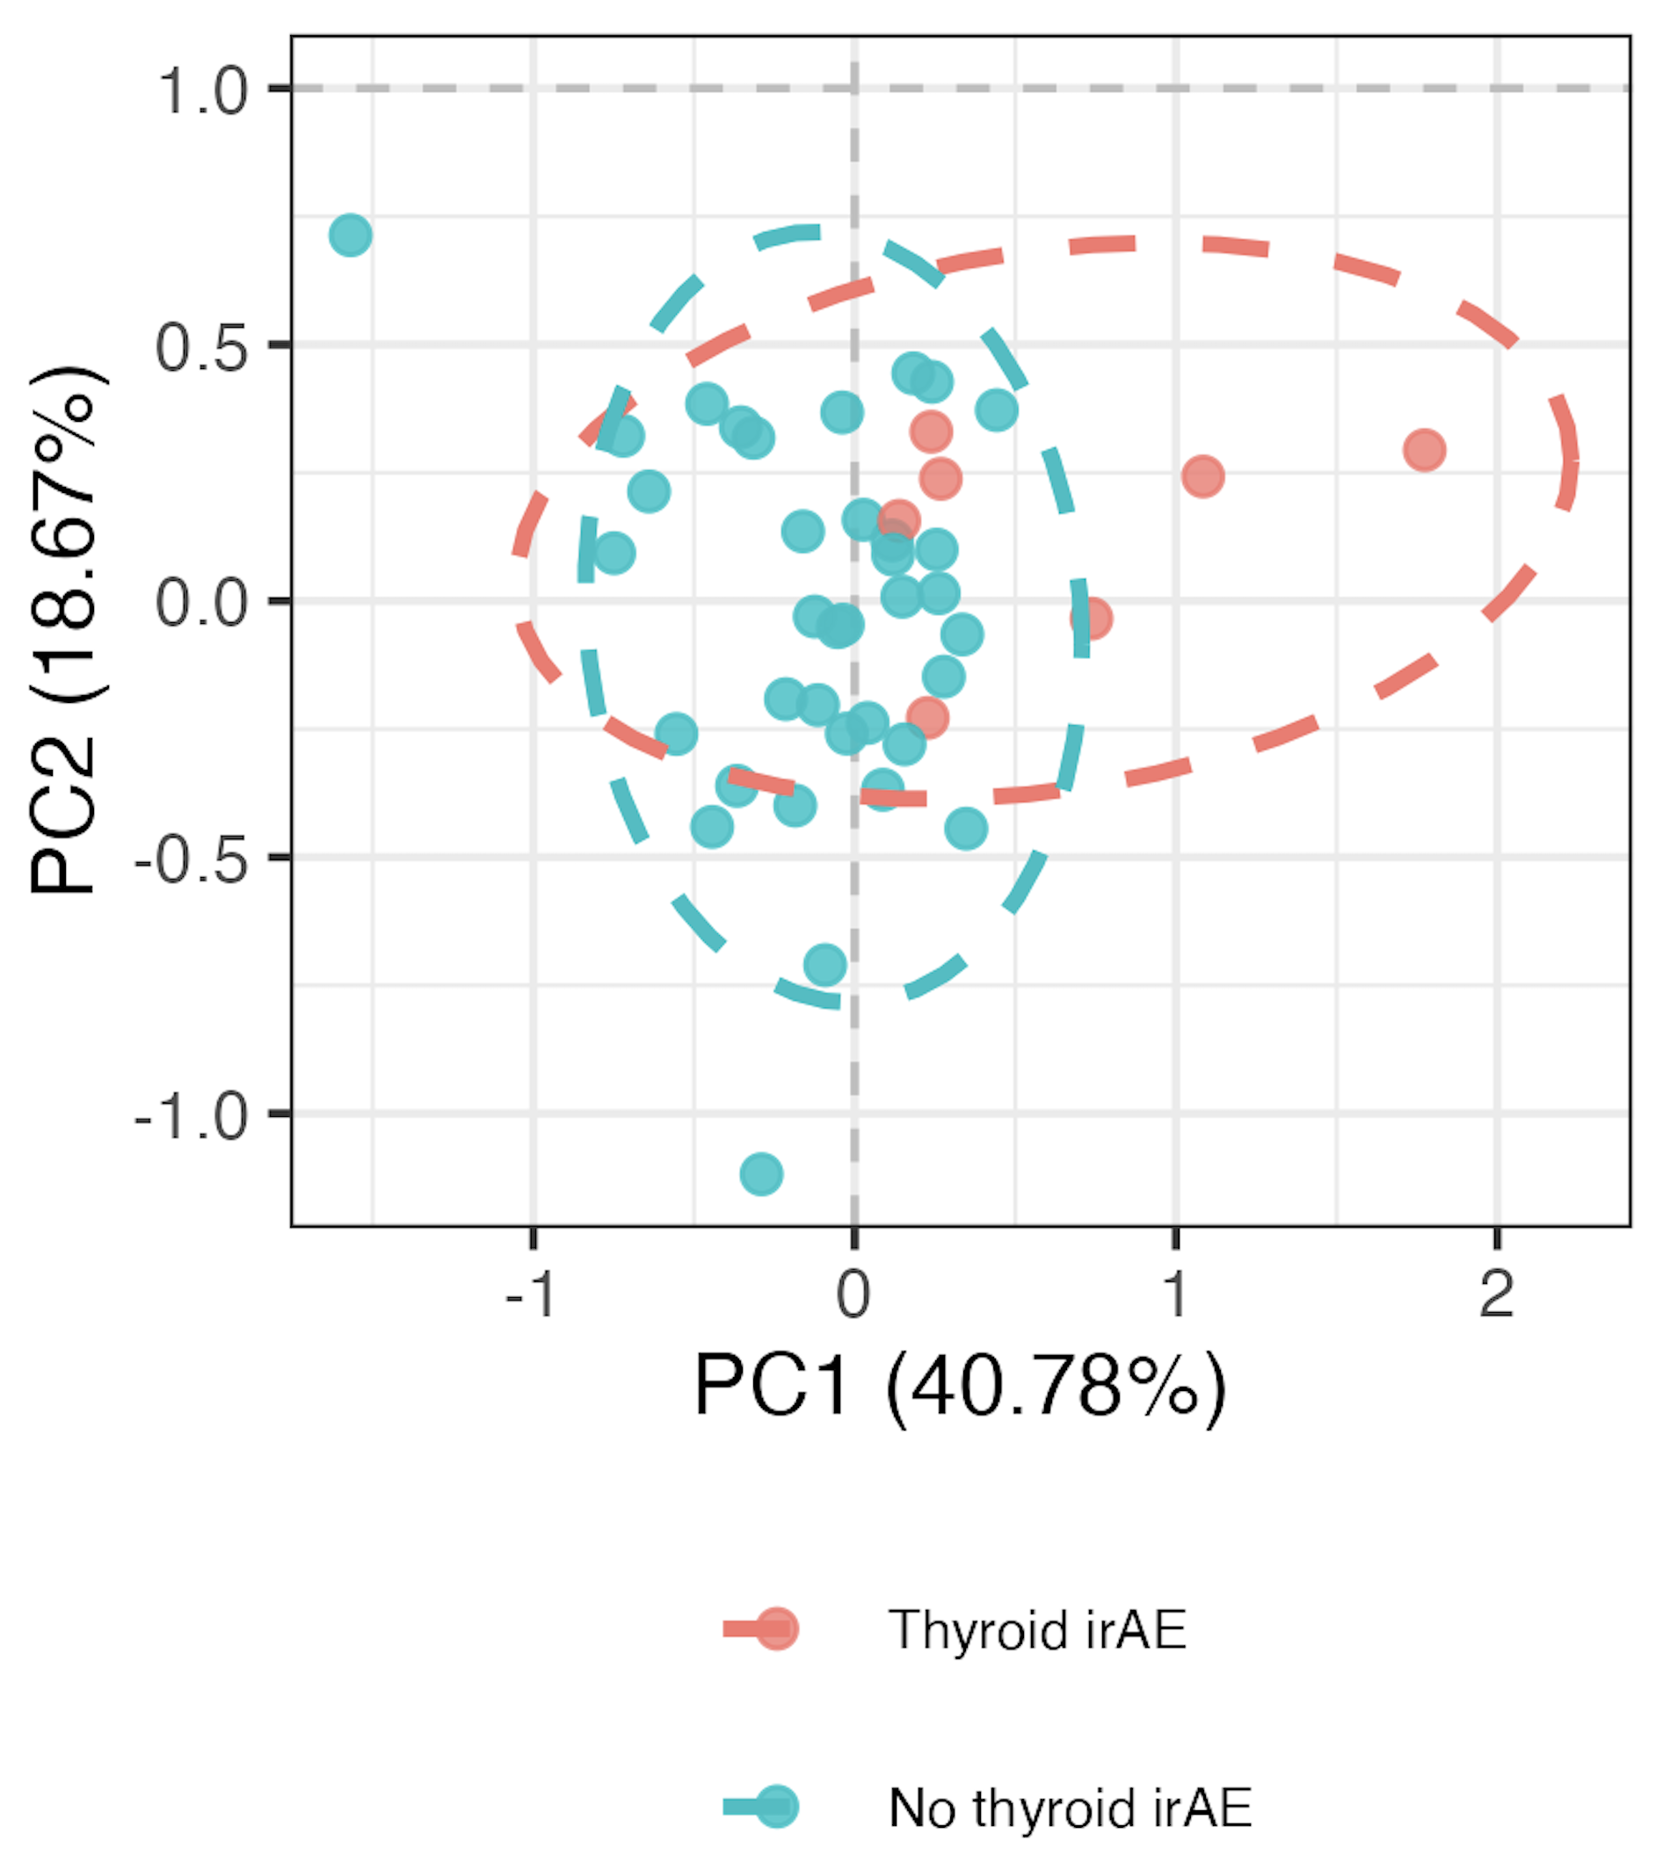
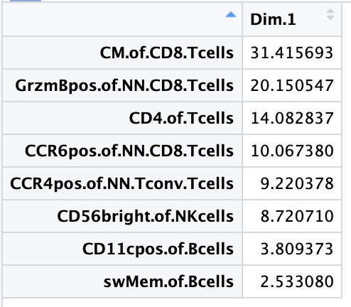
Using module of baseline feature frequencies, can differentiate between those who develop thyroid irAEs
PC1 contributions
PC1 pval: 0.015
Notes:
~similar if including OOR in sense that module needed and then see PC1 (and then PC3) significantly different, contributing features ~different

Slide 6
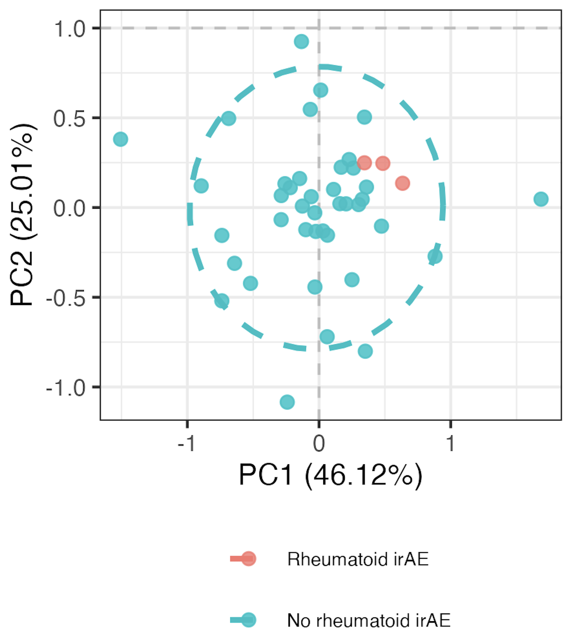
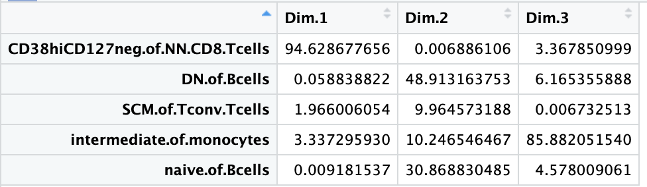
Using module of baseline feature frequencies, can differentiate between those who develop “rheumatoid” irAEs
PC1 pval: 0.003
PC2 pval: 0.005
PC3 pval: 0.027

Slide 7
Conclusions
Baseline immunotypes of those developing and not developing skin irAEs are similar (even with top feature module approach)

Slide 8
Next steps

Slide 9

Acknowledgements
Holly Akilesh
Long lab/HIPcore
Alice Long, Alice Wiedeman
Buckner lab
Jane Buckner, Sylvia Posso
Peter Linsley
Clinical team

Slide 10
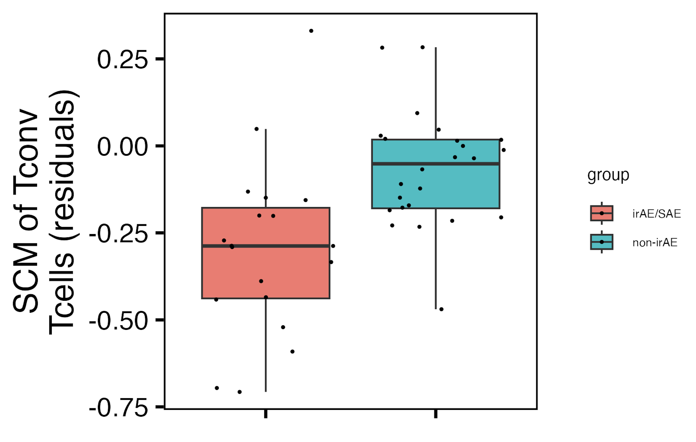
SCM of Tconv Tcells frequency perhaps higher in non-irAE group at baseline
padj = 0.065

