Slide 1
Weekly meeting
3-20-2025
Ty Bottorff

Slide 2
Outline
NCI project
summary of strongest results
plan for experimental followup

Slide 3
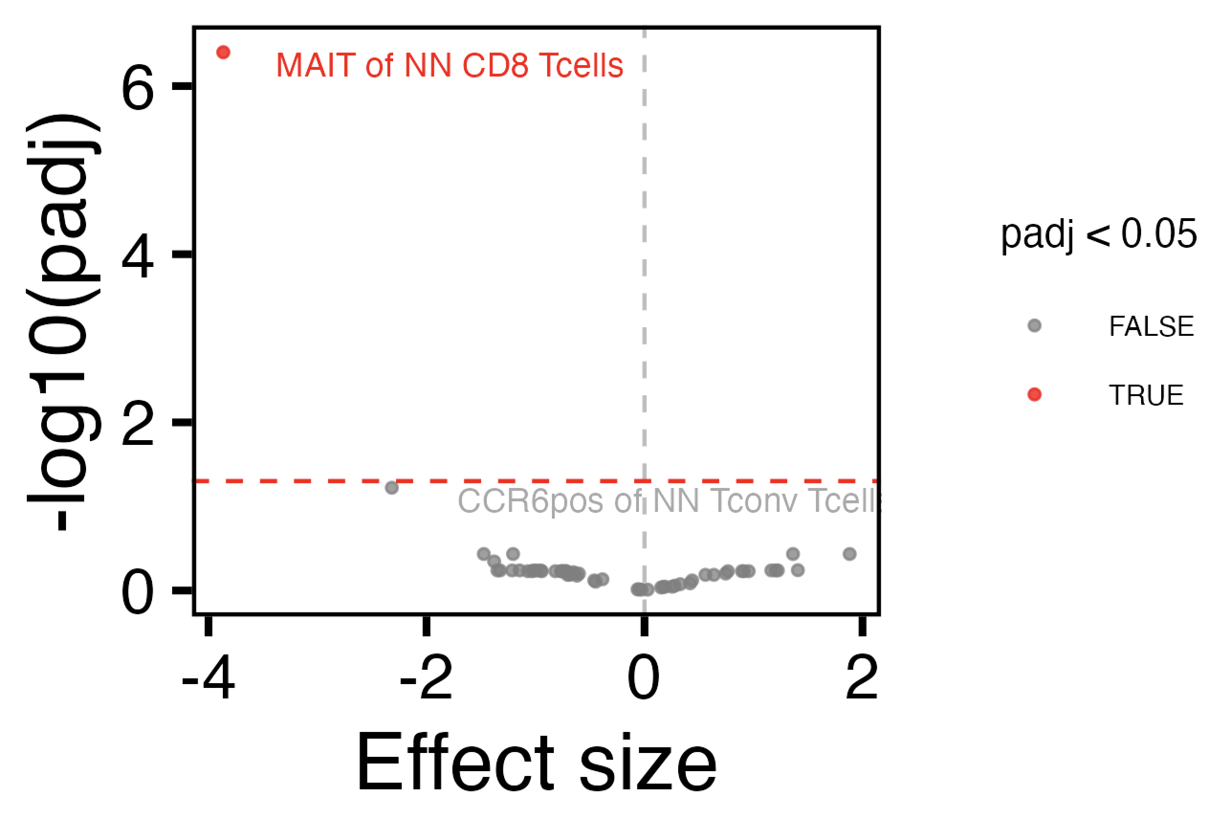
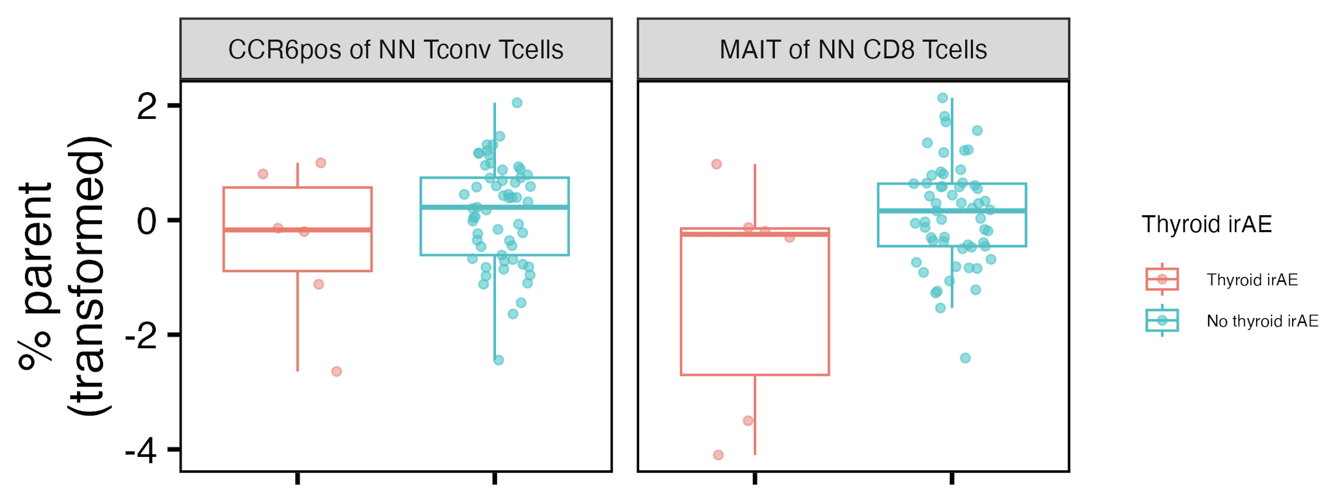
Baseline thyroid irAE group differences

Slide 4
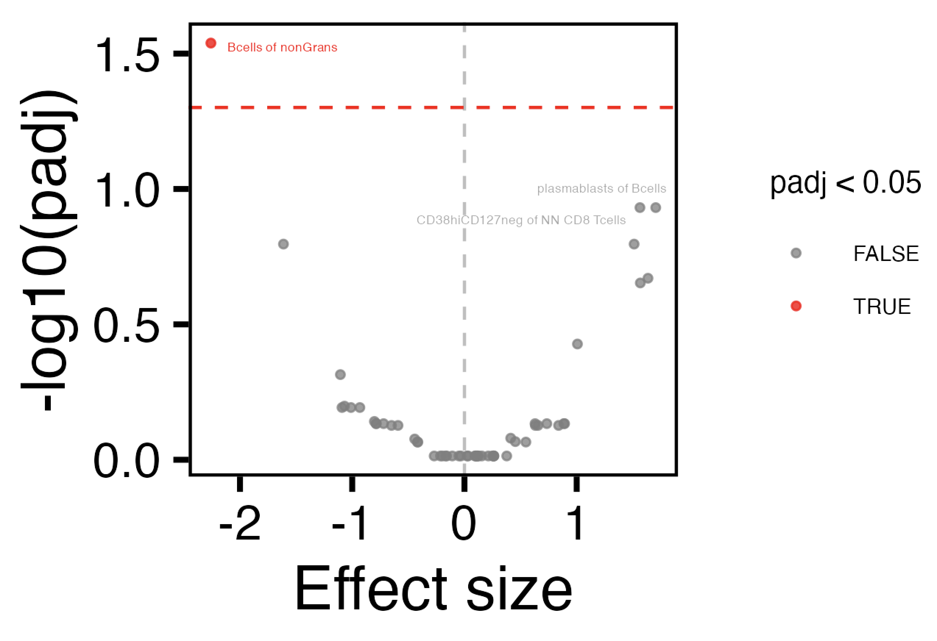
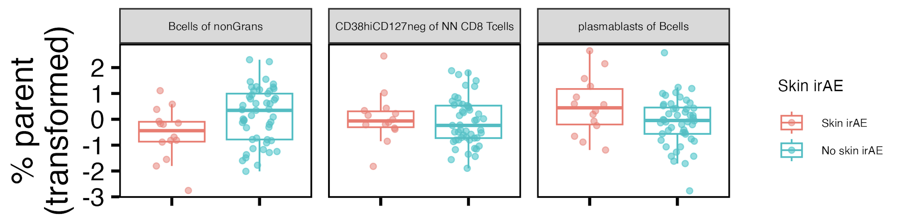
Baseline skin irAE group differences

Slide 5
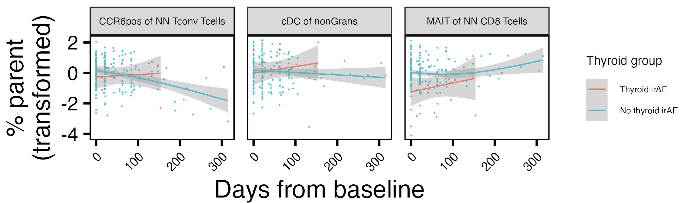
Populations changing differentially over ICI by thyroid irAE group
*
*
*
*
padj < 0.1 at baseline
padj < 0.05 at baseline
padj < 0.05: *
Notes:
Results ~changed with response in model formula too now

Slide 6
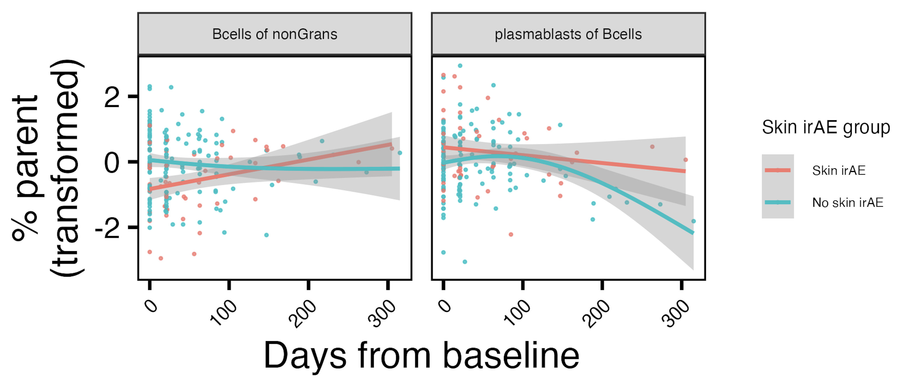
Populations changing differentially over ICI by skin irAE group
*
*
padj < 0.05 at baseline
padj < 0.05: *
Notes:
Results ~changed with response in model formula too now
Bcells of nonGrans lower at baseline in combined/skin irAE

Slide 7
Main takeaway to follow up on
Different immune cell populations associated with skin vs. thyroid irAE development
Notes:
There are some combined irAE differences as well at baseline/longitudinally but follow up clearer I think for specific irAE angle?

Slide 8
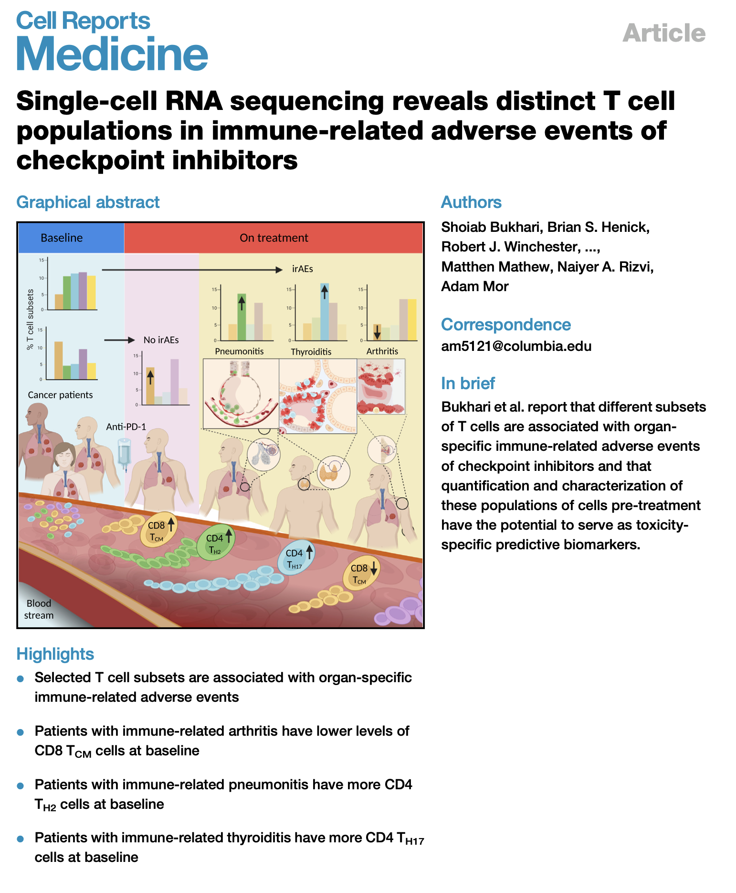
Different immune cell populations have been associated with distinct irAEs
But not widely discussed
Notes:
Only paper I can really find discussing IMMUNE CELL SUBSETS & specific irAEs (others discuss clinical characteristics/lab tests and whatever other stuff for specific irAEs)
Different subsets maybe are irAE-type-specific due to different immune microenvironments of different organs
heterogeneity amongst irAE organs likely complicates prediction

Slide 9
Experimental followup
What’s driving any/specific irAEs (phenotype of T/B cells in those with thyroid, skin, other irAEs)
Cohort groups
NCI: only thyroid irAE, only skin irAE, mixed irAE (non-skin/thyroid), no irAE
New AID samples?
n = 3-4/group
1 time point for NCI groups: visit 3
Assay: scRNAseq of T/B cells sorted from PBMCs
Sample availability
500,000 PBMCs frozen in RLT (for RNA)/sample
Notes:
Sample meaning subject-timepoint
Complication: thyroid only group (n = 4) ¾ have irAE ~kinda long after most recent draw… (0, 40, 50, 60 days past irAE for next draw, and these are different times on ICI…)
Have info for volumes of samples leftover as well

