Slide 1
Weekly meeting
10 19 2023
Ty Bottorff

Slide 2
Outline
Clarify relationship between germline-ness and cross-reactivity
Exploration into Newman TCR features with stitchr, IGoR analysis
Next steps

Slide 3
Relationship between germline-ness and cross-reactivity
Hypothesis: more germline-like TCRs are more cross-reactive due to lower sequence complexity

Slide 4
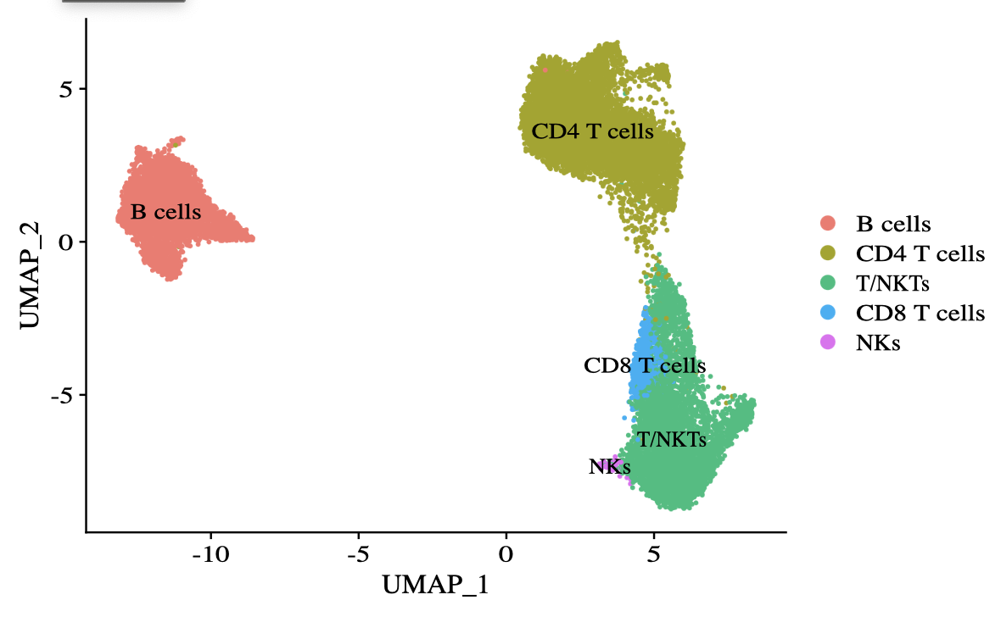
Re-performed dimensional reduction, clustering after removing monocytes, DCs

Slide 5
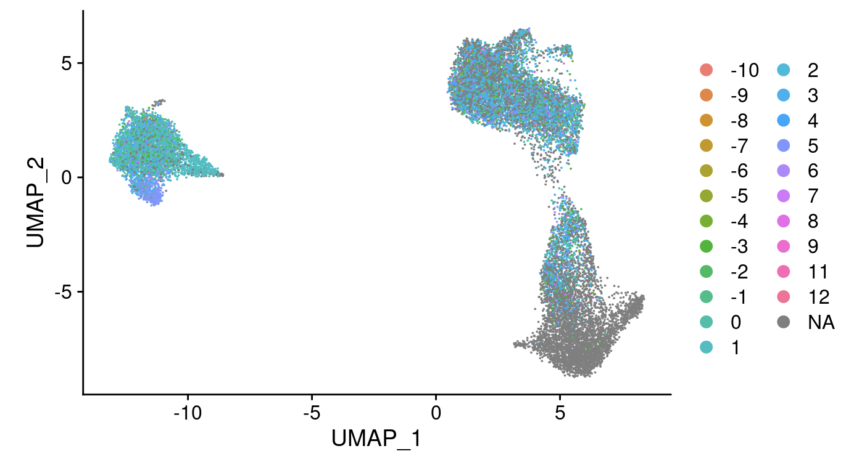
Overlayed CDR3 hydrophobicity onto UMAP

Slide 6
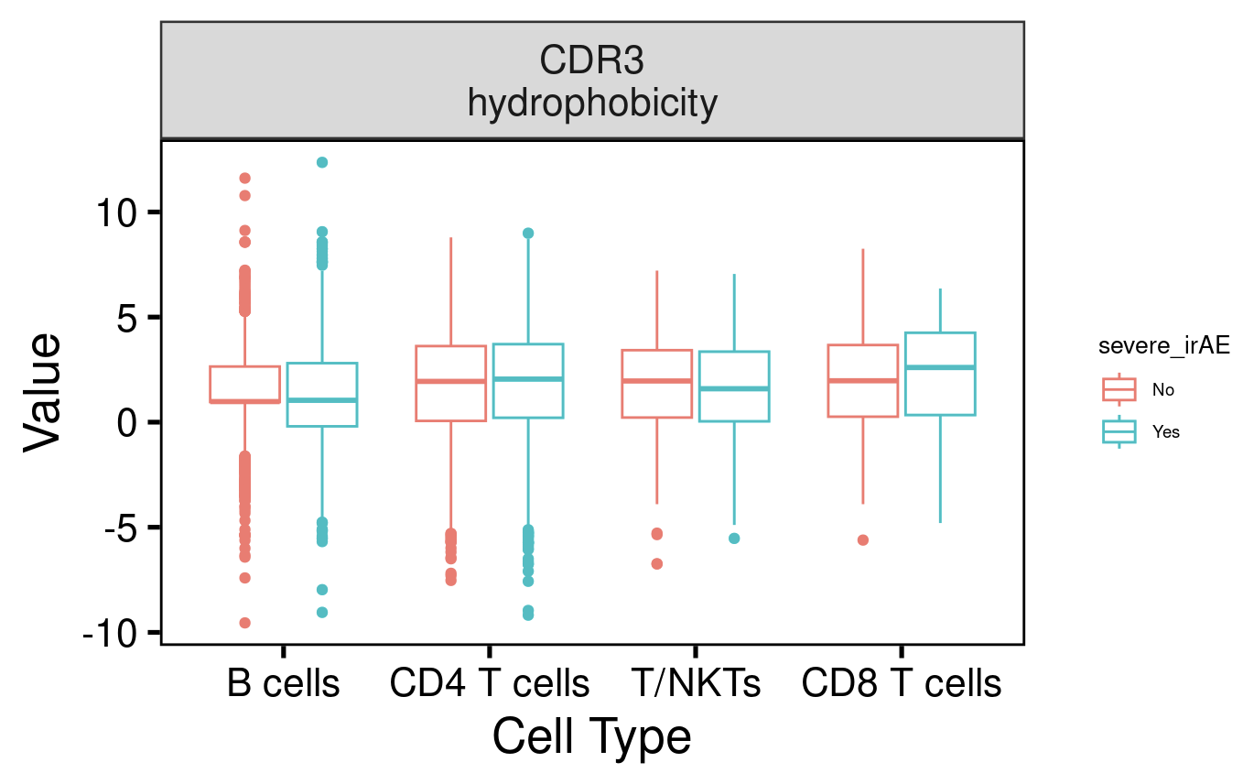
See no differences in CDR3 hydrophobicity among cell types by severe irAE development

Slide 7
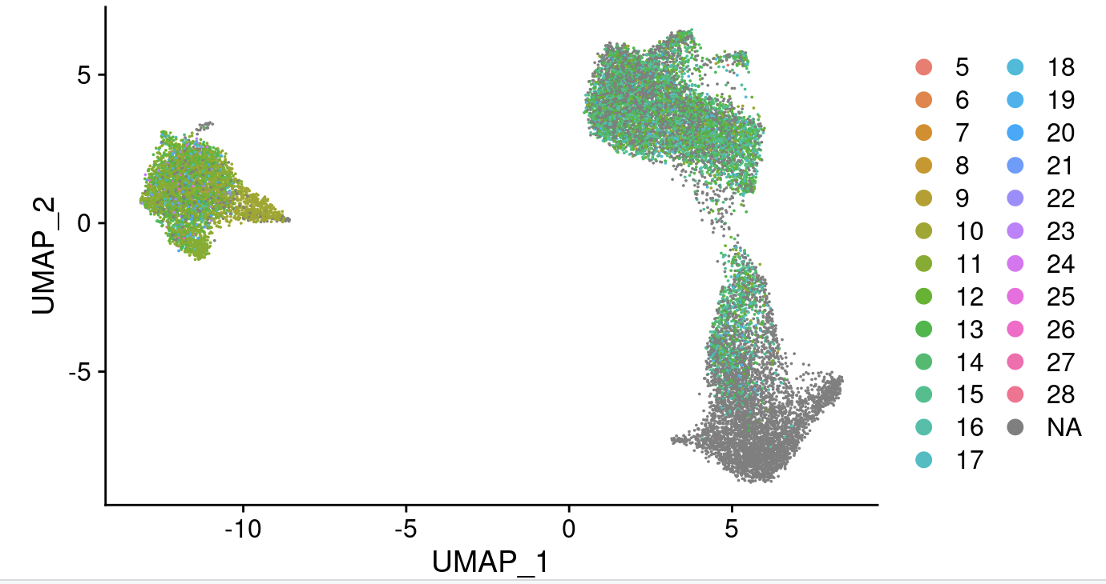
Overlayed CDR3 AA length onto UMAP

Slide 8
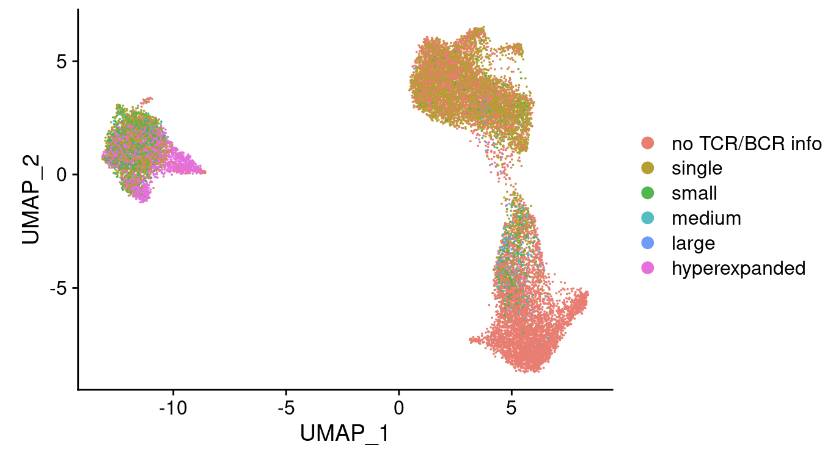
Overlayed (pre-treatment) expansion onto UMAP

Slide 9
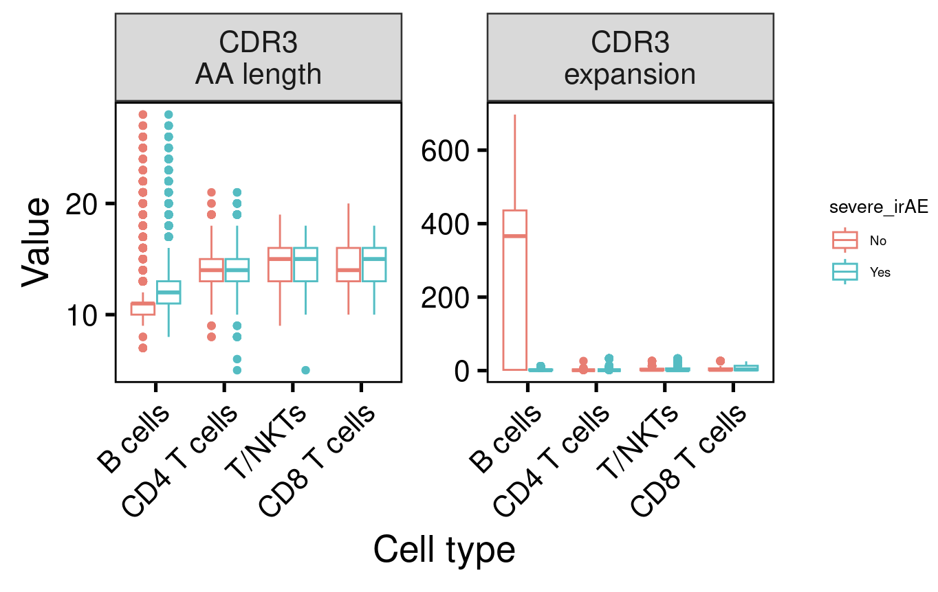
With all patients included, B cell CDR3 AA length and (pre-treatment) expansion seems to relate to severe irAE development

Slide 10
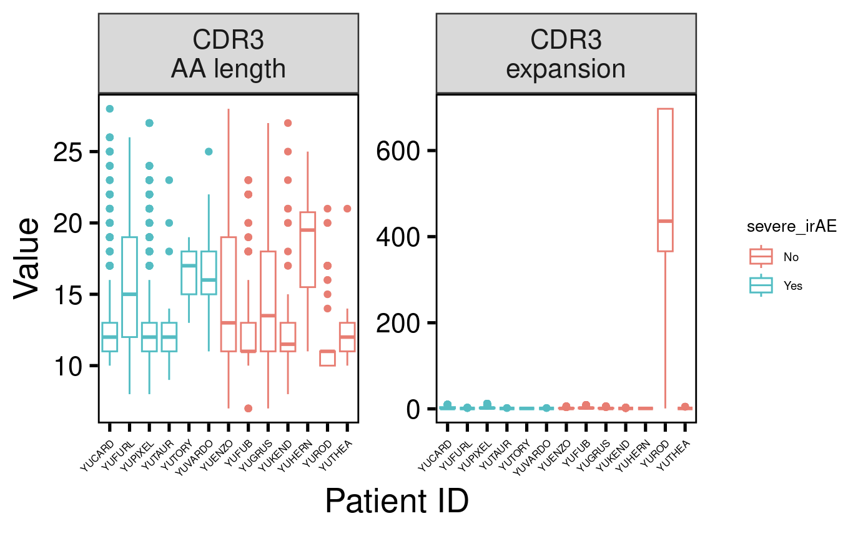
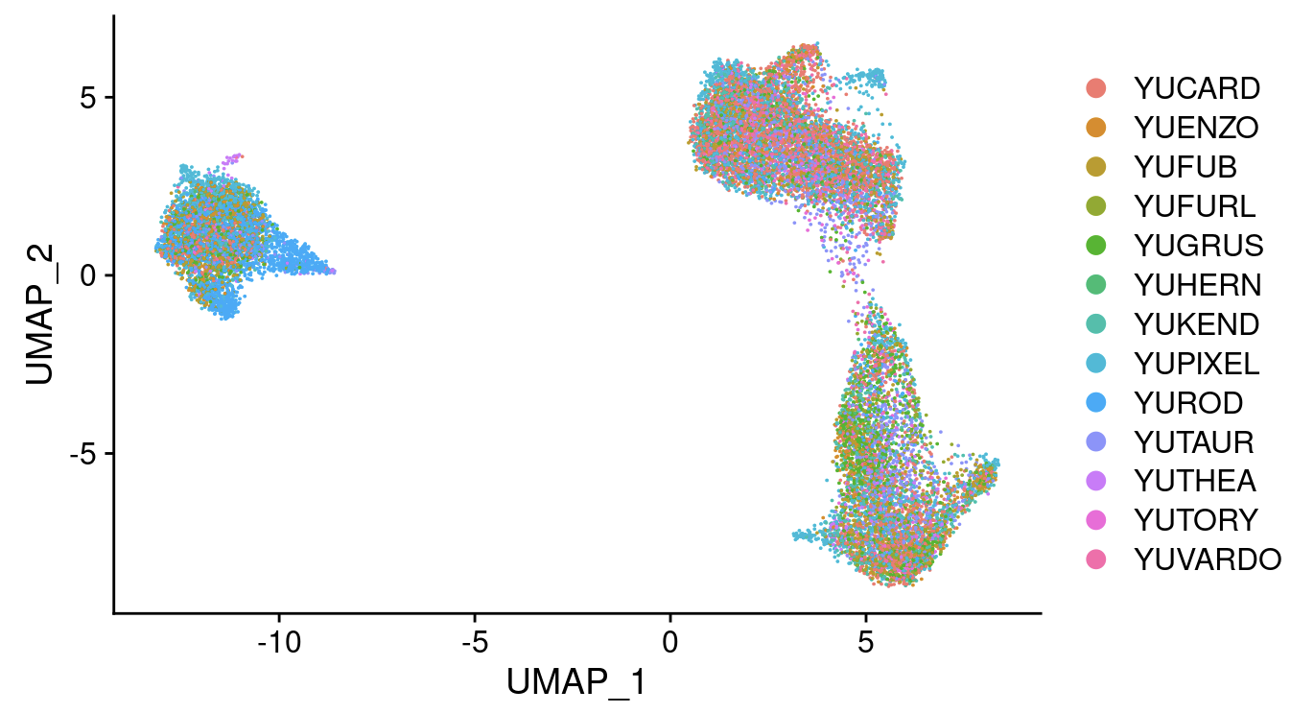
B cell CDR3 AA length and (pre-treatment) expansion differences by severe irAE development are driven by 1 patient (YUROD)

Slide 11
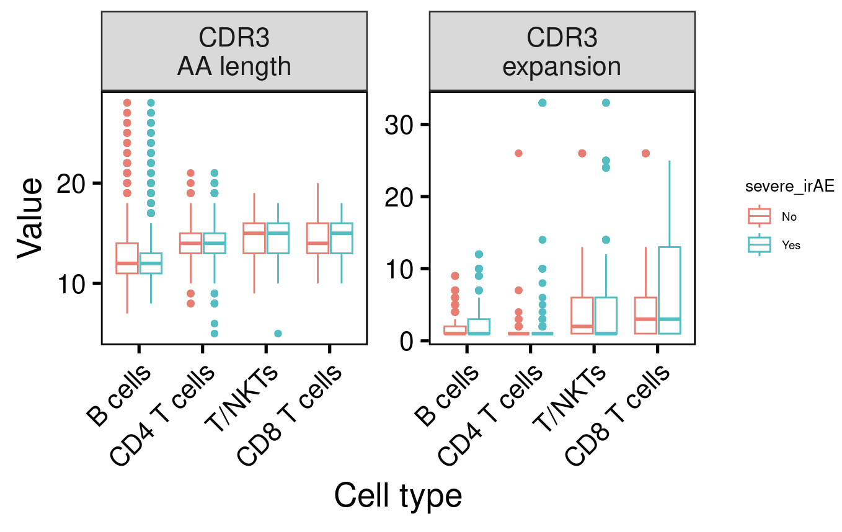
No longer observe B cell CDR3 AA length and (pre-treatment) expansion differences by severe irAE development when removing YUROD patient sample

Slide 12
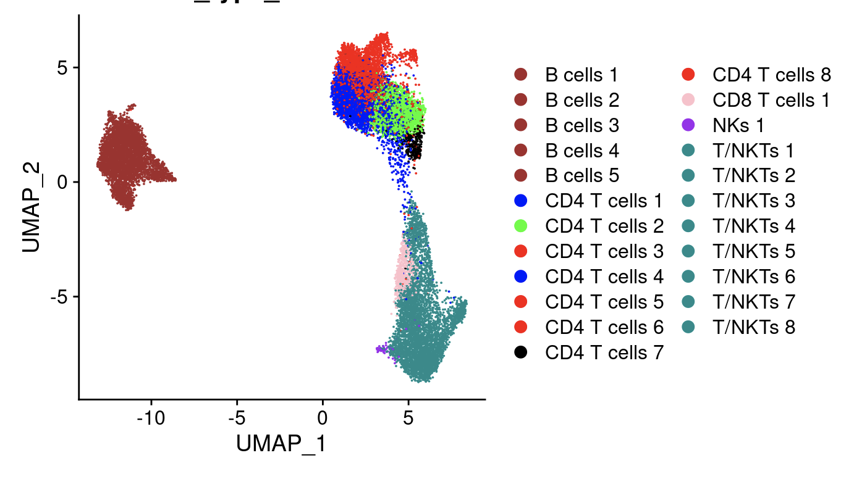
Focused in on CD4 T effector memory cells authors found to expand with ICB
subclusters 2, 4, 7

Slide 13
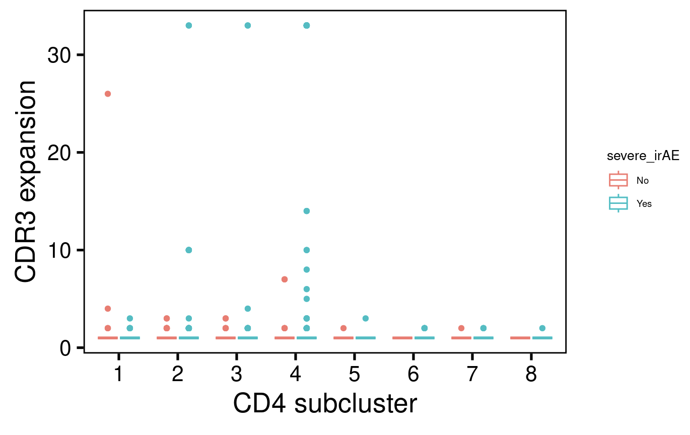
See no predictors of severe irAE development by (pre-treatment) expansion among CD4 subclusters

Slide 14
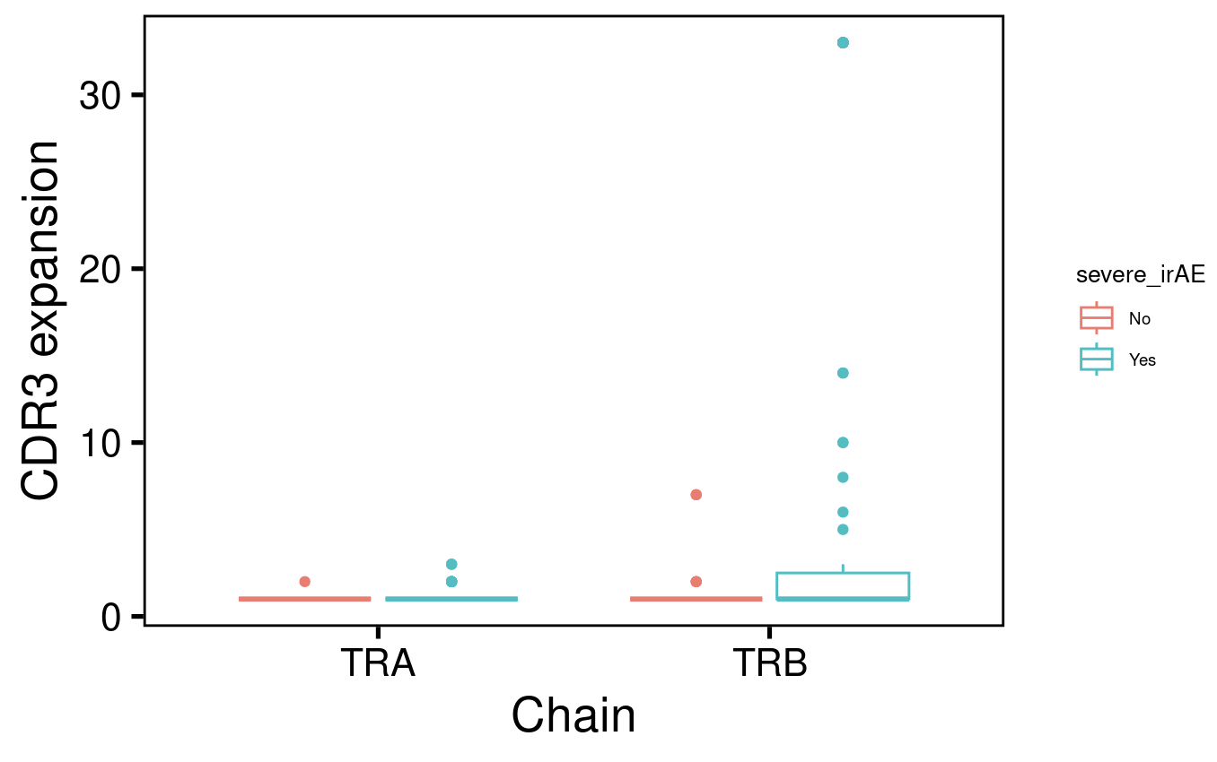
See no statistically significant predictors of severe irAE development by (pre-treatment) expansion among CD4 subcluster 4 chains
Notes:
Wilcoxon rank sum test with continuity correction data: group1 and group2 W = 1569, p-value = 0.3255 alternative hypothesis: true location shift is not equal to 0

Slide 15
Stitchr and IGoR & IMGT/HIGHV-QUEST methods
Stitchr
Read in scV(D)Jseq data: 13,403 (7,141 unique) barcodes
Filtered for barcodes with exactly 1 alpha and 1 beta chain (4232 unique barcodes)
Run Stitchr
Only get full TCR linked sequences for 1,067 barcodes, 1,631 for alpha chain, 2,793 for beta chain
IGoR & IMGT/HIGHV-QUEST
Run separately for alpha and beta chains

Slide 16
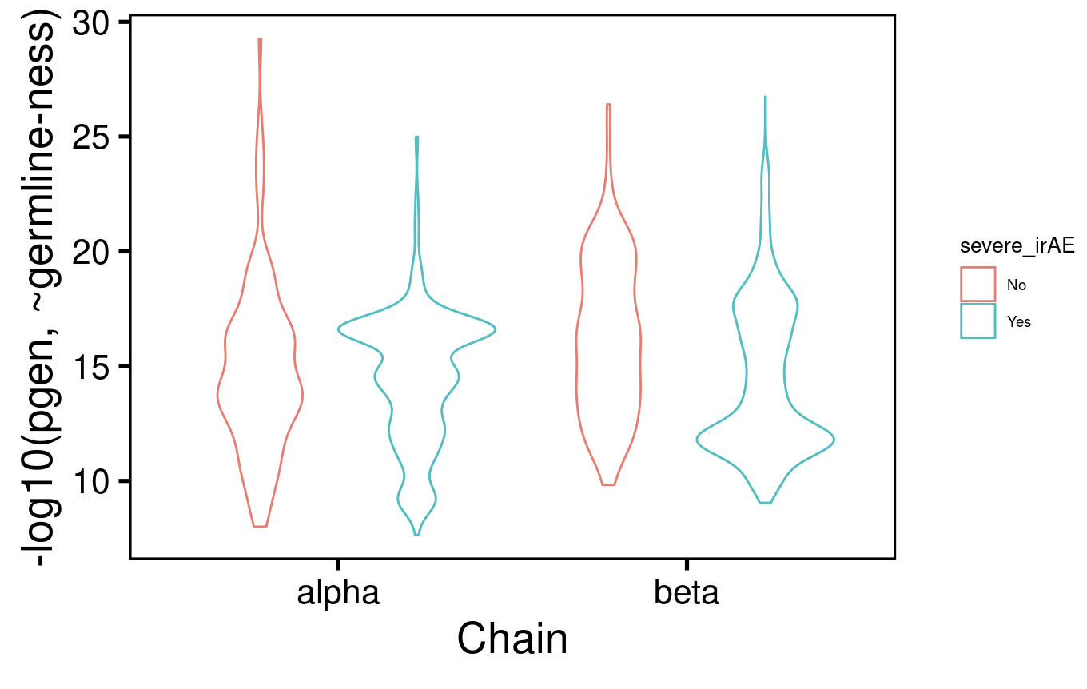
pgen scores don’t differ dramatically between TCR chains by severe irAE development
Notes:
Higher -log10(pgen value) means higher probability of generation (more germline-like) because higher (less negative) pgen values have a higher probability of generation by V(D)J recombination. Conversely, sequences with lower (more negative) pgen values have a lower probability of generation

Slide 17
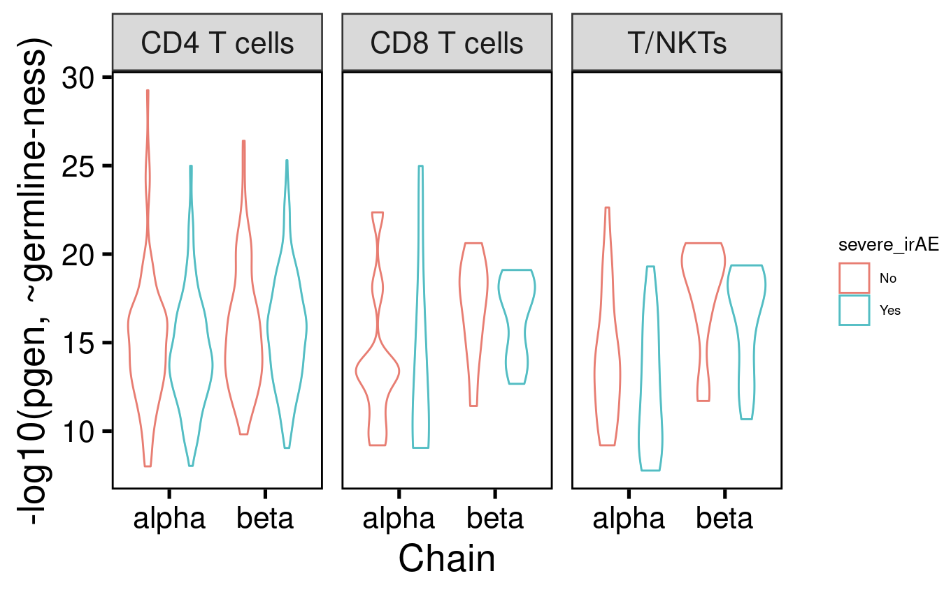
pgen scores don’t differ dramatically between TCR chains or cell type by severe irAE development
Notes:
Higher -log10(pgen value) means higher probability of generation (more germline-like) because higher (less negative) pgen values have a higher probability of generation by V(D)J recombination. Conversely, sequences with lower (more negative) pgen values have a lower probability of generation

Slide 18
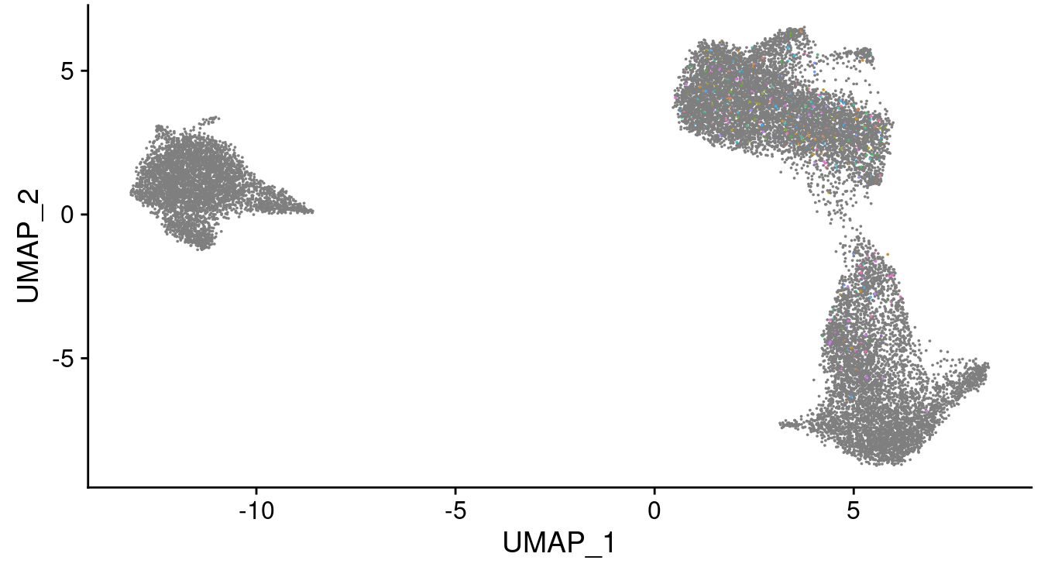
Lost too many barcodes during stitching process to gain insights from UMAP overlay
Lost barcodes
in gray

Slide 19
Next steps
Try to recover more barcodes in stitchr analysis by resolving errors
Unable to locate N terminus of CDR3 in V gene correctly. Please ensure sequence plausibility. Cannot stitch a sequence for TRA
Problematic TRAV genes seem to not have allele specified, no help when adding on *01 or *% to specify 1 or all, respectively
String index out of range. Cannot stitch a sequence for TRB
Analyze IMGT/HighV-Quest output
Move on to other datasets
Input stitched TCR seqs into algorithms to predict/cluster by epitope specificity?
GLIPH: group TCRs of common specificities, define TCR clusters often contacting antigenic peptides
TCRdist: distance measure of TCR space
VDJdb

