Slide 1
NCI update – analyzing CyTOF data
10 23 2024
Ty Bottorff – Bioinformatics postdoc
Linsley lab

Slide 2
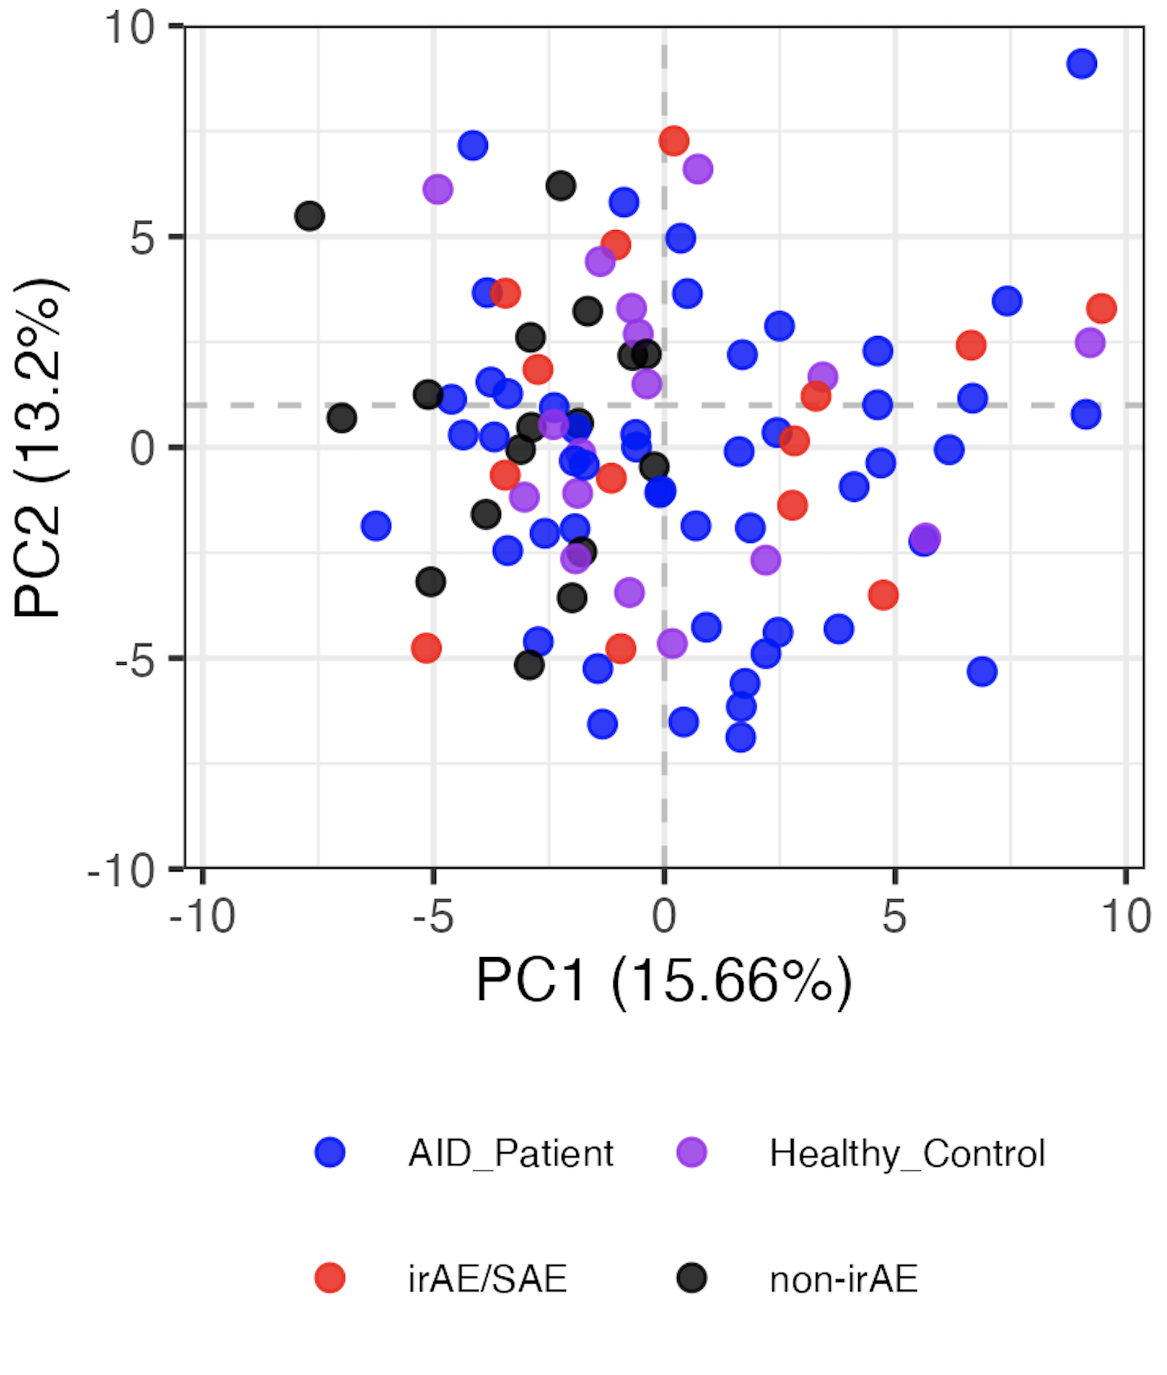
Baseline immunotypes are not distinct by group
Notes:
LOGIT TRANSFORMED FREQS
Including all PD1/PDL1 sorts here but that’s fine I believe (baseline, no ICI yet)
Significant hits
# (severe) irAE vs. no irAE: none
# AID vs. HC, none
# AID vs. cancer:
# naive of CD8 Tcells, Treg of CD4 Tcells, Tcells of nonGrans, Tfh of NN Tconv Tcells, NKcells of nonGrans, CXCR3pos of NN CD8 Tcells, CD11cpos of Bcells, naive of Treg Tcells, MAIT of NN CD8 Tcells, unswMem of Bcells, CRTH2pos of NN CD8 Tcells
# AID vs. non-irAE: Treg of CD4 Tcells, naive of CD8 Tcells, CRTH2pos of NN CD8 Tcells, CCR4pos of NN Tconv Tcells, ICOSpos of Tfh Tconv Tcells
# AID vs. irAE: CD11cpos of Bcells, NKcells of nonGrans, Tcells of nonGrans, Tfh of NN Tconv Tcells, naive of CD8 Tcells, unswMem of Bcells, Bcells of nonGrans, CXCR3pos of NN CD8 Tcells
# HC vs. cancer: CD38hiCD127neg of NN CD8 Tcells, Treg of CD4 Tcells
# HC vs. non-irAE: CRTH2pos of NN Tconv Tcells, Treg of CD4 Tcells, CD38hiCD127neg of NN CD8 Tcells, CRTH2pos of NN CD8 Tcells, SCM of Tconv Tcells
# HC vs. irAE: none

Slide 3
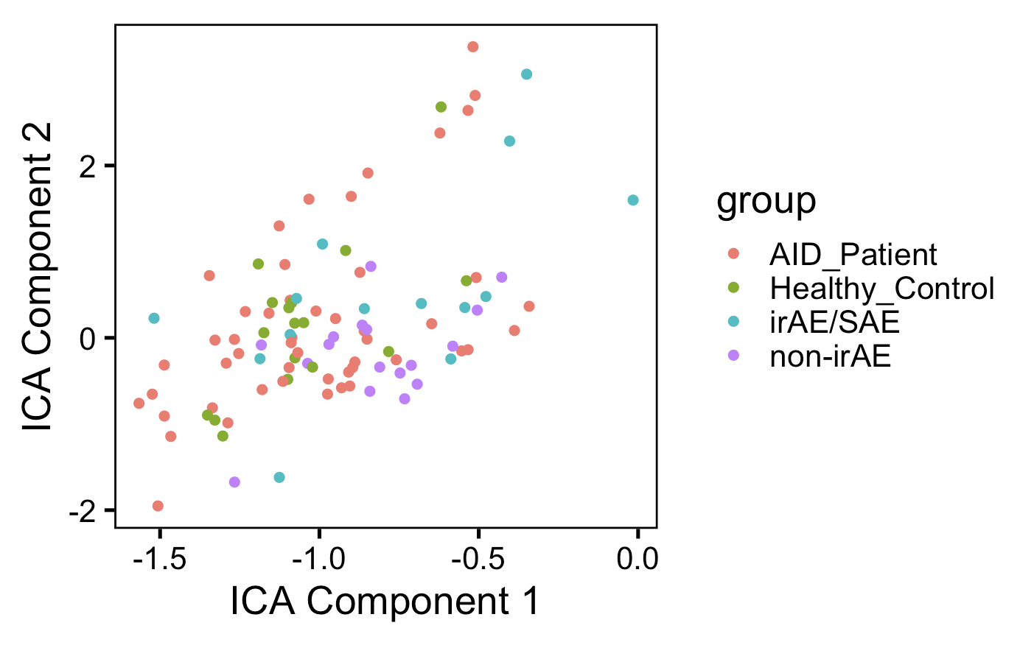
ICA doesn’t appear better at distinguishing unique immunotypes by group than PCA (baseline data)

Slide 4
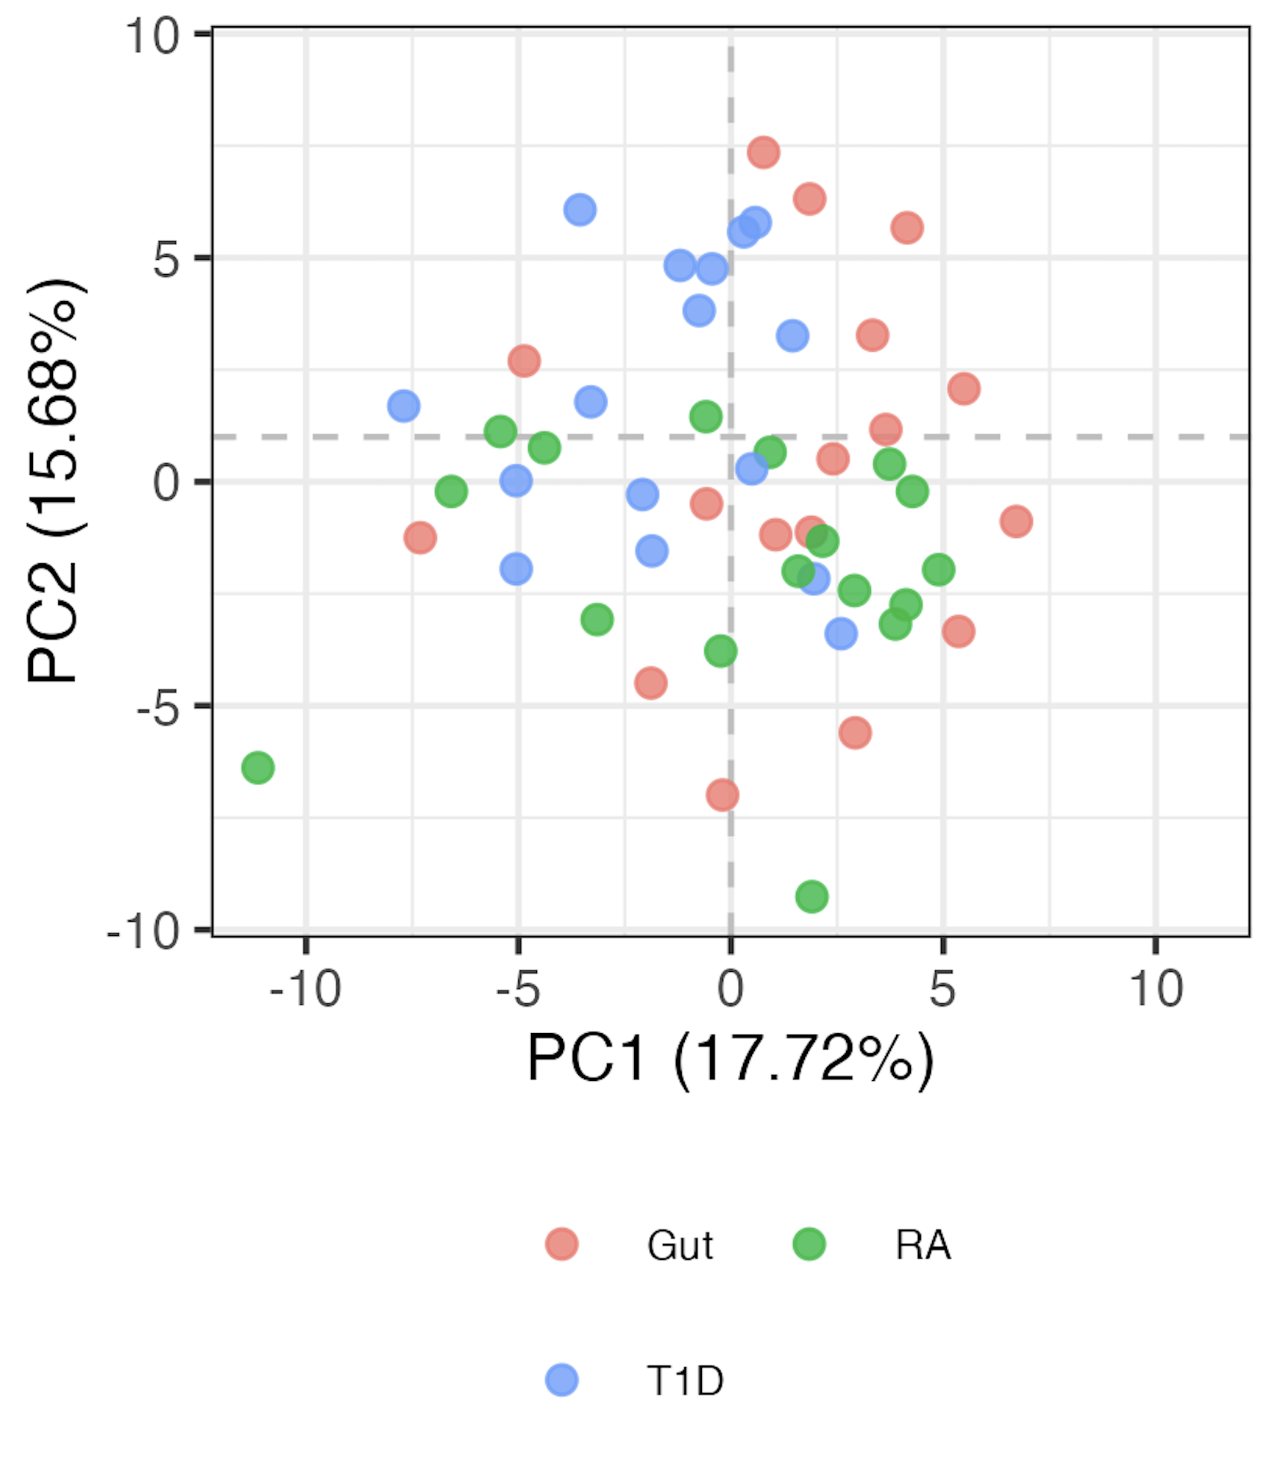
AID subgroup immunotypes are not very distinct either
Notes:
LOGIT TRANSFORMED FREQS

Slide 5
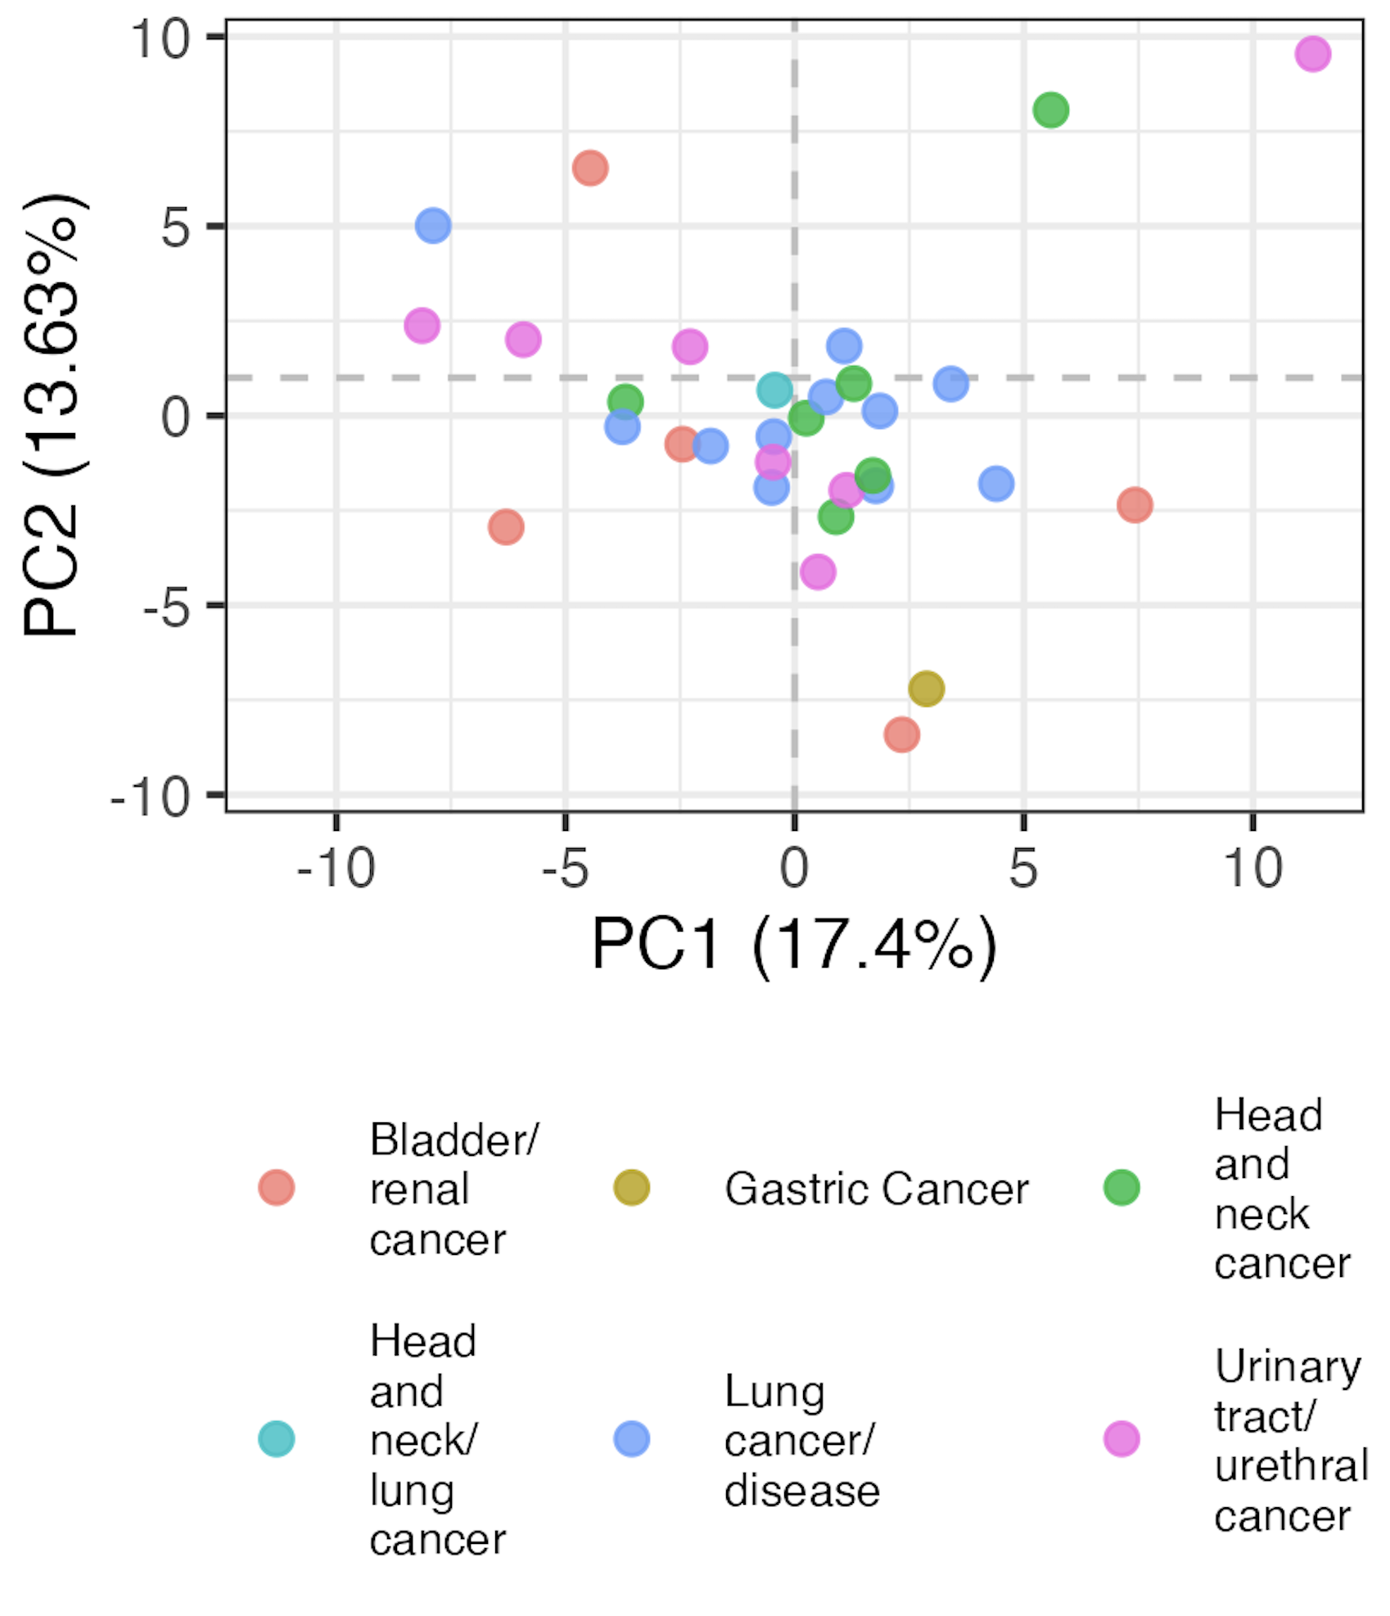
Baseline head, neck, and lung cancer immunotypes are distinct from other cancer subtypes

Slide 6
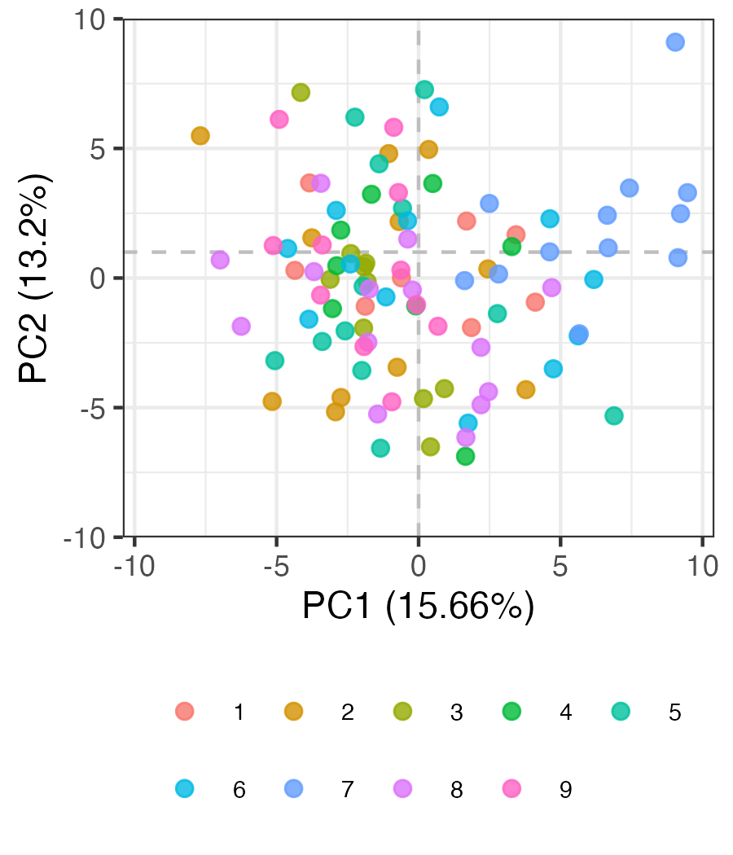
Some evidence of batch effects in baseline data
Batch #
Notes:
Batch 7 kind of all clustering together in bottom left…

Slide 7
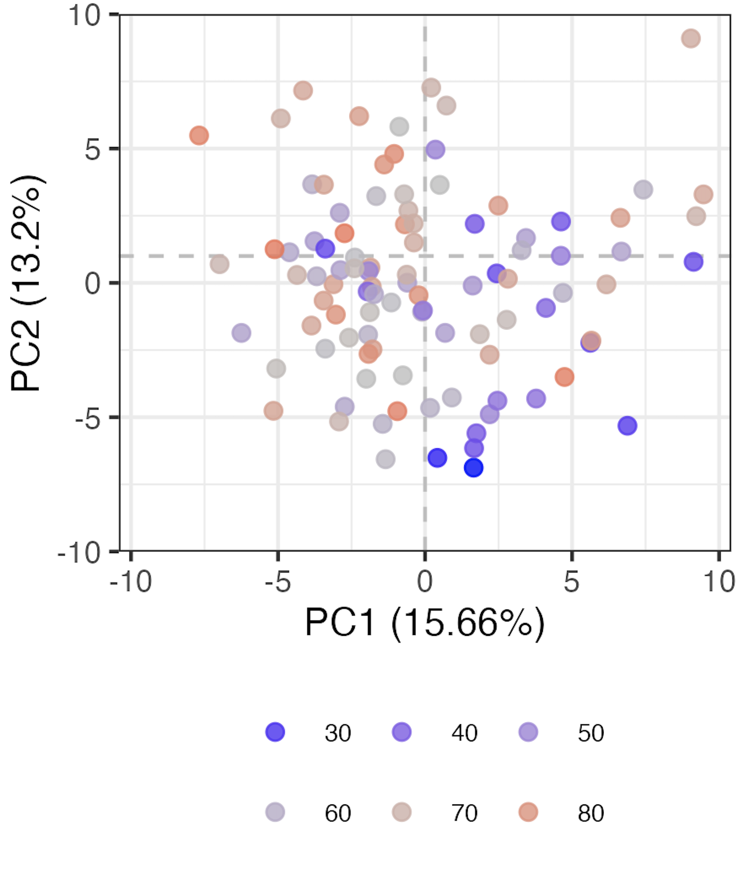
Age contributes to variation (baseline samples)
Age

Slide 8
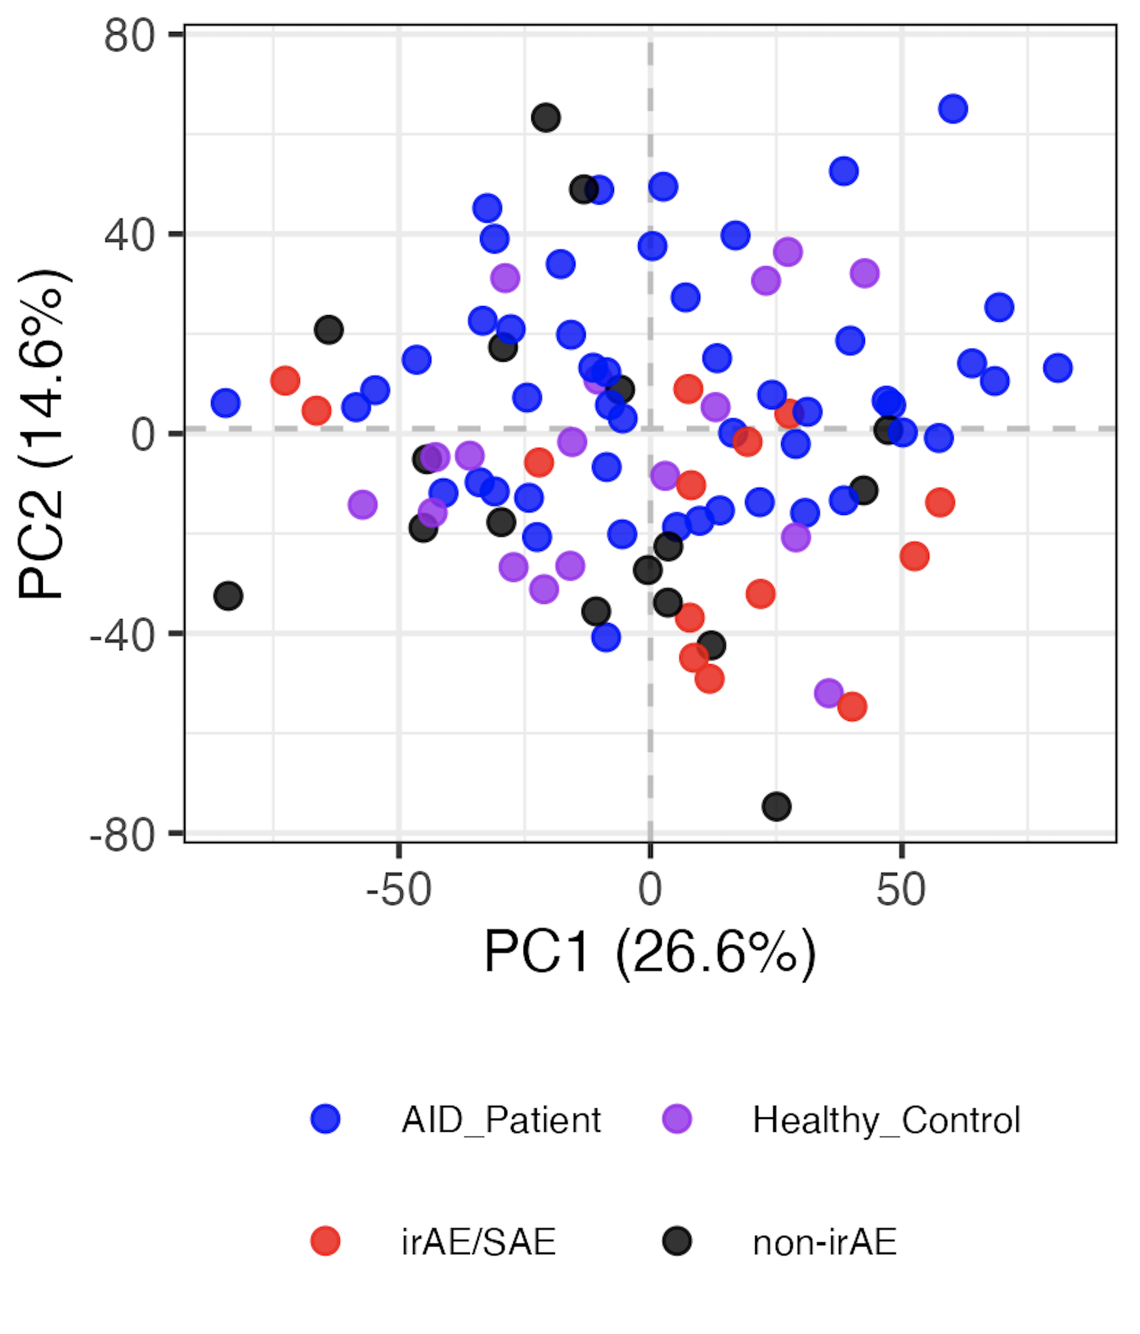
Regressing out age & batch from baseline samples doesn’t reveal clearly distinct immunotypes
Batch regressed out
Notes:
Left is normal logit
Right is residuals from linear models with age and Batch as confounders

Slide 9
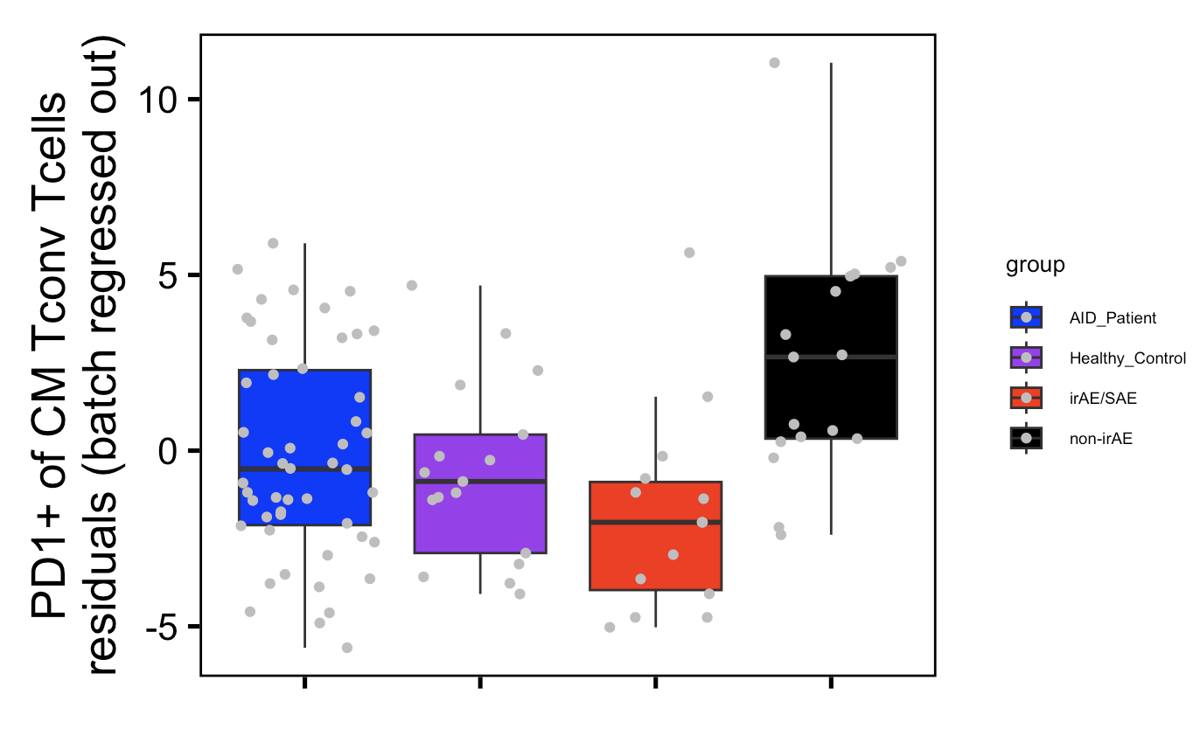
However, PD1⁺ of CM T_{conv} T_{cells} does appear slightly higher in non-irAE group vs. irAE/SAE group post-regressing out batch
~*
Wilcoxon rank sum test. ~*; padj < 0.1

Slide 10
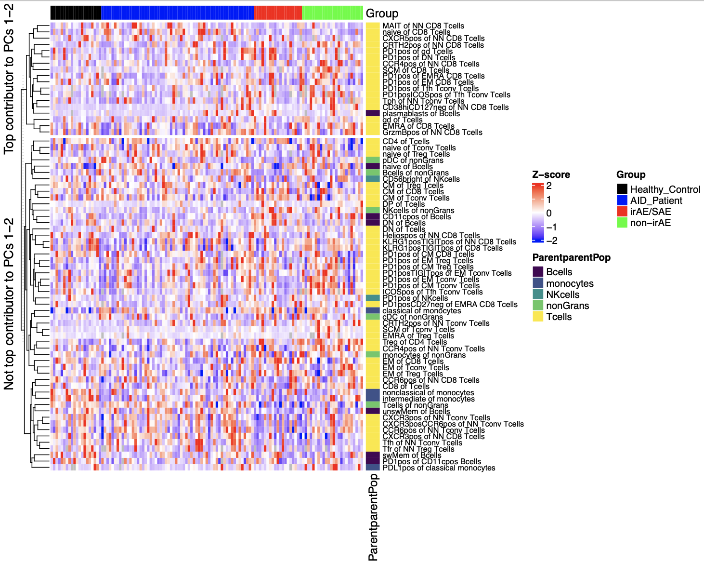
Certain features contribute more to variation (baseline)

Slide 11
Conclusions
don’t see effect of previous treatments (radiation, chemoradiation…) on baseline cancer immunotypes (data not shown)
ICA does not appear better at distinguishing unique immunotypes by group (baseline) than PCA
PD1⁺ of CM T_{conv} T_{cells} slightly higher in non-irAE group vs. irAE/SAE group at baseline (after regressing out batch)

Slide 12
Next steps

Slide 13

Acknowledgements
Holly Akilesh

Slide 14
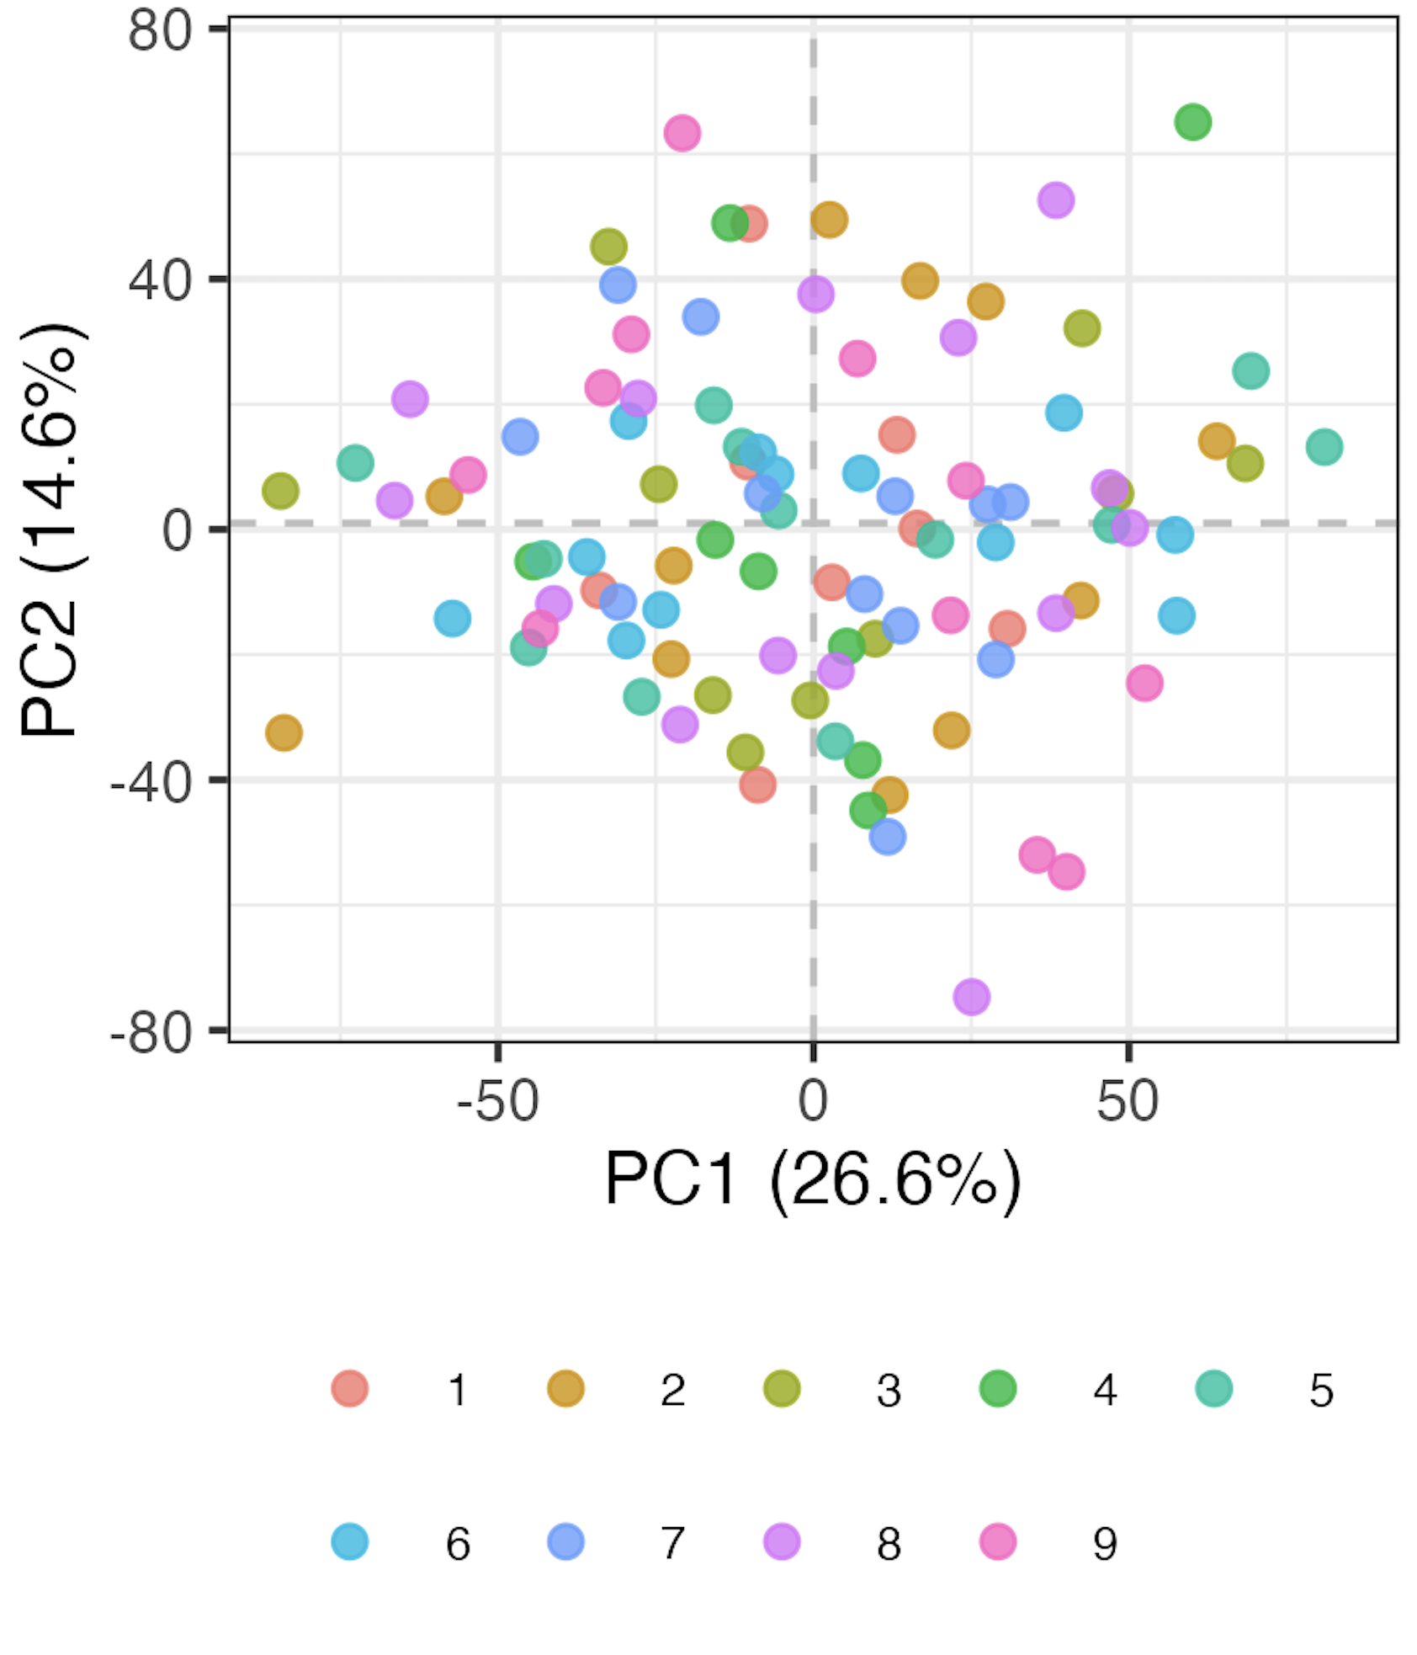
Regressing out batch works
Batch #

