Slide 1
Weekly meeting
11 21 2023
Ty Bottorff

Slide 2
Outline
CDR3 feature analysis by cell type, expansion degree
IGoR pgen analysis by cell type, expansion degree

Slide 3
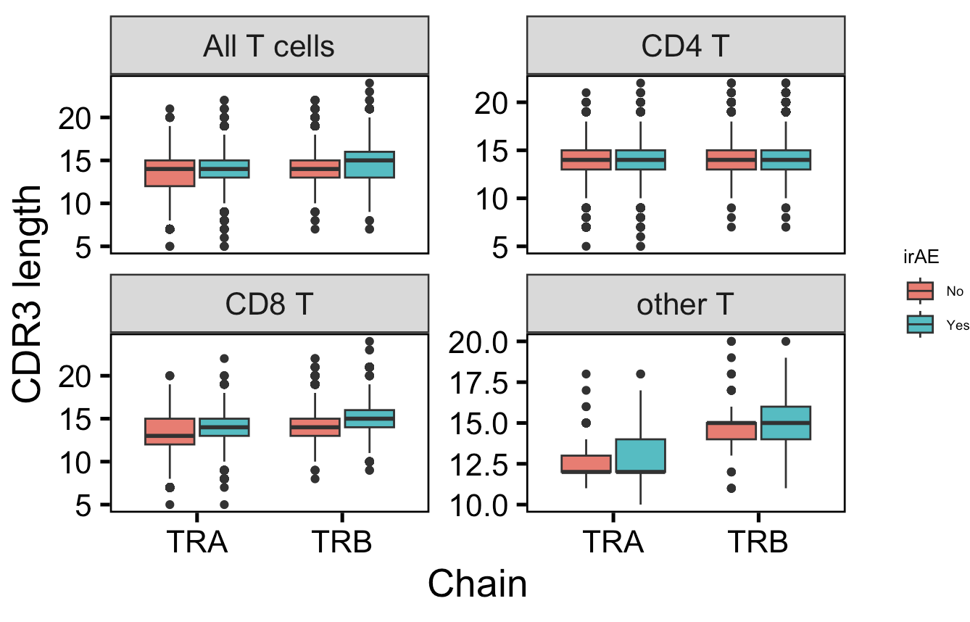
Across all CD8 TCRs, CDR3s are longer in those developing irAEs
*
**
n.s
n.s
n = 7,324
n = 10,926
n = 11,886
n = 18,250
**
**
n.s
*
n = 4,418
n = 7,120
n = 144
n = 204
Notes:
other T includes double negative T (dnT), MAITs
this is consistent with past results before QC/aberrant TCR exclusion

Slide 4
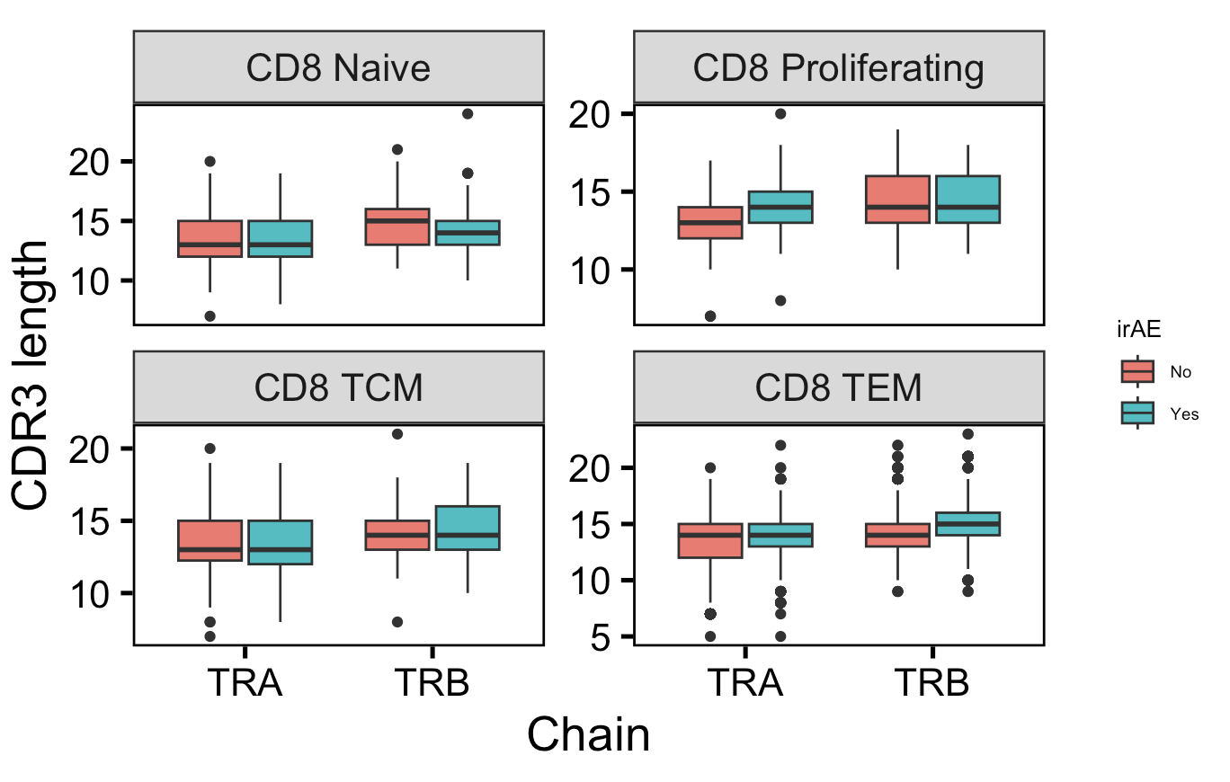
CD8 TEMs and proliferating CD8 TRA CDR3s longer in those with irAEs; naïve CD8s TRB CDR3s shorter in those with irAEs
n = 421
n = 428
n.s.
n.s.
n = 31
n = 121
*
*
n.s.
*
**
**
n = 202
n = 280
n = 3,764
n = 6,291

Slide 5
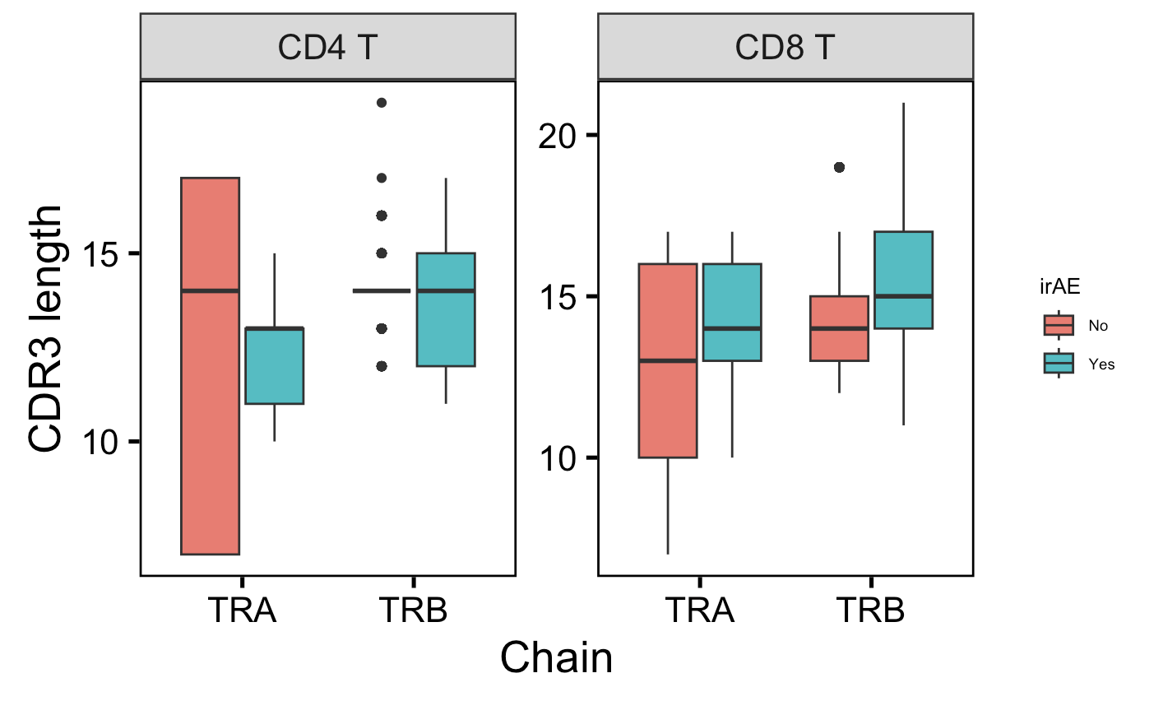
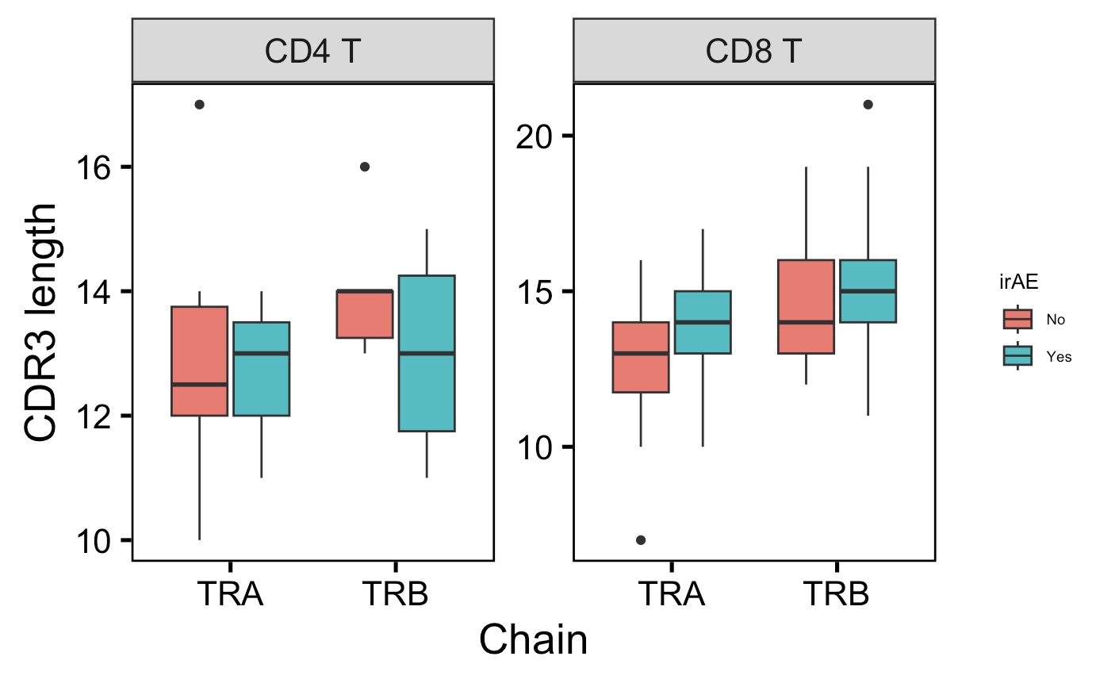
Within (unique) highly expanded CD8 T cells, TRA CDR3s are generally longer in those developing irAEs
All highly expanded CD8 TCRs
Unique highly expanded CD8 TCRs
*
*
**
**
n.s.
n.s.
n.s.
p = 0.06
n = 616
n = 133
n = 623
n = 148
n = 1,777
n = 3,446
n = 1,790
n = 3,557
n = 6
n = 3
n = 6
n = 4
n = 20
n = 54
Notes:
Counts > 20

Slide 6
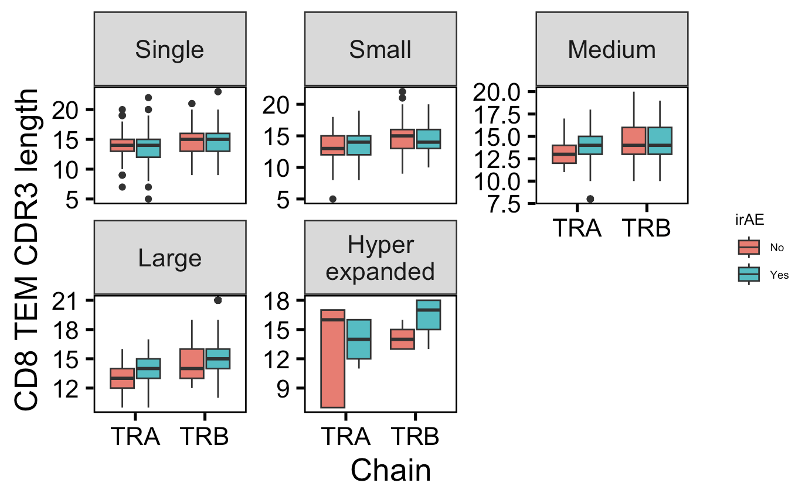
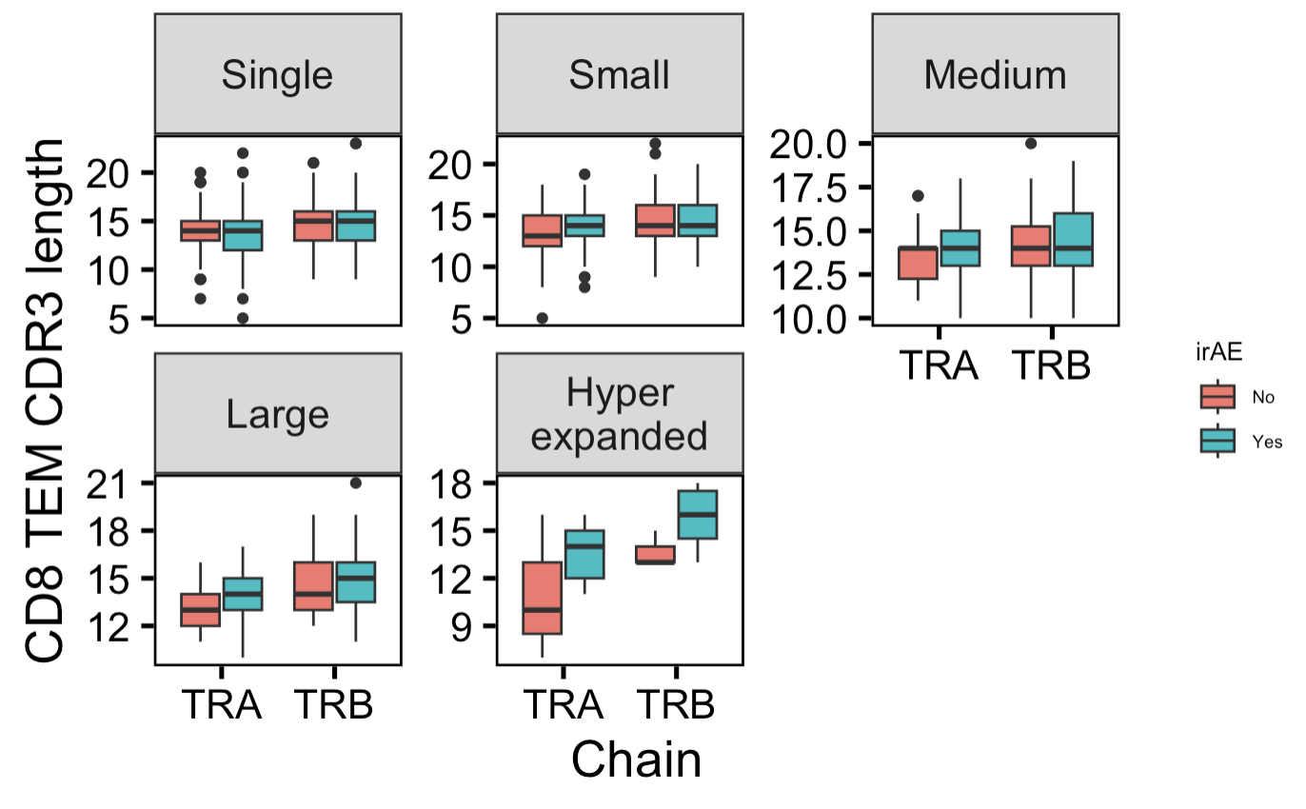
Within (unique) highly expanded CD8 TEMs, TRB CDR3s generally longer in those developing irAEs
All CD8 TEM TCRs
Unique CD8 TEM TCRs
n.s.
n.s.
n.s.
**
**
*
**
p = 0.13
Count buckets:
Single: 1
Small: 2-5
Medium: 6-20
Large: 21-100
Hyperexpanded: > 100
n = 710
n = 2082
n = 677
n = 2177
n = 16
n = 47
n = 1058
n = 1359
n = 1103
n = 1365
n = 3
n = 7

Slide 7
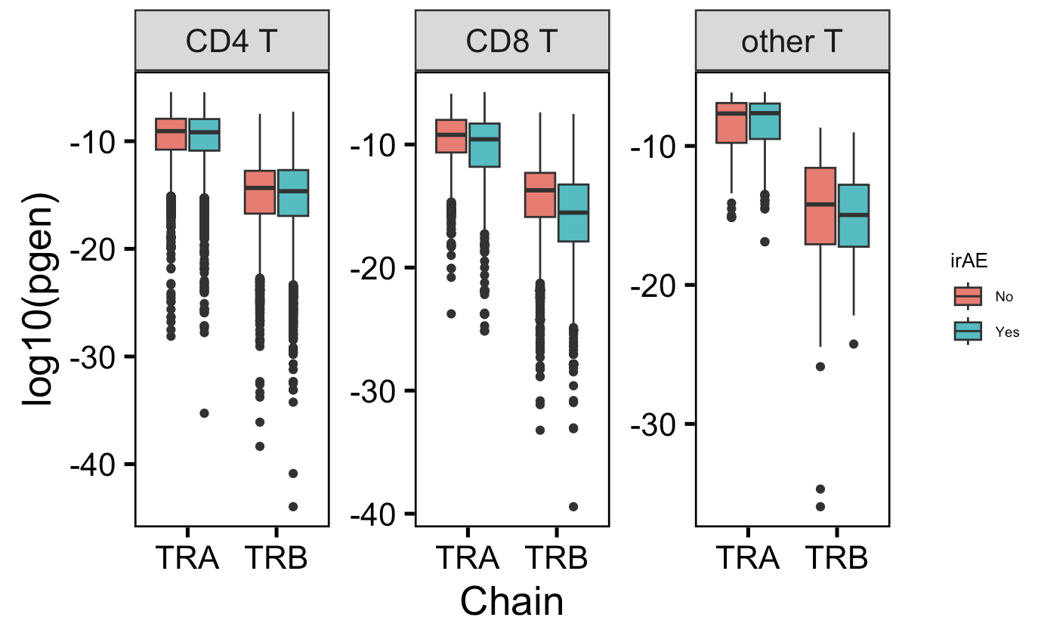
Across all CD8 TCRs and TRB CD4s, see less germline-like TCRs in those developing irAEs
n.s.
*
**
**
→
More germline-like
Less germline-like
n.s.
p = 0.054
→
n = 7,324
n = 10,926
n = 4,418
n = 7,120
n = 144
n = 204
Notes:
# Lower log10(pgen) means lower pgen which means less germline-like
# Higher log10(pgen) means higher pgen which means more germline-like

Slide 8
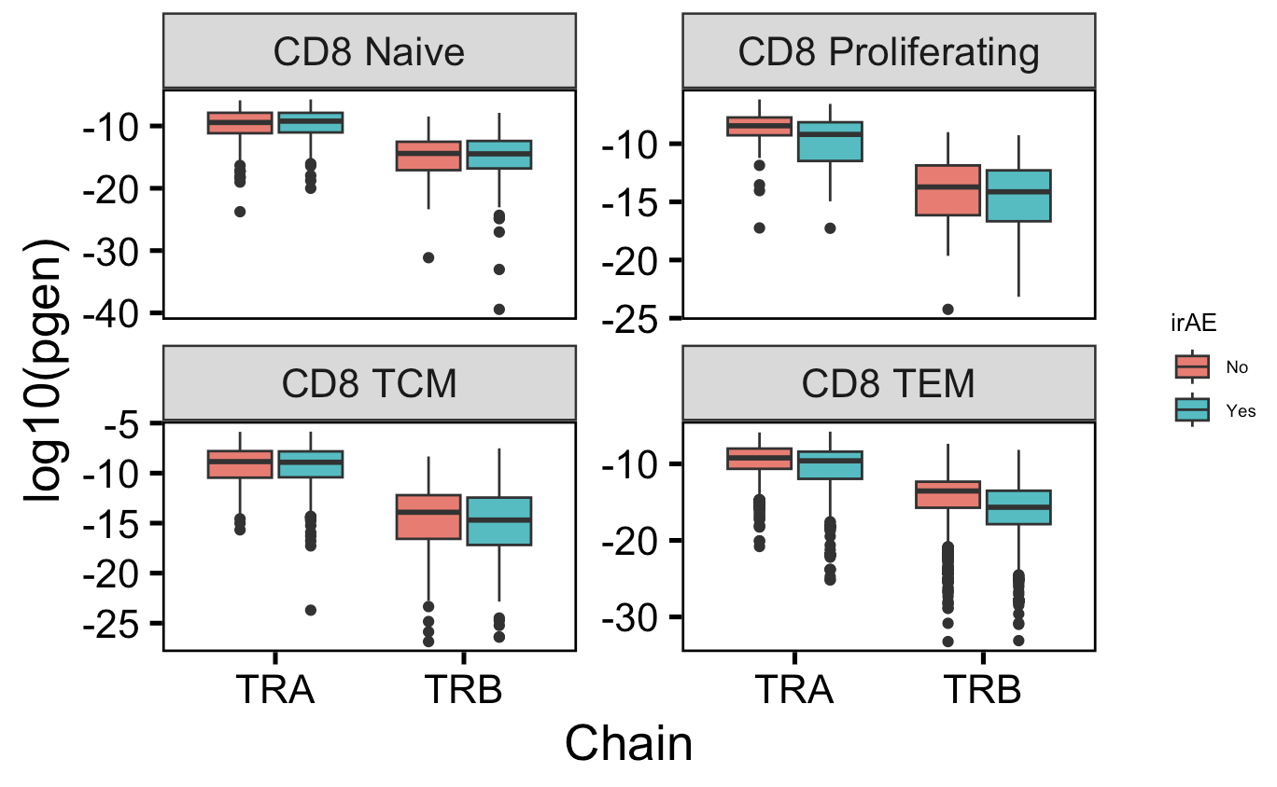
Proliferating (TRA) and TEM CD8s are less germline-like in those developing irAEs
n = 421
n = 428
n = 31
n = 121
→
n.s.
n.s.
p = 0.054
n.s.
More germline-like
Less germline-like
→
n.s.
n.s.
**
**
n = 202
n = 280
n = 3,764
n = 6,291
Notes:
# Lower log10(pgen) means lower pgen which means less germline-like
# Higher log10(pgen) means higher pgen which means more germline-like

Slide 9
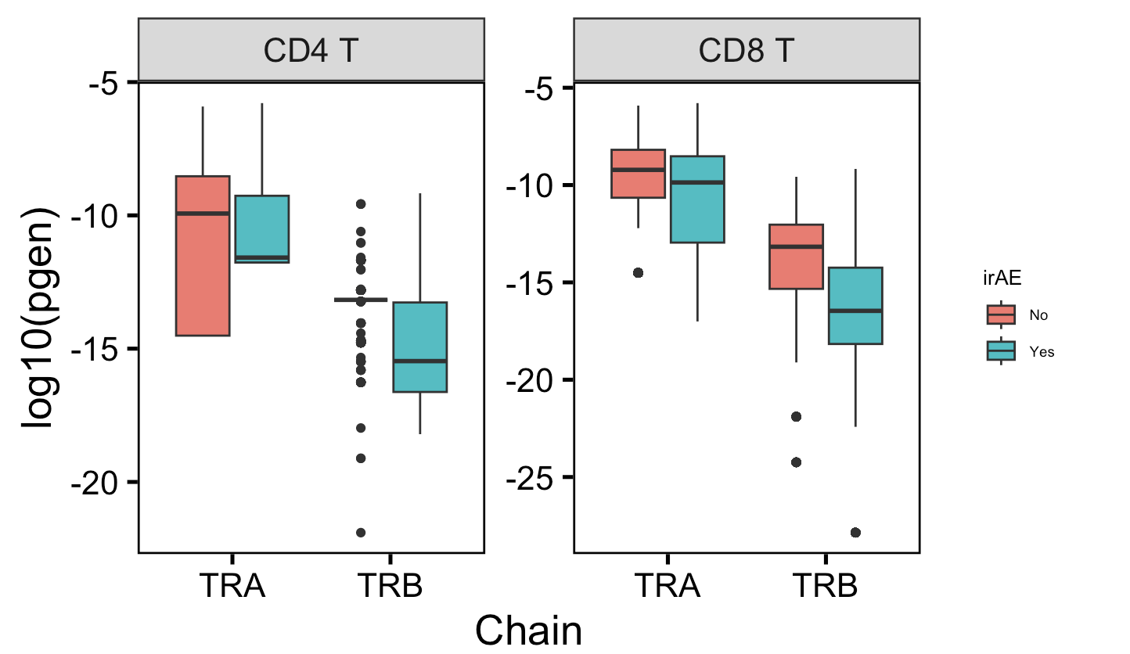
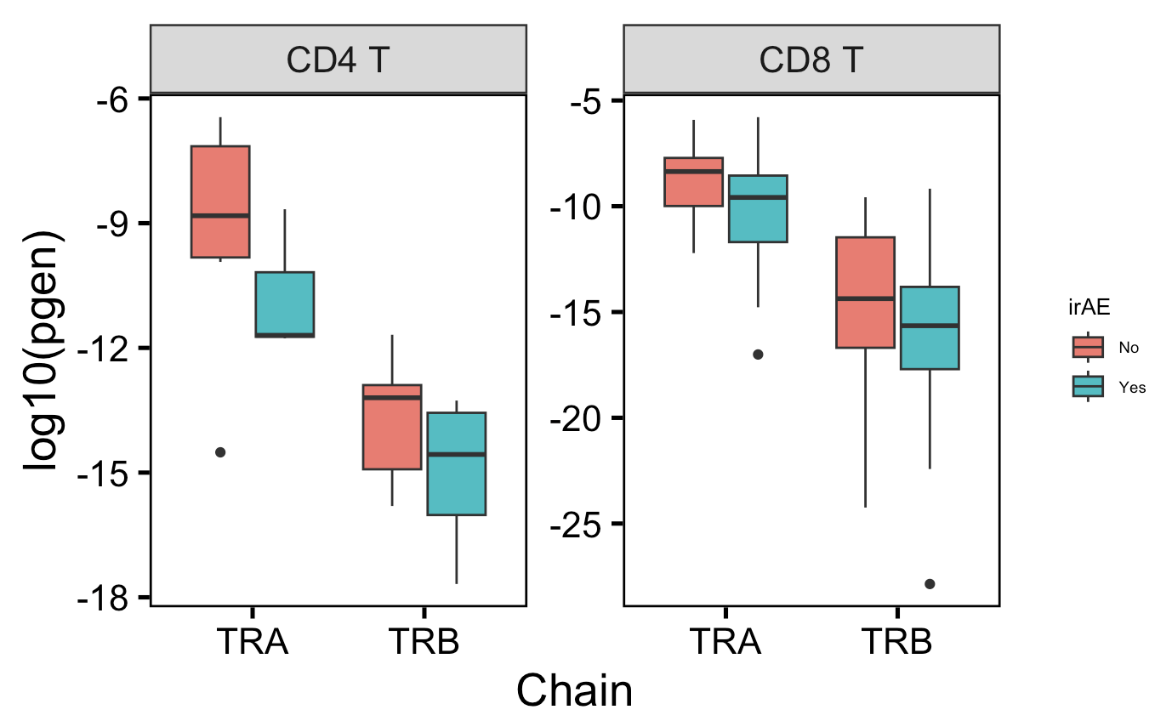
Among (unique) highly expanded T cells, both CD4 and CD8 TCRs are less germline-like in those developing irAEs
All highly expanded TCRs
Unique highly expanded TCRs
→
More germline-like
Less germline-like
→
n = 616
n = 133
n = 623
n = 148
n = 1,777
n = 3,446
n = 1,790
n = 3,557
n = 20
n = 54
n = 6
n = 3
n = 6
n = 4
Notes:
# Lower log10(pgen) means lower pgen which means less germline-like
# Higher log10(pgen) means higher pgen which means more germline-like

Slide 10
Conclusions
CD8 CDR3s generally longer in those developing irAEs, particularly interested in highly expanded T cell groups effects
CD8 TRA
CD8 TEM TRB
Contrary to germline-ness hypothesis, some TCRs are less germline-like in patients developing irAEs
Proliferating CD8 TRA TCRs
TEM CD8 TCRs
Highly expanded CD4 TCRs
Notes:
Short CDR3α and CDR3β loops might limit steric flexibility and thereby enhance the specificity of antigen-driven selection

Slide 11
Next steps
IMGT/HighV-Quest data analysis
N regions length distribution vs. irAE development
CDR1/2 features?
GLIPH
find AA motifs differentially encountered in yes/no irAEs to pinpoint feature analysis
GLIPH2: compare specificity groups by irAE development
Notes:
During V(D)J recombination, joints between segments are partially digested and nucleotides are randomly added (i.e. N region) to form highly variable and non-germline-encoded complementarity-determining regions 3 (CDR3) loop that recognizes peptides
Longer N region would mean less germline-like, less crossreactive?

Slide 12
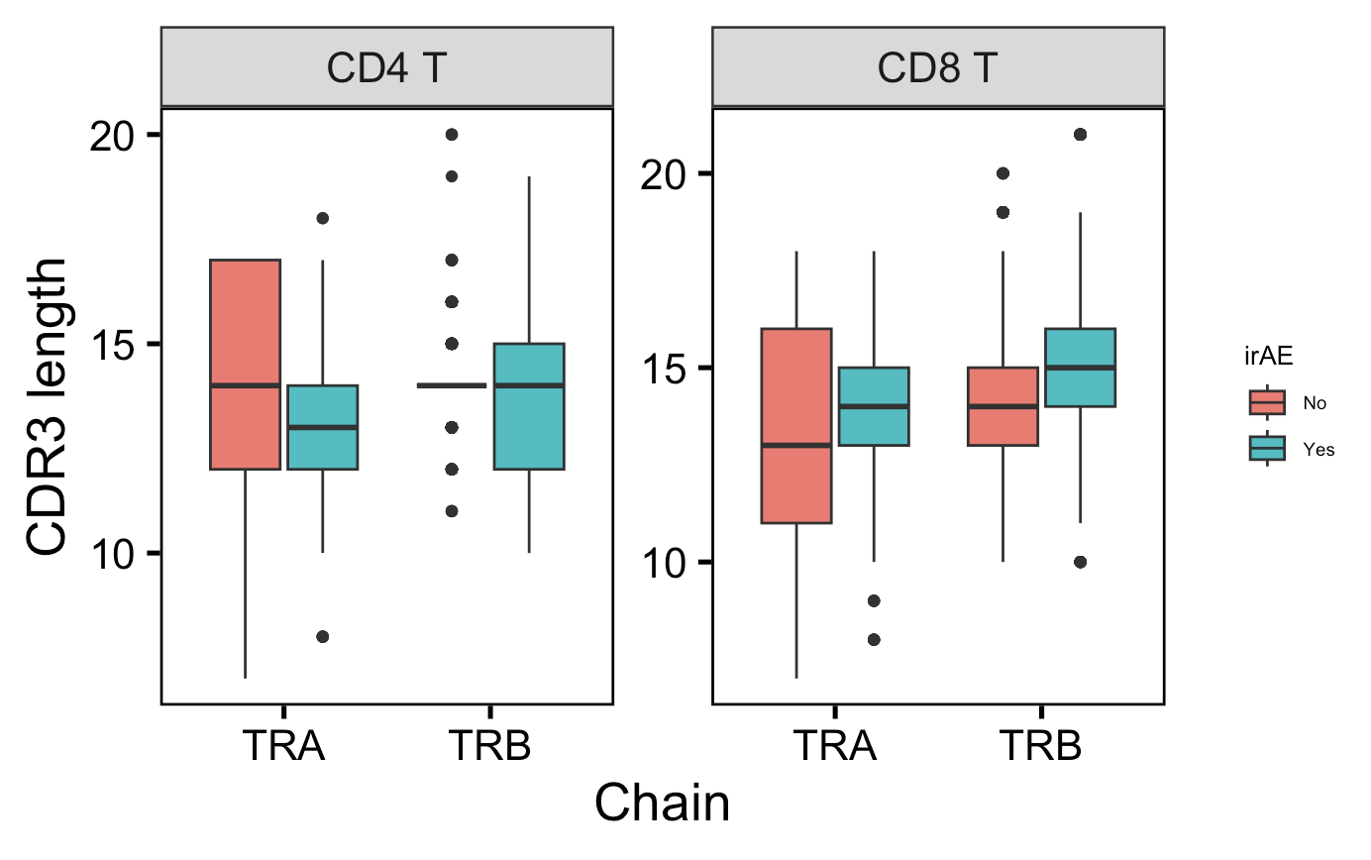
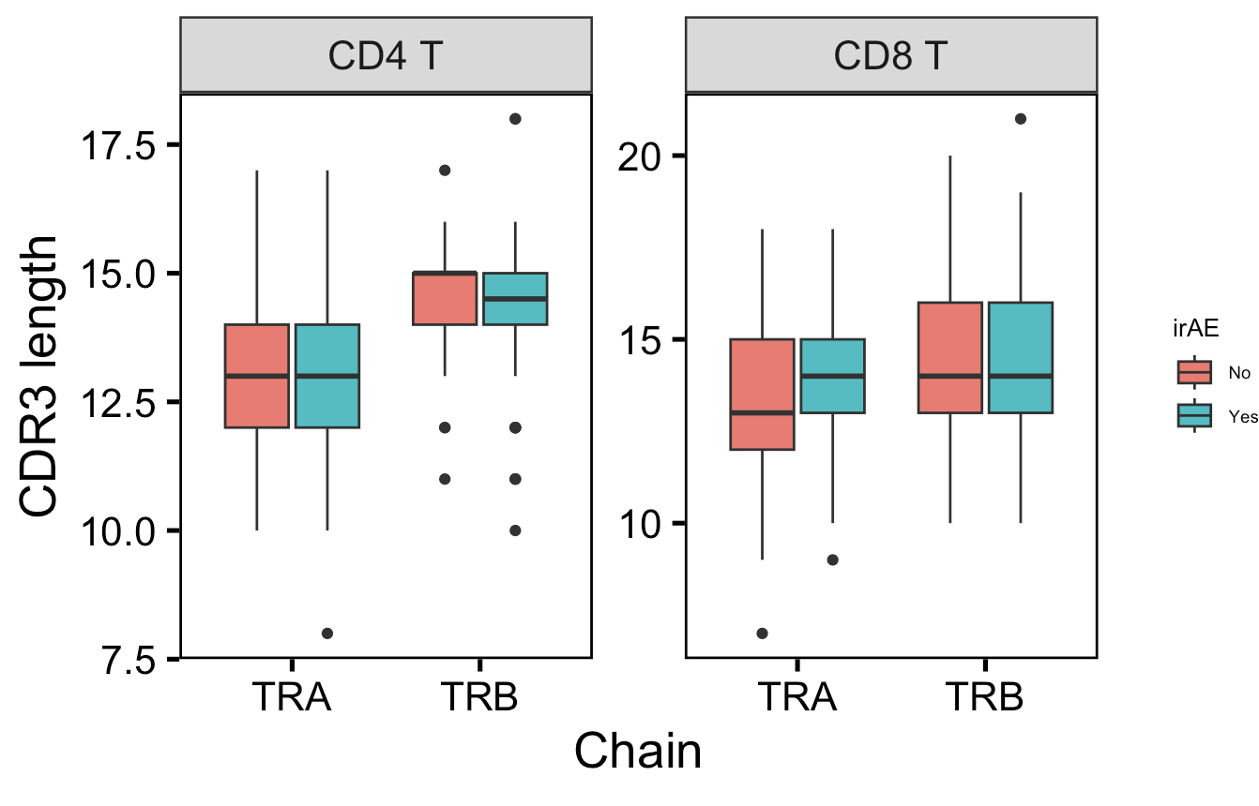
Within (unique) differentially encountered TCRs between yes/no irAEs, still generally observe longer CD8 TRA CDR3s with irAEs
Most differentially encountered TCRs
Between yes/no irAEs
Unique most differentially encountered TCRs
Between yes/no irAEs
p = 0.07
*
**
**
n.s.
n.s.
p = 0.19
n.s.
n = 861
n = 475
n = 797
n = 395
n = 2,556
n = 4,984
n = 2,535
n = 4,970
n = 62
n = 113
n = 37
n = 54
n = 138
n = 289
n = 123
n = 269

Slide 13
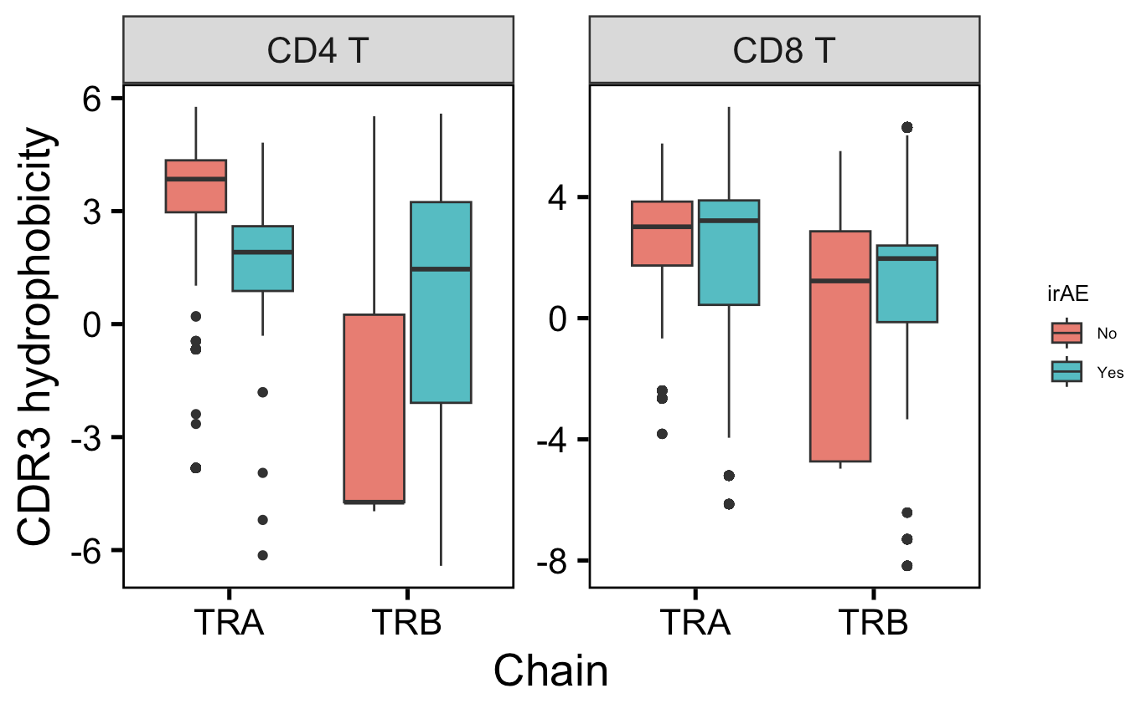
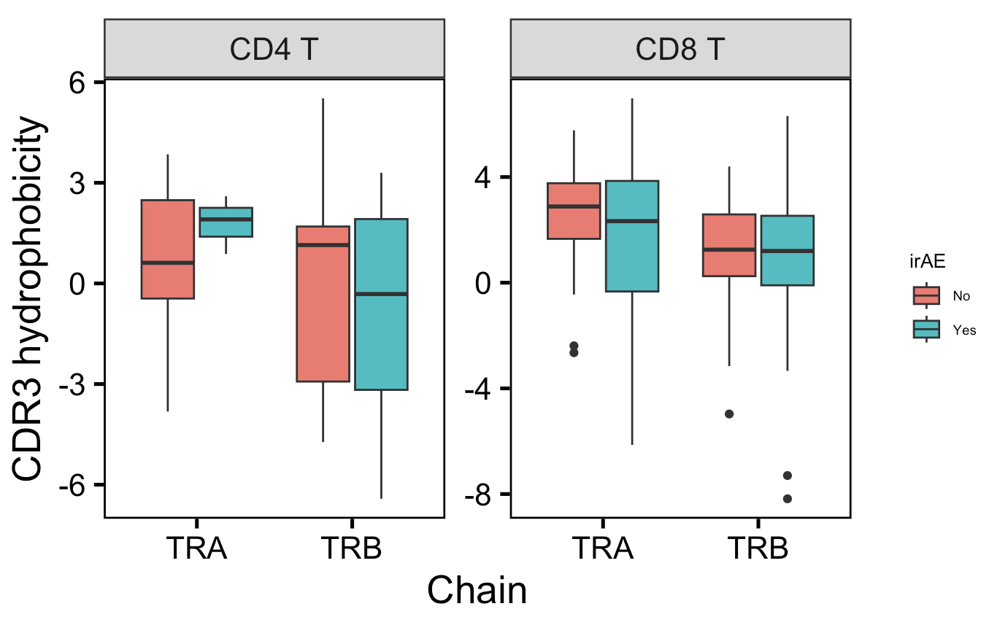
No consistent trends for CDR3 hydrophobicity among highly expanded T cells
All highly expanded T cells
Unique highly expanded T cells

Slide 14
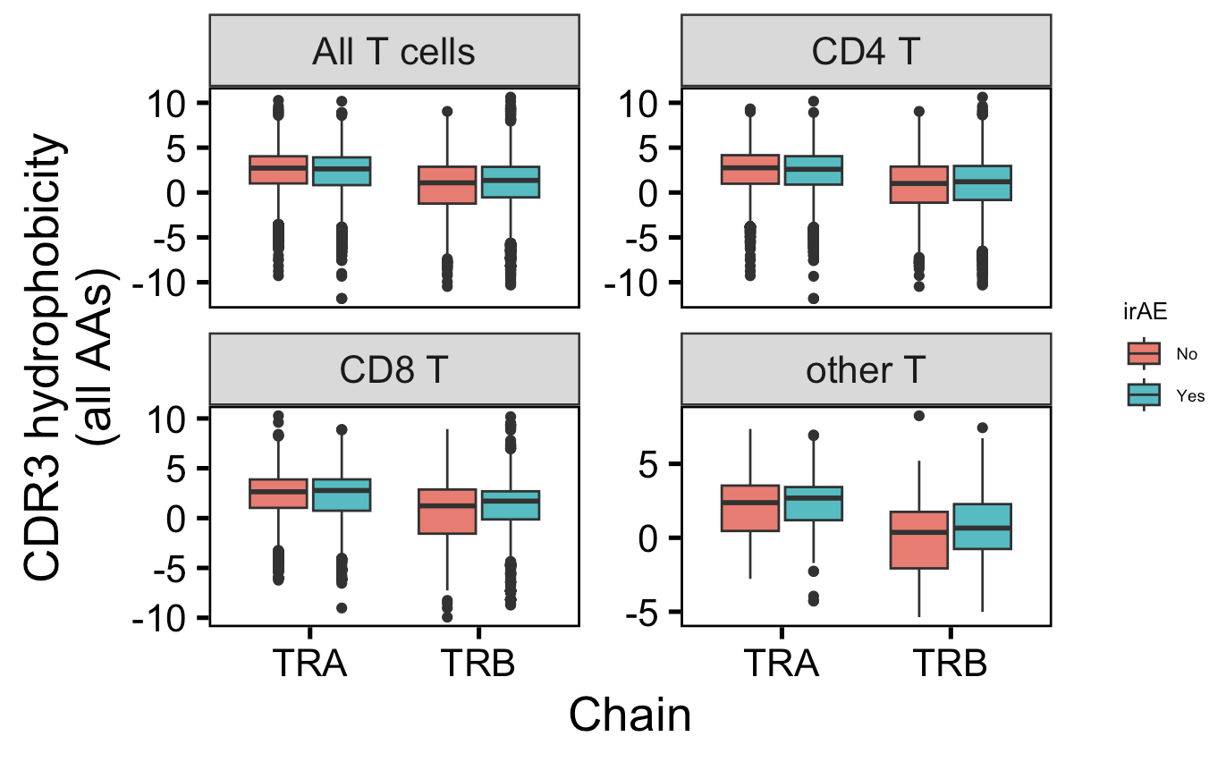
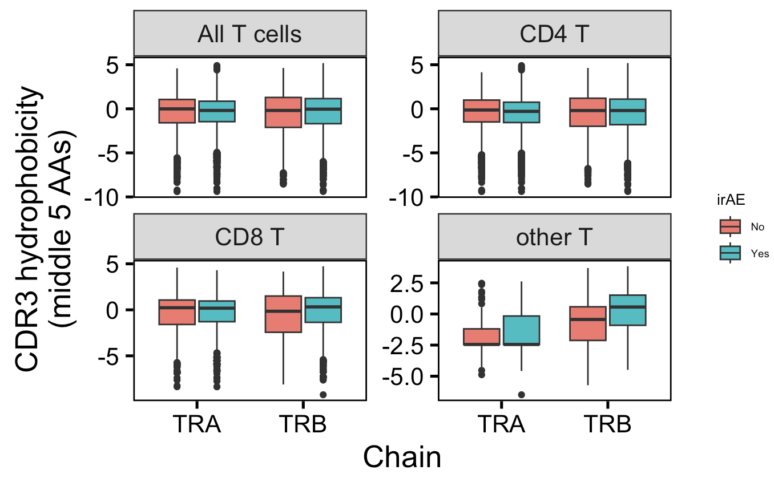
CD8 and other T cell TRB CDR3s more hydrophobic in those developing irAEs, CD4 TRA CDR3s less hydrophobic in those developing irAEs
n = 11,886
n = 18,250
n = 7,324
n = 10,926
n.s.
**
*
*
**
**
*
n.s.
n.s.
**
n.s.
*
**
**
n.s.
**
n = 4,418
n = 7,120
n = 144
n = 204
Same n values as left
Notes:
Among all T cells, CD8 TEM/TCM and MAIT TRB CDR3s more hydrophobic in those developing irAEs

Slide 15
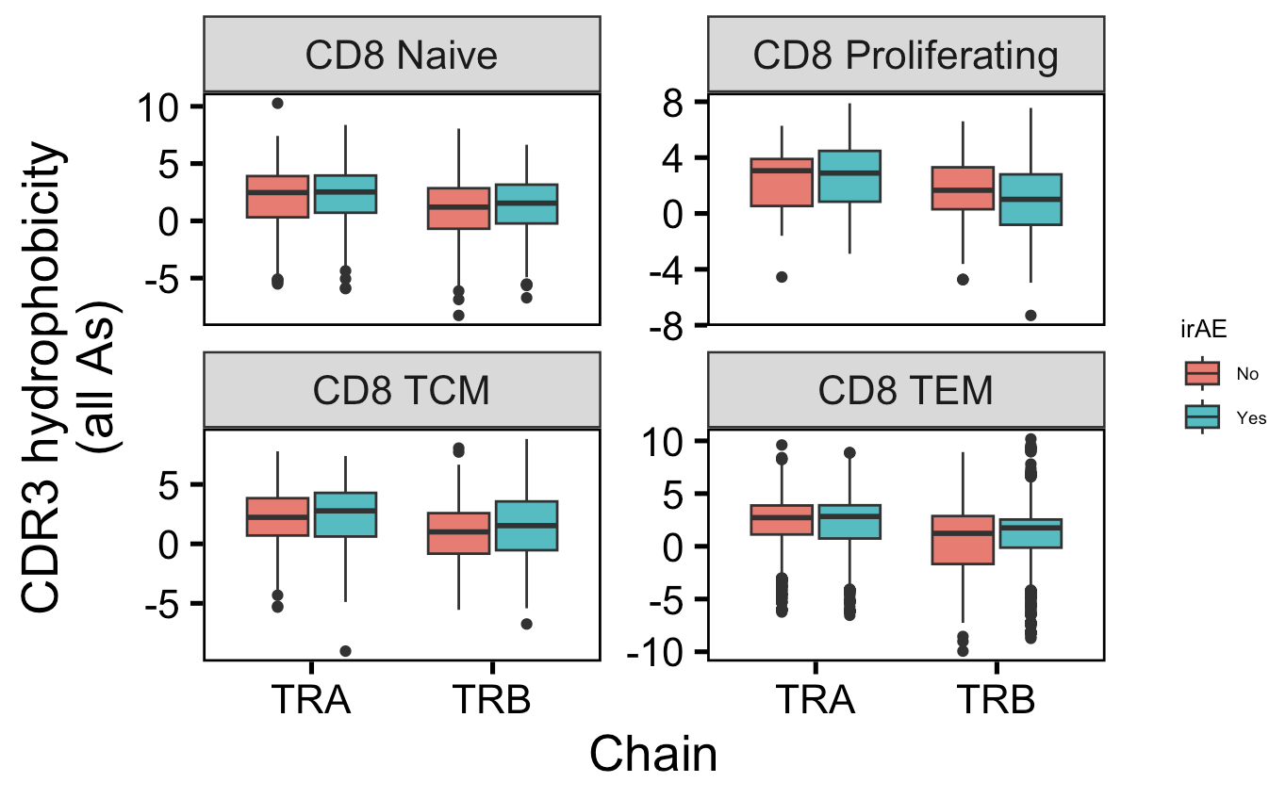
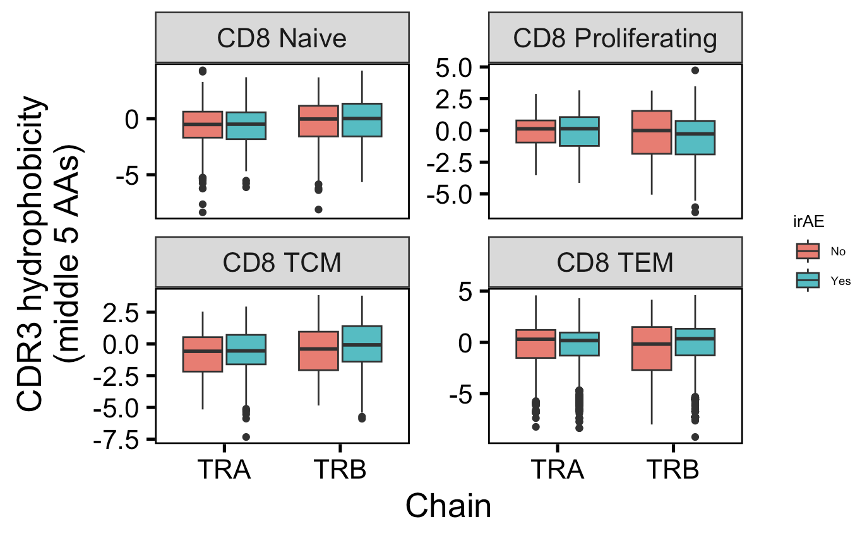
CD8 TEM TRB & TCM CDR3s more hydrophobic in those developing irAEs
n = 421
n = 428
n = 31
n = 121
n.s.
*
n.s.
n.s.
n.s.
n.s.
n.s.
n.s.
*
*
n.s.
**
*
*
**
**
n = 202
n = 280
n = 3,764
n = 6,291
Same n values as left
Notes:
Among all T cells, CD8 TEM/TCM and MAIT TRB CDR3s more hydrophobic in those developing irAEs

Slide 16
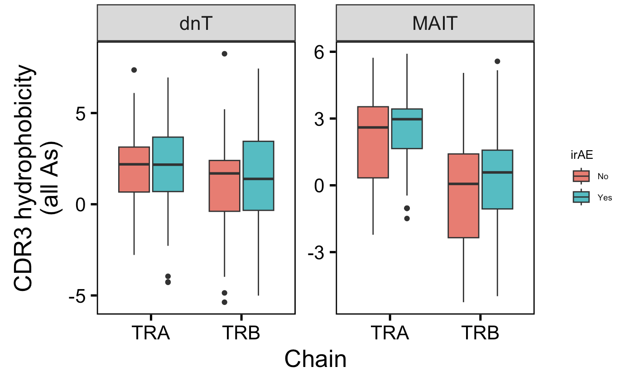
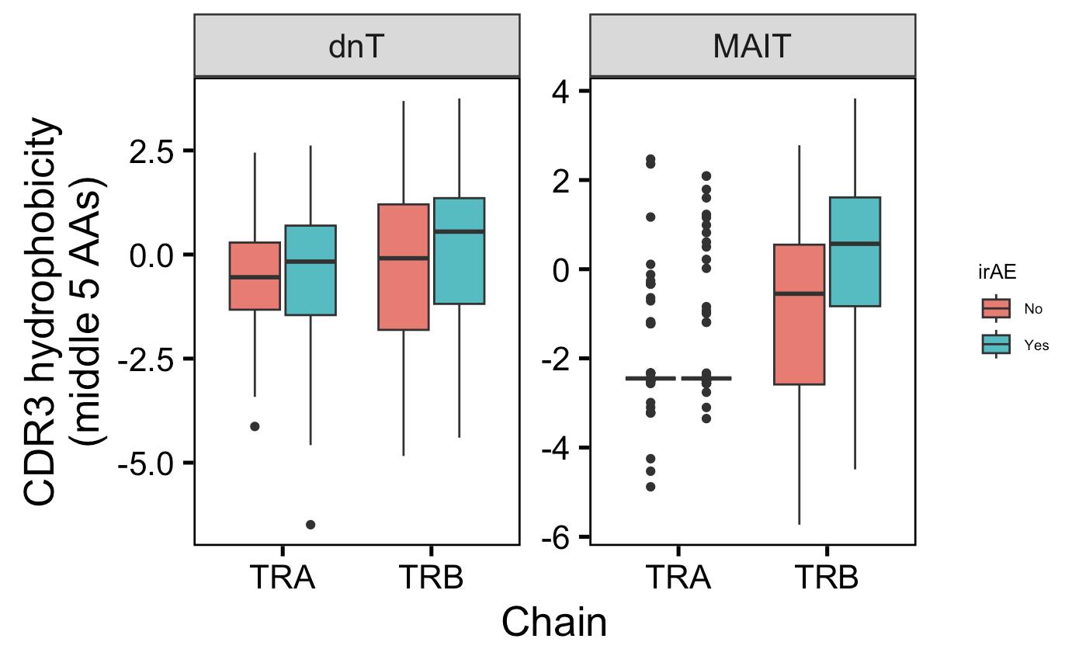
MAITs TRBs CDR3s more hydrophobic in those developing irAEs
n.s.
n.s.
n.s.
p = 0.059
n.s.
n.s.
n.s.
*
n = 224
n = 250
n = 64
n = 158
Same n values as left
Notes:
Among all T cells, CD8 TEM/TCM and MAIT TRB CDR3s more hydrophobic in those developing irAEs

