Slide 1
Weekly meeting
11 9 2023
Ty Bottorff

Slide 2
Outline
Myocarditis irAE dataset progress
Attempts to improve stitching
IMGT/HighV-Quest data → issues with stitching even with stitched TCR sequences
Next steps

Slide 3
Attempts to improve stitching and lose fewer TCRs
Main error: unable to find N terminus of CDR3 in V gene, more often for TRA than TRB
Trends of yes/no errors: problematic V genes more often don’t have *01 suffix
Attempts to fix
Try CDR3 nt sequence instead of AA sequence as input: no change
Try stripping C & F from CDR3 AA as input: lose even more TCRs
Add *01 (prototypical allele designation) to V/J alleles: no change

Slide 4
Stitching likely dysfunctional despite producing TCR sequences
Filtered input data for productive TCRs
Removes 16,713 unproductive TCRs, leaves 112,549 productive ones
Stitch
All TRA_aa and TRB_aa from stitchr have stop codons… at least in frame it’s displayed in
”User specified leader sequence is not evenly divisible by 3 – stitched TCR frame will likely be wrong” error present for all stitched TCRs
IMGT/HighV-Quest TCR issues
2nd-CYS 104 not identified: this may indicate potential nucleotide insertion(s) and/or deletion(s) which are not dealt in this release
IMGT/HighV-Quest summary | TRA | TRB
# productive | 7 | 3,502
# rearranged but no junction found | 1,762 | 14,592
# unproductive | 7,703 | 3,959
Notes:
TRA
# 4104 + 3602 (stop codons) unproductive
TRB
# 2621 + 1338 (stop codons) unproductive

Slide 5
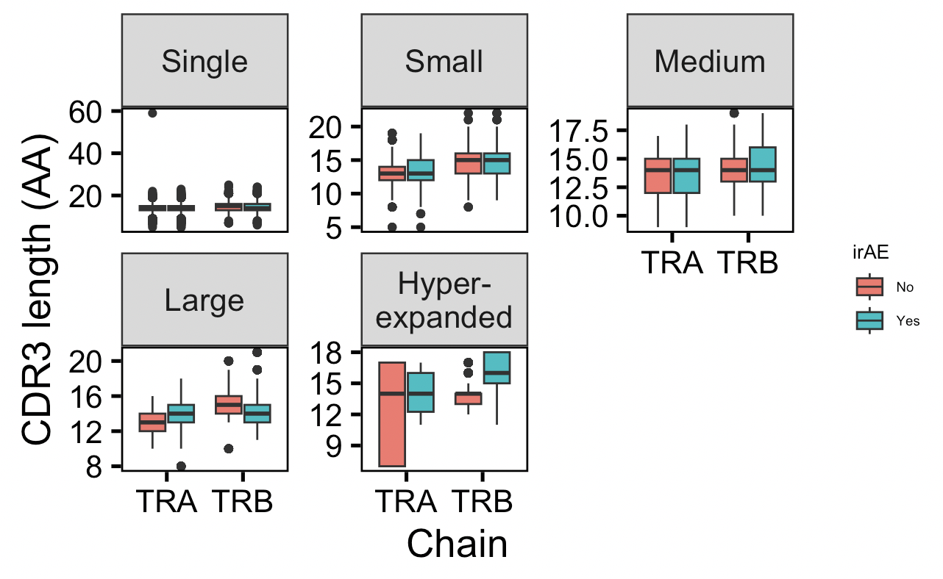
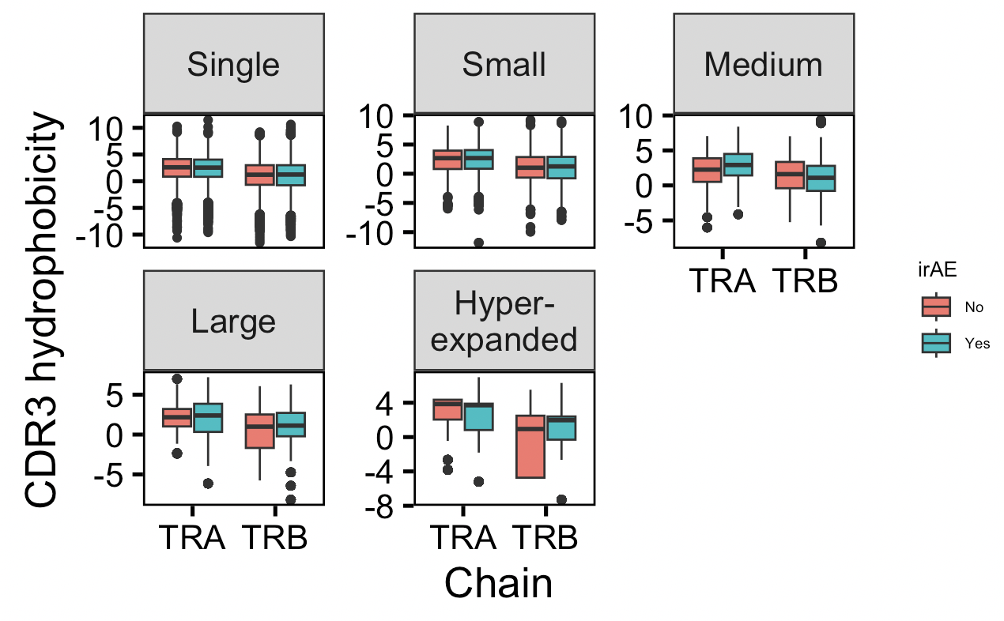
Stratifying TCR feature analysis by expansion degree

Slide 6
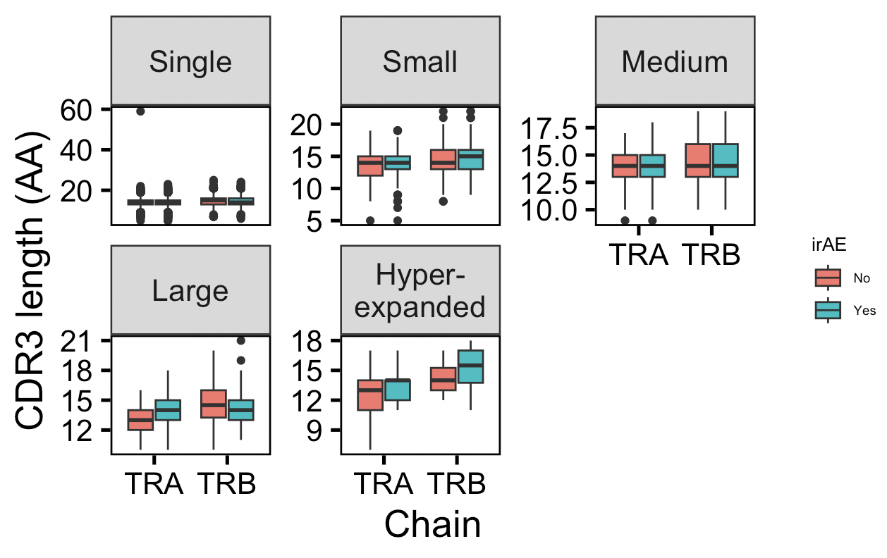
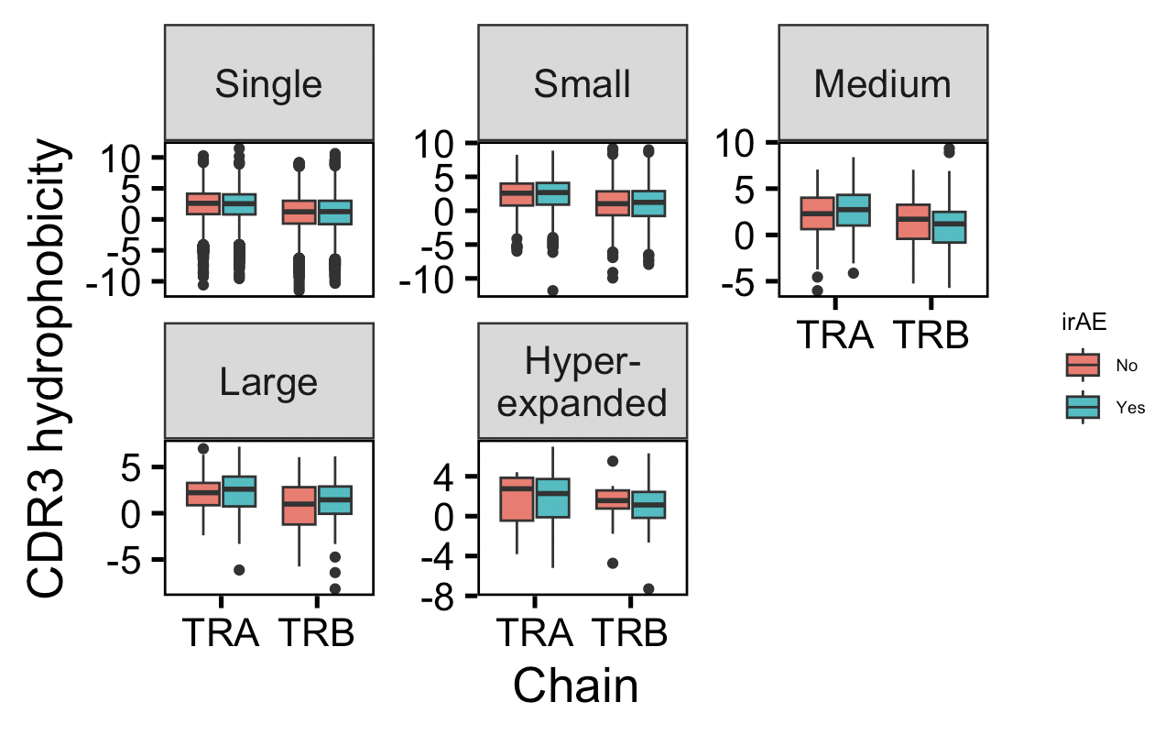
Stratifying unique TCR feature analysis by expansion degree

Slide 7
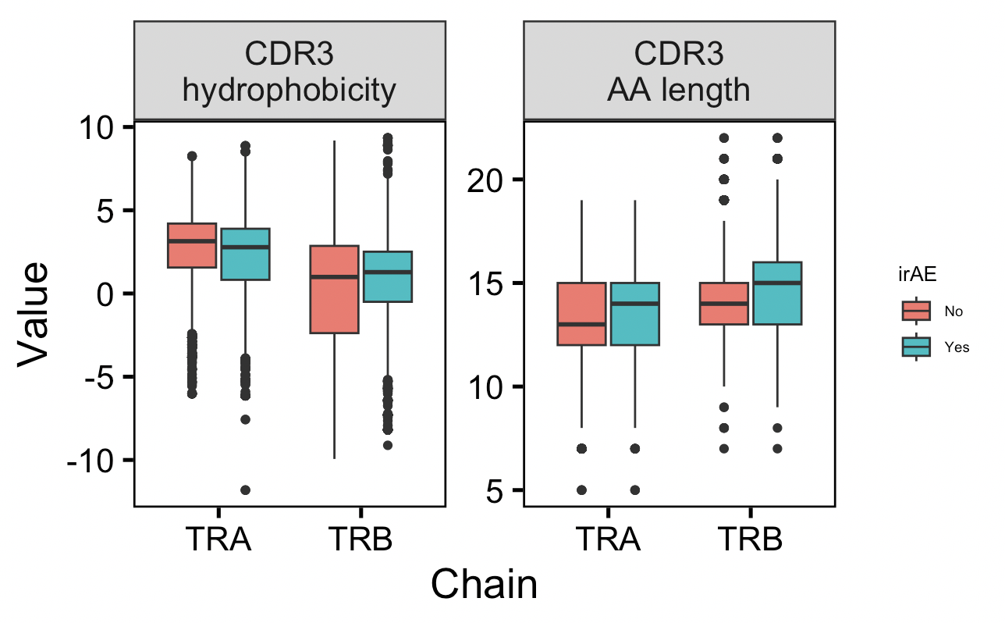
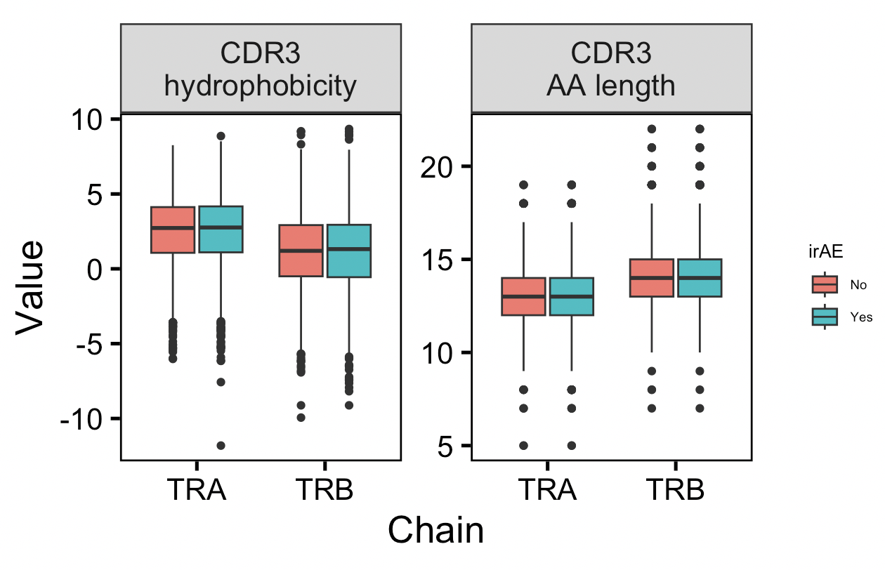
Public TCR feature analysis
All public TCRs
Unique public TCRs

Slide 8
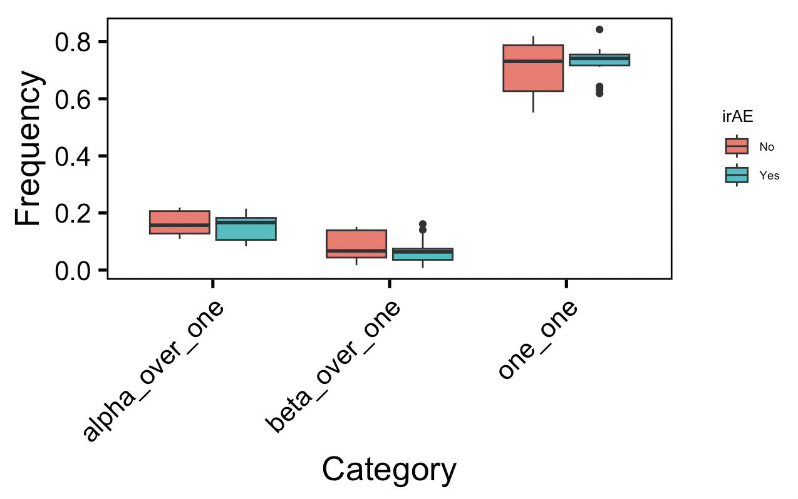
Calculating frequencies of TRA:TRB combinations per patient
Notes:
~30% of T cells apparently have 2 alpha, ~1% 2 beta

Slide 9
Conclusions
Across largely/hyper-expanded (unique) TCR alpha chains, CDR3s longer in those developing severe irAEs

Slide 10
Next steps
Using TCRfold/TCRmodel2 to predict if a TCR’s specificity ranks higher for tumor or self antigens, or both rank high?
Compare expanded TCRs in patients with and without severe irAEs

