Slide 1
Weekly meeting
3 7 2024
Ty Bottorff

Slide 2
Outline
Colitis cohort differences & combining datasets

Slide 3
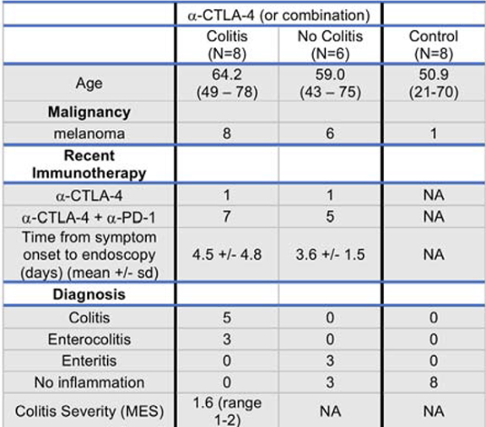
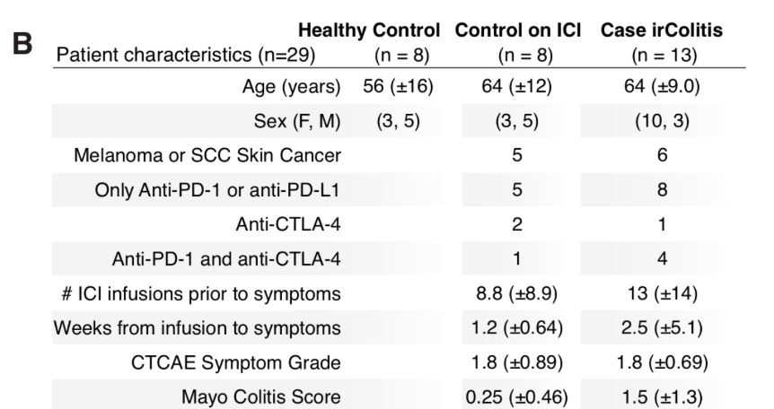
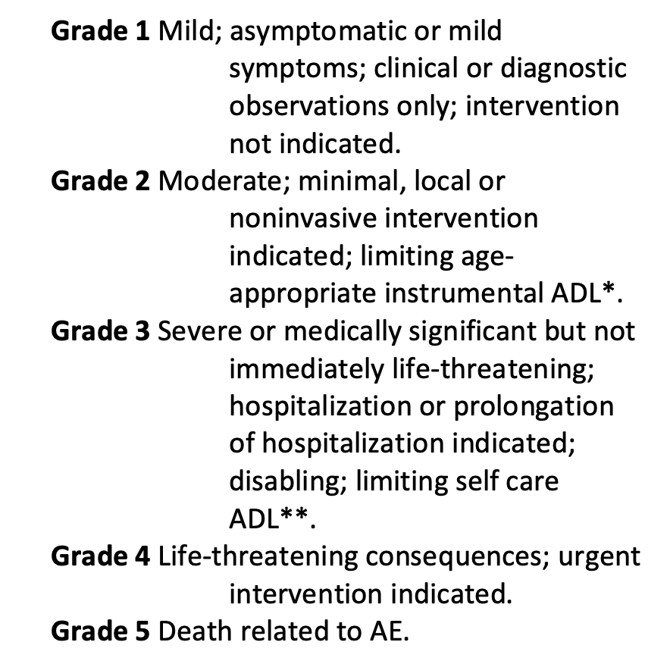
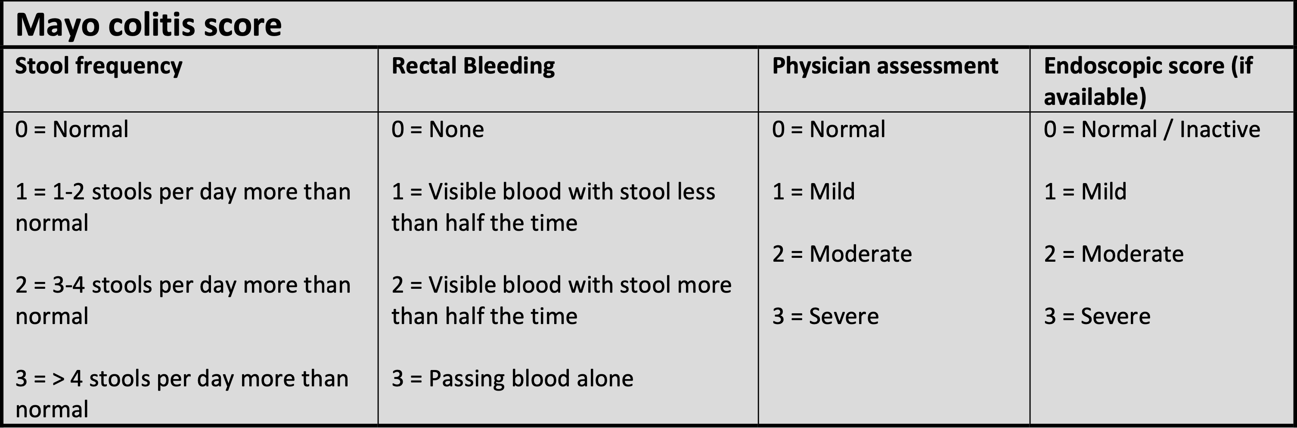
Colitis severity seems similar between 2 datasets
2020 cell Luoma
2021 biorxiv Thomas
CTCAE grades
Notes:
MES = Mayo endoscopic score
Active colitis elsewhere defined as Mayo colitis score > 1

Slide 4
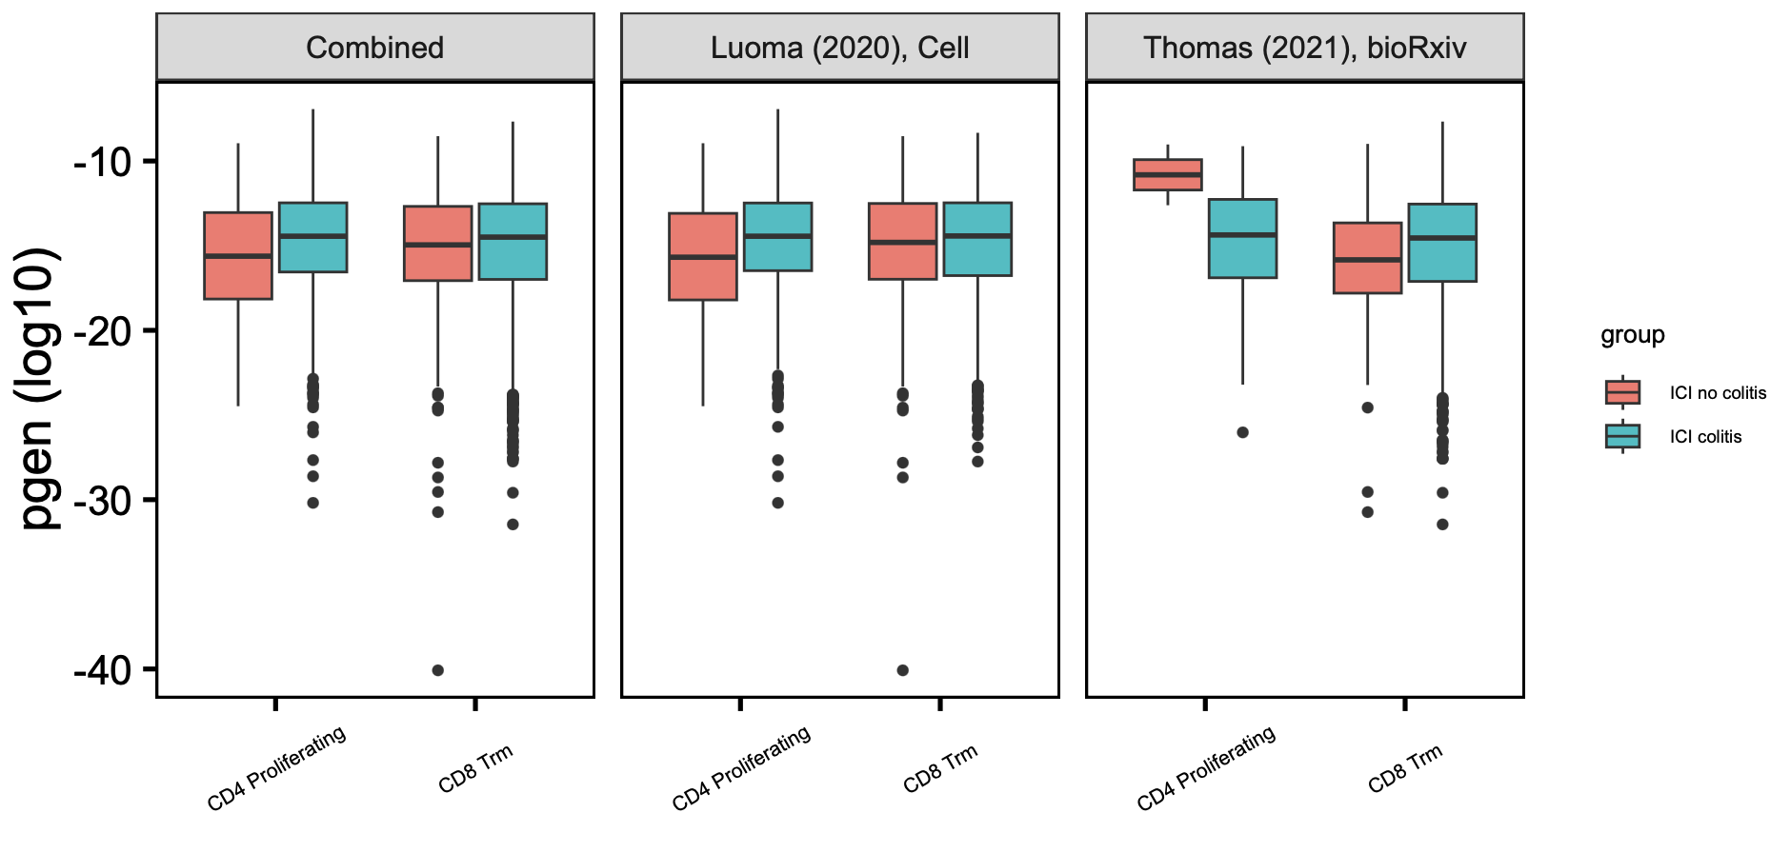
CD4 proliferating TRB pgen effect opposite in 2 datasets, but CD8 Trm TRBs seem slightly more germline in both datasets
*
padj = 0.08
*
TRB
many more CD4 proliferating clonotypes in Luoma, but about same for CD8 Trm in both datasets
Wilcoxon rank sum test. *, padj < 0.05
Notes:
TRB
There are many more unique CD4 prolif clonotypes in Luoma (~1200) than in Thomas (~200), about same for CD8 Trm (~3.5k in Luoma and ~4.5k in Thomas)

Slide 5
IL-6 potentially associated with irAEs
Systemically, higher IL-6 levels seem to be associated with irAEs (PMID36367776, PMID33643899)
At barrier tissue irAE sites, IL-6 also seems implicated (PMID35537412, PMID33060784)
IL-6 inhibitors may help prevent severe irAEs (PMID36198831)
IL-6 promotes Th17 over Treg differentiation (PMID20583029)

Slide 6
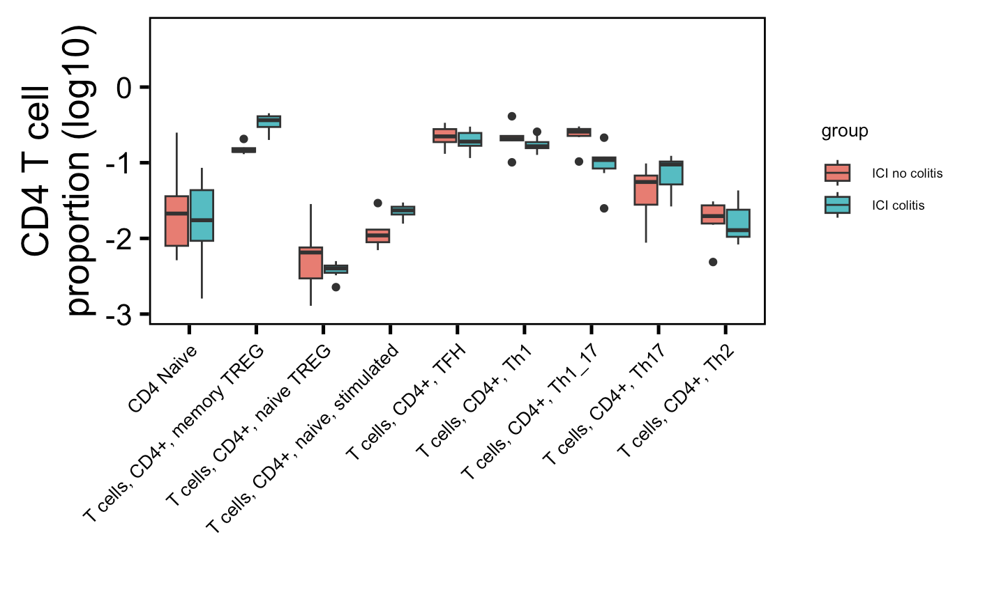
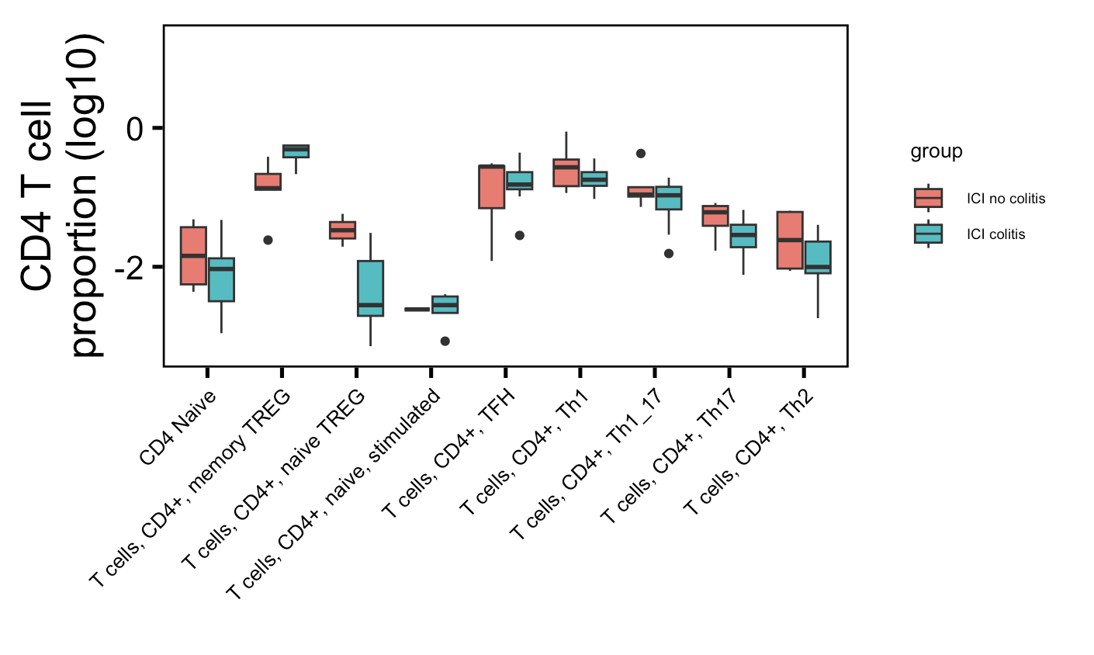
Using an alternative cell typing method (SingleR, motivated by looking for Th subsets), see memory Tregs higher in colitis tissue in both datasets
Luoma (2020), Cell
Thomas (2021), bioRxiv
*
padj =
0.09
padj =
0.06
*
What SingleR calls memory Treg is mostly called CD4 TCM (~50-75%) or Treg (~15-30%) by Seurat
Cell typing scores don’t seem too bad…
Wilcoxon rank sum test. *, padj < 0.05
Notes:
Dice: # normalized expression values of 1561 bulk RNA-seq samples generated by DICE from pure populations of human immune cells
Doesn’t fit with IL-6 inhibiting Treg development...
Seurat scores similar between Seurat CD4 TCM - SingleR memory Tregs and Treg-memory Tregs, little lower for Treg-memory Tregs…
SingleR scores don’t seem that bad either for memory Tregs… i.e. clear high score block in score heatmap for memory Tregs
#luoma
# padj
# memory Treg: 0.01
# Th1_17: 0.06
# naive stimulated: 0.09
# thomas
# padj
# memory Treg: 0.03
Thomas: Seurat called TCM is most abundant SingleR memory Treg (~4k), then Seurat Treg SingleR memory Treg (~700)
Same for Luoma: Seurat TCM ~ 2.3k for SingleR memory Treg, and then Seurat Treg ~1.4k for SingleR memory Treg

Slide 7
Conclusions (new ones bolded) from joined colitis datasets analysis
Germline-ness
Highly expanded CD8 Trm TRAs may be more germline-like in colitis tissue (driven by Luoma dataset though)
CD8 Trms TRB may be more germline-like in colitis tissue across both datasets
CD4 proliferating TRB germline effect opposite in 2 datasets
Cell abundances
CD4 TEMs less abundant in colitis tissue
CD4 proliferating T cells more abundant in colitis tissue
CD4 TCMs may be more abundant in colitis tissue (substantial label overlap w/ memory Tregs)
Memory Tregs may be more abundant in colitis tissue (substantial label overlap w/ CD4 TCMs)

Slide 8
Next steps
Open up dataset search to include samples only from tumors, rather than restricting search to PBMCs/irAE samples?

