Slide 1
Weekly meeting
2-6-2025
Ty Bottorff

Slide 2
Outline
IMPACD progress
Kevan Herold scRNAseq analysis

Slide 3
IMPACD approach
Used more markers to investigate T cell subsets
Markers: CD57, CD27, CD28, CD39, HLADR, CD38, ICOS, PD1, TIGIT, KLRG1, GrzmB, GrzmK, CD127, TCF7, Helios, CRTHs, CD103, CXCRs, CD73, CD161, CCR4, CCR6
Subsets: T, CD4, CD4 Treg, CD4 naïve/SCM, CD4 CM, CD4 EMRA, CD4 EM, CD8, CD8 naïve/SCM, CD8 CM, CD8 EMRA, CD8 EM, DN T, DP T, γδ T
Depth of 2 past root, > 2k subsets/root
Looked for baseline % parent frequency differences between combined/specific irAE groups

Slide 4
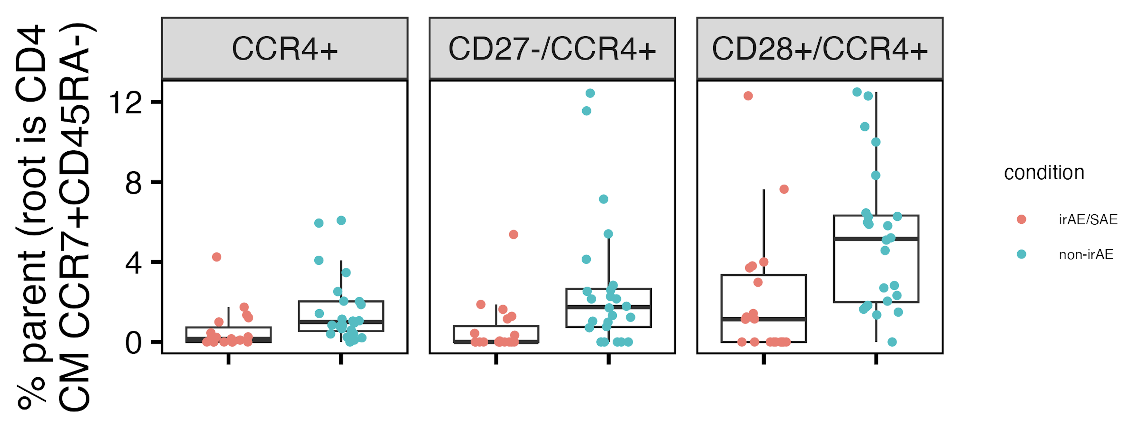
Baseline CCR4⁺ CD4 CM frequencies may be lower in those developing irAEs
*
*
*
*: FDR < 0.05
Notes:
As a first pass did check that this seems generally true in all batches, but haven’t done anything rigorous yet
CCR4: may mean Th2 skewing although not sure if that’s consistent with CD27- and CD28+ results…
If going with Th2 skewing in non-irAE group, THIS IS ~INCONSISTENT WITH BUKHARI 2023 FINDING OF MORE CD4 Th2 at BASELINE IN PNEUMONITIS GROUP (not specifically memory though I don’t think), perhaps inconsistent (but idk) w/ finding of higher CCR4 on CD4s in Crohns (but not UC)/atopic dermatitis patients…
CD28: costim receptor, expected + for most CD4 CM unless terminally differentiated
CD27- means less proliferative/responsive?
“association of CCR4 expression with TH2 cells, the predominance of CCR4⁺ cells in blood from patients with AD, and an important role of CCR4 in the migration of TH2 cells from blood into AD lesional skin.”
(J Allergy Clin Immunol 2001;107:353-8.

Slide 5
Next steps for NCI project
Follow up on CD4 CM results w/ depth 3 analysis, preliminarily looks consistent
Look into other cell types (NK, B, monocytes, DCs...)
Prepare slides for update next week on IMPACD progress
IMPACD intro
CCR4⁺ result (depths 2/3)
depth 2 baseline results from other cell types (if there are any)
Take batch effects into account for stats
Include more samples from batches 10-14
Look into changes over ICI
Notes:
B cells running currently
# combined irAE FDR < 0.1 CD28+/ICOS-/CCR4+, CD28+/CCR4+ (so same as seen from depth 2), ICOS-/CCR4+, CD28+/HLADR-/CCR4+, HLADR-/CCR4+, CD28+/CD161-/CCR4+, CD161-/CCR4+, CD28+/CD57-/CCR4+, CD57-/CCR4+, CD28+/CD27-/CCR4+... (didn't manually go through modifier analysis for all p < 0.1 so there's likely more)

Slide 6
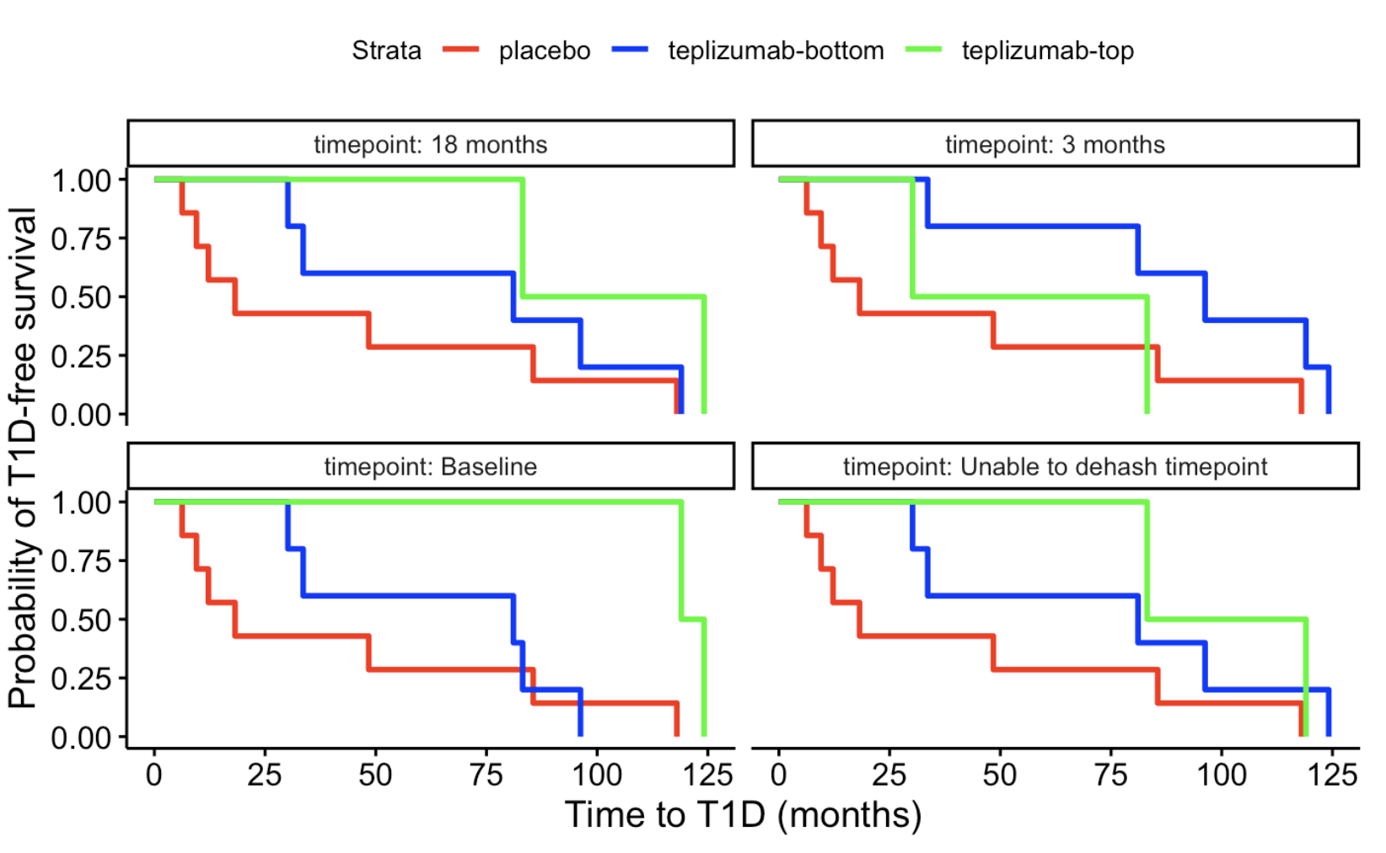
Higher baseline CD8 PD1 expression associates w/ longer T1D-free intervals
p = 0.04

Slide 7
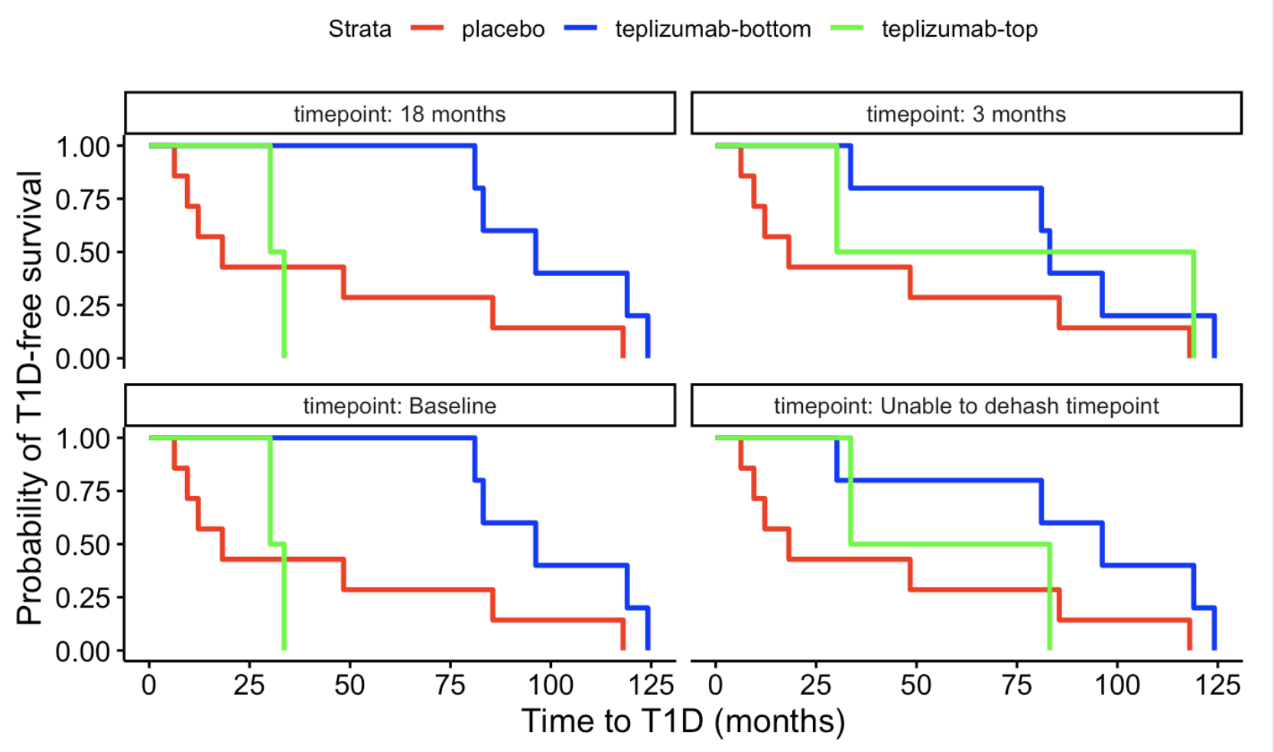
Higher baseline/18 month CD8 CD28 expression associates w/ shorter T1D-free intervals
p = 0.008
p = 0.008
Also see similar baseline effect for CD52, CD164
Notes:
This may make sense with CD28 relating to activation, so lower levels could mean exh
CD52 is another activation marker, CD164 relates to homing/differentiation perhaps

Slide 8
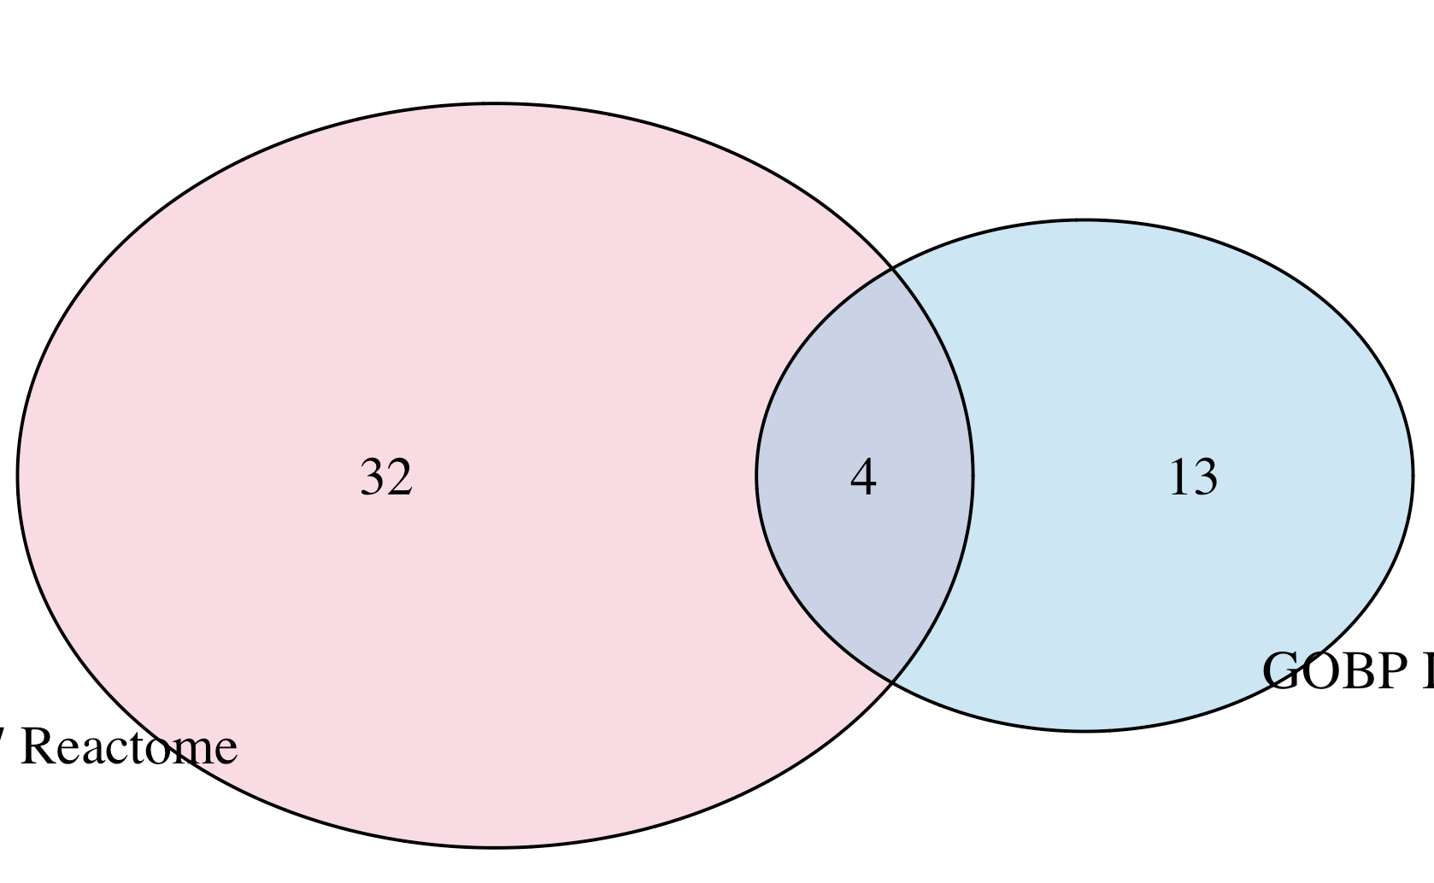
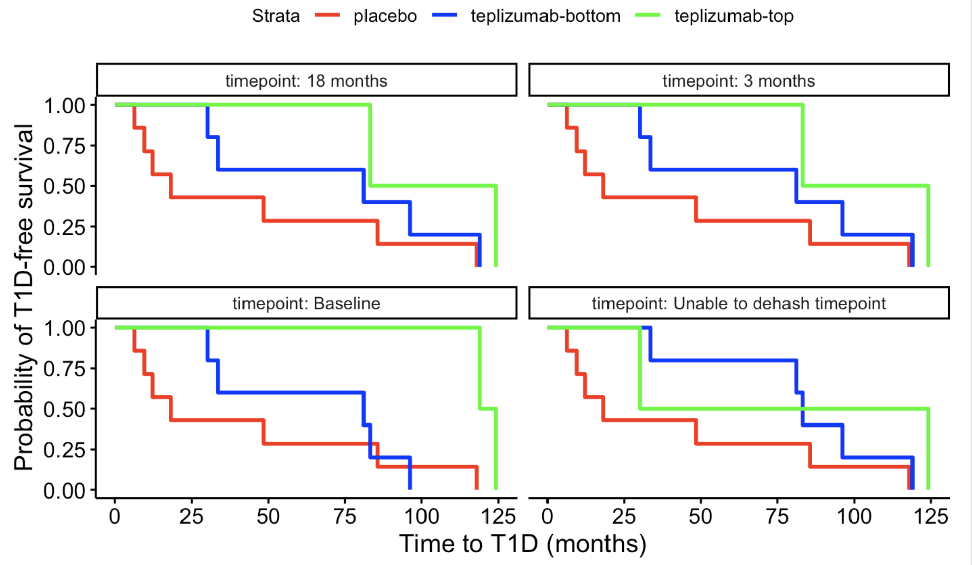
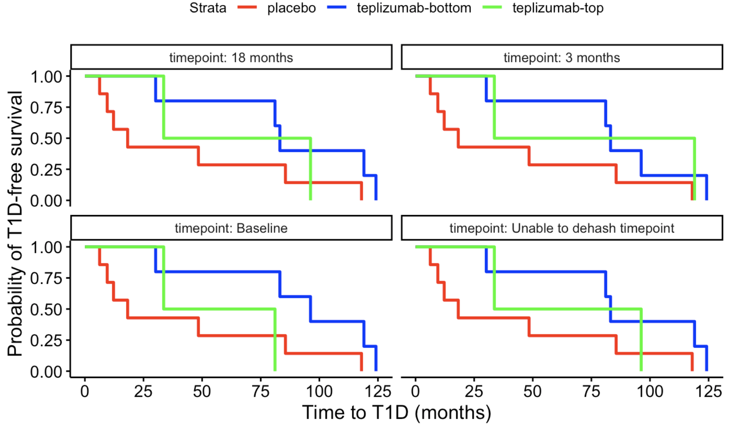
Stratifying donors by CD8 expression of GOBP IL7 and IL7 reactome modules leads to different baseline conclusions…
"IL2RG" "IL7"
"IL7R" "TSLP"
GOBP IL7
IL7 reactome
p = 0.12
p = 0.04
Notes:
GOBP is response to IL7: “Any process that results in a change in state or activity of a cell or an organism (in terms of movement, secretion, enzyme production, gene expression, etc.) as a result of an interleukin-7 stimulus”
Reactome is IL7 pathway…

Slide 9
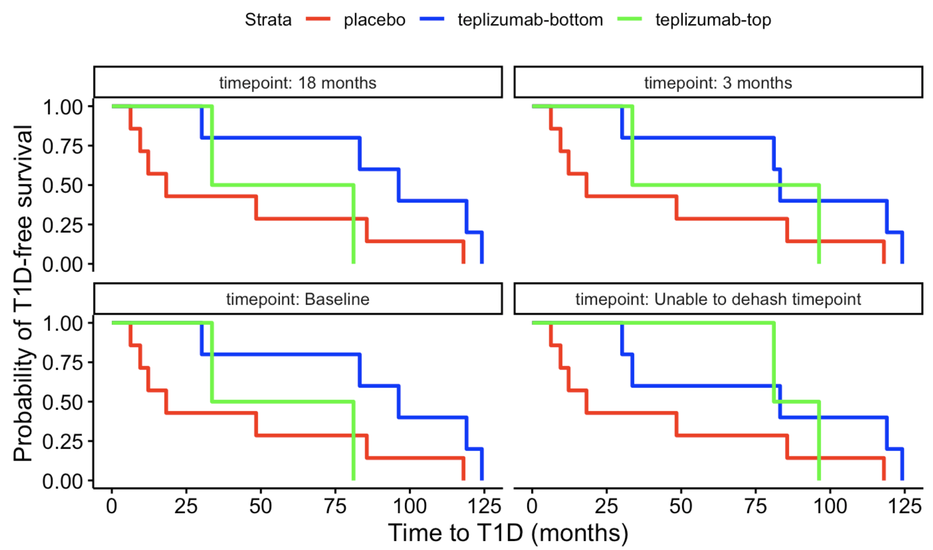
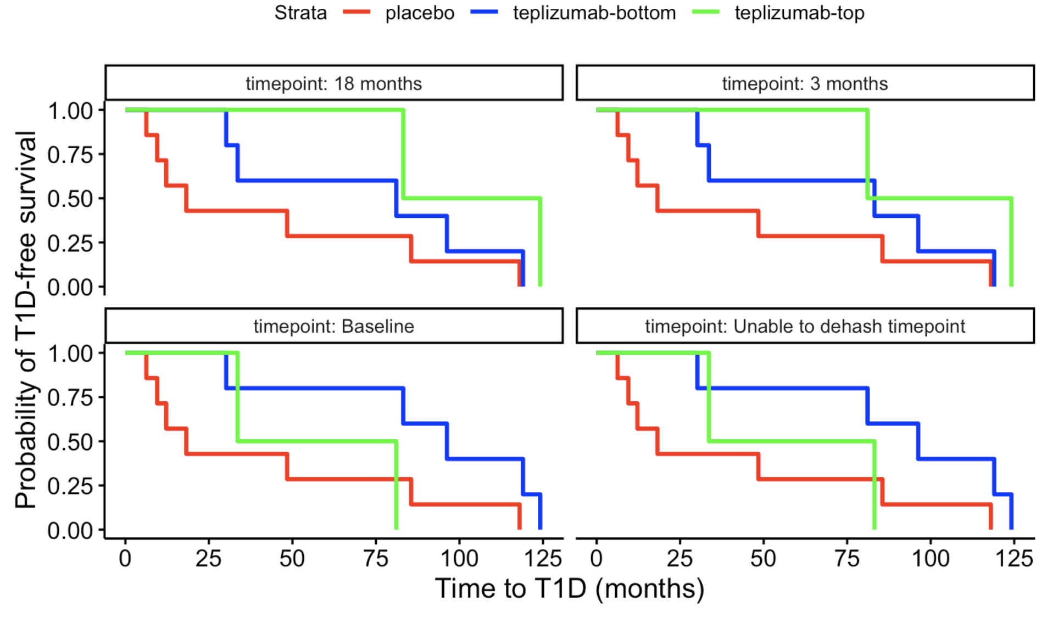
Stratifying donors by CD8 expression of genes up/down-regulated w/ IL7 treatment also leads to different conclusions…
Genes down-regulated in comparison of memory CD8 T cells versus those treated with IL7
Genes up-regulated in comparison of memory CD8 T cells versus those treated with IL7
p = 0.12
p = 0.12
p = 0.12

Slide 10
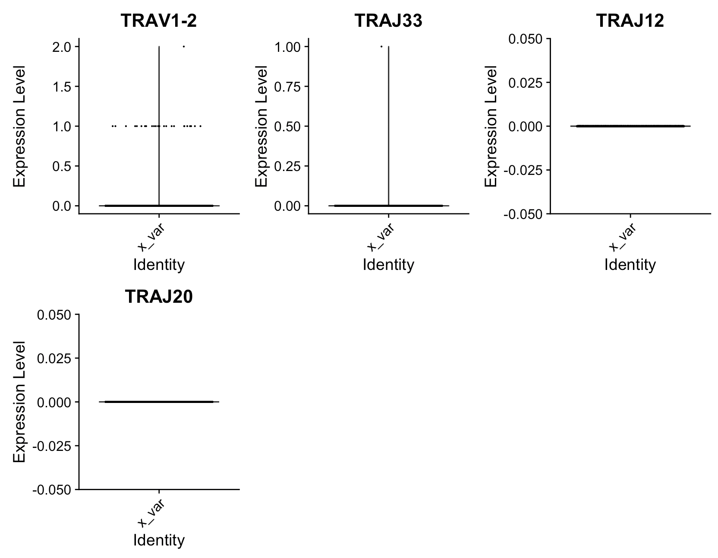
TCR genes not highly/variably expressed
25 CD8 cells with TRAV1-2 counts > 0

Slide 11
Summary for Kevan Herold scRNAseq analysis
no padj < 0.05 for single-gene KM plots (even CD127)
using different IL7 modules gives contradictory effects
unable to identify CD8 MAITs by RNA expression of TRA V/J genes
Notes:
impression is that results are obscured by noise even w/ EOMES result (higher CD8 expr of EOMES module at 3 month associating w/ longer T1D-free intervals) matching expectation

