Slide 1
Weekly meeting
4 4 2024
Ty Bottorff

Slide 2
Outline
Proliferation vs. activation comparison
TCR graphs
ATAC QC

Slide 3
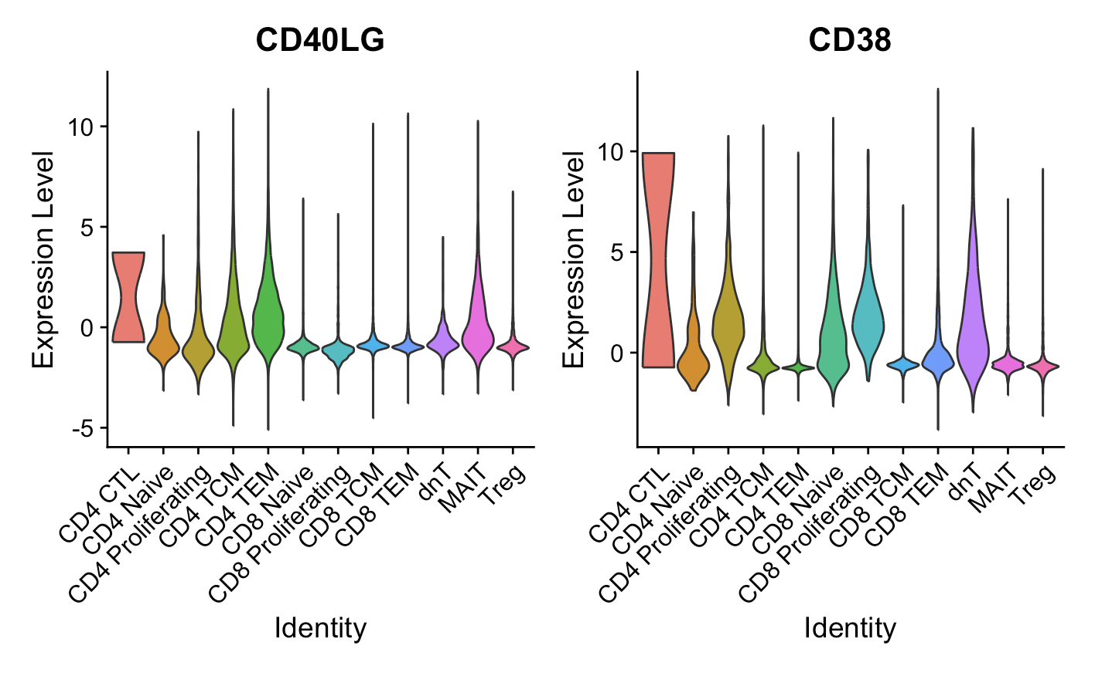
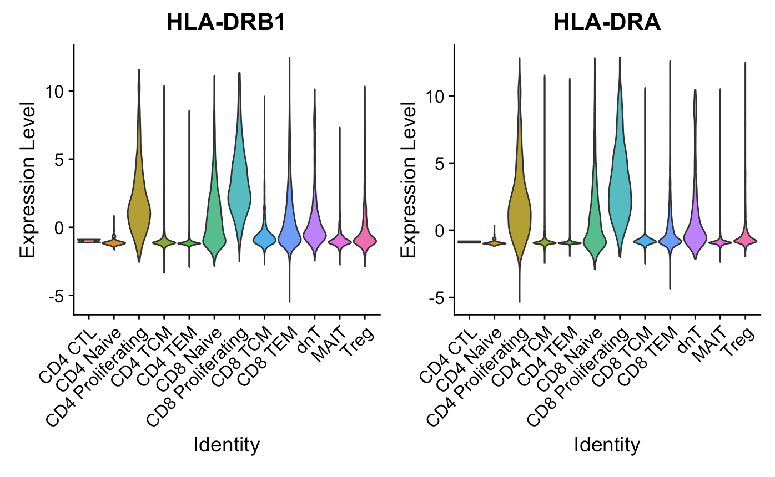
Proliferating cells are ~generally high for activation markers (Luoma (2020), Cell dataset)
CD154
*CD69, CD44, EGR1 different stories
Notes:
CD69, not really higher in proliferating cells, also a marker for Trm though? so...
CD154/CD40LG: kinda high in CD4 prolif but moreso in CD4 CTL/TCM?TEM and MAITs
EGR1, low in everything except MAITs
CD44: lowest in proliferating cells
CD38: yes higher in proliferating cells but really highest in CD4 CTLs, also high in dnTs
HLA-DR: B1 yes higher in proliferating cells (also CD8 naive/TEM), A (yes higher in proliferating cells also in CD8 naive), B5 kinda higher in proliferating cells
HLA-DRB1/DRA are class II, some CD8s can express it but it seems pretty high in CD8 prolif… but they definitely have high CD8A/B…

Slide 4
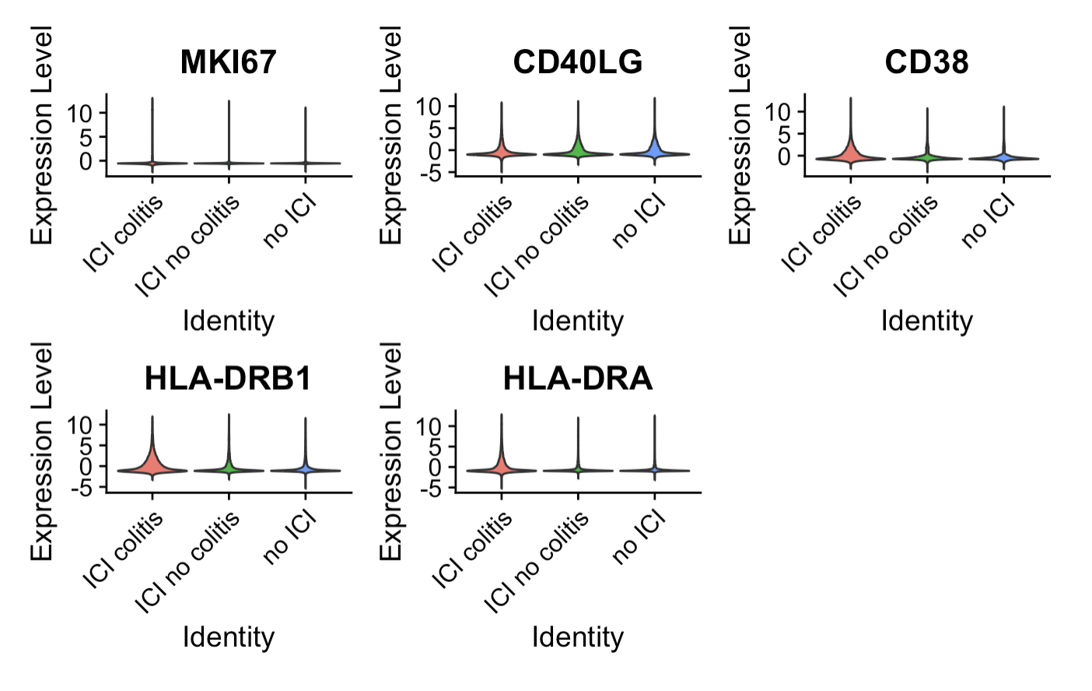
Some activation markers appear higher in ICI colitis tissue (Luoma (2020), Cell dataset), but no significant differences
Notes:
MKI67 probably looks same because there are so few proliferating cells and difference between irAE groups wasn’t even huuge in proliferating cells alone
Did for all T cells, CD4 prolifs, didn’t try for all CD4s but yea not expecting anything…

Slide 5
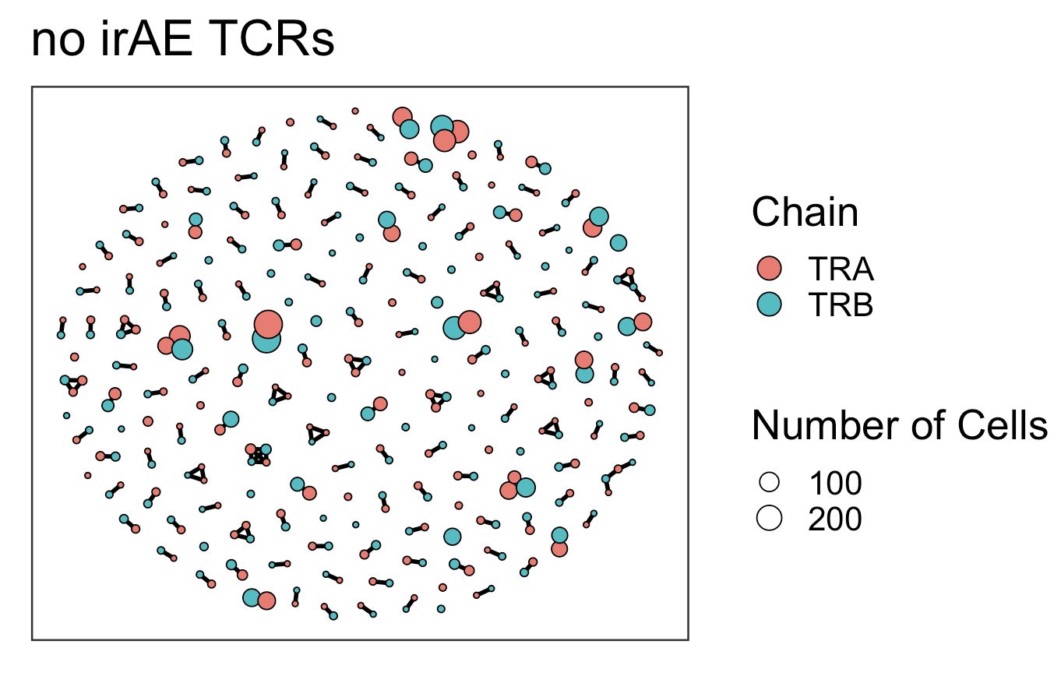
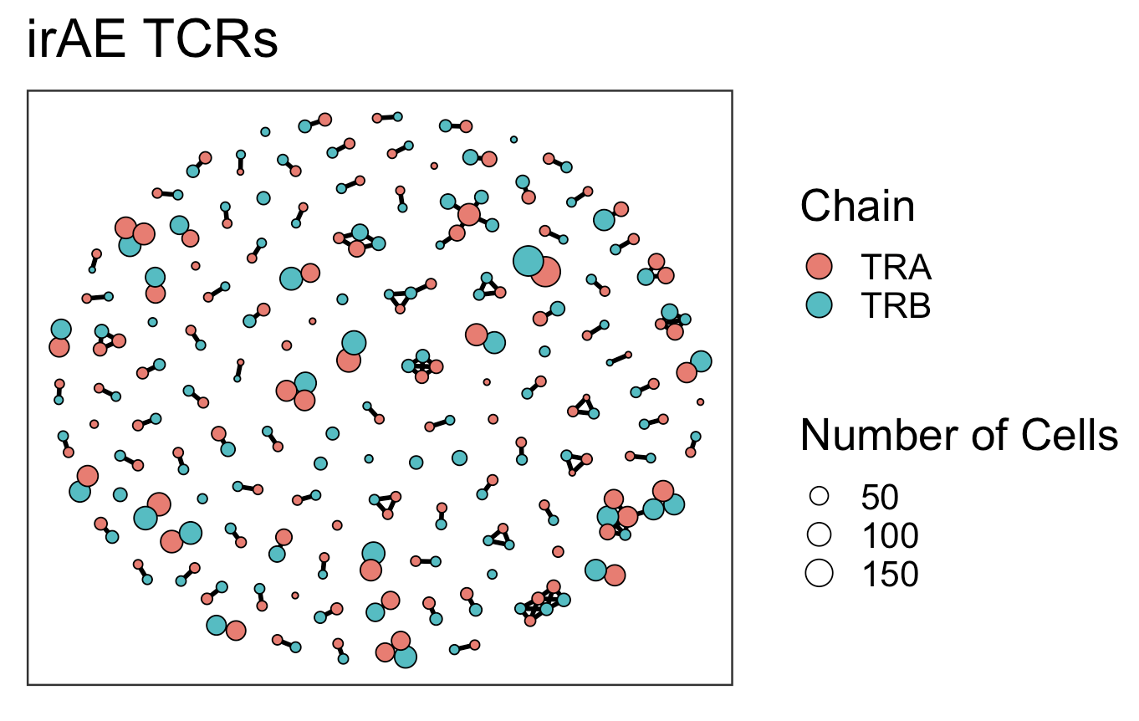
TCR graphs similar between irAE groups (Luoma (2020), Cell dataset), perhaps slightly higher connectivity (2*edges/vertices) in irAE group
Average Connectivity: 1.029762
Number of Edges: 173
Number of Vertices: 336
Average Connectivity: 1.258687
Number of Edges: 163
Number of Vertices: 259
Notes:
average_connectivity = 2 * num_edges / num_vertices
Top 350 clonotypes per patient per chain

Slide 6
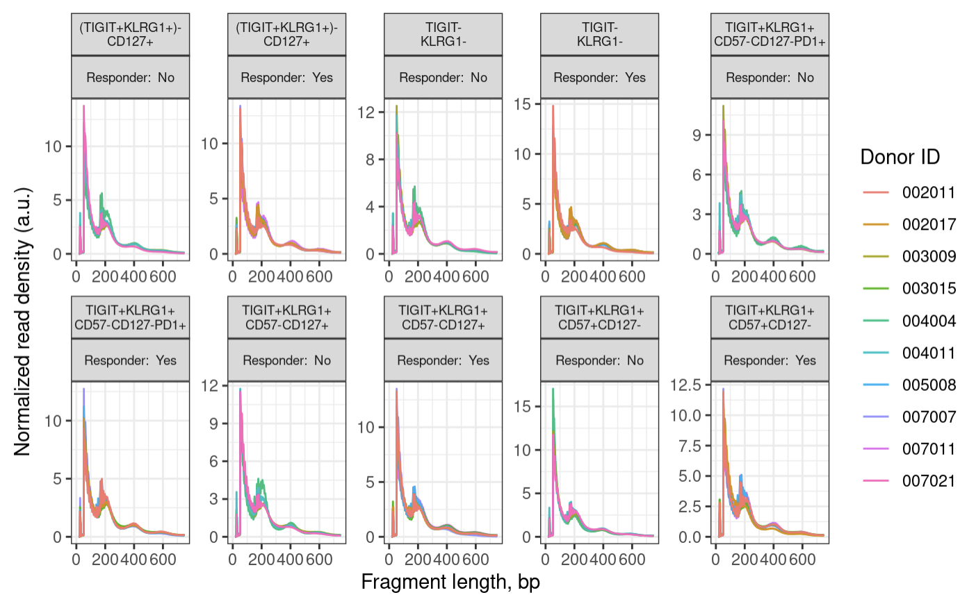
ATAC QC: fragment size distributions look good (100 bp peak, 200, 400 bp oscillations)
Notes:
expect a peak around 100 bp (nuclesome free region) and then oscillations with maxima 200 bp mono-nucleosome, 400 bp di-nucleosome and so on
wiggles in the below plot are a biological feature and come from 10 bp per helical turn of the DNA

Slide 7
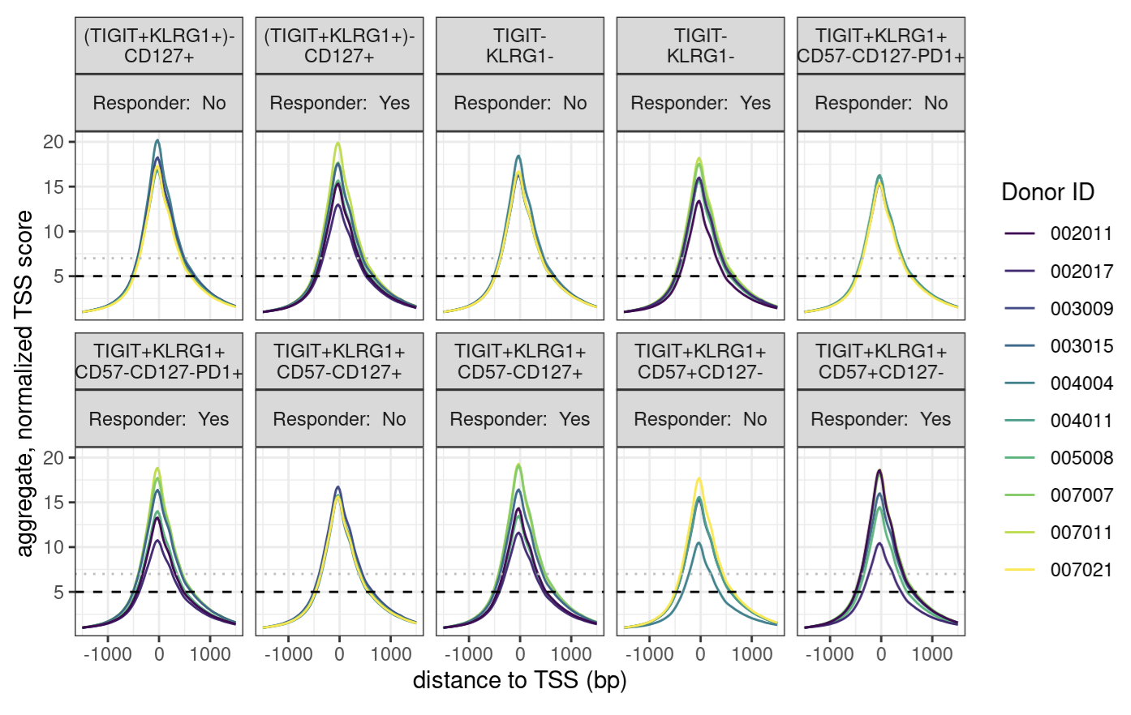
ATAC QC: TSSe looks good
Notes:
enrichment over TSS, signal:noise
we are looking for > 7, while 5-7 is still acceptable

Slide 8
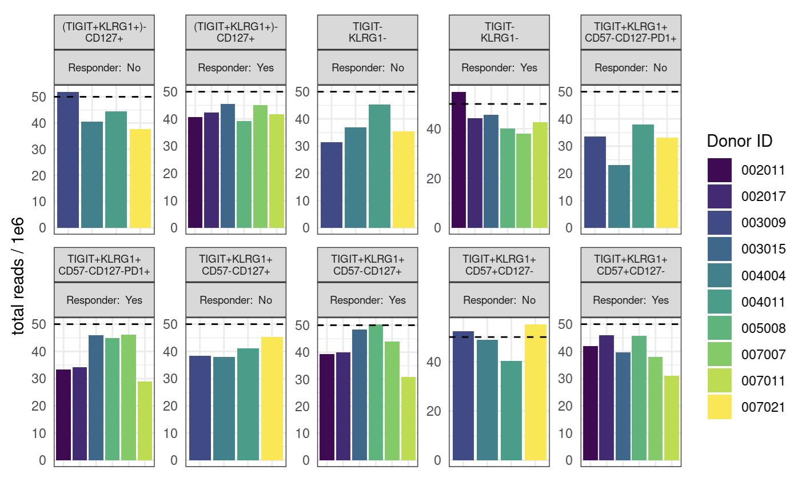
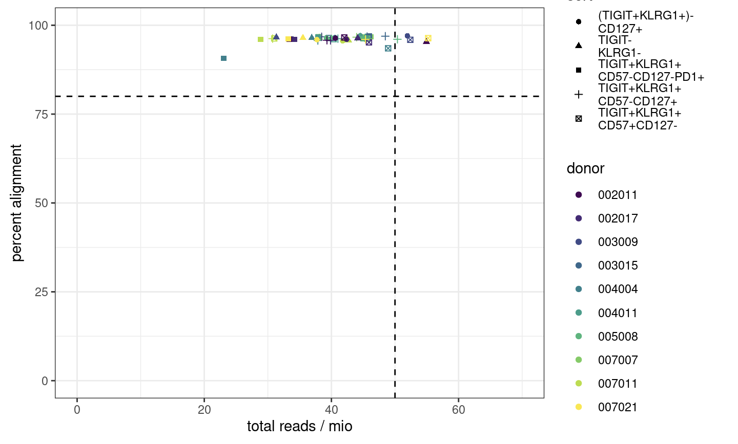
ATAC QC: most samples’ read counts are lower than desired, alignment good though
Notes:
ENCODE recommends 50 mio (aligned) reads for paired-end, 25 mio for single read
ENCODE: each replicate should have 25 million non-duplicate, non-mitochondrial aligned reads for single-end sequencing and 50 million for paired-ended sequencing (i.e. 25 million fragments, regardless of sequencing run type). The alignment rate, or percentage of mapped reads, should be greater than 95%, though values > 80% may be acceptable
want 10-50 mil reads depending on if TF analysis required (ENCODE suggestions)
we now want our samples to fall into the top right corner
consequences: may have reduced sensitivity (for low abundance/rare stuff), increased noise, decreased reproducibility across replicates (i.e. within sort+responder groups)

Slide 9
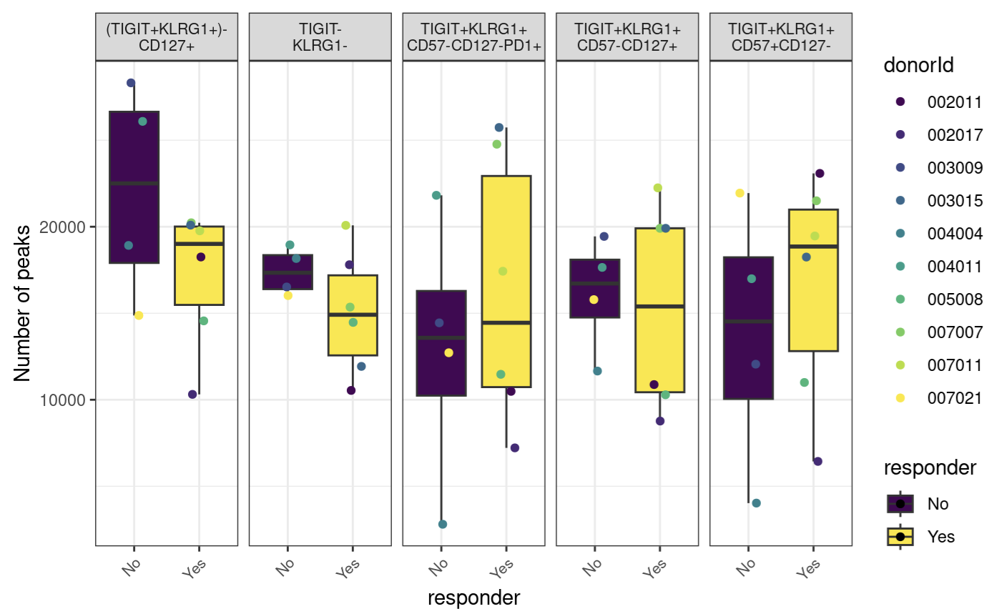
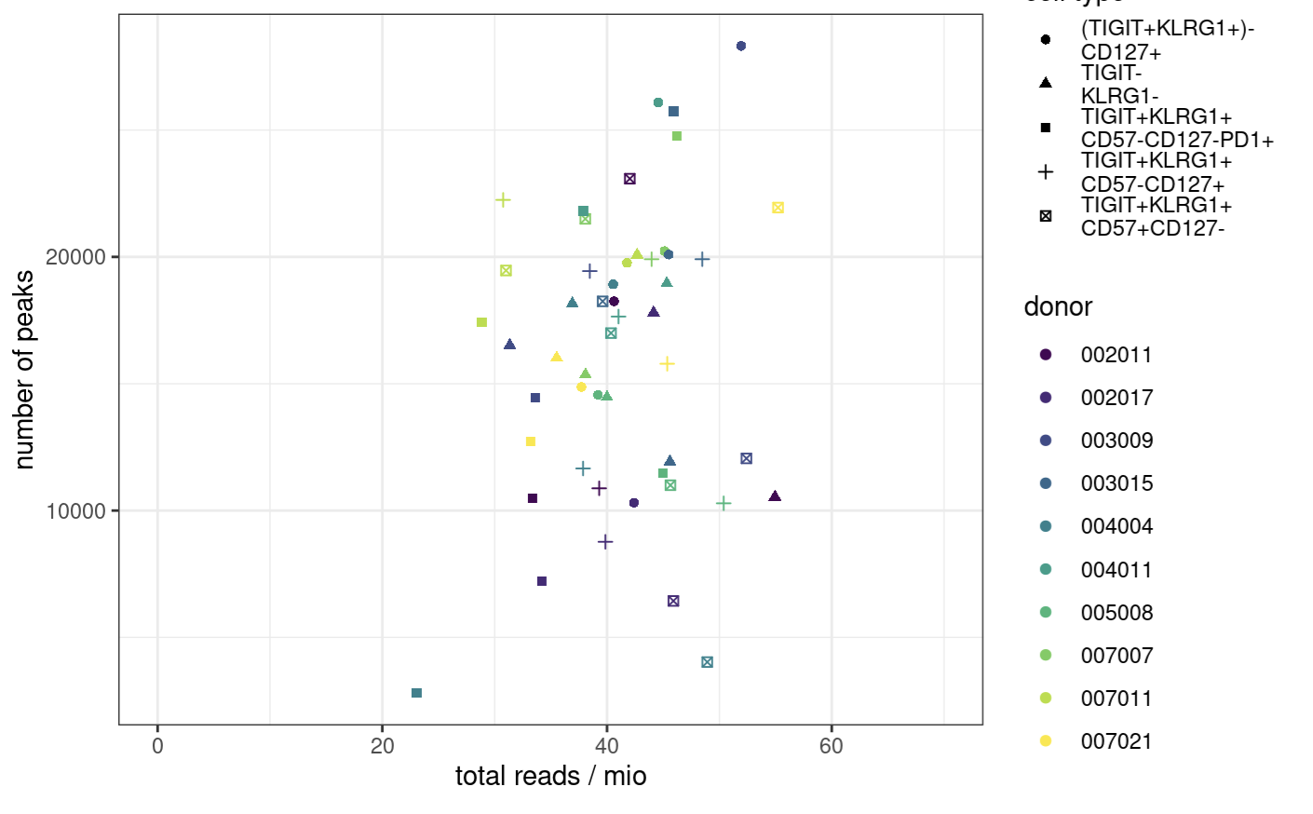
ATAC QC: way fewer than desired peaks
Notes:
ENCODE:The number of peaks within a replicated peak file should be >150,000, though values >100,000 may be acceptable.
ENCODE recommends > 150,000 peaks, although > 100,000 is still acceptable

Slide 10
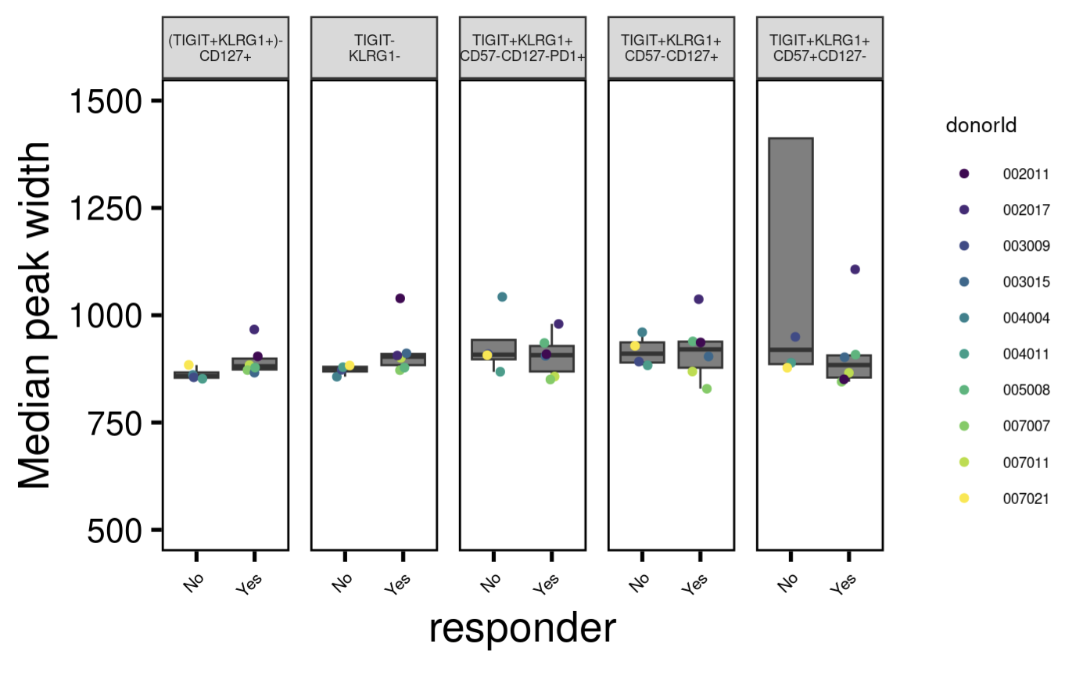
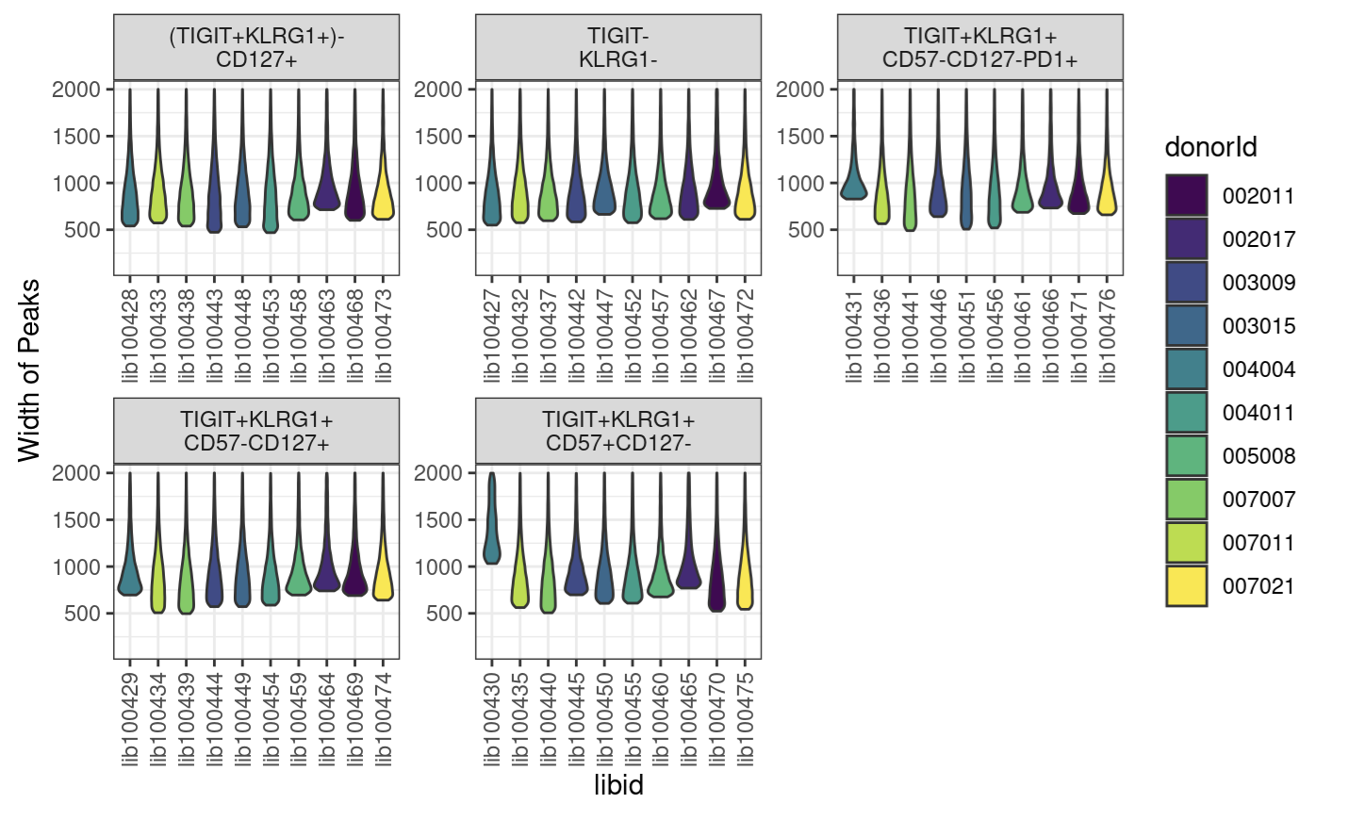
ATAC QC: one sample has way wider peaks than desired
Notes:
want ~400-1000 bp peak widths as medians
libid100430 is wide peak one

Slide 11
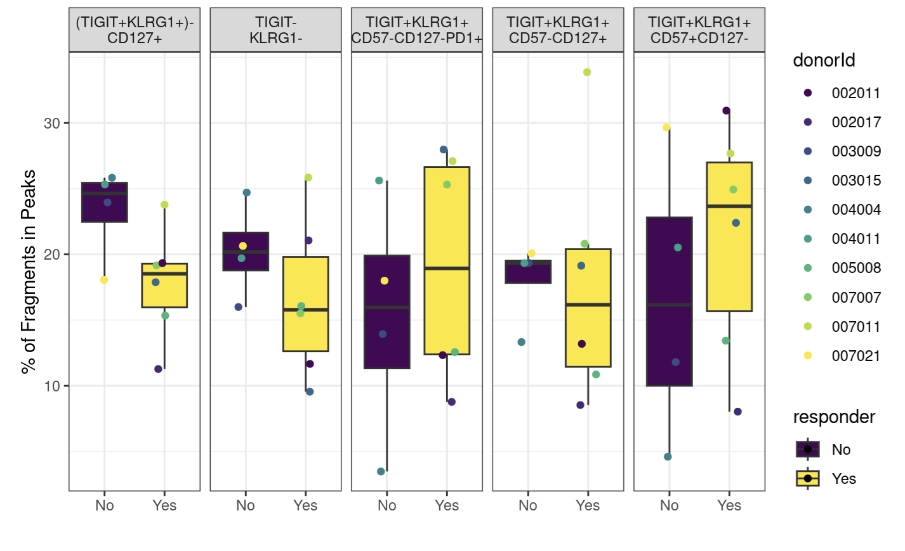
ATAC QC: fraction of reads in peaks lower than desired for most samples
Notes:
ENCODE: The fraction of reads in called peak regions (FRiP score) should be > 0.3, though values greater than 0.2 are acceptable. TSS enrichment remains in place as a key signal to noise measure
FRiP is calculated by going through the bam files and counting the reads that fall within a called peak

Slide 12
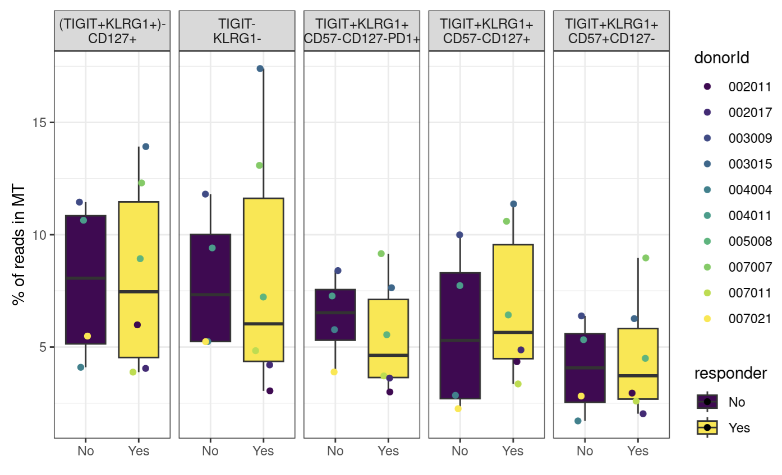
ATAC QC: MT %s

Slide 13
Conclusions
ATACseq QC: generally good, may exclude few samples from subsequent analyses
TCR graphs were similar between irAE groups
Not shown: Erin’s ATACseq, comparing Stephan’s method vs. Erin’s method
Merged alignment files by condition/timepoint
Ran peak caller on merged alignment files
TODO: differentially accessible gene analysis (volcano plot comparison)

Slide 14
Next steps
ATACseq: merging alignment files, calling peaks on aligned files, making volcano plots
Worth trying to make activated (CD4) cell type category to compare abundances between irAE groups?
Would need to set thresholds for +/- for markers like CD154, CD38, HLA-DR(A/B1)

