Slide 1
Weekly meeting
8 8 2024
Ty Bottorff

Slide 2
Outline
BRI retreat abstract
AbATE DN outlier analyses

Slide 3
BRI retreat: abstract + any authors needed on patient recruitment side?
T cell exhaustion, a state of reduced effector function, results from chronic stimulation from antigens that cannot be fully cleared.
In recent T1D studies, levels of TIGIT+KLRG1+ (DP) PD-1+ and DP CD57+ exhausted CD8s early after treatment have correlated with better response to therapy, consistent with the reduced effector function of these exhausted T cells.
However, levels of DP CD127+ exhausted CD8s may in fact correlate with worse outcome in T1D.
To investigate this heterogeneity in association with response to therapy amongst DP exhausted CD8s and given the epigenetic changes that characterize T cell exhaustion, here we profiled the epigenetic states of different non-naive CD8 populations from PBMCs of 10 T1D patients treated with teplizumab using bulk ATAC-seq.
We found that the epigenetic states of DP CD127+ CD8s were intermediate to that of other DP CD8s (PD-1+ and CD57+) and TIGIT+KLRG1+ CD8s.
We also analyzed mitochondrial-mapping ATAC-seq reads and found that the DP CD57+ CD8s had the most mitochondrial single nucleotide variants.
We hypothesize that a bifurcation occurs in non-naive CD8 differentiation where one branch leads to the DP CD127+ CD8s and the other branch leads to the DP PD-1+ CD8s and the more terminal, downstream DP CD57+ CD8s.
This separation of the DP CD127+ lineage from other DPs lineage is consistent with the observed heterogeneity in association with response to therapy and …
the possible protective effect of IL7R blockade against autoimmune diabetes.
the reversal of autoimmune diabetes with IL7R blockade in NOD mice.
bodes well for new trials combining teplizumab and anti-IL7R.
Notes:
There’s also few DP CD127+ CD57+ cells, supporting this bifurcation

Slide 4
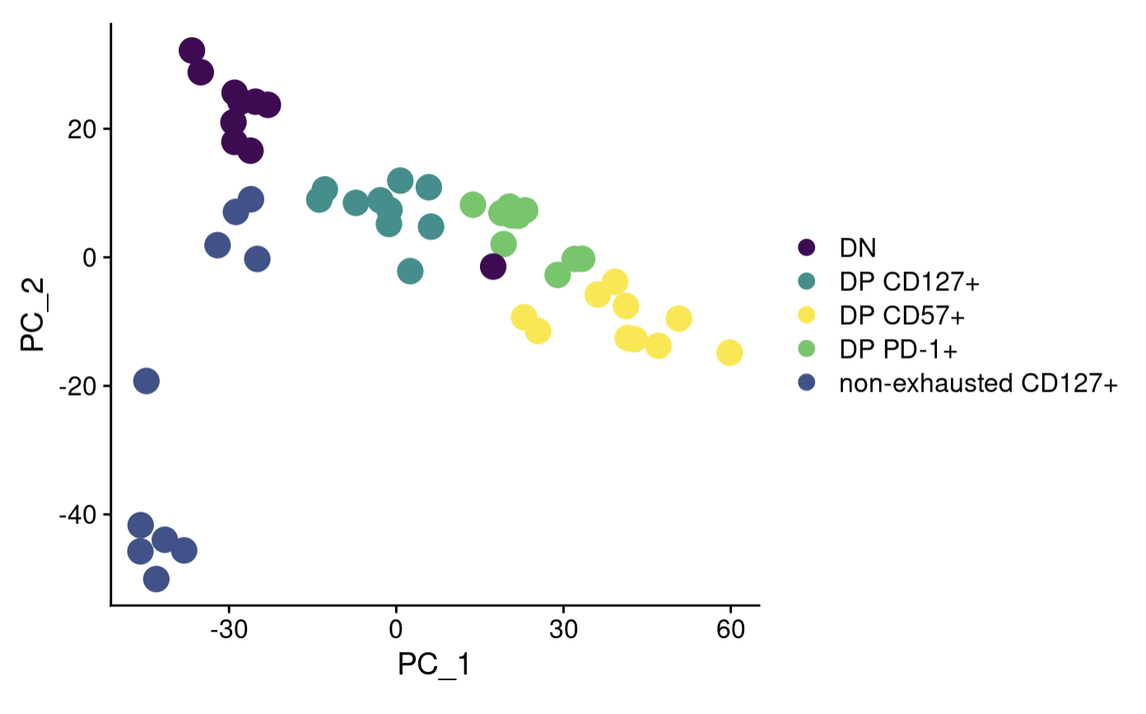
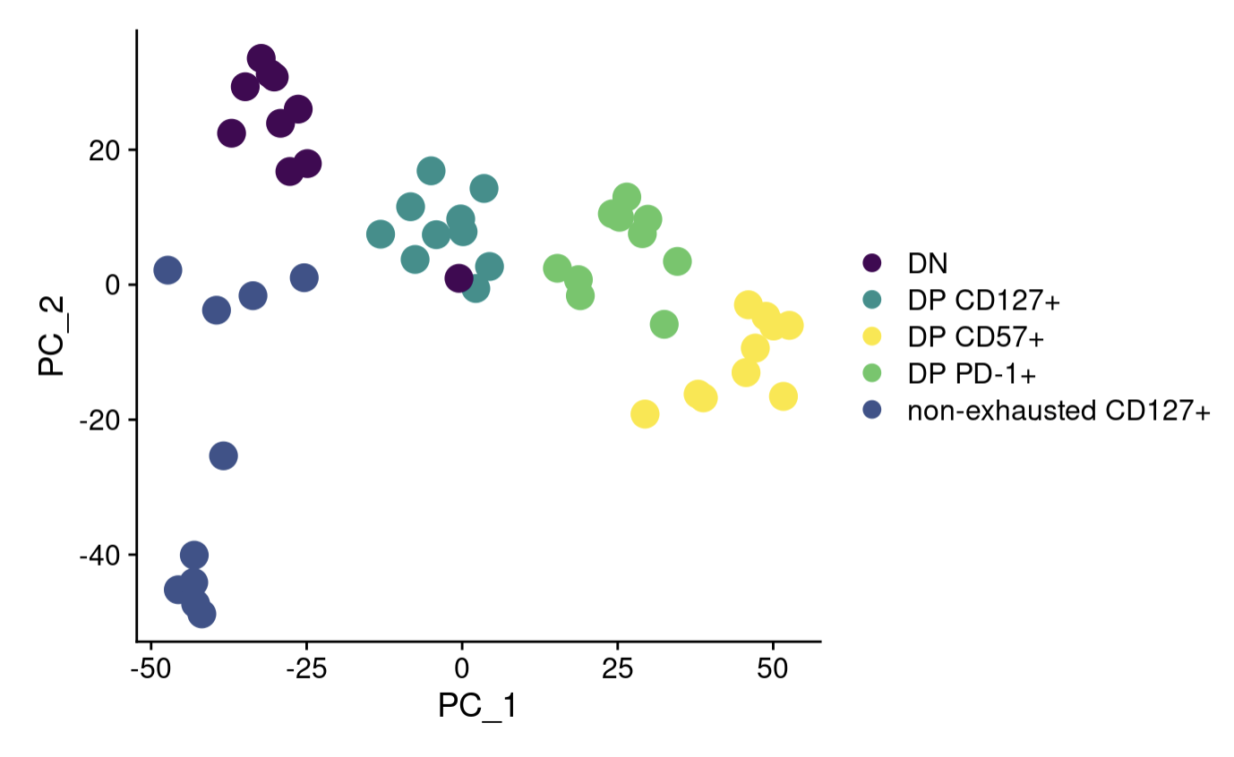
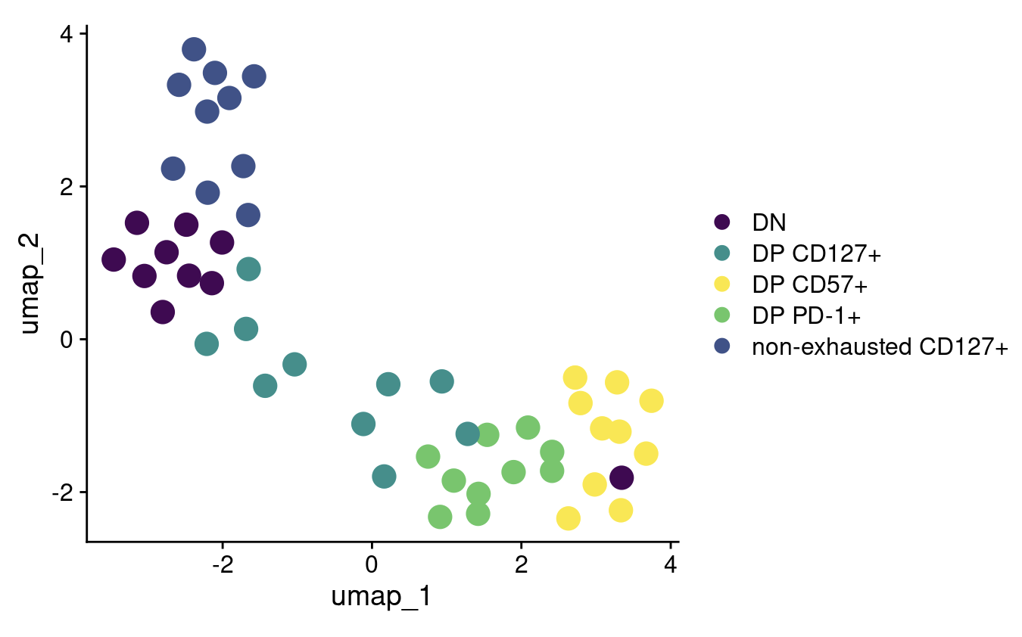
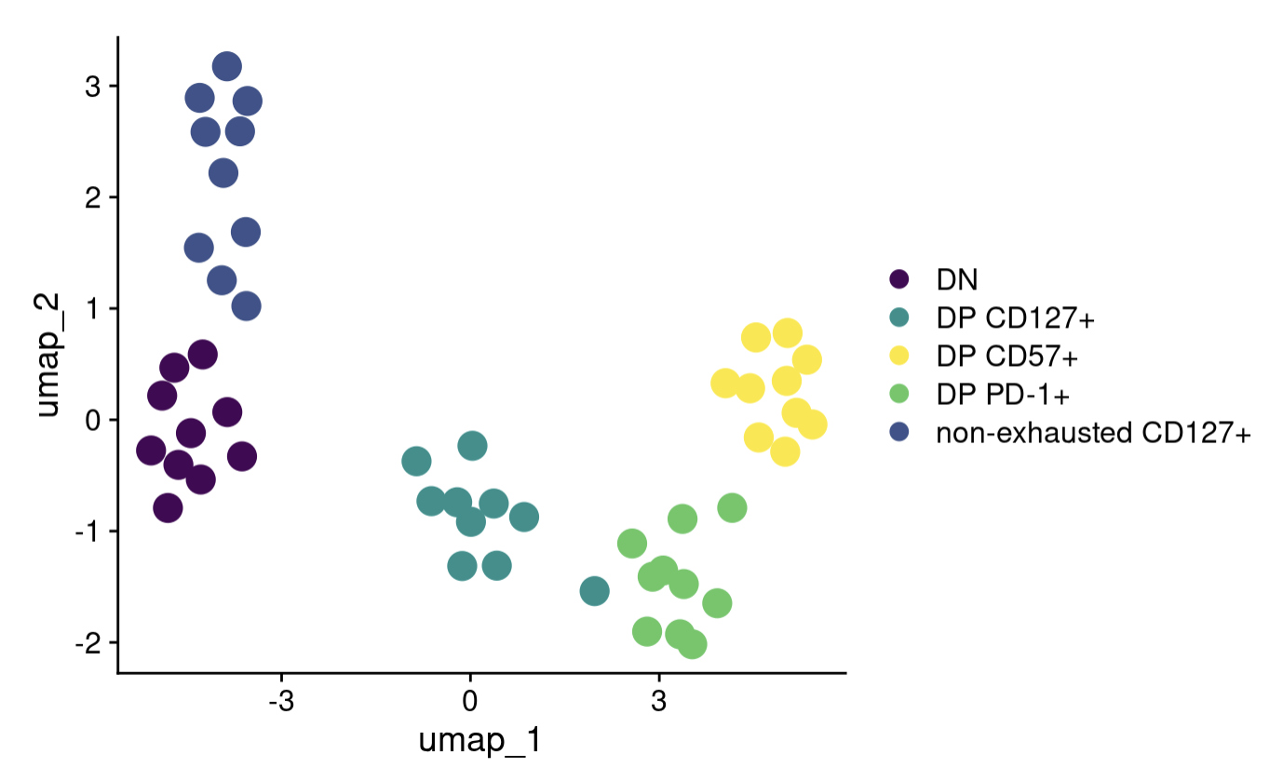
Regressing out donorId and responder status (had done in DiffBind but hadn’t done yet in Seurat)
Not regressed out
Regressed out
Notes:
Perhaps that donor’s DNs were just much less DN and much more DP whatever than other donors’ DNs… hard to believe in bulk though…
Diffbind did regress out/block for responder status (and replicate), replicate symmetric (not right word but mapped 1:1 to) with donorId, so diffbind regressing out/blocking is fine! It’s just that I forgot to do this in Seurat

Slide 5
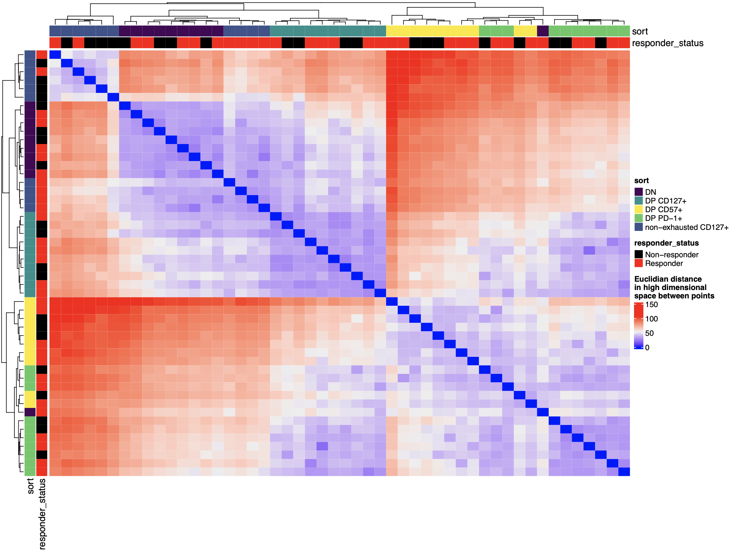
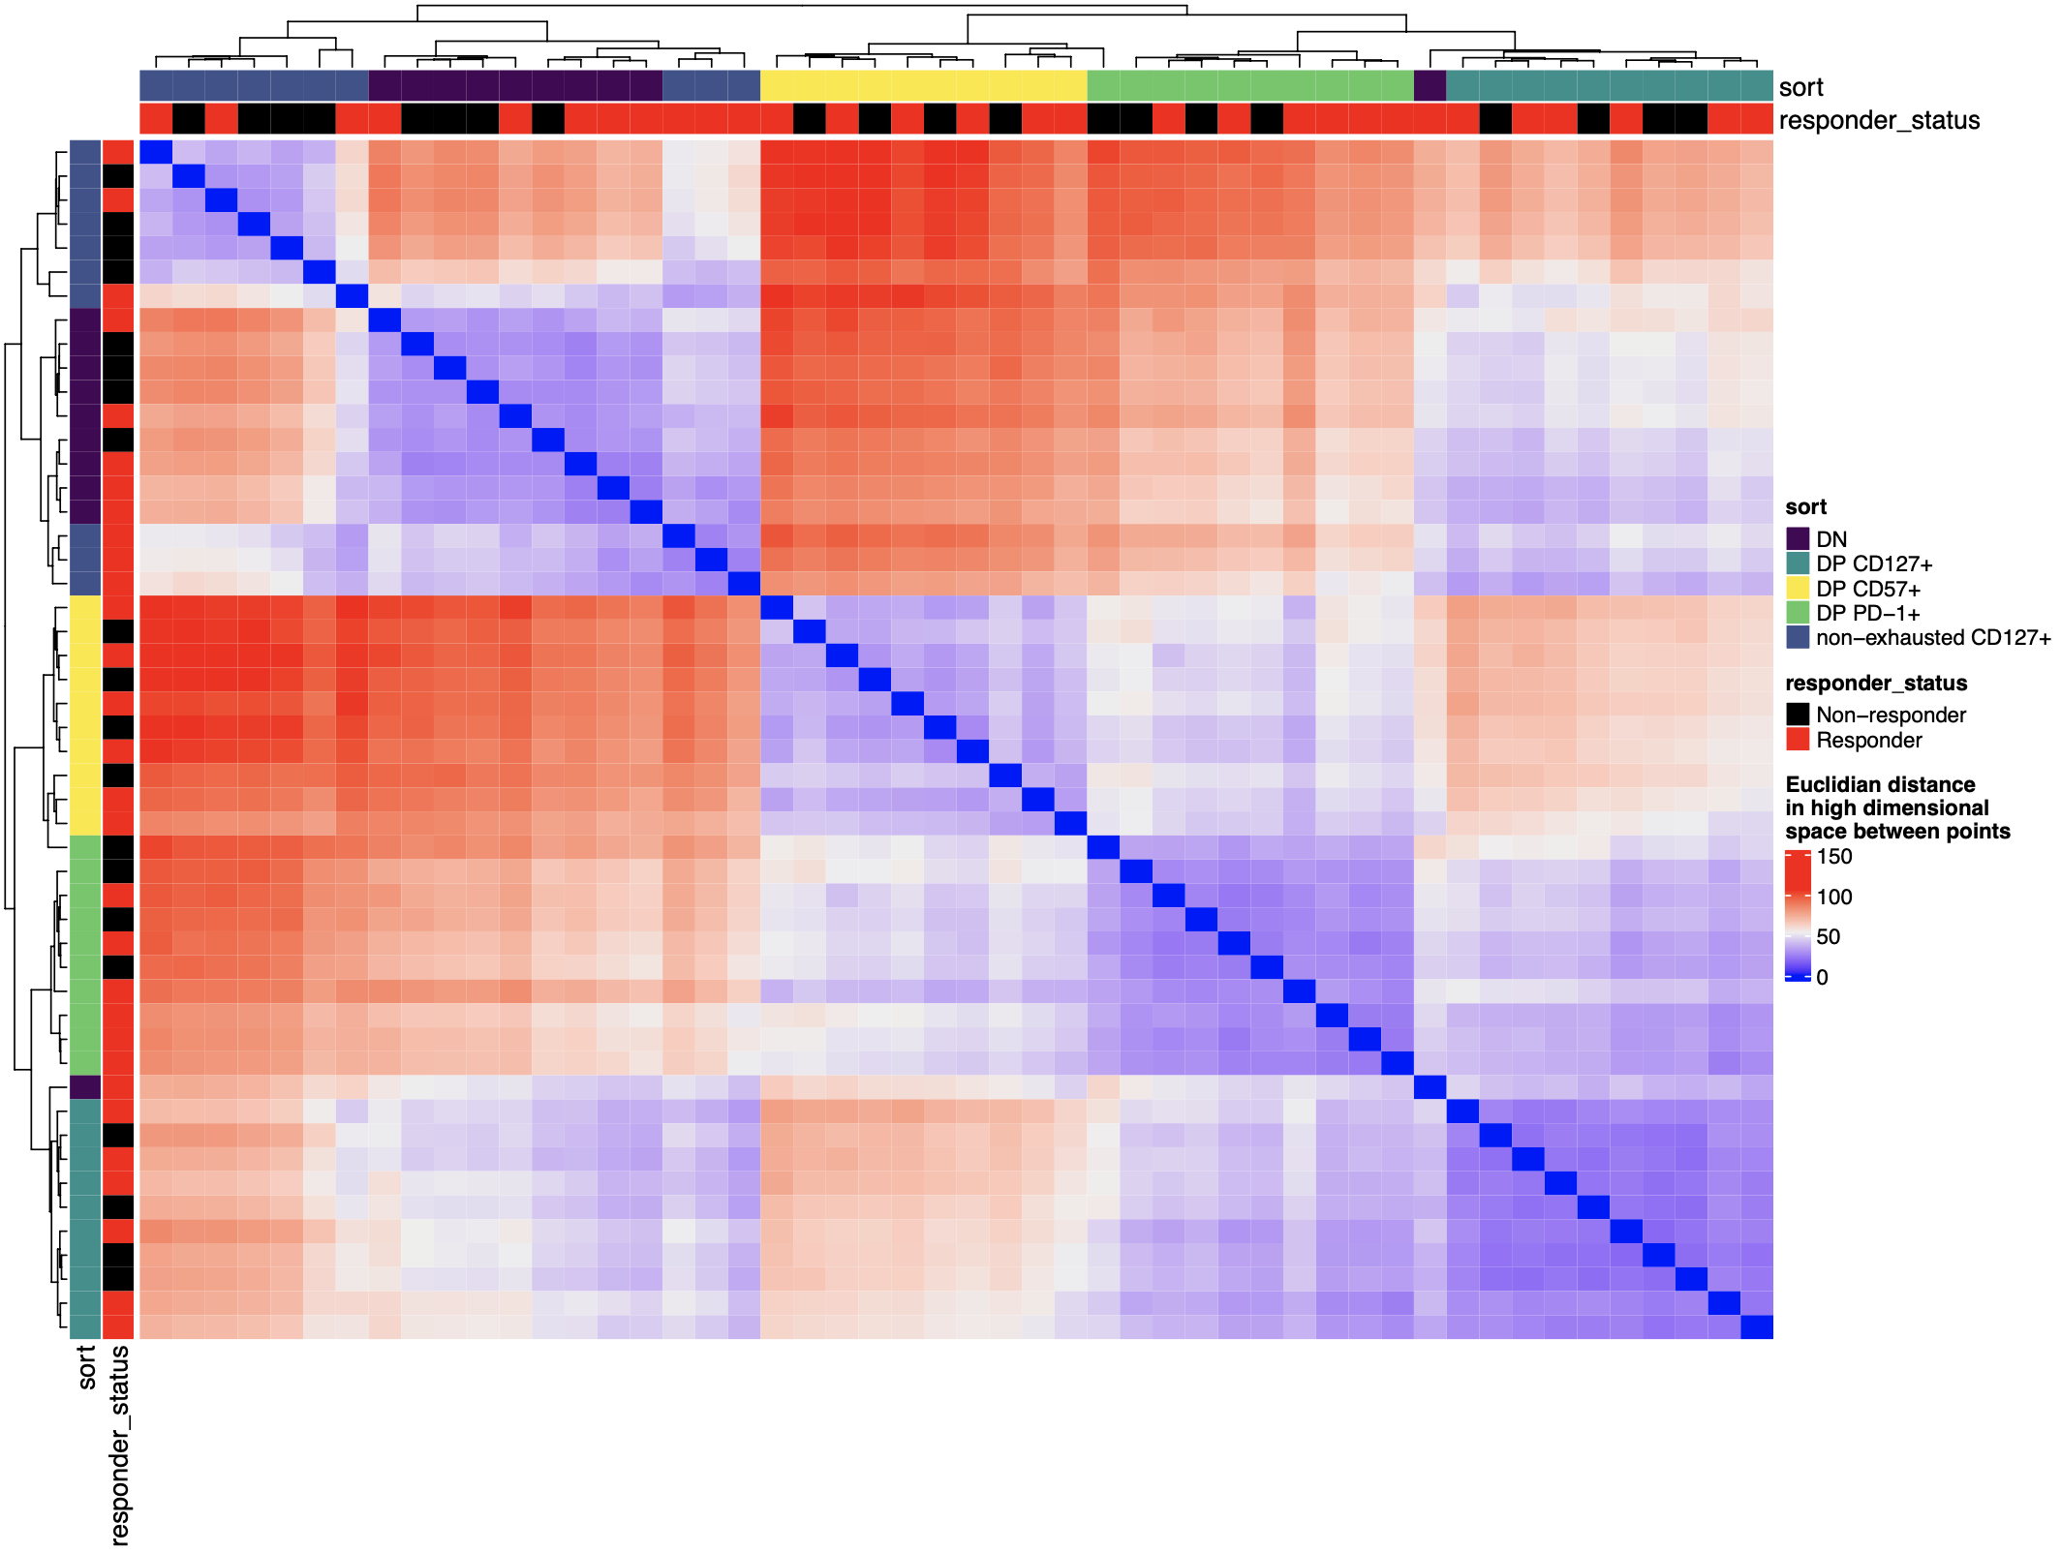
Even after regressing out donorId & responder status, outlier DN is still an outlier (UMAP hides this)
Not regressed out
Regressed out

Slide 6
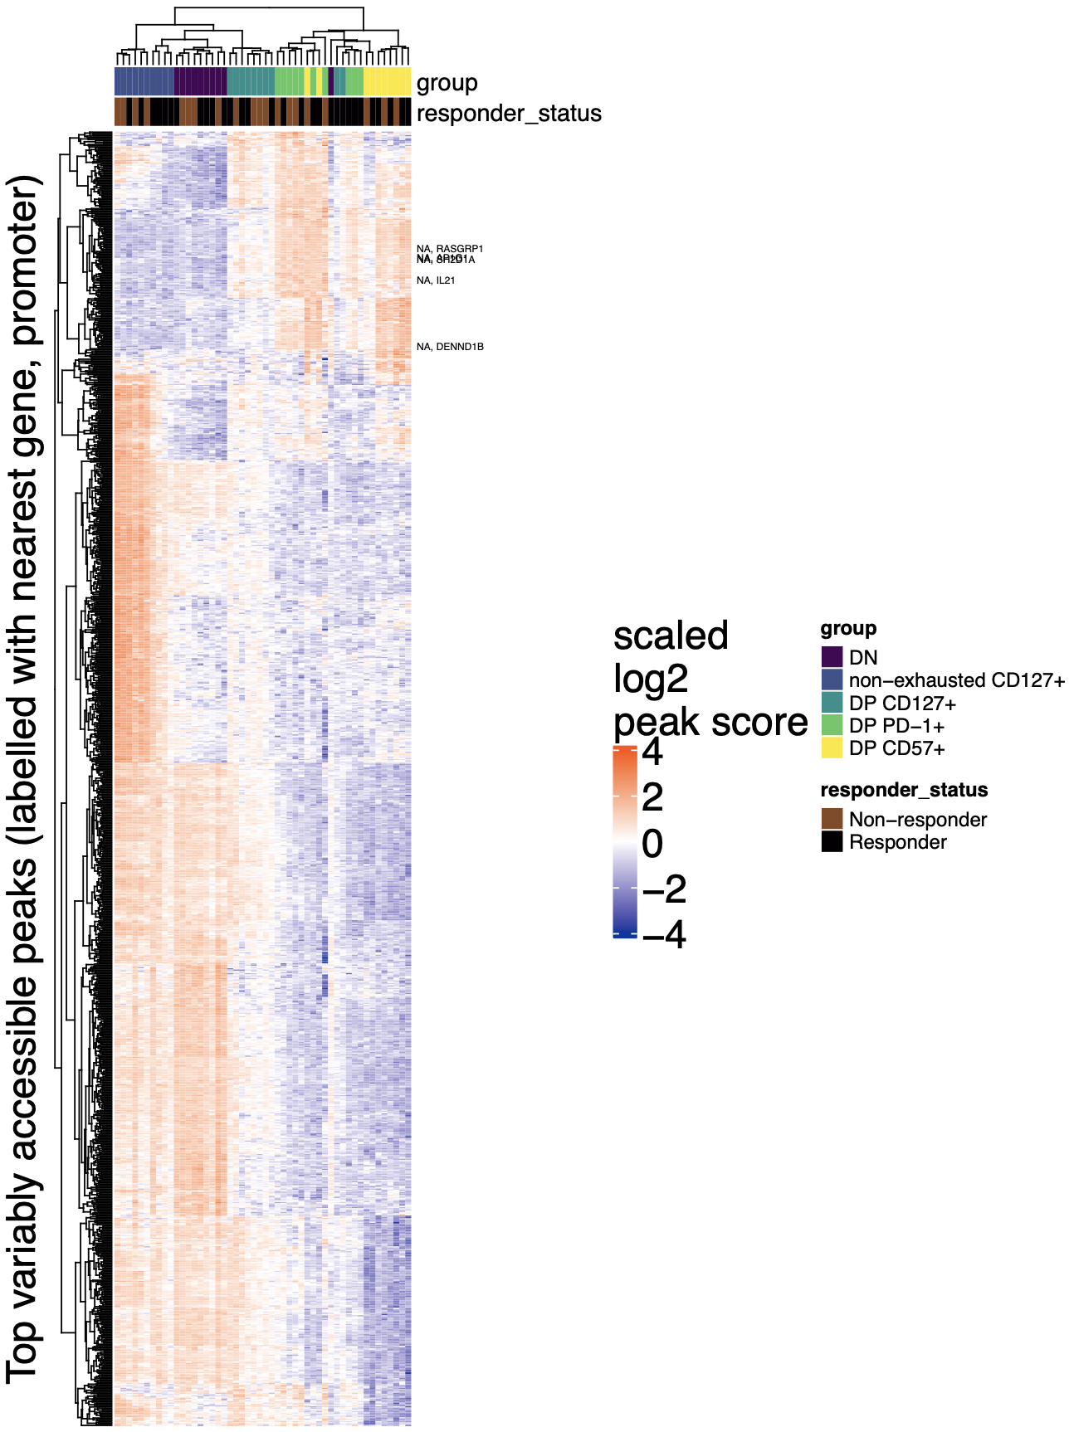
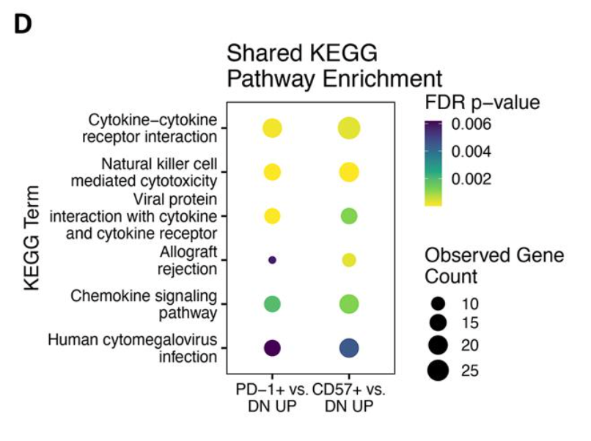
Peaks near promoters related to positive regulation of NK/lymphocyte-mediated cytotoxicity/immunity more accessible in DP CD57⁺/DP PD-1⁺ clusters
Enrichment in this top block
Positive regulation of lymphocyte mediated immunity
IL21, SH2D1A, RASGRP1, AP1G1, DENND1B (5/116)
FDR: 0.02
Positive regulation of NK cell mediated cytotoxicity
IL21, SH2D1A, RASGRP1, AP1G1 (4/27)
FDR: 0.007
Consistent with Erin’s
Notes:
Not the most correct method here, summing peaks from 10 pairwise contrasts (to get ~1000 peaks) rather than the more correct way of finding variably accessible peaks from Seurat code stuffs, but this is consistent with Erin’s so not too worried

Slide 7
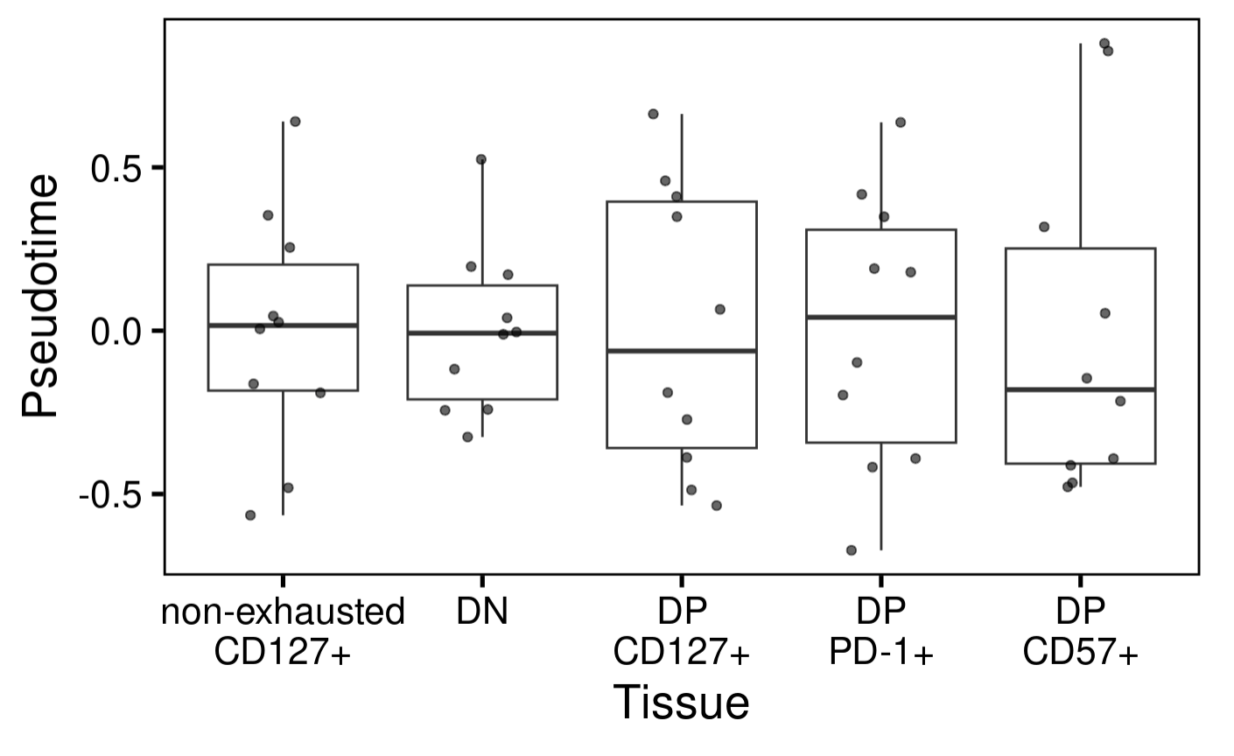
Don’t observe pseudotime associating with cell sort
tried using scaled read counts and peak scores as inputs
Notes:
Tested for significances already
PhenoPath analyzes the accessibility of genomic regions (peaks) in your ATAC-seq data, modeling how these accessibilities change along a biological trajectory and how this trajectory is influenced by tissue type
PhenoPath models gene expression expression 𝑦 in terms of a latent pathway score (pseudotime) 𝑧. Uniquely, the evolution of genes along the trajectory isn’t common to each gene but can be perturbed by an additional sample-specific covariate 𝛽 (cell sort here)
The default peak score for macs peaks is the "=-10*LOG10(pvalue)" value. It is normalised to a 0..1 scale by dividing the scores by the maximum score (so the max score gets a value of 1)

Slide 8
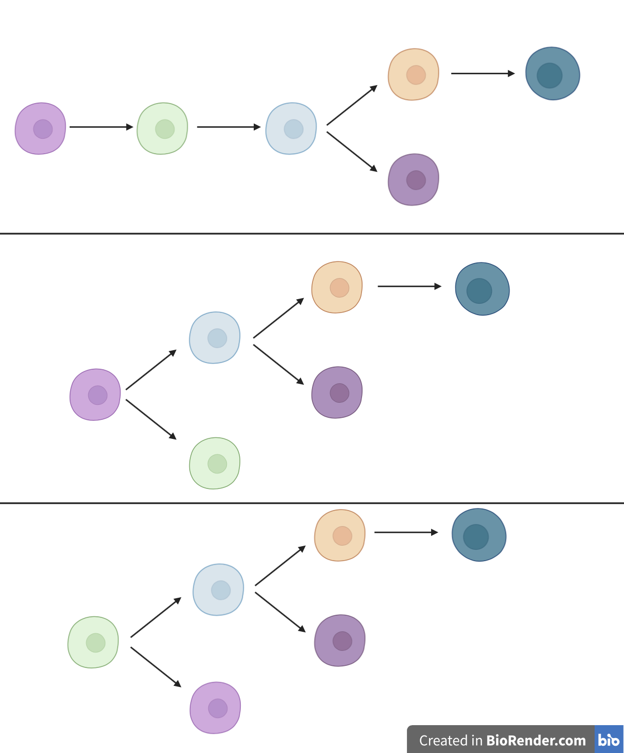





Conclusions
TIGIT⁺
KLRG1⁺
(DP)
DP PD-1⁺
DP CD57⁺
Non-exhausted
CD127⁺
TIGIT⁻
KLRG1⁻
DP
CD127⁺
T1DAL: var freq (high vs. low) didn’t matter much for sharing across time points (data not shown)
DP CD127⁺ more epigenetically intermediate
DN and non-exh CD127⁺ epigenetically similar
DP PD-1⁺ and DP CD57⁺ epigenetically similar
Increasing MT vars
Notes:
Not drawing a DN → nonexh → DPs linear path because we don’t observe that in UMAP/PCA plots, but it could also be possible…
There’s also few DP CD127+ CD57+ cells in Long lab data, supporting this bifurcation
From Josh: “CD57+CD127+ population (less than 0.5% of total CD8s or 4% of DP). as for the CD127+PD1+ … about 1.5% of total CD8s (or 12.4% of DP).”
Additional evidence for bifurcation for CD127 and PD-1 split: “IL-7 suppressed PD-1 expression on activated T cells in vitro” and “Interestingly, exhausted memory T cells show low IL-7Rα expression (35), and we speculate that a causal relation exists between the absence of IL-7 signals and the up-regulation of PD-1.” from PMC3411948

Slide 9
Next steps
Analyzing additional AbATE reads as soon as processed (expecting to begin by Monday at the latest)
Preparing poster for BRI retreat (all abstracts make a poster?)
scATACseq for MT variant-based lineage mapping
authors from this paper recommended working backwards from rare variant frequency threshold to get cell numbers (i.e. with a lower bound variant frequency of 0.0005 then want 2,000 cells per sort per replicate, presumably?), that’s already lower bound than lowest bound I have looked at/showed results for… so maybe we don’t need (many) more cells for scATACseq than bulk ATACseq…
might ask around BRI for/download public scATACseq data eventually to practice lineage mapping

Slide 10
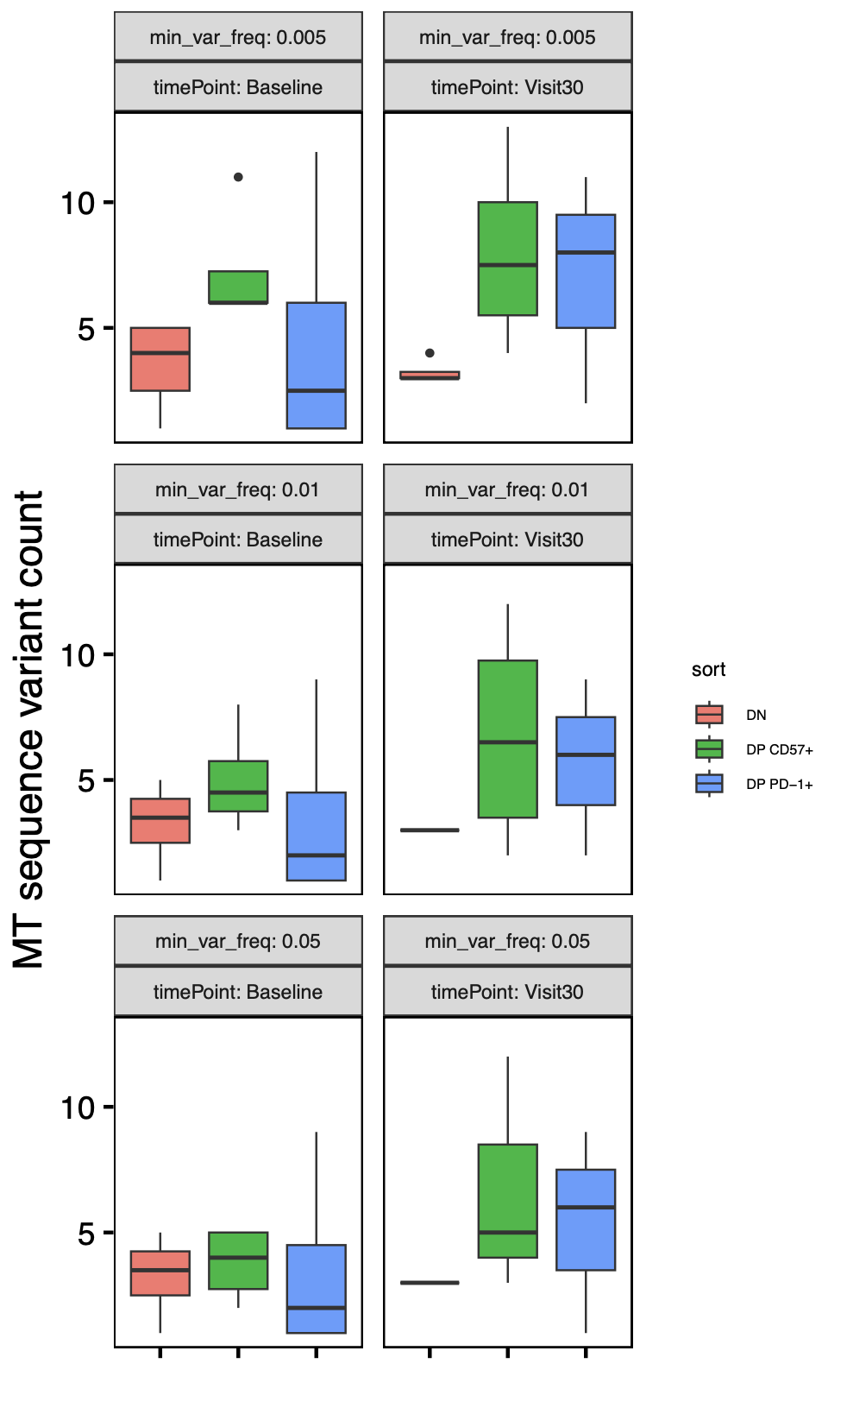
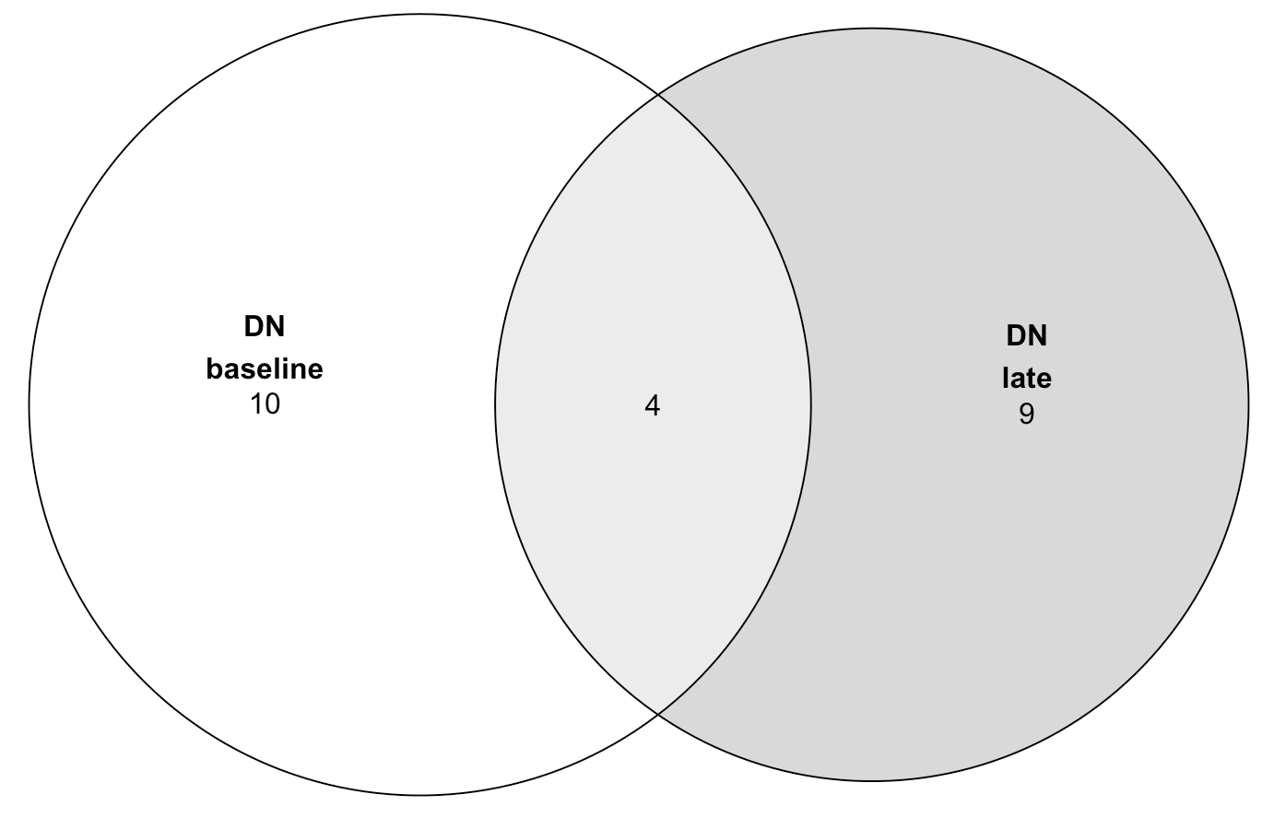
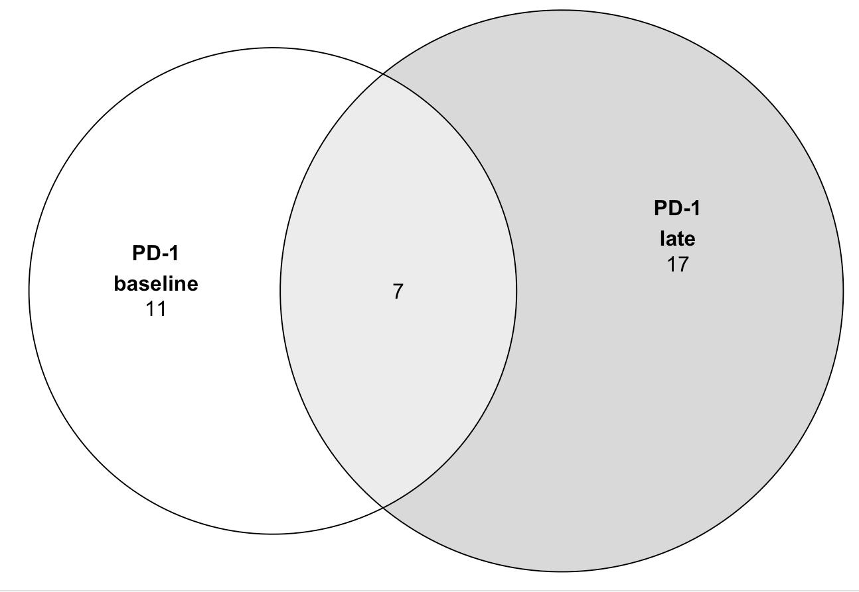
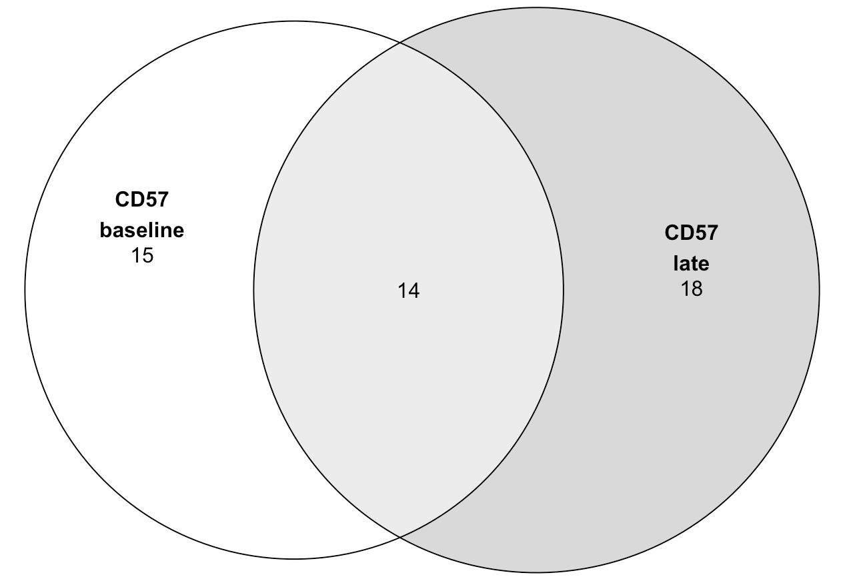
P452 (T1DAL): faceting MT variant analysis by timepoint
Takeaways:
- no significant differences in variant counts by timepoint within each sort
- substantial variant loss/gain over time (more sharing in CD57s ~30% vs. ~20% for others)
- not very different filtering for high freq vars (most here are high freq)
n = 4 (donors)
Notes:
Cell loss presumably explains higher than expected loss/gain of vars over time (loss could be death or swapping cell sort), loss/gain could also be due to insufficient sampling
Only R in P452: “we first measured their bulk chromatin accessibility at baseline (Week 0/Visit 0) and 104 wk (Visit 30) post-treatment in alefacept responders (R, defined by C-peptide preservation) using ATAC-seq following sorting from PBMC (Figure 1A, Because cell population differences rather than treatment response differences were the focus of our investigation, we sequenced only alefacept responder (R) samples“
Updated to remove vars present in all sorts in a donor
MT notes:
Mitochondrial genomes have high copy number (100–1,000s)
homoplasmy is when all copies of the mitochondrial genome in a cell are identical; heteroplasmy is when there is a mixture of two or more mitochondrial genotypes
mutations in mtDNA often reach high levels of heteroplasmy (proportion of mitochondrial genomes containing a specific mutation) due to a combination of vegetative segregation, random genetic drift, and relaxed replication
Exclusively maternal inheritance
mtDNA mutation rates are estimated to be 10- to 100-fold higher than for nuclear DNA

Slide 11
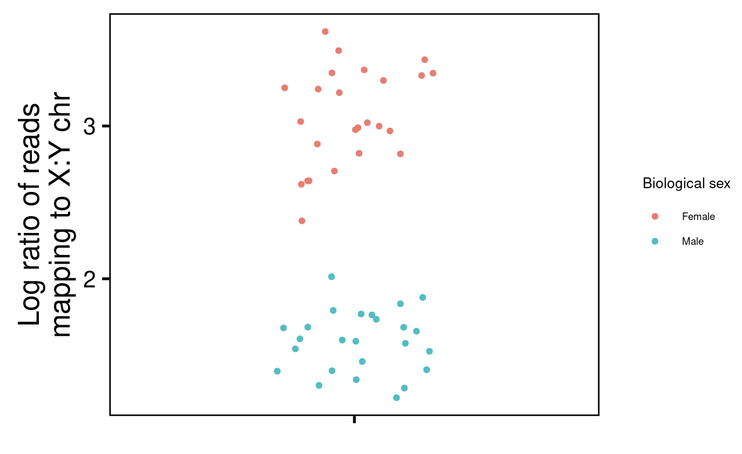
Additional QC check for biological sex (sex chr reads vs. metadata): all samples pass

