Slide 1
NCI update – analyzing CyTOF data
10-23-2024
Ty Bottorff – Bioinformatics postdoc
Linsley lab

Slide 2
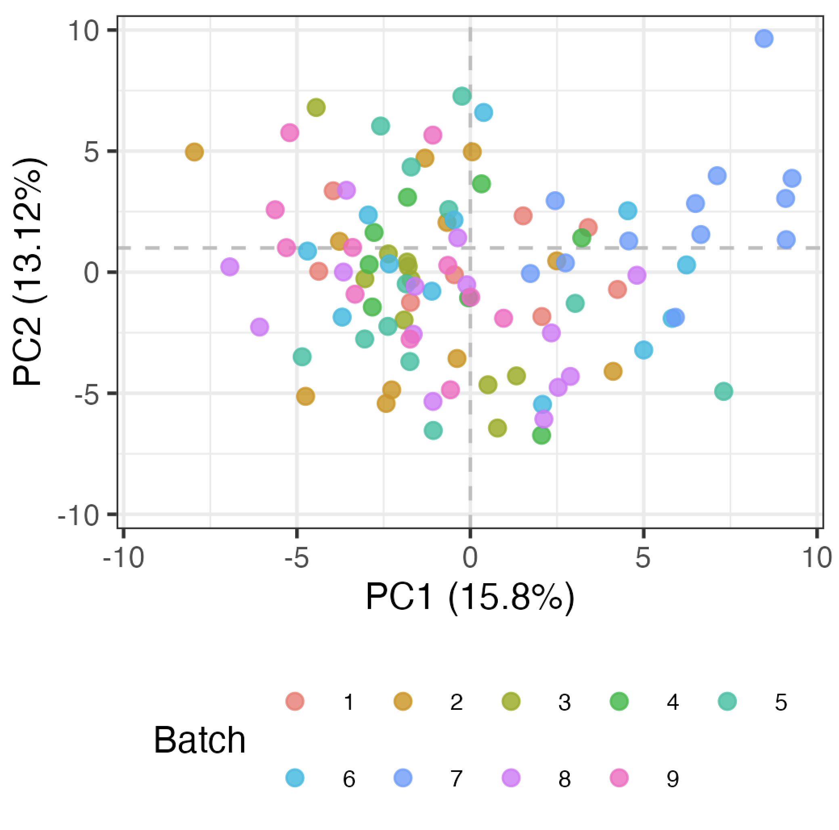
Some evidence of batch effects in baseline data

Slide 3
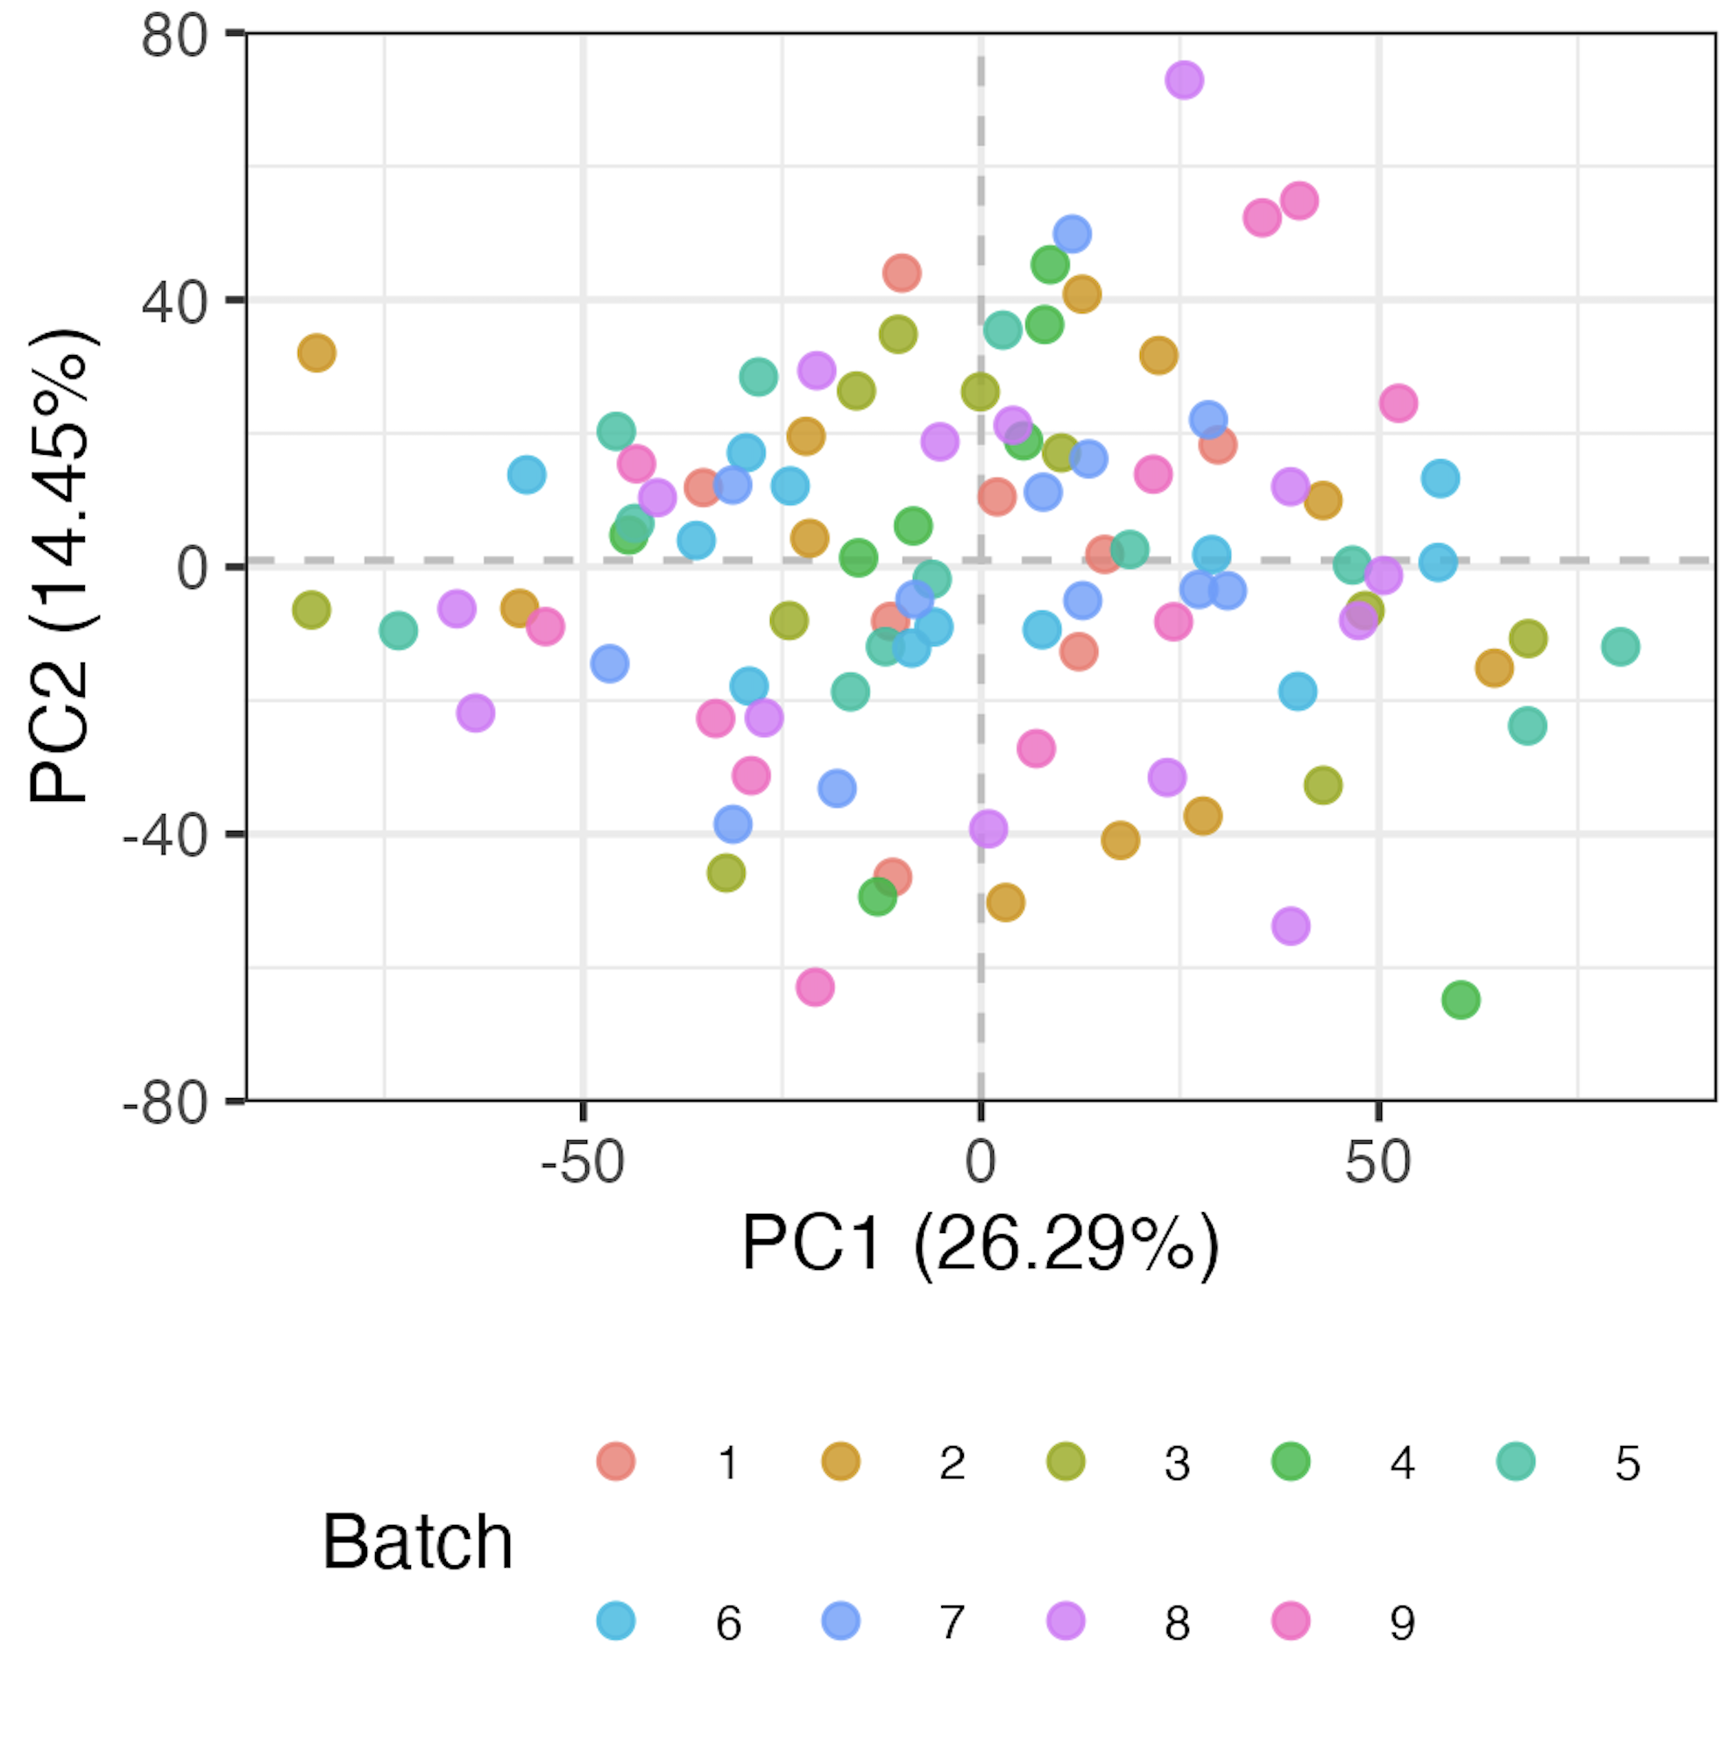
Regressing batch out
Batch not regressed out
Batch regressed out
Notes:
# run a linear model (lm(feature ~ batch)) with only batch as effect, then take residuals (i.e. all variation not explained by batch) as "batch-corrected" data
# did lose 12/~40 patients due to > 1 NA in > 1 feature (which screws up lm)

Slide 4
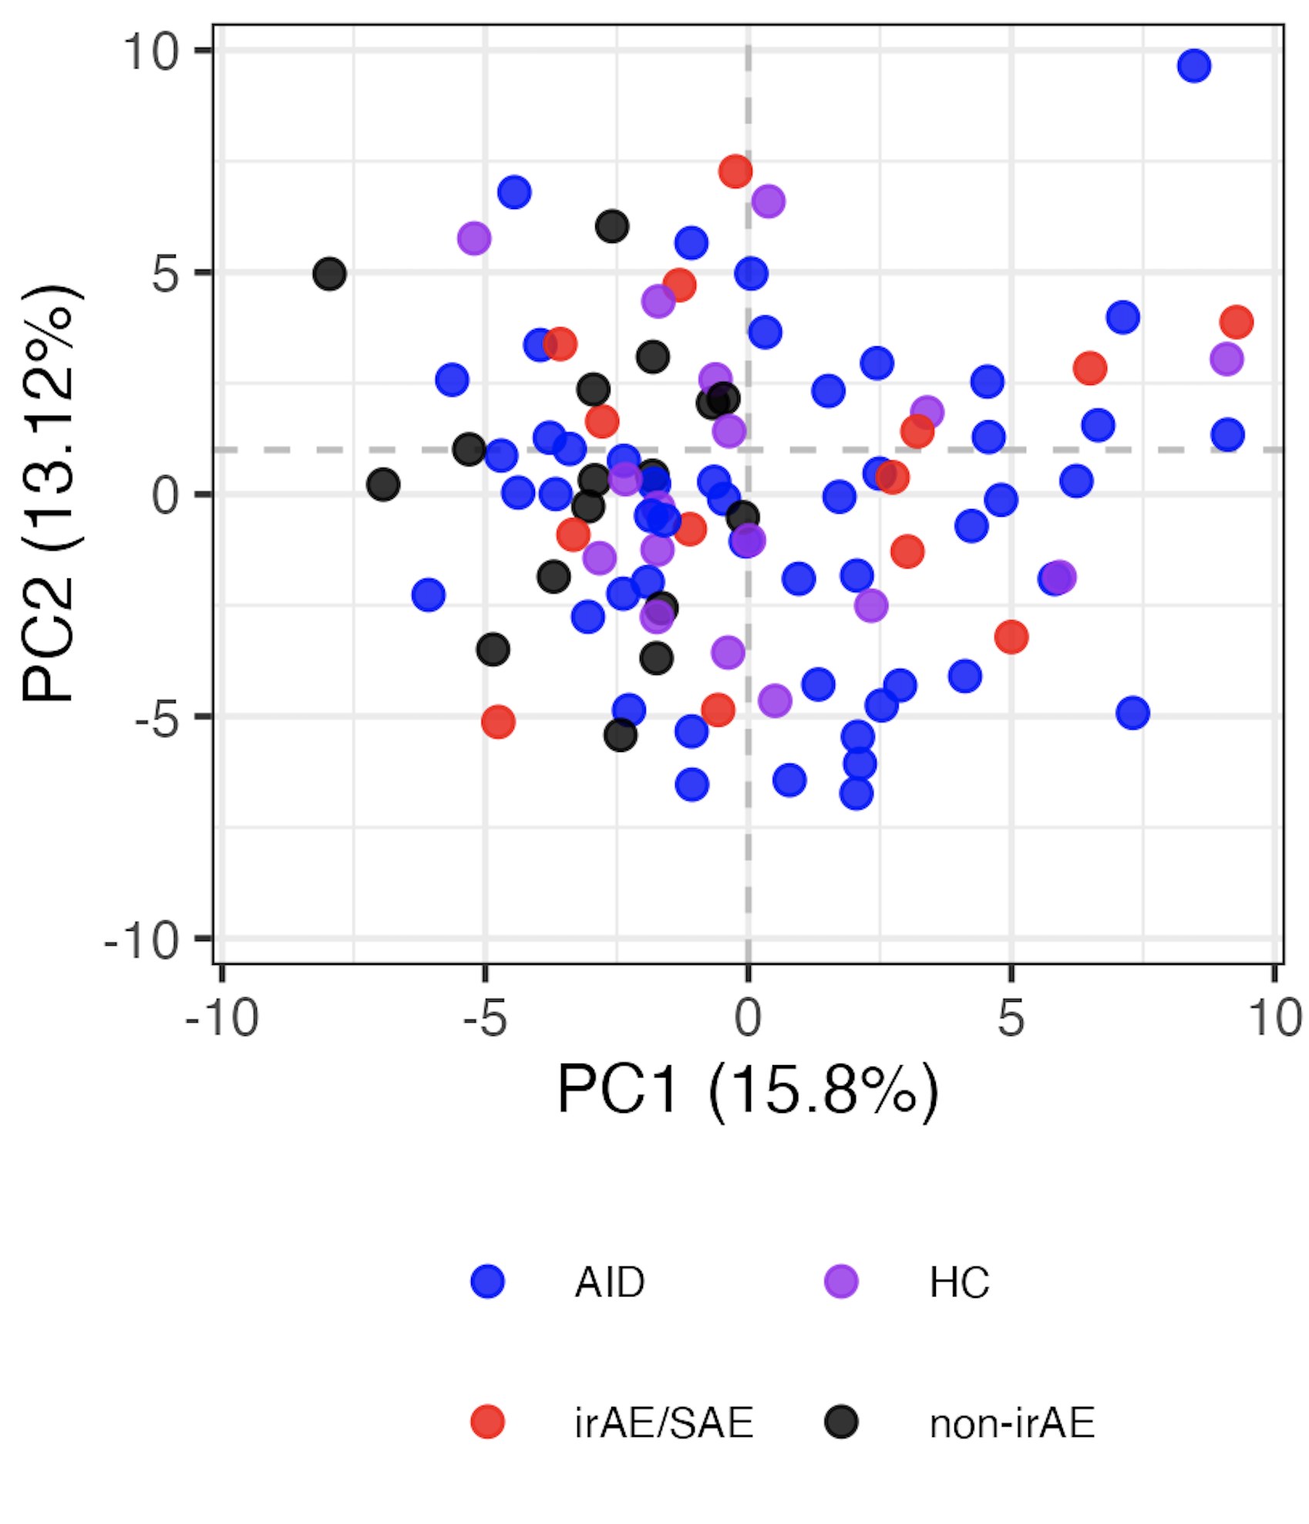
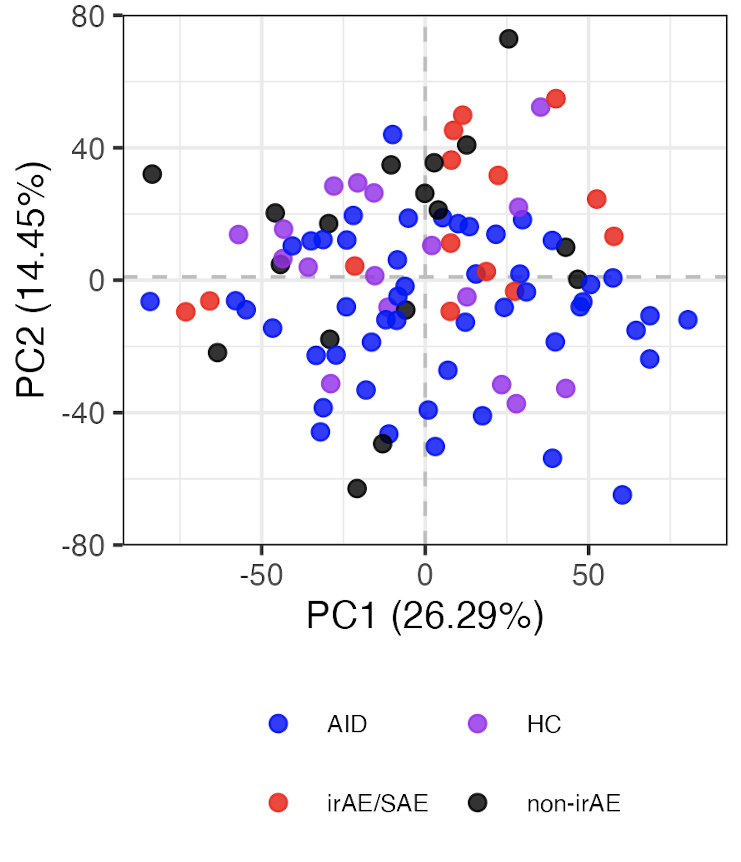
Regressing out batch from baseline samples doesn’t reveal clearly distinct immunotypes
Batch not regressed out
Batch regressed out
Notes:
Left is normal logit
Right is residuals from linear models with Batch as var/confounder

Slide 5
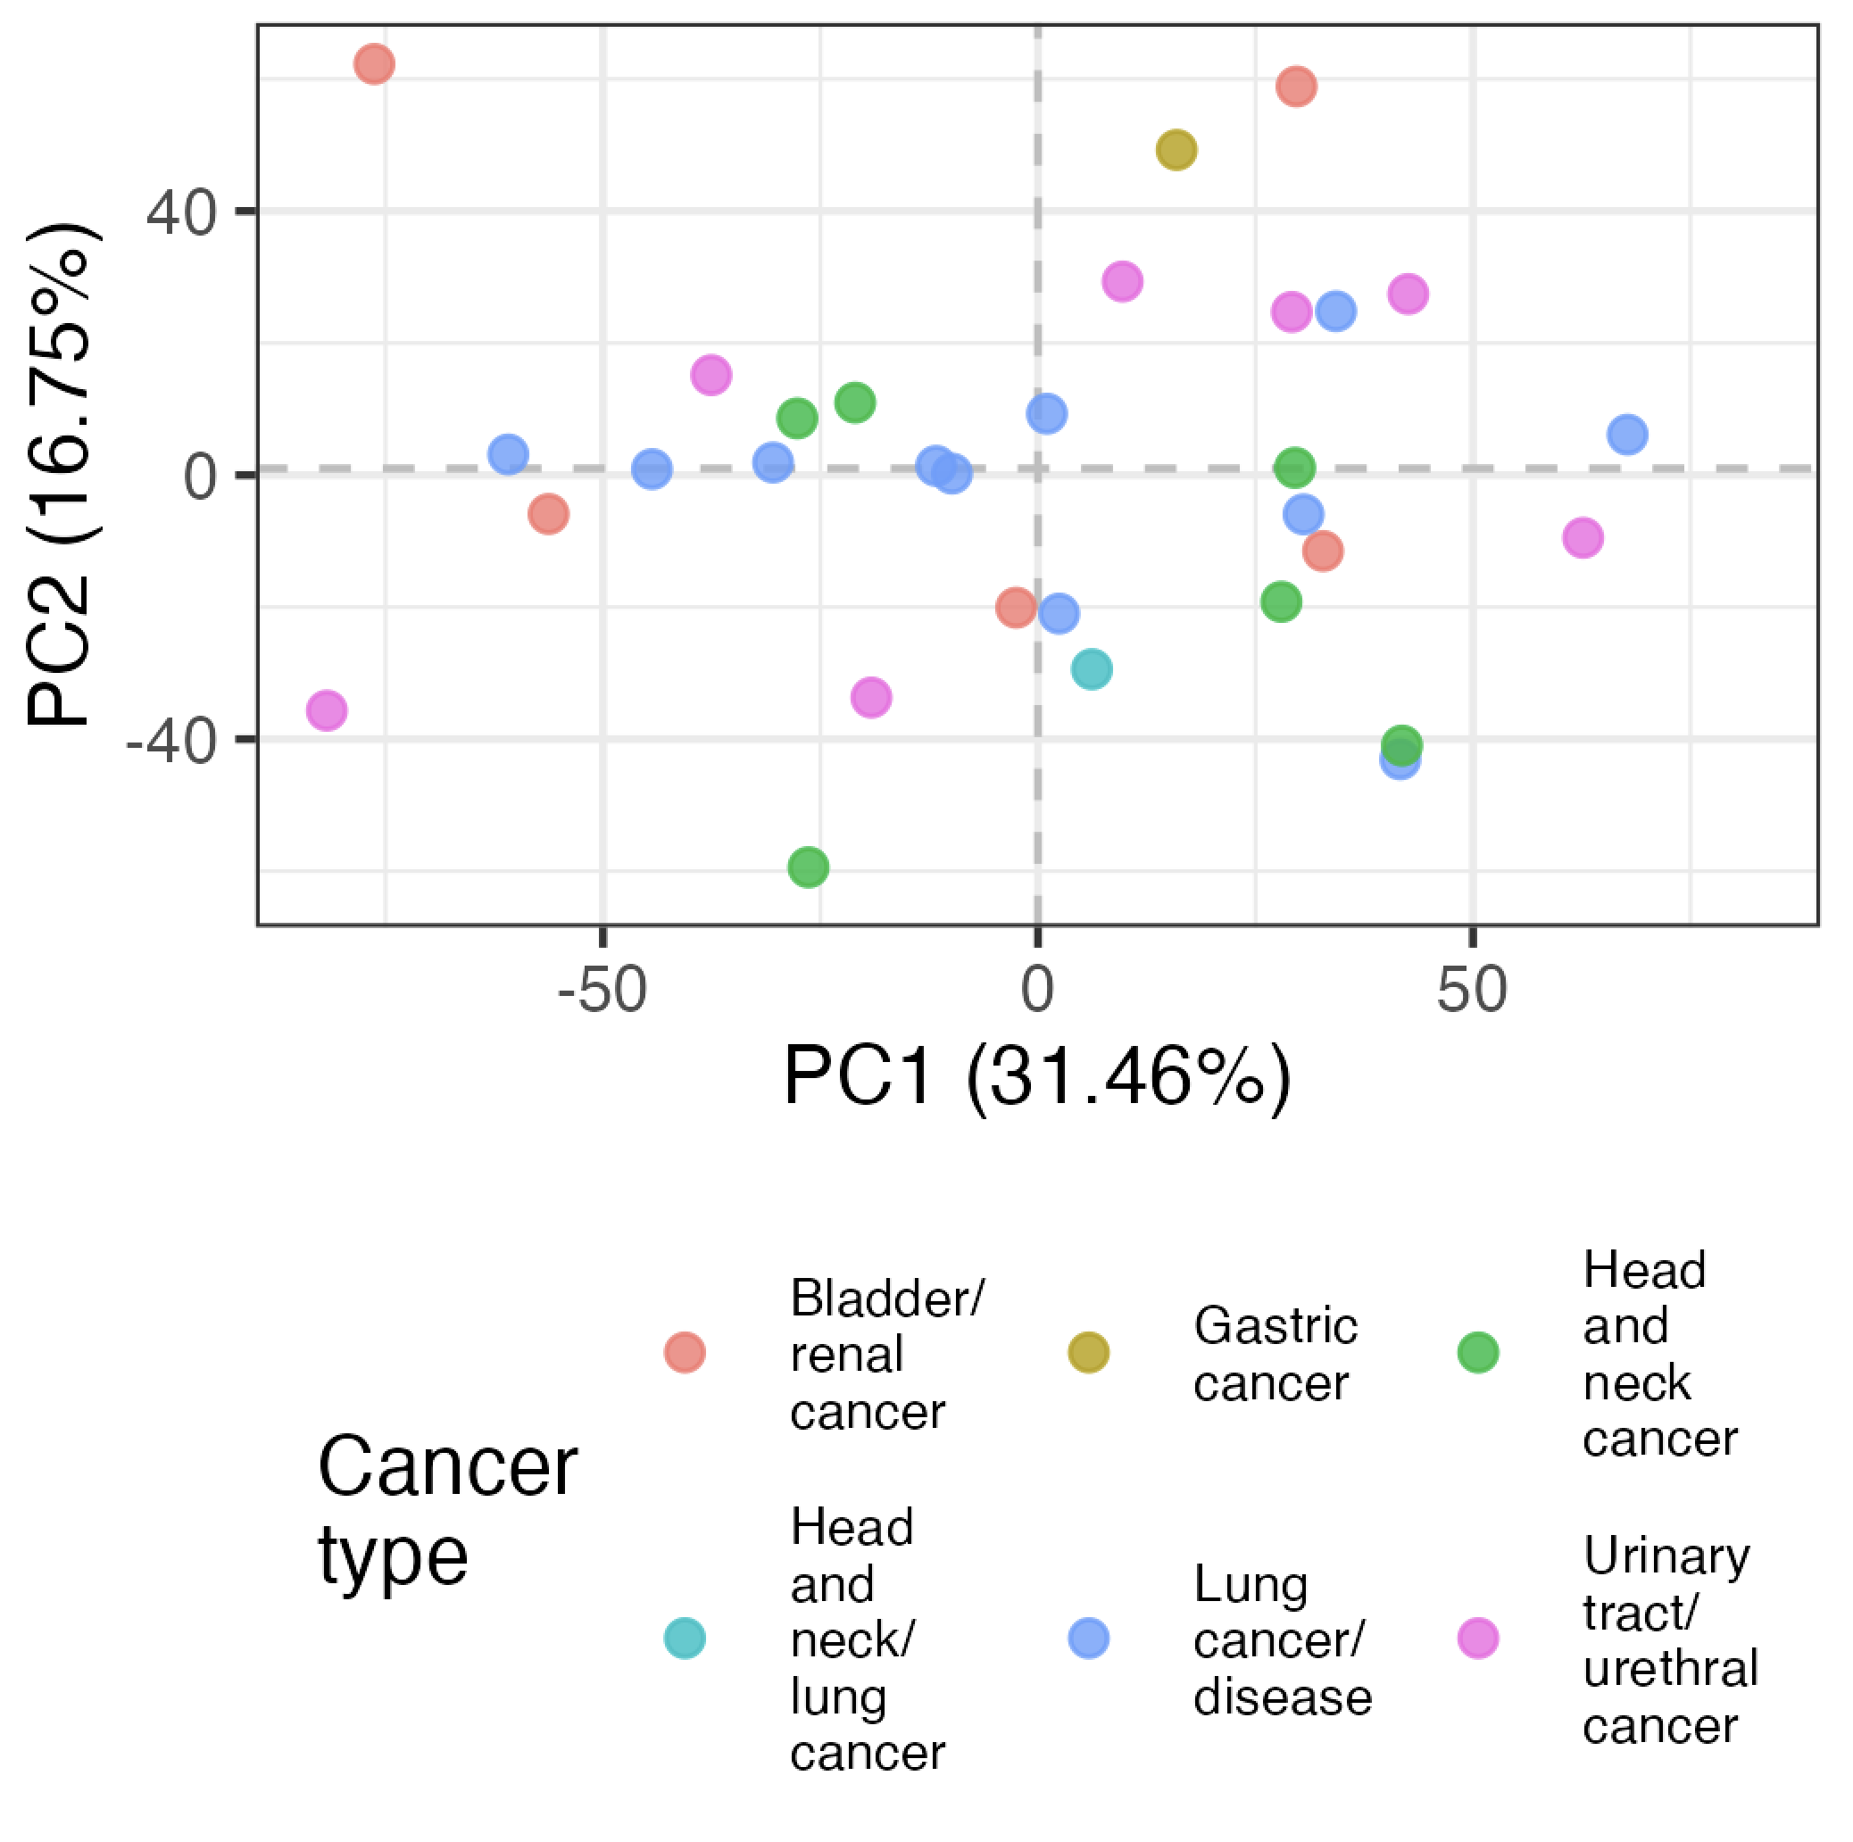
Cancer types don’t have distinct immunotypes either (baseline)
Batch regressed out
Notes:
LOGIT TRANSFORMED FREQS, batch regressed out, so residuals

Slide 6
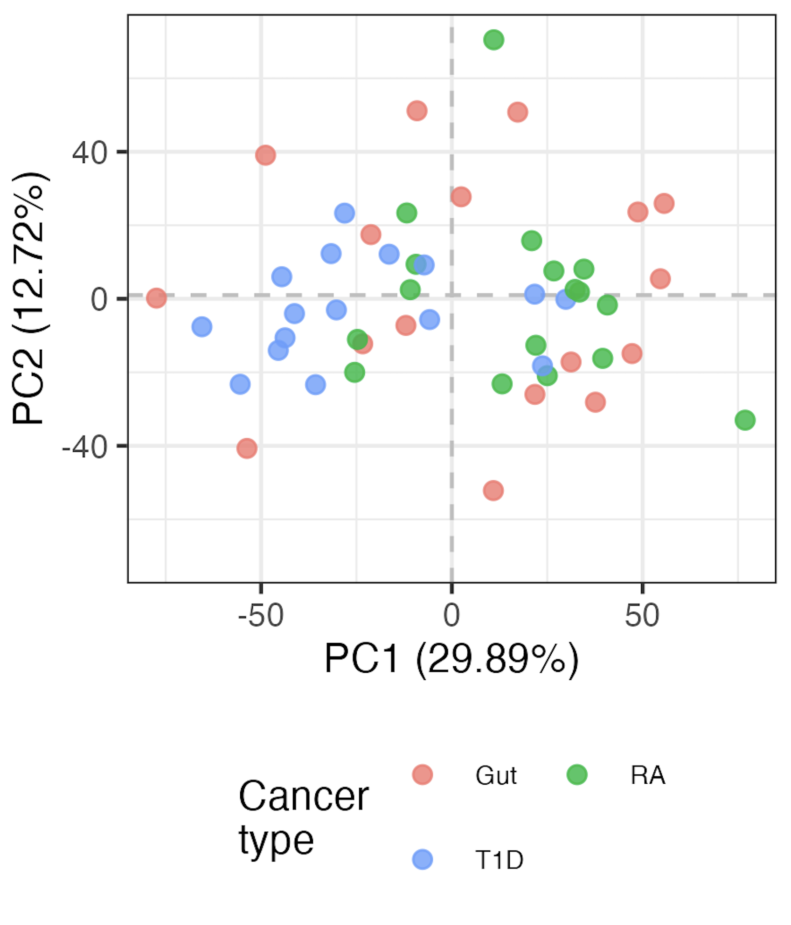
T1D and RA immunotypes may be somewhat distinct
Batch regressed out
Notes:
LOGIT TRANSFORMED FREQS, batch regressed out, so residuals

Slide 7
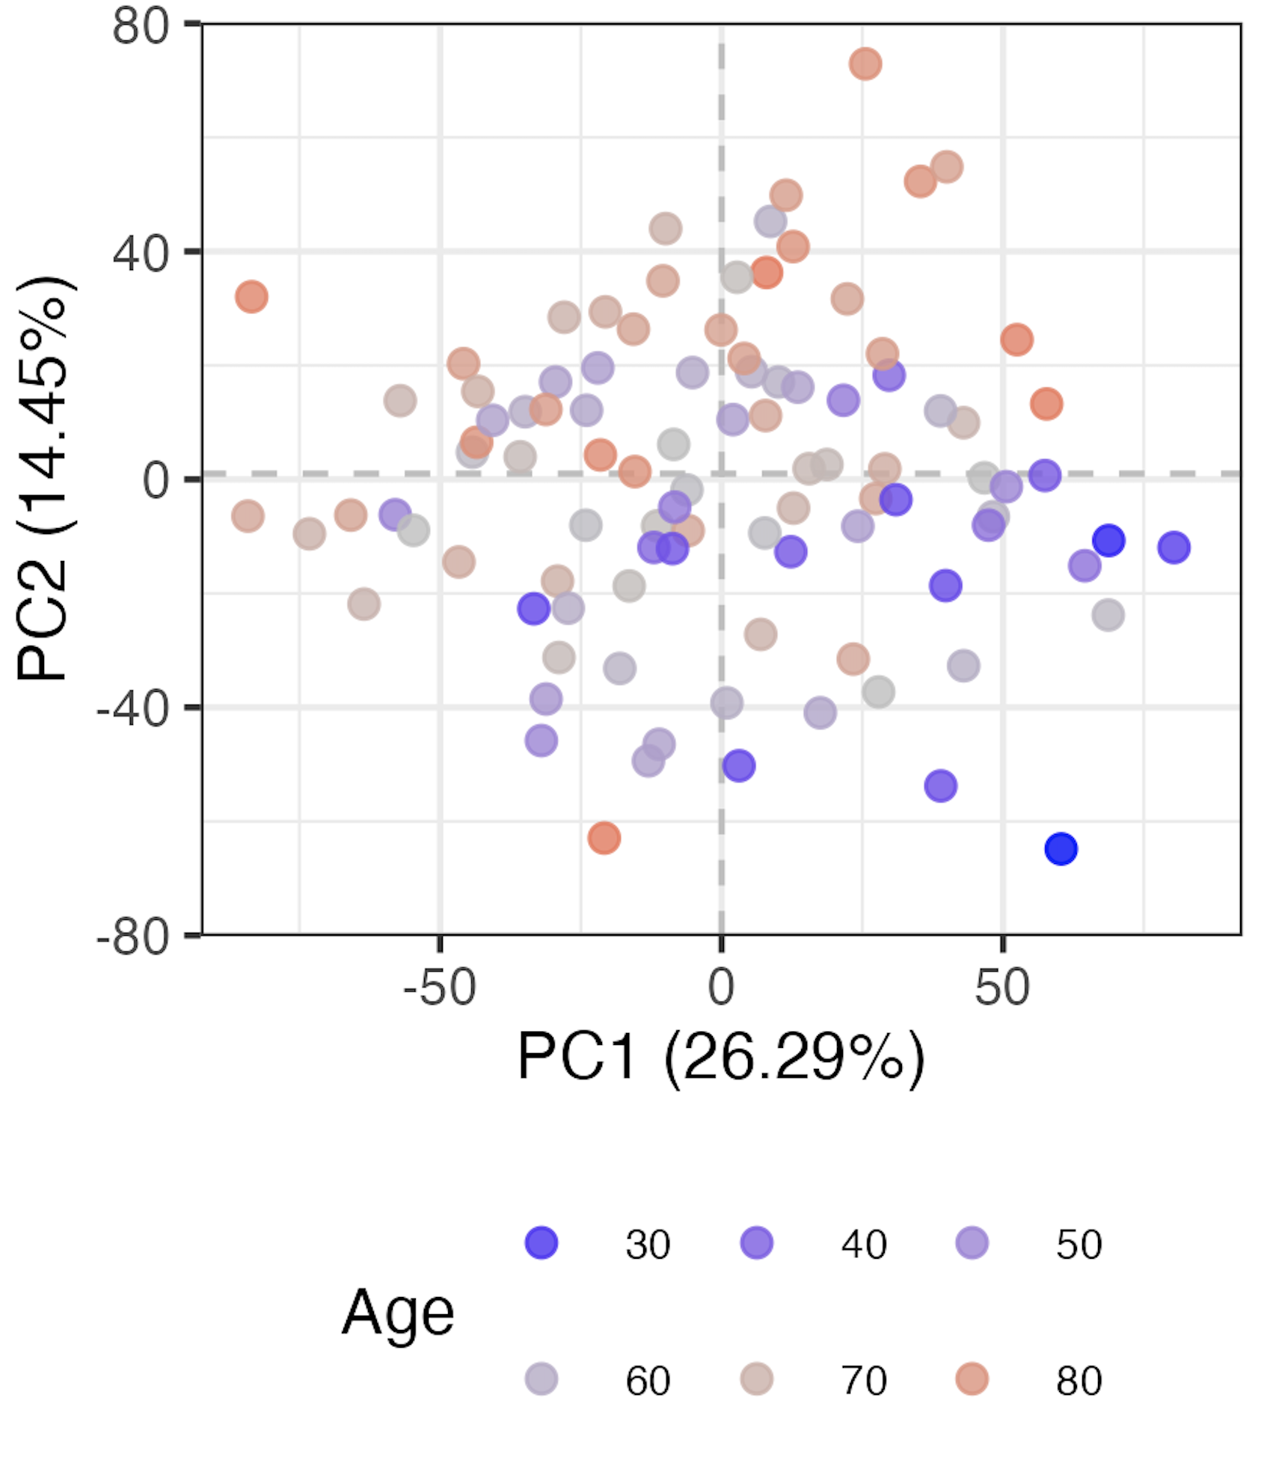
Age contributes to variation in immunotypes (baseline)
Batch regressed out

Slide 8
Conclusions
Baseline immunotypes are not distinct by study group, even after regressing batch out
cancer type immunotypes are not very distinct either
T1D and RA immunotypes may be somewhat distinct
age contributes to variation in immunotypes
data not shown, do not see…
baseline temporally-stable group differences (“subtract” ICI/ICI+group effects from baseline)
any subset frequencies correlating with CTCAE grade (baseline)
distinct baseline immunotypes by ICA (PCA alternative)
effect of previous treatment on baseline cancer immunotypes
distinct baseline immunotypes by study group even when including all features (even those with high technical variation)
Notes:
Also share that there were very few grade > 2 patients (2), so comparing their immunotypes vs. lower grade wasn’t fruitful unsurprisingly…
ICA’s goal is to max statistical independence b/w ICs (independent components, non-gaussian distributions, better for signal separation/feature extraction), PCA maximizes variance (orthogonal components, linear combos, better for data viz/noise reduction)

Slide 9
Next steps
IMPACD: using hierarchical/combinatorial gating, do we see distinct immunotypes by irAE group at baseline?
Notes:
Also ICI/ICI-group effects: update analyses w/ CTCAE irAE/SAE grade

Slide 10

Acknowledgements
Holly Akilesh
Long lab/HIPcore
Alice Long, Alice Wiedeman
Buckner lab
Jane Buckner, Sylvia Posso
Peter Linsley
Clinical team

Slide 11
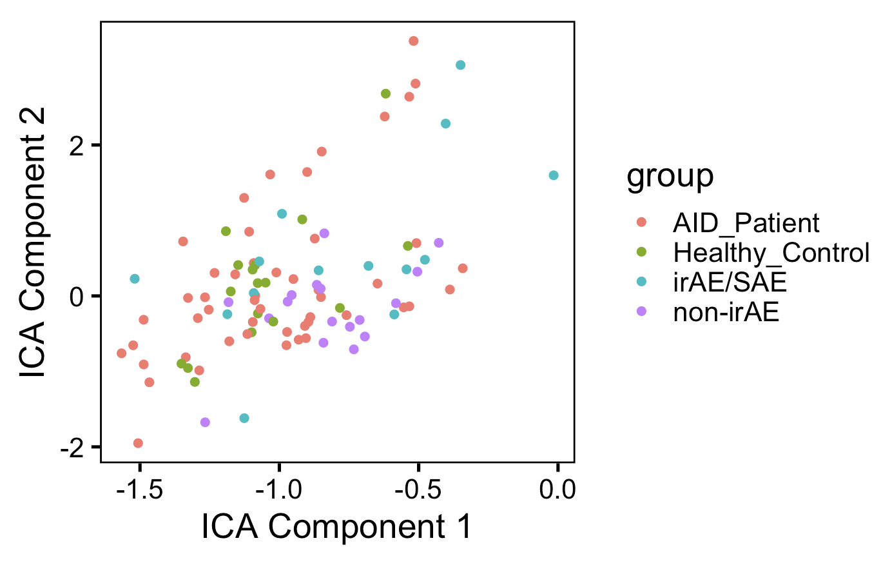
ICA doesn’t appear better at distinguishing unique immunotypes by group than PCA (baseline data)
Notes:
ICA’s goal is to max statistical independence b/w ICs (independent components, non-gaussian distributions, better for signal separation/feature extraction), PCA maximizes variance (orthogonal components, linear combos, better for data viz/noise reduction)

