Slide 1
NCI irAE literature review
10-24-2024
Ty Bottorff – Bioinformatics postdoc
Linsley lab

Slide 2
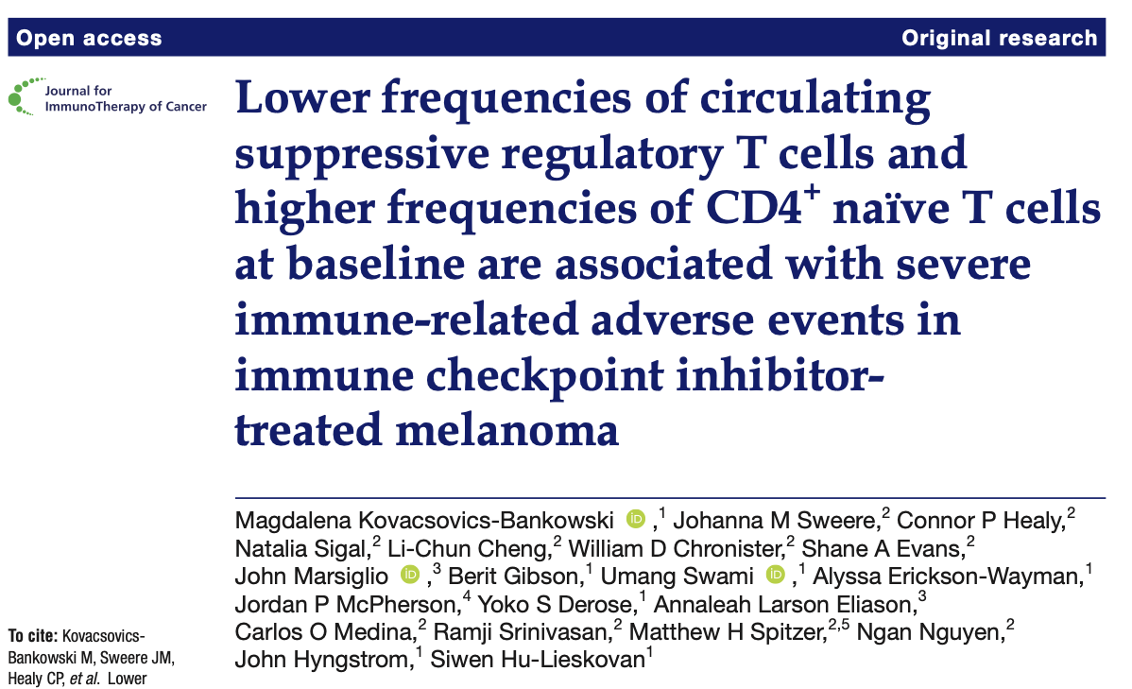
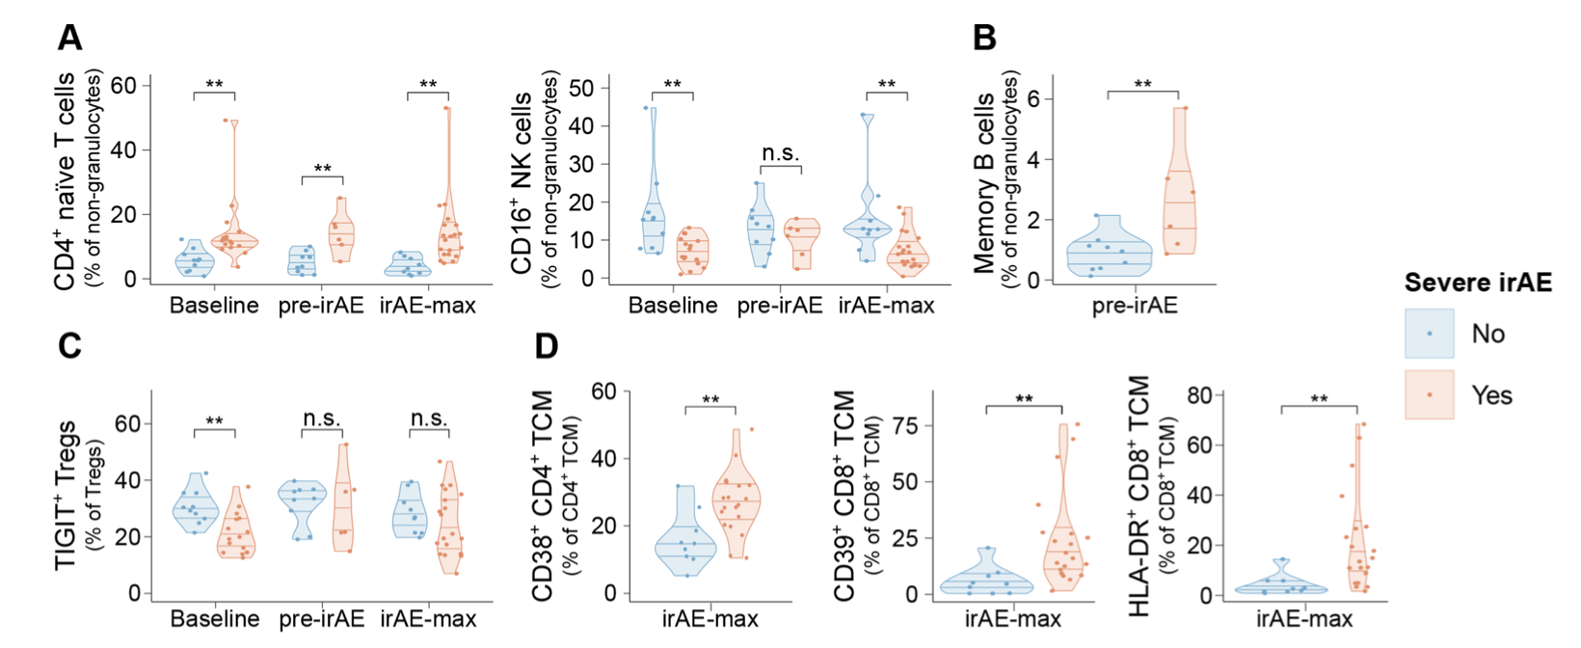
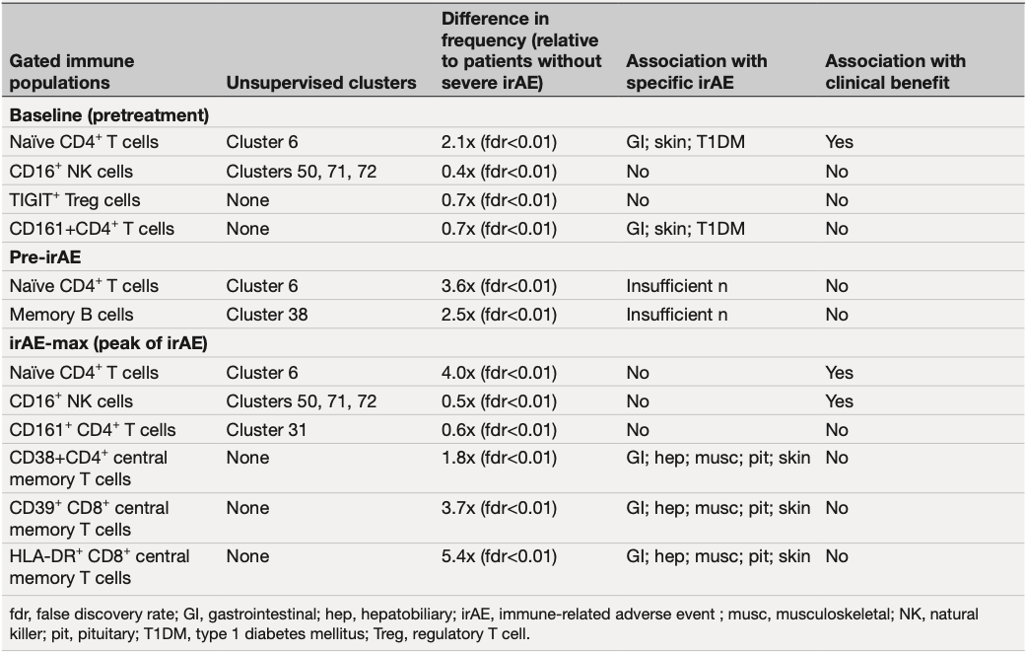
n: 18 (severe irAE), 11 (no severe irAE)
tissue studied: PBMCs
primary tumor type: melanoma
irAE types (in order of frequency): hepatobiliary, endocrine, cutaneous, musculoskeletal, gastrointestinal, pulmonary…
ICI intervention: ~70% anti-PD-1, ~30% combination anti-PD-1/anti-CTLA-4
technologies: 43-marker mass cytometry → FlowSOM/manual gating
cell types implicated: naïve CD4s, CD16⁺ NKs, memory B cells, CD38⁺ CD4 TCMs, CD39⁺ CD8 TCMs, HLA-DR⁺ CD8 TCMs
Notes:
Severe irAE means > grade 2 and required immunosuppression and/or permanent medical intervention
FlowSOM appears to generate clusters of cells (75 clusters here) that they then identify as being a specific cell type somehow?
Cluster 6 defined by CCR7hi, CD27hi, CD45RAhi, CD28med, CD127med, CD56med, CD38med (low activation?)
There were 2 other CD16+ NK clusters that showed similar results
Cluster 50 is CD16hiCD56loCD161hiGZMBmedCD38medTbetloCD57neg (less mature), other 2 clusters are different in sense of being CD57hiCD161med, among other differences unique to clusters (more mature)
Pre-irAE median # ICI cycles/patient 3.5 (range 1-5) for severe irAE and 2 (range 1-3) for no severe irAE
irAE-max: median # of ICI cycles/patient was 4 (range 1-13) for severe irAE, 6 (range 3-8) for no severe irAE
Actually 28 patients but 1 had 2 lines of treatment?

Slide 3
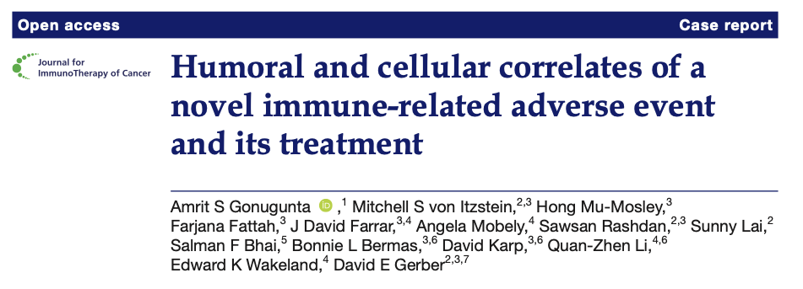
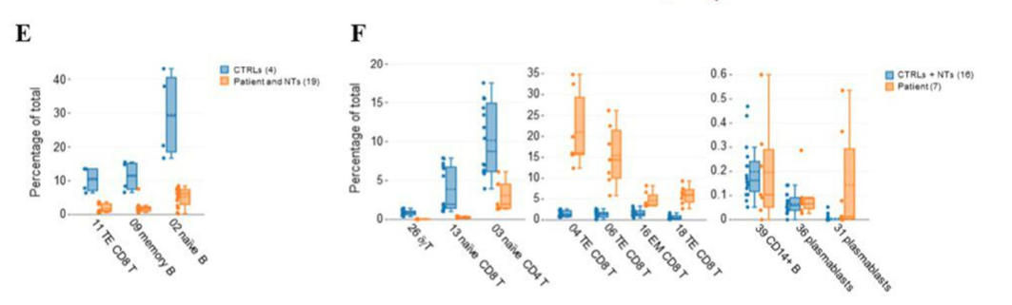
n: 1 (irAE), 2 (no irAE), 2 (HCs)
tissue studied: PBMCs
primary tumor type: lung
irAE type: delayed-onset visual
ICI intervention: anti-PD-1
technologies: CyTOF, autoantigen array, cytokine/chemokine
cell types implicated: CD8s, plasmablasts
cytokines implicated: IL-6, IFNγ, CXCL2, CCL17
autoantibodies implicated: angiotensin receptor, alpha-actin, amyloid
Notes:
Corticosteroids decreased inflammatory cells, cytokines, autoantibodies
NT means no toxicity/irAE, so they grouped and compared HCs vs. ICI-treated, so these are just ICI effects…??

