Slide 1
Weekly meeting
6 13 2024
Ty Bottorff

Slide 2
Outline
P576
MT sequence variant analyses
R vs. NR DARs (across cell sorts)

Slide 3
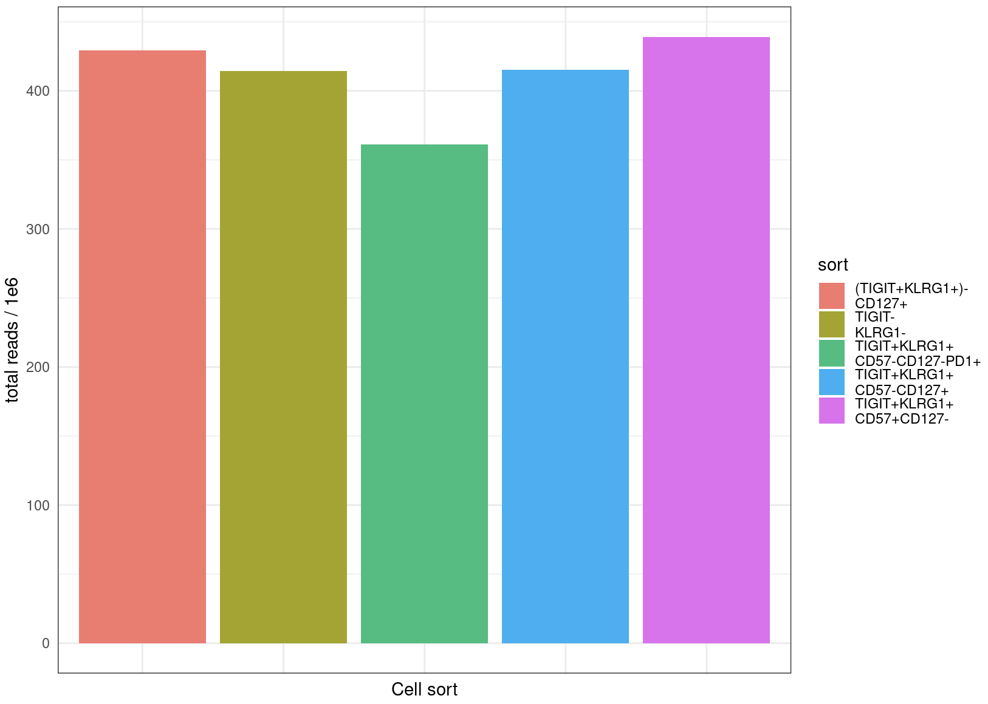
Read counts are comparable between cell sorts

Slide 4
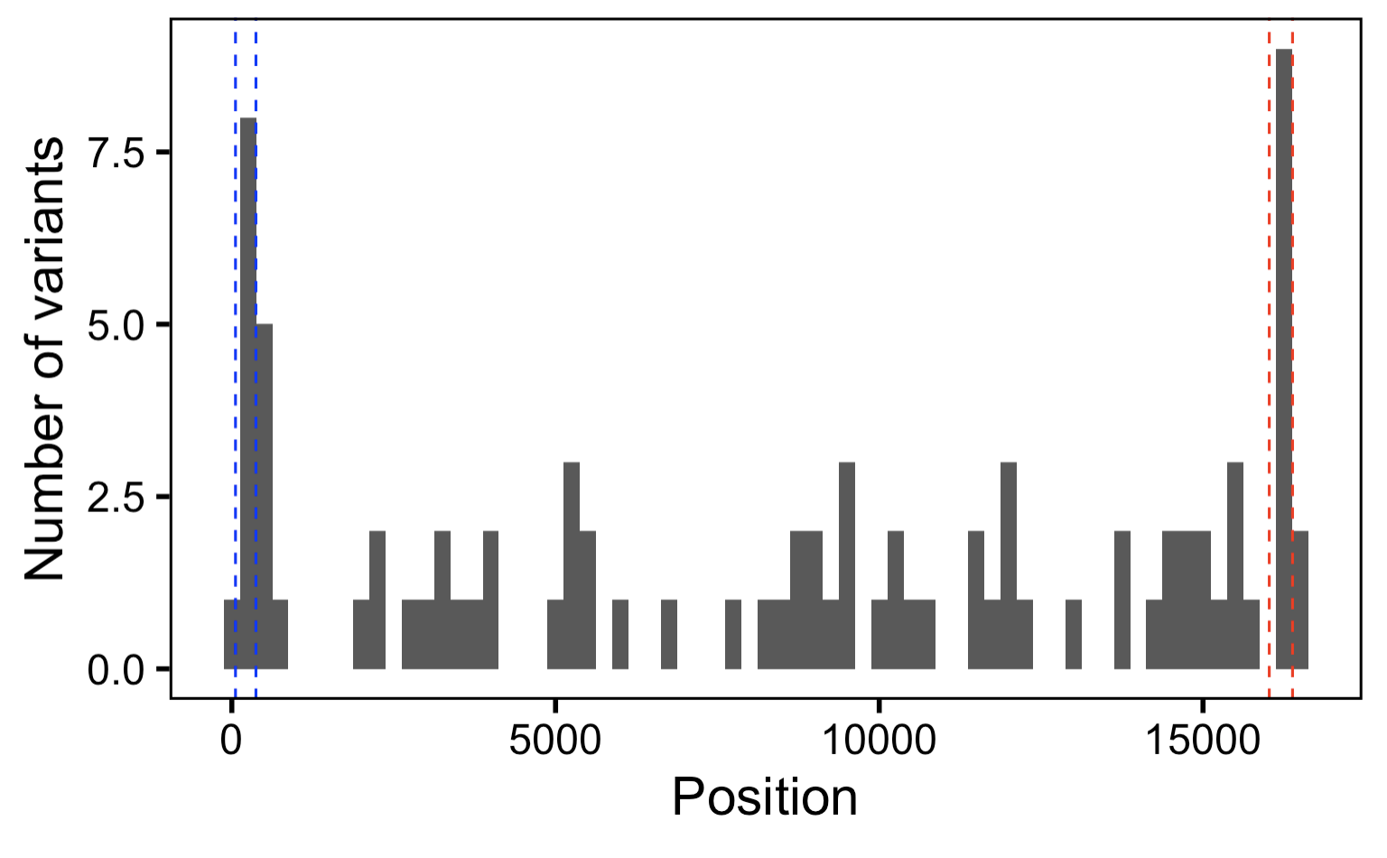
As expected, do observe more MT variants within hypervariable regions
HV2
HV1
Notes:
Bin width 250 bp

Slide 5
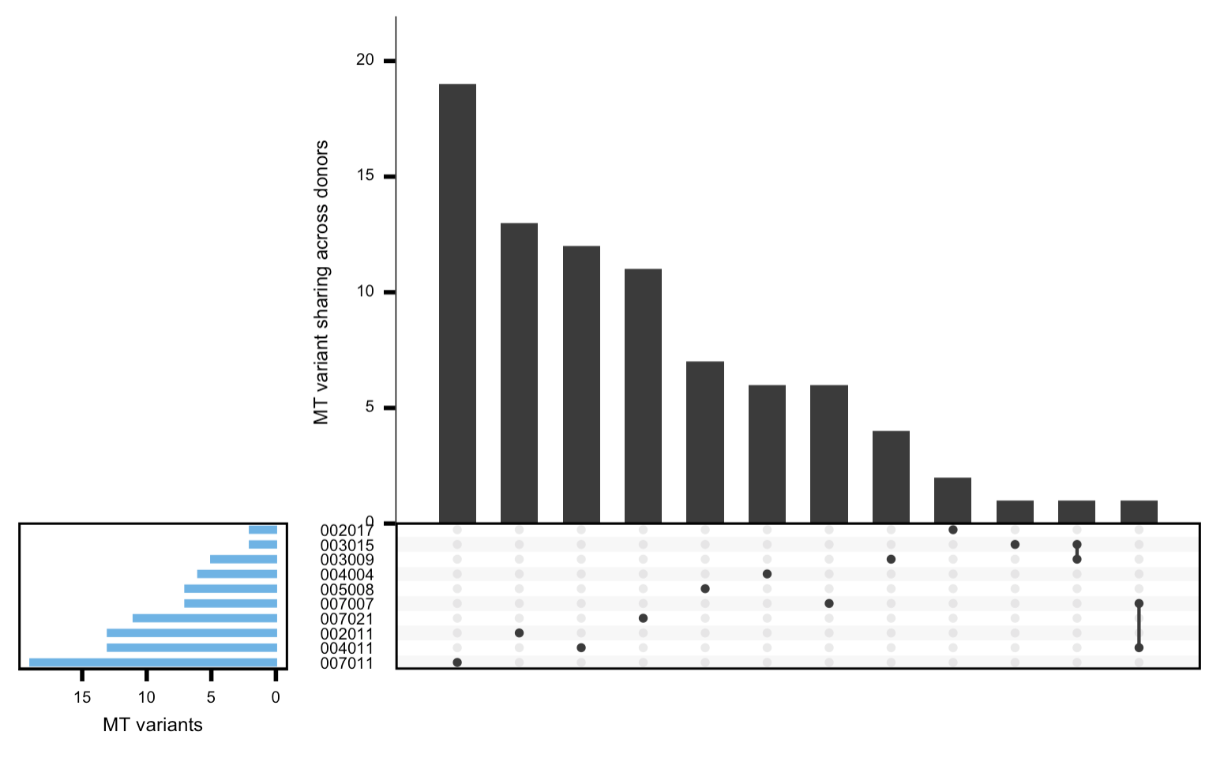
As expected, most MT variants are private within a donor

Slide 6
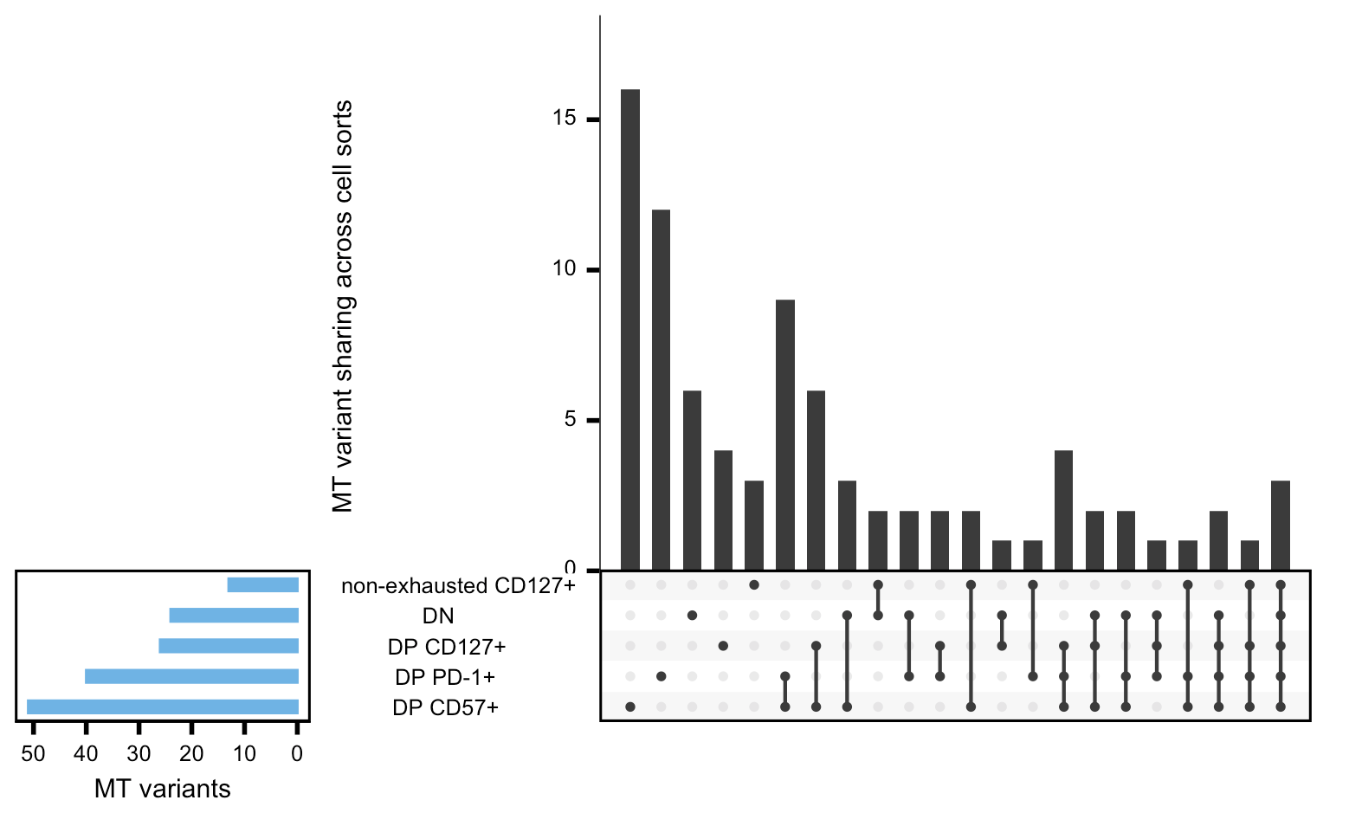
With more stringent parameters, obtain many fewer variants but still observe similar trends (DPs PD-1⁺/CD57⁺ high sharing, all 3 DPs high sharing)
Notes:
--min_coverage 20 (was 8 previously, default) --min-var-freq 0.01 --p-value 0.1 (was 0.99 previously, default)
AND
Now filtering based on ref AND var
var_supporting_reads_on_plus_strand > 2,
var_supporting_reads_on_minus_strand > 2,
ref_supporting_reads_on_plus_strand > 2,
ref_supporting_reads_on_minus_strand > 2,
var_supporting_reads_on_plus_strand / (var_supporting_reads_on_plus_strand + var_supporting_reads_on_minus_strand) > 0.3,
var_supporting_reads_on_plus_strand / (var_supporting_reads_on_plus_strand + var_supporting_reads_on_minus_strand) < 0.7,
ref_supporting_reads_on_plus_strand / (ref_supporting_reads_on_plus_strand + ref_supporting_reads_on_minus_strand) > 0.3,
ref_supporting_reads_on_plus_strand / (ref_supporting_reads_on_plus_strand + ref_supporting_reads_on_minus_strand) < 0.7)

Slide 7
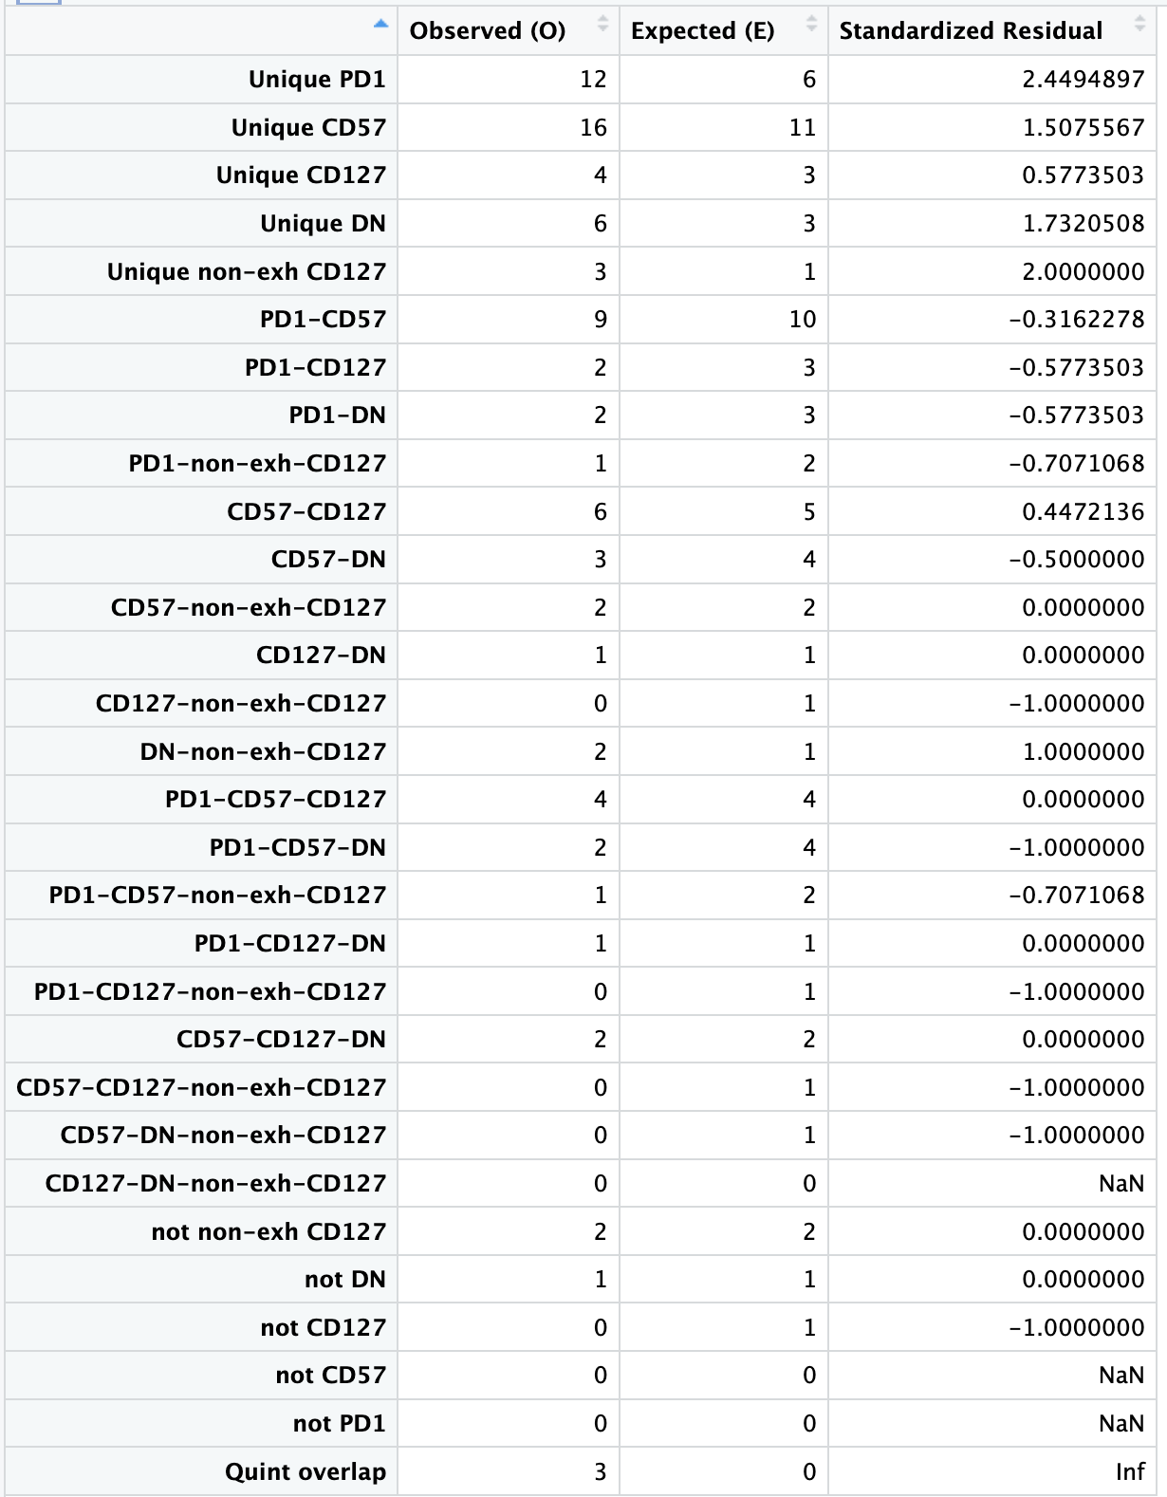
However, trends do seem to just be due to different set sizes (O ~= E), although there are more unique variants/cell sort than expected

Slide 8
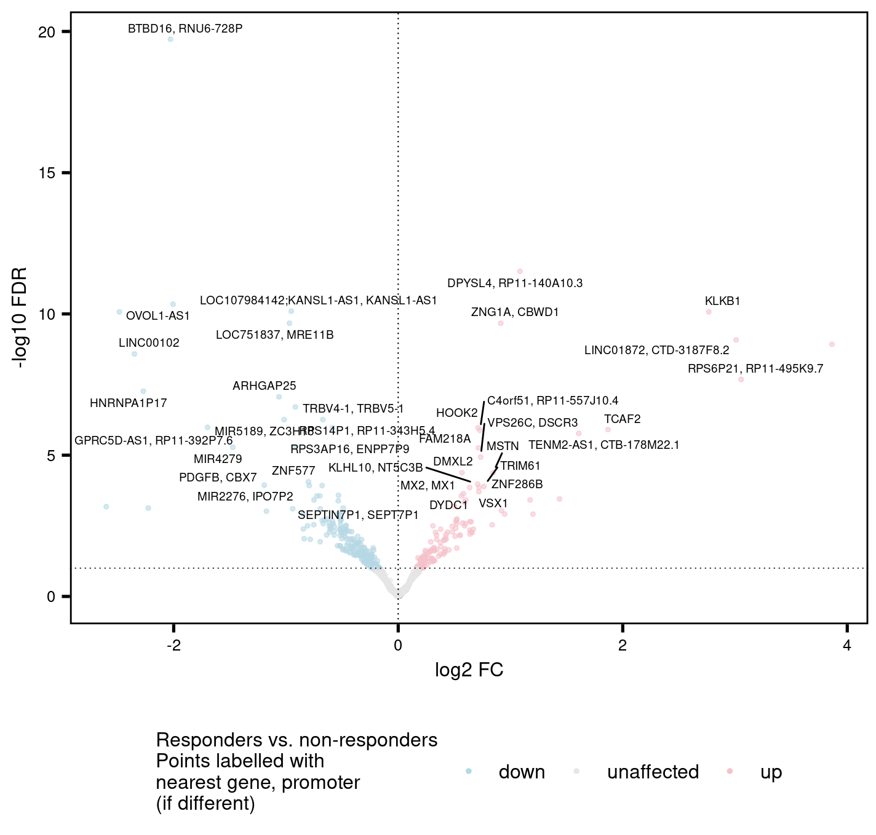
Obtain more DARs between R and NR looking across all cell sorts
KEGG analysis yielded no enriched pathways
potentially interesting hits
BTB16 nearby the 10q26.13 T1D susceptibility locus
DPYSL4 associated with T1D progression, see figure 2B
TRBV genes (4-1/2, 5-1, 6-1) less accessible in responders

Slide 9
Conclusions
TIGIT⁺KLRG1⁺ non-naïve CD8 counts not different between irAE groups in Luoma (2020), Cell colitis or Zhu (2022), Circulation myocarditis datasets (data not shown)
Consistent trends across sensitivity analyses
DP CD57⁺ has the most MT variants, followed by DP PD-1⁺, these are most “terminal”
DN/non-exhausted CD127⁺ have the least MT variants, these are most like reference
so, we can conclude that these pairs of sorts are at opposite ends of cell differentiation pathway (consistent with previous evidence/models)
*ideally would be able to use DN as MT reference but lack full DN MT genome sequence
Obtain few hundred DARs between R & NR across all cell sorts
Some top hits may indicate that T1D progression-associated genes (BTB16, DPYSL4) are being picked up as DARs between R & NR, perhaps unsurprisingly

Slide 10
Next steps
P576: investigate changes in results post-regressing out covariates (replicate, also cell sort (Tissue) or responder status (Condition) for the other’s analysis)
So far results seem similar (qualitatively) but do expect/observe differences (quantitatively)
Old code
R vs. NR analysis: consensusPeaks_obj = dba.contrast(consensusPeaks_obj, design = c(“0 + Condition”)
Cell sort analysis: consensusPeaks_obj = dba.contrast(consensusPeaks_obj, design = c(“0 + Tissue”)
New code (use of design param causes block param to be ignored)
R vs. NR analysis: consensusPeaks_obj = dba.contrast(consensusPeaks_obj, categories = DBA_CONDITION, block = c(DBA_REPLICATE, DBA_TISSUE), reorderMeta = list(Condition = “Yes”))
Cell sort analysis: consensusPeaks_obj = dba.contrast(consensusPeaks_obj, categories = DBA_TISSUE, block = c(DBA_REPLICATE, DBA_CONDITION))

