Slide 1
Weekly meeting
6 13 2024
Ty Bottorff

Slide 2
Outline

Slide 3
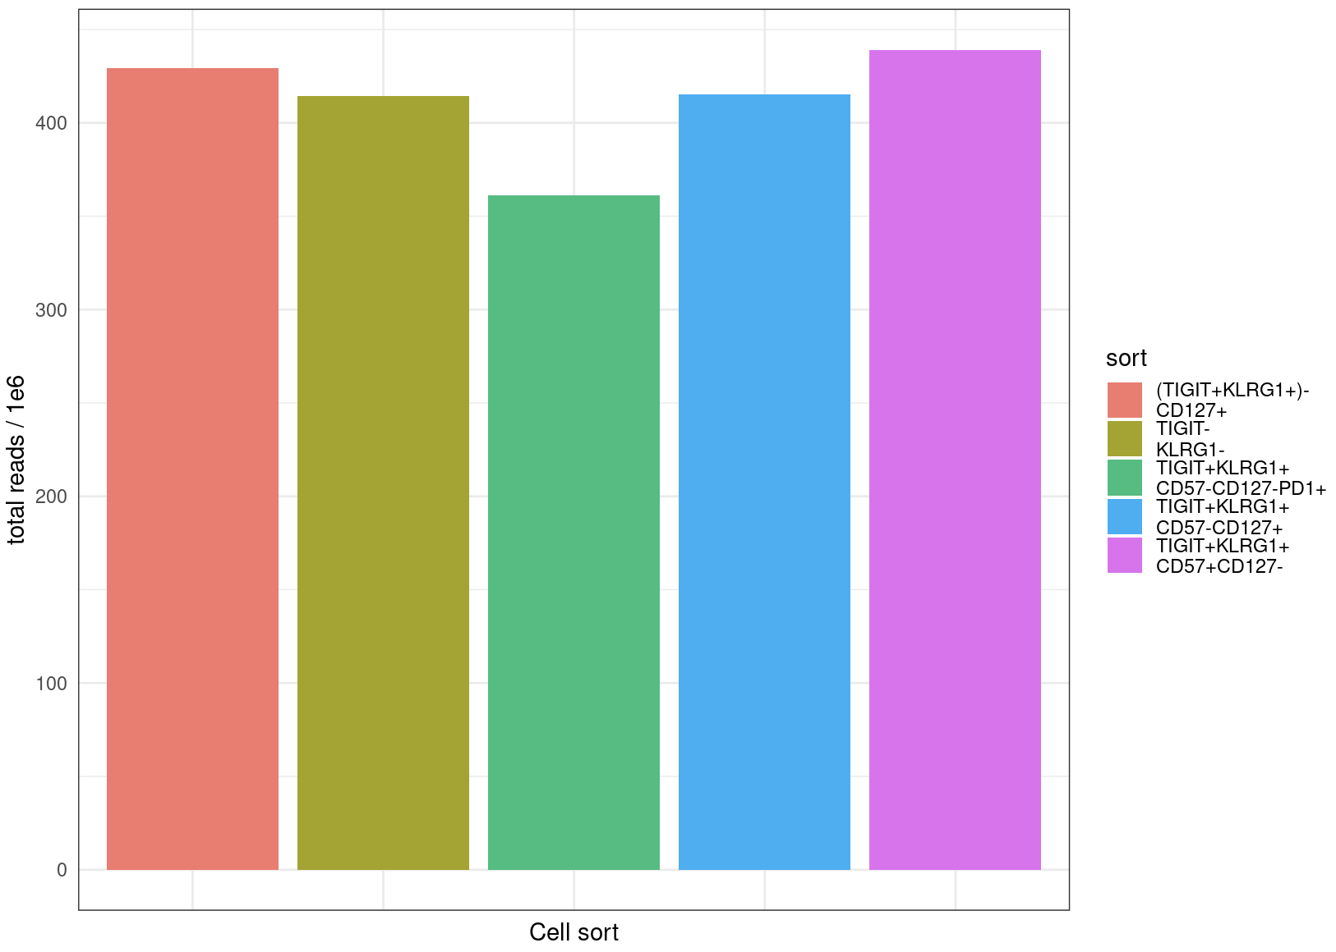
Read counts are comparable between cell sorts

Slide 4
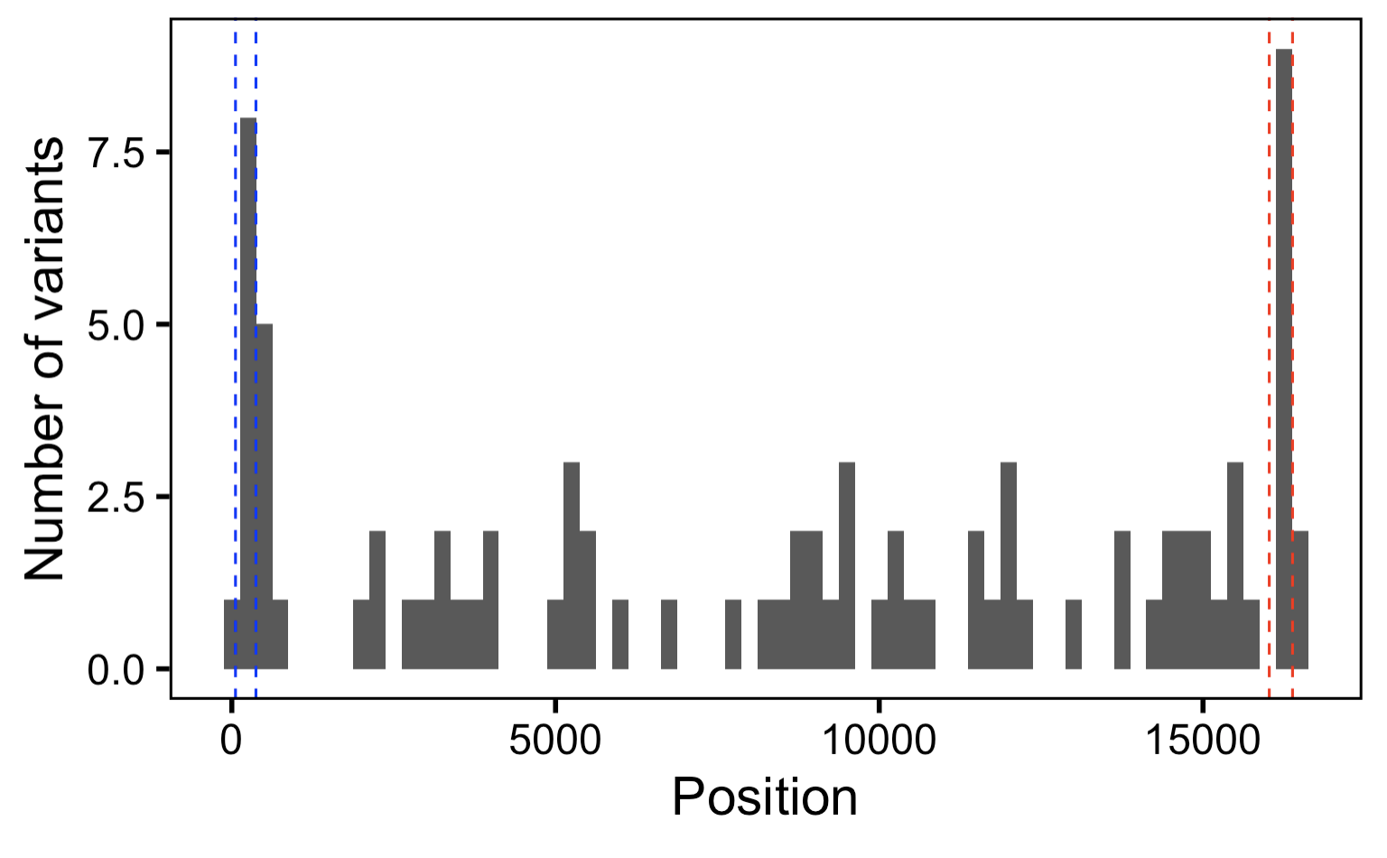
As expected, do observe more MT variants within hypervariable regions
HV2
HV1
Notes:
Bin width 250 bp

Slide 5
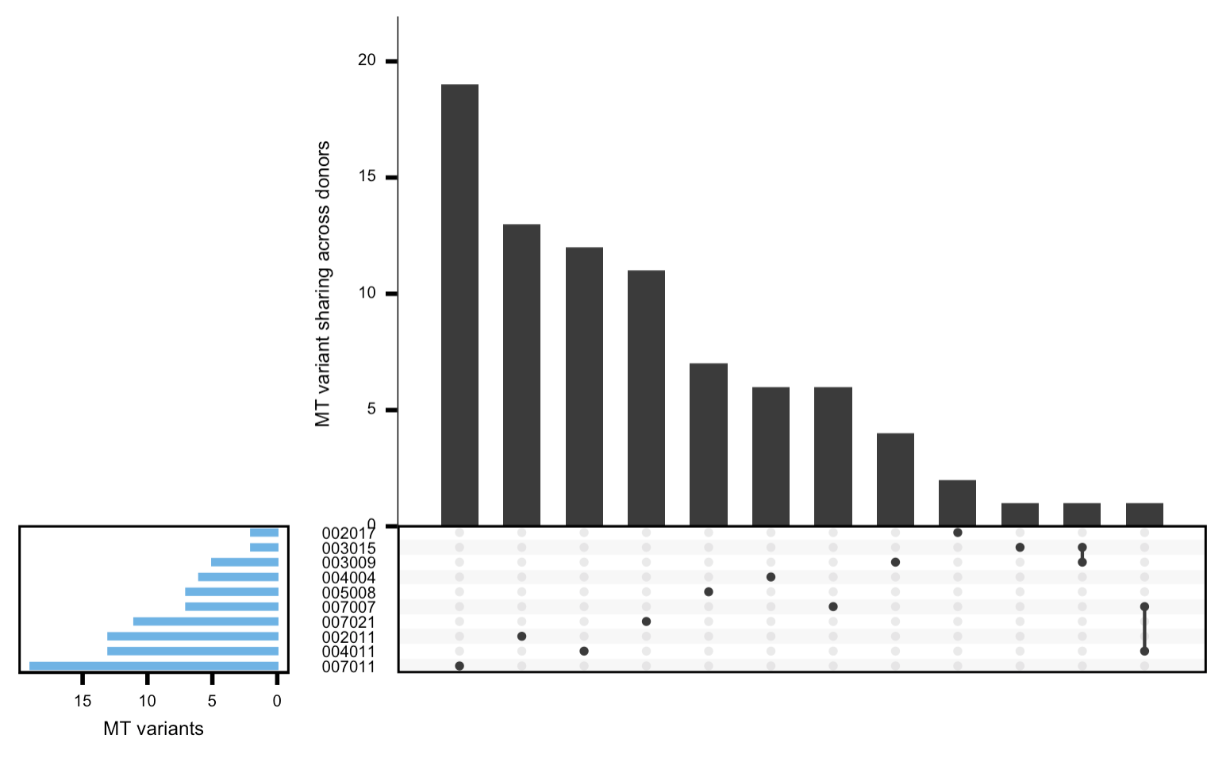
As expected, most MT variants are private within a donor

Slide 6
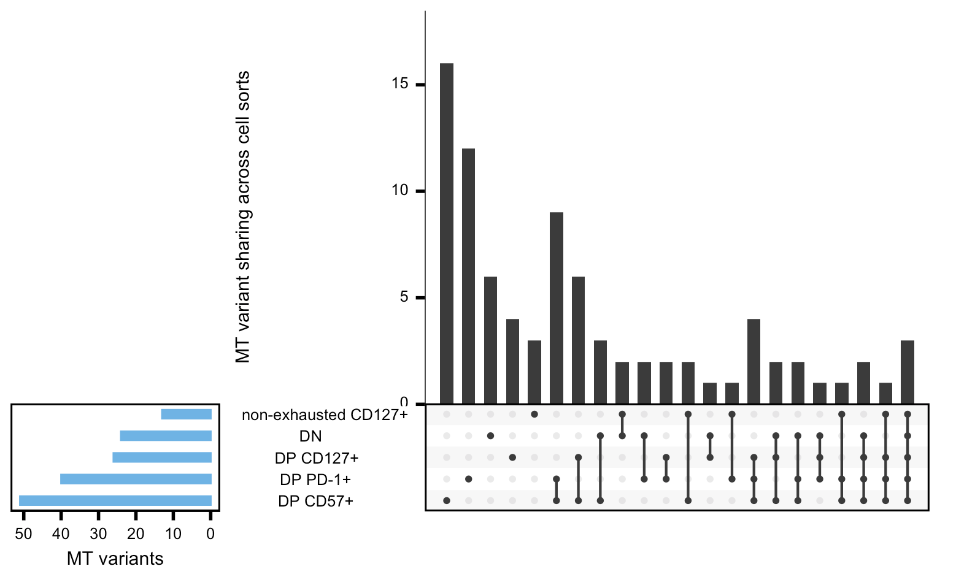
With more stringent parameters, obtain many fewer variants but still observe similar trends (DPs PD-1⁺/CD57⁺ high sharing, all 3 DPs high sharing)
Notes:
--min_coverage 20 (was 8 previously, default) --min-var-freq 0.01 --p-value 0.1 (was 0.99 previously, default)
AND
Now filtering based on ref AND var
var_supporting_reads_on_plus_strand > 2,
var_supporting_reads_on_minus_strand > 2,
ref_supporting_reads_on_plus_strand > 2,
ref_supporting_reads_on_minus_strand > 2,
var_supporting_reads_on_plus_strand / (var_supporting_reads_on_plus_strand + var_supporting_reads_on_minus_strand) > 0.3,
var_supporting_reads_on_plus_strand / (var_supporting_reads_on_plus_strand + var_supporting_reads_on_minus_strand) < 0.7,
ref_supporting_reads_on_plus_strand / (ref_supporting_reads_on_plus_strand + ref_supporting_reads_on_minus_strand) > 0.3,
ref_supporting_reads_on_plus_strand / (ref_supporting_reads_on_plus_strand + ref_supporting_reads_on_minus_strand) < 0.7)

Slide 7
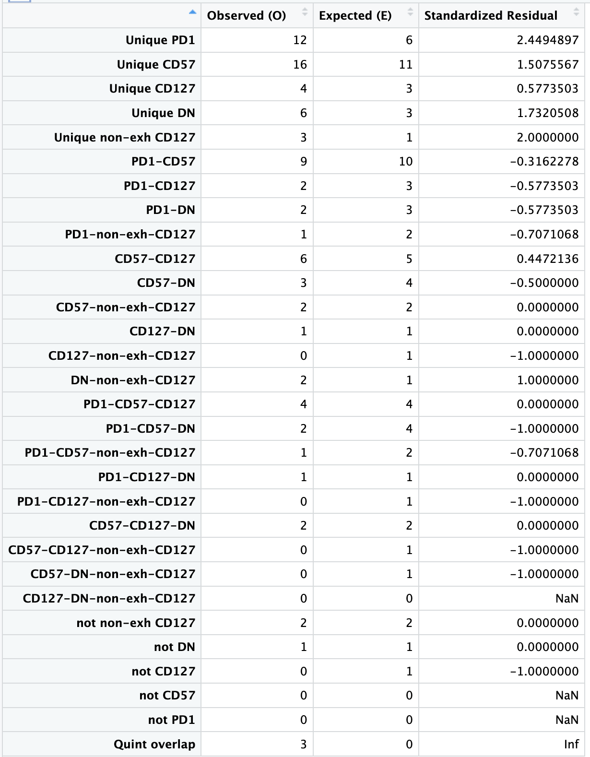
However, trends do seem to just be due to different set sizes (O ~= E), although there are more unique variants/cell sort than expected
Notes:
--min_coverage 20 (was 8 previously, default) --min-var-freq 0.01 --p-value 0.1 (was 0.99 previously, default)
AND
Now filtering based on ref AND var
var_supporting_reads_on_plus_strand > 2,
var_supporting_reads_on_minus_strand > 2,
ref_supporting_reads_on_plus_strand > 2,
ref_supporting_reads_on_minus_strand > 2,
var_supporting_reads_on_plus_strand / (var_supporting_reads_on_plus_strand + var_supporting_reads_on_minus_strand) > 0.3,
var_supporting_reads_on_plus_strand / (var_supporting_reads_on_plus_strand + var_supporting_reads_on_minus_strand) < 0.7,
ref_supporting_reads_on_plus_strand / (ref_supporting_reads_on_plus_strand + ref_supporting_reads_on_minus_strand) > 0.3,
ref_supporting_reads_on_plus_strand / (ref_supporting_reads_on_plus_strand + ref_supporting_reads_on_minus_strand) < 0.7)

Slide 8
Conclusions
TIGIT⁺KLRG1⁺ non-naïve CD8 counts not different between irAE groups in Luoma (2020), Cell colitis or Zhu (2022), Circulation myocarditis datasets (data not shown)
Consistent trends across sensitivity analyses
DP CD57⁺ has the most MT variants, followed by DP PD-1⁺, these are most “terminal”
DN/non-exhausted CD127⁺ have the least MT variants, these are most like reference
so, we can conclude that these pairs of sorts are at opposite ends of cell differentiation pathway (consistent with previous evidence/models)
*ideally would be able to use DN as MT reference but lack full DN MT genome sequence
Notes:
TIGIT+KLRG1+ = TIGIT > 0, KLRG1 > 0 (normalized counts)

Slide 9
Next steps

