Slide 1
Weekly meeting
2 29 2024
Ty Bottorff

Slide 2
Outline

Slide 3
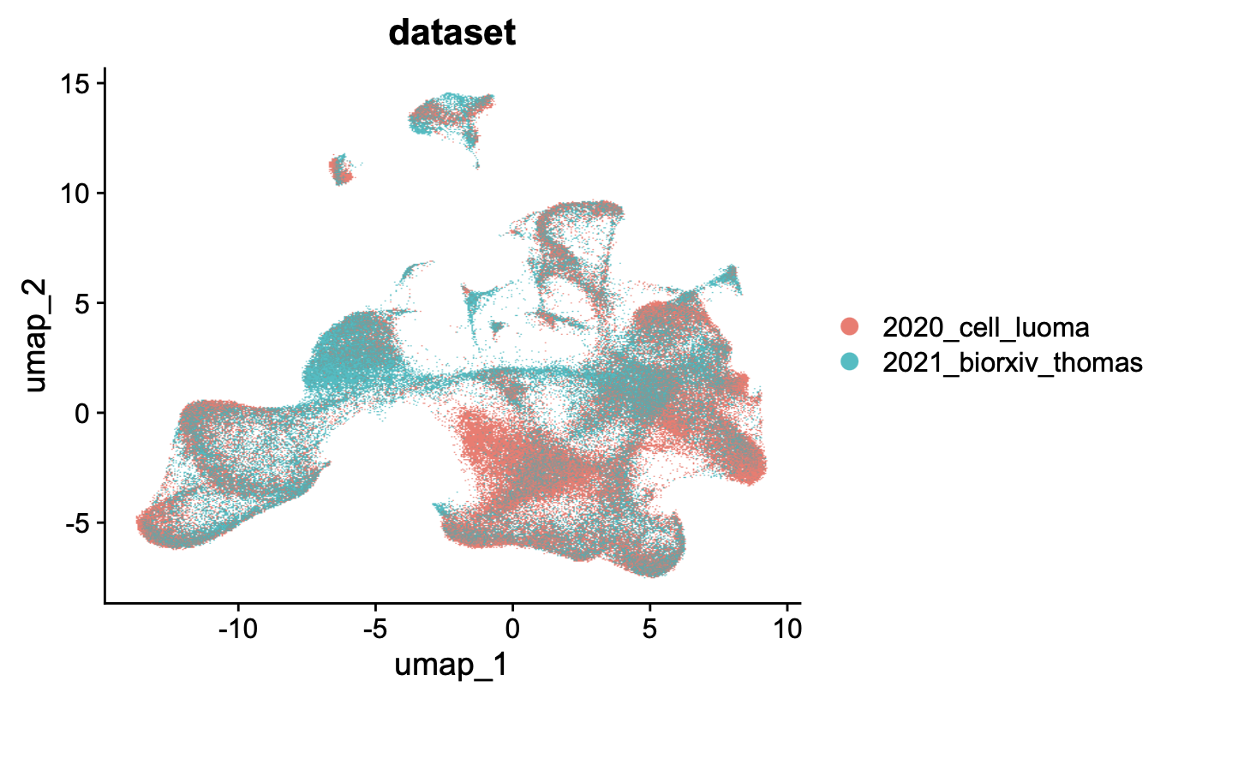
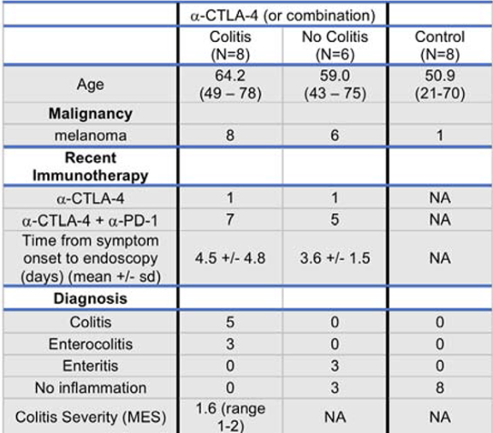
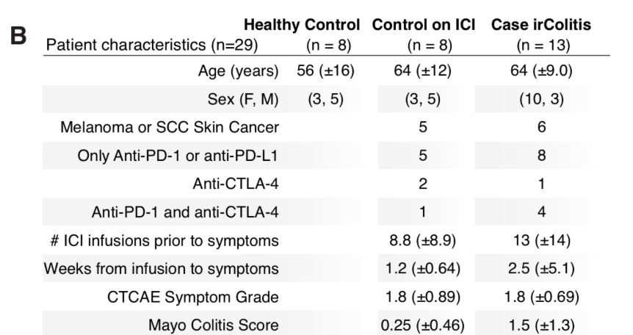
Cohorts differ most in ICB drug and cancer type, may contribute to batch effects in integration
2020 cell Luoma
100% melanoma
Mostly combo ICB
2021 biorxiv Thomas
~50% melanoma/skin
Mostly PD-(L)1 blockade

Slide 4
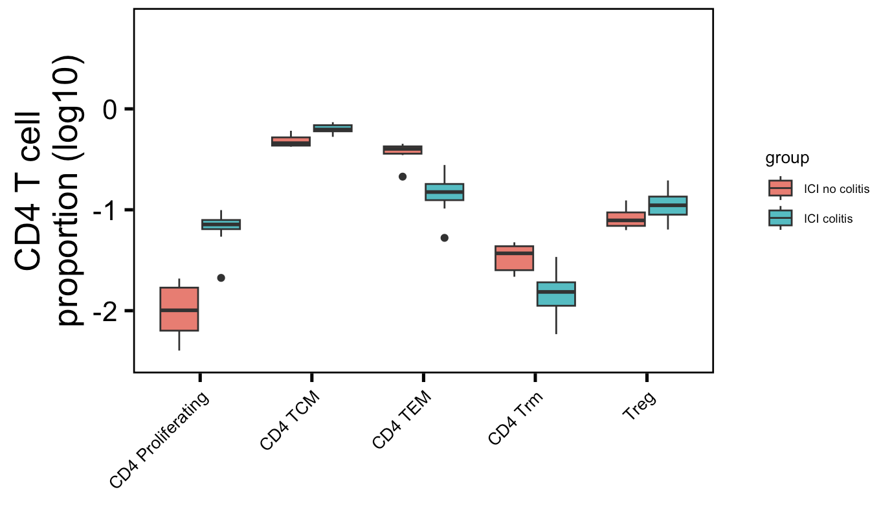
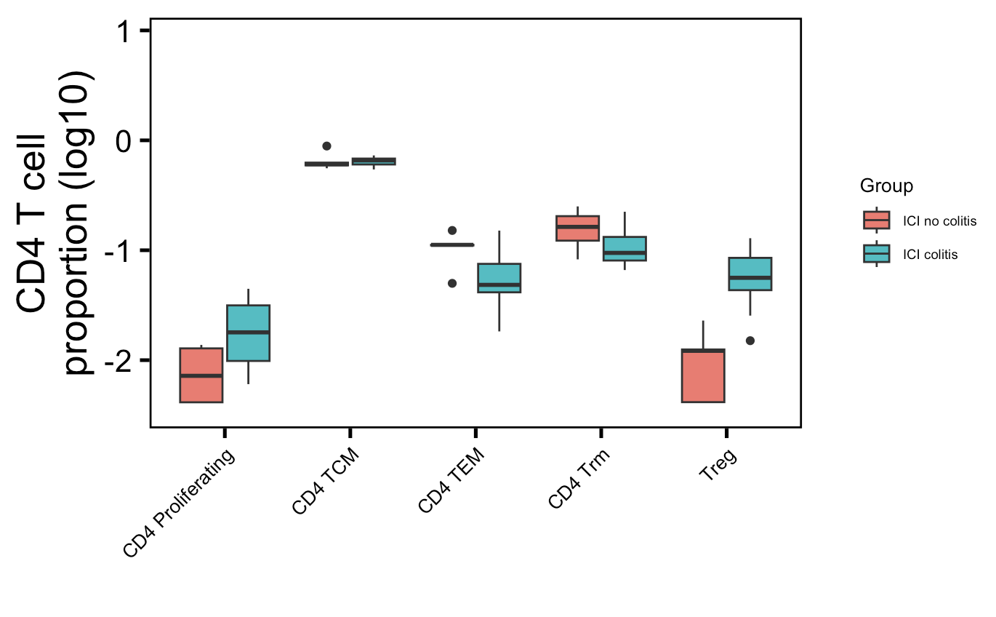
Splitting cell type analysis by CD4/CD8 doesn’t improve similarity between colitis datasets
Luoma (2020), Cell
Thomas (2021), bioRxiv
**
**
**
*
p =
0.07
**
Wilcoxon rank sum test. **, padj < 1e-2; *, padj < 0.05
Notes:
old
# CD4 prolif: 0.004
# CD4 TEM: 0.008
# CD4 TCM: 0.009
# CD4 Trm: 0.01
new
# Treg: 0.003
# CD4 TEM: 0.07

Slide 5
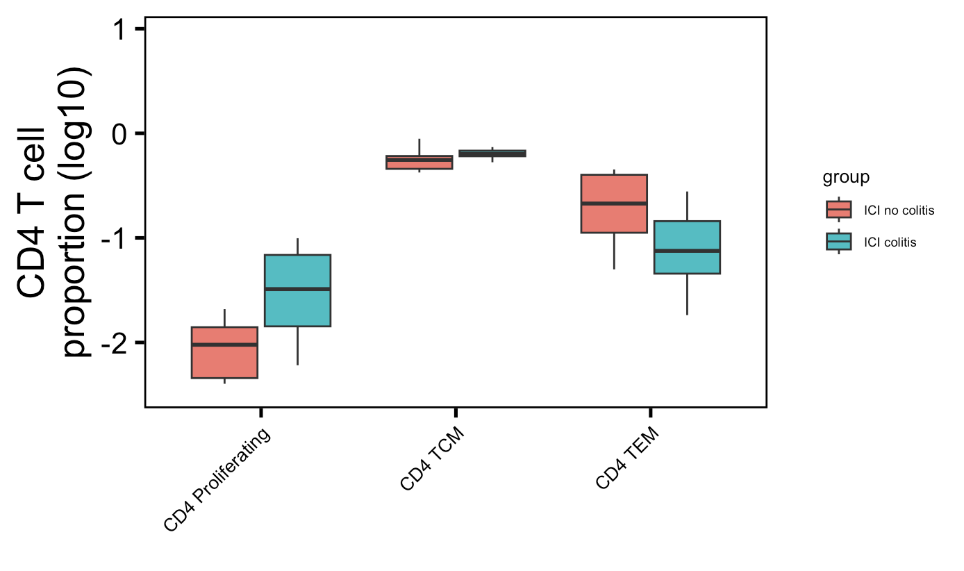
Combining colitis datasets for CD4 cell type abundance analysis
**
*
**
Wilcoxon rank sum test. **, padj < 1e-2; *, padj < 0.05
Notes:
# CD4 prolif: 0.006
# CD4 TEM: 0.008
# CD4 TCM: 0.02

Slide 6
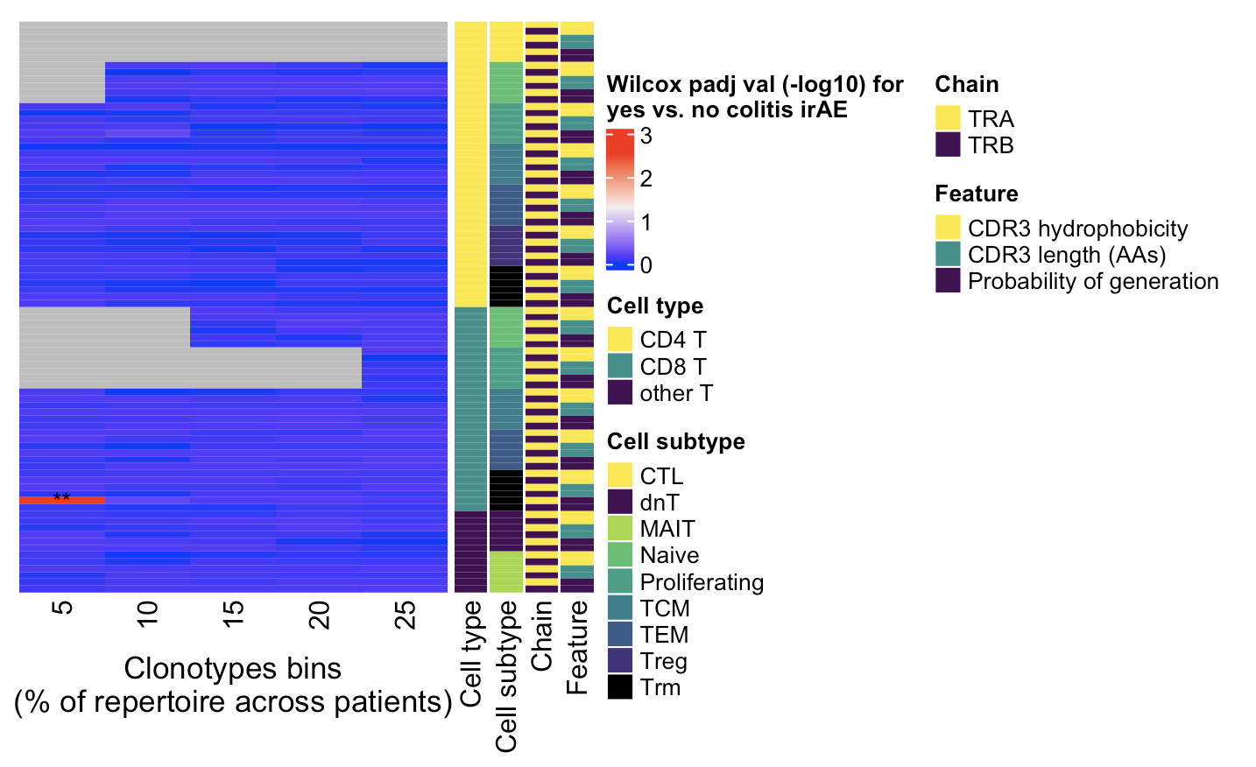
Combining colitis datasets for TCR feature analysis: highly expanded CD8 Trm TRA pgen scores different between irAE groups (what was seen in new colitis dataset)
Wilcoxon rank sum test. **, padj < 1e-2; *, padj < 0.05

Slide 7
Conclusions
CD4 T cell abundances differences between colitis and healthy colon tissue
CD4 TEMs less abundant in colitis tissue
CD4 proliferating T cells more abundant in colitis tissue
CD4 TCMs slightly more abundant in colitis tissue

Slide 8
Next steps

Slide 9
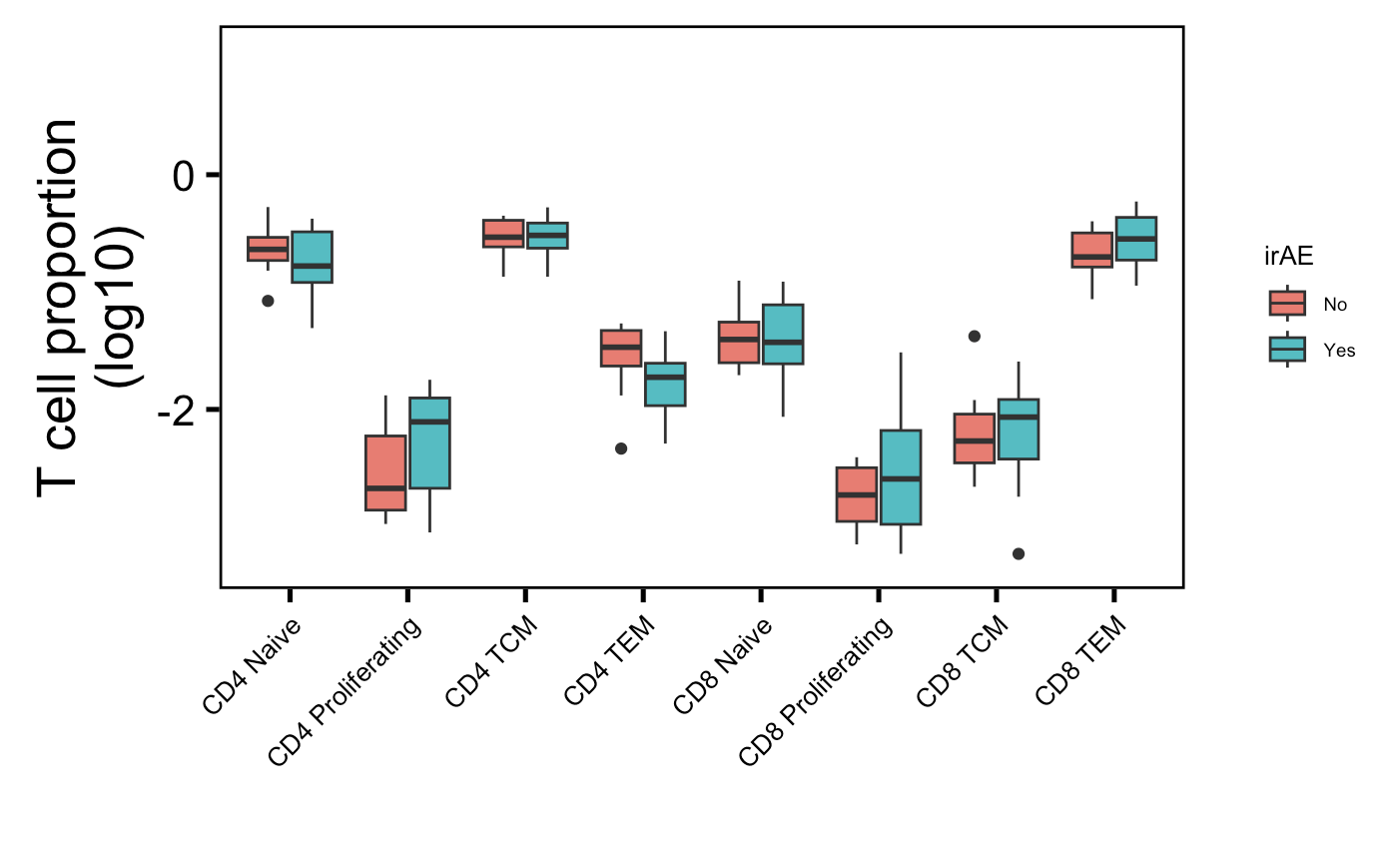
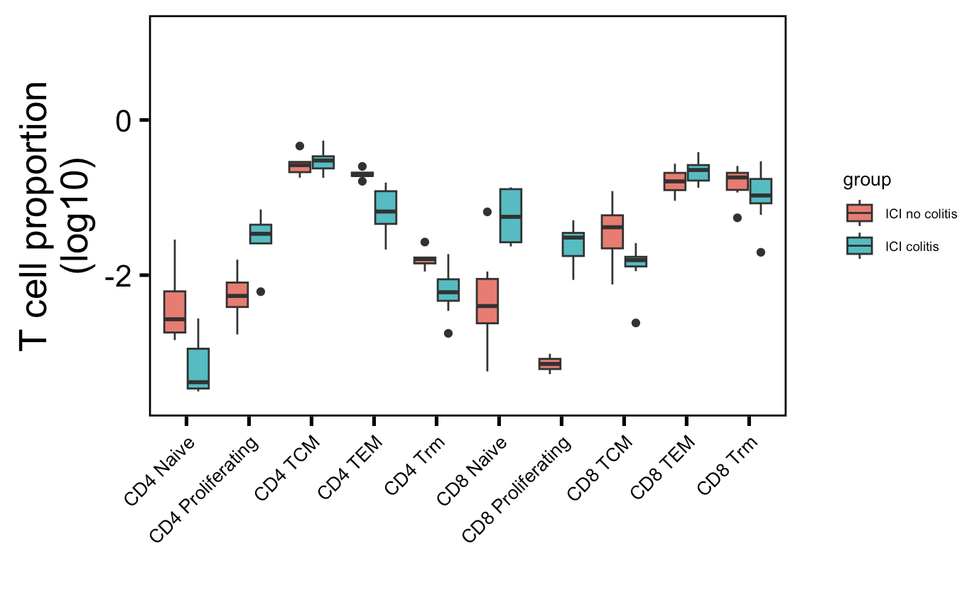
Old cell type abundance analysis
→
: up in their analysis
→
: down in their analysis
PBMC myocarditis-focused dataset (mostly PD-1 blockade)
Colon tissue colitis dataset (CTLA-4/combo blockade)
→
→
→
→
**
Wilcoxon rank sum test. **, padj < 1e-2
Notes:
Basically not sure how useful this will be for cytometry people as it’s 1) in colon tissue, 2) doesn’t replicate super well with other papers (yes it does with same paper though but…)

Slide 10
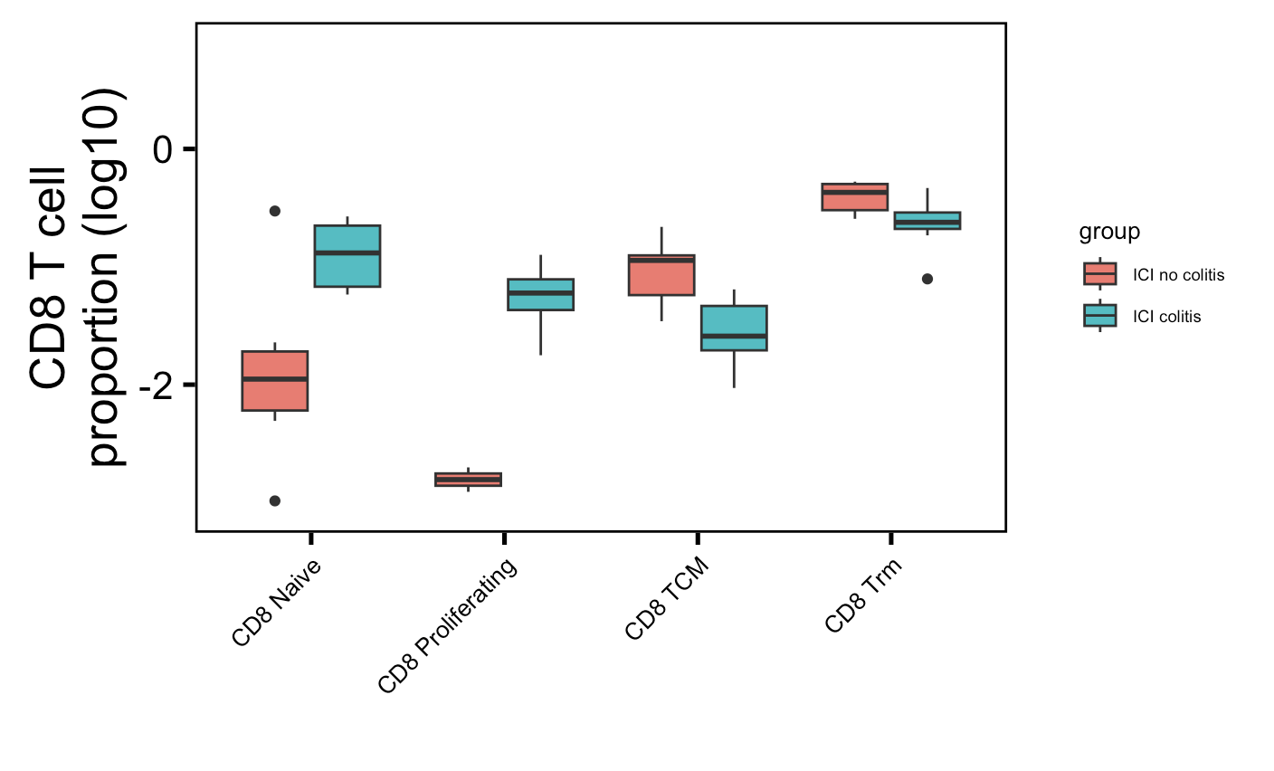
CD8s for old colitis dataset
padj ~= 0.05 for all of these

