Slide 1
Weekly meeting
1 25 2024
Ty Bottorff

Slide 2
Outline

Slide 3
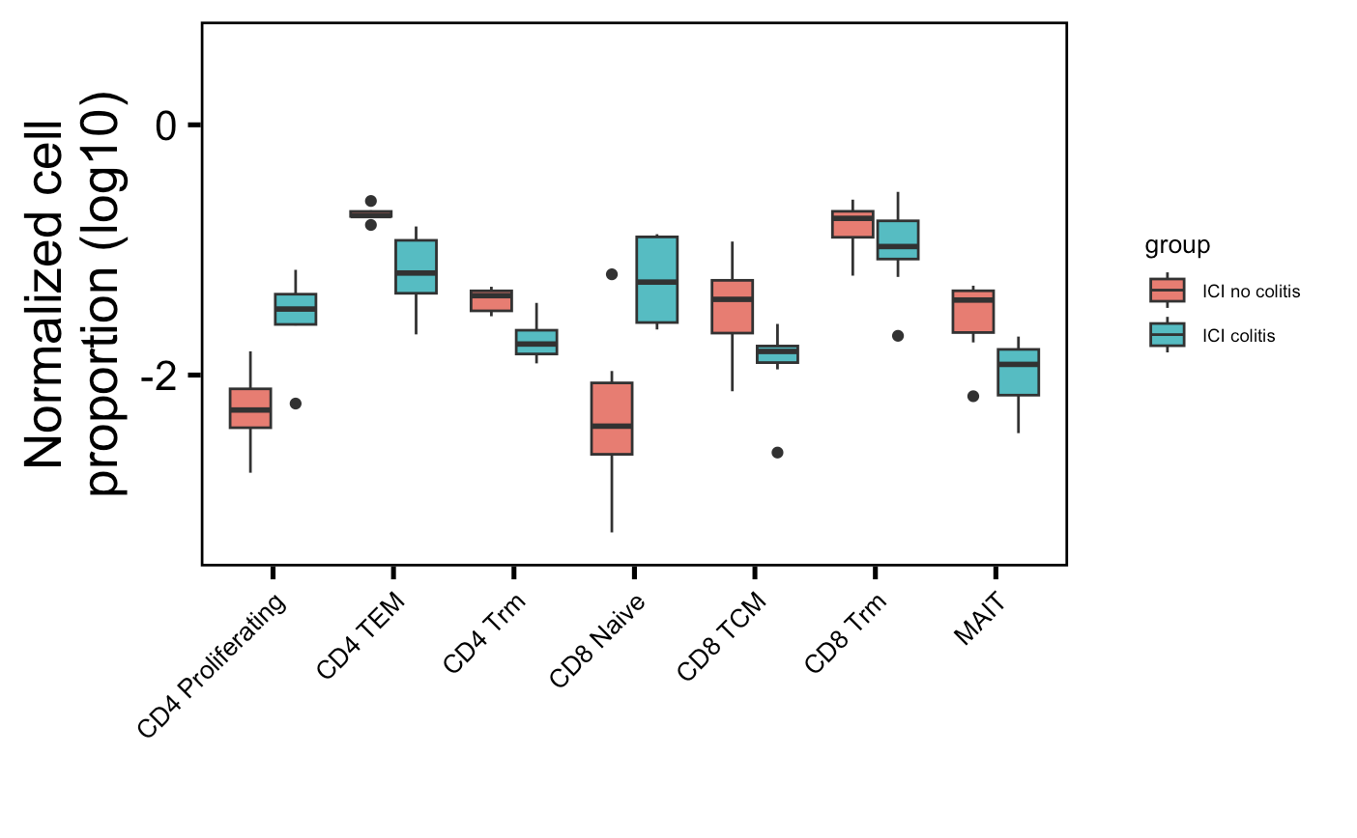
Manually looked through colitis dataset clusters for those expressing Trm markers (CD69, CD103, CD49a): 2 CD4 TCM → CD4 Trm, 5 CD8 TEM → CD8 Trm, do see same trend as published (Trm lower in irAE colitis group)
Notes:
CD4 Trm: 0.004662 (not adjusted but looks significant still guessing even with adjustment)

Slide 4
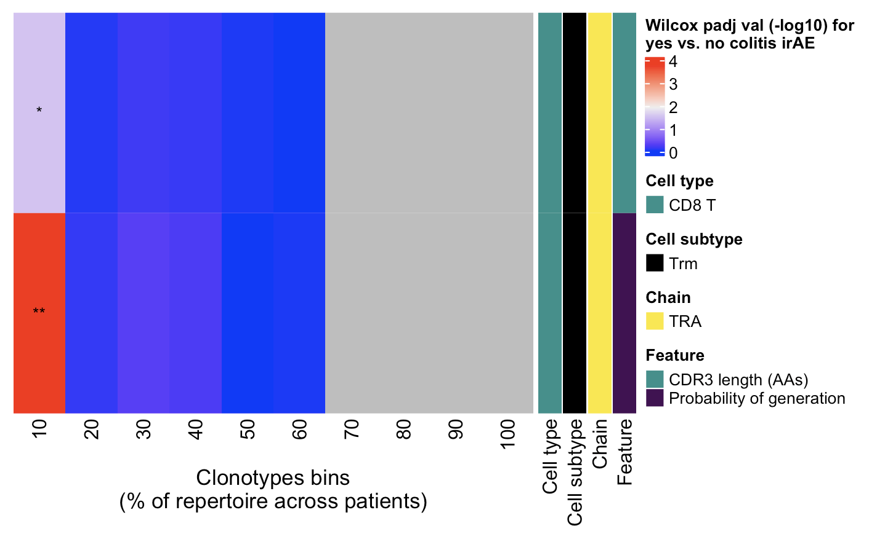
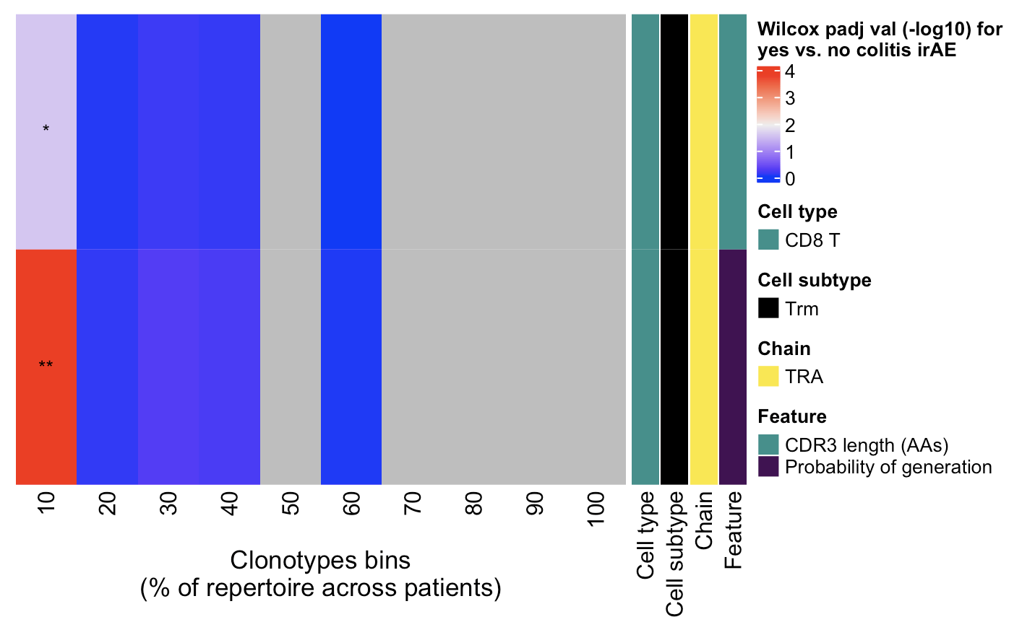
Highly expanded CD8 Trm TRAs seem to have distinct features between colitis irAE and no colitis irAE groups
Normalized by clonotype depth
Downsampled
← Increasing clonotype abundance
← Increasing clonotype abundance
Wilcox rank sum test: ****; padj < 1e-4, **; padj <1e-2, *; padj <0.05
Notes:
Cumulative binning

Slide 5
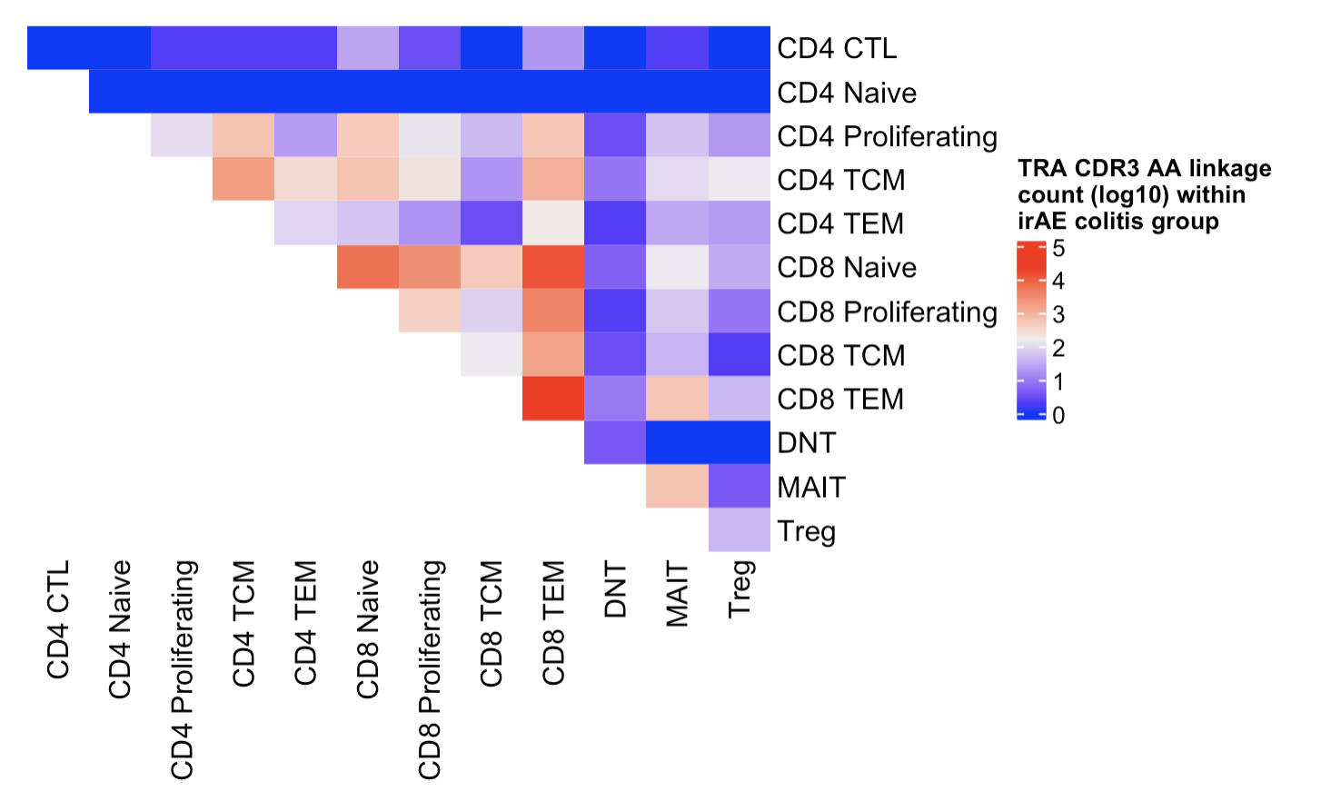
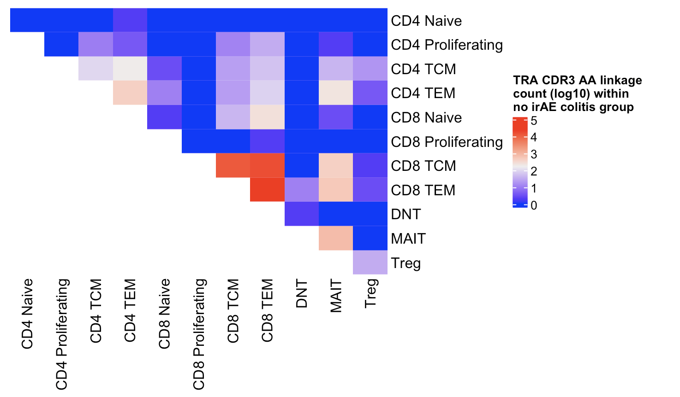
Colitis dataset linkage summary heatmaps (TRA): CDR3 AA linkage sharing seems more common across more cell types within irAE colitis group (no Trms)
Within irAE colitis group
Within no irAE colitis group
Total linkages = 61,623
Total linkages = 61,326
Notes:
Despite similar total linkages between groups, could still be biased by cell types up in irAE being more abundant and introducing more linkages across more other cell types?

Slide 6
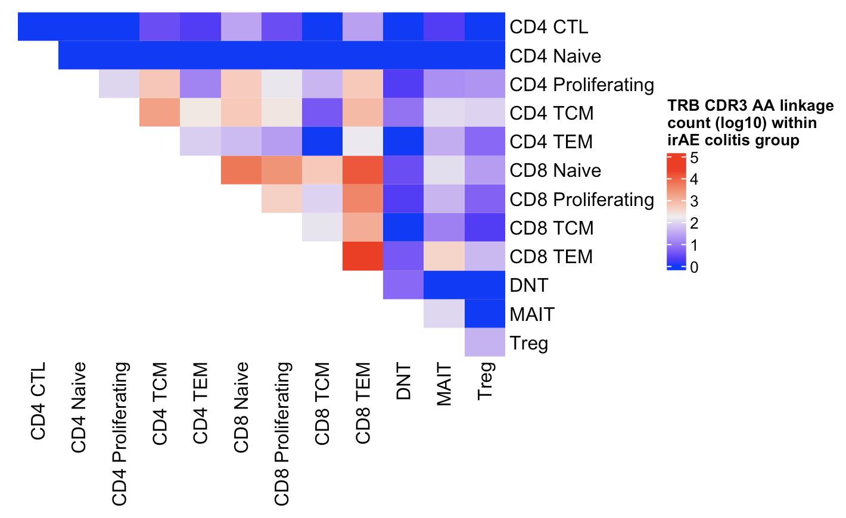
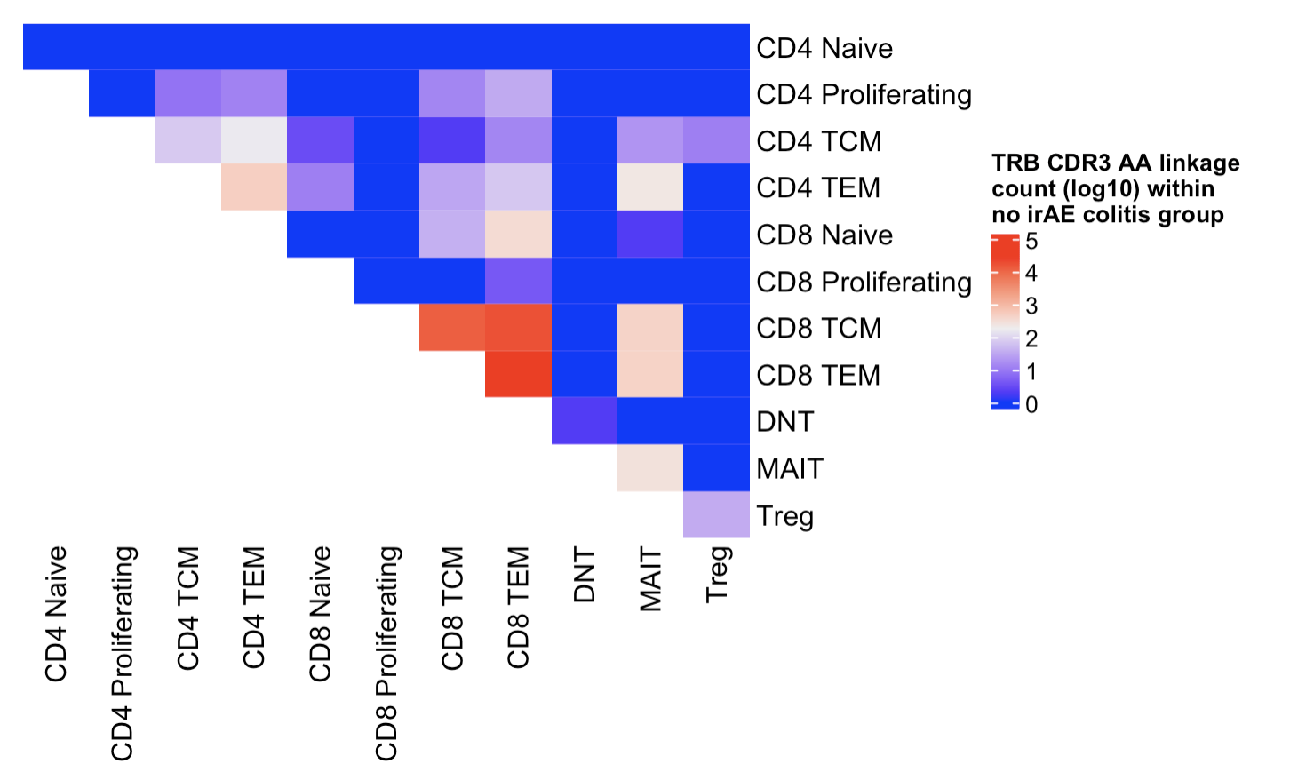
See same trend for TRB in colitis dataset (no Trms)
Within irAE colitis group
Within no irAE colitis group
Total linkages = 63,816
Total linkages = 65,208
Perhaps more diverse cell types are recognizing same antigen in irAE colitis group
Notes:
Despite similar total linkages between groups, could still be biased by cell types up in irAE being more abundant and introducing more linkages across more other cell types?

Slide 7
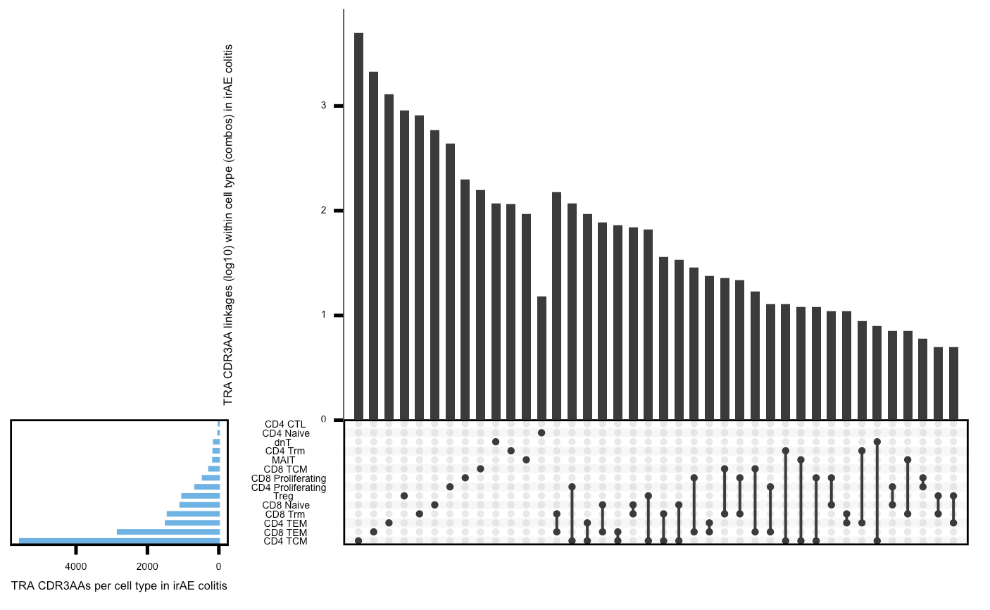
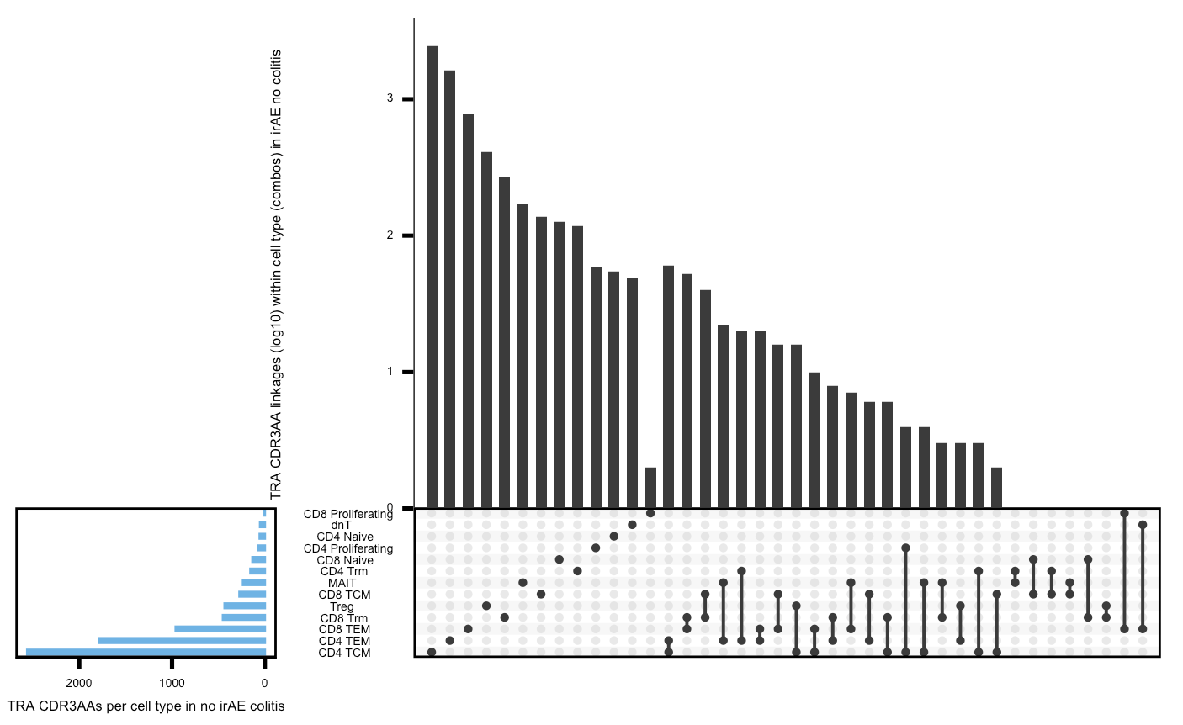
Colitis upset plots (TRA) show same trend but are more biased by set sizes differences
Within irAE colitis group
Within no irAE colitis group

Slide 8
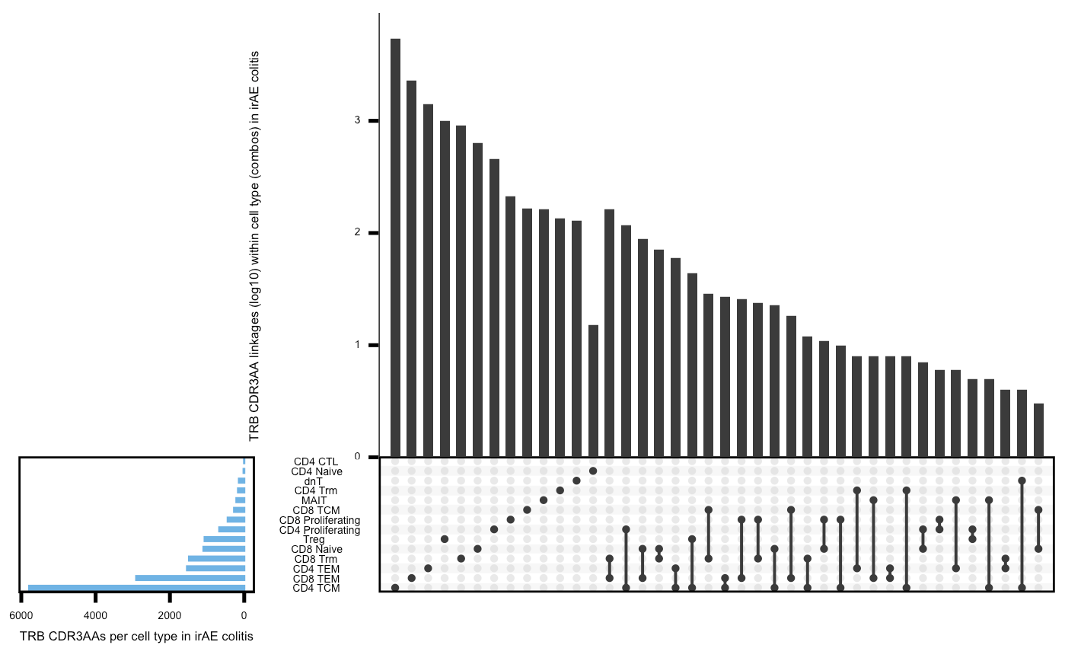
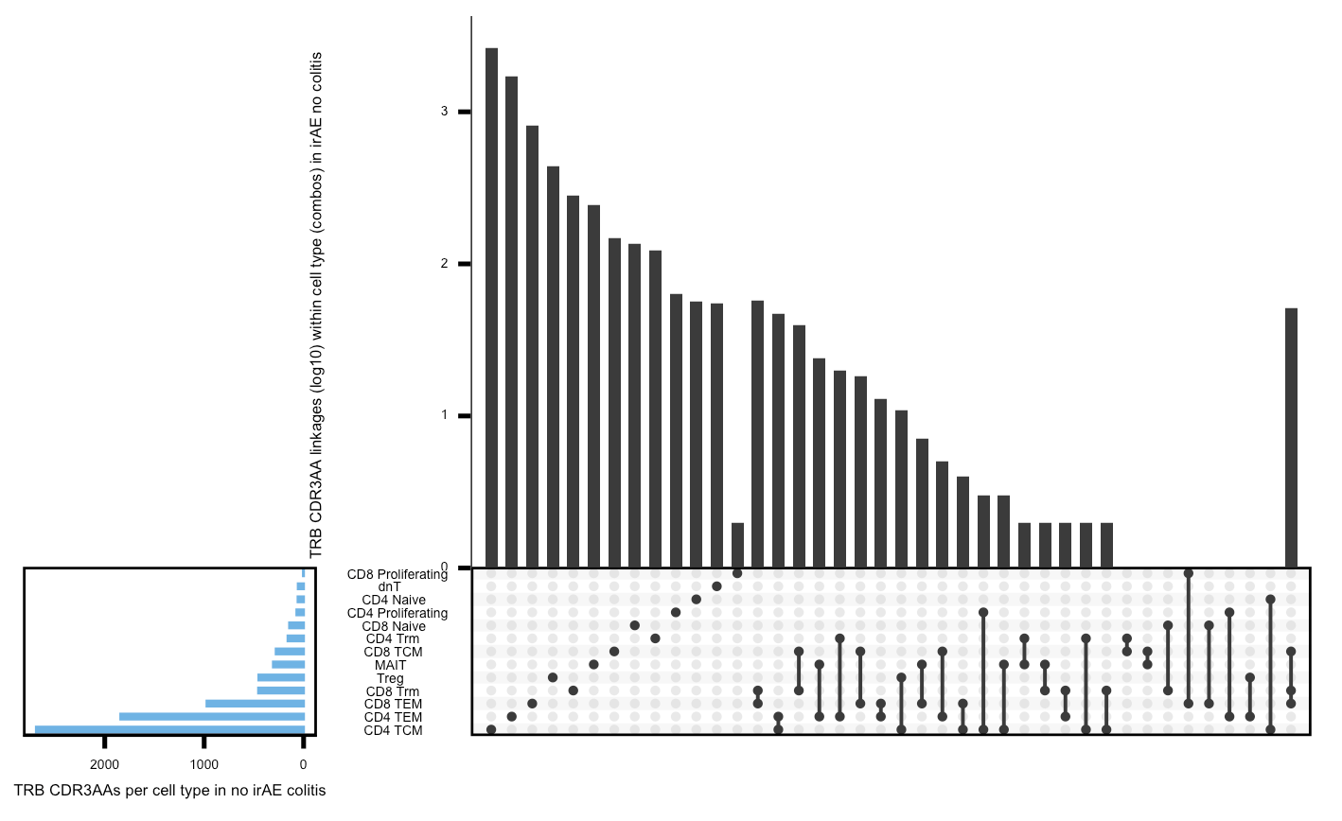
Colitis upset plots (TRB) show same trend but are more biased by set sizes differences
Within irAE colitis group
Within no irAE colitis group

Slide 9
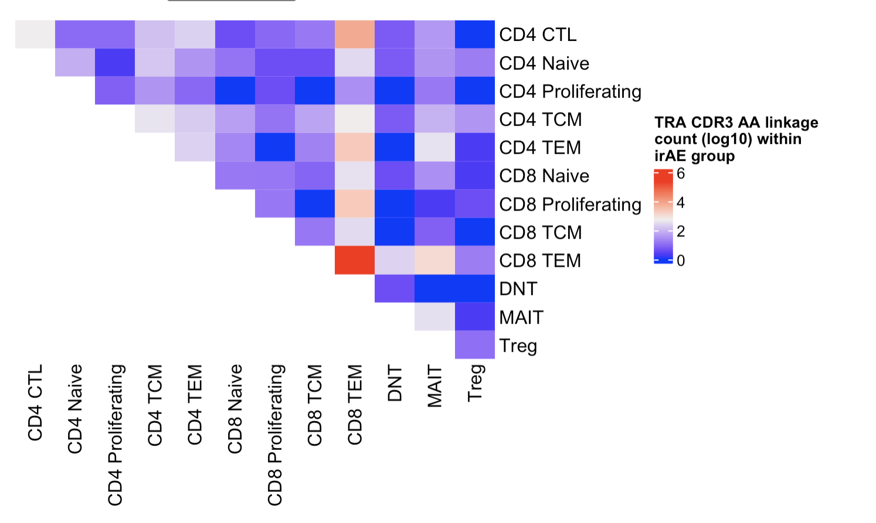
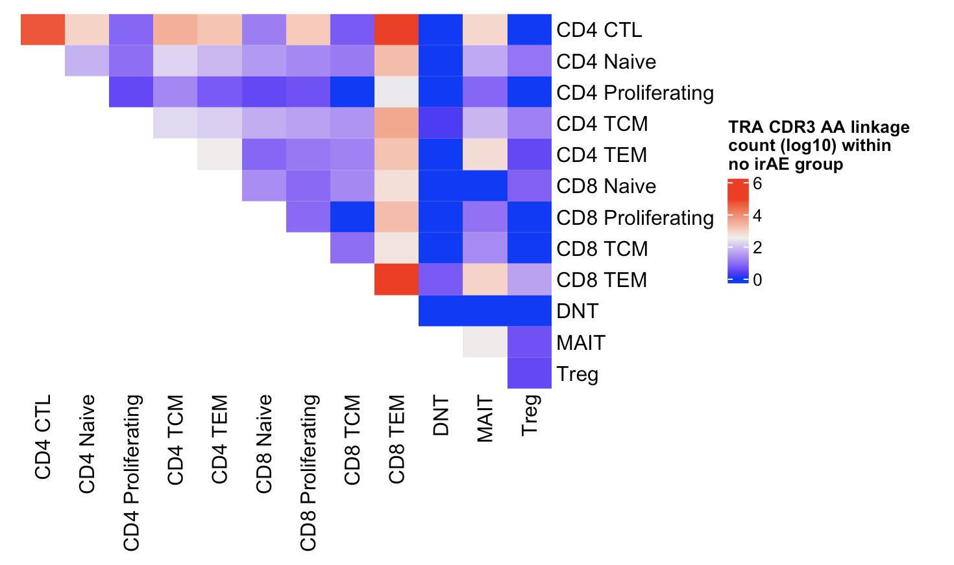
In myocarditis dataset (TRA), don’t see same trend
Within irAE group
Within no irAE group
Total linkages = 298,075
Total linkages = 273,226

Slide 10
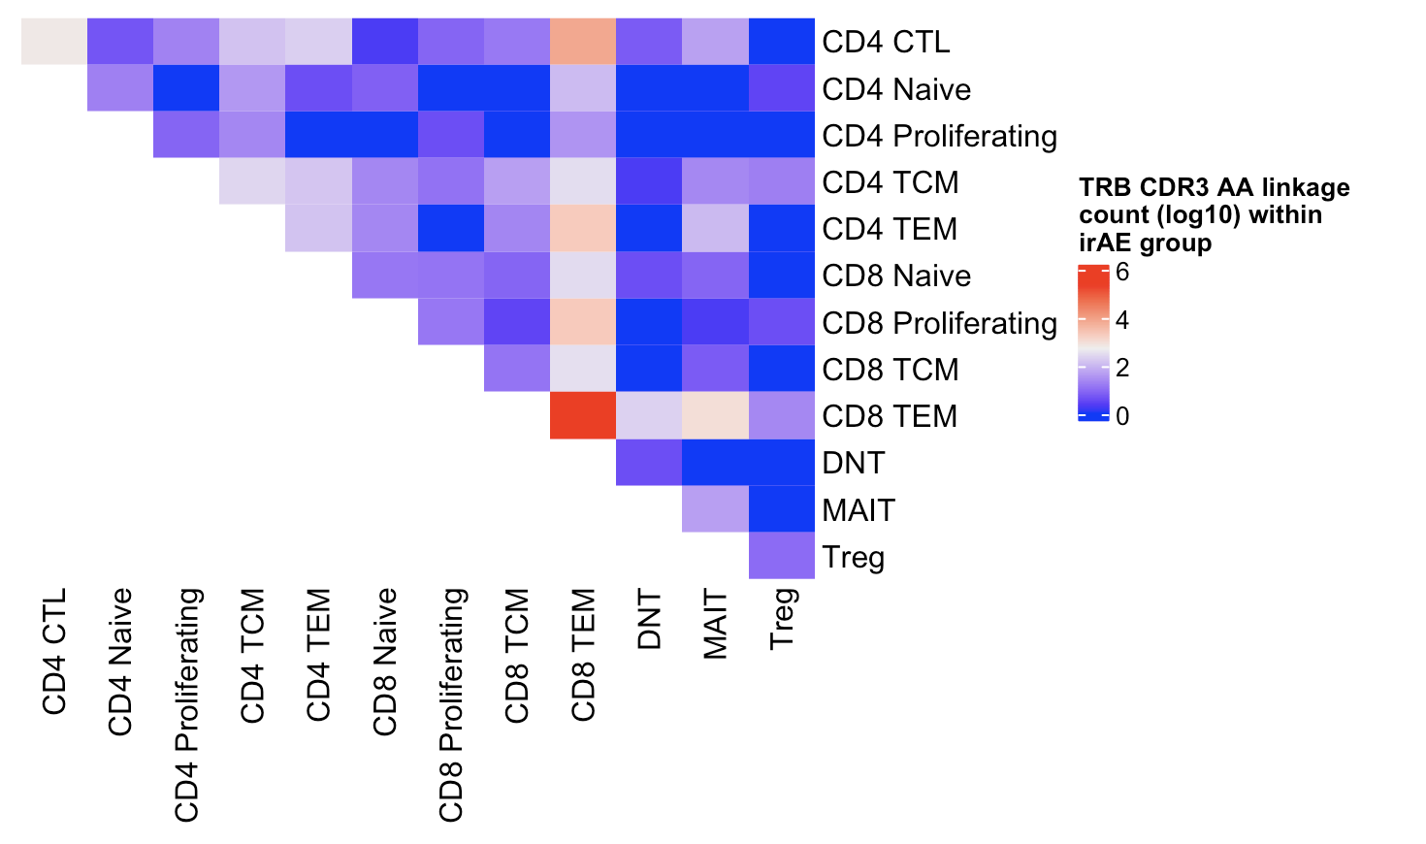
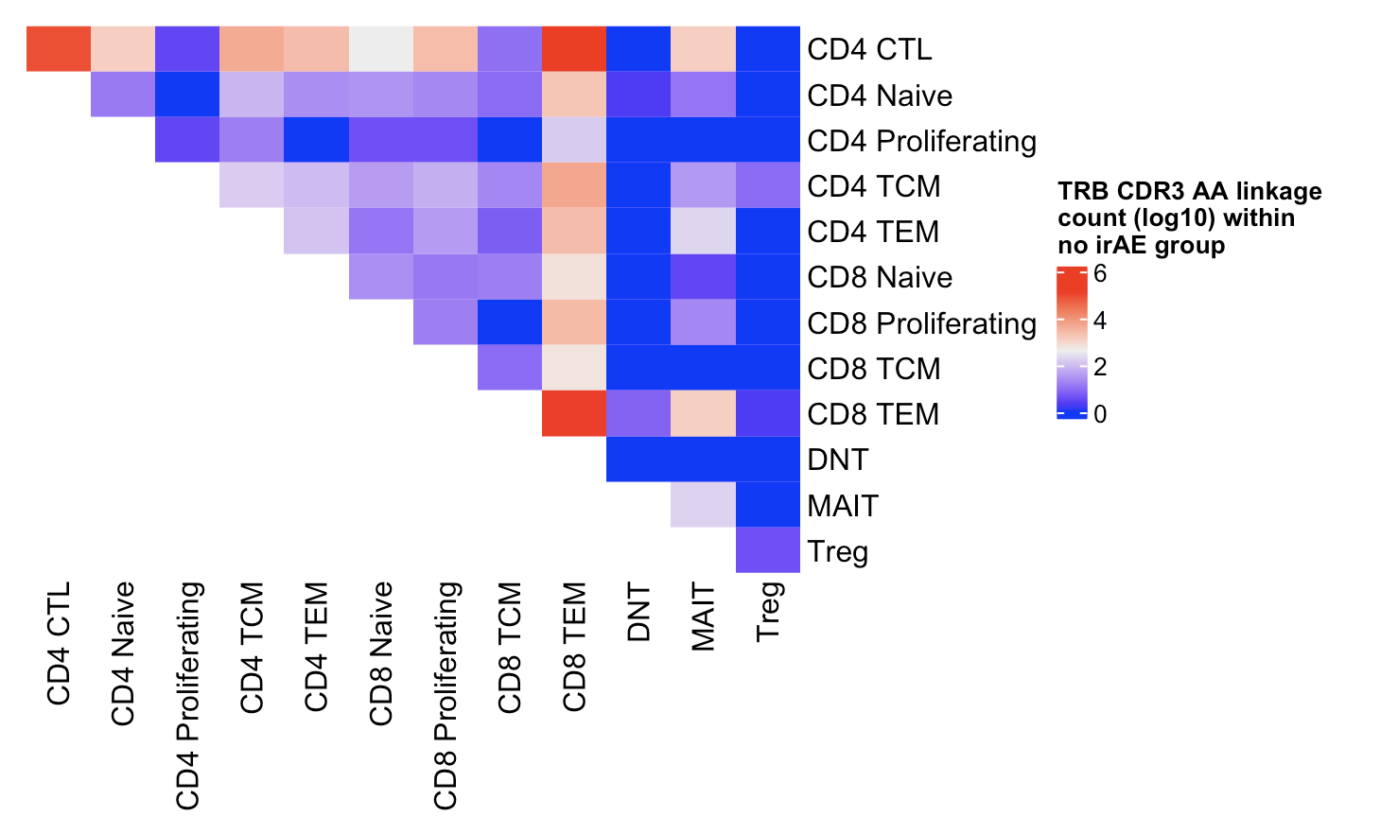
In myocarditis dataset (TRB), don’t see same trend
Within irAE group
Within no irAE group
Total linkages = 300,944
Total linkages = 408,859

Slide 11
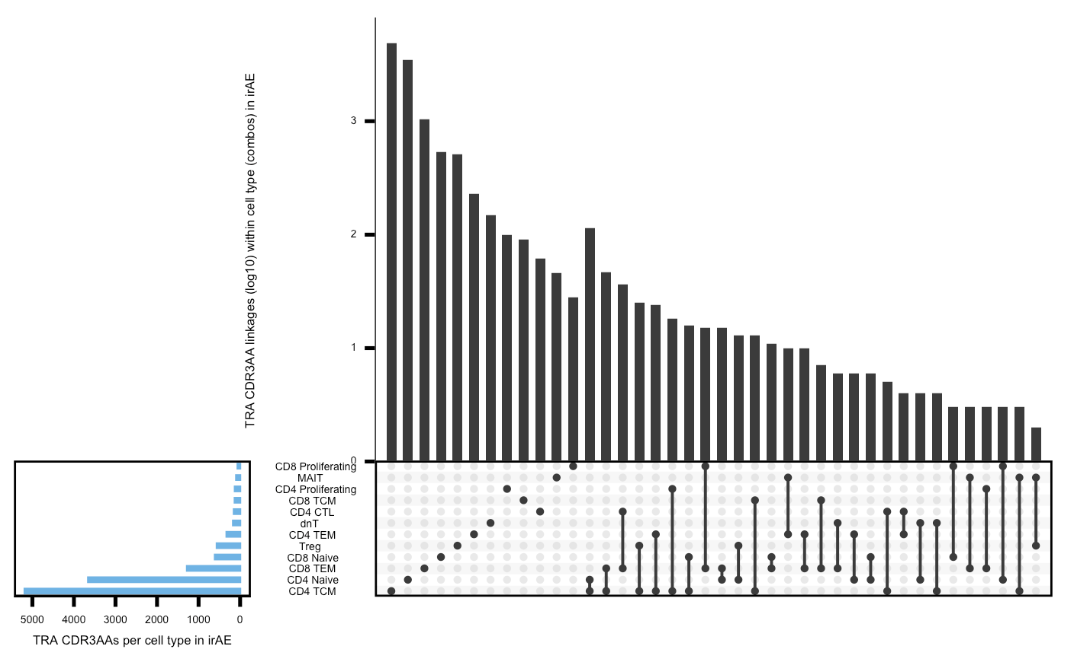
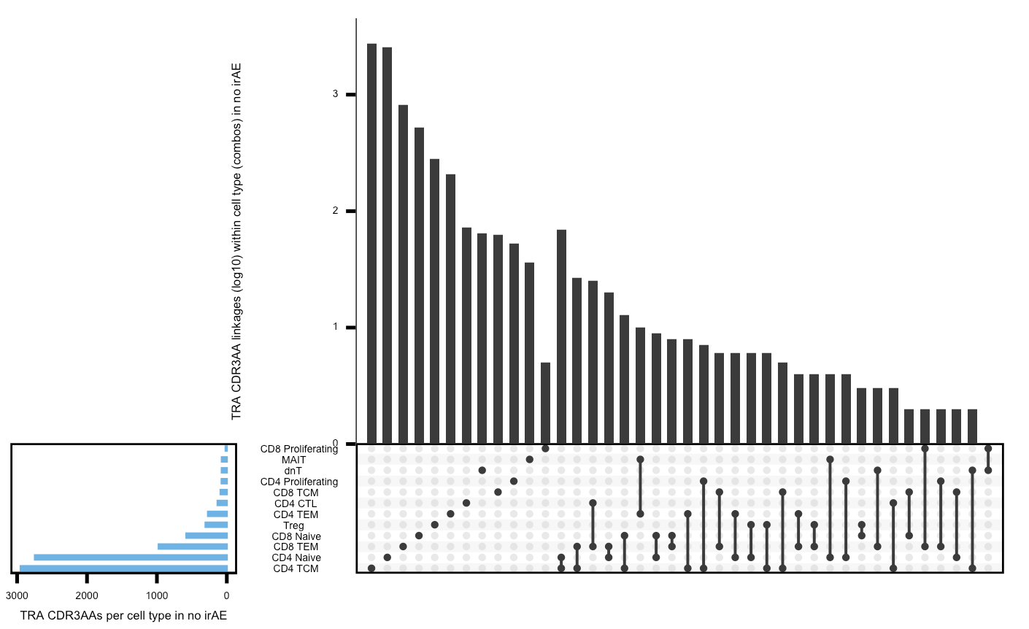
Myocarditis upset plots (TRA) don’t seem very different by irAE group
Within irAE group
Within no irAE group

Slide 12
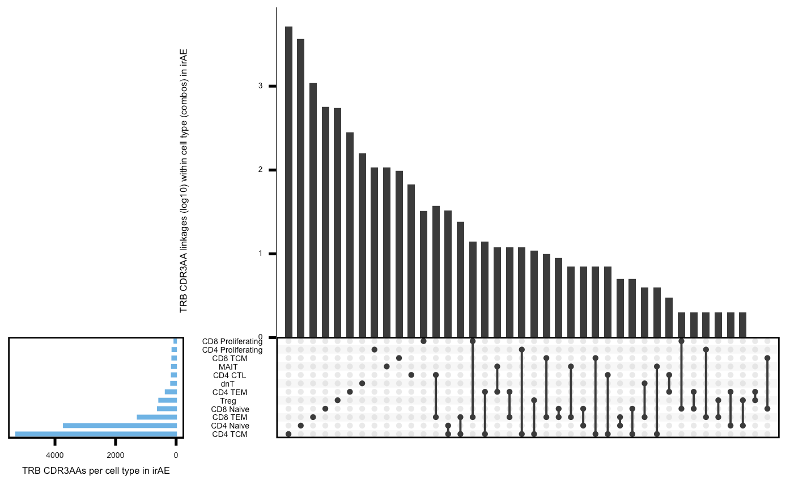
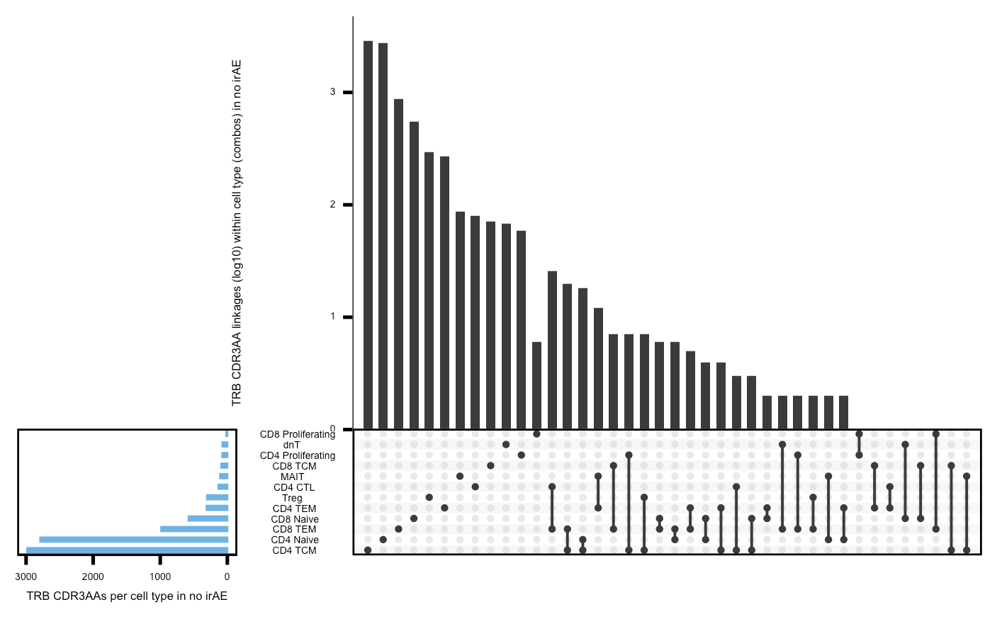
Myocarditis upset plots (TRB) don’t seem very different by irAE group
Within irAE group
Within no irAE group

Slide 13
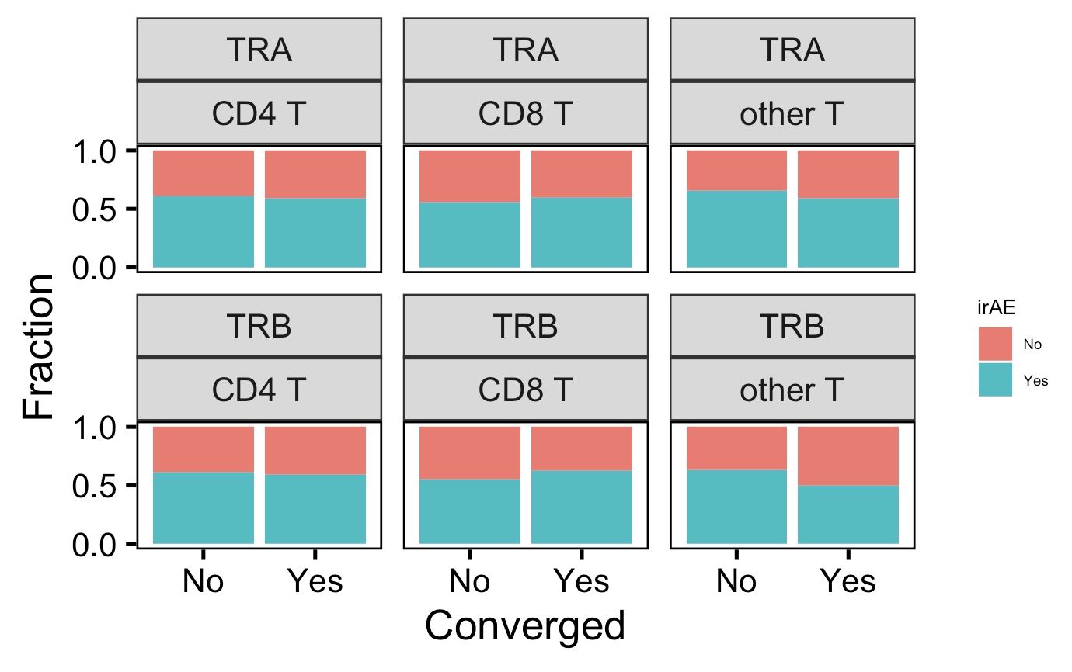
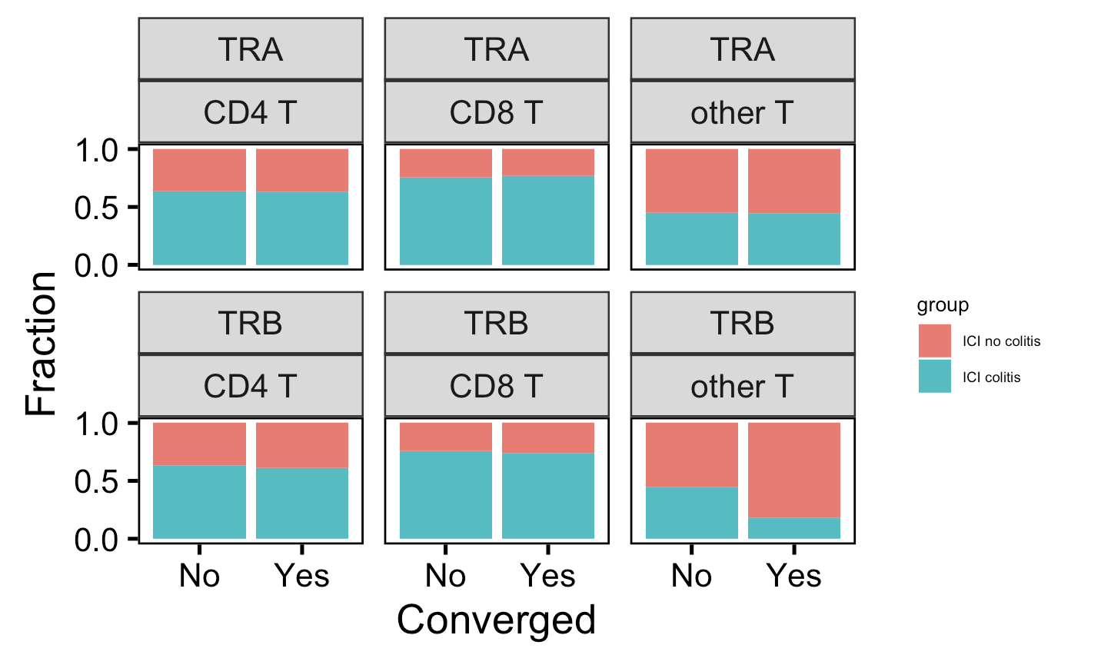
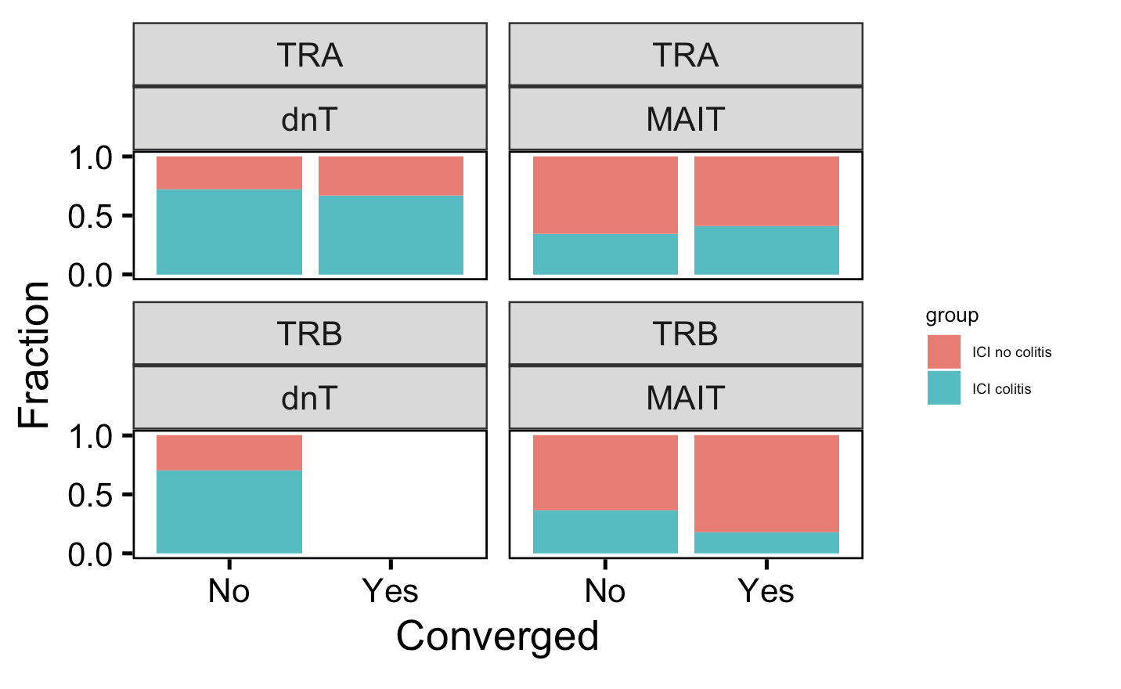
No differences in convergence (not publicity, privicity, not shown) between irAE groups by chain, cell type (nor at l2 level, not shown)
Myocarditis dataset
Colitis dataset

Slide 14
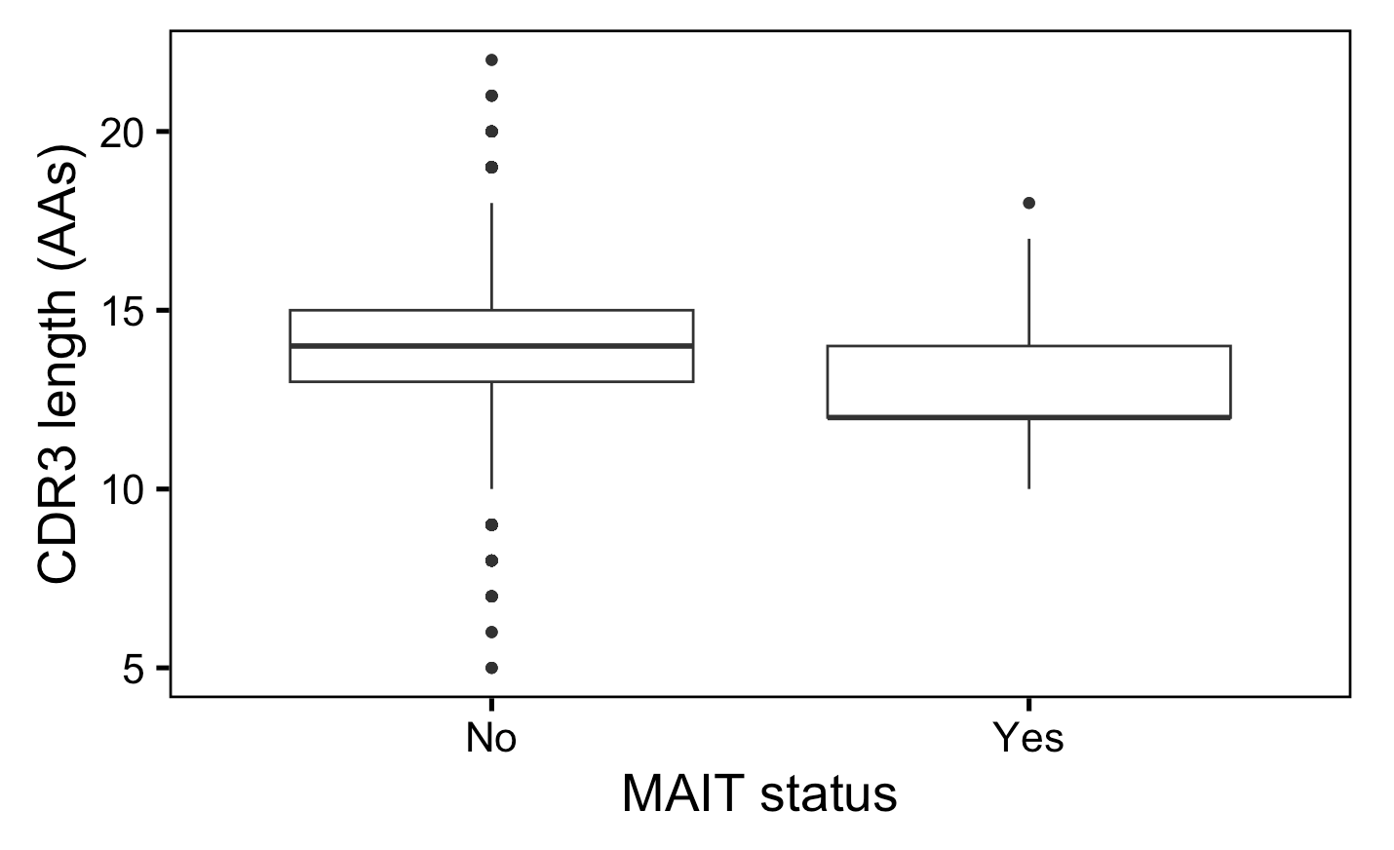
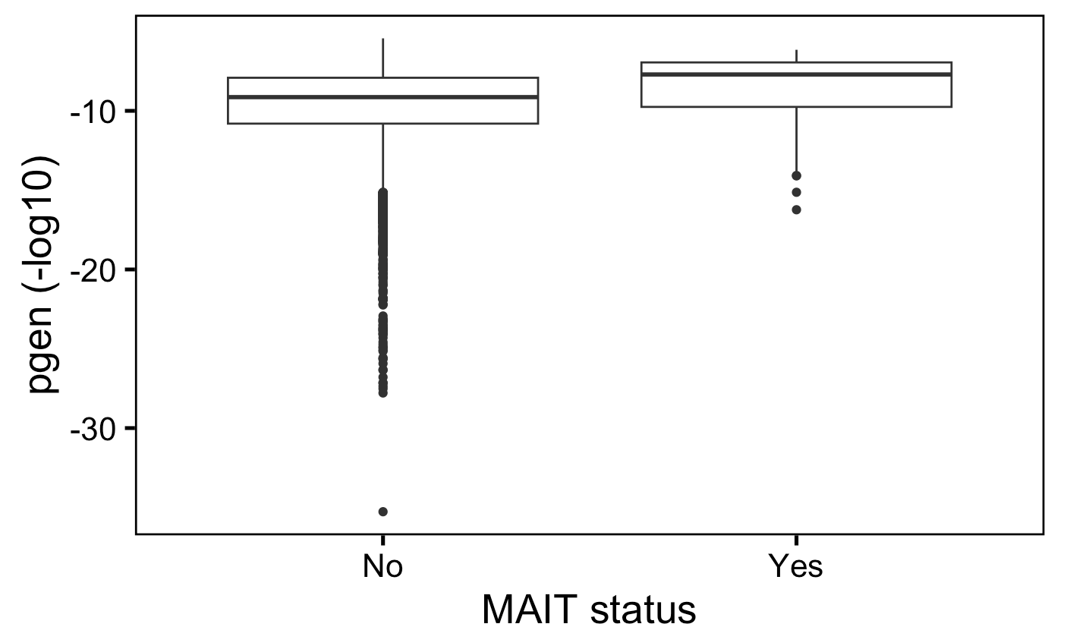
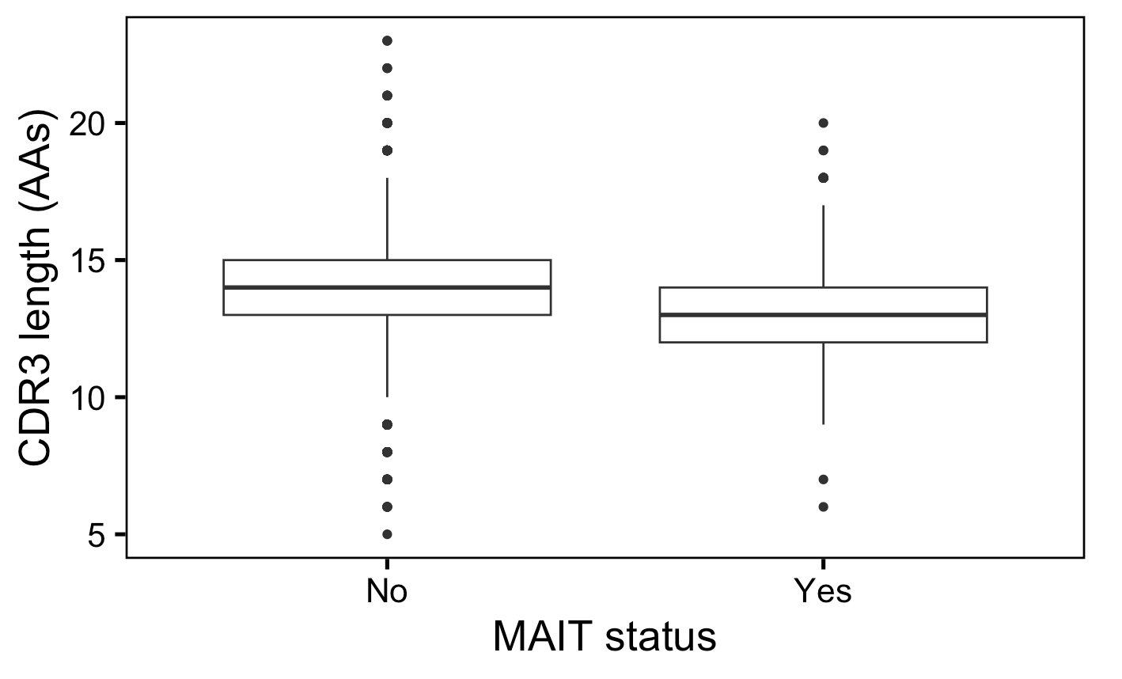
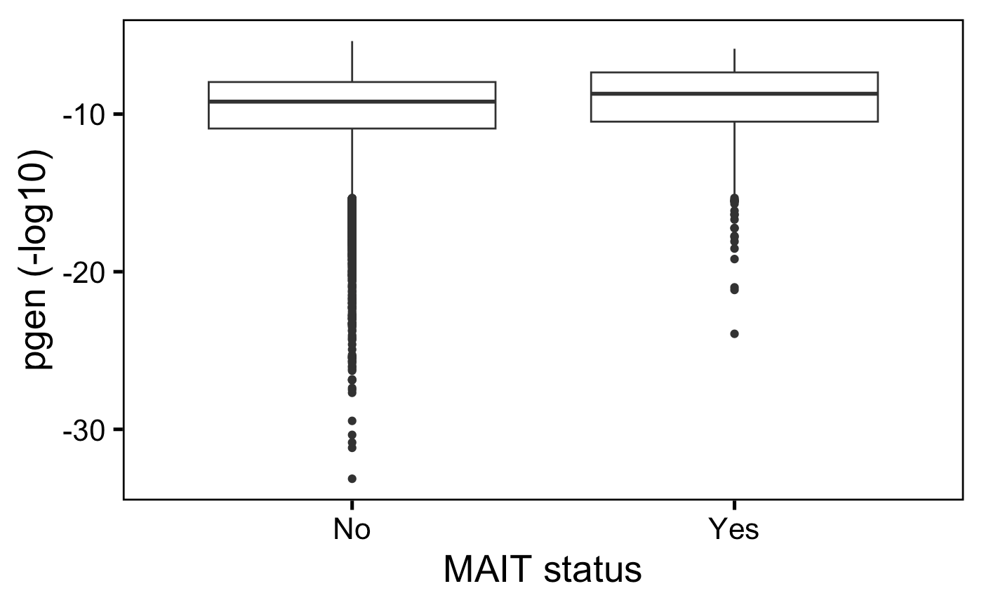
In both datasets, MAITs (less abundant in irAE colitis tissue) have shorter TRA CDR3s and more germline-like TRA chains vs. other cell types
****
****
Myocarditis dataset
****
****
Colitis dataset
Wilcox rank sum test: ****; padj < 1e-4, **; padj <1e-2, *; padj <0.05
Notes:
myocarditis
# pgen (TRA) padj vals
# MAITs: 1.485e-13
# CDR3 length (TRA): padj vals (adjusted within 5 cell types I tested for this feature for TRA)
# MAITs: 8.52e-12
Colitis:
# cdr3 pgen TRA padj
# MAIT: 6.635000e-13
# cdr3 length # MAIT: 2.3965e-10

Slide 15
Conclusions

Slide 16
Next steps

