Slide 1
Weekly meeting
1 11 2024
Ty Bottorff

Slide 2
Outline

Slide 3
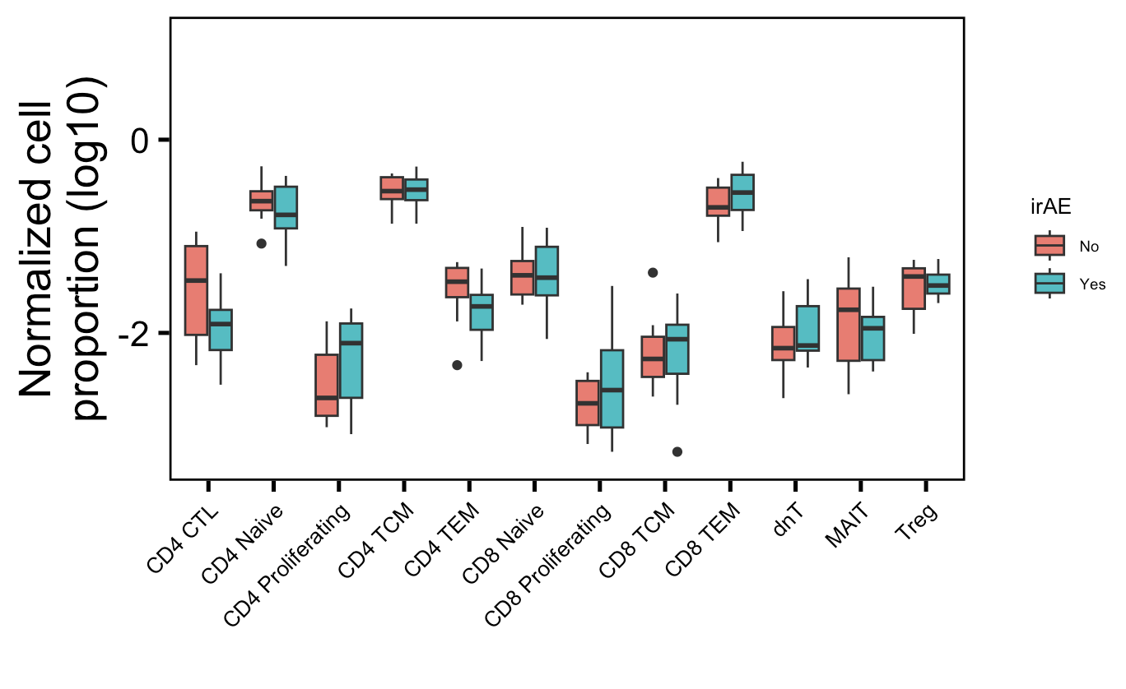
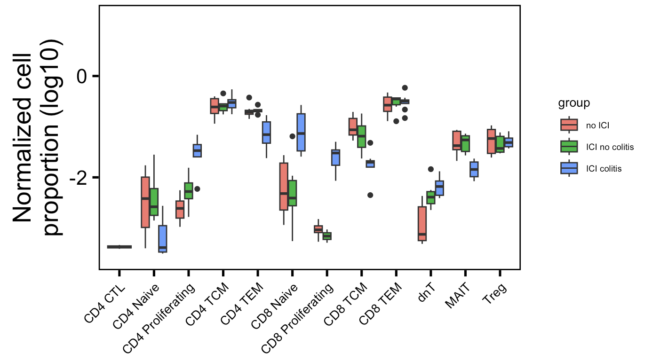
Some cell type normalized abundances in irAE tissue (colitis dataset) are different between irAE groups
Myocarditis dataset
Colitis dataset
**
**
*
*
**
More proliferating T cells (CD4 and CD8), fewer memory T cells (CD4 TEM, CD8 TCM),
fewer MAITs in irAE tissue
Wilcoxon rank sum test. **, p <1e-2; *; p <0.05
Notes:
Fewer Tregs associated with irAEs in literature, don’t see that here though, don’t even see ICI decreasing Tregs…

Slide 4
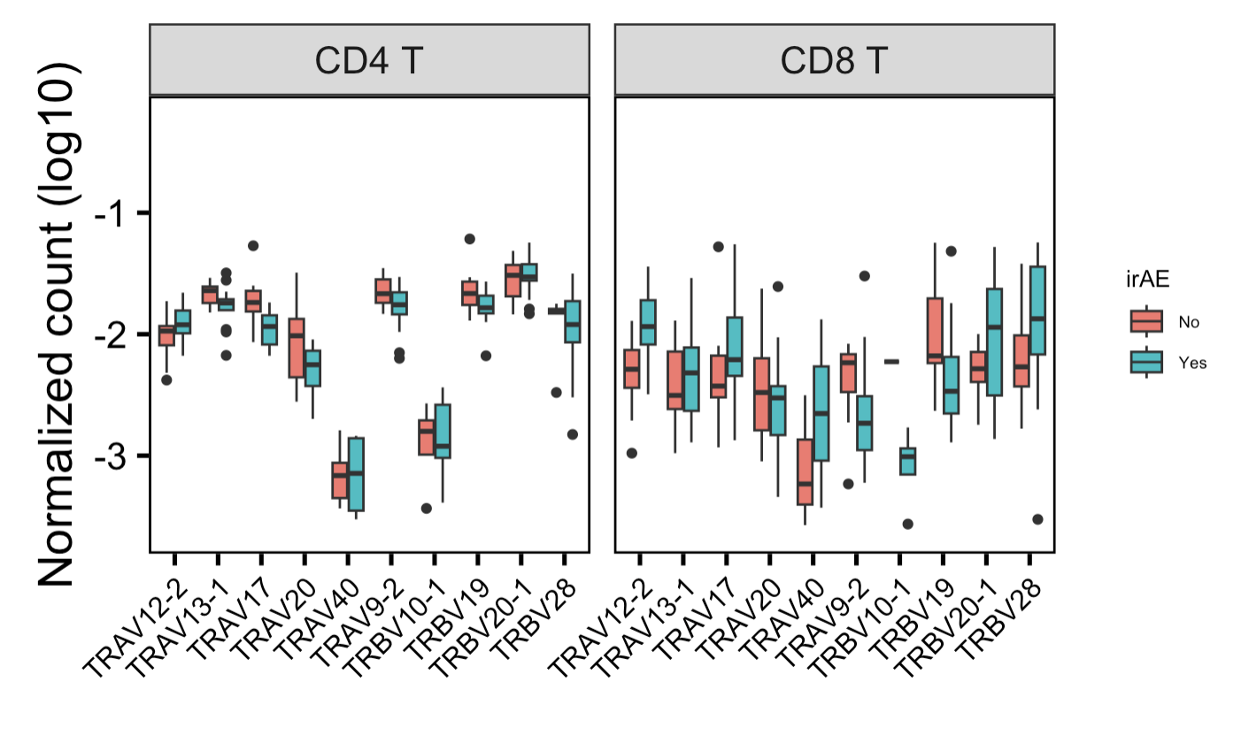
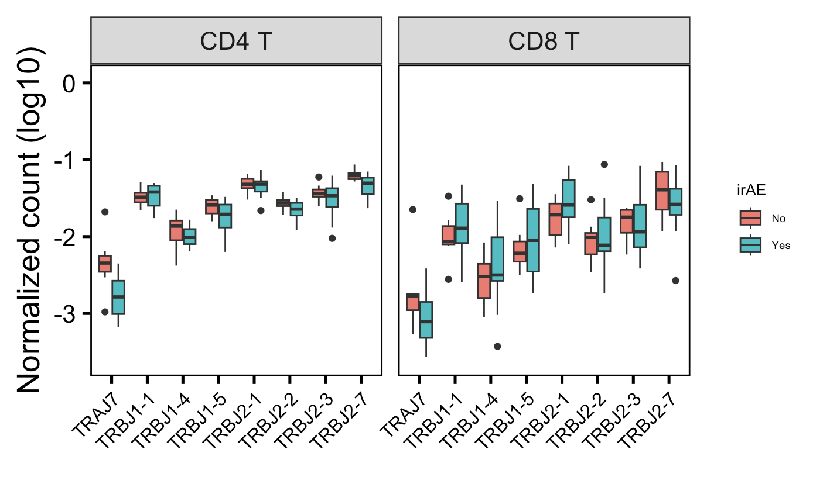
In myocarditis dataset, a few VJ genes are differentially encountered in different irAE groups
*
*
**
Showing 10 V/J genes with highest differences in median normalized counts between irAE groups
Wilcoxon rank sum test. **, p <1e-2; *; p <0.05

Slide 5
In colitis dataset, there is higher “dominance” of specific CDR3 nts in irAE patients

Slide 6
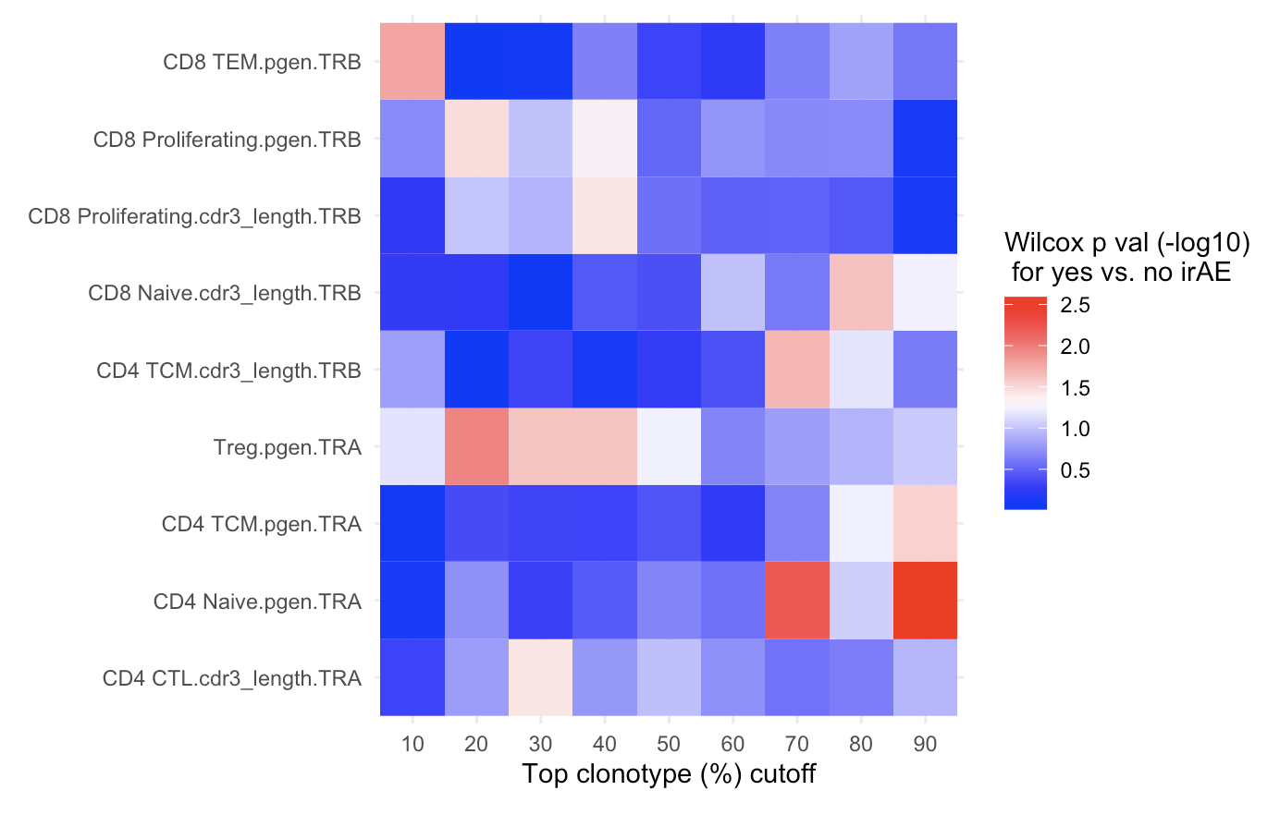
Summary heatmaps

Slide 7
Conclusions

Slide 8
Next steps
Should I use VJ genes for convergence/publicity calling? i.e. clonotype vs. CDR3 publicity
JC prep: use RNAseq to call TCR clonotypes, although only captures top clonotypes
After 1/16 JC focus on ATACseq prep. and 2/1 SI talk prep

