Slide 1
NCI update – analyzing CyTOF data
10 23 2024
Ty Bottorff – Bioinformatics postdoc
Linsley lab

Slide 2
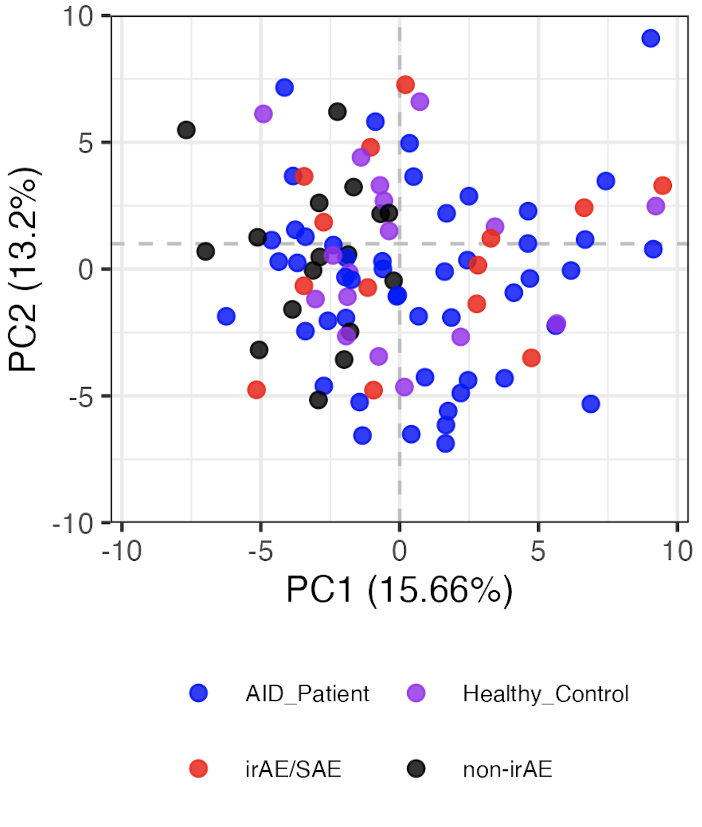
Baseline immunotypes are not distinct by group
Notes:
LOGIT TRANSFORMED FREQS
Including all PD1/PDL1 sorts here but that’s fine I believe (baseline, no ICI yet)
Significant hits
# (severe) irAE vs. no irAE: none
# AID vs. HC, none
# AID vs. cancer:
# naive of CD8 Tcells, Treg of CD4 Tcells, Tcells of nonGrans, Tfh of NN Tconv Tcells, NKcells of nonGrans, CXCR3pos of NN CD8 Tcells, CD11cpos of Bcells, naive of Treg Tcells, MAIT of NN CD8 Tcells, unswMem of Bcells, CRTH2pos of NN CD8 Tcells
# AID vs. non-irAE: Treg of CD4 Tcells, naive of CD8 Tcells, CRTH2pos of NN CD8 Tcells, CCR4pos of NN Tconv Tcells, ICOSpos of Tfh Tconv Tcells
# AID vs. irAE: CD11cpos of Bcells, NKcells of nonGrans, Tcells of nonGrans, Tfh of NN Tconv Tcells, naive of CD8 Tcells, unswMem of Bcells, Bcells of nonGrans, CXCR3pos of NN CD8 Tcells
# HC vs. cancer: CD38hiCD127neg of NN CD8 Tcells, Treg of CD4 Tcells
# HC vs. non-irAE: CRTH2pos of NN Tconv Tcells, Treg of CD4 Tcells, CD38hiCD127neg of NN CD8 Tcells, CRTH2pos of NN CD8 Tcells, SCM of Tconv Tcells
# HC vs. irAE: none

Slide 3
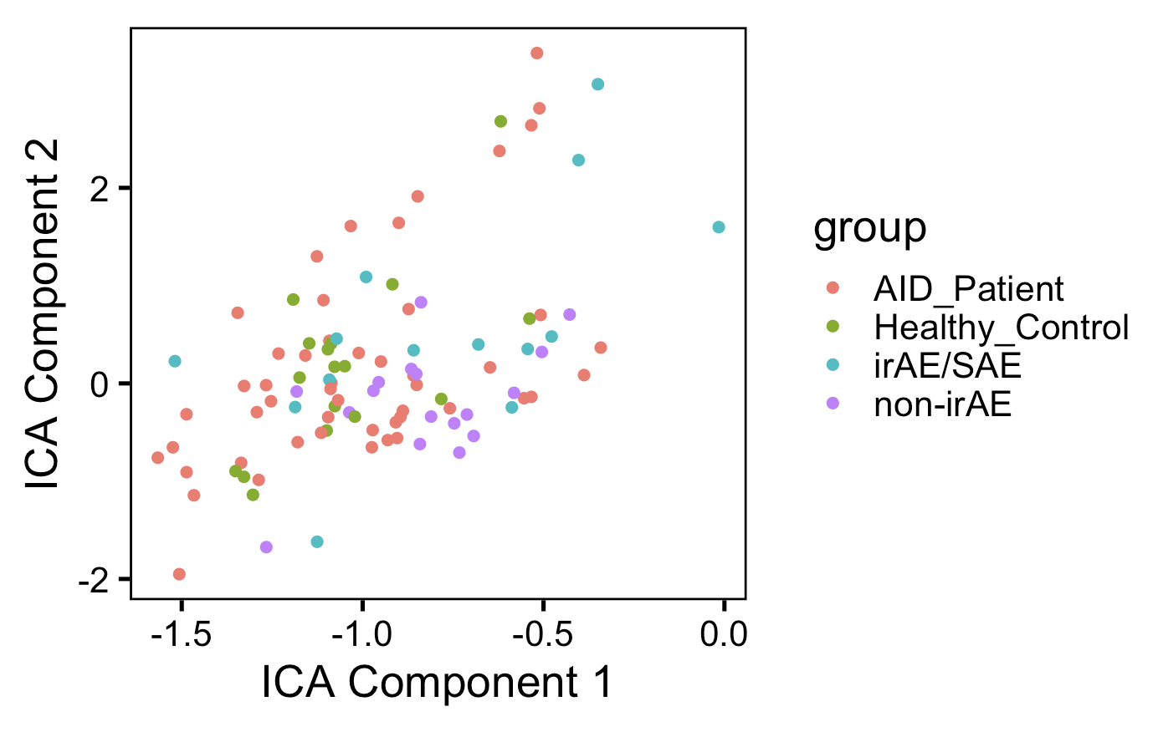
ICA doesn’t appear better at distinguishing unique immunotypes by group than PCA (baseline data)
Re-do w/ same colors as previous slide

Slide 4
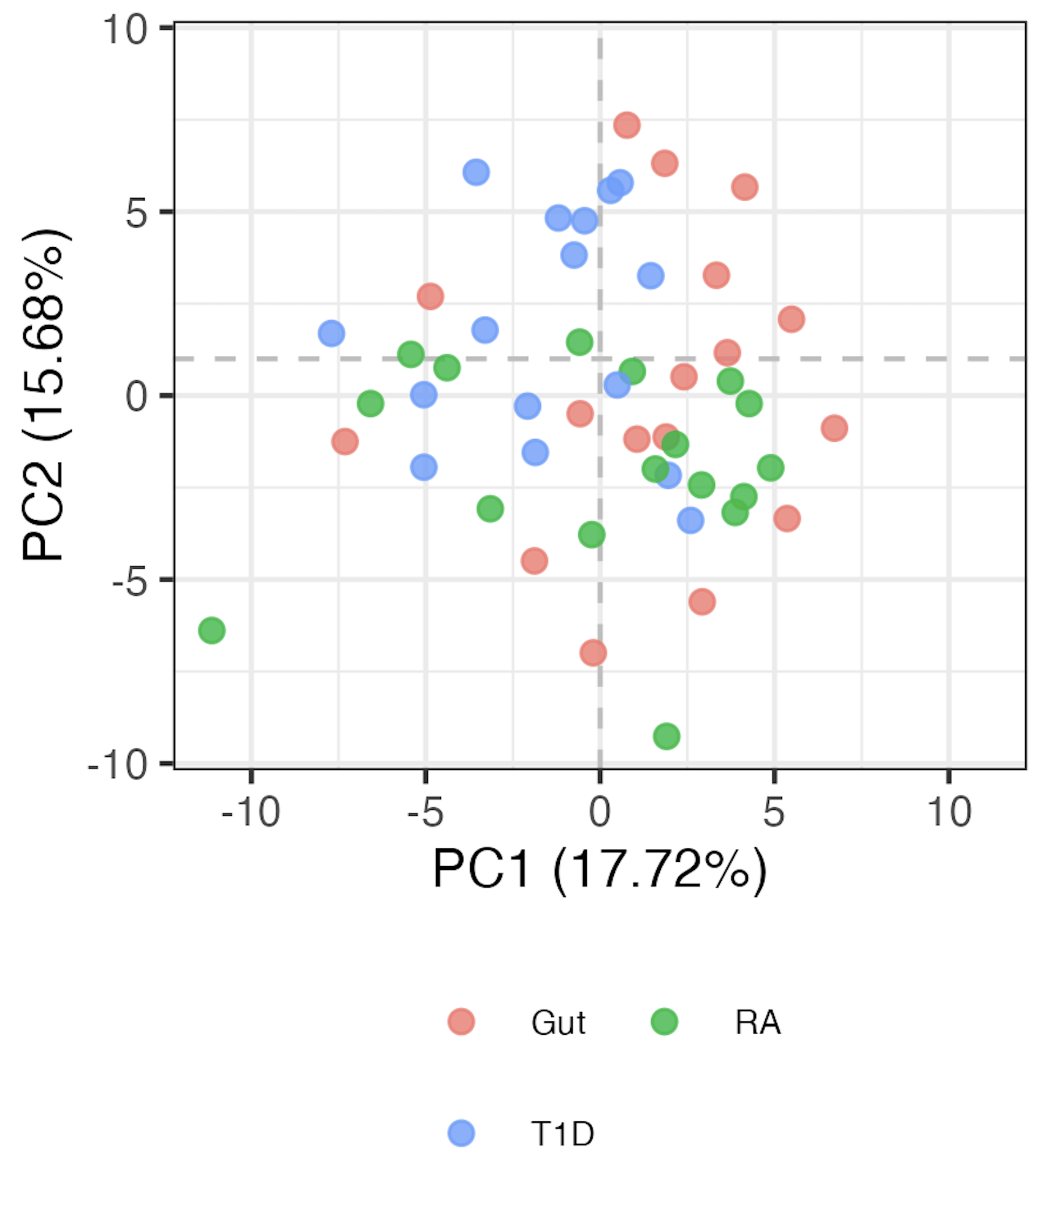
AID subgroup immunotypes are not very distinct either
Notes:
LOGIT TRANSFORMED FREQS

Slide 5
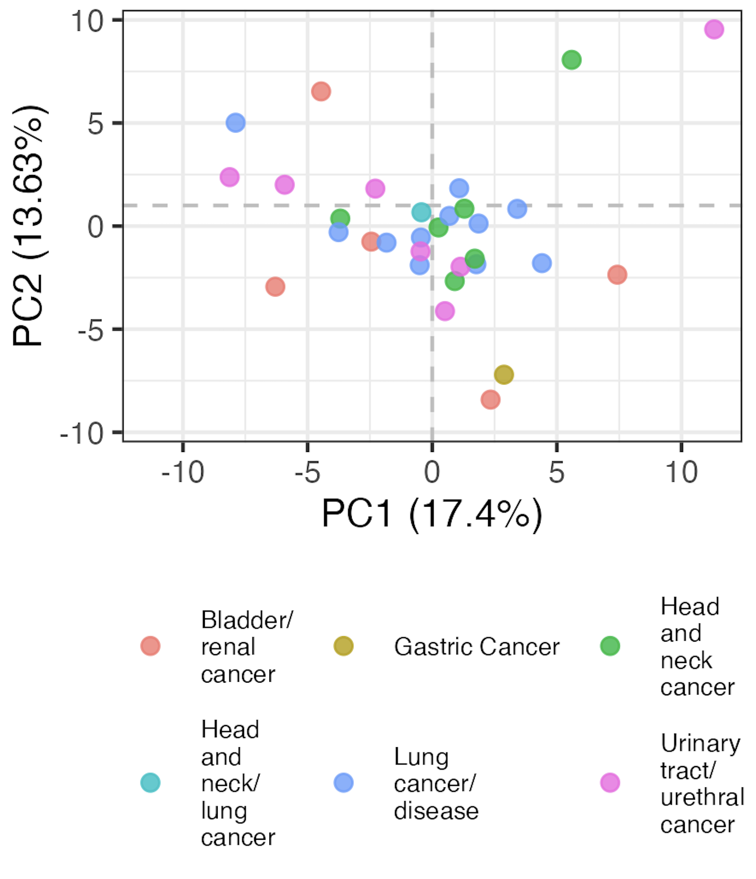
Baseline head, neck, and lung cancer immunotypes are distinct from other cancer subtypes

Slide 6
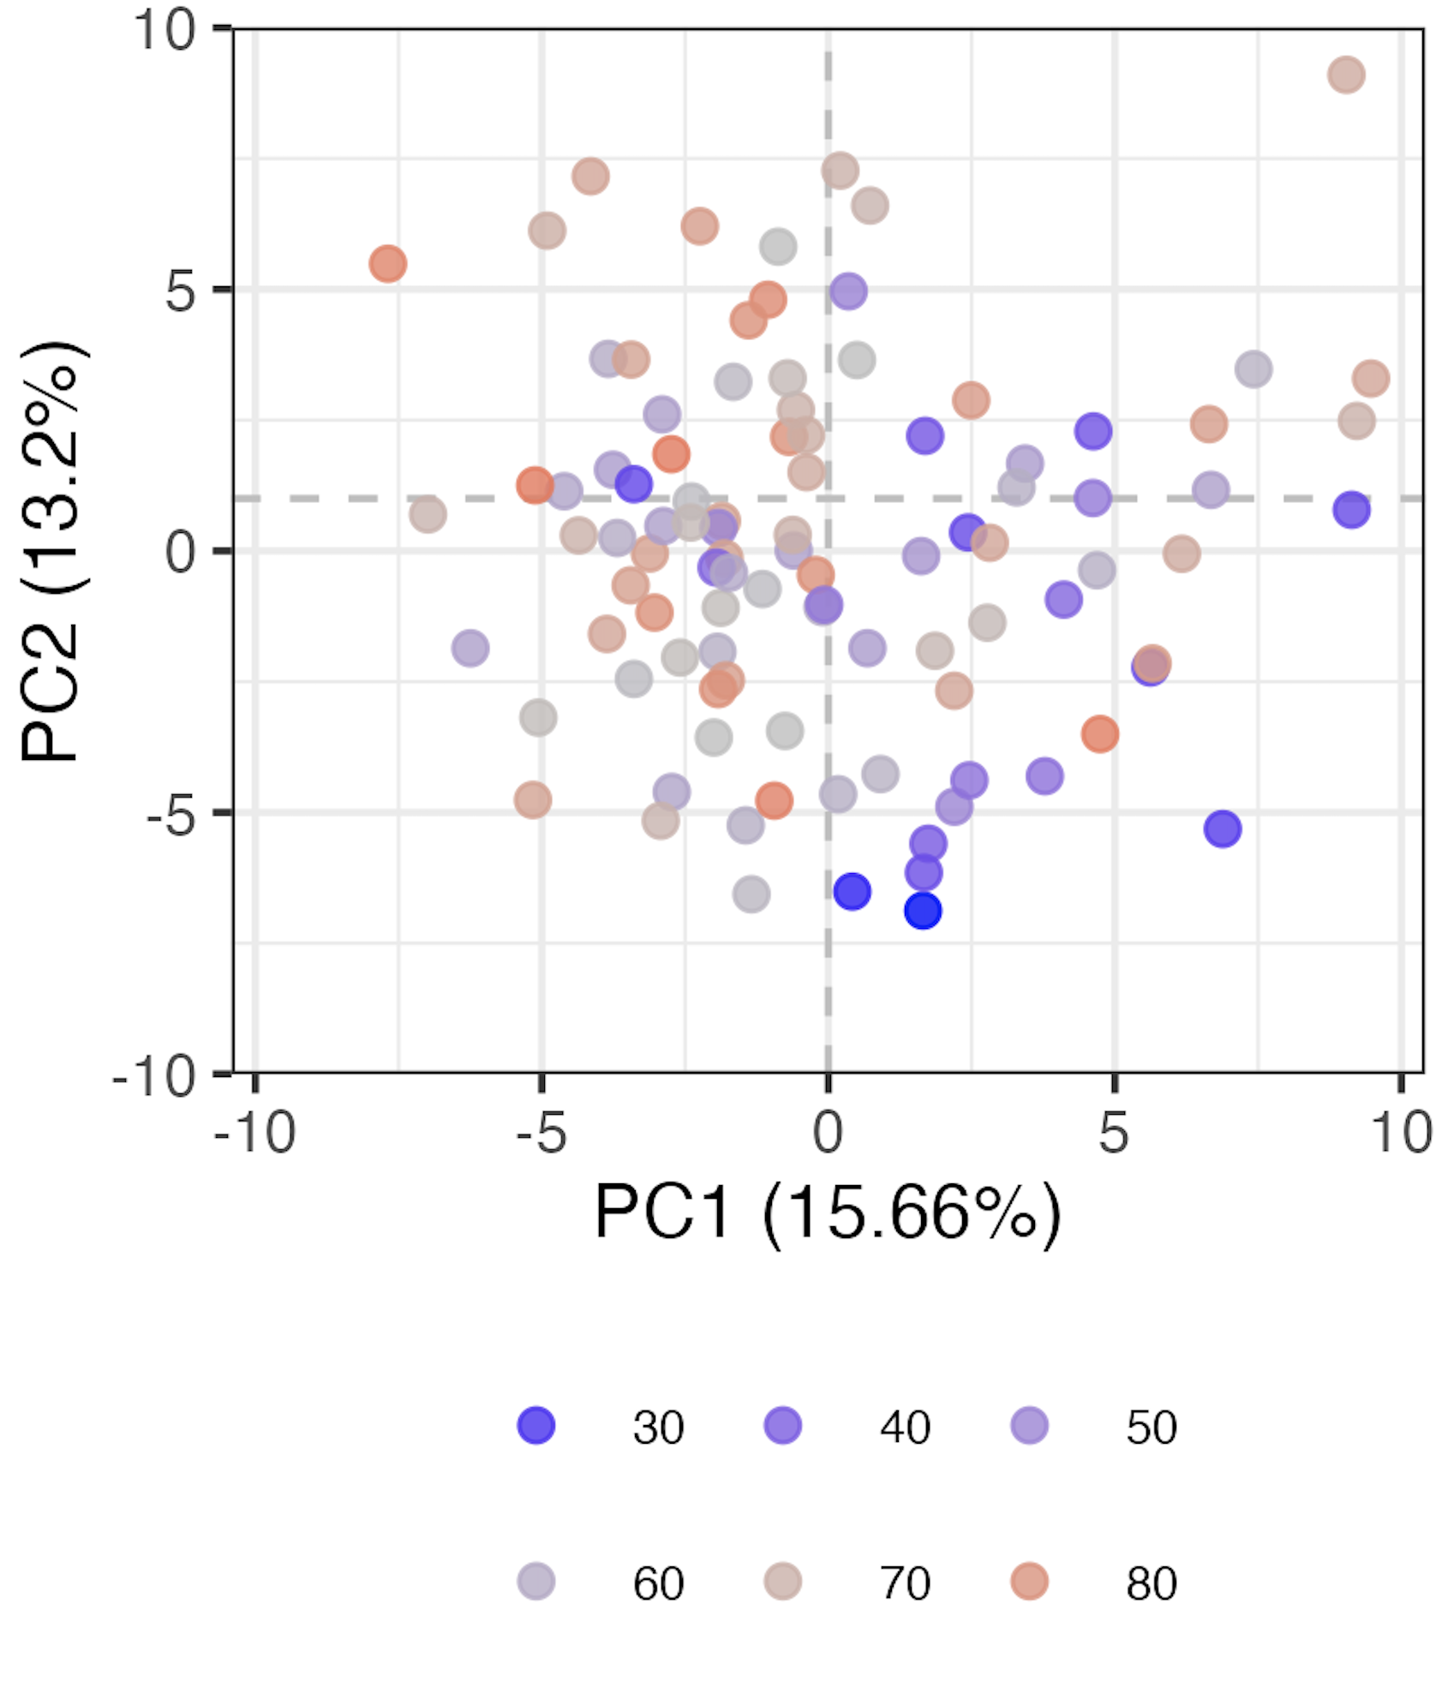
Age contributes to variation (baseline samples)
Age

Slide 7
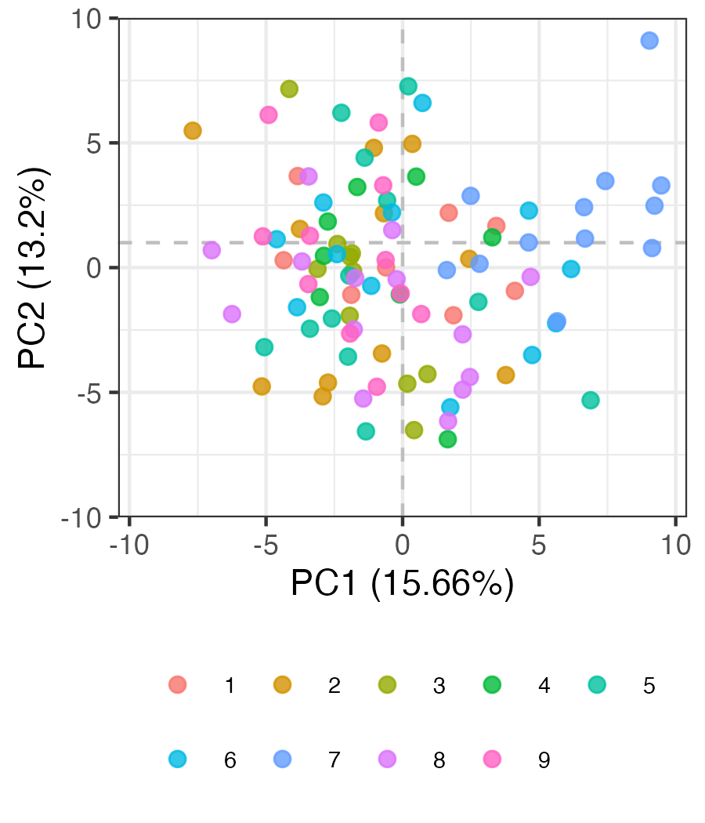
Some evidence of batch effects in baseline data
Batch #
Notes:
Batch 7 kind of all clustering together in bottom left…

Slide 8
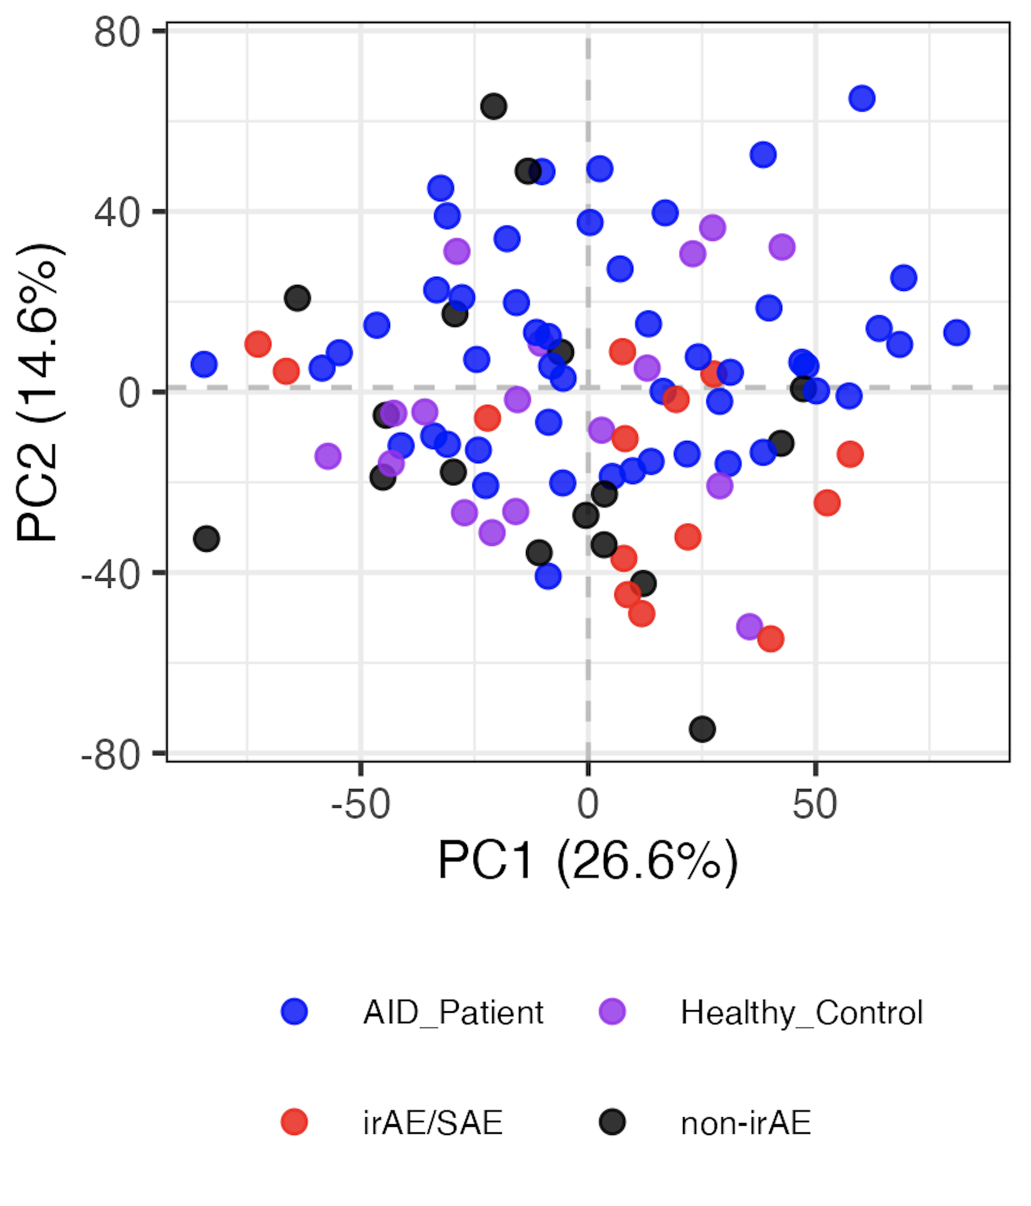
Regressing out batch from baseline samples doesn’t reveal clearly distinct immunotypes
Batch regressed out
Notes:
Left is normal logit
Right is residuals from linear models with age and Batch as confounders

Slide 9
Conclusions
Baseline immunotypes are not distinct by general group, even after regressing batch out
ICA does not appear better at distinguishing unique immunotypes by group (baseline) than PCA
AID subgroup immunotypes are not very distinct either
baseline head, neck, and lung cancer subgroup immunotypes are distinct from other cancer subtypes
age contributes to variation (baseline samples)
data not shown
subtracting ICI/ICI+group effects from baseline does not uncover features different between irAE groups
don’t see effect of previous treatments (radiation, chemoradiation…) on baseline cancer immunotypes
including all features at baseline (even those with high technical variation) does not reveal distinct immunotypes by irAE group

Slide 10
Next steps
Do severe irAE (high grade) patient immunotypes appear distinct from non-severe irAE patient immunotypes at baseline? Re-do all analyses w/ irAE grade rather than arbitrary severity split
IMPACD: using hierarchical/combinatory gating, do we see distinct immunotypes by irAE group

Slide 11

Acknowledgements
Holly Akilesh

Slide 12
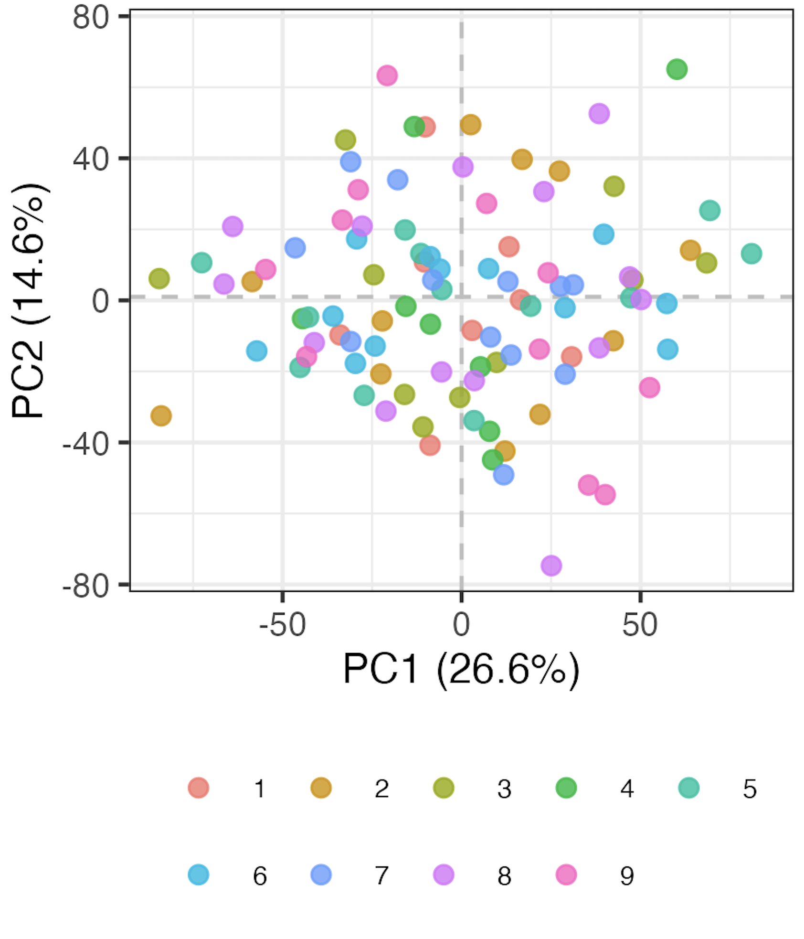
No longer see batch effects after regressing batch out
Batch #

Slide 13
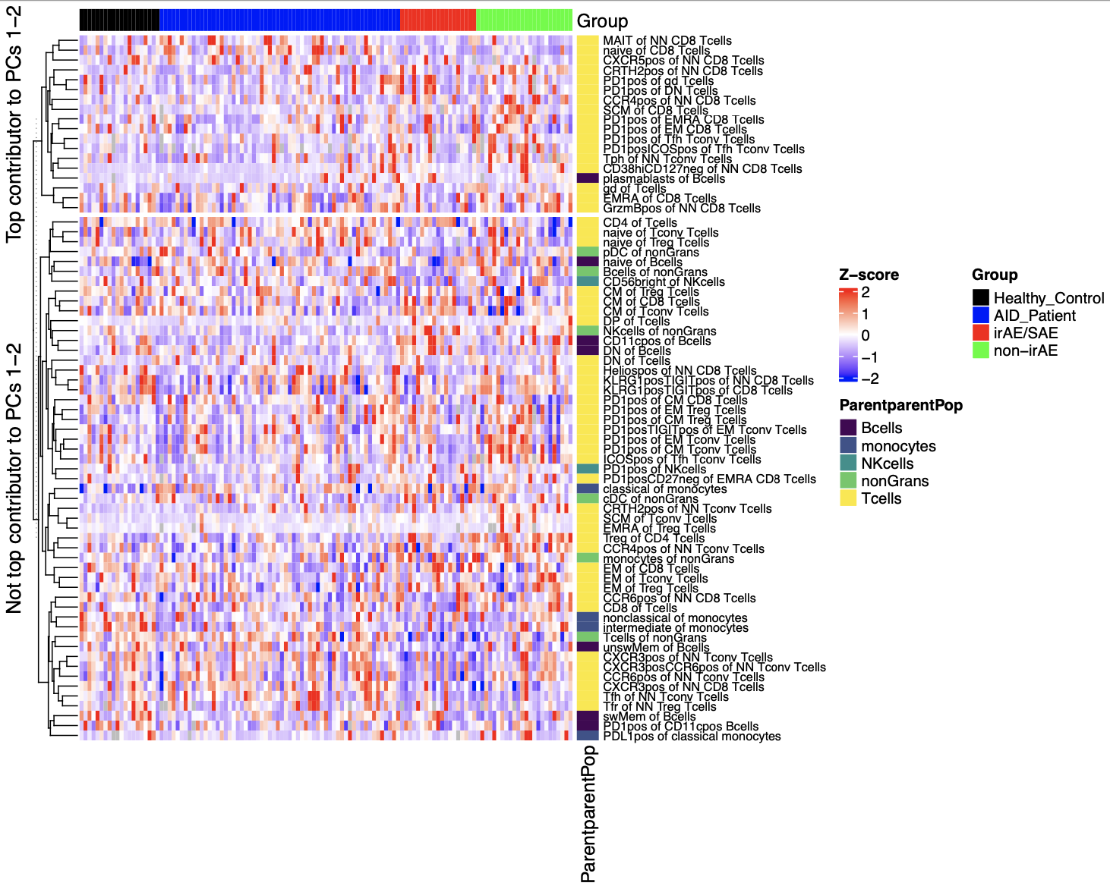
Certain features contribute more to variation (baseline)

