Slide 1
Weekly meeting
11 7 2024
Ty Bottorff

Slide 2
Outline
MT SNV sharing (Upset plot) analyses
Baseline cancer CyTOF irAE vs. no irAE analyses

Slide 3
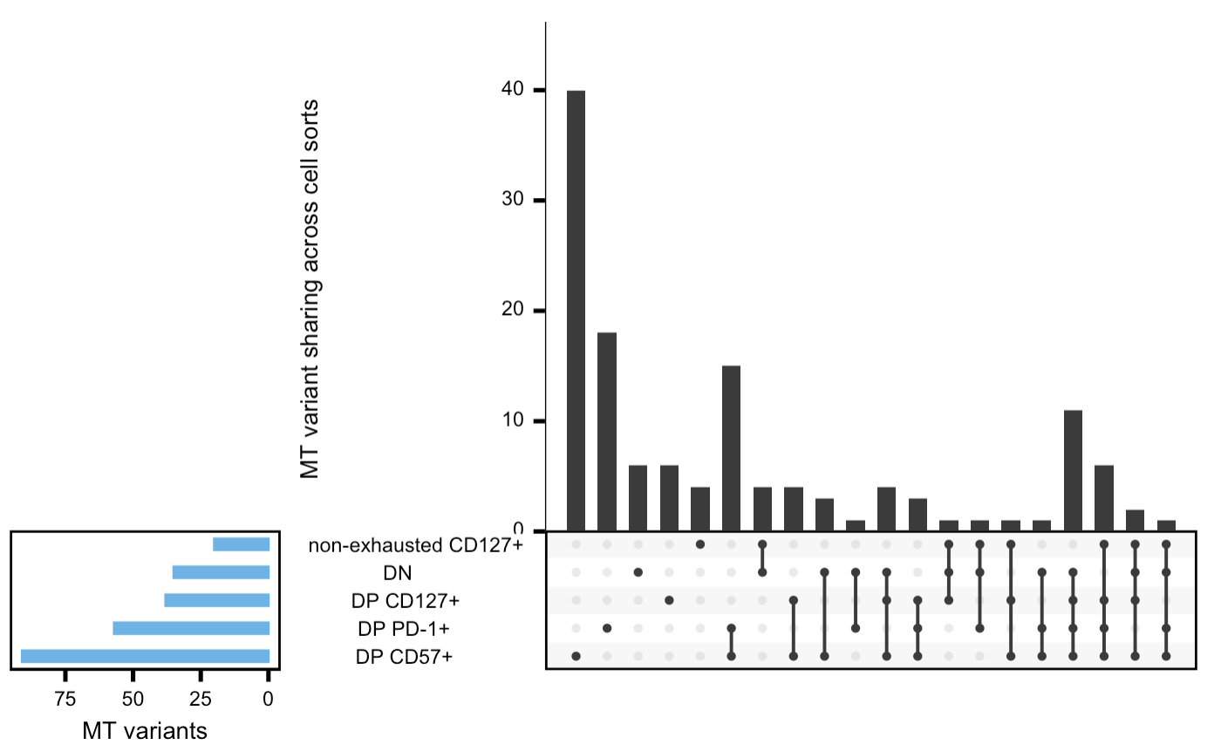
Based on SNV sharing, unable to differentiate which is more parent among DN and non-exhausted CD127⁺
SNVs shared w/ 3 DP
Total SNVs
Notes:
1) DN slightly higher for total SNVs, ~similar for unique SNVs
2) similar ratio between total SNVs and SNVs shared w/ 3 DP

Slide 4
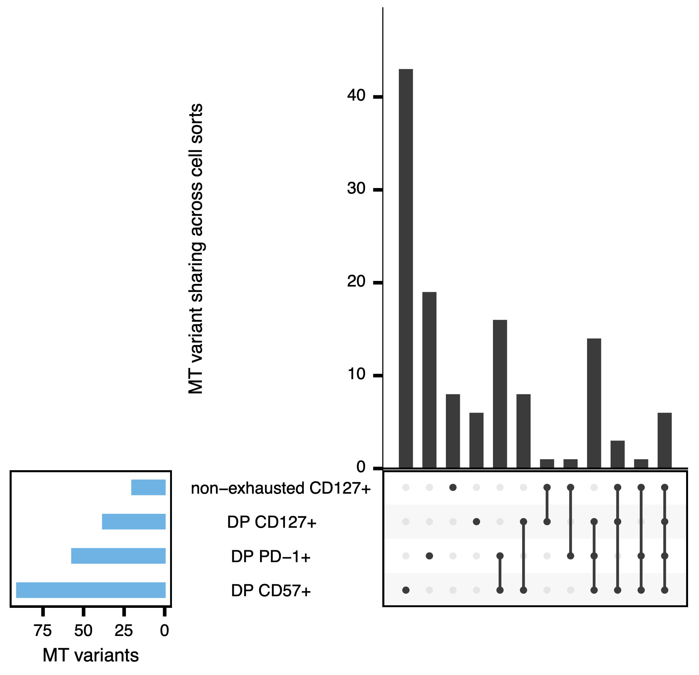
DP CD127⁺ more terminal than non-exhausted CD127⁺
Notes:
1) DP has more SNVs
2) Ratio of shared w/ DP to total much higher in DP (closer in lineage to other DPs)

Slide 5
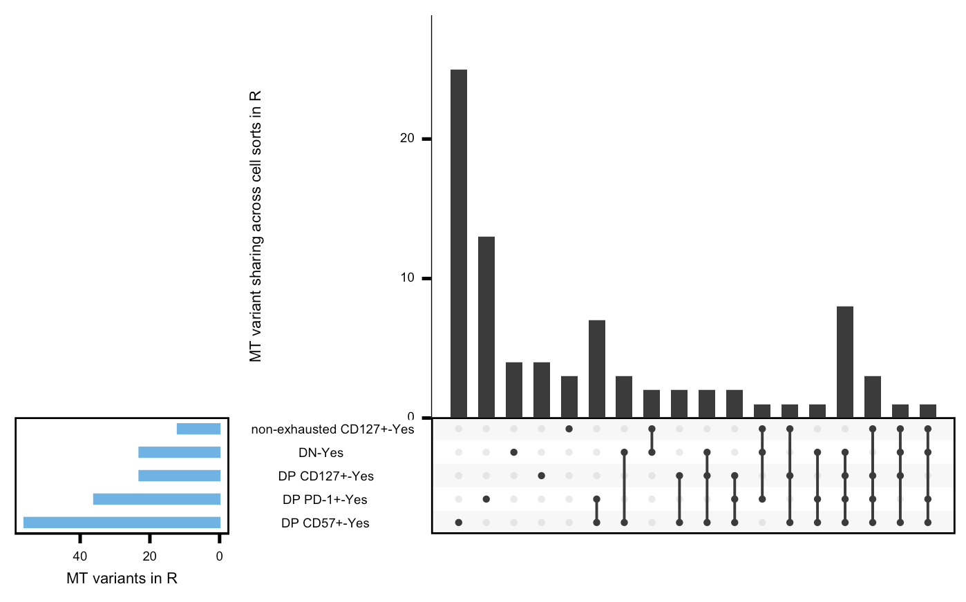
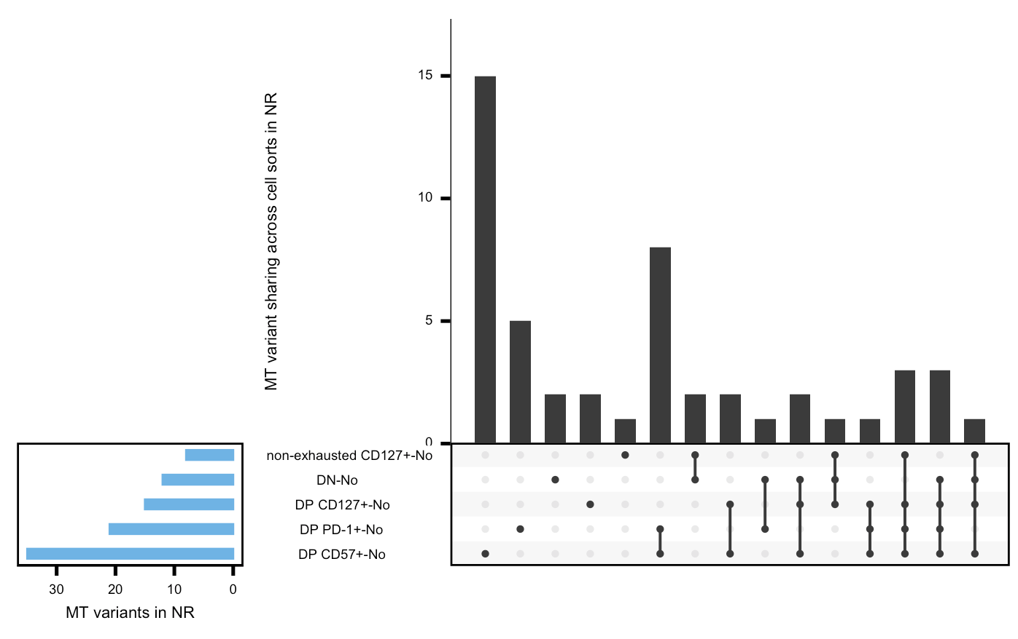
MT SNV sharing in responders and non-responders looks similar
Notes:
Ask Peter if he would like this emailed to look at

Slide 6
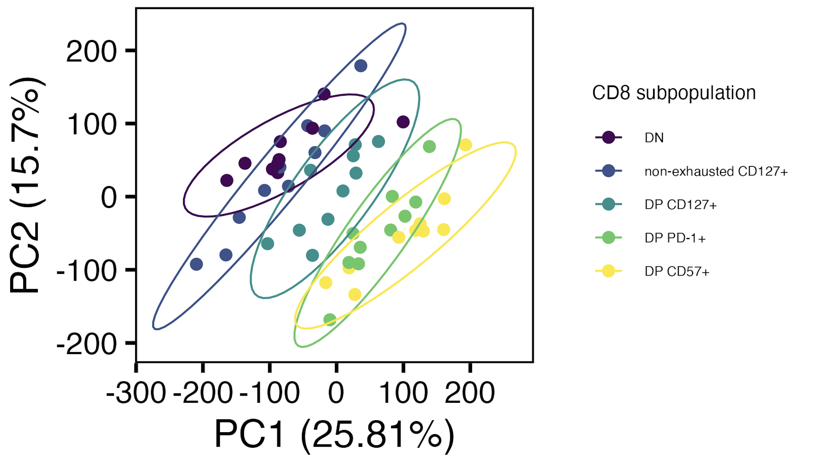
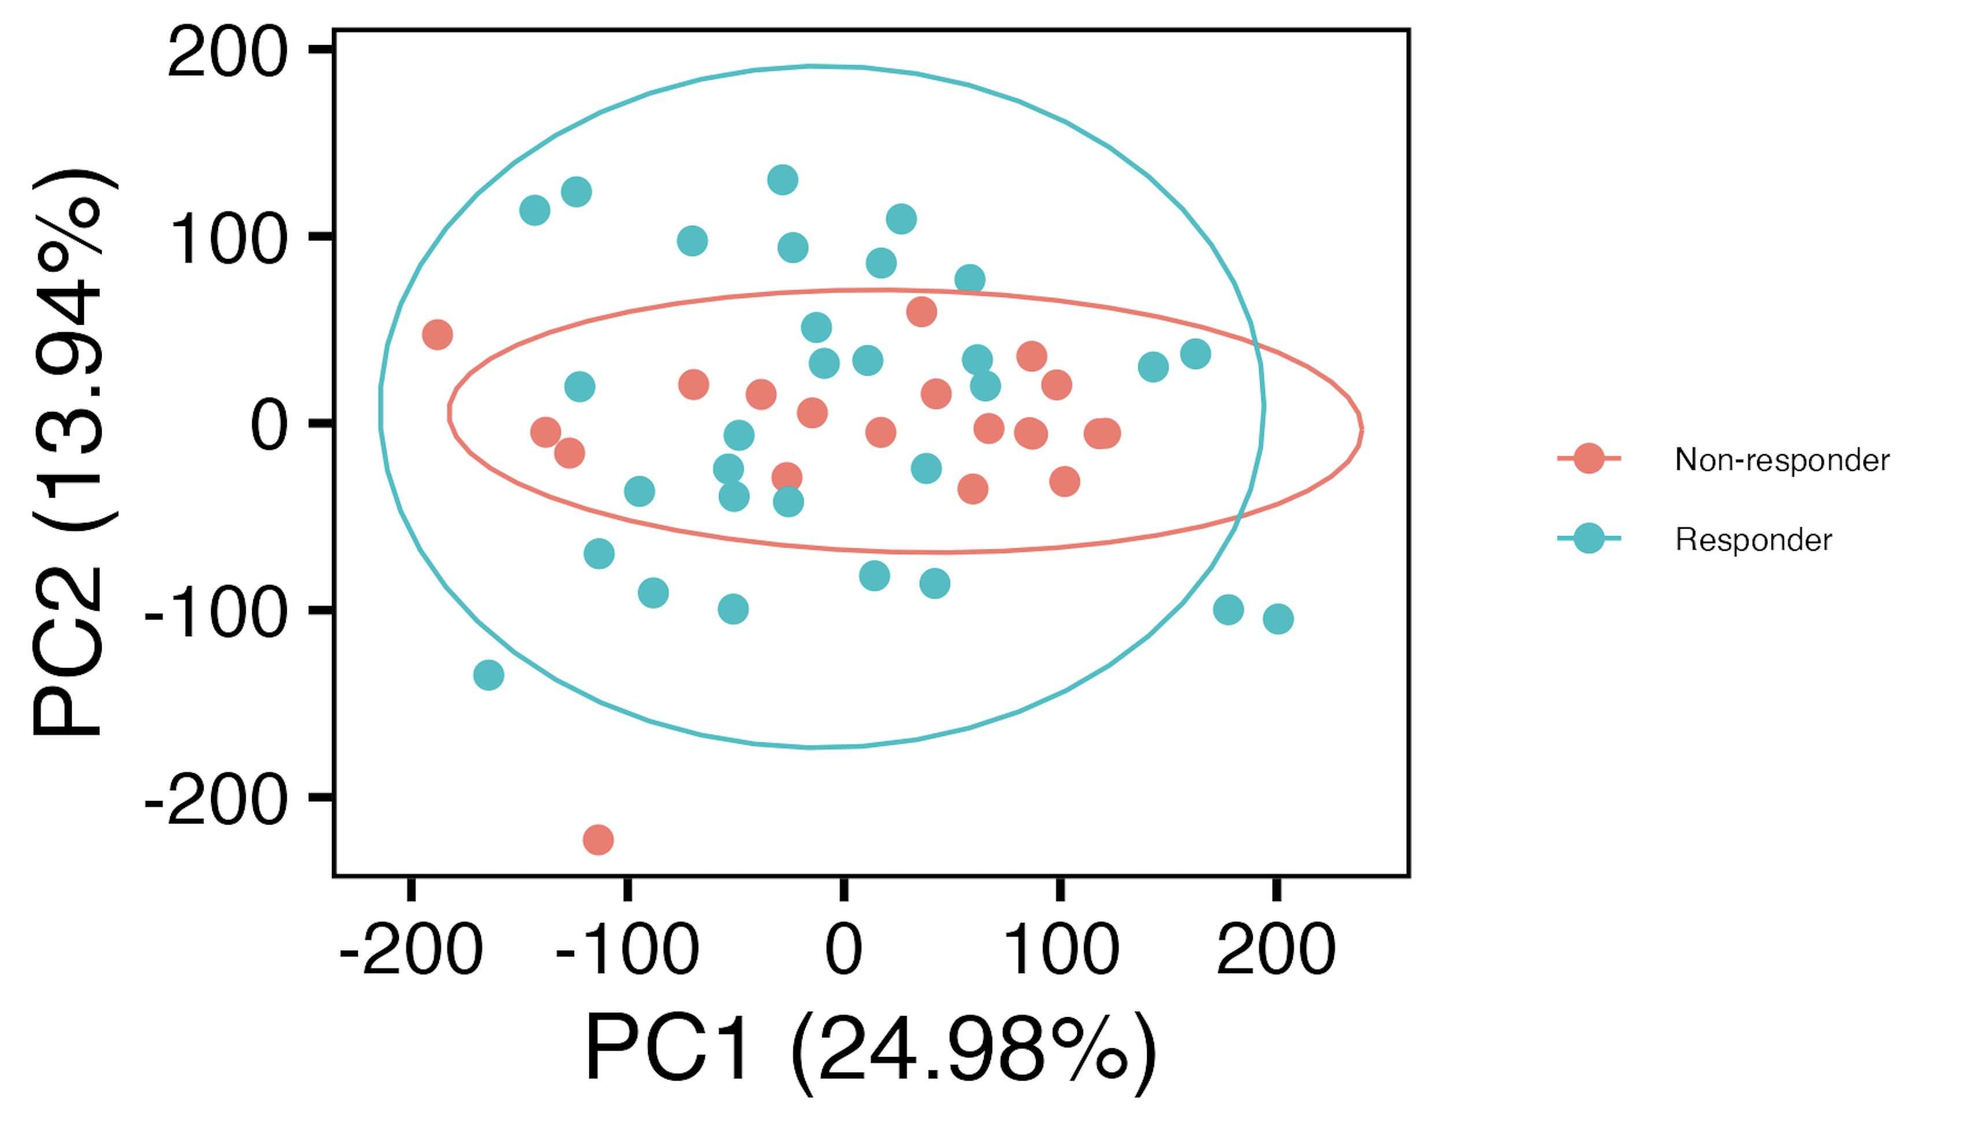
AbATE PCAs revisited
Notes:
subpopulations significantly different in PCs 1-2 (p < 0.001)
Left, regressing out R/NR, right regressing out sort

Slide 7
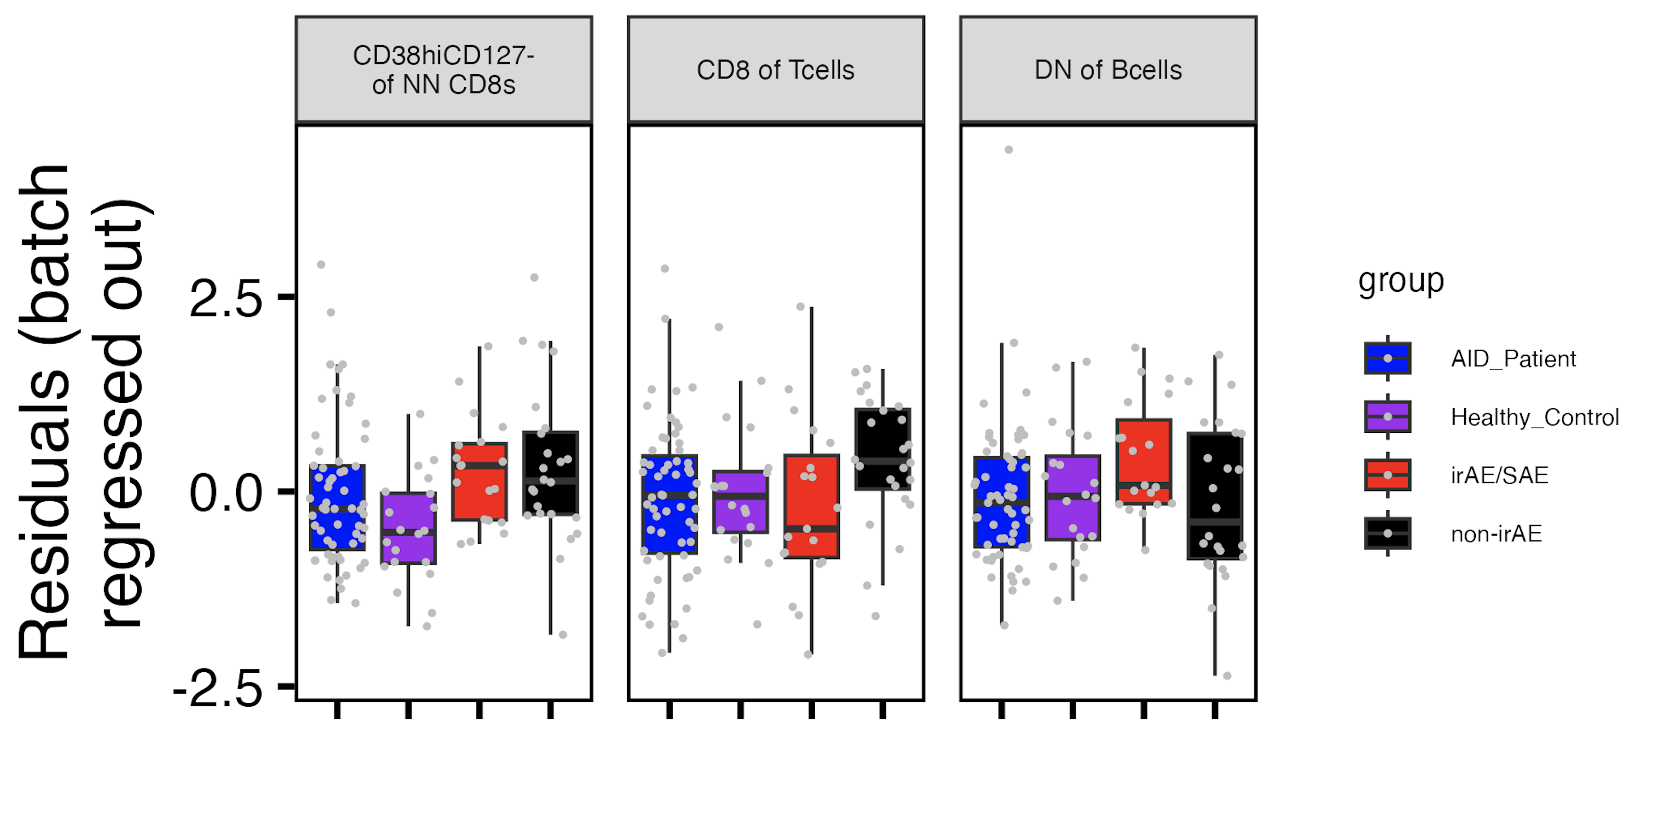
Literature-driven feature analysis
Trending in expected
direction?
Yes
No
Yes
Notes:
Batch regressed out here, logit+zscore (which ~changed CD38 interpretation a bit maybe)

Slide 8
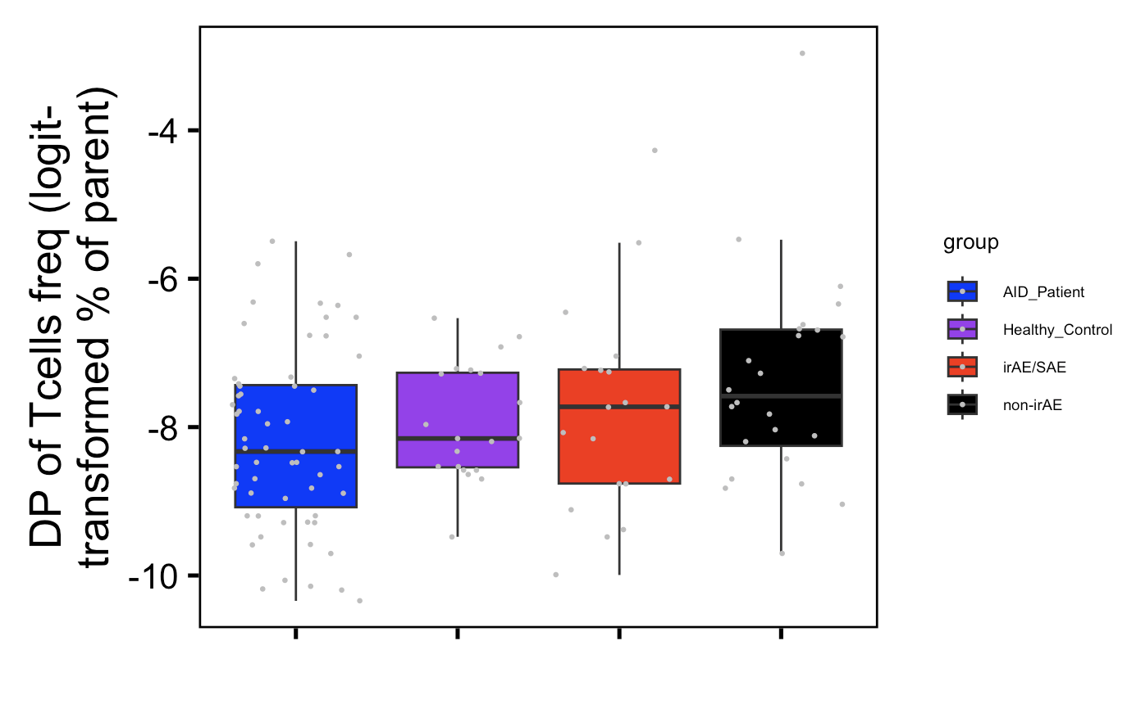
DP frequency does trend higher in non-irAE group
Notes:
Also maybe interesting to note that DP freq is lower in AID than HC (a kind of analog for irAE vs. no irAE perhaps)
so DP of Tcells (exhausted-like, expected higher in non-irAE) is one of the cut features with NA issue…, so can only look at not batch corrected data for that
logit = ln(x/(1-x)) where 0<x<1 (so decimals of %s). when x = 0.5 logit(x) = 0, when x approaches 0 logit(x) approaches -inf, when x approaches 1 logit(x) approaches +inf
Not z-scored

Slide 9
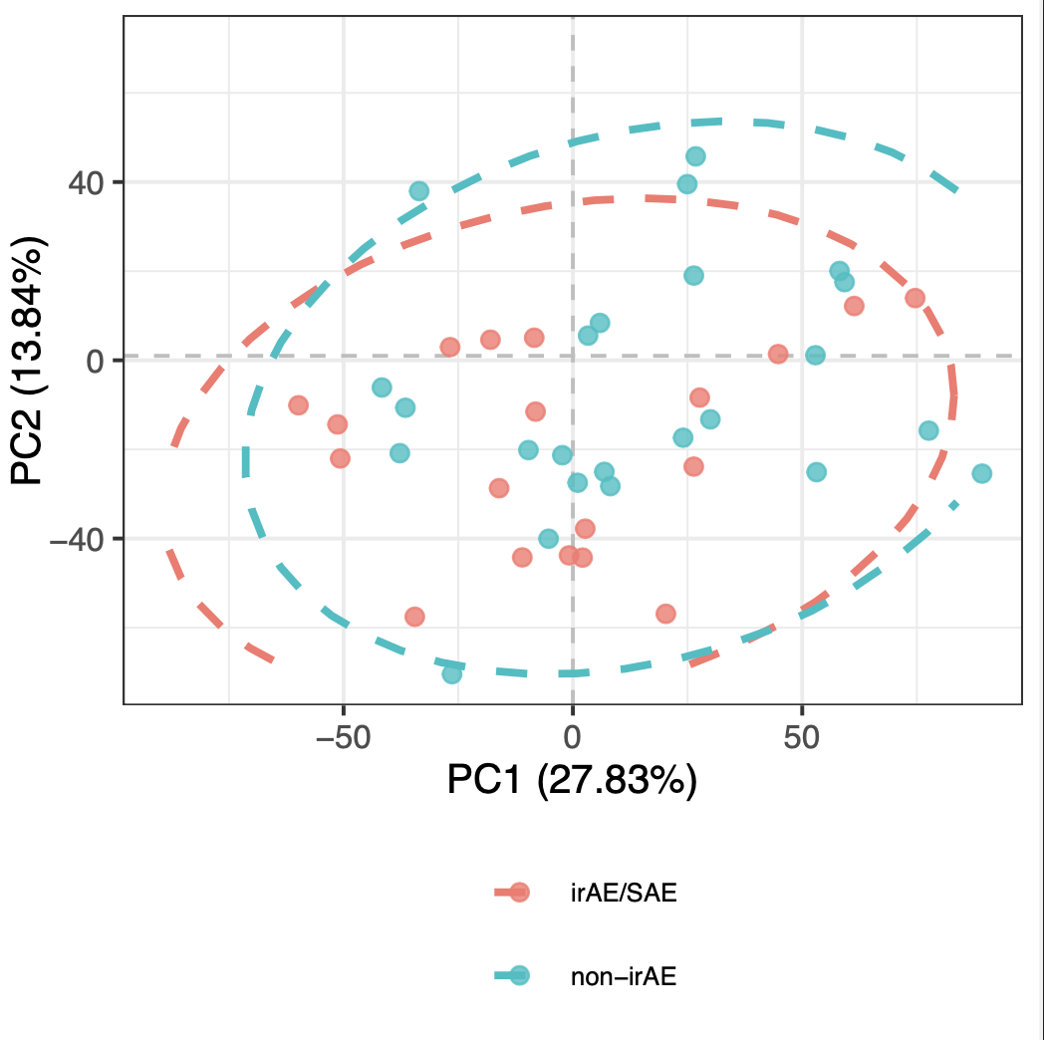
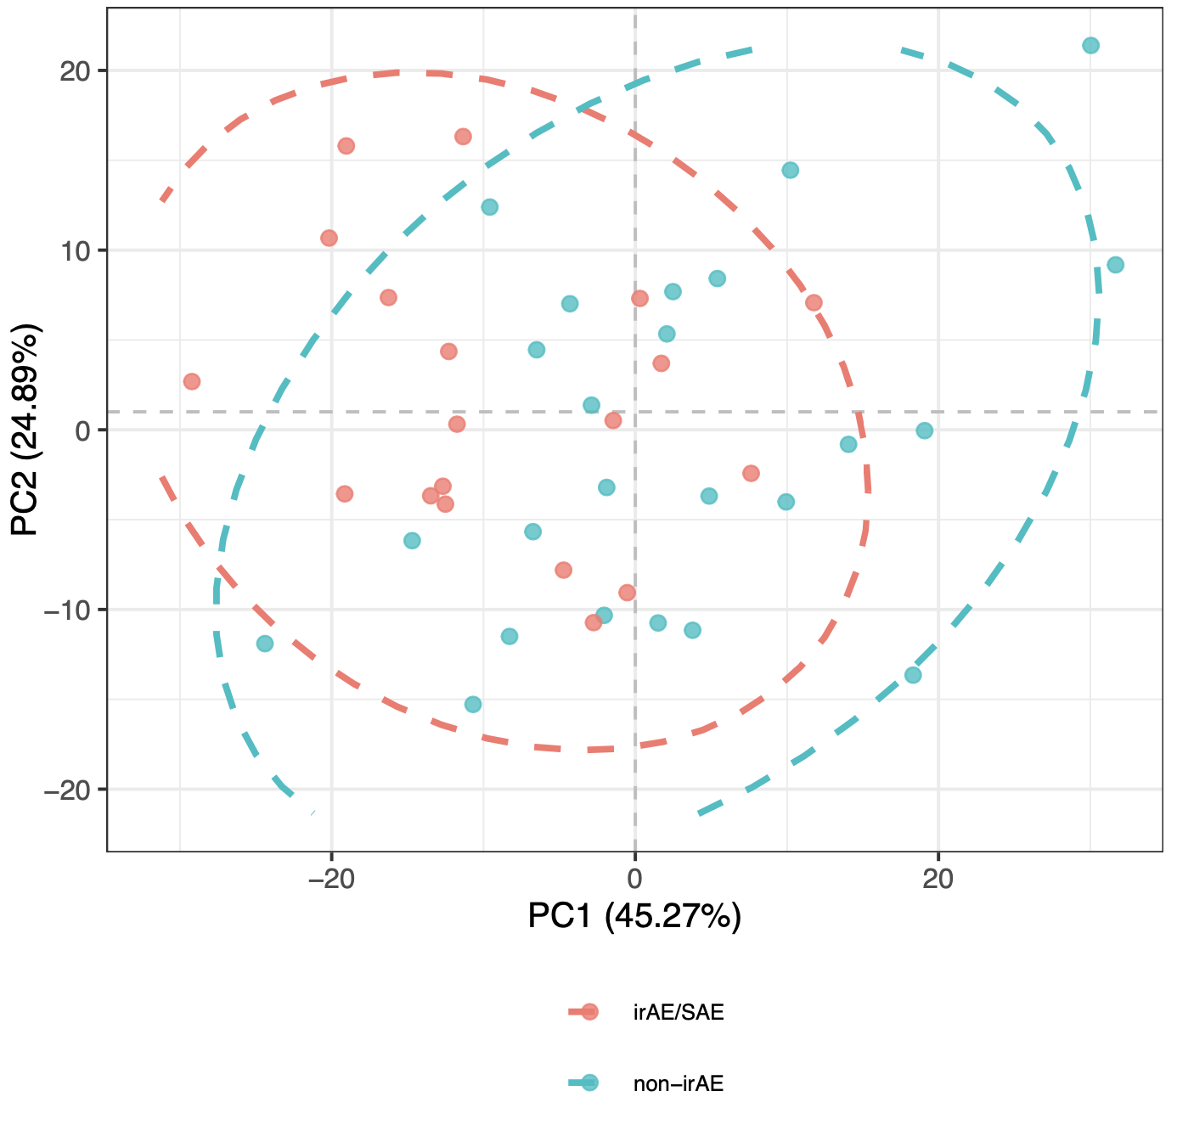
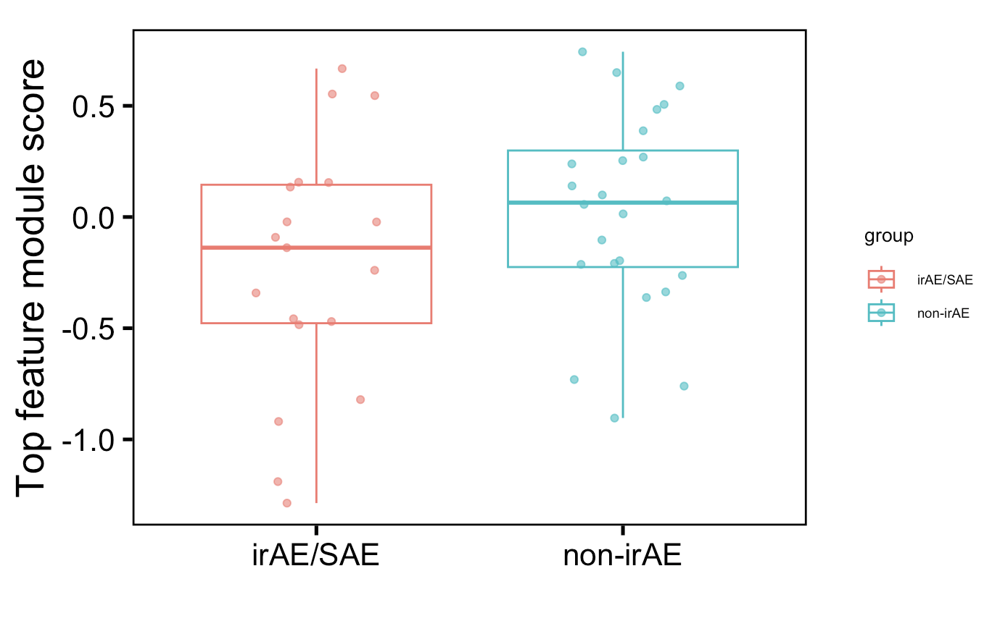
Baseline cancer immunotypes from those with/without irAEs very similar
All features
Top 6 features
ns
Notes:
ellipse center is centroid, and width/height determined by data spread/variance
Batch regressed out here

Slide 10
Conclusions
AbATE MT SNV data
from SNV sharing, unable to differentiate which is more parent among DN and non-exhausted CD127⁺
DP CD127⁺ more terminal than non-exhausted CD127⁺
MT SNV sharing in responders and non-responders to teplizumab looks similar
HC + untreated T1D: groups of cells later in pseudotime have less diverse TCRs (data not shown)
NCI irAE
published results not always consistent in our data
DP frequency does trend higher in non-irAE group
baseline cancer immunotypes from those with/without irAEs are very similar (do not see strong enrichment of irAE/no irAE groups in clusters in PCA space, data not shown)

Slide 11
Next steps
Compare CD127 expression between 2 progenitor clusters in T1DAL
NCI irAE
see if clusters in ICA space enriched for study group
look for correlations between feature freqs and time to irAE onset
summarize cohort info: time to treatment/irAE, previous therapy, irAE type…
IMPACD
Notes:
Have been having rstudio server issues…

Slide 12
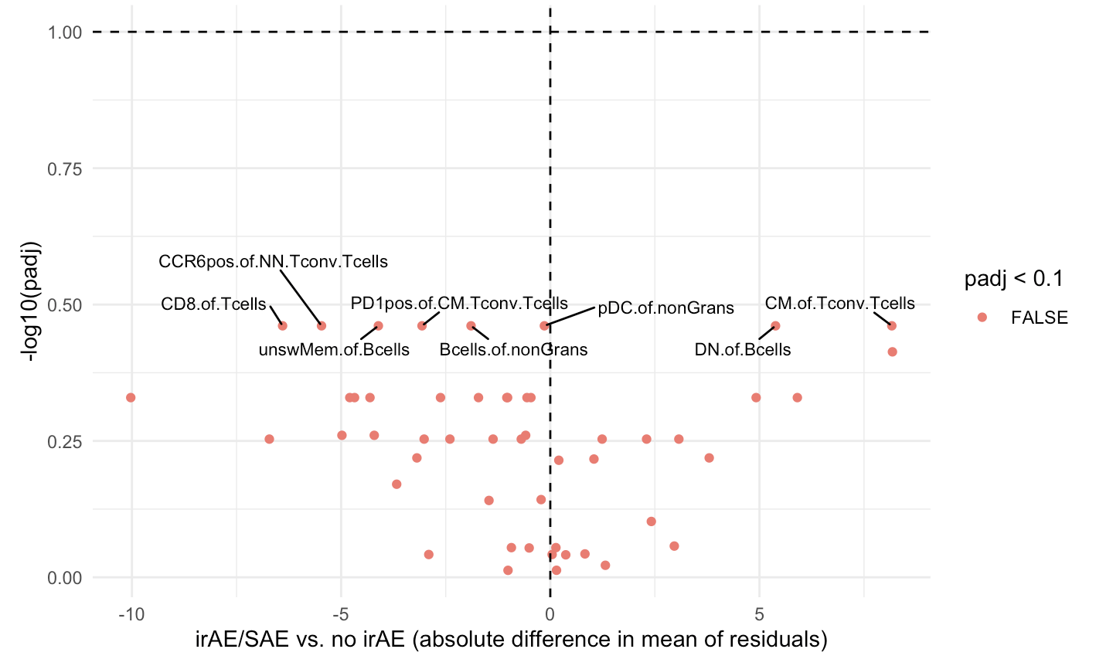
Baseline cancer immunotypes from those with/without irAEs very similar
Notes:
Batch regressed out here

Slide 13
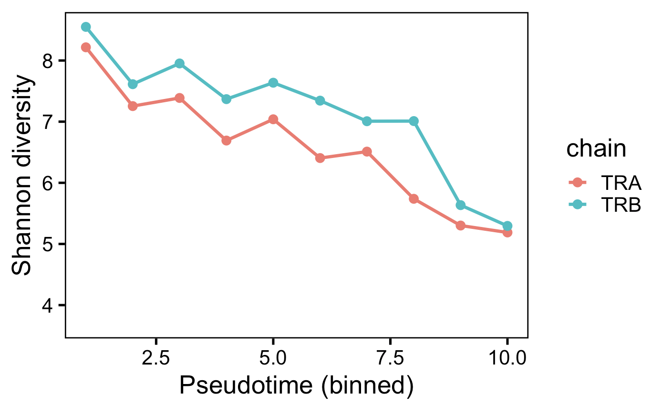
HC + untreated T1D: groups of cells later in pseudotime have less diverse TCRs
Notes:
Much less drastic differences if using Simpson diversity, which is less sensitive to rare clonotypes…
Shannon entropy/diversity same thing…
Consistent with use of CD57 as a marker of antigen experience

Slide 14
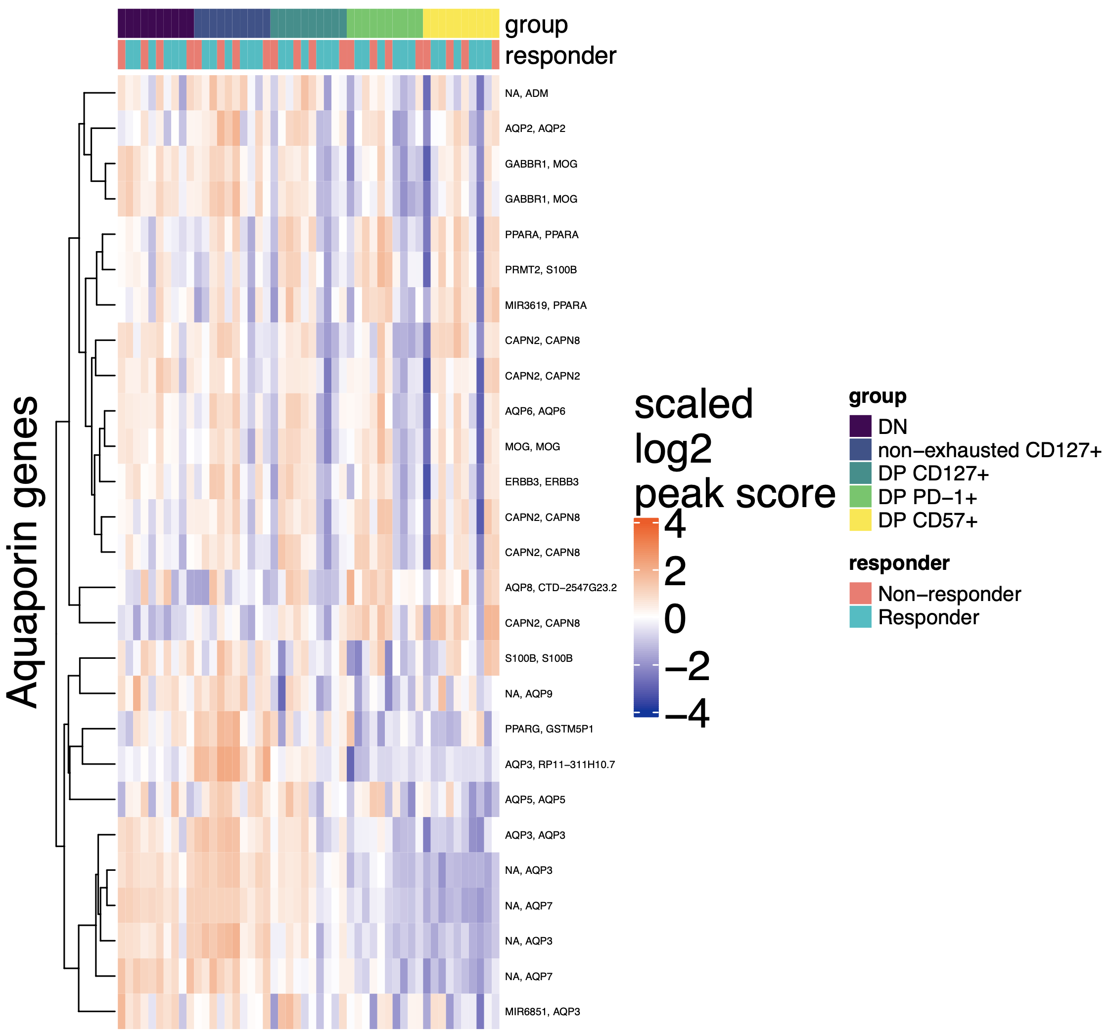
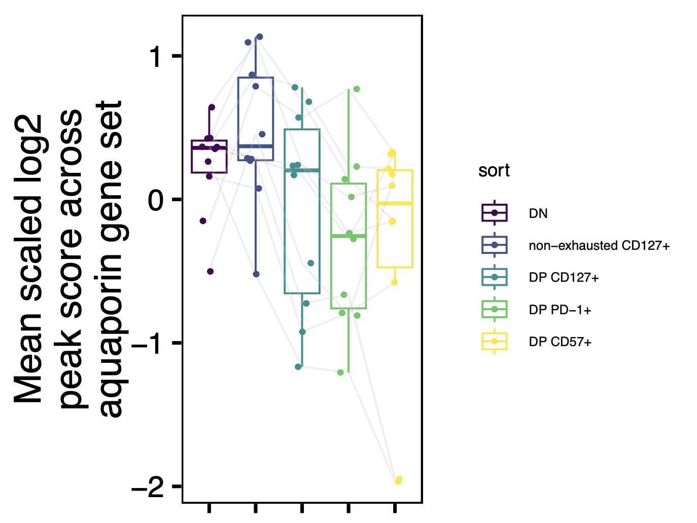
Aquaporin gene set less accessible in more terminal populations
AQP3 co-expressed with IL7R in human T cells (Szabo et al. (2019), Nat commun)
Notes:
Gene set: 22 genes co-occuring with the biological term aquaporin in literature-supported statements describing functions of genes from the GeneRIF Biological Term Annotations dataset
From https://maayanlab.cloud/Harmonizome/gene_set/aquaporin/GeneRIF+Biological+Term+Annotations
Some aquaporins like AQP9 also import glycerol, metabolic changes?
AQP1, AQP3, and AQP5 expressed in activated B and T lymphocytes

