Slide 1
Weekly meeting
6 13 2024
Ty Bottorff

Slide 2
Outline
P576
MT sequence variant analyses
R vs. NR DARs (across cell sorts)

Slide 3
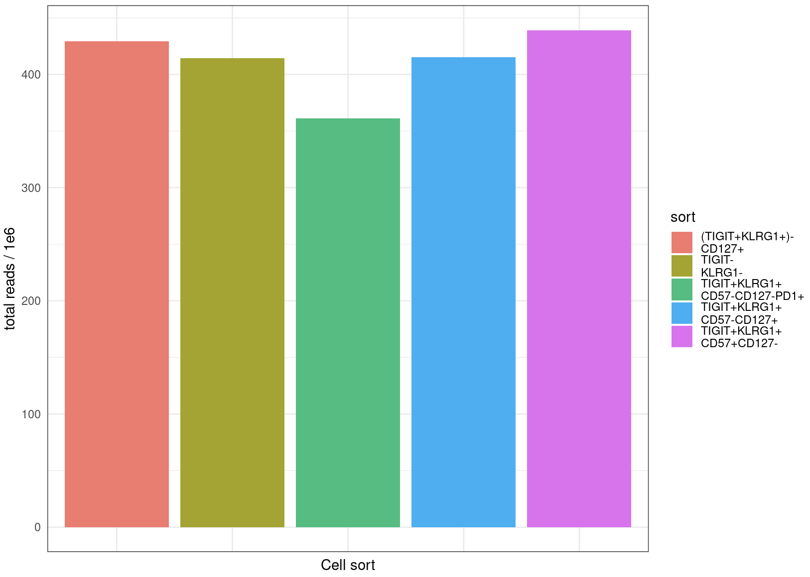
Read counts are comparable between cell sorts

Slide 4
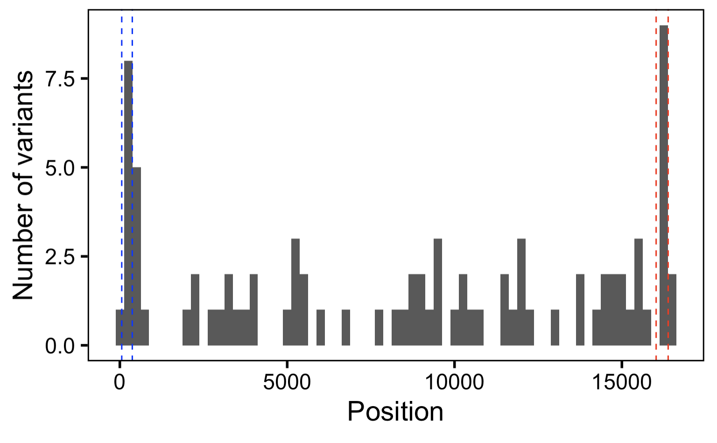
As expected, do observe more MT variants within hypervariable regions
HV2
HV1
Notes:
Bin width 250 bp

Slide 5
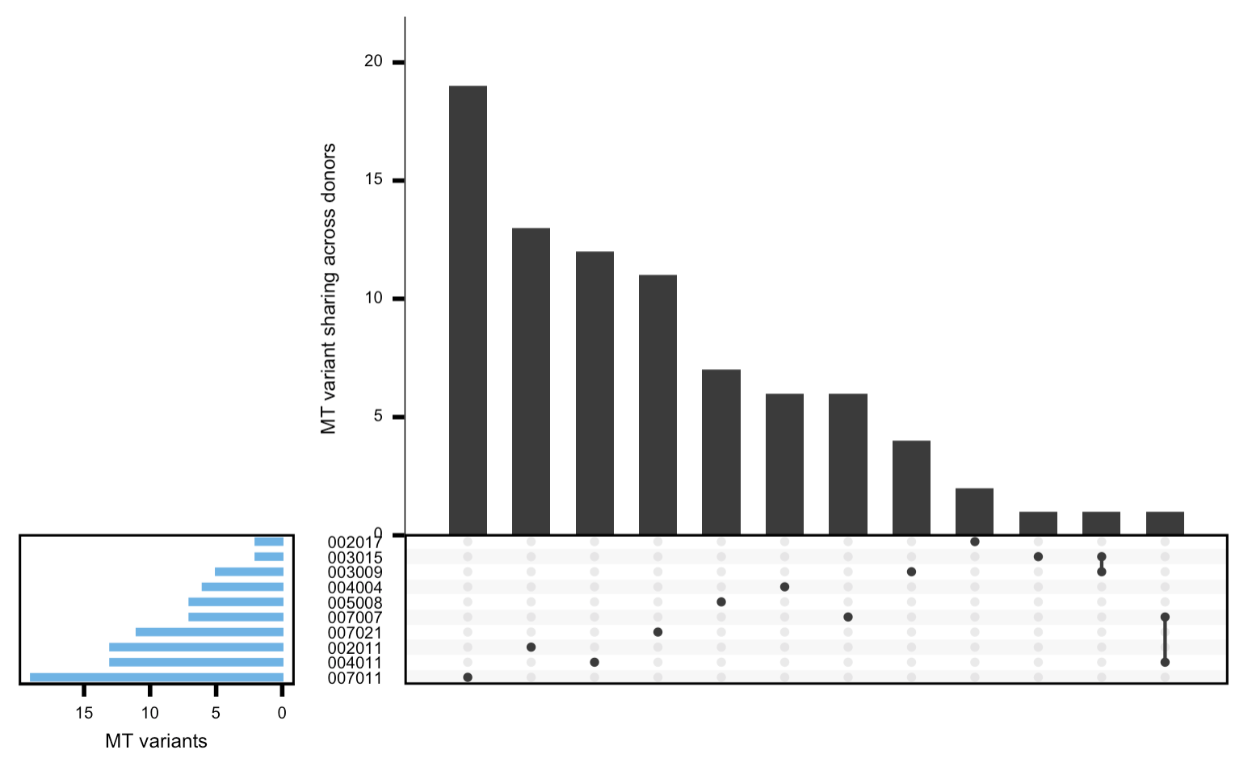
As expected, most MT variants are private within a donor

Slide 6
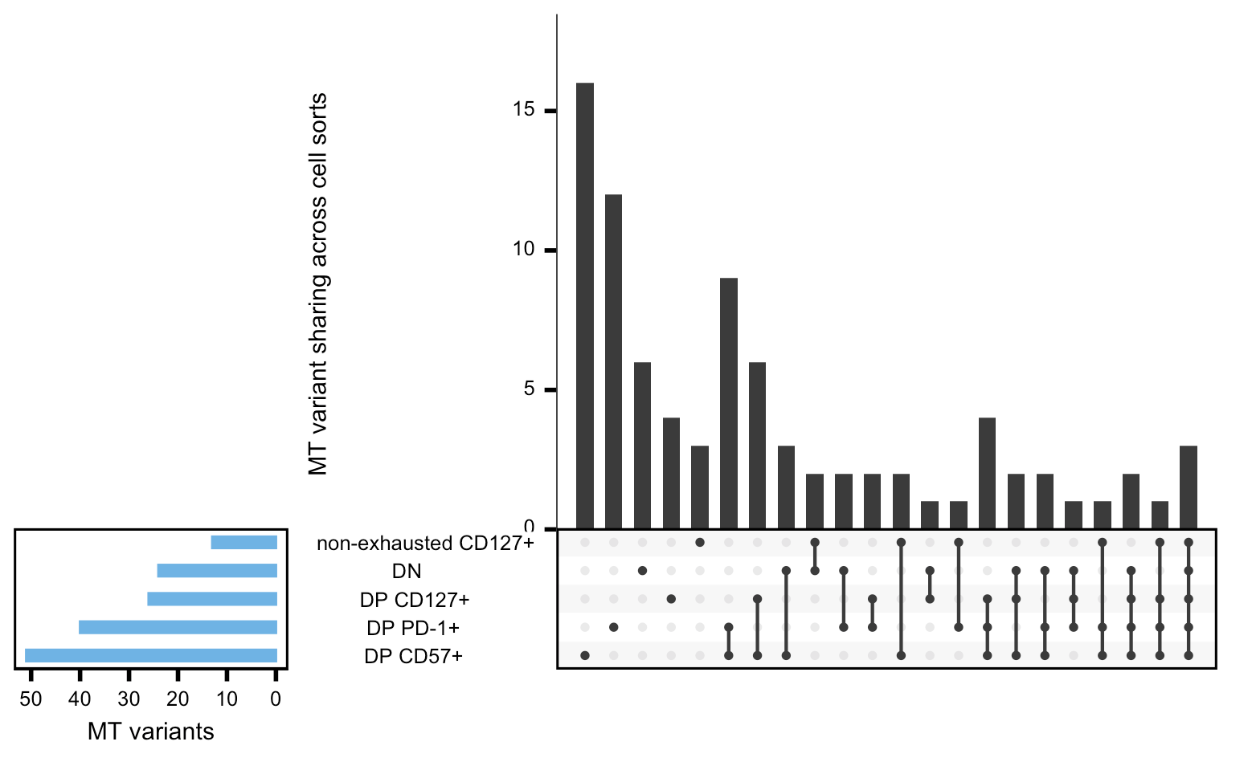
With more stringent parameters, obtain many fewer variants but still observe similar trends (DPs PD-1⁺/CD57⁺ high sharing, all 3 DPs high sharing)
Notes:
--min_coverage 20 (was 8 previously, default) --min-var-freq 0.01 --p-value 0.1 (was 0.99 previously, default)
AND
Now filtering based on ref AND var
var_supporting_reads_on_plus_strand > 2,
var_supporting_reads_on_minus_strand > 2,
ref_supporting_reads_on_plus_strand > 2,
ref_supporting_reads_on_minus_strand > 2,
var_supporting_reads_on_plus_strand / (var_supporting_reads_on_plus_strand + var_supporting_reads_on_minus_strand) > 0.3,
var_supporting_reads_on_plus_strand / (var_supporting_reads_on_plus_strand + var_supporting_reads_on_minus_strand) < 0.7,
ref_supporting_reads_on_plus_strand / (ref_supporting_reads_on_plus_strand + ref_supporting_reads_on_minus_strand) > 0.3,
ref_supporting_reads_on_plus_strand / (ref_supporting_reads_on_plus_strand + ref_supporting_reads_on_minus_strand) < 0.7)

Slide 7
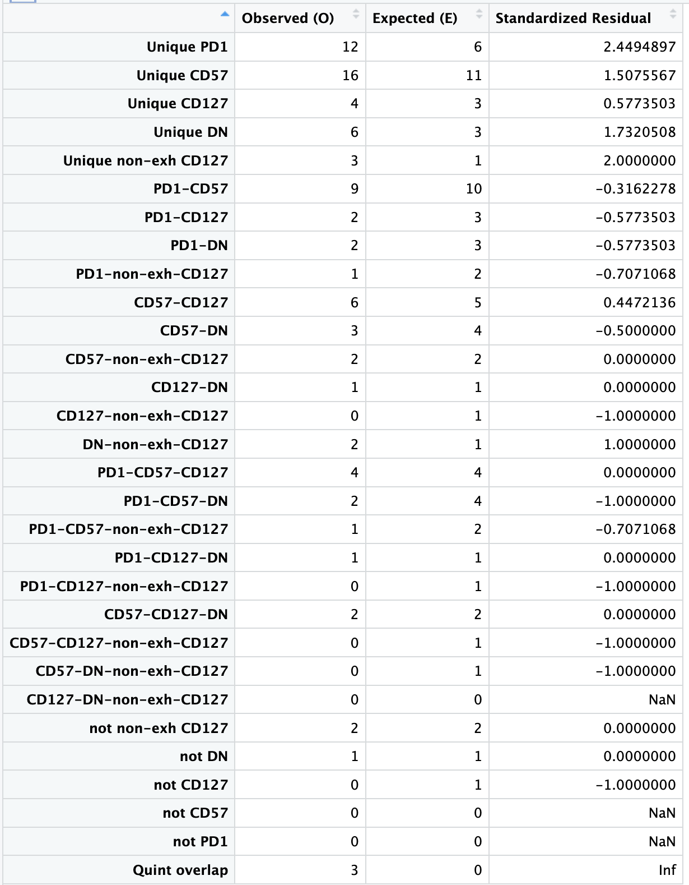
However, trends do seem to just be due to different set sizes (O ~= E), although there are more unique variants/cell sort than expected

Slide 8
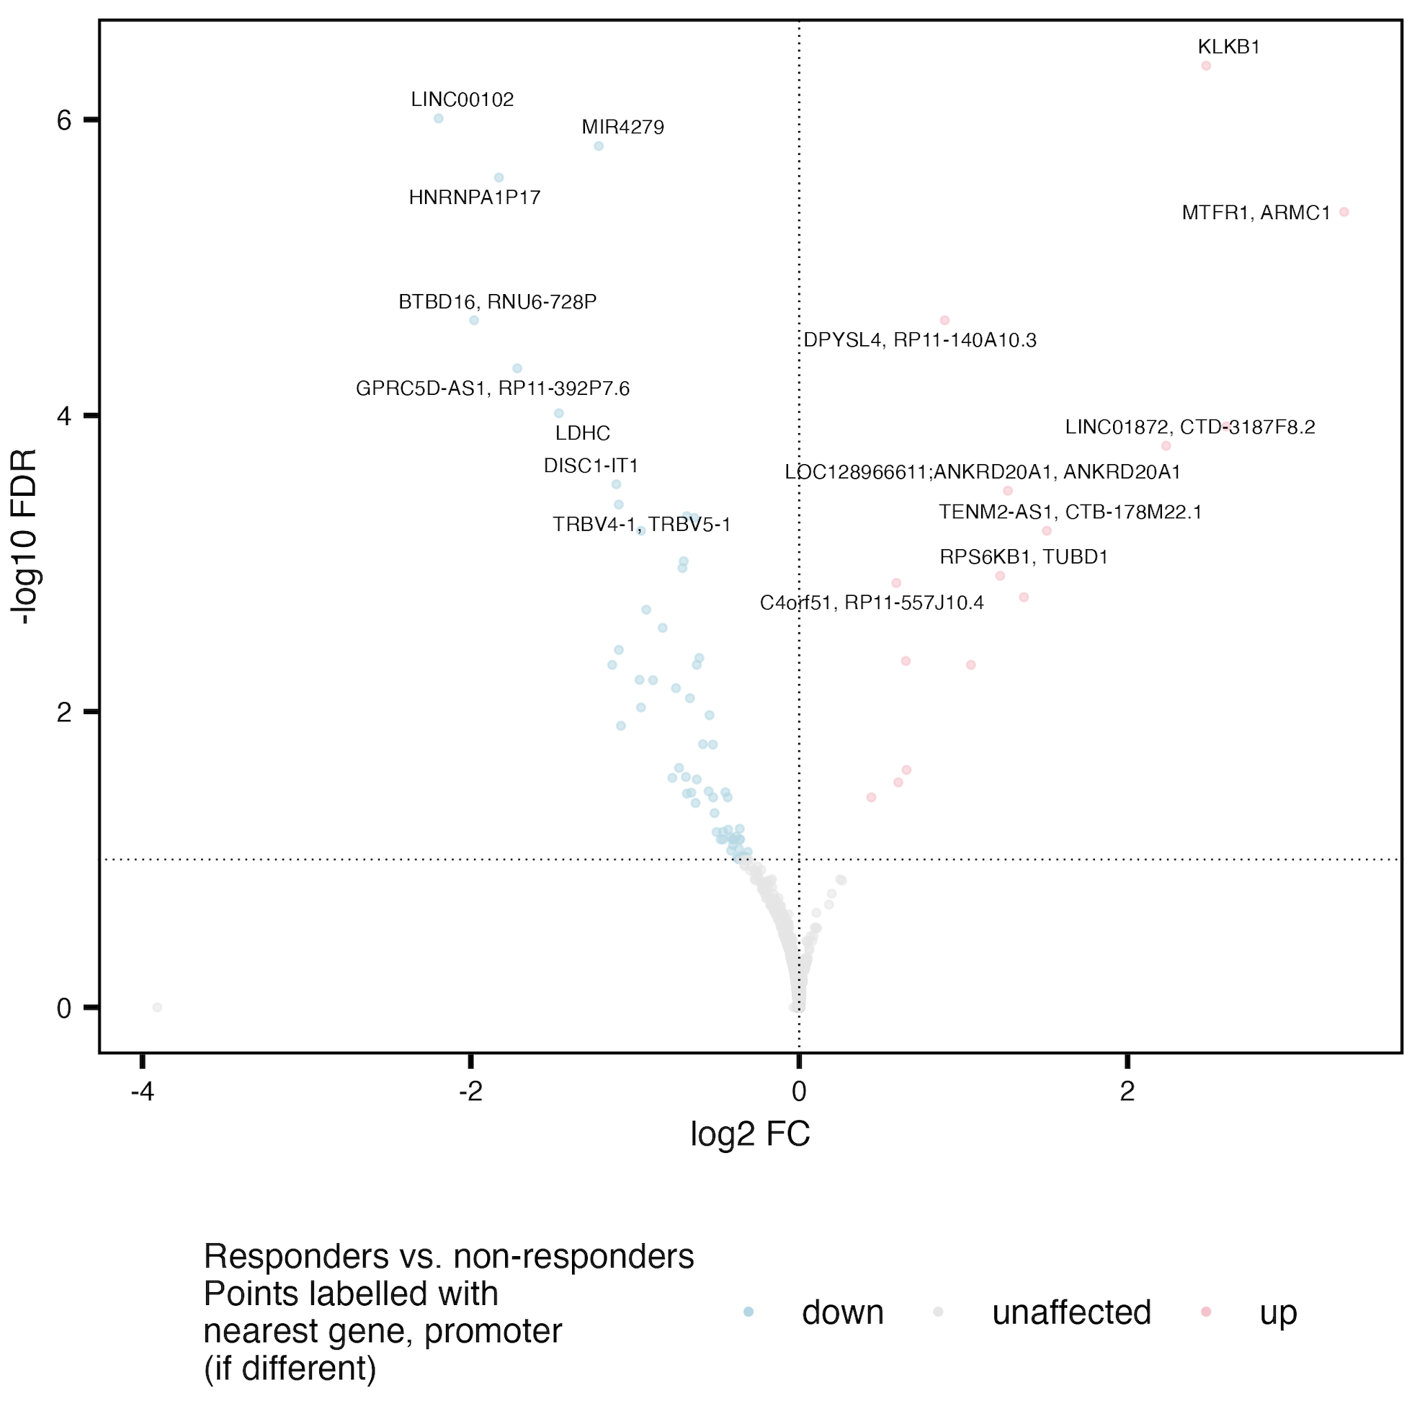
Obtain some DARs between R and NR looking across all cell sorts
KEGG analysis yielded only 1 significantly enriched pathway: propanoate metabolism (6 genes) suppressed in responders
potentially interesting hits
BTB16 nearby the 10q26.13 T1D susceptibility locus
DPYSL4 associated with T1D progression, see figure 2B
Some TRBV genes less accessible in responders
Notes:
Plot/analysis made with new covariate regressing out code

Slide 9
Conclusions
Consistent trends across sensitivity analyses
DP CD57⁺ has the most MT variants, followed by DP PD-1⁺, these are most “terminal”
DN/non-exhausted CD127⁺ have the least MT variants, these are most like the reference MT genome
so, we can conclude that these pairs of sorts are at opposite ends of cell differentiation pathway (consistent with previous evidence/models)
Obtain some DARs between R & NR across all cell sorts
Some top hits may indicate that T1D progression-associated genes (BTB16, DPYSL4) are being picked up as DARs between R & NR, perhaps unsurprisingly
No obvious differences in data after regressing out variation due to replicate and responder status (in case of cell sort comparisons) or cell sort (in case of responder status comparisons), also takes care of paired samples (data not shown)
TIGIT⁺KLRG1⁺ non-naïve CD8 frequencies not different between irAE groups in Luoma (2020), Cell colitis or Zhu (2022), Circulation myocarditis datasets (data not shown)

Slide 10
Next steps
MT analyses
Try assembling MT genome from DN MT mapping reads, then could use that MT genome as reference for mapping MT variants in other cell sorts (i.e. now if DP CD57⁺ still has the most variants then it’s easily interpretable as most terminal from DN “ancestor” in differentiation pathway)
Revisit Homer analyses
Try all consensus peaks as background for Homer vs. just using peaks up/down in a specific contrast
Mean read count/library in P576 was ~41 million, much lower than P452 (Erin’s) ~57 million → downsample Erin’s libraries to avg of 41 million read counts/library & see how dramatically Homer results differ

