Slide 1
Weekly meeting
1 18 2024
Ty Bottorff

Slide 2
Outline

Slide 3
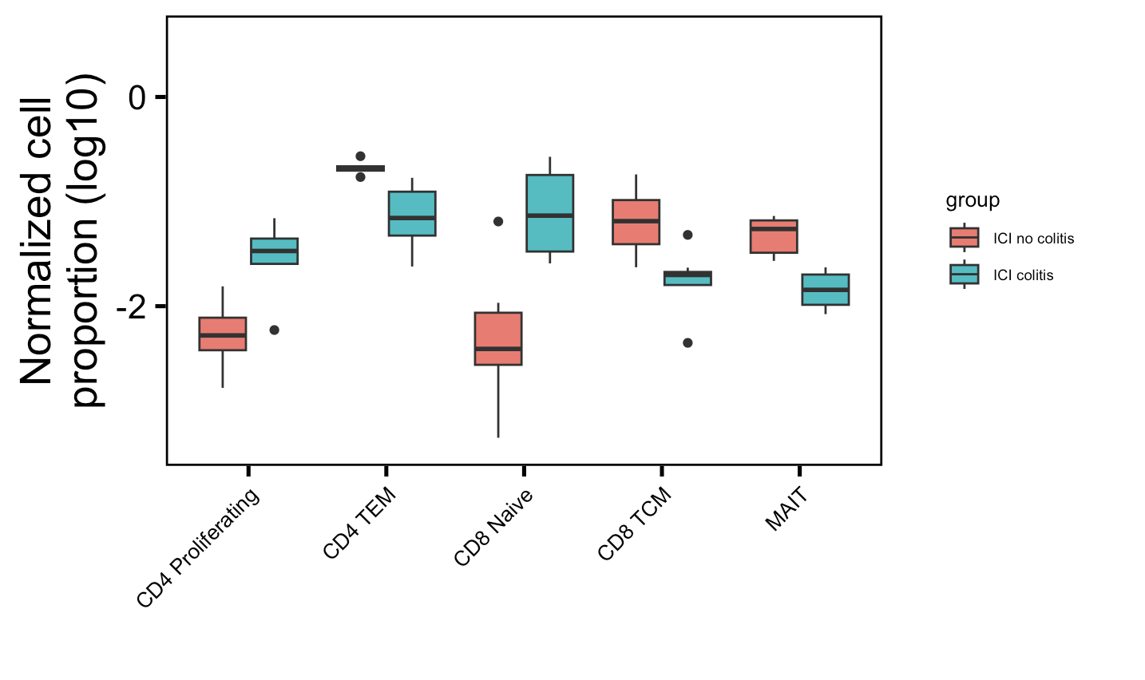
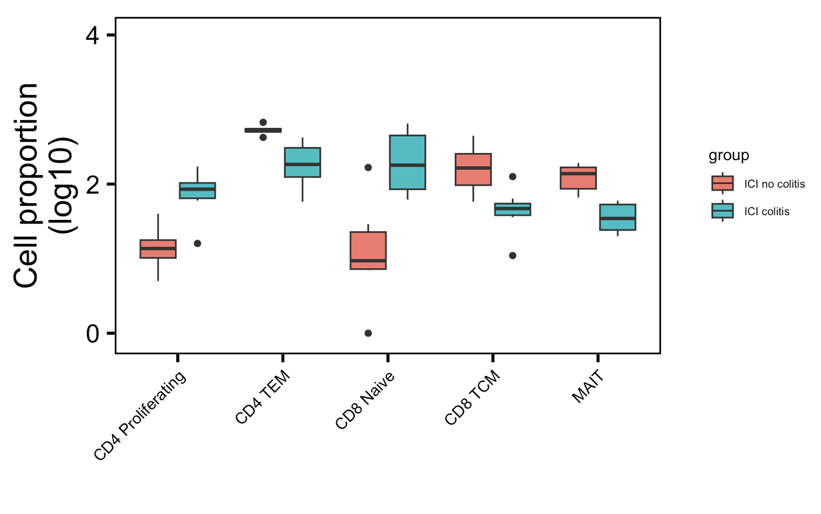
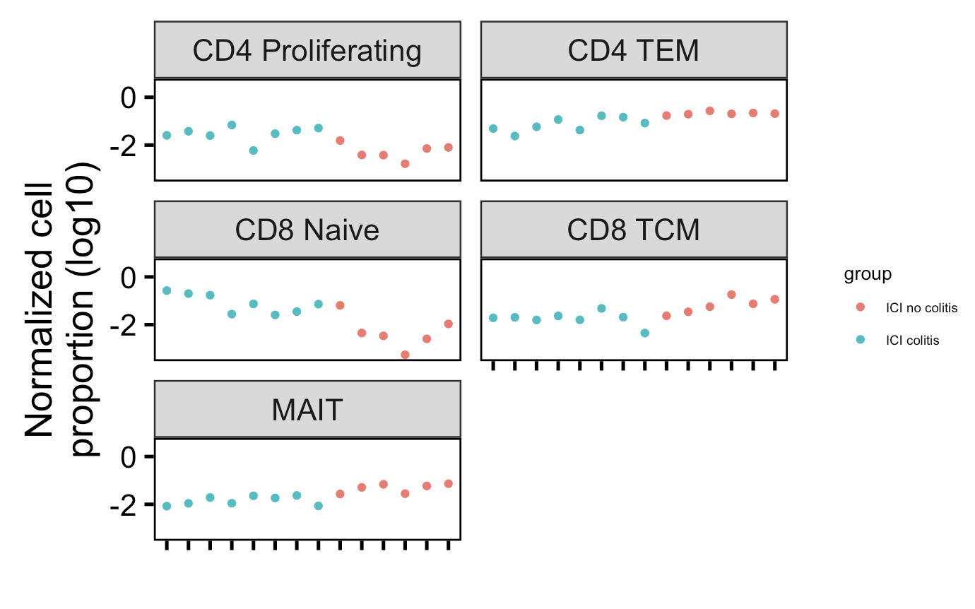
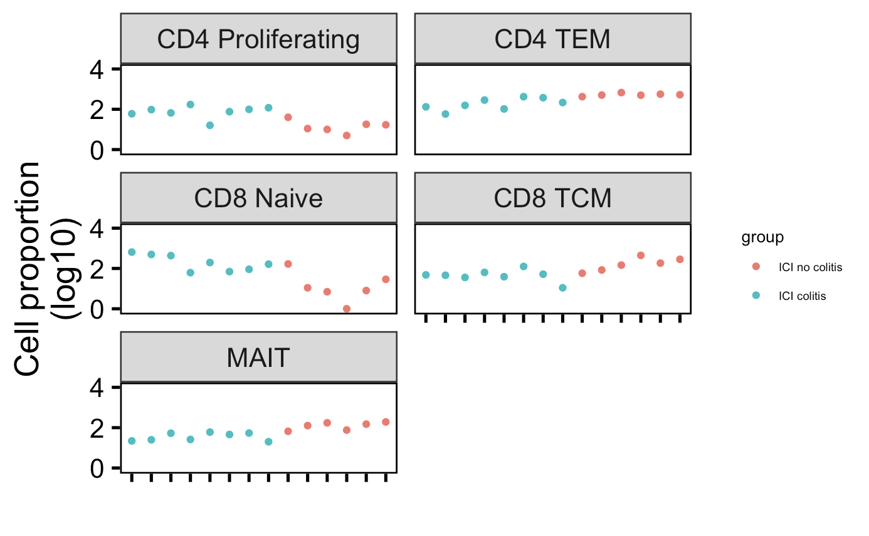
Cell type abundance differences in colitis dataset do not seem to be driven by single/few patients
Normalized by clonotype depth
Downsampled
*
**
*
*
**
*
**
*
*
**
Wilcox rank sum test: **; padj <1e-2, *; padj <0.05
Notes:
# padj normalized by clonotype depth
# CD4 Proliferating: 0.01
# CD4 TEM: 0.004
# CD8 Naive: 0.01
# CD8 TCM: 0.01
# MAITs: 0.004
# padj values downsampled
# CD4 Proliferating: 0.01
# CD4 TEM: 0.004
# CD8 Naive: 0.02
# CD8 TCM: 0.01
# MAITs: 0.004

Slide 4
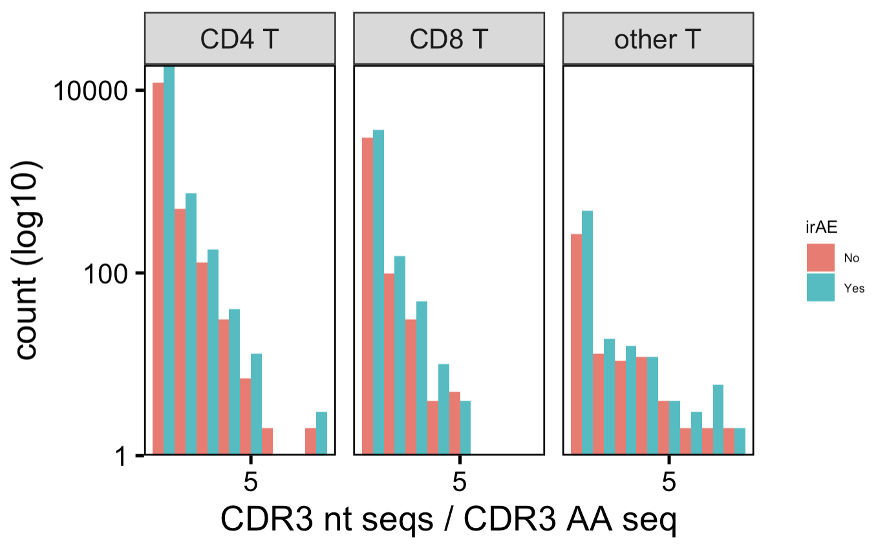
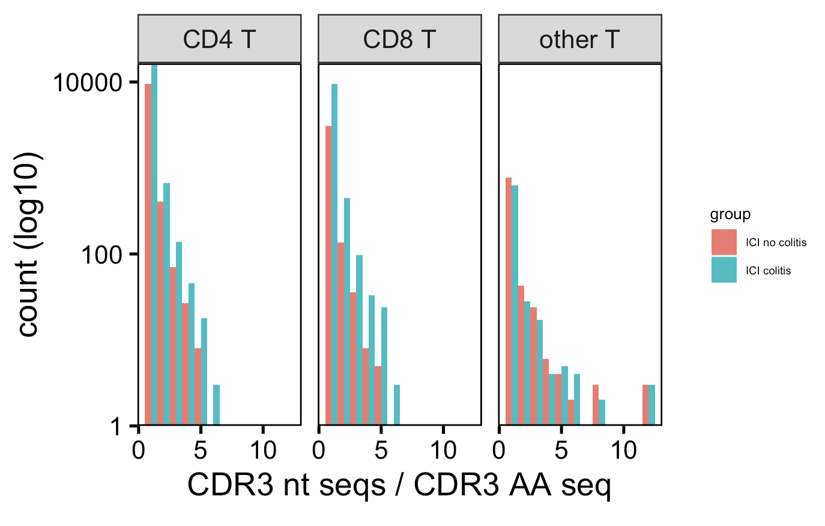
Not sure if I should group by patient/group before slicing
Myocarditis dataset
Colitis dataset
Caveats:
- including both intrapatient & interpatient convergence
- some CDR3 AAs present in both irAE groups
Notes:
Myocarditis: # padj = 0.08 for CD8 T within l1 group, CD8 TEM within l2 group

Slide 5
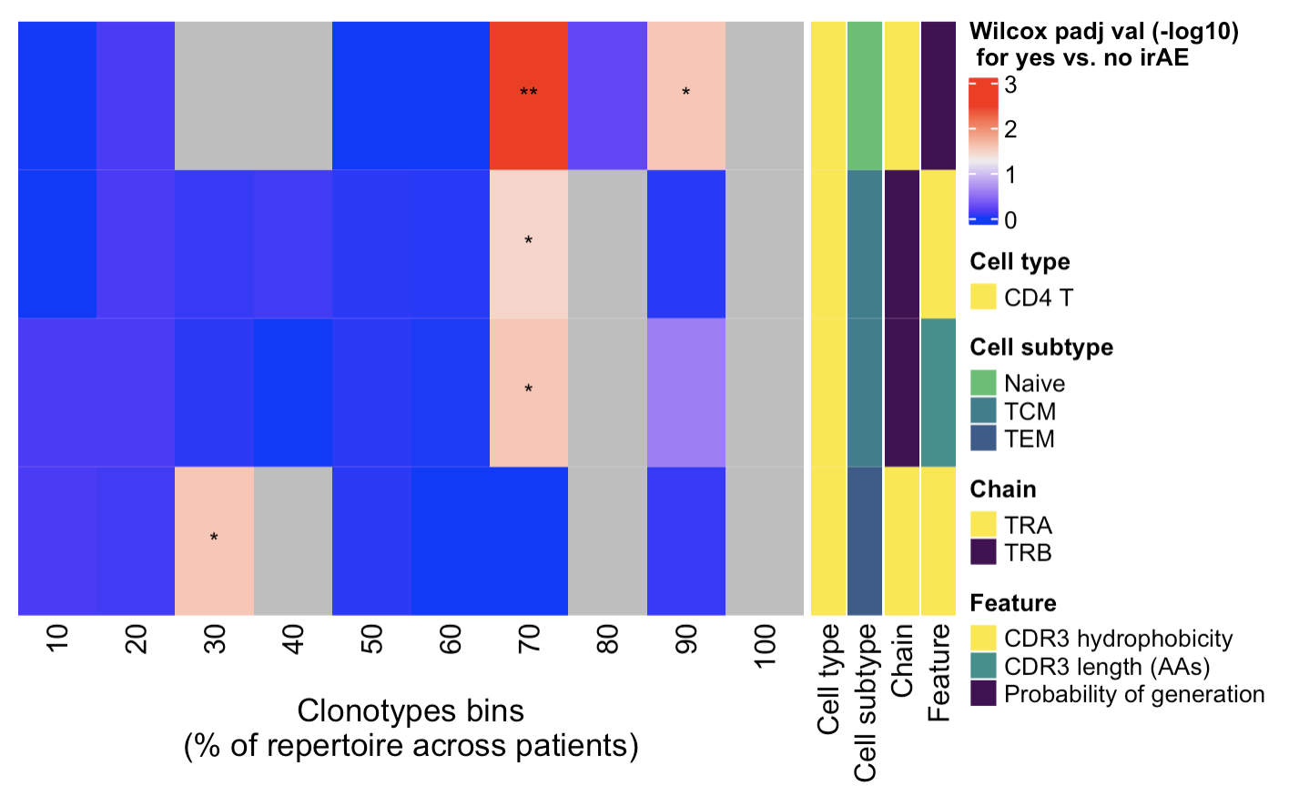
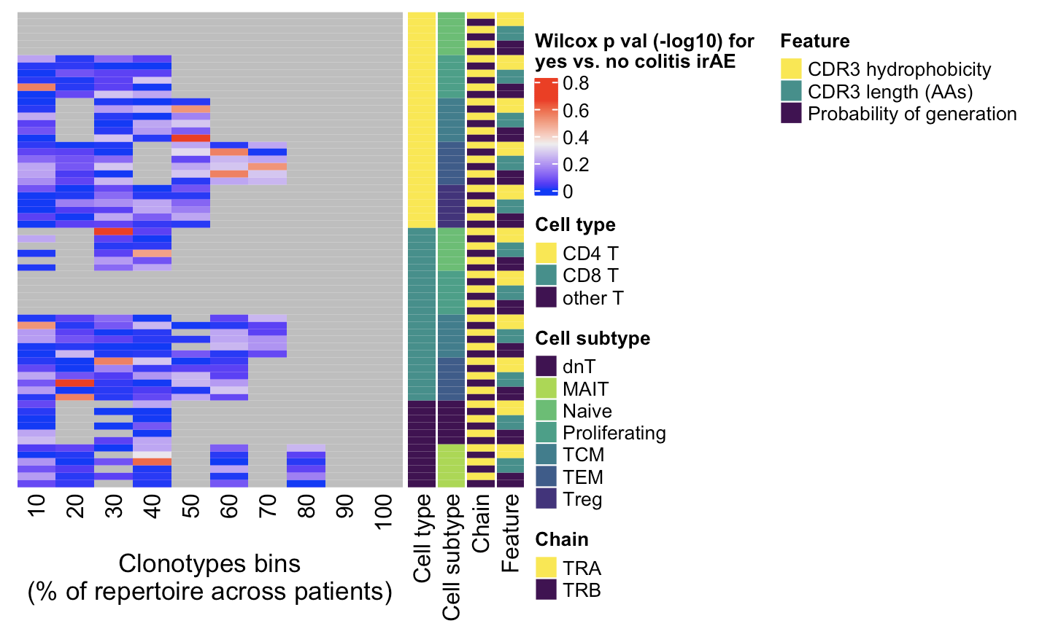
Given ability of rare clonotypes to drive disease, also looked into non-cumulative clonotype heatmaps
CD4s in myocarditis dataset (normalized by clonotype depth) have some feature differences (padj), not recapitulated if downsampled or in colitis dataset
Myocarditis dataset
Colitis dataset
← Increasing clonotype abundance
← Increasing clonotype abundance
**, p <1e-2; *; p <0.05
Notes:
# CD4 Naive TRB hydrophobicity 70, 90%
# CD4 TCM TRB hycrophobicity 70%
# CD4 TCM TRB CDR3 length 70%
# CD4 TEM TRA hydrophobicity 30%

Slide 6
Conclusions

Slide 7
Next steps

