Slide 1
Weekly meeting
8 8 2024
Ty Bottorff

Slide 2
Outline

Slide 3
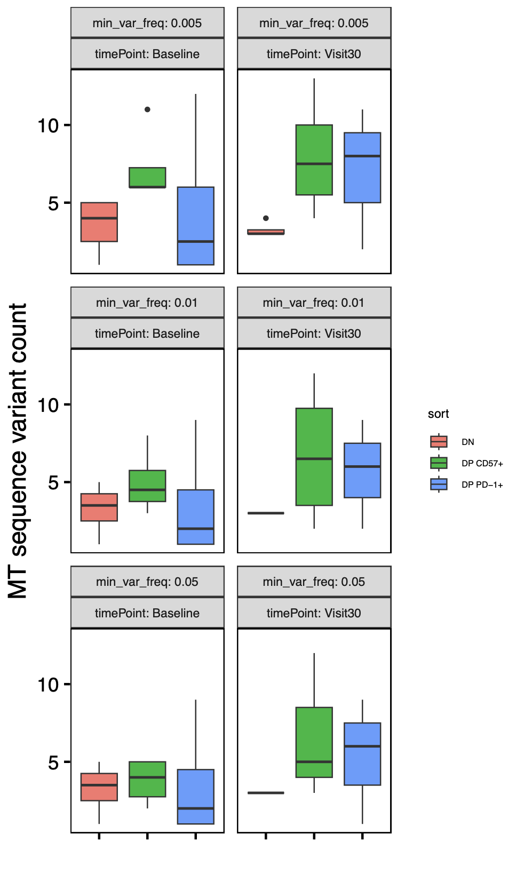
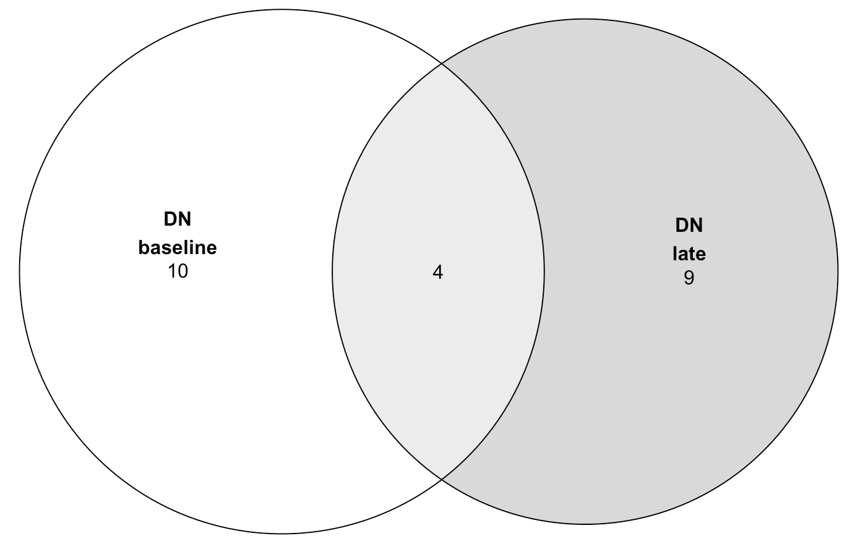
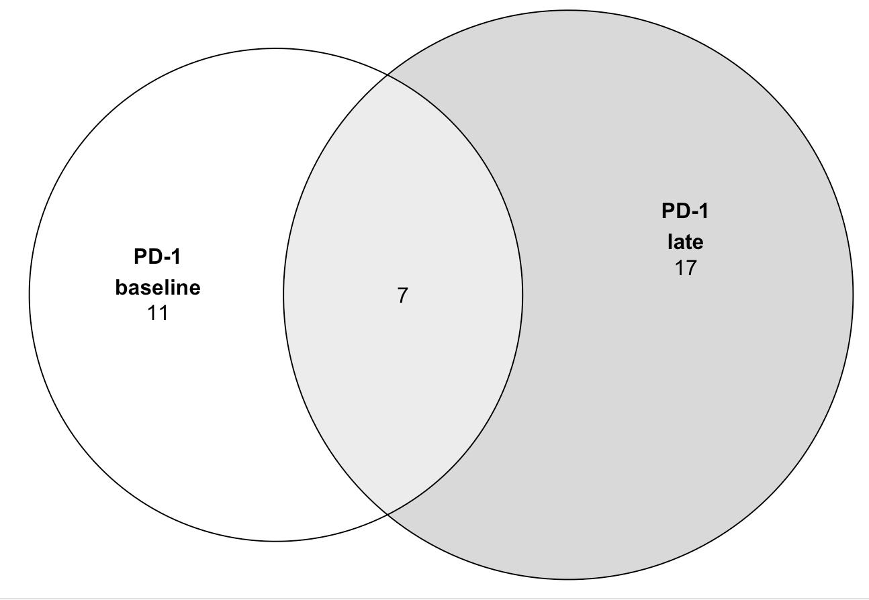
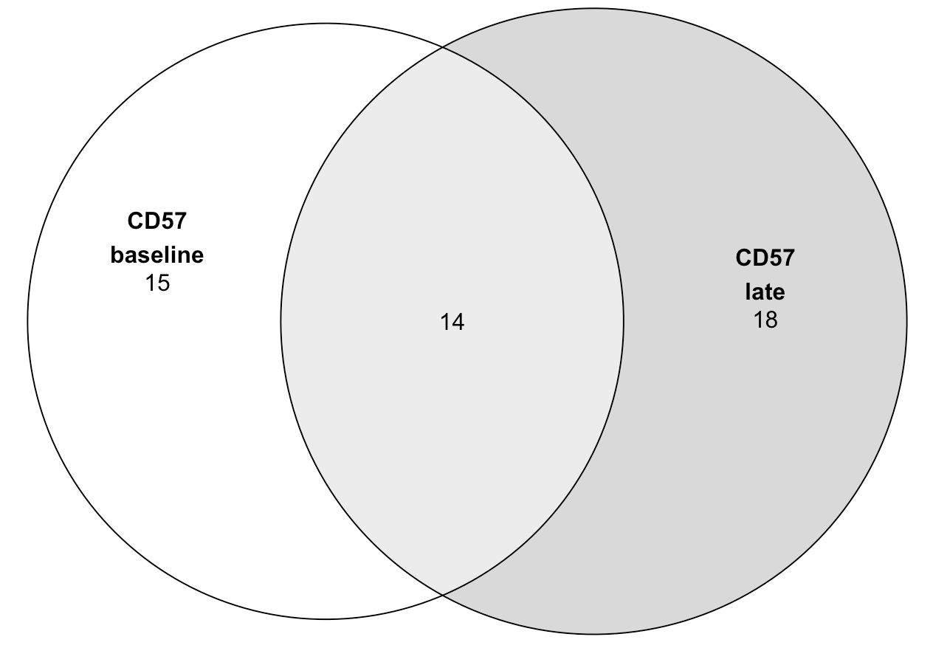
P452 (T1DAL): faceting MT variant analysis by timepoint
Takeaways:
- no significant differences in variant counts by timepoint within each sort
- substantial variant loss/gain over time (more sharing in CD57s ~30% vs. ~20% for others)
- not very different filtering for high freq vars (most here are high freq)
n = 4 (donors)
Notes:
Cell loss presumably explains higher than expected loss/gain of vars over time (loss could be death or swapping cell sort), loss/gain could also be due to insufficient sampling
Only R in P452: “we first measured their bulk chromatin accessibility at baseline (Week 0/Visit 0) and 104 wk (Visit 30) post-treatment in alefacept responders (R, defined by C-peptide preservation) using ATAC-seq following sorting from PBMC (Figure 1A, Because cell population differences rather than treatment response differences were the focus of our investigation, we sequenced only alefacept responder (R) samples“
Updated to remove vars present in all sorts in a donor
MT notes:
Mitochondrial genomes have high copy number (100–1,000s)
homoplasmy is when all copies of the mitochondrial genome in a cell are identical; heteroplasmy is when there is a mixture of two or more mitochondrial genotypes
mutations in mtDNA often reach high levels of heteroplasmy (proportion of mitochondrial genomes containing a specific mutation) due to a combination of vegetative segregation, random genetic drift, and relaxed replication
Exclusively maternal inheritance
mtDNA mutation rates are estimated to be 10- to 100-fold higher than for nuclear DNA

Slide 4
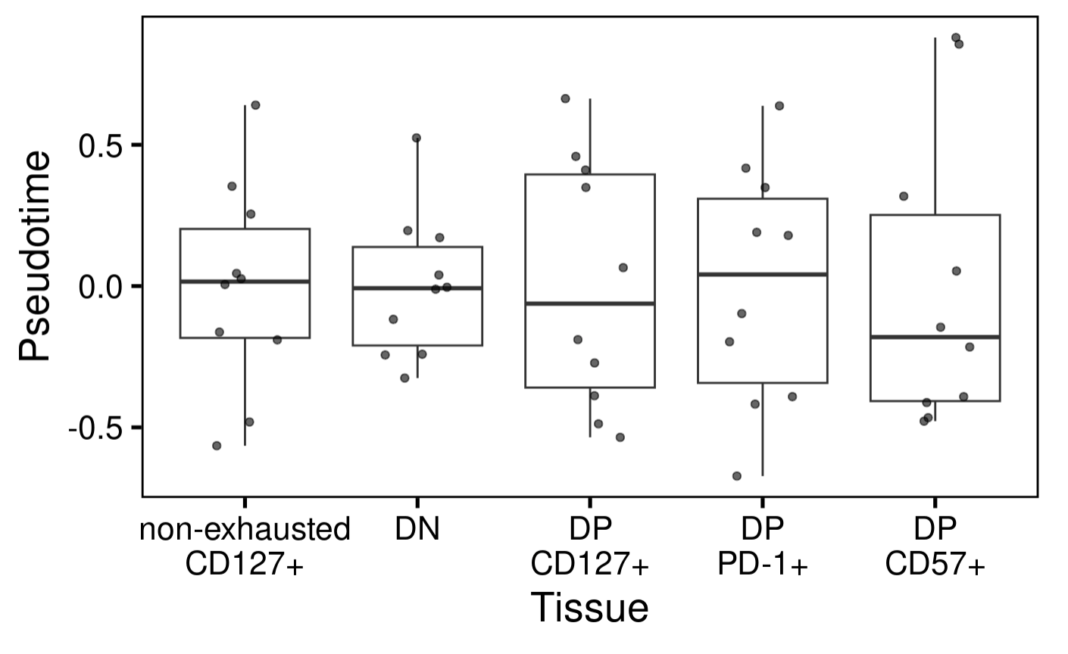
P576 (AbATE): don’t observe pseudotime associating with cell sort
Notes:
Tested for significances already
PhenoPath analyzes the accessibility of genomic regions (peaks) in your ATAC-seq data, modeling how these accessibilities change along a biological trajectory and how this trajectory is influenced by tissue type
PhenoPath models gene expression expression 𝑦 in terms of a latent pathway score (pseudotime) 𝑧. Uniquely, the evolution of genes along the trajectory isn’t common to each gene but can be perturbed by an additional sample-specific covariate 𝛽 (cell sort here)

Slide 5
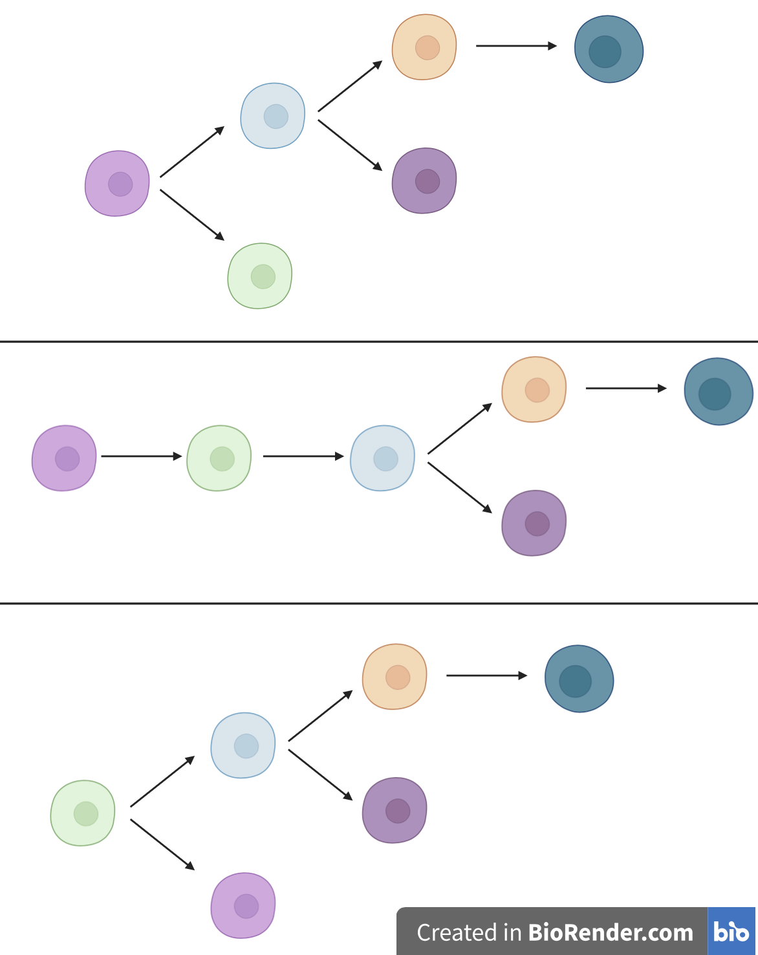
Conclusions
TIGIT⁺
KLRG1⁺
(DP)
DP PD-1⁺
DP CD57⁺
DP
CD127⁺
Non-exhausted
CD127⁺
TIGIT⁻
KLRG1⁻
PCA/UMAP outlier DN actually had most reads of any R DN…
Notes:
Perhaps that donor’s DNs were just much less DN and much more DP whatever than other donors’ DNs… hard to believe in bulk though…

Slide 6
Next steps

