Slide 1
NCI update – analyzing CyTOF data
10-23-2024
Ty Bottorff – Bioinformatics postdoc
Linsley lab

Slide 2
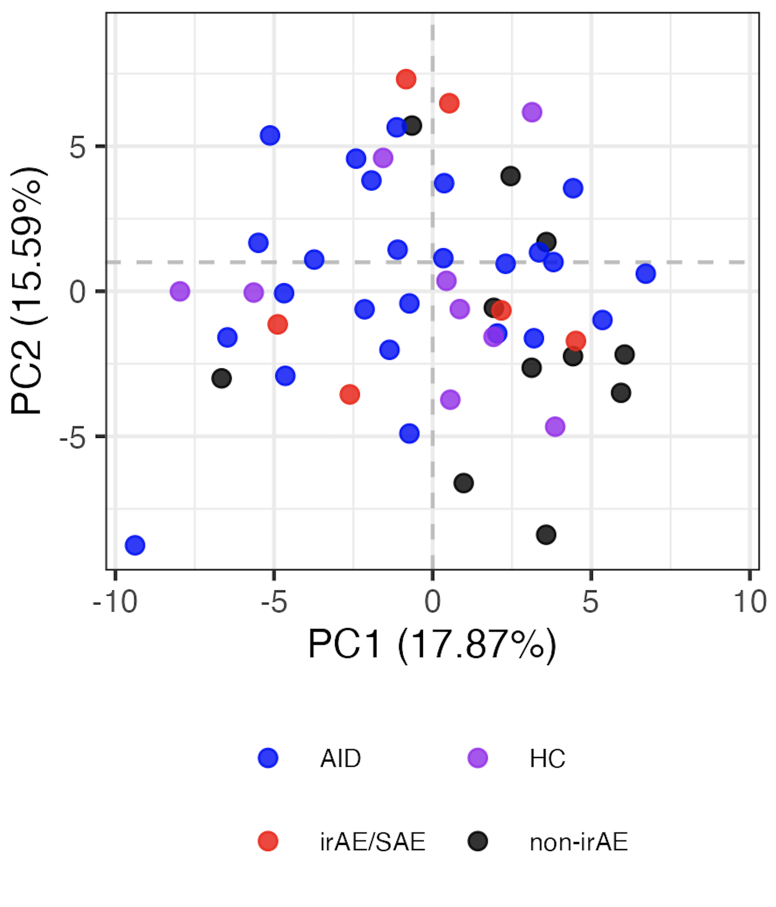
Baseline immunotypes are not distinct by group
Notes:
LOGIT TRANSFORMED FREQS
Including all PD1/PDL1 sorts here but that’s fine I believe (baseline, no ICI yet)
Significant hits
# (severe) irAE vs. no irAE: none
# AID vs. HC, none
# AID vs. cancer:
# naive of CD8 Tcells, Treg of CD4 Tcells, Tcells of nonGrans, Tfh of NN Tconv Tcells, NKcells of nonGrans, CXCR3pos of NN CD8 Tcells, CD11cpos of Bcells, naive of Treg Tcells, MAIT of NN CD8 Tcells, unswMem of Bcells, CRTH2pos of NN CD8 Tcells
# AID vs. non-irAE: Treg of CD4 Tcells, naive of CD8 Tcells, CRTH2pos of NN CD8 Tcells, CCR4pos of NN Tconv Tcells, ICOSpos of Tfh Tconv Tcells
# AID vs. irAE: CD11cpos of Bcells, NKcells of nonGrans, Tcells of nonGrans, Tfh of NN Tconv Tcells, naive of CD8 Tcells, unswMem of Bcells, Bcells of nonGrans, CXCR3pos of NN CD8 Tcells
# HC vs. cancer: CD38hiCD127neg of NN CD8 Tcells, Treg of CD4 Tcells
# HC vs. non-irAE: CRTH2pos of NN Tconv Tcells, Treg of CD4 Tcells, CD38hiCD127neg of NN CD8 Tcells, CRTH2pos of NN CD8 Tcells, SCM of Tconv Tcells
# HC vs. irAE: none

Slide 3
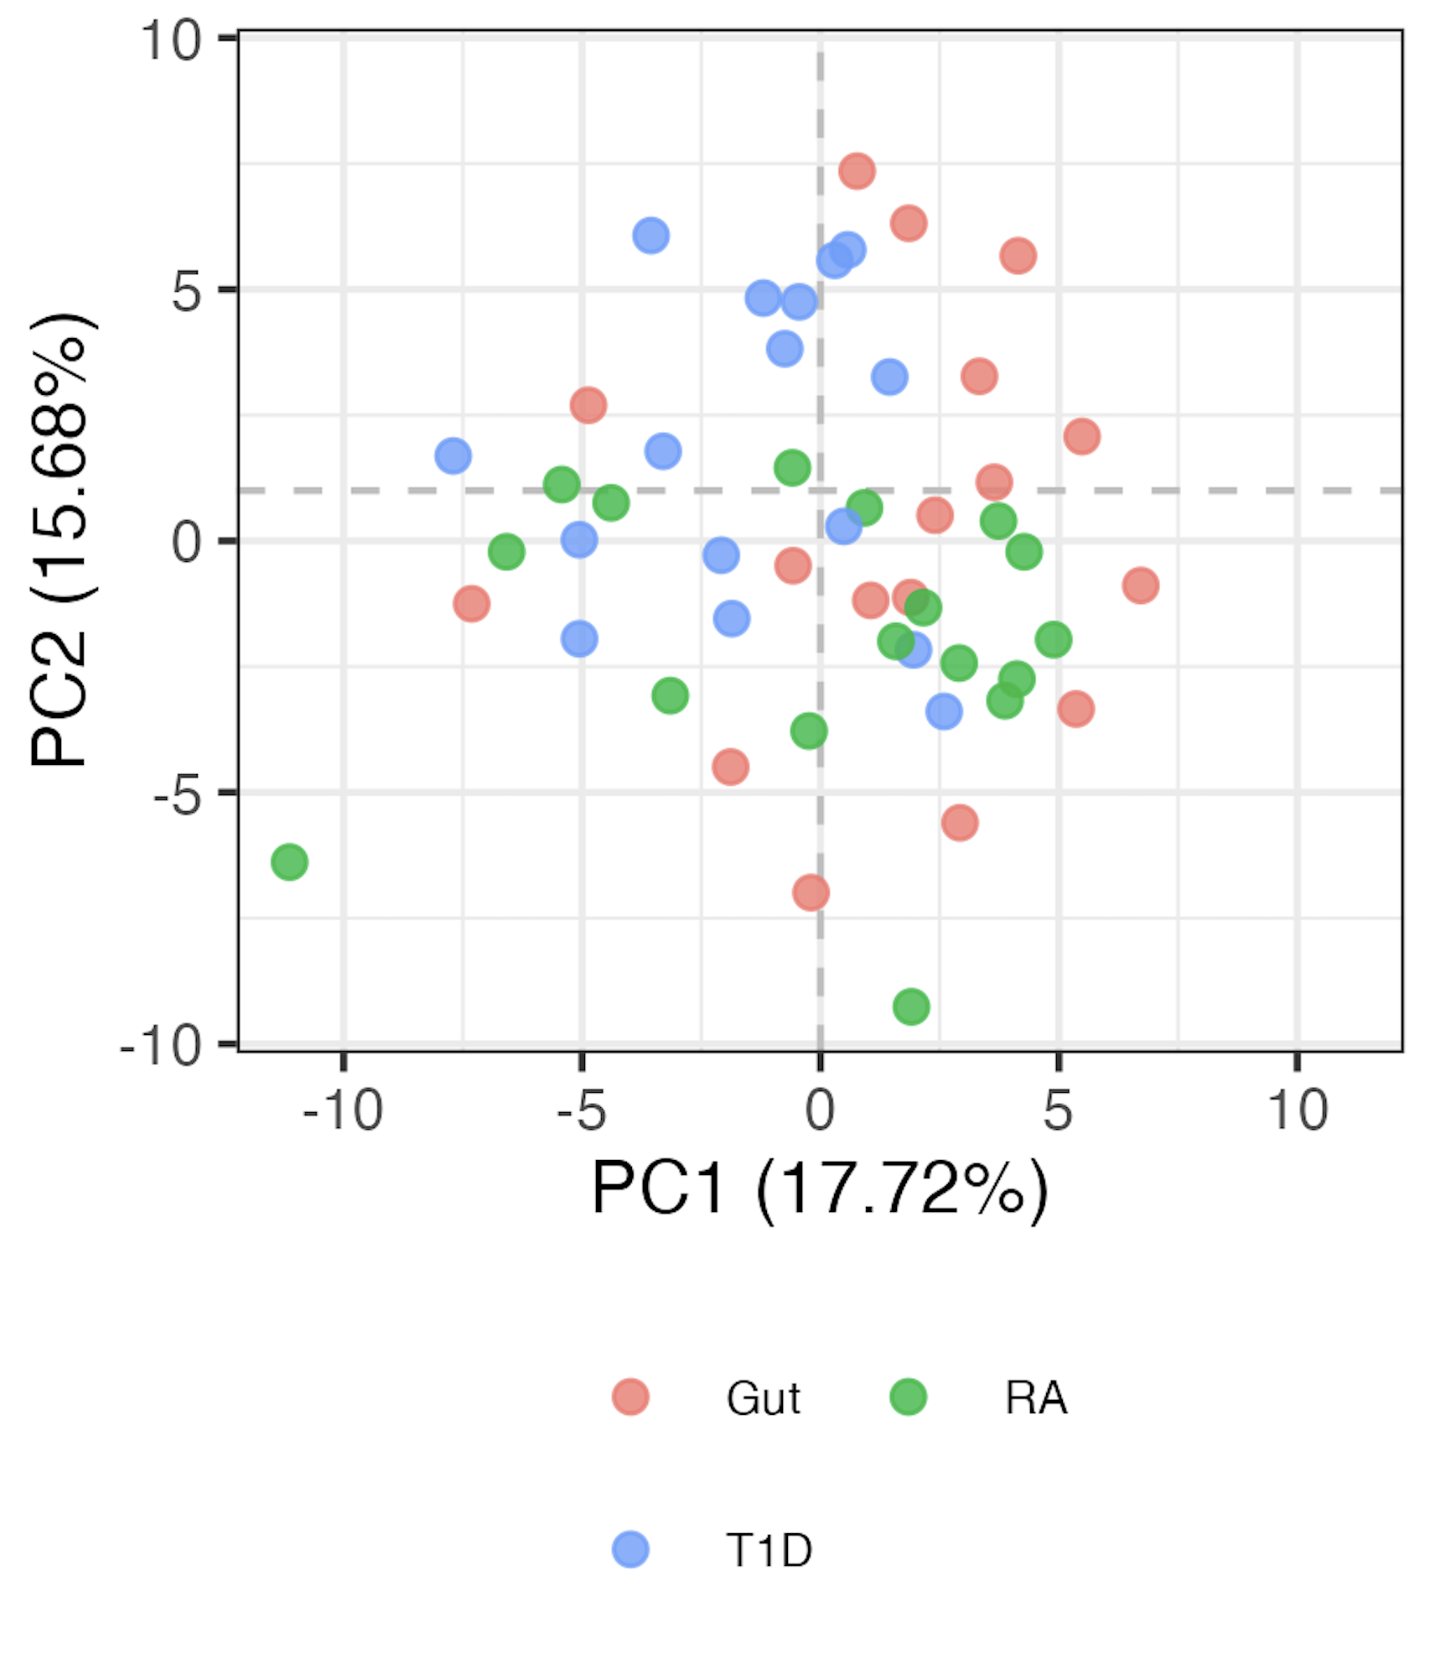
AID subgroup immunotypes are not very distinct either
Notes:
LOGIT TRANSFORMED FREQS

Slide 4
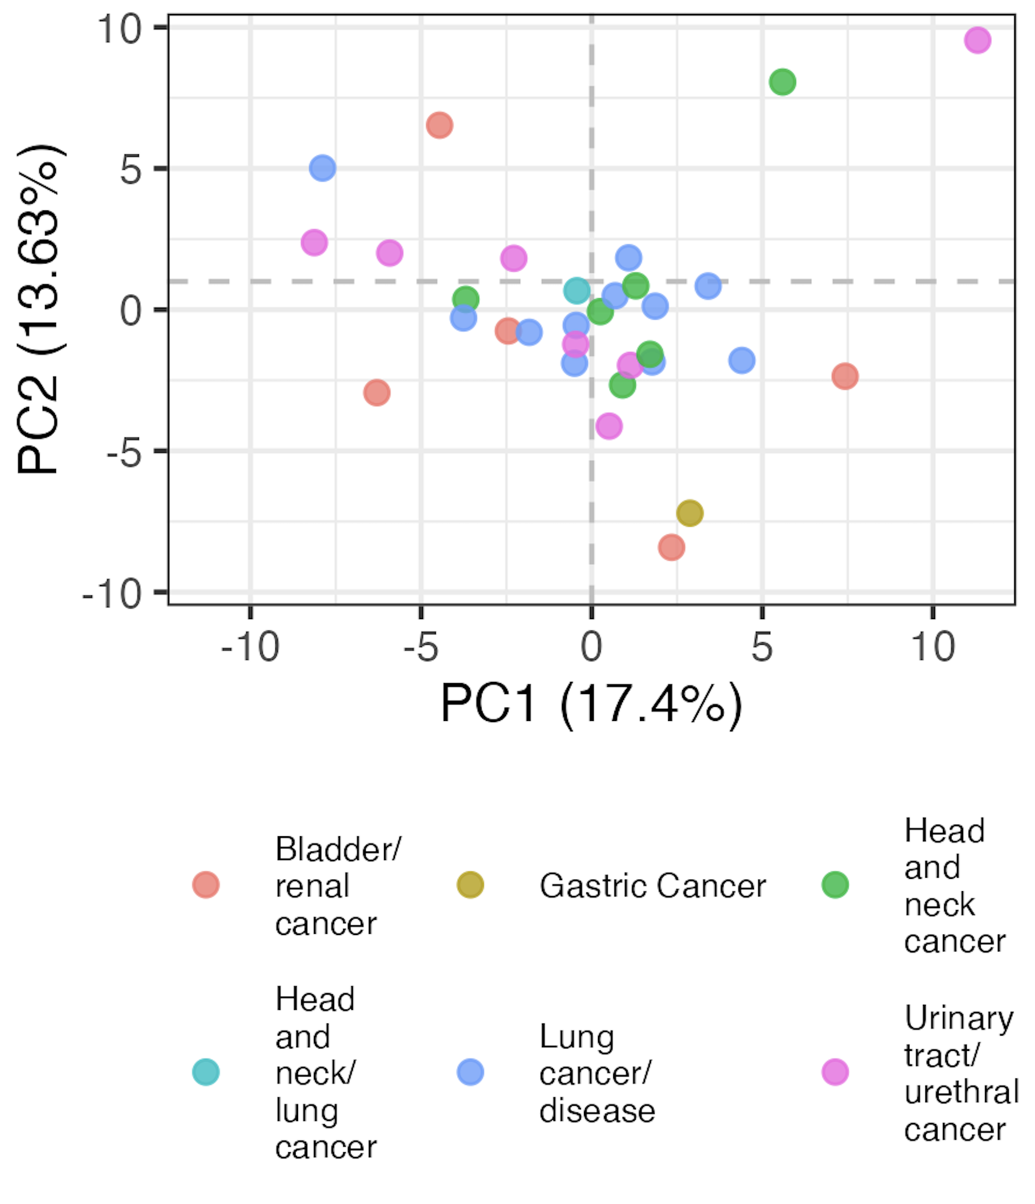
Baseline head, neck, and lung cancer immunotypes are distinct from other cancer subtypes

Slide 5
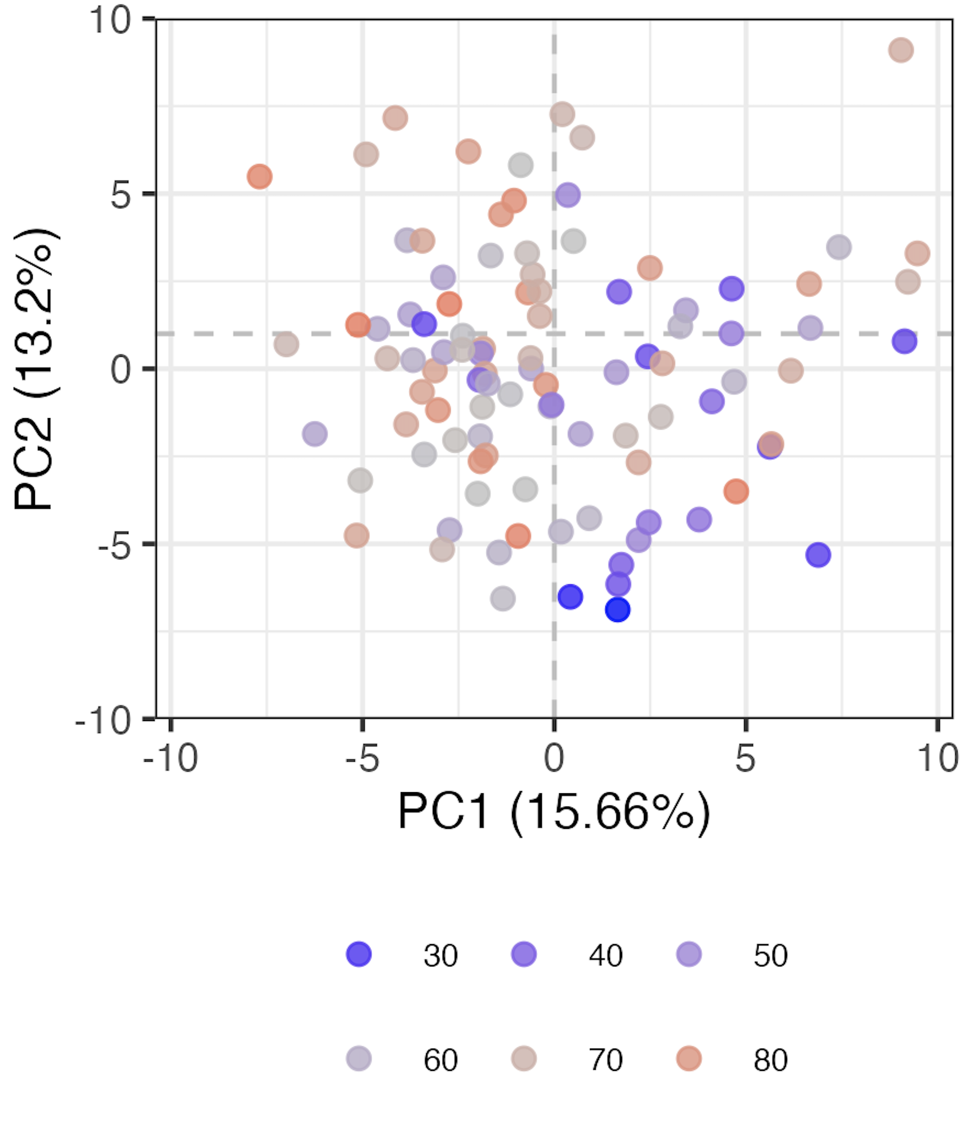
Age contributes to variation (baseline samples)
Age

Slide 6
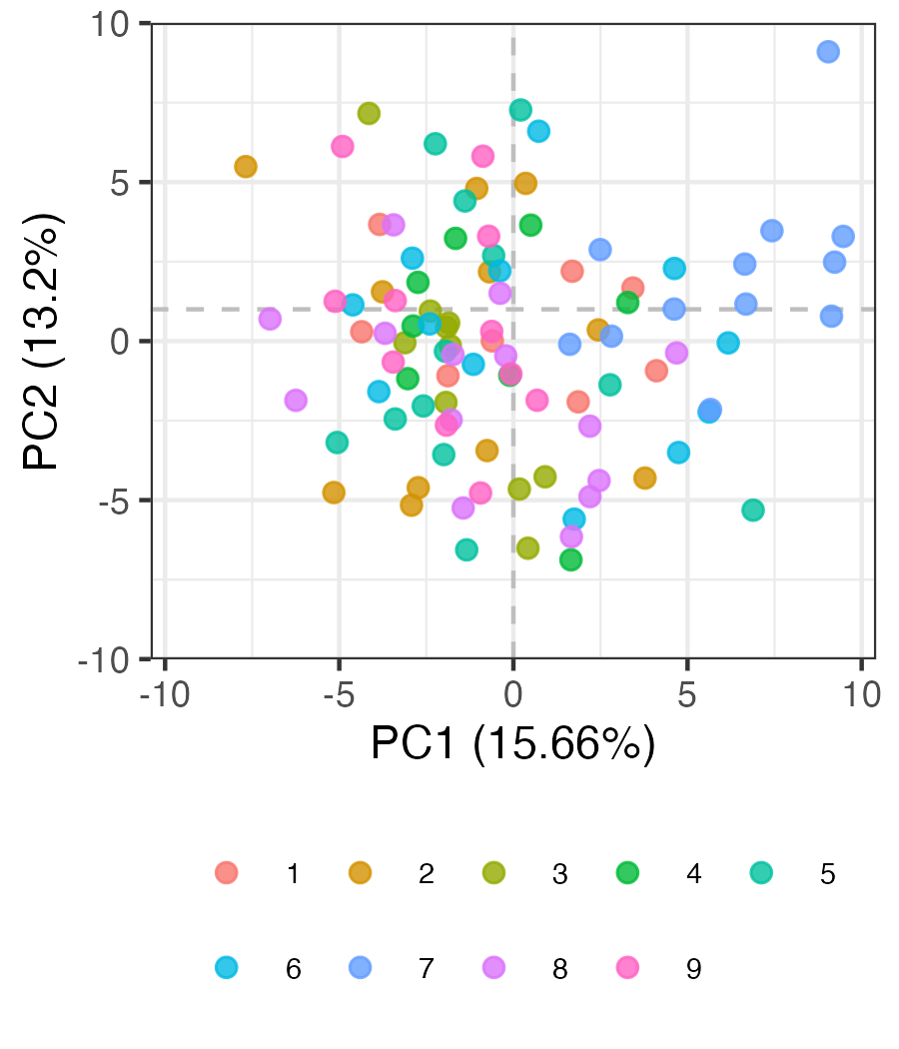
Some evidence of batch effects in baseline data
Batch #
Notes:
Batch 7 kind of all clustering together in bottom left…

Slide 7
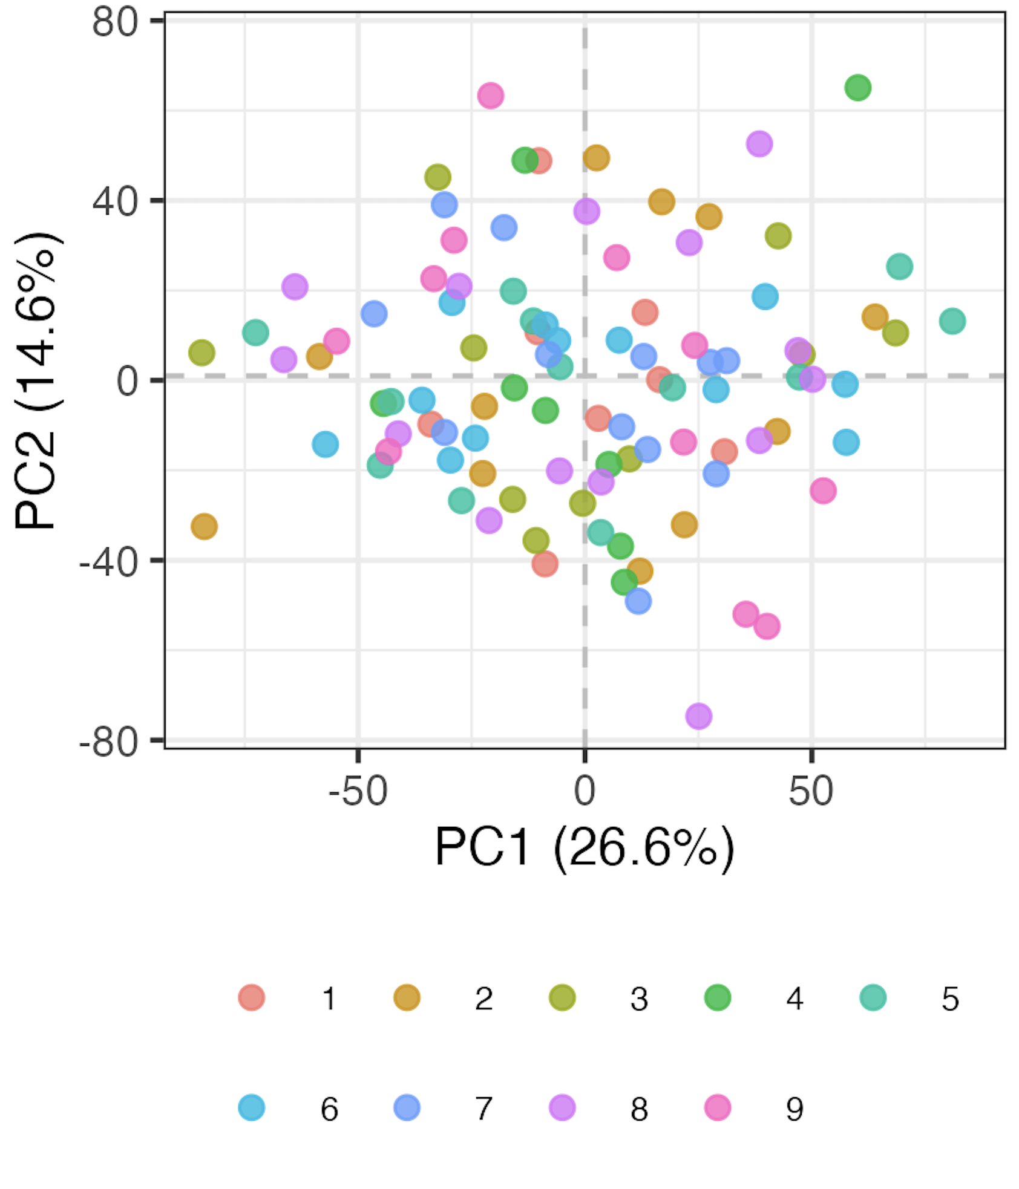
Regressing batch out
Batch regressed out
Batch #
Batch #

Slide 8
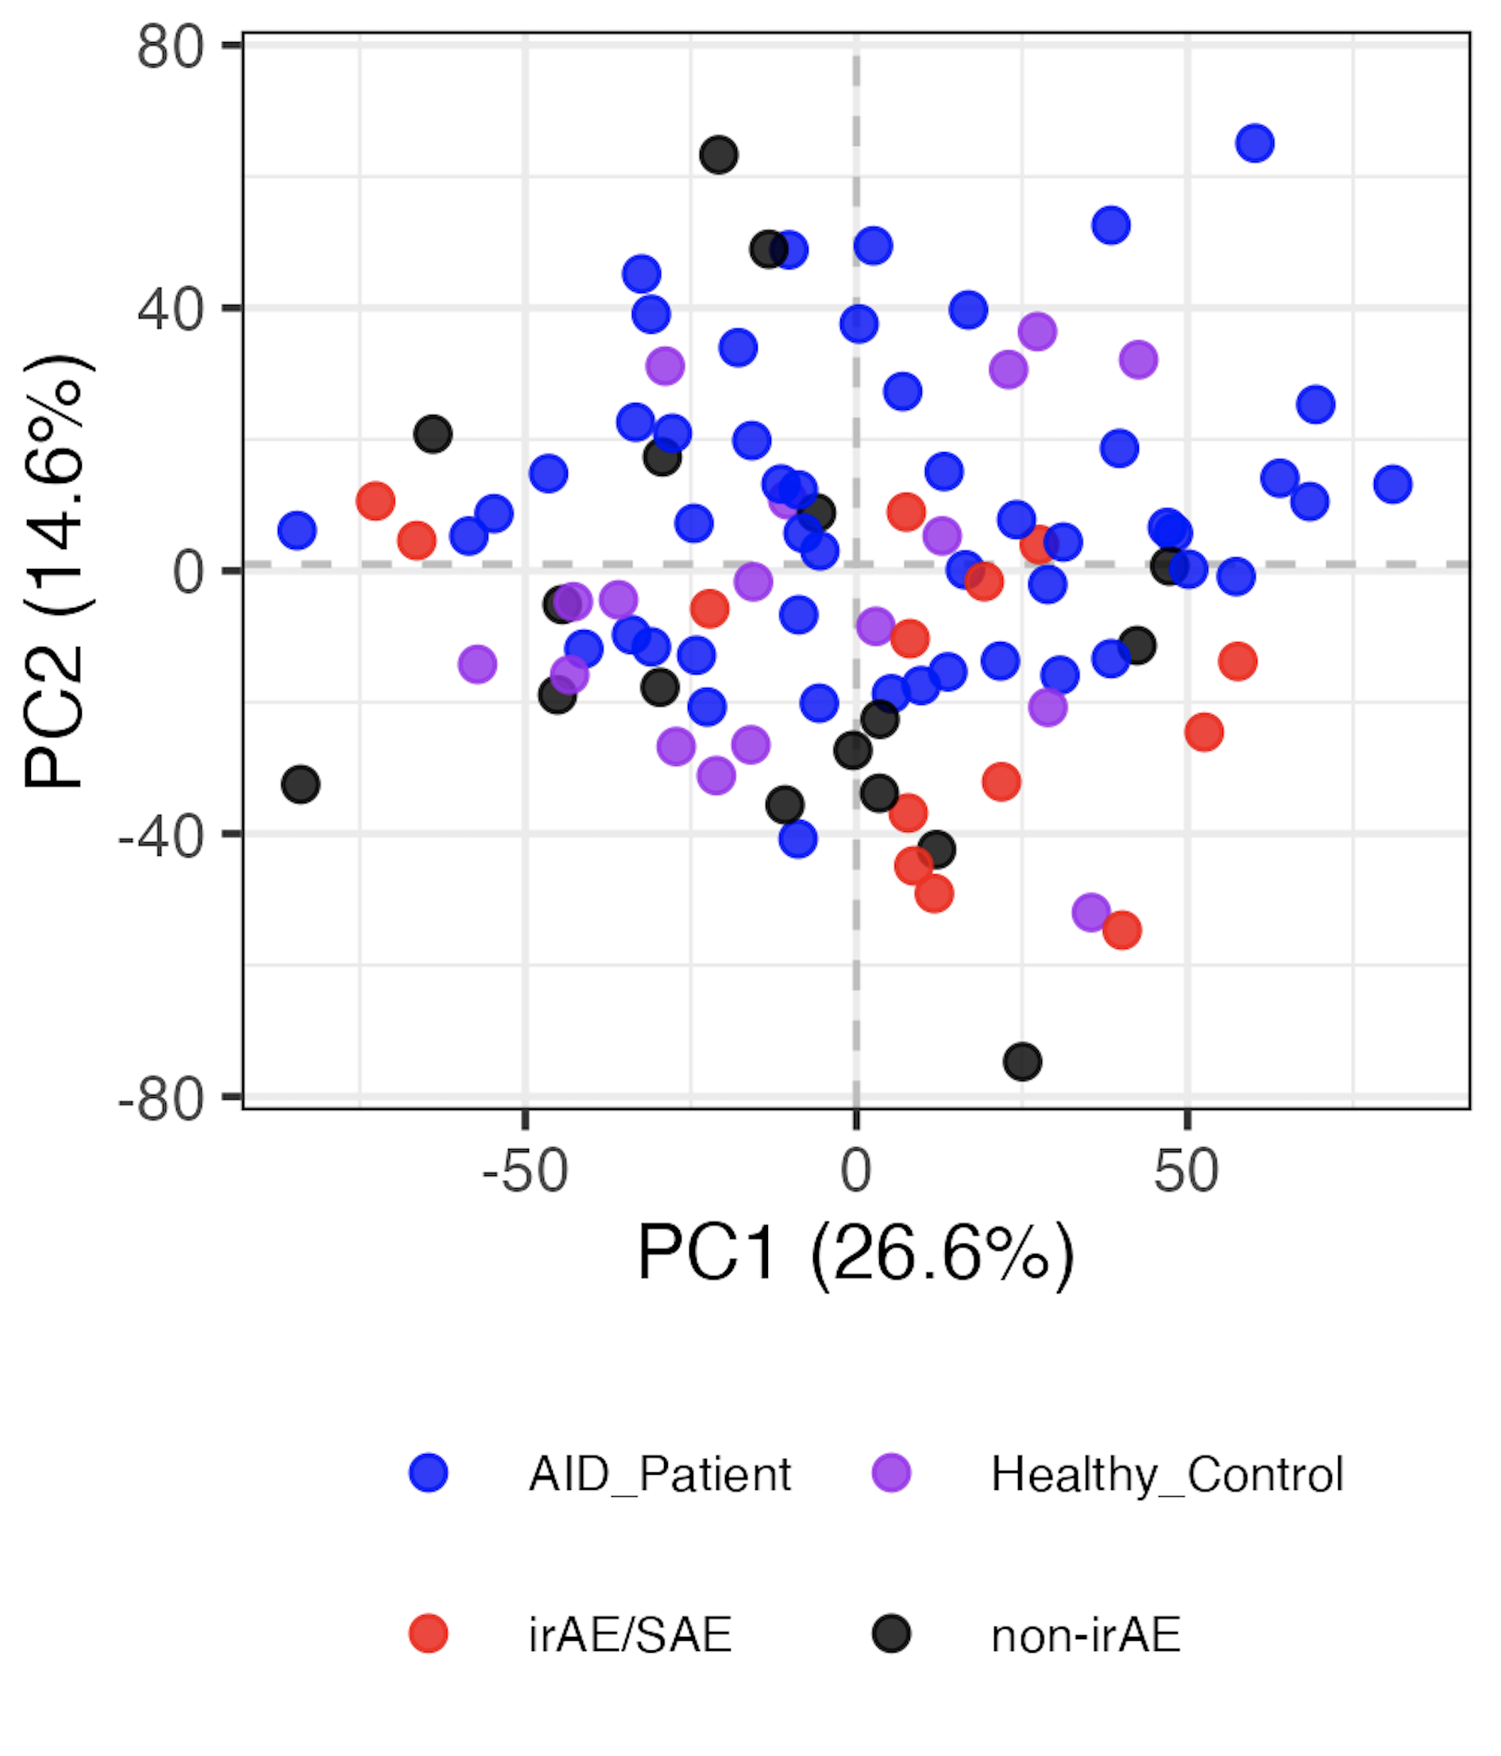
Regressing out batch from baseline samples doesn’t reveal clearly distinct immunotypes
Batch regressed out
Notes:
Left is normal logit
Right is residuals from linear models with Batch as var/confounder

Slide 9
Conclusions
Baseline immunotypes are not distinct by group, even after regressing batch out
AID subgroup immunotypes are not very distinct either
cancer subtype immunotypes appear more distinct
age contributes to variation (baseline samples)
data not shown, do not see…
baseline temporally-stable group differences (”subtract” ICI/ICI+group effects from baseline)
any subset frequencies correlating with CTCAE grade (baseline)
distinct baseline immunotypes by ICA (PCA alternative)
effect of previous treatment on baseline cancer immunotypes
distinct baseline immunotypes by group even when including all features (even those with high technical variation)
Notes:
Also share that there were very few grade > 2 patients (2), so comparing their immunotypes vs. lower grade wasn’t fruitful unsurprisingly…
ICA’s goal is to max statistical independence b/w ICs (independent components, non-gaussian distributions, better for signal separation/feature extraction), PCA maximizes variance (orthogonal components, linear combos, better for data viz/noise reduction)

Slide 10
Next steps
IMPACD: using hierarchical/combinatorial gating, do we see distinct immunotypes by irAE group
Notes:
Also ICI/ICI-group effects: update analyses w/ CTCAE irAE/SAE grade

Slide 11

Acknowledgements
Holly Akilesh
Long lab/HIPcore
Alice Long, Alice Wiedeman
Buckner lab
Jane Buckner, Sylvia Posso
Peter Linsley
Clinical team

Slide 12
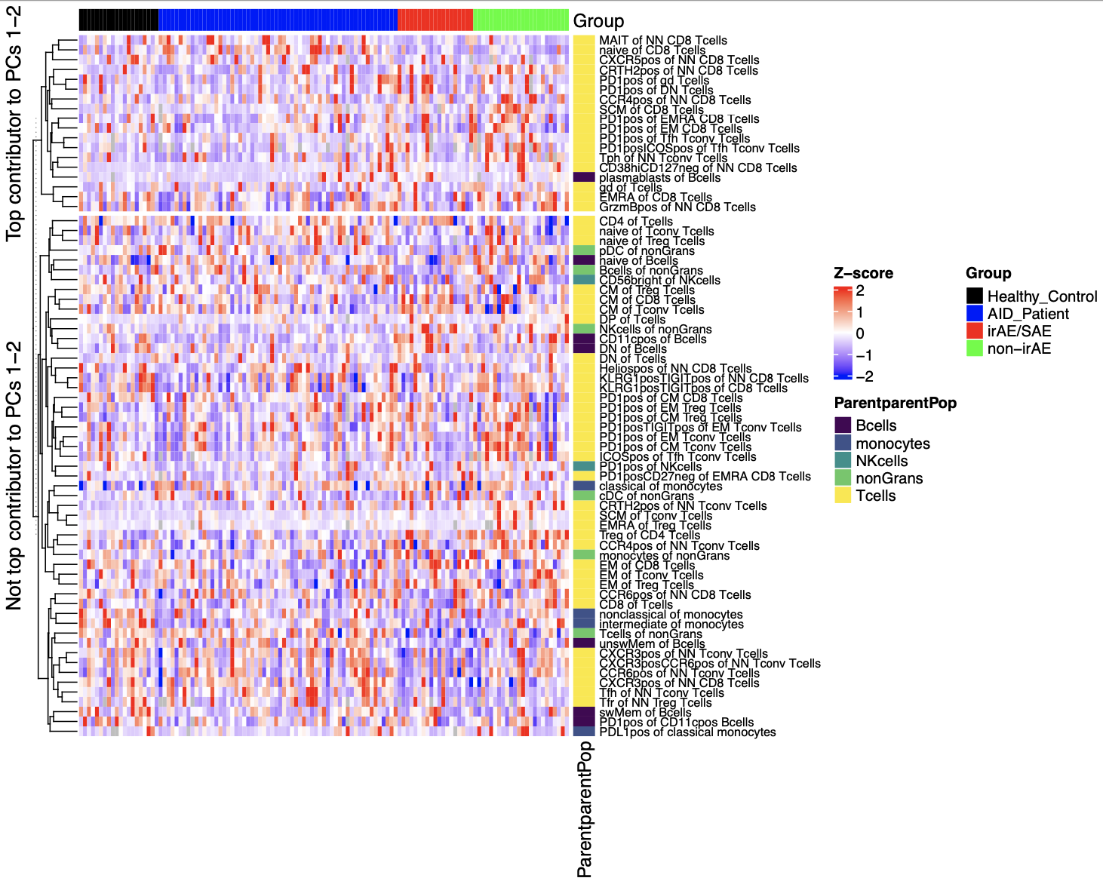
Certain features contribute more to variation (baseline)

Slide 13
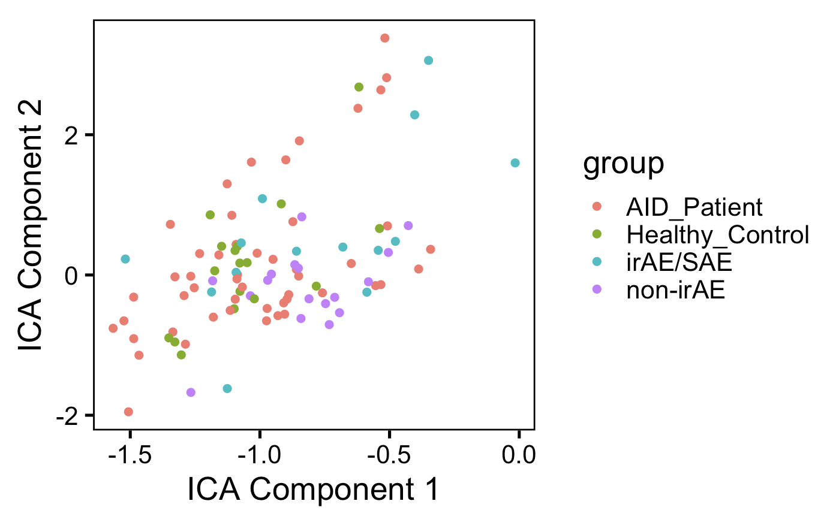
ICA doesn’t appear better at distinguishing unique immunotypes by group than PCA (baseline data)
Notes:
ICA’s goal is to max statistical independence b/w ICs (independent components, non-gaussian distributions, better for signal separation/feature extraction), PCA maximizes variance (orthogonal components, linear combos, better for data viz/noise reduction)

