Slide 1
Weekly meeting
6 27 2024
Ty Bottorff

Slide 2
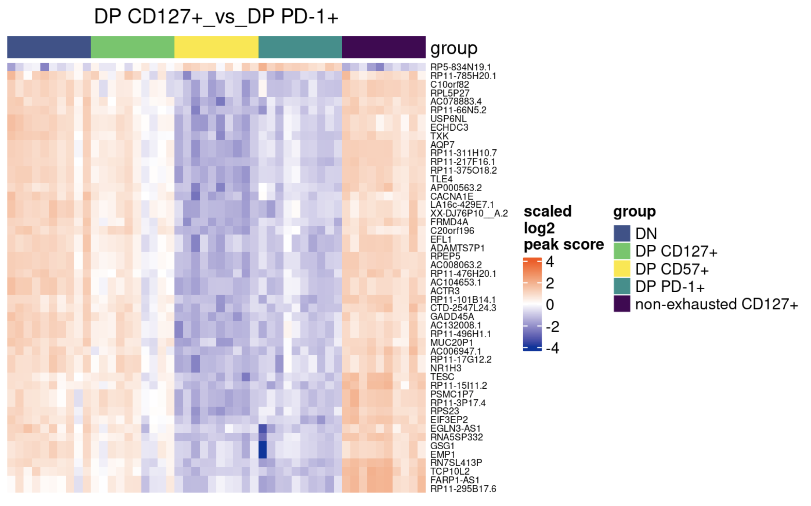
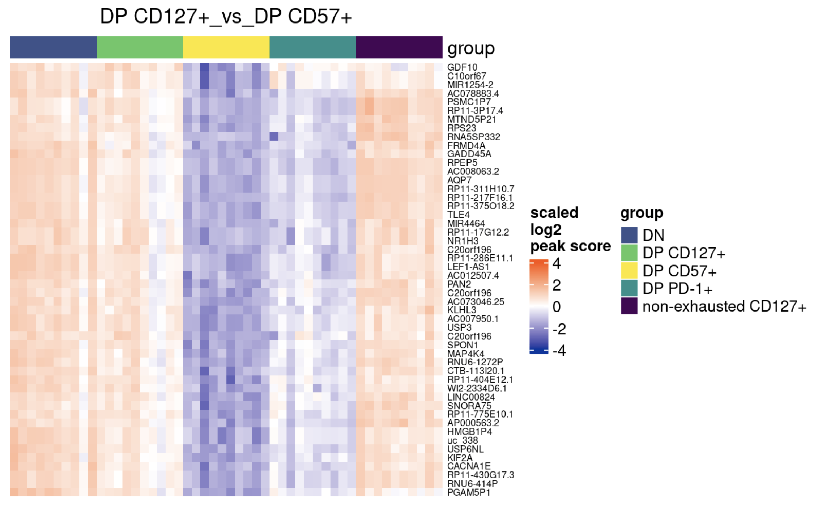
Consistent with other analyses, looking at top 50 promoter peaks for contrasts shows DP PD-1⁺ and DP CD57⁺ more closely “related”, DP CD127⁺ more “distant”
Trend (DP PD-1⁺ and DP CD57⁺ similar scores) true across most contrasts, also similar for top genes
Notes:
see some (but not all…) matches for top hits visible in VP, maybe because VP shows both gene and promoter same time (vs. just ordering top by one), so I think it’s sensible top here

Slide 3
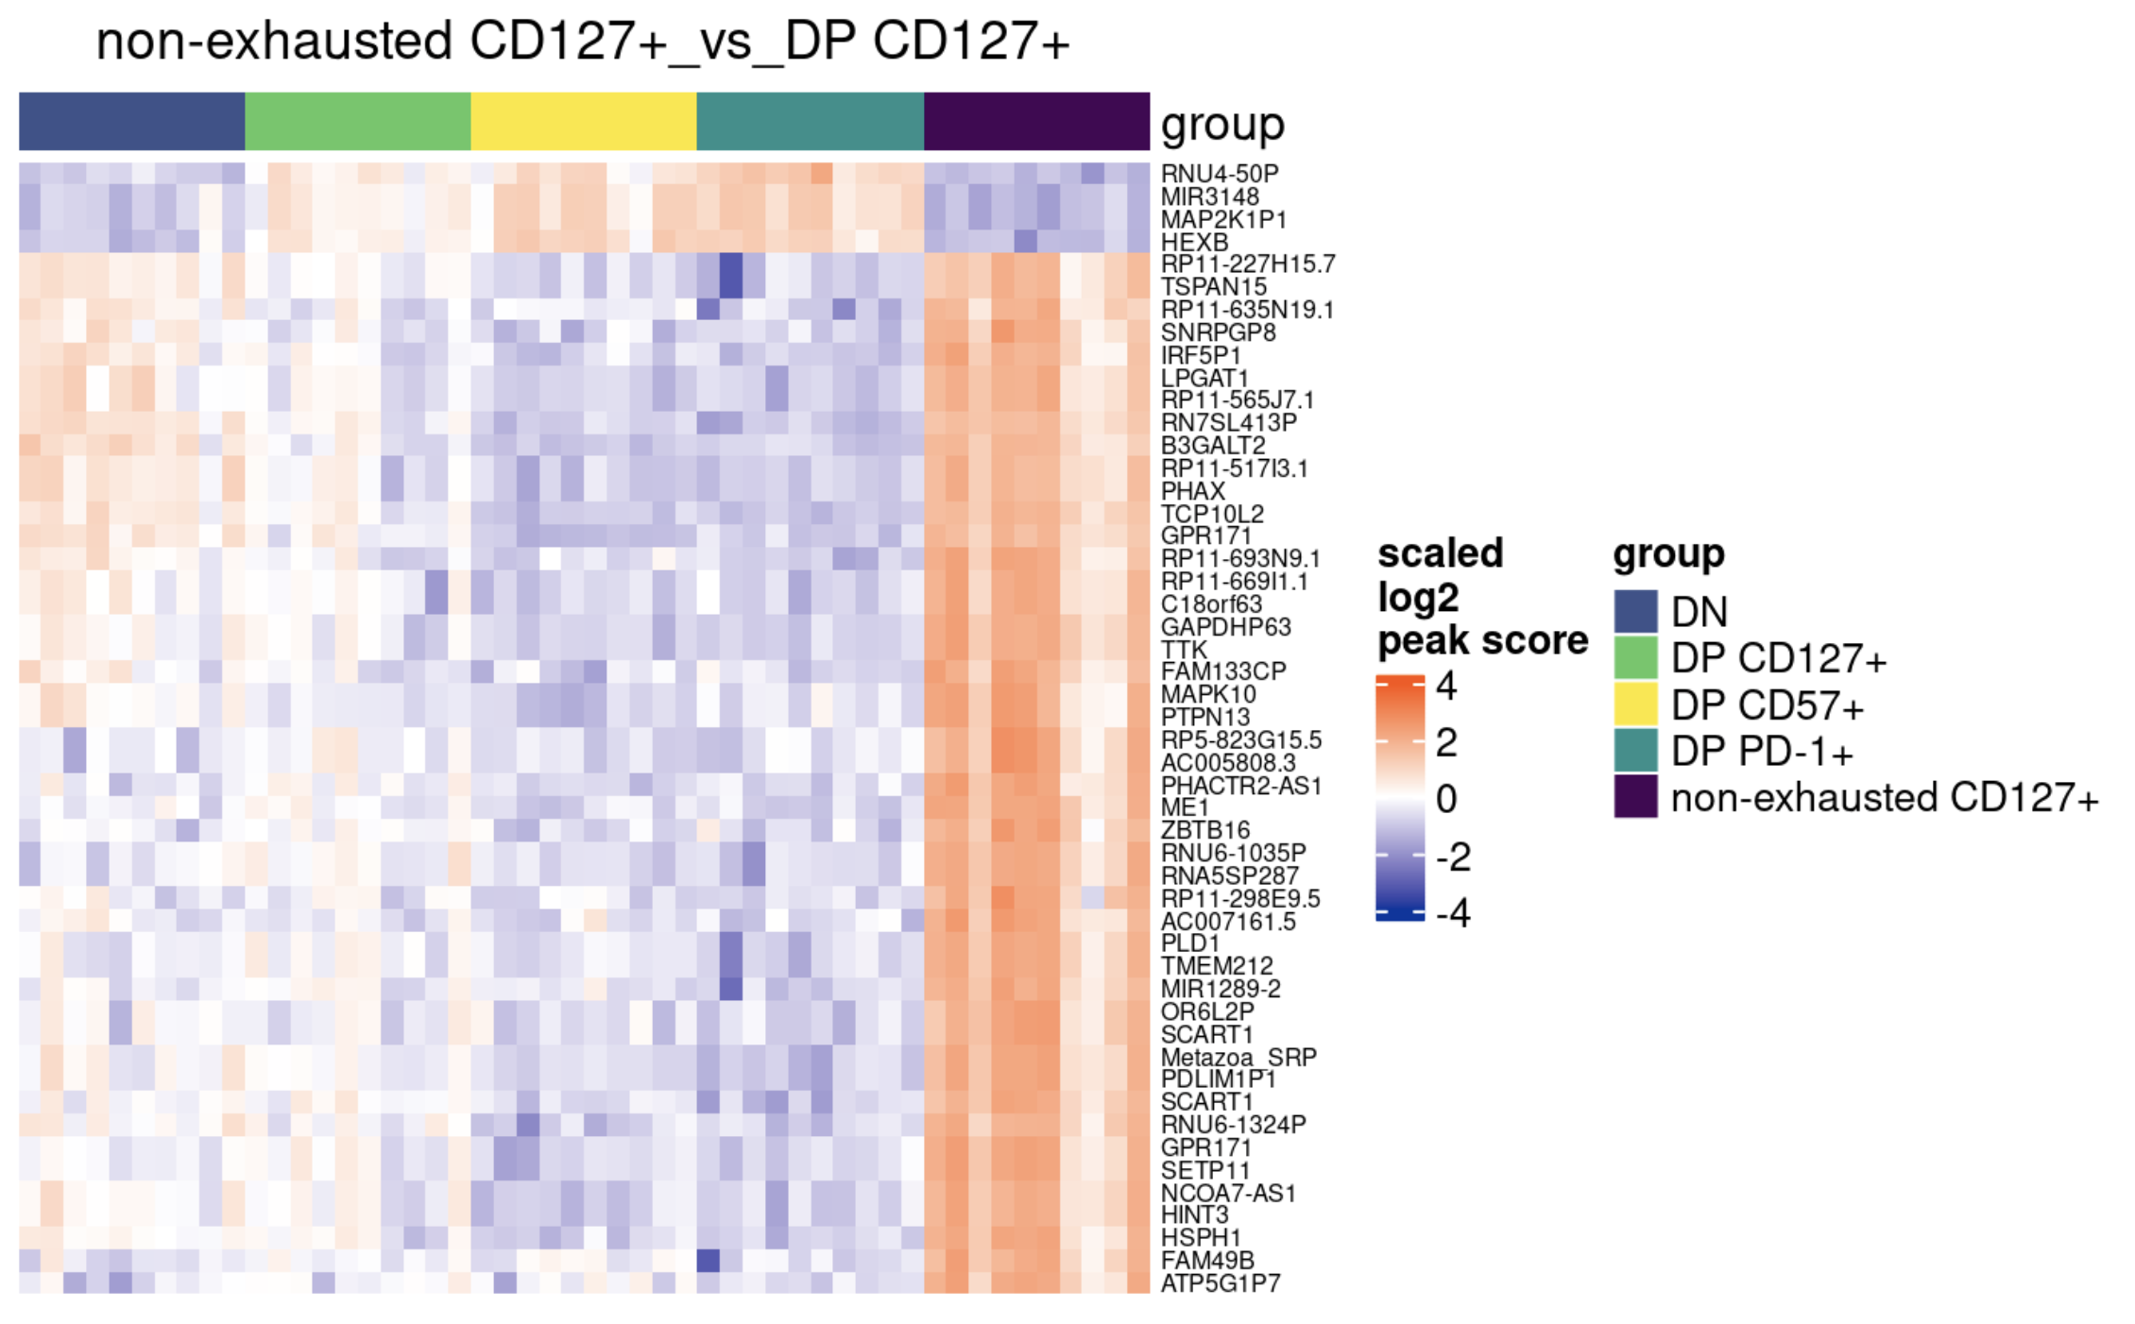
Comparing non-exhausted CD127⁺ and DP CD127⁺, still see close relation between DP CD57⁺ and DP PD-1⁺

Slide 4
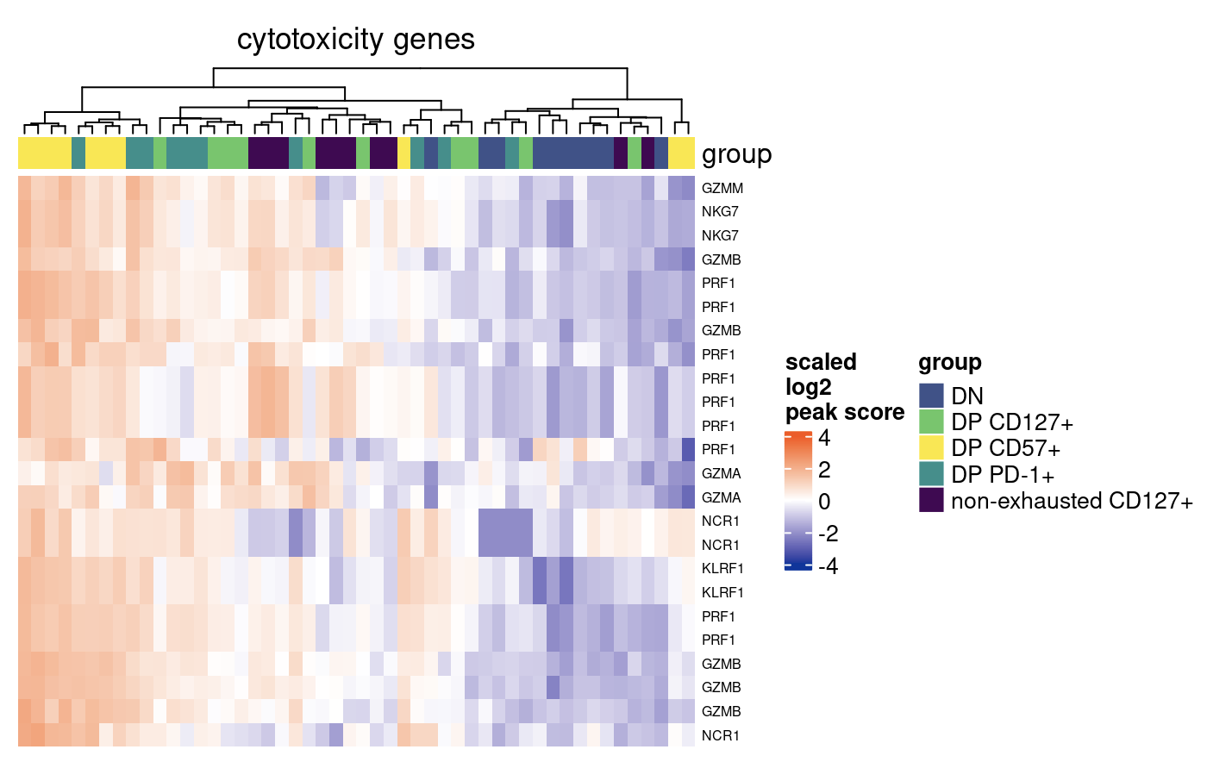
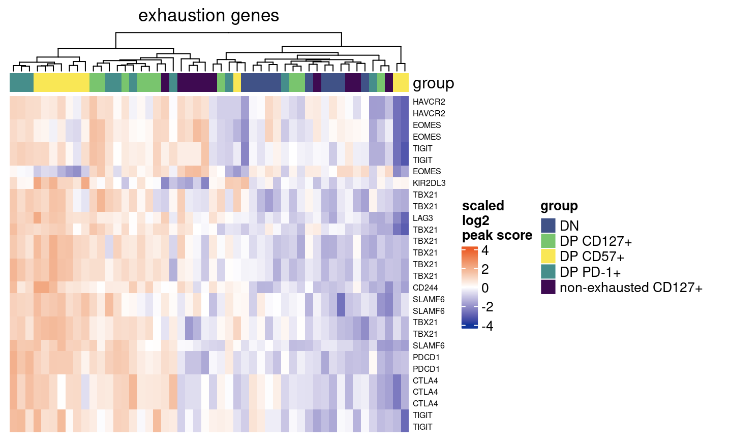
Looking at specific gene sets, don’t really see clustering by cell sort

Slide 5
Conclusions
Consistent with prior analyses, DP PD-1⁺ and DP CD57⁺ seem closest related out of DPs
DP CD57⁺ has most unique TFs enriched in accessible seqs. vs. DN across different background choices for Homer analyses (data not shown), consistent with DP CD57⁺ having most MT variants (terminal/distinct population)

Slide 6
Next steps
Attempts to use MT assembled genome from DN cell sorts as reference for MT variant calling didn’t work as expected (nonsensical results, data not shown)…
Assembled MT genome looks rather different from reference but sensical (size, nucleotide BLAST)
Think I need to use assembled MT genome in alignment process (to avoid discrepancy between ref MT genome and assembled MT genome?) → asked Stephan to re-run alignment pipeline
Downsampled Erin’s P452 fastas to ~70% of their sizes to get to mean of P576 library sizes → Stephan re-ran alignment pipeline → now can compare Homer pre/post downsample
Caveat: pipeline was ~different when P452 was first run
Look into Erin’s P452 RNAseq data for CD127 insights?

