Slide 1
Weekly meeting
12 14 2023
Ty Bottorff

Slide 2
Outline
Review of conclusions from myocarditis dataset from NCI update
Issue with thyroiditis dataset
Next steps with colitis/vitiligo datasets

Slide 3
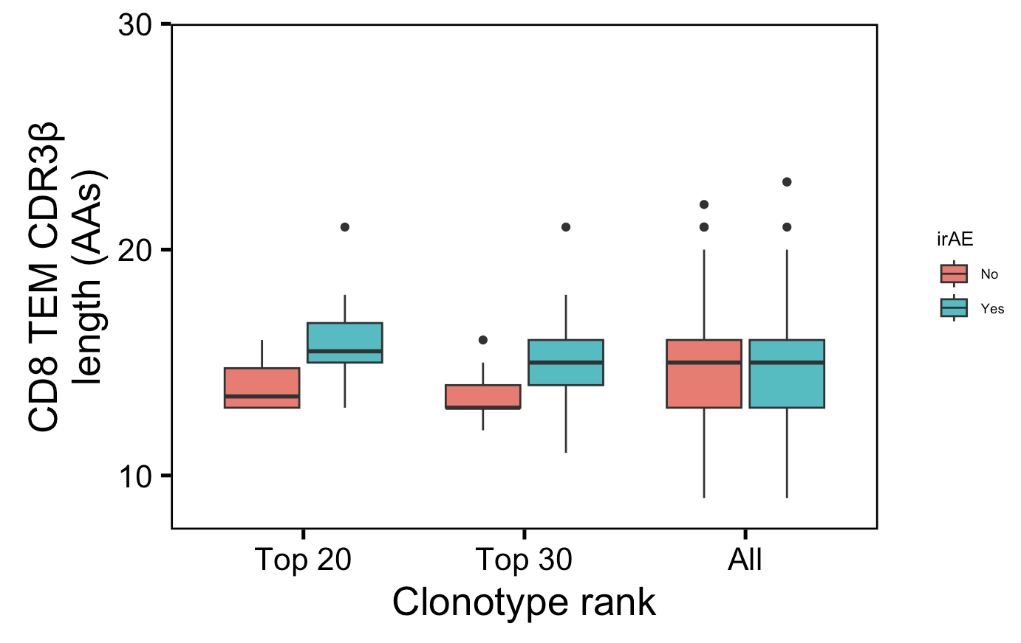
Highly expanded CD8 TEM CDR3βs slightly longer in those developing irAEs
n = 6, 14
n = 9, 22
n = 1265, 1422
n.s.
*
n.s.
Wilcoxon rank sum test. ****, padj <1e-4; **, padj <1e-2; *; padj <0.05
Notes:
Not downsampled but unique!
p = 0.06 for top 20
only a small portion of an antigen is needed to be recognized by a TCR (8-10 amino acids for MHCI, 14-18 for MHCII, does this mean that CD8+ T cells might be more cross-reactive?)
T cell repertoire analysis and metrics of diversity and clonality
CDR1-2 contact MHC and CDR3 contacts peptide is the general rule, but CDR1α also contacts peptide and CDR3β doesn't contact peptide too much
Public refers to clonotype not (CD8 T) cell

Slide 4
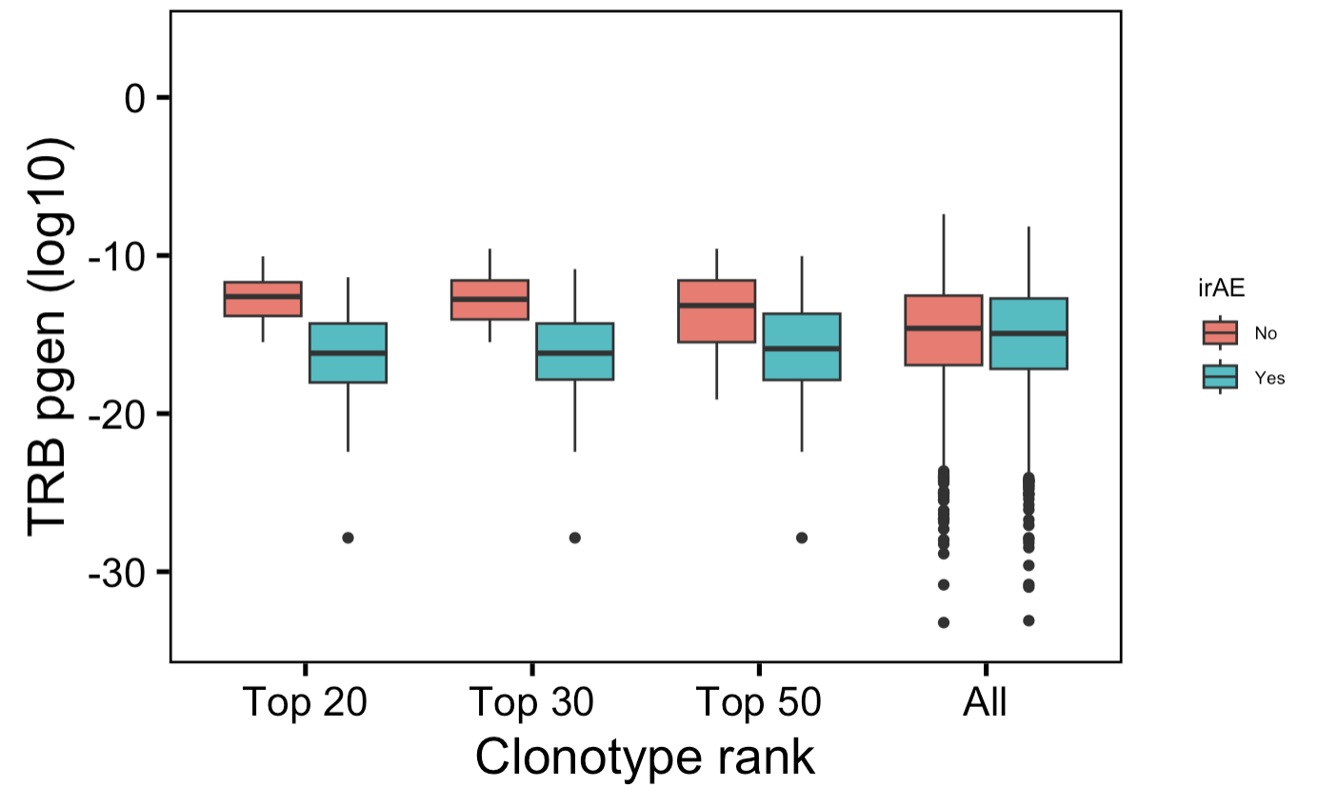
Highly expanded CD8 TEM TRBs less germline-like in those developing irAEs
n = 6,
14
n = 9,
22
n = 13,
39
n = 1265,
1422
→
*
*
*
n.s.
More germline-like
Less germline-like
→
Wilcoxon rank sum test. ****, padj <1e-4; **, padj <1e-2; *; padj <0.05
Notes:
NOT downsampled but unique!
Higher pgen generally means that it's closer to germline because the probability of mutation is lower than not mutation
Public refers to clonotype not (CD8 T) cell

Slide 5
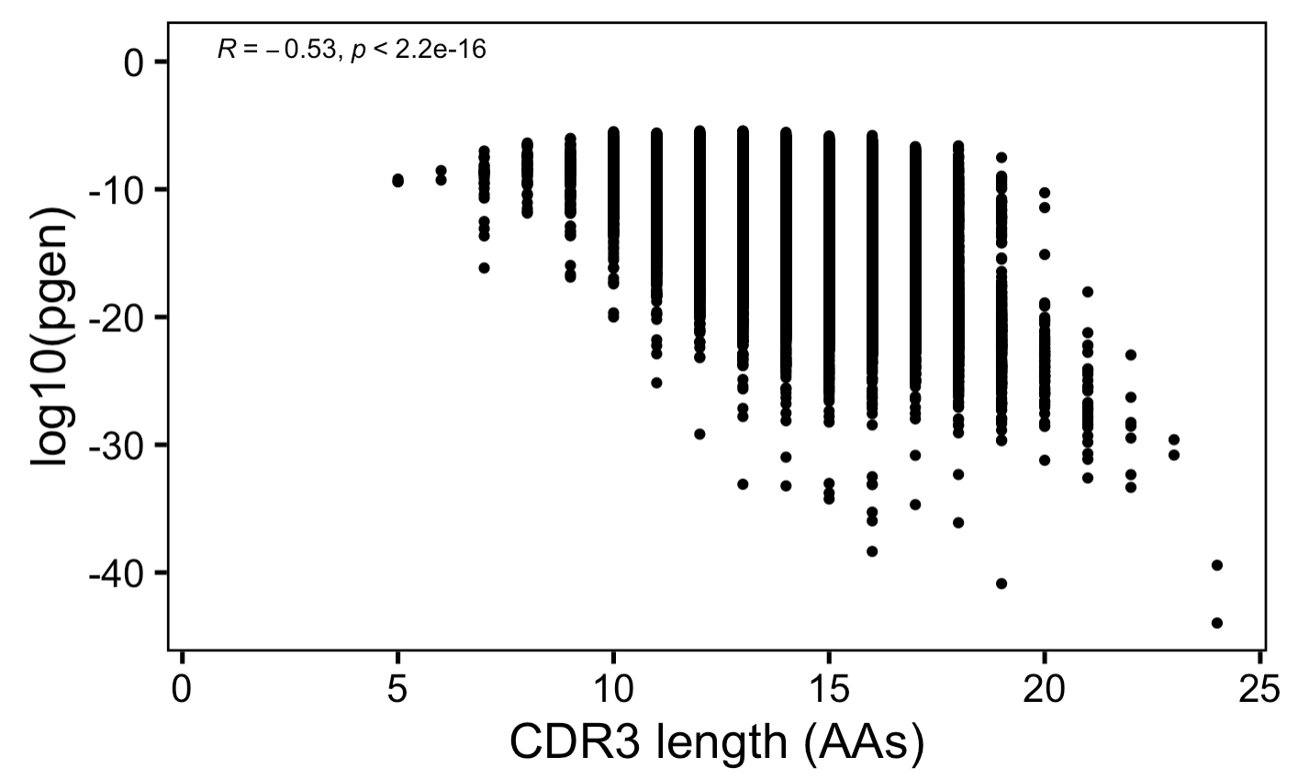
Anticorrelation between CDR3 length and germline-ness
→
More germline-like
Less germline-like
→

Slide 6
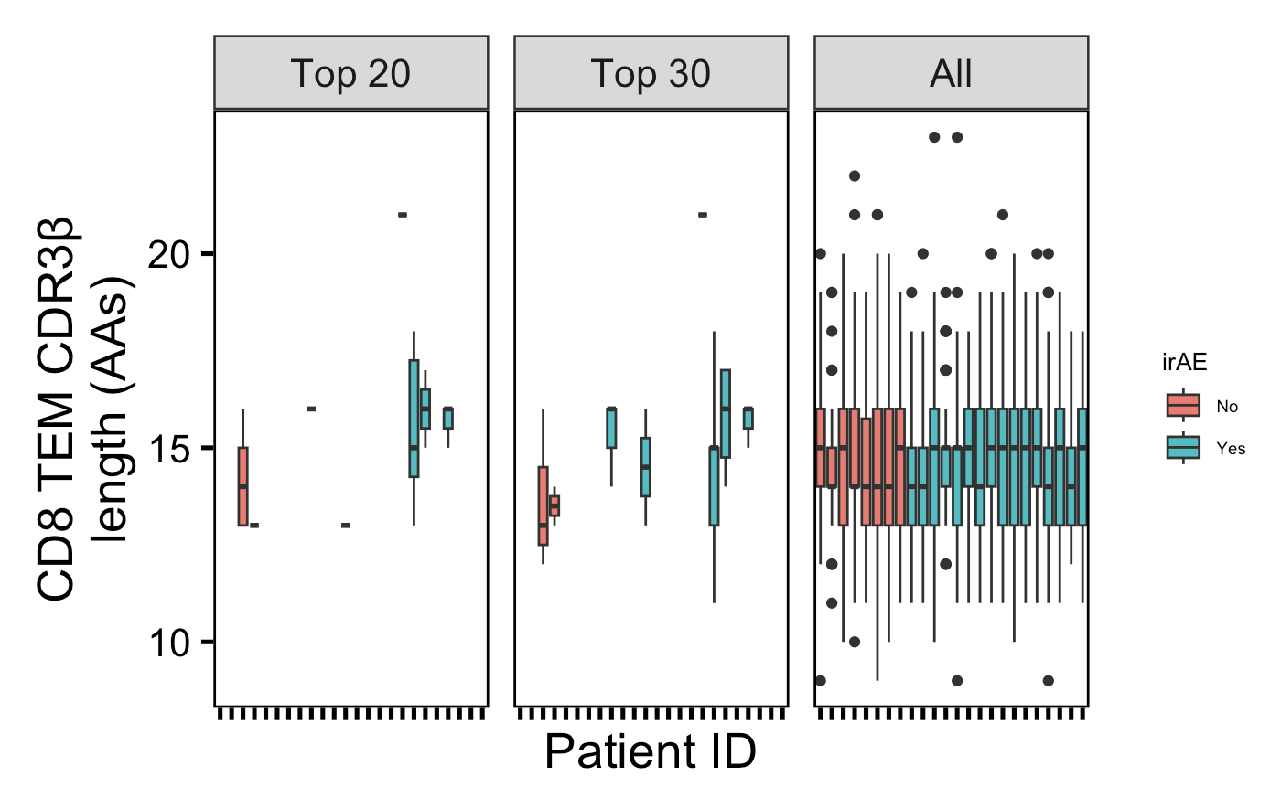
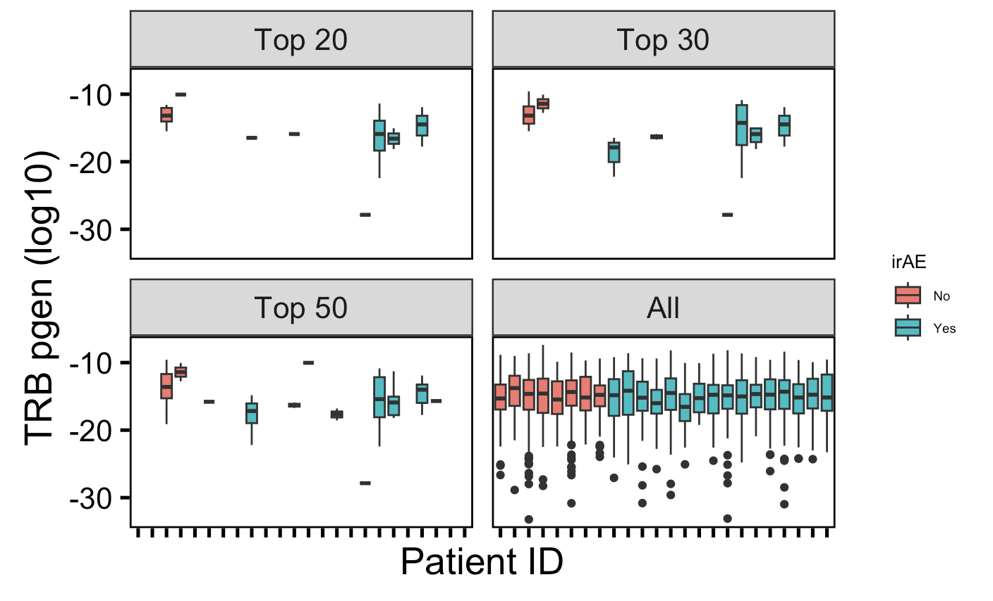
Not all patients are represented in top clonotypes

Slide 7
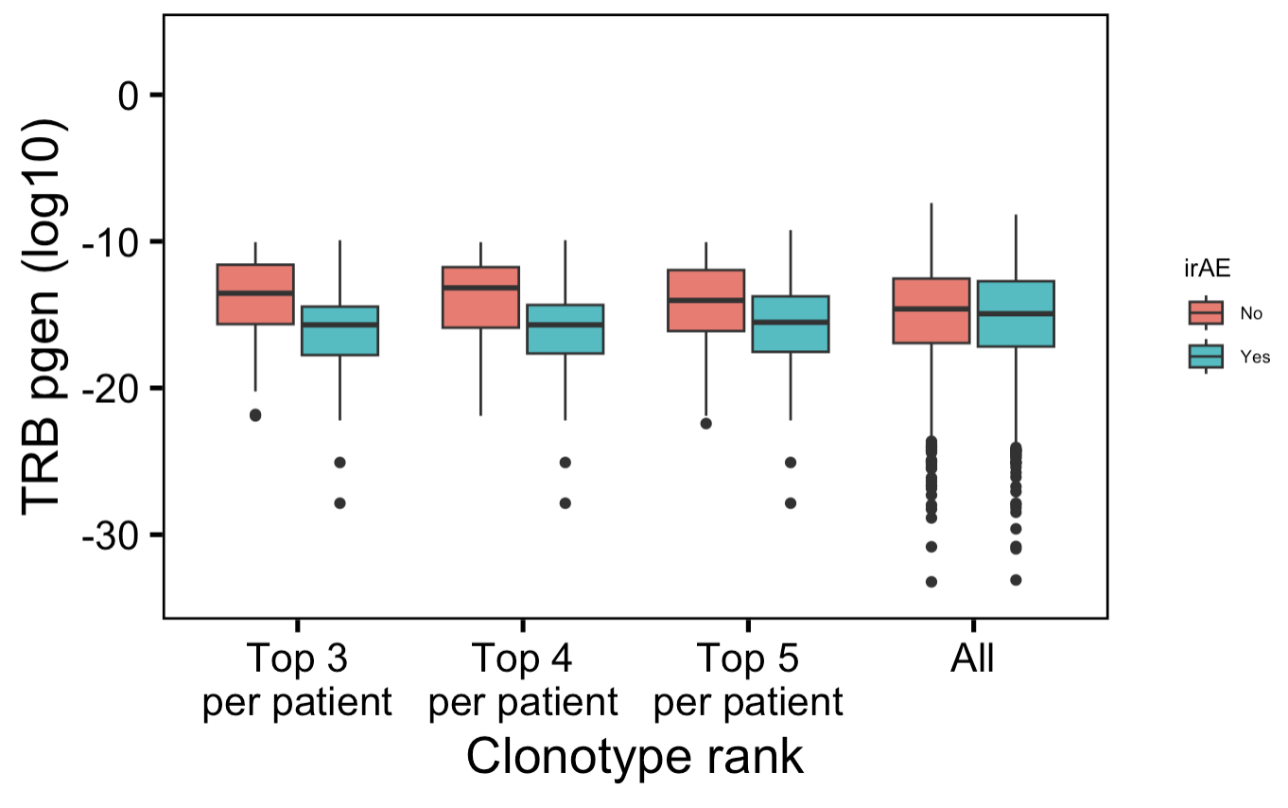
Highly expanded CD8 TEM TRBs less germline-like in those developing irAEs
n = 24,
48
n = 32,
64
n = 40,
80
n = 1265,
1422
→
*
*
*
n.s.
More germline-like
Less germline-like
→
Wilcoxon rank sum test. ****, padj <1e-4; **, padj <1e-2; *; padj <0.05
Notes:
NOT downsampled but unique!
Higher pgen generally means that it's closer to germline because the probability of mutation is lower than not mutation
Public refers to clonotype not (CD8 T) cell

Slide 8
Review of conclusions from myocarditis dataset
Within highly expanded CD8 TEMs in those developing irAEs…
less germlike-like TRBs (solid)
slightly longer CDR3Bs (less solid)
Notes:
Context of BRI/VDJdb data…
Public/shorter CD8 TRAs/higher pgen expected more crossreactive from BRI/VDJdb data... (VDJdb not pgen, BRI all 3)

Slide 9
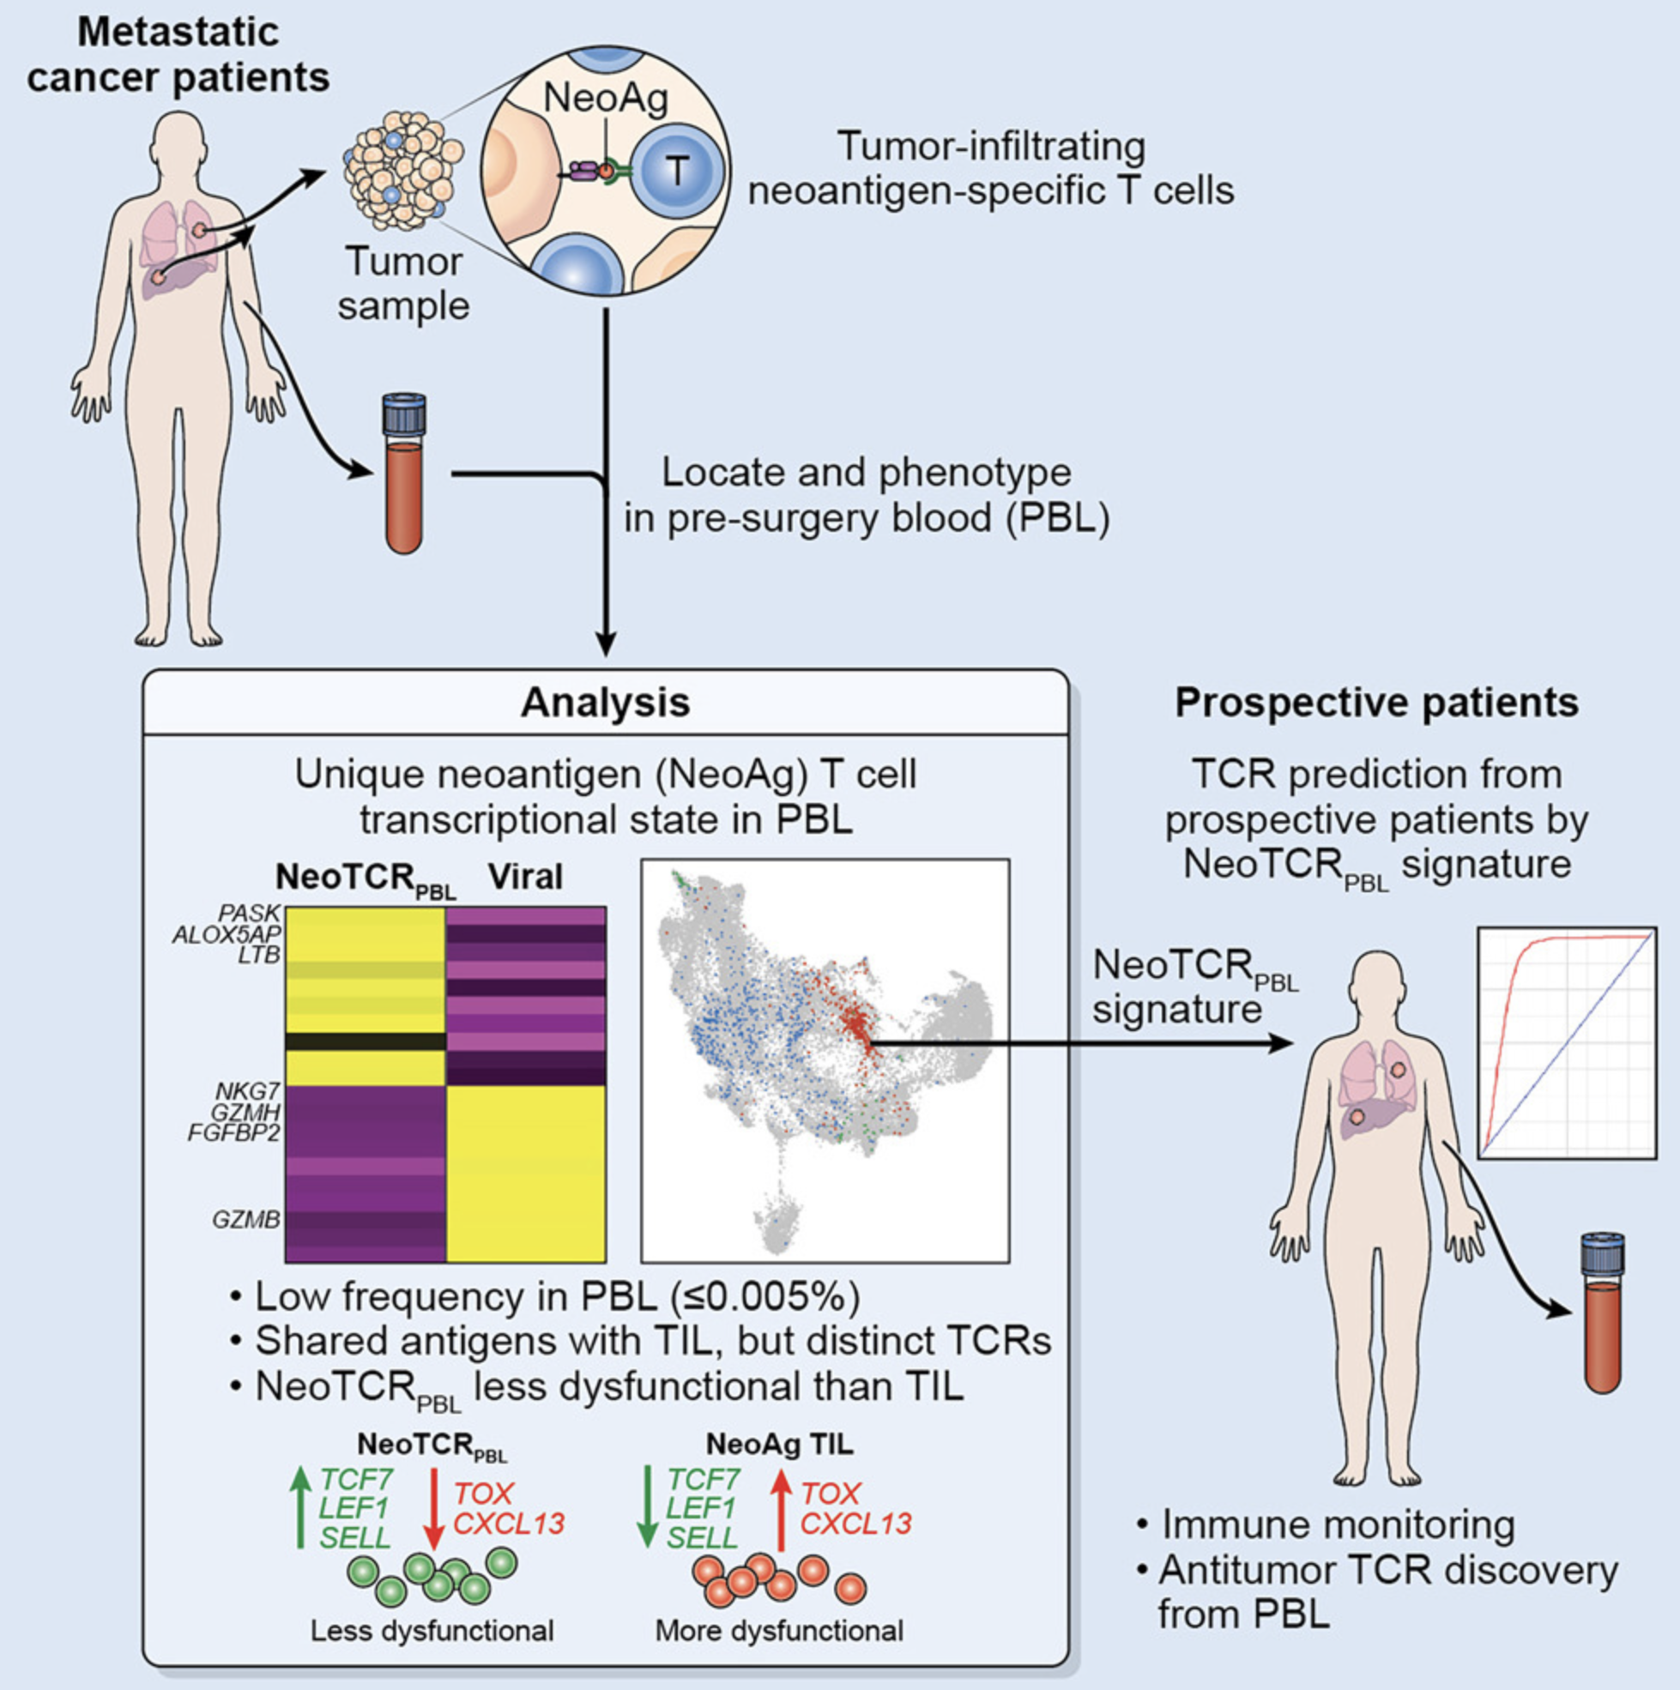
Phenotypic signatures of circulating neoantigen-reactive CD8⁺ T cells in patients with metastatic cancers
Test myocarditis dataset PBMCs
See if CD8 TEM TCR feature conclusions change in +/- NeoTCR_{PBL} transcriptional signature?
Notes:
Seems as though this NeoTCR_{PBL} transcriptional signature may be unique to tumor reactive PBMCs!
circulating tumor reactive T cells: lower expression of cytotoxic molecules, higher expression of T cell activation genes, memory quiescence, tissue residency, inhibitory markers

Slide 10
Issue with irAE thyroiditis dataset
No normal thyroid HC T cells had TCR seq data
Low T cell infiltration in healthy thyroid
Not sure if worth comparing TCR features between irAE and HT groups
Do have opportunity to get PBMC data from healthy controls, HT, Graves disease…

Slide 11
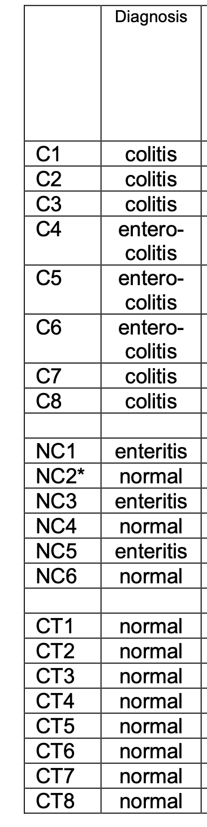
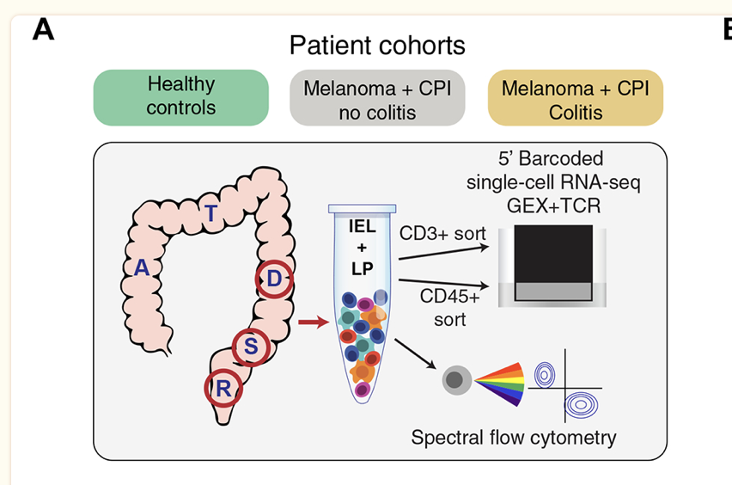
New dataset: colitis irAE
Molecular Pathways of Colon Inflammation Induced by Cancer Immunotherapy (Cell, 2020)
HC: n = 8 (CT group)
ICB no colitis: n = 6 (NC group)
3 enteritis
3 no intestinal inflammation
ICB colitis: n = 8 (C group)
5 enterocolitis
3 colitis
Expecting more T cells in healthy colon than healthy thyroid
Notes:
Not sure if ICB no colitis had other irAEs… doesn’t matter as much probably given sampling from colon
ICB no colitis: CPI-treated melanoma patients who underwent endoscopic evaluation for suspected +CPI colitis but were found to have normal colonic mucosa both endoscopically and histologically (n=6, +CPI no-colitis) (Figure 1B). This group of drug-exposed patients without colitis was evenly split between patients who had or did not have inflammation of the small intestine (enteritis)
Enteritis is inflammation of the small intestine, while colitis is inflammation of the colon
Mining vitiligo dataset
Insight into immune profile associated with vitiligo onset and anti-tumoral response in melanoma patients receiving anti-PD-1 immunotherapy (Front Immunol, 2023)
Paired data pre/post ICB
n = 6 (vitiligo), n = 6 (no vitiligo)
Metastasis and vitiligo T cell infiltrates share more clonotypes than primary melanoma and vitiligo T cell infiltrates

Slide 12
New dataset: vitiligo irAE
Insight into immune profile associated with vitiligo onset and anti-tumoral response in melanoma patients receiving anti-PD-1 immunotherapy (Front Immunol, 2023)
Paired data pre/post ICB
n = 6 (vitiligo), n = 6 (no vitiligo)
Metastasis and vitiligo T cell infiltrates share more clonotypes than primary melanoma and vitiligo T cell infiltrates
Notes:
Flow/cytometry instead of RNA I think for vitiligo dataset
they usually find different TCR sequences in vitiligo and primary melanoma lesions, so T cell response against normal melanocytes leading to vitiligo is not usually mediated by reactivation of T cell clones infiltrating/specific to primary melanoma but rather perhaps by T cells targeting metastatic tissues, so kind of different from my thinking of usually crossreactivity between primary tumor and irAE site but could also be crossreactivity between metastases and irAE sites
metastasis and vitiligo sample TCRs more similar than primary melanoma and vitiligo TCRs

Slide 13
Next steps
See if CD8 TEM TCR feature conclusions change in +/- NeoTCR_{PBL} transcriptional signature?
Mining colitis/vitiligo datasets

Slide 14
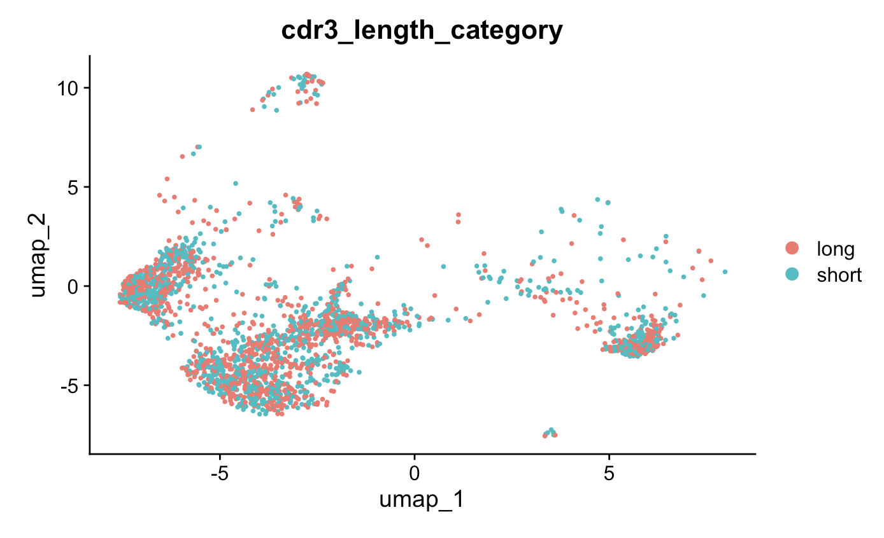
RNA phenotype of cells with longest and shortest TRB CDR3s likely very similar

